Slide 1
YASS
(Yet Another Solar System)
Álison Fernandes | 6129
Hugo Ruivo | 6110

Slide 2
The foundation of a good simulation is the use of real and previously studied data

Slide 3
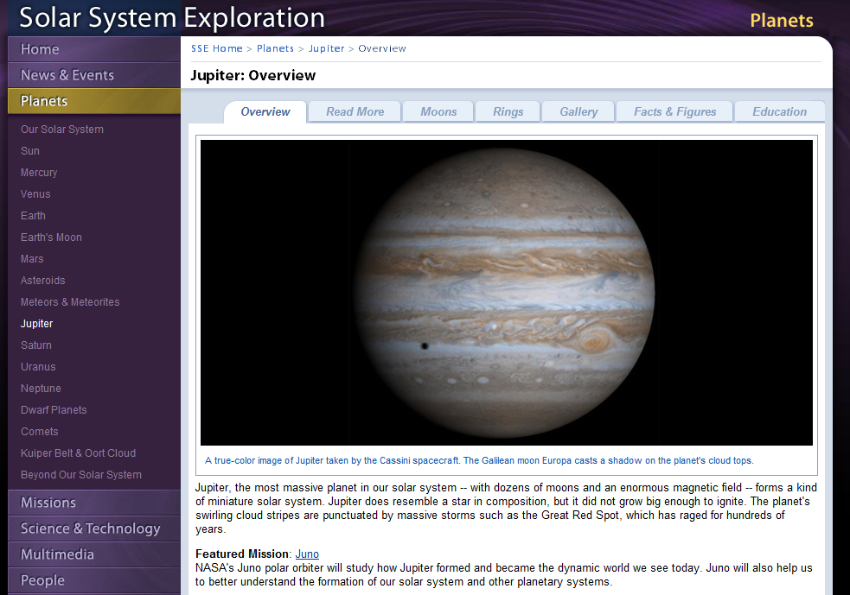
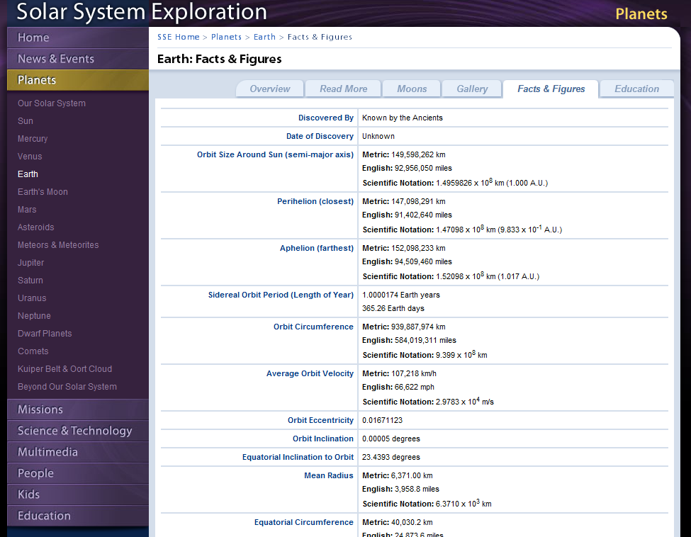
Data Acquisition

Slide 4
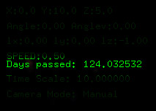
Time measurement
The planets orbital speed is based on the number of terrestrial days it takes to go around the sun
lifetime indicates the number of days since the beginning of the simulation
Orbit_getPosition(Planet_getOrbit(planet),
(lifetime / planet->lengthOfYear) * (2 * 3.14));

Slide 5
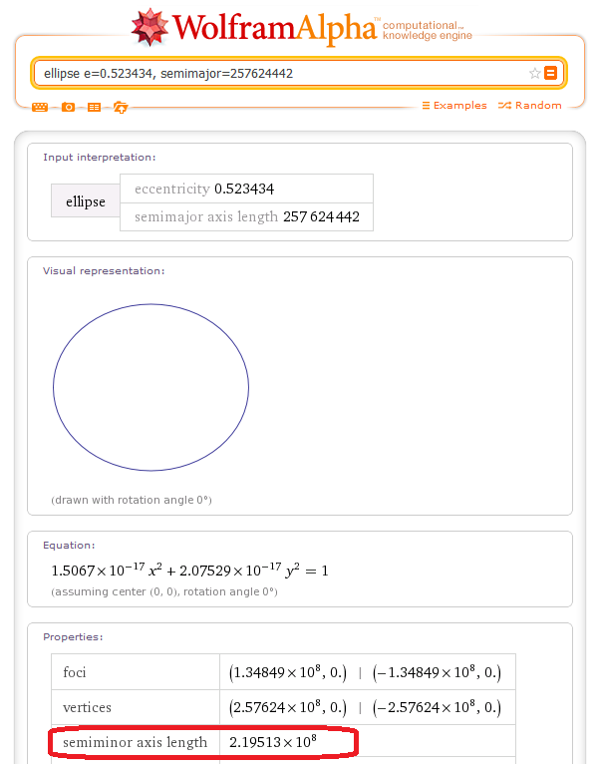
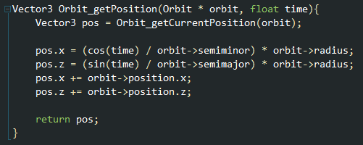
Orbits
X = (cos(t) / SemiMinor) * Radius
Z = (sin(t) / SemiMajor) * Radius

Slide 6
Implementation
All requirements were achieved
Manual and automatic camera (orbits around the solar system)
Draw planets orbits
Simulated sizes, distance and speed close to reality
Orbit speed is controllable
Camera repositioning using the mouse
Game Mode and Window Mode visualization
Texture the sun, earth moon and remaining planets

Slide 7
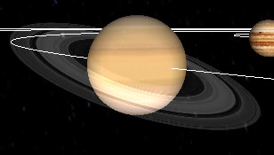
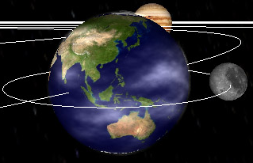
Implementation
Extras:
Each planet (even the moon) has its own tilt and rotation
Render the rings of Saturn, using a single texture and alpha blending
In-game Screenshots
Moon orbit independent from earth rotation
Earth atmosphere, alpha blended and independent from Earth rotation
Skybox
Emissive material on the Sun
Fancy GUI !

Slide 8
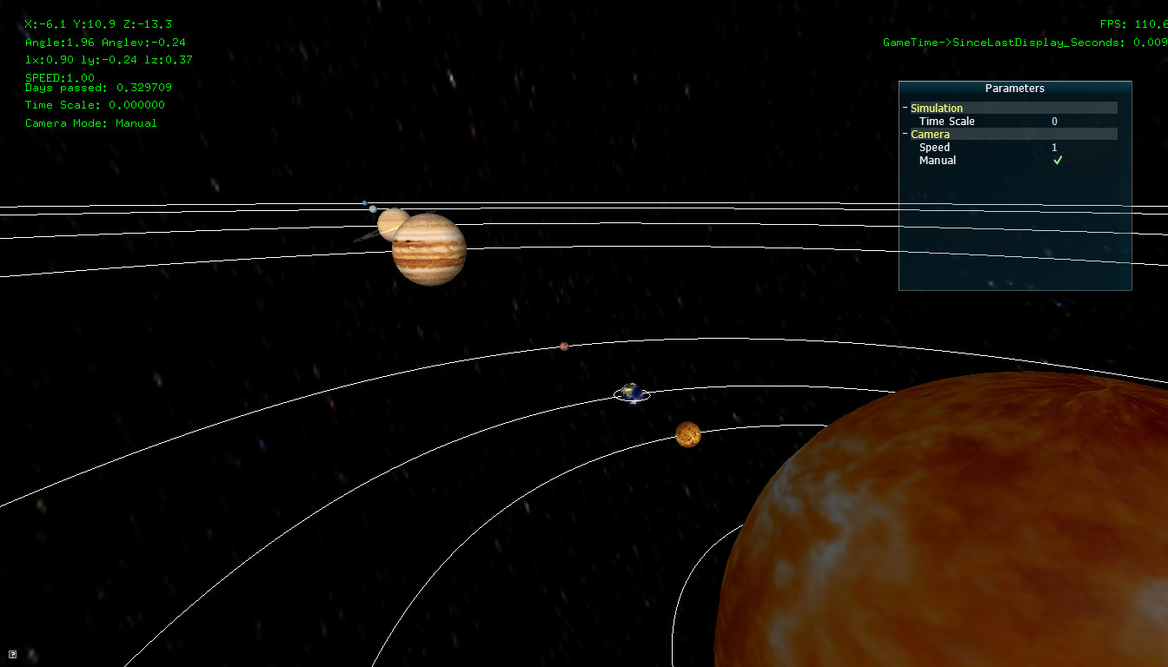

Slide 9

Code structure
Object Oriented-ish C code, “data hiding using incomplete types”, GOOGLE IT! ( ref: http://tinobox.com )
In a nutshell, it consists in hiding the members of a given structure, providing functions that know how to interact with the structure data, thereby achieving a perfect encapsulation of the underlying information
Example:

Slide 10
Code structure
Advantages
Better code management
Easy to track down bugs and make changes
Prevent bugs through bad (or not predicted) usage of the data structure in a team project
Disadvantages
Code so well structured it hurts!!1!

Slide 11
Code structure
Main
SolarSystemController
Planet
Orbit

Slide 12
Third-party libs used
SOIL - Simple OpenGL Image Library
Takes out the pain in loading OpenGL textures
Supports a good variety of image types

Slide 13
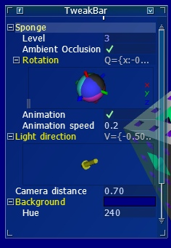
Bibliotecas externas utilizadas
AntTweakBar
Allows you to create neat GUI fast!

Slide 14


