Slide 1

OS-ED COURSE PROJECT
Title: Motor Safety Interlock with Multi-Sensor Check
Course: Operating System and Embedded Systems Design
Course Code: 25EECC304
Semester: V
Faculty Mentor: Prof. Basawaraj Patil
Team Details
Sl. No | Roll No. | Div | SRN | Name
1 | 303 | C | 01FE23BEC067 | Mallikarjun Kelur
2 | 331 | C | 01FE23BEC125 | Ritesh Kulkarni
3 | 332 | C | 01FE23BEC126 | Varun Pai
4 | 336 | C | 01FE23BEC077 | Vishwa Rachotimath

Slide 2
Title: Motor Safety Interlock with Multi-Sensor Check
PROBLEM STATEMENT
Motor Safety Interlock with Multi-Sensor Check Scenario: DC/stepper motors
operate only if temperature, gas, and ultrasonic readings are safe; motor stops immediately on
unsafe conditions; logs event.
Tasks:
Temp sensor
Gas sensor
Ultrasonic sensor
Motor
control task Kernel Objects: Event flag group, semaphore, message queue

Slide 3
Title: Motor Safety Interlock with Multi-Sensor Check
INTRODUCTION
Industrial and domestic motor-driven systems require high safety standards to avoid accidents caused by overheating, gas leakage, or unexpected obstacles. Manual monitoring is unreliable and slow.
This project implements a Motor Safety Interlock System using multiple sensors and an RTOS on the LPC1768 microcontroller. Temperature, gas, and ultrasonic sensors continuously monitor the environment. Based on these readings, the RTOS coordinates multiple tasks to ensure the motor operates only under safe conditions.
The system improves reliability, response time, and fault handling using multitasking and inter-task communication.

Slide 4
Title: Motor Safety Interlock with Multi-Sensor Check
Problem Analysis
Features selected:
Feature | Description
Temperature Monitoring | Continuously measures temperature to detect overheating conditions
Gas Detection | Identifies presence of harmful or combustible gases
Obstacle Detection | Measures distance to nearby objects using ultrasonic sensor
Automatic Motor Shutdown | Instantly stops motor when unsafe condition occurs
Event Logging | Stores unsafe condition data through UART communication
RTOS Multitasking | Executes multiple sensor and control tasks simultaneously
Task Synchronization | Coordinates tasks using kernel objects

Slide 5
Title: Motor Safety Interlock with Multi-Sensor Check
Problem Analysis
Peripherals chosen:
Peripheral | Purpose
Temperature Sensor (LM35) | To monitor temperature for overheating protection
Gas Sensor (MQ-2) | To detect gas leakage and ensure safety
Ultrasonic Sensor (HC-SR04) | To detect obstacles and measure distance
DC / Stepper Motor | To perform mechanical motion
Motor Driver (L298) | To drive motor with sufficient current
LPC1768 Microcontroller | To control system and execute RTOS
UART Module | To transmit event logs to PC
Buzzer / LED | To provide alert indication

Slide 6
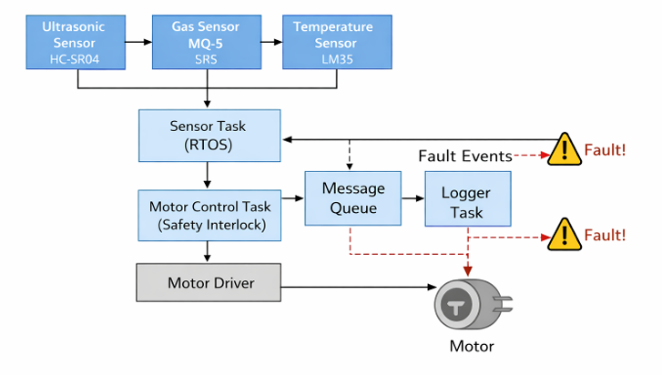
Title: Motor Safety Interlock with Multi-Sensor Check
Block Diagram

Slide 7
Title: Motor Safety Interlock with Multi-Sensor Check
Specifications of All Peripherals Used & Calculations
Temperature Sensor: LM35 (10mV/°C)
Gas Sensor: MQ-2 (Analog output)
Ultrasonic Sensor: HC-SR04 (2cm – 400cm)
Motor: 12V DC / Stepper Motor
Motor Driver: L298
Microcontroller: LPC1768 ARM Cortex-M3
Communication: UART 9600 baud

Slide 8
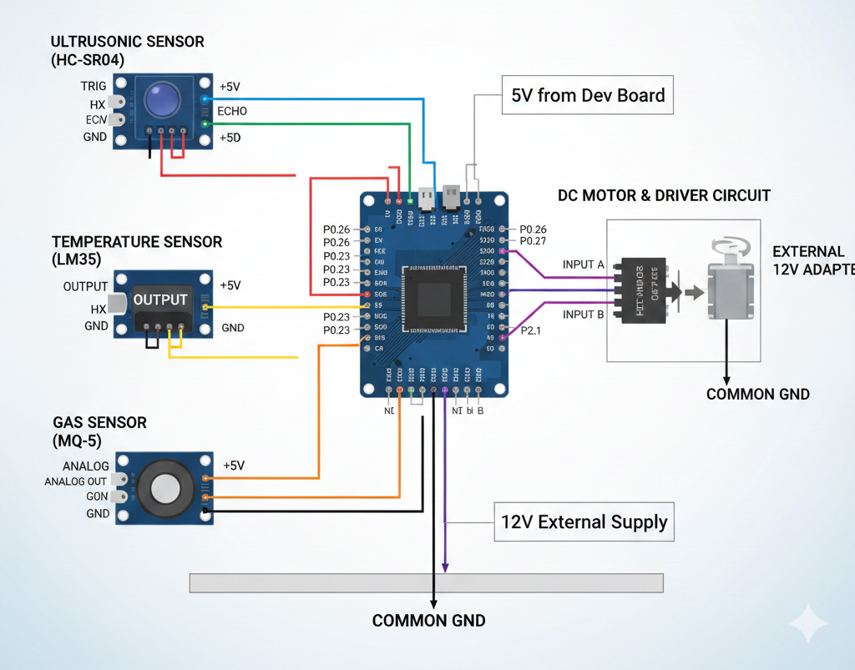
Title: Motor Safety Interlock with Multi-Sensor Check
Interfacing Diagram

Slide 9
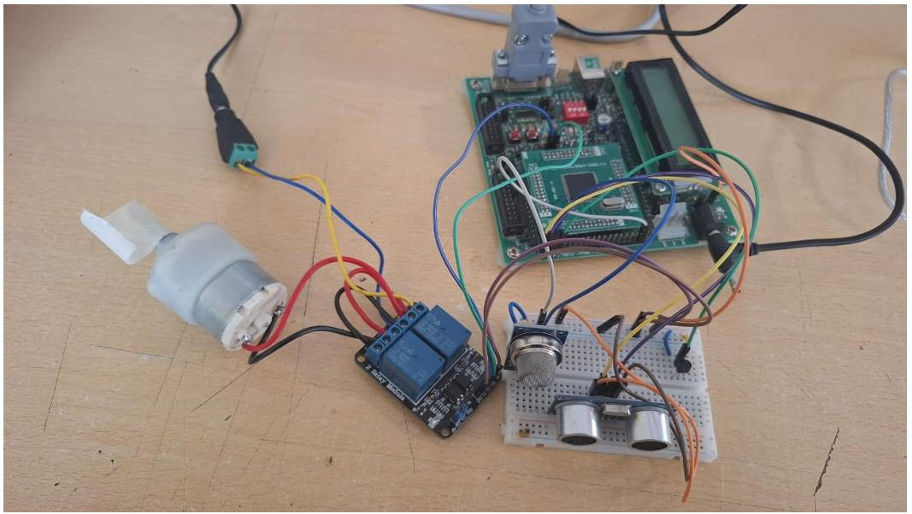
Title: Motor Safety Interlock with Multi-Sensor Check
Results

Slide 10
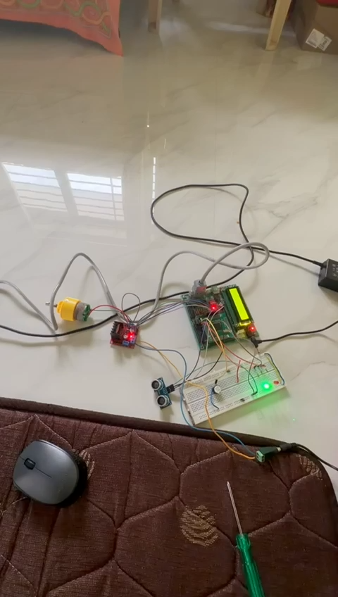
Title: Motor Safety Interlock with Multi-Sensor Check
Results

Slide 11
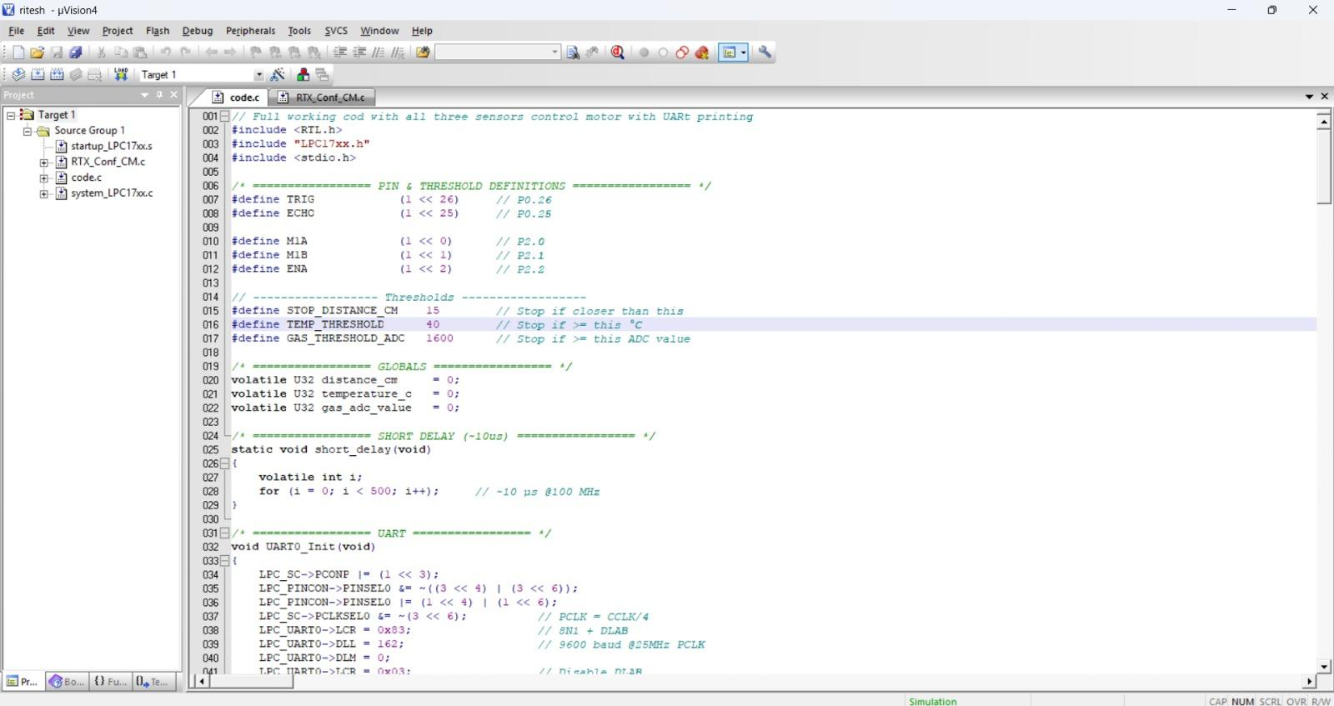
Title: Motor Safety Interlock with Multi-Sensor Check
Code

Slide 12
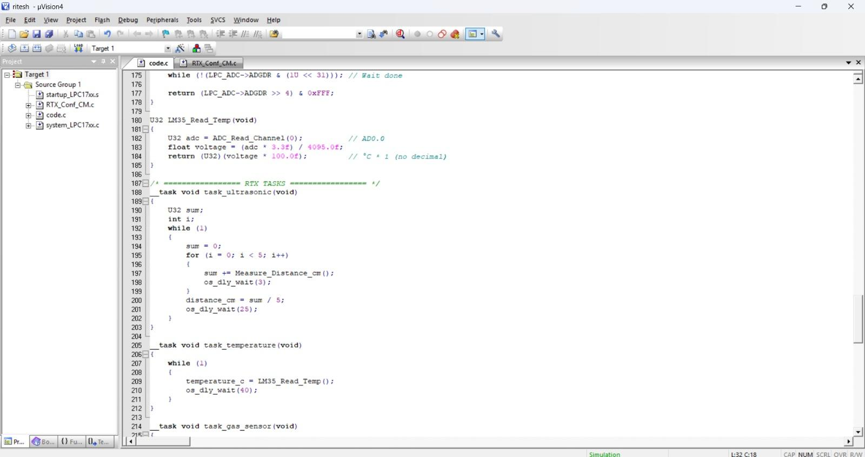
Title: Motor Safety Interlock with Multi-Sensor Check
Code

Slide 13
Title: Motor Safety Interlock with Multi-Sensor Check
Conclusion
The Motor Safety Interlock System using LPC1768 and RTOS successfully ensures safe motor operation by continuously monitoring temperature, gas, and distance parameters. The use of RTOS enables efficient multitasking, fast response, and reliable inter-task communication.
This system is suitable for industrial automation, robotic platforms, and safety-critical motor applications. Future enhancements can include IoT monitoring and mobile alerts.

Slide 14
Thank You

