Slide 1
Introduction To Real-Time Operating Systems

Slide 2
Content
Why Real-Time Operating System?
Introduction to Real-Time Operating System
Types of Real-Time Operating System
Characteristics of Real-Time Operating System
Differnces B/W RTOS vs GPOS
Real-Time Operating System Structure
Kernel of Real-Time Operating System
Scheduling in Real-Time Operating System
Kernel Objects

Slide 3
Why RTOS?
Concurrency
Pre-emption
Synchronization Tools
Third Party Software

Slide 4
Introduction to Real- Time Operating System
A real-time operating system (RTOS) is an operating system with two key features: predictability and determinism.
In an RTOS, repeated tasks are performed within a tight time boundary
Predictability and determinism, in this case, go hand in hand: We know how long a task will take, and that it will always produce the same result.

Slide 5
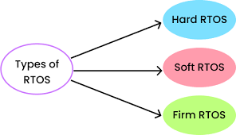
Types of RTOS

Slide 6
Hard RTOS
The RTOS can meet timing deadlines deterministically.
The pre-emption period for a hard RTOS is usually less than a few microseconds
A Hard RTOS is generally preferable for use cases involving mission critical applications such as those found in robotics and drones.
Example: Medical critical care systems, Aircraft systems, etc.

Slide 7
Soft RTOS
The response time of the system is prime but not critical to the operation of the system.
It has a deadline specified but the system can accept a short amount of delay
Example: Online transaction system, Price quotation system, etc.

Slide 8
Firm RTOS
The RTOS has certain time constraints, which are not strict and may cause undesired yet acceptable effects.
Example: Multimedia applications

Slide 9
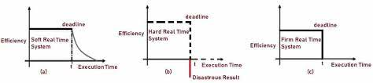
Time Efficiency Curves for RTOS

Slide 10

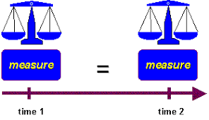

Key Characteristics of an RTOS
Reliability,
Predictability,
Performance,
Compactness, and
Scalability.

Slide 11
Comaprision
GPOS
RTOS
A GPOS is used for systems/applications that are not time critical. Example:- Windows, Linux, Unix etc.
GPOS kernel is not preemptible.
Response is deterministic, i.e time bound
GPOS is large in size
A GPOS is made for high end, general purpose systems like a personal computer, a work station, a server system etc.
An RTOS is used for time critical systems. Example:- VxWorks, uCos etc.
The kernel of an RTOS is preemptible
Response time is in-deterministic i.e not guaranteed
RTOS is light weight and small in size
An RTOS is usually designed for a low end, stand alone device like an ATM, Vending machines, Kiosks etc.

Slide 12
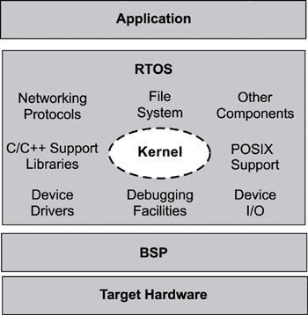
Structure of RTOS

Slide 13
Kernel Components:
Scheduler- is contained within each kernel and follows a set of algorithms that determines which task executes when. Some common examples of scheduling algorithms include round-robin and preemptive scheduling.
Objects-are special kernel constructs that help developers create applications for real-time embedded systems. Common kernel objects include tasks, semaphores, and message queues.
Services-are operations that the kernel performs on an object or, generally operations such as timing, interrupt handling, and resource management.

Slide 14
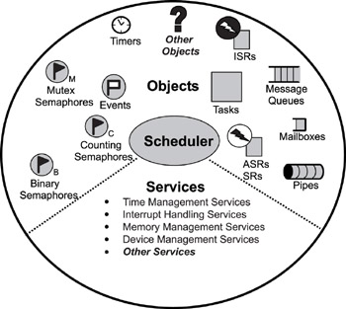
Common components in an RTOS kernel that including objects, the scheduler, and some services.

Slide 15
The Scheduler
The scheduler is at the heart of every kernel. A scheduler provides the algorithms needed to determine which task executes when.
schedulable entities,
multitasking,
context switching,
dispatcher, and
scheduling algorithms.

Slide 16
Schedulable Entities
A schedulable entity is a kernel object that can compete for execution time on a system, based on a predefined scheduling algorithm.
Tasks and processes are all examples of schedulable entities found in most kernel

Slide 17
Multitasking
Multitasking is the ability of the operating system to handle multiple activities within set deadlines. A real-time kernel might have multiple tasks that it has to schedule to run.

Slide 18
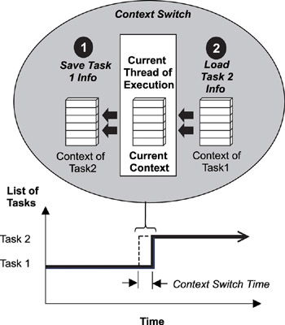
The Context Switch
Each task has its own context, which is the state of the CPU registers required each time it is scheduled to run.
A context switch occurs when the scheduler switches from one task to another.
The time it takes for the scheduler to switch from one task to another is the context switch time
Every time a new task is created, the kernel also creates and maintains an associated task control block (TCB).
TCBs are system data structures that the kernel uses to maintain task-specific information.
Multitasking using a context switch.

Slide 19
The Dispatcher
The dispatcher is the part of the scheduler that performs context switching and changes the flow of execution.
It is the scheduling algorithms of the scheduler that determines which task executes next.
It is the dispatcher that does the actual work of context switching and passing execution control.

Slide 20
Scheduling Algorithms
Two common scheduling algorithms
Preemptive priority-based scheduling
Round-Robin scheduling.

Slide 21
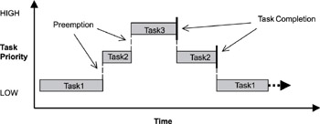
Preemptive Priority-Based Scheduling
Real-time kernels generally support 256 priority levels, in which 0 is the highest and 255 the lowest.
Some kernels appoint the priorities in reverse order, where 255 is the highest and 0 the lowest

Slide 22
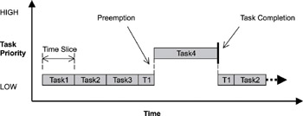
Round-Robin Scheduling
Round-robin scheduling provides each task an equal share of the CPU execution time.
Pure round-robin scheduling cannot satisfy real-time system requirements because in real-time systems, tasks perform work of varying degrees of importance.

Slide 23
Objects
Tasks are concurrent and independent threads of execution that can compete for CPU execution time.
Semaphores are token-like objects that can be incremented or decremented by tasks for synchronization or mutual exclusion.
Message Queues are buffer-like data structures that can be used for synchronization, mutual exclusion, and data exchange by passing messages between tasks.

Slide 24
Services
Kernels provide services that help developers create applications for real-time embedded systems.
These services comprise sets of API calls that can be used to perform operations on kernel objects or can be used in general to facilitate timer management, interrupt handling, device I/O, and memory management.

Slide 25
Tasks
Most RTOS kernels provide task objects and task management services to facilitate designing concurrency within an application.
A task is an independent thread of execution that can compete with other concurrent tasks for processor execution time.
A task is schedulable. The task is able to compete for execution time on a system, based on a predefined scheduling algorithm.

Slide 26
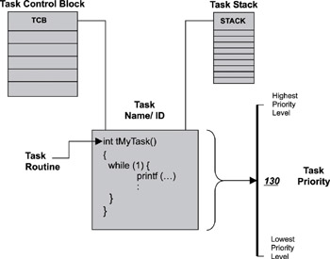
Task Structure
A task is defined by its distinct set of parameters and supporting data structures. Specifically, upon creation, each task has
an associated name
a unique ID,
a priority (if part of a preemptive scheduling plan),
a task control block (TCB),
a stack, and
a task routine.

Slide 27
System tasks are…
initialization or startup task initializes the system and creates and starts system tasks,
idle task uses up processor idle cycles when no other activity is present,
logging task logs system messages,
exception-handling task handles exceptions, and
debug agent task allows debugging with a host debugger.

Slide 28
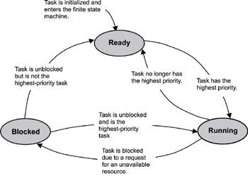
Task States and Scheduling
ready state-the task is ready to run but cannot because a higher priority task is executing.
blocked state-the task has requested a resource that is not available, has requested to wait until some event
occurs, or has delayed itself for some duration.
running state-the task is the highest priority task and is running.

Slide 29
Running State
A running task can move to the blocked state in any of the following ways:
by making a call that requests an unavailable resource,
by making a call that requests to wait for an event to occur, and
by making a call to delay the task for some duration.

Slide 30
Blocked State
The possibility of blocked states is extremely important in real-time systems because without blocked states, lower priority tasks could not run.
If higher priority tasks are not designed to block, CPU starvation can result.
CPU starvation occurs when higher priority tasks use all of the CPU execution time and lower priority tasks do not get to run.

Slide 31
Typical Task Operations
creating and deleting tasks,
controlling task scheduling, and
obtaining task information.

Slide 32
Semaphores
A semaphore (sometimes called a semaphore token) is a kernel object that one or more threads of execution can acquire or release for the purposes of synchronization or mutual exclusion.
When a semaphore is first created, the kernel assigns to it an associated semaphore control block (SCB), a unique ID, a value (binary or a count), and a task-waiting list, as shown
Semaphore Structure

Slide 33
A kernel can support many different types of semaphores, including binary, counting, and mutual-exclusion (mutex) semaphores.
A binary semaphore can have a value of either 0 or 1. When a binary semaphore s value is 0, the semaphore is considered unavailable (or empty); when the value is 1, the binary semaphore is considered available (or full ).
Note that when a binary semaphore is first created, it can be initialized to either available or unavailable (1 or 0,respectively).

Slide 34
Counting Semaphores
A counting semaphore uses a count to allow it to be acquired or released multiple times.
When creating a counting semaphore, assign the semaphore a count that denotes the number of semaphore tokens it has initially. If the initial count is 0, the counting semaphore is created in the unavailable state.
If the count is greater than 0, the semaphore is created in the available state, and the number of tokens it has equals its count,

Slide 35
Mutual Exclusion (Mutex) Semaphores
A mutual exclusion (mutex) semaphore is a special binary semaphore that supports ownership, recursive access, task deletion safety, and one or more protocols for avoiding problems inherent to mutual exclusion.
As opposed to the available and unavailable states in binary and counting semaphores, the states of a mutex are unlocked or locked (0 or 1, respectively).
A mutex is initially created in the unlocked state, in which it can be acquired by a task. After being acquired, the mutex moves to the locked state. Conversely, when the task releases the mutex, the mutex returns to the unlocked state.

Slide 36
Mutex State Diagram

Slide 37
Ownership of a mutex is gained when a task first locks the mutex by acquiring it.
A task loses ownership of the mutex when it unlocks it by releasing it.
When a task owns the mutex, it is not possible for any other task to lock or unlock that mutex.
Contrast this concept with the binary semaphore, which can be released by any task, even a task that did not originally acquire the semaphore.
Mutex implementations also support recursive locking , which allows the task that owns the mutex to acquire it multiple times in the locked state.
The mutex with recursive locking is called a recursive mutex .
This type of mutex is most useful when a task requiring exclusive access to a shared resource calls one or more routines that also require access to the same resource.

Slide 38
Mutex implementations also have built-in task deletion safety.
Premature task deletion is avoided by using task deletion locks when a task locks and unlocks a mutex.
Enabling this capability within a mutex ensures that while a task owns the mutex, the task cannot be deleted.

Slide 39
Priority inversion commonly happens in poorly designed real-time embedded applications.
Priority inversion occurs when a higher priority task is blocked and is waiting for a resource being used by a lower priority task, which has
itself been preempted by an unrelated medium-priority task. In this situation, the higher priority task s priority level has effectively been inverted to the lower priority task s level.
priority inheritance protocol ensures that the priority level of the lower priority task that has acquired the mutex is raised to that of the higher priority task that has requested the mutex when inversion happens. The priority of the raised task is lowered to its original value after the task releases the mutex that the higher priority task requires.
ceiling priority protocol ensures that the priority level of the task that acquires the mutex is automatically set to the highest priority of all possible tasks that might request that mutex when it is first acquired until it is released.

Slide 40
Priority Inversion
Priority inversion is a situation in which a low-priority task executes while a higher priority task waits on it due to resource contentions.
Priority inversion results from resource synchronization among tasks of differing priorities.
Priority inversion cannot be avoided, but it can be minimized using resource access control protocols.
Bounded Priority Inversion
Un-Bounded Priority Inversion

Slide 41
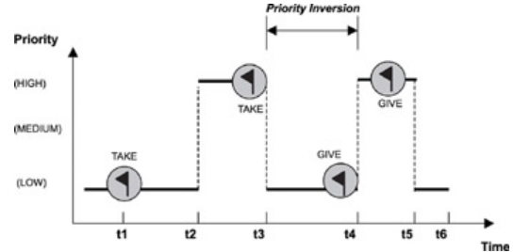
Bounded Priority Inversion
A higher priority task shares a resource with a lower priority task.
The higher priority task must wait when the lower priority task has locked the resource, even though the higher priority task is eligible to run.

Slide 42
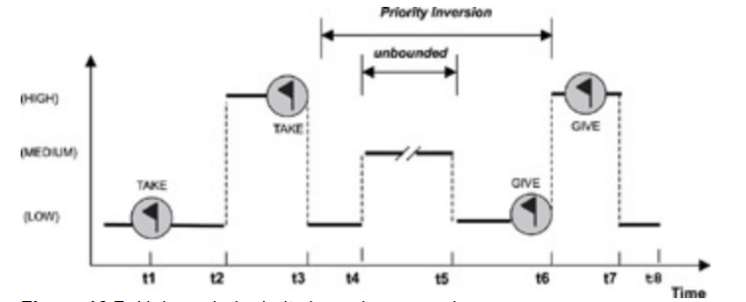
Un-Bounded Priority Inversion
It is possible for a medium-priority task to preempt the low-priority task for an undetermined amount of time, which would cause the high-priority task to wait indefinitely.

Slide 43
These access control protocols eliminate the unbound priority inversion

Slide 44
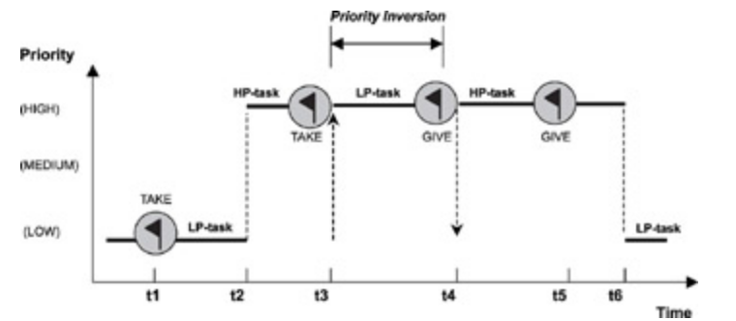
Priority Inheritance Protocol
The Priority Inheritance Protocol is a resource access control protocol that raises the priority of a task, if that task holds a resource being requested by a higher priority task, to the same priority level as the higher priority task.

Slide 45
Priority Inheritance Protocol rules.
Rule # | Description
1 | If R is in use, T is blocked.
2 | If R is free, R is allocated to T.
3 | When a task of a higher priority requests the same resource, T's execution priority is raised to the requesting task's priority level.
4 | The task returns to its previous priority when it releases R.

Slide 46
Ceiling Priority Protocol
In the ceiling priority protocol, the priority of every task is known, as are the resources required by every task.
For a given resource, the priority ceiling is the highest priority of all possible tasks that might require the resource.
For example, if a resource R is required by four tasks (T1 of priority 4, T2 of priority 9, T3 of priority 10, and T4 of priority 8), the priority ceiling of R is 10, which is the highest priority of the four tasks.

Slide 47
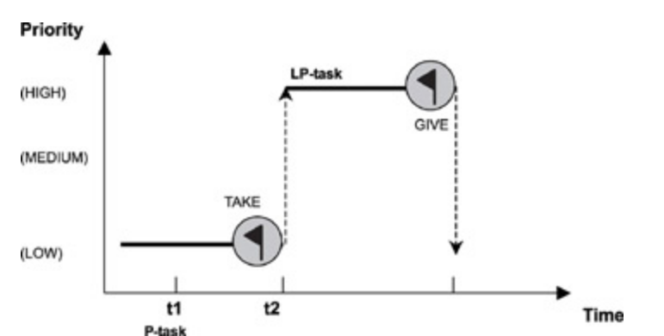
Ceiling Priority Protocol

Slide 48
Rule # | Description
1 | If R is in use, T is blocked.
2 | If R is free, R is allocated to T. T's execution priority is raised to the priority ceiling of R if that is higher. At any given time, T's execution priority equals the highest priority ceiling of all its held resources.
3 | T's priority is assigned the next-highest priority ceiling of another resource when the resource with the highest priority ceiling is released.
4 | The task returns to its assigned priority after it has released all resources.

Slide 49
Typical Semaphore Use
Semaphores are useful either for synchronizing execution of multiple tasks or for coordinating access to a shared resource
wait-and-signal synchronization,
multiple-task wait-and-signal synchronization,
credit-tracking synchronization,
single shared-resource-access synchronization,
recursive shared-resource-access synchronization, and
multiple shared-resource-access synchronization.

Slide 50
Figure : Wait-and-signal synchronization between two tasks.
tWaitTask ( )
{
:
Acquire binary semaphore token
:
}
tSignalTask ( )
{
:
Release binary semaphore token
:
}

Slide 51
Figure : Wait-and-signal synchronization between multiple tasks.
tWaitTask ()
{
:
Do some processing specific to task Acquire binary semaphore token
:
}
tSignalTask ()
{
:
Do some processing Flush binary semaphore's task-waiting list
:
}

Slide 52
Figure : Credit-tracking synchronization between two tasks.
tWaitTask ()
{
:
Acquire counting semaphore token
:
}
tSignalTask ()
{
:
Release counting semaphore token
:
}

Slide 53
Figure : Single shared-resource-access synchronization.
tAccessTask ()
{
:
Acquire binary semaphore token
Read or write to shared resource
Release binary semaphore token
:
}

Slide 54
tAccessTask ()
{
:
Acquire mutex
Access shared resource
Call Routine A
Release mutex
:
}
Routine A ()
{
:
Acquire mutex
Access shared resource
Call Routine B
Release mutex
:
}
Routine B ()
{
:
Acquire mutex
Access shared resource
Release mutex
:
}
Figure : Recursive shared- resource-access synchronization.

Slide 55
Single shared-resource-access synchronization
tAccessTask ()
{
:
Acquire first mutex in non-blocking way
If not successful then acquire 2nd mutex in a blocking way
Read or Write to shared resource
Release the acquired mutex
:
}
tAccessTask ()
{
:
Acquire a counting semaphore token
Read or Write to shared resource
Release a counting semaphore token
:
}

Slide 56
Message Queues
A message queue is a buffer-like object through which tasks and ISRs send and receive messages to communicate and synchronize with data. A message queue is like a pipeline.
It temporarily holds messages from a sender until the intended receiver is ready to read them.
This temporary buffering decouples a sending and receiving task; that is, it frees the tasks from having to send and receive messages simultaneously.

Slide 57
A message queue, its associated parameters, and supporting data structures
When a message queue is first created, it is assigned an associated queue control block (QCB), a message queue name, a unique ID, memory buffers, a queue length, a maximum message length, and one
or more task-waiting lists

Slide 58
The state diagram for a message queue.
Message copying and memory use for sending and receiving messages.

Slide 59
Message Queue Storage
System Pools
Using a system pool can be advantageous if it is certain that all message queues will never be filled to capacity at the same time.
The advantage occurs because system pools typically save on memory use. The downside is that a message queue with large messages can easily use most of the pooled memory, not leaving enough memory for other message queues. Indications that this problem is occurring include a message queue that is not full that starts rejecting messages sent to it or a full message queue that continues to accept more messages.
Private Buffers
Using private buffers, on the other hand, requires enough reserved memory area for the full capacity of every message queue that will be created.
This approach clearly uses up more memory; however, it also ensures that messages do not get overwritten and that room is available for all messages, resulting in better reliability than the pool approach.

Slide 60
Typical Message Queue Operations
Typical message queue operations include the following:
creating and deleting message queues,
sending and receiving messages, and
obtaining message queue information.

Slide 61
Typical Message Queue Use
non-interlocked, one-way data communication,
interlocked, one-way data communication,
interlocked, two-way data communication, and
broadcast communication.

Slide 62
Figure : Non-interlocked, one-way data communication
tSourceTask ()
{
:
Send message to message queue
:
}
tSinkTask ()
{
:
Receive message from message queue
:
}

Slide 63
Figure : Interlocked, one-way data communication
tSourceTask ()
{
:
Send message to message queue
Acquire binary semaphore
:
}
tSinkTask ()
{
:
Receive message from message queue
Give binary semaphore
:
}

Slide 64
Figure : Interlocked, two-way data communication
tClientTask ()
{
:
Send a message to the requests queue
Wait for message from the server queue
:
}
tServerTask ()
{
:
Receive a message from the requests queue
Send a message to the client queue
:
}

Slide 65
tBroadcastTask ()
{
:
Send broadcast message to queue
:
}
Note: similar code for tSignalTasks 1, 2, and 3.
tSignalTask ()
{
:
Receive message on queue
:
}
Figure : Broadcasting messages

Slide 66
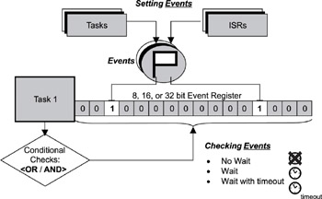
Event Registers
Event register, is an object belonging to a task and consists of a group of binary event flags used to track the occurrence of specific events.
An event register can be 8-, 16-, or 32-bits
Each bit in the event register is treated like a binary flag (also called an event flag) and can be either set or cleared.
Through the event register, a task can check for the presence of particular events that can control its execution.
An external source, such as another task or an ISR, can set bits in the event register to inform the task that a particular event has occurred.

Slide 67
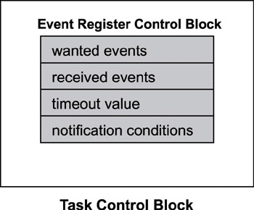
Event Register Control Blocks
The task specifies the set of events it wishes to receive. This set of events is maintained in the wanted events register.
Similarly, arrived events are kept in the received events register. The task indicates a timeout to specify how long it wishes to wait for the arrival of certain events.
The kernel wakes up the task when this timeout has elapsed if no specified events have arrived at the task.

Slide 68
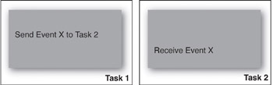
Typical Uses of Event Registers
Event registers are typically used for unidirectional activity synchronization.
It is unidirectional because the issuer of the receive operation determines when activity synchronization should take place.
Pending events in the event register do not change the execution state of the receiving task.

Slide 69
References
Qing Li with Caroline Yao, Real-Time Concepts for Embedded Systems, 1E, Published, 2011

Slide 70
Thank you

