Slide 1
Advanced Microcontroller Bus Architecture

Slide 2
Objectives of the AMBA specification
The AMBA specification has been derived to satisfy four key requirements:
• To facilitate the right-first-time development of embedded microcontroller
products with one or more CPUs or signal processors
• To be technology-independent and ensure that highly reusable peripheral and system macrocells can be migrated across a diverse range of IC processes and be appropriate for full-custom, standard cell and gate array technologies
• To encourage modular system design to improve processor independence,
providing a development road-map for advanced cached CPU cores and the development of peripheral libraries
• To minimize the silicon infrastructure required to support efficient on-chip and off-chip communication for both operation and manufacturing test.

Slide 3
AMBA has been proven in and is being designed into:
• PDA microcontrollers, with a high number of integrated peripherals but also with very low power consumption
• multi-media microcontrollers with floating-point co-processors, on-chip video controller and high memory bandwidth
• complex peripheral ASICs for consumer products
• Digital mobile communication devices integrating control and signal-processing functions

Slide 4
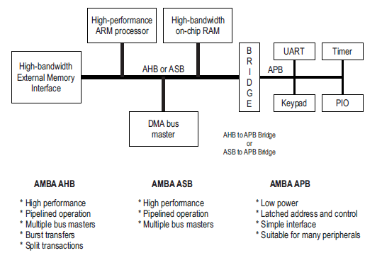
A typical AMBA-based microcontroller
In order to achieve the above, the architecture has the key features of:
• highly modularity
• multi-master support
• low-power emphasis
• innovative test methodology

Slide 5
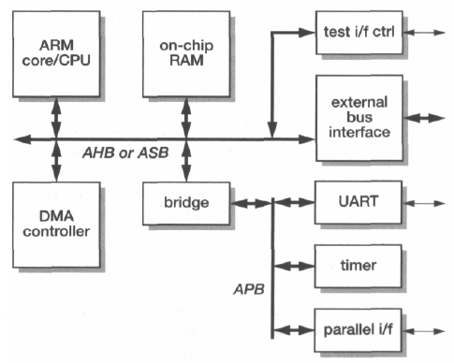
The Advanced Microcontroller Bus Architecture (AMBA)

Slide 6
Bus Transfer steps
The bus clock, BCLK. This will usually be the same as mclk, the ARM processor
clock.
The bus master which holds the grant then proceeds with the bus transaction using the following signals:
Bus transaction, BTRAN[1:0], indicates whether the next bus cycle will be
address-only, sequential or non-sequential. It is enabled by the grant signal and is ahead of the bus cycle to which it refers.
3. The address bus, BA[31:OJ. (Not all address lines need be implemented in systems with modest address-space requirements, and in a multiplexed implementation the address is sent down the data bus.)
4. Bus transfer direction, BWRITE.
5. Bus protection signals, BPROT[1:0], which indicate instruction or data fetches
and supervisor or user access.
6. The transfer size, BSIZE[1:0], specifies a byte, half-word or word transfer.
Bus lock, BLOK, allows a master to retain the bus to complete an atomic readmodify-write transaction.
8. The data bus, BD[31:0], used to transmit write data and to receive read data. In an
implementation with multiplexed address and data, the address is also transmitted down this bus.

Slide 7
A slave unit may process the requested transaction immediately, accepting write data or issuing read data on ED[31:0], or signal one of the following responses:
Bus wait, BWAIT, allows a slave module to insert wait states when it cannot complete the transaction in the current cycle.
Bus last, BLAST, allows a slave to terminate a sequential burst to force the bus master to issue a new bus transaction request to continue.
Bus error, BERROR, indicates a transaction that cannot be completed. If the master is a processor it should abort the transfer.

Slide 8
ZIGbee technology
Wireless networking standards are everywhere. You’ve heard of WiFi™ and Bluetooth™ and cellular technology. Perhaps you’ve heard of Active RFID, Wibree, WiMAX™, or Wireless USB. So, why ZigBee™?

Slide 9
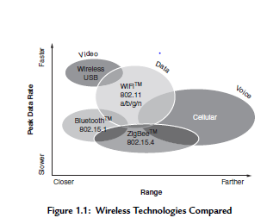

Slide 10
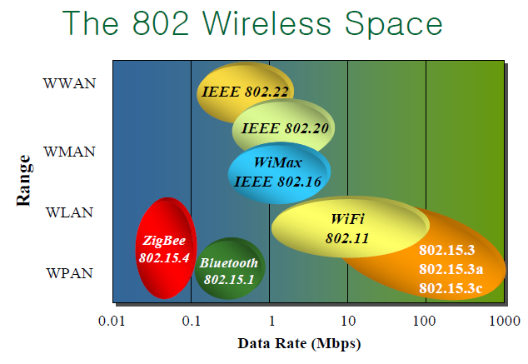

Slide 11
ZigBee serves is called “ wireless sensor networking and control, ” or simply, “ wireless control.
The wireless control market has a number of unique needs for which ZigBee is ideally suited,
because ZigBee is:
● Highly reliable
● Cost-effective
● Able to achieve very low power
● Highly secure
● An open global standard
To achieve the low power and low cost criteria, ZigBee added a constraint to the technology:
Low data rate
The ZigBee protocol fits on 8-bit microcontrollers, with 16- and 32-bit solutions available.

Slide 12
Bluetooth™ is great at point-to-point (as seen in many headsets and cell phones). ZigBee is great at wireless control, where anywhere from two to thousands of nodes are all connected together, in multi-hop mesh network.

Slide 13
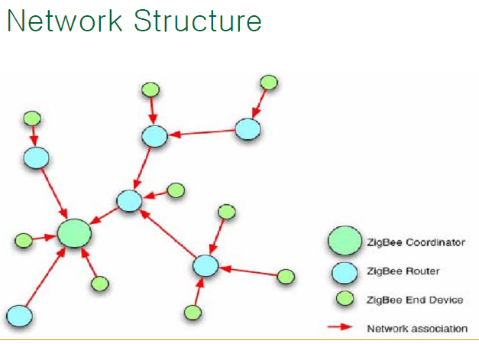

Slide 14
A network coordinator is a device that sets up the network, is aware of all the nodes within its network, and manages both the information about each node as well as the information that is being transmitted/received within the network. Every ZigBee network must contain a network coordinator.
End device-that interact with the physical world.

Slide 15
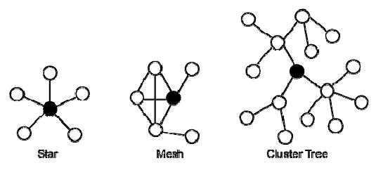

Slide 16
star topology is most useful when several end devices are located close together so that they can communicate with a single router node
That node can then be a part of a larger mesh network that ultimately communicates with the network coordinator. Mesh networking allows for redundancy in node links, so that if one node goes down, devices can find an alternative path to communicate with one another.

Slide 17
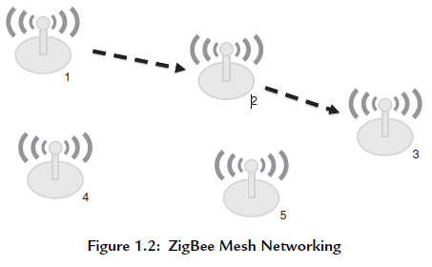
Zigbee topology
With mesh networking, data from the first node can reach any other node in the ZigBee network, regardless of the distance as long as there are enough radios in between to pass the message along (see Figure 1.2 ). Node 1 wants to communicate to node 3, but is out of radio range. ZigBee automatically figures out the best path and so node 1 sends the information to node 2, which forwards it on to node 3.

Slide 18
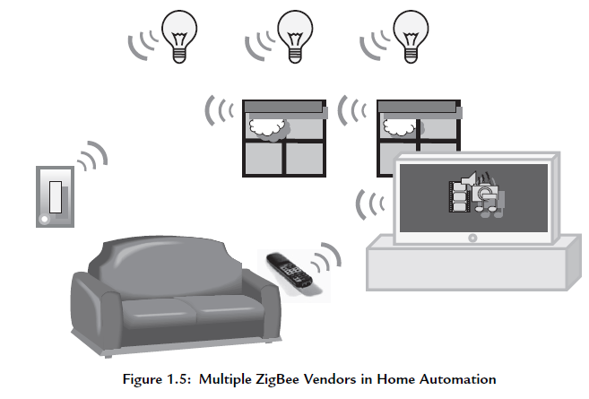
Application

Slide 19
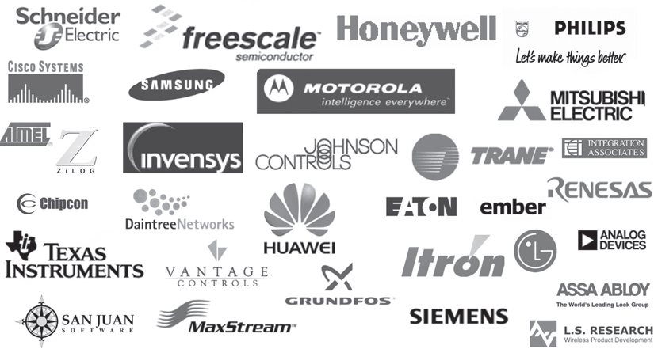
The ZigBee Alliance Members—Over 200 Companies and Growing!

Slide 20
