Slide 1
Inter integrated circuit.

Slide 2
Serial interfaces
I2c.
SPI.
UART.

Slide 3
I²C Features
Multiple receivers do not require separate select lines as in SPI
  At start of each I²C transaction a 7-bit device address is sent
  Each device listens – if device address matches internal address, then device responds.
SDA (data line) is bidirectional, communication is half duplex.
SDA, SCLK are open-drain, require external pullups
It has bidirectional data transfer between master and slave.
  Serial clock synchronization can be used as handshake mechanism to suspend and resume serial transfer.

Slide 4
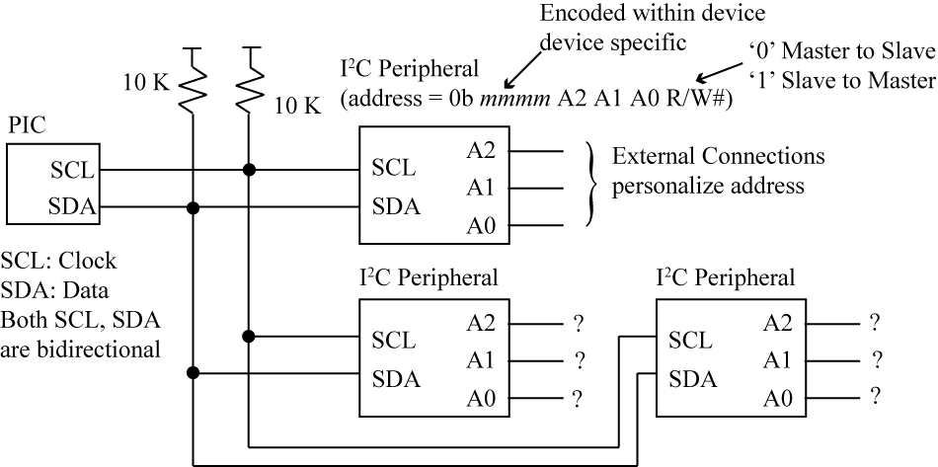
pullups are needed
I2C Bus Addressing
© Charles River Media 2005
No chip selects needed!!!!!
V 0.3

Slide 5
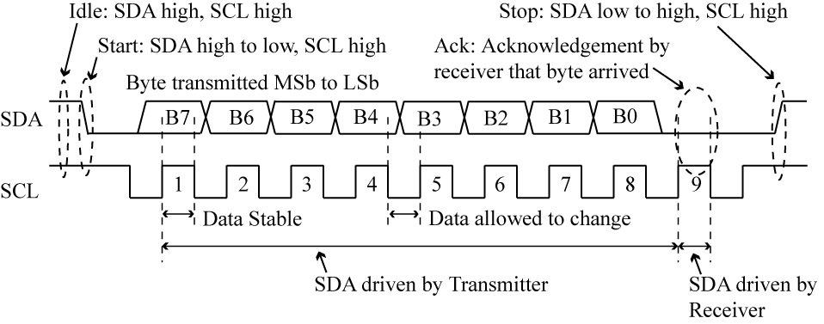
I2C Bus Transfer
Multiple bytes sent in a transaction; every 8 bits has a 9th bit that is an acknowledge.
V 0.3

Slide 6
I²C Device Addressing
Each I2C device has either a 7-bit or 10-bit device address.
For ex: an I2C EEPROM and an I2C DAC. Both of these devices have a 7-bit address.
Upper four bits are assigned by device manufacturer and are hardcoded in the device. Lower three bits are used in different ways by manufacturer.
Microchip 24LC515
LC515 control byte (contains slave address):
7 6 5 4 3 2 1 0
1 0 1 0 B0 A1 A0 R/W
‘B0’ is block select (upper/lower 32K). A1, A0 are chip selects, four devices on one bus.
R/W = 1 for read, 0 for write.
SCL
A2
A1
SDA
A0
V 0.3

Slide 7
Acknowledgement
ACK sent by slave after every 8-bits received. Master releases line (stops driving), samples line on next clock.
Slave MUST pull line low. If Master does not detect ACK, then sets error bit. If Slave does not pull line low, the pullup resistors will pull the line low.
Most common cause of ACK error – incorrect device address.

Slide 8
I2C operating modes
In a given application, the I2C block may operate as a master, a slave, or both.
In the slave mode, the I2C hardware looks for its own slave address and the general call address. If one of these addresses is detected, an interrupt is requested.
In the master mode, the hardware waits until the bus is free before the master mode is entered so that a possible slave operation is not interrupted.
If bus arbitration is lost in the master mode, the I2C block switches to the slave mode immediately and can detect its own slave address in the same serial transfer.

Slide 9
Masters and Slaves
Master device
  controls the SCL
  starts and stops data transfer
  controls addressing of other devices
Slave device
  device addressed by master
Transmitter/Receiver
  master or slave
  master-transmitter sends data to slave-recevier
  master-receiver requires data from slave-transmitter

Slide 10
Master Mode Options
Once Master mode is enabled, the user has six options.
1. Assert a START condition on SDA and SCL.
2. Assert a Repeated START condition on SDA and SCL.
3. Write to the SSPBUF register initiating transmission of data/address.
4. Configure the I2C port to receive data.
5. Generate an Acknowledge condition at the end of a received byte of data.
6. Generate a STOP condition on SDA and SCL.

Slide 11
Master Transmitter Mode
In Master Transmitter mode, serial data is output through SDA, while SCL outputs the serial clock.
The first byte transmitted contains the slave address of the receiving device (7 bits) and the Read/Write (R/W) bit. In this case, the R/W bit will be logic ’0’. Serial data is transmitted 8 bits at a time.
After each byte is transmitted, an Acknowledge bit is received.
START and STOP conditions are output to indicate the beginning and the end of a serial transfer.

Slide 12
Slave Receiver mode
In the slave receiver mode, data bytes are received from a master transmitter.

Slide 13
Slave Transmitter mode
The first byte is received and handled as in the slave receiver mode. However, in this mode, the direction bit will be 1, indicating a read operation.
Serial data is transmitted via SDA while the serial clock is input through SCL.
START and STOP conditions are recognized as the beginning and end of a serial transfer.

Slide 14
I2C Extensions
10 bit addressing (up to 1024 addresses)‏
Fast mode – up to 400 kbits/sec
High-Speed – up to 3.4 Mbits/sec

Slide 15


Introduction
I2C is a 2 wire bi-directional serial bus .
The 2 I2C signals are serial data (SDA) and serial clock (SCL).
The device which a transaction is on an I2C bus is termed as a master.
The device being addressed by the master is the slave.
The master normally controls the clock signal.
Master
Slave 1
Slave 2

Slide 16
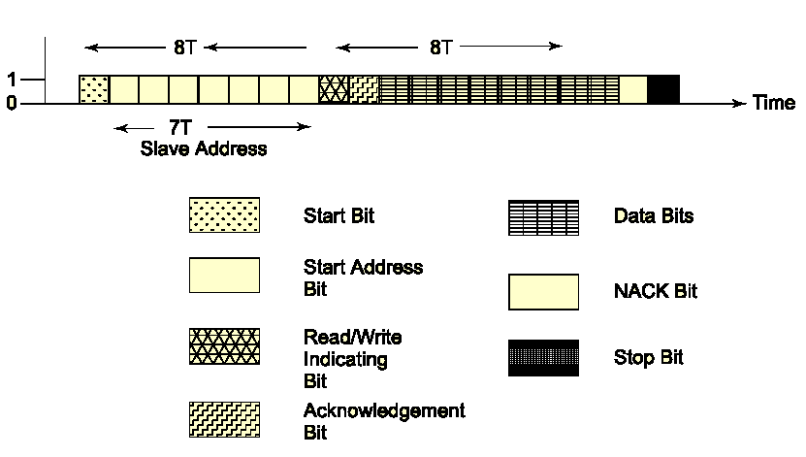
Bits as per I2C protocol

Slide 17
Protocol
First field of 1 bit - the start bit.
Second field of 7 bits- slave address.
Third field of 1 bit – read/write.
Fourth field of 1 bit – ACK bit (from slave).
Fifth field of 8 bits – data.
Sixth field of 1 bit – NACK (negative acknowledgement) from the receiver.
Seventh field 1 bit-STOP bit.

Slide 18
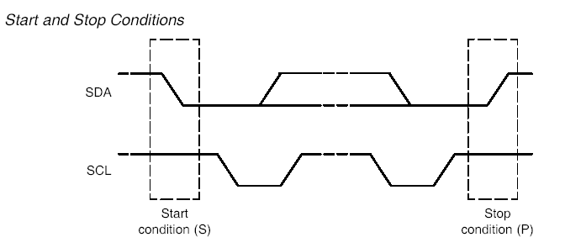

Start and stop condition

Slide 19
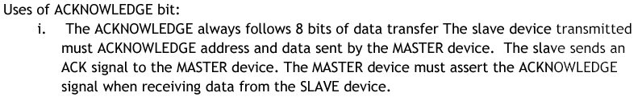
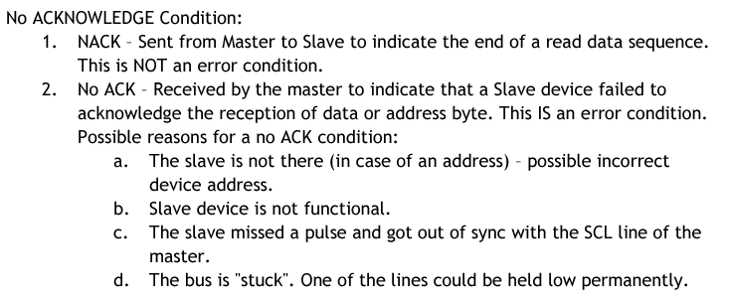
ACK and NACK bit.

Slide 20
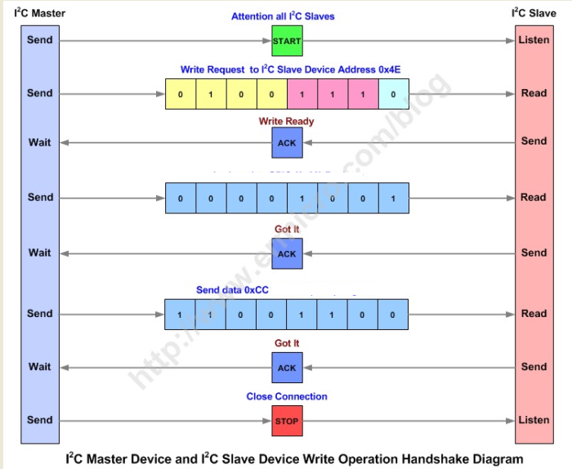

Slide 21
Registers
I2C control group
I2CnCONSET(I2C CONTROL SET RESISTOR) IS USED TO SET BITS IN I2C CONTROL REGISTER.A bit value of zero in this register has no effect on the I2C control register. It contains the following control bits:
I2EN (ENABLE) (6th bit) is set to enable this I2C interface.
STA (START) (5th bit) is set to enter master mode and send start condition.
STO (4th bit) (STOP) is set to send stop condition in master mode, and recover from an error in slave mode.
AA (2nd bit) (ASSERT ACK) is set to request an acknowledge be returned from the slave device.
SI (3rd bit) (Interrupt) is set to indicate a state change in the I2C controller.

Slide 22
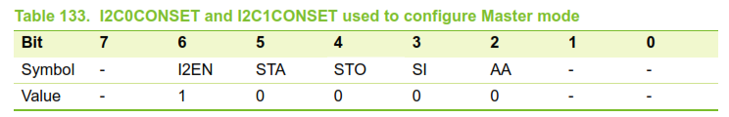

Slide 23
I2CnCONCLR (I2C Control clear register) is used to clear the bits in the I2C CONTROL REGISTER.A bit value of zero in this register has no effect on the I2C control register. It contains the following control bits:
I2ENC disables the I2C Controller.
STAC clears the start flag.
AAC clears the assert ACK flag.
SIC clears the I2C interrupt flag.

Slide 24
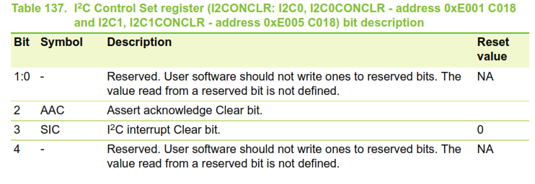
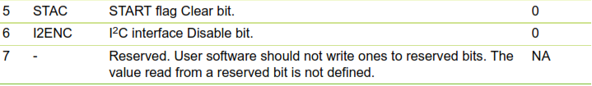

Slide 25
Data group
I2CnDAT contains the data byte to be sent or the last data byte received.
Status group
I2CnSTAT (Slave Status Register) contains interface status code. The device mode and status display a decoded description of the interface status register value.
Address group
I2CnADR (I2C Slave address Register) contains the value the I2C slave address register. The register is valid only in slave mode.

Slide 26
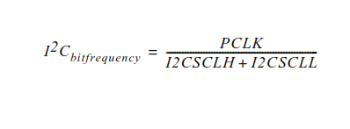
Clock rate group
I2CnSCLL (I2C SCL Low duty cycle register) contains SCL low duty cycle count.
I2CnSCLH (I2C SCL High duty cycle register) contains SCL High duty cycle count.
100kHz=12Mhz/I2CSCLH+I2SCLL
Notes:
100kHz=12Mhz/I2CSCLH+I2SCLL

Slide 27
Algorithm
Enable i2c device using i2cconset reg (I2EN)
Start the communication by setting start bit(STA) in i2cconset reg
Send slave address (rtc)
Send control reg address of rtc and set to 00. to disable sqwout .
Stop i2c by setting stop bit(STO) in i2cconset reg
Poll for serial interrupt flag(SI) from i2cconset reg for each transaction of read or write to ensure the ACK from the slave. Because SI =1 whenever there is TXN or RXN is finished.
Clear SI for every successful TXN.

Slide 28
Set time by sending address of sec reg by enabling write mode and then write value into it.
Initialize all rtc registers by loading known values.
Read the rtc by enabling i2c in read mode.
Stop

Slide 29


Slide 30
Application
Interfaces to external I2C standard parts, such as serial RAMs, LCDs, tone generators, etc.

