Slide 1
ZigBee /
IEEE 802.15.4
ZigBee Alliance: http://www.ZigBee.org
IEEE 802.15.4: http://www.ieee802.org/15/pub/TG4.html

Slide 2
The Wireless Market
TEXT
INTERNET/AUDIO
COMPRESSED
VIDEO
MULTI-CHANNEL
DIGITAL VIDEO
ZigBee
802.11b
802.15.3/WIMEDIA
802.11a/HL2 & 802.11g
SHORT < RANGE > LONG
Bluetooth 2
Bluetooth1
LOW < ACTUAL THROUGHPUT > HIGH

Slide 3
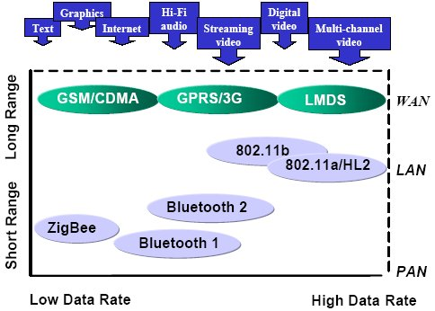
The Wireless Market (2)

Slide 4
What Is the ZigBee Alliance?
An organization with a mission to define reliable, cost-effective, low-power, wirelessly networked, monitoring and control products based on an open global standard
Alliance provides
  Upper layer stack and application profiles
  Compliance and certification testing
  Branding
Result is a set of interoperable solutions recognizable in the market
Eight promoter companies
  Ember, Freescale, Honeywell, Invensys, Mitsubishi, Motorola, Philips and Samsung
A rapidly growing list (Over 120 participants) of industry leaders worldwide committed to providing ZigBee-compliant products and solutions
  Companies include semiconductor manufacturers, wireless IP providers, OEMs, and end-users

Slide 5
Why Do We Need ZigBee Technology?
No standard approach today that addresses the unique needs of most remote monitoring and control applications
  Enables the broad-based deployment of reliable wireless networks with low-complexity, low-cost solutions
  Provides the ability to run for years on inexpensive primary batteries for a typical monitoring application
  Capable of inexpensively supporting robust mesh networking technologies

Slide 6
How Is ZigBee Related to IEEE 802.15.4?
ZigBee takes full advantage of a physical radio and MAC layers specified by IEEE 802.15.4 (lower layers)
ZigBee adds logical network, security and application software (higher layers)
ZigBee continues to work closely with the IEEE to ensure an integrated and complete solution for the market

Slide 7
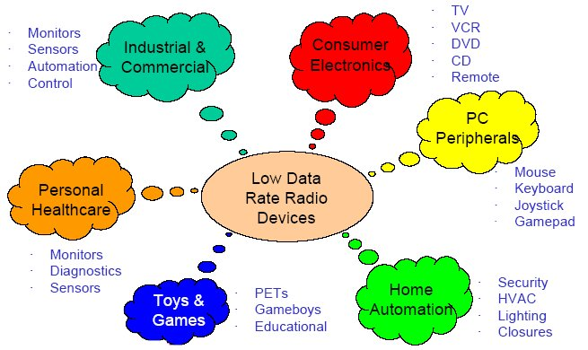
Zigbee target markets

Slide 8






Applications
security
HVAC
AMR
lighting control
access control
BUILDING
AUTOMATION
CONSUMER ELECTRONICS
TV
VCR
DVD/CD
remote
patient monitoring
fitness monitoring
PERSONAL HEALTH CARE
PC & PERIPHERALS
ZigBee
Wireless Control that
Simply Works
mouse
keyboard
joystick
INDUSTRIAL
CONTROL
RESIDENTIAL/
LIGHT COMMERCIAL CONTROL
asset mgt
process control
environmental
energy mgt
security
HVAC
lighting control
access control
lawn & garden irrigation
Notes:
Future applications include Toys and Games, like consoles controllers, portable game pads (like gameboys), educational toys like leap frog stuff, and fun toys like RC (remote control) toys, etc.

Slide 9

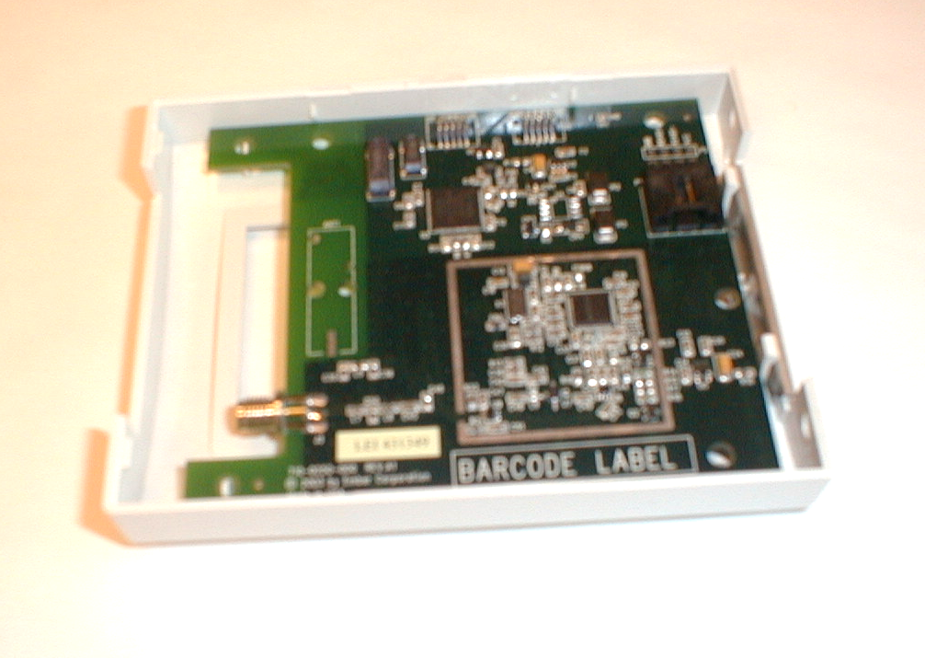
HVAC Energy Management
Hotel energy management
  Major operating expense for hotel
    Centralized HVAC management allow hotel operator to make sure empty rooms are not cooled
  Retrofit capabilities
  Battery operated t-stats can be placed for convenience
  Personalized room settings at check-in

Slide 10
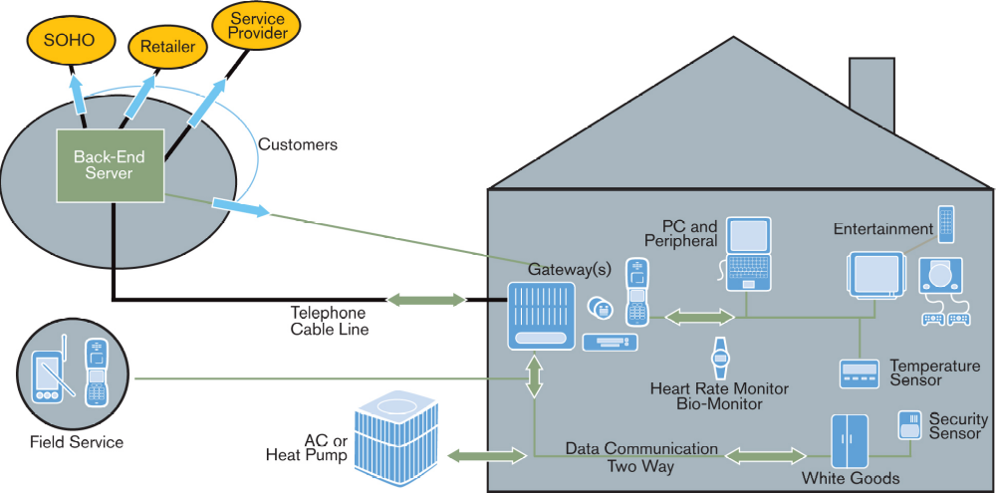
Home/Light Commercial Spaces

Slide 11

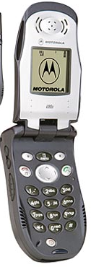
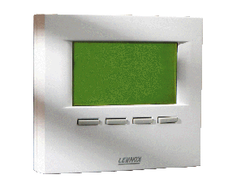
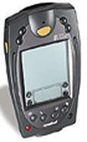



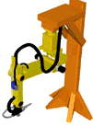

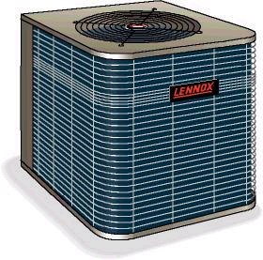
Industrial/Commercial Spaces
Warehouses, Fleet management, Factory, Supermarkets, Office complexes
Gas/Water/Electric meter, HVAC
Smoke, CO, H₂O detector
Refrigeration case or appliance
Equipment management services & Preventative maintenance
Security services
Lighting control
Assembly line and work flow, Inventory
Materials processing systems (heat, gas flow, cooling, chemical)
Energy, diagnostics, e-Business services
Gateway or Field Service links to sensors & equipment
  Monitored to suggest PM, product updates, status changes
Nodes link to PC for database storage
  PC Modem calls retailer, Service Provider, or Corp headquarters
  Corp headquarters remotely monitors assets, billing, energy management
Field Service or mobile worker
Temp.
Sensor
Database
Gateway
Security
Sensor
Back End
Server
Mfg Flow
Telephone
Cable line
Materials handling
HVAC
Corp
Office
Service
Provider
Retailer

Slide 12

Asset Management
Within each container, sensors form a mesh network
Multiple containers in a ship form a mesh to report sensor data
Increased security through on-truck and on-ship tamper detection
Faster container processing. Manifest data and sensor data are known before ship docks at port

Slide 13

IEEE 802.15.4 & ZigBee In Context
Application
Customer
  “the software”
  Network, Security & Application layers
  Brand management
IEEE 802.15.4
  “the hardware”
  Physical & Media Access Control layers
API
Security
32- / 64- / 128-bit encryption
ZigBee
Alliance
Network
Star / Mesh / Cluster-Tree
MAC
IEEE
802.15.4
PHY
868MHz / 915MHz / 2.4GHz
Silicon
Stack
App

Slide 14
Frequencies and Data Rates
 | BAND | COVERAGE | DATA RATE | # of CHANNELS
2.4GHz | ISM | Worldwide | 250kbps | 16
868 MHz |  | Europe | 20kbps | 1
915MHz | ISM | Americas | 40kbps | 10

Slide 15
Basic Network Characteristics
65,536 network (client) nodes
Optimized for timing-critical applications
  Network join time:30 ms (typ)
  Sleeping slave changing to active: 15 ms (typ)
  Active slave channel access time: 15 ms (typ)
Network coordinator
Full Function node
Reduced Function node
Communications flow
Virtual links

Slide 16
Comparison of Key Features of Complementary Protocols
Feature(s) | IEEE 802.11b | Bluetooth | ZigBee
Power Profile | Hours | Days | Years
Complexity | Very Complex | Complex | Simple
Nodes/Master | 32 | 7 | 64000
Latency | Enumeration up to 3 Seconds | Enumeration up to 10 seconds | Enumeration 30ms
Range | 100 m | 10m | 70m-300m
Extendibility | Roaming Possible | No | YES
Data Rate | 11Mbps | 1 Mbps | 250Kbps
Security | Authentication Service Set ID (SSID), WEP | 64 bit, 128 bit | 128 bit AES and Application Layer user defined

Slide 17
Why ZigBee?
Reliable and self healing
Supports large number of nodes
Easy to deploy
Very long battery life
Secure
Low cost
Can be used globally

Slide 18
IEEE 802.15.4 Tutorial

Slide 19
IEEE 802.15.4 Basics
802.15.4 is a simple packet data protocol for lightweight wireless networks
  Channel Access is via Carrier Sense Multiple Access with collision avoidance and optional time slotting
  Message acknowledgement and an optional beacon structure
  Multi-level security
  Three bands, 27 channels specified
    2.4 GHz: 16 channels, 250 kbps
    868.3 MHz : 1 channel, 20 kbps
    902-928 MHz: 10 channels, 40 kbps
  Works well for
    Long battery life, selectable latency for controllers, sensors, remote monitoring and portable electronics
  Configured for maximum battery life, has the potential to last as long as the shelf life of most batteries

Slide 20
802.15.4 General Characteristics
Data rates of 250 kb/s, 40 kb/s and 20 kb/s.
Star or Peer-to-Peer operation.
Support for low latency devices.
CSMA-CA channel access.
Dynamic device addressing.
Fully handshaked protocol for transfer reliability.
Low power consumption.
Frequency Bands of Operation, either:
  16 channels in the 2.4GHz ISM band;
  Or 10 channels in the 915MHz ISM band
  and 1 channel in the European 868MHz band.

Slide 21
802.15.4 Architecture
Upper Layers
IEEE 802.2 LLC
Other LLC
IEEE 802.15.4 MAC
IEEE 802.15.4
IEEE 802.15.4
868/915 MHz
2400 MHz
PHY
PHY

Slide 22
IEEE 802.15.4 PHY Overview
Operating Frequency Bands
Channel 0
Channels 1-10
868MHz / 915MHz
PHY
2 MHz
868.3 MHz
902 MHz
928 MHz
2.4 GHz
PHY
Channels 11-26
5 MHz
2.4 GHz
2.4835 GHz

Slide 23
IEEE 802.15.4 PHY Overview
Packet Structure
PHY Packet Fields
Preamble (32 bits) – synchronization
Start of Packet Delimiter (8 bits)
PHY Header (8 bits) – PSDU length
PSDU (0 to 1016 bits) – Data field
Start of
Packet
Delimiter
PHY
Header
PHY Service
Data Unit (PSDU)
Preamble
6 Octets
0-127 Octets

Slide 24
IEEE 802.15.4 PHY Overview
Modulation/Spreading
2.4 GHz PHY
250 kb/s (4 bits/symbol, 62.5 kBaud)
Data modulation is 16-ary orthogonal modulation
16 symbols are orthogonal set of 32-chip PN codes
Chip modulation is O-QPSK at 2.0 Mchips/s
868MHz/915MHz PHY
Symbol Rate
  868 MHz Band: 20 kb/s (1 bit/symbol, 20 kBaud)
  915 MHz Band: 40 kb/s (1 bit/symbol, 40 kBaud)
Data modulation is BPSK with differential encoding
Spreading code is a 15-chip m-sequence
Chip modulation is BPSK at
  868 MHz Band: 300 kchips/s
  915 MHz Band: 600 kchips/s

Slide 25
IEEE 802.15.4 PHY Overview
Common Parameters
Transmit Power
Capable of at least .5 mW
Transmit Center Frequency Tolerance
± 40 ppm
Receiver Sensitivity (Packet Error Rate <1%)
<-85 dBm @ 2.4 GHz band
<-92 dBm @ 868/915 MHz band
RSSI Measurements
Packet strength indication
Clear channel assessment
Dynamic channel selection

Slide 26
IEEE 802.15.4 PHY Overview
PHY Primitives
PHY Data Service
PD-DATA – exchange data packets between MAC and PHY
PHY Management Service
PLME-CCA – clear channel assessment
PLME-ED - energy detection
PLME-GET / -SET– retrieve/set PHY PIB parameters
PLME-TRX-ENABLE – enable/disable transceiver

Slide 27
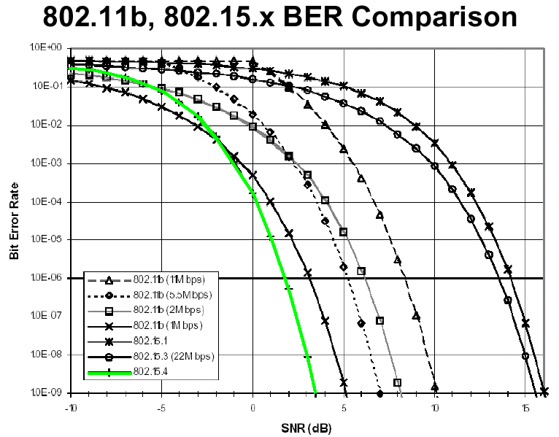
PHY Performance
802.15.4 has excellent performance in low SNR environments
Bluetooth

Slide 28
IEEE 802.15.4 MAC Overview
Design Drivers
Extremely low cost
Ease of implementation
Reliable data transfer
Short range operation
Very low power consumption
Simple but flexible protocol

Slide 29
IEEE 802.15.4 MAC Overview
Employs 64-bit IEEE & 16-bit short addresses
  Ultimate network size can reach 2⁶⁴ nodes (more than we’ll probably need…)
  Using local addressing, simple networks of more than 65,000 (2^16) nodes can be configured, with reduced address overhead
Three devices specified
  Network Coordinator
  Full Function Device (FFD)
  Reduced Function Device (RFD)
Simple frame structure
Reliable delivery of data
Association/disassociation
AES-128 security
CSMA-CA channel access
Optional superframe structure with beacons
Optional GTS mechanism

Slide 30
IEEE 802.15.4 MAC Overview
Device Classes
Full function device (FFD)
  Any topology
  Network coordinator capable
  Talks to any other device
Reduced function device (RFD)
  Limited to star topology
  Cannot become a network coordinator
  Talks only to a network coordinator
  Very simple implementation

Slide 31
Topology Models
Star
Mesh
PAN coordinator
Full Function Device
Reduced Function Device
Cluster Tree

Slide 32
IEEE 802.15.4 MAC Overview
Star Topology
PAN
Coordinator
Master/slave
Full function device
Communications flow
Reduced function device

Slide 33
IEEE 802.15.4 MAC Overview
Peer-Peer (Mesh) Topology
Point to point
Cluster tree
Full function device
Communications flow

Slide 34
IEEE 802.15.4 MAC Overview
Combined Topology
Clustered stars - for example,
cluster nodes exist between rooms
of a hotel and each room has a
star network for control.
Communications flow
Full function device
Reduced function device

Slide 35
Mesh Networking
Coordinator (FFD)
Router (FFD)
End Device (RFD or FFD)
Mesh Link
Star Link

Slide 36
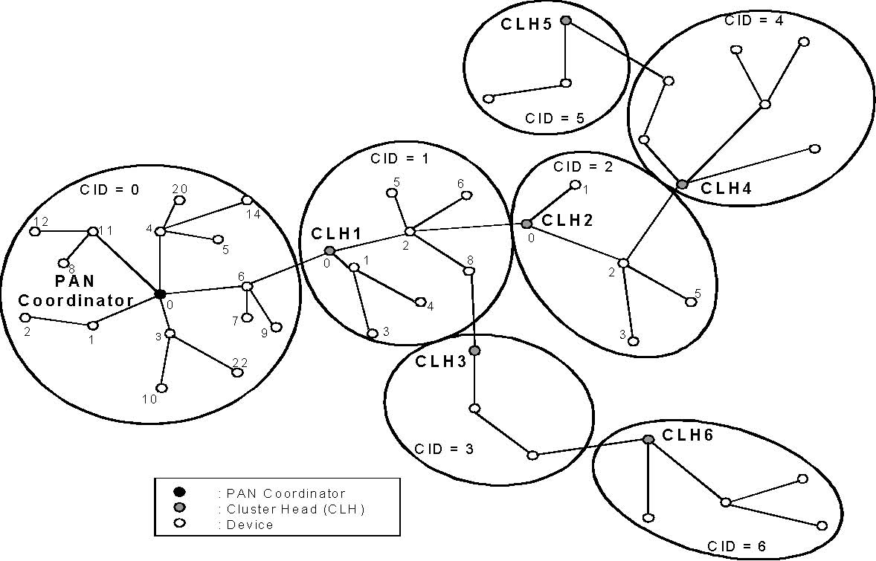
Cluster Tree

Slide 37
Star Network Key Attributes
Simplicity
Low Cost
Long Battery Life
Single Point of Failure
Node
Controller
Repeater (optional)

Slide 38
Mesh Network Key Attributes
Reliability
Extended Range
No Battery Life
Routing Complexity
Router Node
Controller

Slide 39
Hybrid Network Key Attributes
Flexibility
Reliability/Range of Mesh
Battery Life of Star
Design Complexity
Router Node
Node
Controller

Slide 40
IEEE 802.15.4 MAC Overview
Addressing
All devices have 64 bit IEEE addresses
Short addresses can be allocated
Addressing modes:
  Network + device identifier (star)
  Source/destination identifier (peer-peer)

Slide 41
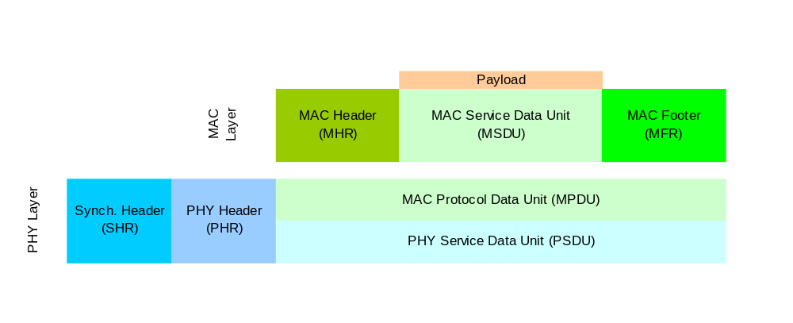
IEEE 802.15.4 MAC Overview
General Frame Structure
4 Types of MAC Frames:
  Data Frame
  Acknowledgment Frame
  MAC Command Frame
  Beacon Frame

Slide 42
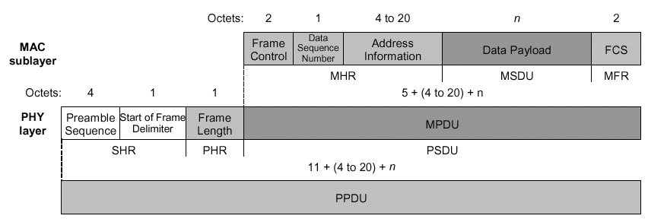
Data Frame format
One of two most basic and important structures in 802.15.4
Provides up to 104 byte data payload capacity
Data sequence numbering to ensure that packets are tracked
Robust structure improves reception in difficult conditions
Frame Check Sequence (FCS) validates error-free data
Notes:
Frame control: + type of frame (4 types), format of address field, controls Ack, I.e. specifies how the frame looks and what it contains. The ACK and MAC command are lower level used for peer-to-peer
Sequence number: and Frame check sequency: verifies the integrity of the MAC frame. A transmission is considered successful if the ack frame contains the same sequence number as the previous frame. FCS is a 16-bit cyclic redundancy check (CRC)
Address field size: can contain both source and destination info

Slide 43
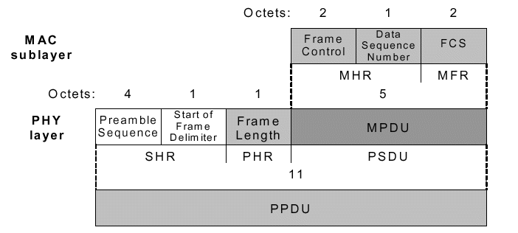
Acknowledgement Frame Format
The other most important structure for 15.4
Provides active feedback from receiver to sender that packet was received without error
Short packet that takes advantage of standards-specified “quiet time” immediately after data packet transmission
Notes:
Frame control: + type of frame (4 types), format of address field, controls Ack, I.e. specifies how the frame looks and what it contains. The ACK and MAC command are lower level used for peer-to-peer
Sequence number: and Frame check sequency: verifies the integrity of the MAC frame. A transmission is considered successful if the ack frame contains the same sequence number as the previous frame. FCS is a 16-bit cyclic redundancy check (CRC)
Address field size: can contain both source and destination info

Slide 44
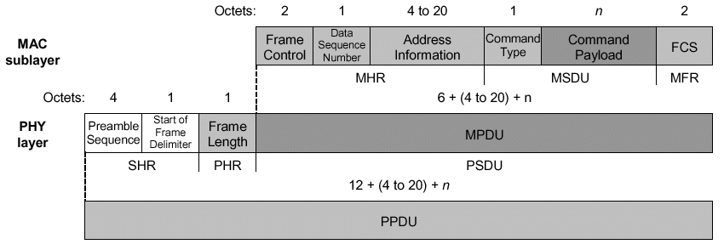
MAC Command Frame format
Mechanism for remote control/configuration of client nodes
Allows a centralized network manager to configure individual clients no matter how large the network
Notes:
Frame control: + type of frame (4 types), format of address field, controls Ack, I.e. specifies how the frame looks and what it contains. The ACK and MAC command are lower level used for peer-to-peer
Sequence number: and Frame check sequency: verifies the integrity of the MAC frame. A transmission is considered successful if the ack frame contains the same sequence number as the previous frame. FCS is a 16-bit cyclic redundancy check (CRC)
Address field size: can contain both source and destination info

Slide 45
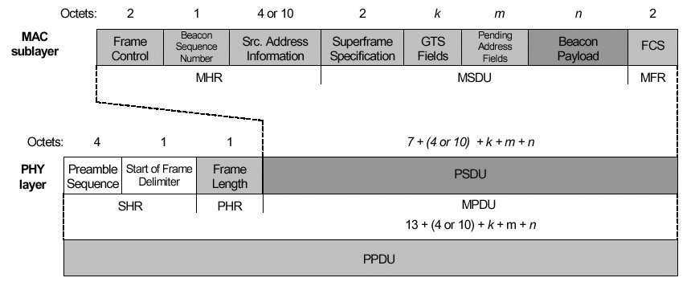
Beacon Frame format
Beacons add a new level of functionality to a network
Client devices can wake up only when a beacon is to be broadcast, listen for their address, and if not heard, return to sleep
Beacons are important for mesh and cluster tree networks to keep all of the nodes synchronized without requiring nodes to consume precious battery energy listening for long periods of time
Notes:
Frame control: + type of frame (4 types), format of address field, controls Ack, I.e. specifies how the frame looks and what it contains. The ACK and MAC command are lower level used for peer-to-peer
Sequence number: and Frame check sequency: verifies the integrity of the MAC frame. A transmission is considered successful if the ack frame contains the same sequence number as the previous frame. FCS is a 16-bit cyclic redundancy check (CRC)
Address field size: can contain both source and destination info

Slide 46
IEEE 802.15.4 MAC Overview
Optional Superframe Structure
GTS 2
GTS 1
Contention Access Period
Contention Free Period
15ms * 2^{n}
where 0 ≥ n ≥ 14
Network beacon
Transmitted by network coordinator. Contains network information,
frame structure and notification of pending node messages.
Contention period
Access by any node using CSMA-CA
Guaranteed
Time Slot
Reserved for nodes requiring guaranteed bandwidth

Slide 47
IEEE 802.15.4 MAC Overview
Traffic Types
Periodic data
  Application defined rate (e.g. sensors)
Intermittent data
  Application/external stimulus defined rate (e.g. light switch)
Repetitive low latency data
  Allocation of time slots (e.g. mouse)

Slide 48
IEEE 802.15.4 MAC Overview
MAC Data Service
Originator
MAC
Recipient
MAC
MCPS-DATA.request
Channel
access
Data frame
Originator
Recipient
Acknowledgement
(if requested)
MCPS-DATA.indication
MCPS-DATA.confirm

Slide 49
IEEE 802.15.4 PHY Overview
MAC Primitives
MAC Data Service
MCPS-DATA – exchange data packets between MAC and PHY
MCPS-PURGE – purge an MSDU from the transaction queue
MAC Management Service
MLME-ASSOCIATE/DISASSOCIATE – network association
MLME-SYNC / SYNC-LOSS - device synchronization
MLME-SCAN - scan radio channels
MLME- COMM-STATUS – communication status
MLME-GET / -SET– retrieve/set MAC PIB parameters
MLME-START / BEACON-NOTIFY – beacon management
MLME-POLL - beaconless synchronization
MLME-GTS - GTS management
MLME-RESET – request for MLME to perform reset
MLME-ORPHAN - orphan device management
MLME-RX-ENABLE - enabling/disabling of radio system

Slide 50
802.15.4 MAC Layer Specs
CSMA-CA (like 802.11) channel access scheme
Unlike 802.11 no RTS/CTS mechanism (due to relatively low data rate collisions are much less likely)
Different Modes of Operation Depending on Nature of Traffic
  Periodic Transmissions
    Beacon Mode
  Intermittent Transmissions
    Disconnection Mode, node not attached to network when it doesn't need to communicate (energy savings!)
  Low Latency Transmissions
    Guaranteed Time Slot (GTS), allows for device to get an assigned time slot in super frame (a TDMA scheme)
16 bit short addressing scheme or 64bit long addressing scheme
Four MAC frame types:
  Beacon Frame
  Data Frame
  ACK Frame
  MAC Command Frame

Slide 51
Non-Beacon Mode (Unslotted CSMA-CA)
Coordinator
Node
Coordinator
Node
Data Request
Data frame
Acknowledgement
Acknowledgement
(opcional)
Data frame
Acknowledgement
Data to Coordinator
Data from Coordinator
Coordinator always active, Node with low duty cycle

Slide 52
Beacon Mode (Slotted CSMA-CA)
Coordinator
Node
Coordinator
Node
Beacon
Beacon
Data frame
Data Request
Acknowledgement
Acknowledgement
(opcioanl)
Data frame
Acknowledgement
Data to Coordinator
Data from Coordinator
Nodes synchronized with Coordinator

Slide 53
Peer-Peer Transfer
Node 1
Node 2
Data frame
Acknowledgement
Nodes synchronized with each other

Slide 54
Network Layer Functions
Starting a network – able to establish a new network
Joining and Leaving Network – nodes are able to become members of the network as well as quit being members
Configuration – Ability of the node to configure its stack to operate in accordance with the network type
Addressing – The ability of a ZigBee coordinator to assign addresses to devices joining the network
Synchronization – ability of a node to synchronize with another node by listening for beacons or polling for data
Security – ability to ensure end-to-end integrity of frames
Routing – nodes can properly route frames to their destination (AODV, etc.)

Slide 55

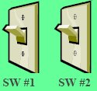
Application Support Layer Functions
Zigbee Device Object (ZDO) maintains what the device is capable of doing and makes binding requests based on these capabilities
Discovery – Ability to determine which other devices are operating in the operating space of this device
Binding – Ability to match two or more devices together based on their services and their needs and allow them to communicate

Slide 56
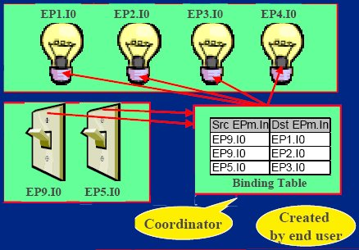
Binding
EP – Endpoint (subunit of a node)

Slide 57
MicaZ,TinyOS, and Zigbee

Slide 58
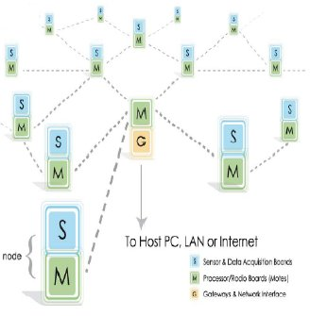
Micaz Crossbow
MicaZ motes use the 802.15.4 standard defined in 2003
MicaZ motes do not use the network and application layers defined by the Zigbee Alliance’s network and application layers
Zigbee upper layers had not been finalized in time
MicaZ motes are using TinyOS 1.1.7 and Crossbow’s mesh networking stack

Slide 59
MicaZ Network & Application layers
Network Layer:
Any Network Layer/ Routing Algorithm can be implemented in TinyOS
  Many available already
Application Layer
open-source TinyOS supported
  Applications can be developed for use with TinyOS

Slide 60
More 802.15.4 Specs
MicaZ Power Consumption
  30 µW during sleep
  33 mW while active
MicaZ Lifetime
  ~ 1 year (Zigbee specifies up to 2 years)
MicaZ Range
  75 – 100 m (outdoors)
  20 – 30 m (indoors)

Slide 61
MICAz MOTE
IEEE 802.15.4
250 kbps radio
128KB program flash memory
512KB measurement log memory (xbow estimates > 100000 samples)
10 bit Analog to Digital Converter
Red, Green, & Yellow LEDs

Slide 62
TinyOS
Open Source Operating System designed for MOTEs
Programs written in an extension of C called nesC
  TinyOS is event driven
  nesC - wire together components that handle events/fire commands through interfaces to build an application (highly modular)
Preinstalled (8 motes) Surge ad-hoc multi-hop (Destination-Sequenced Distance Vector routing) software (xbow) written in nesC

Slide 63
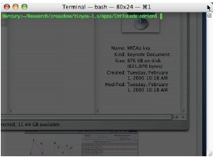
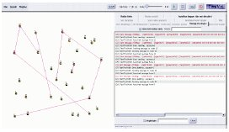
Simulation Tools
TOSSIM - TinyOS simulator
  simulates application code more so than a network simulation like ns2, Opnet
TinyViz - graphical interface for TOSSIM
  can be extended with plug-ins

Slide 64
Most important characteristics of WSN
Survey conducted mid-2002 on the characteristics of a
wireless sensor network most important to its users:
  Data Reliability
  Battery Life
  Cost
  Transmission Range
  Data Rate
  Data Latency
  Physical Size
  Data Security

Slide 65
Designing with 802.15.4 and ZigBee
IEEE 802.15.4 vs Bluetooth

Slide 66
Motorola 802.15.4 / ZigBee™ features
  2.4 GHz Band, -92 dBm RX sensitivity at 1% PER
    IEEE requirement is at least –85 dBm
  Power supply 2.0-3.6 V w/ on-chip regulator, logic interface 1.7 to 3.3
    Runs off a single Li or 2 alkaline cells
  Complete RF transceiver data modem – antenna in, fully packetized data out
  Data and control interface via standard SPI at 4 MHz minimum
  802.15.4 MAC supplied
  Four new Motorola HCS08 MCUs will interoperate with the data modem chip
    Often 802.15.4 functionality can be added to existing systems simply by including the modem chip and reprogramming an existing MCU that may already be in the application
  HC08 RAM/FLASH configurations from 384B/4kB to 2kB/60kB depending upon application SW needs

Slide 67
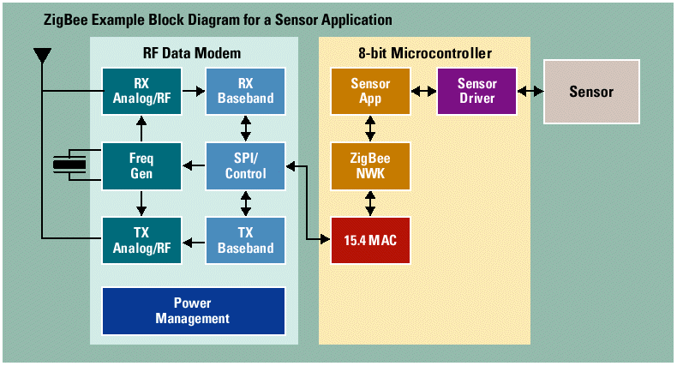
System Simplicity and Flexibility
Motorola RF Packet Radio
Motorola 8-Bit MCU

Slide 68
Motorola’s 802.15.4 Platform Advantages
One-Stop-Shop Solution
  Single source for platform solution
    Integrated Circuits, Reference Designs, Modules, Stack Software, Development Systems
Key technology enhancements provide for a superior solution
  Excellent adjacent channel rejection
    No external filtering required under most conditions
  High Sensitivity Radio Solution
    7 dBm better than spec – longer range
  Extended Temperature Operating Range
    -40°C to +85°C for industrial and automotive applications
  Operating voltage range optimized for alkaline or lithium primary cells
    2.0 Vdc to 3.6 Vdc, disposable
      Nearly 100% of available battery life whether Alkaline or Lithium
      Normal 2.7v EOL silicon systems can only get perhaps 30% of available alkaline battery energy
  Adjustable TX Output power
    Improved coexistence for short range applications
IEEE Participation and ZigBee™ Alliance leadership
  Technology and standards driver
  Early access to new technology

Slide 69
IEEE 802.15.4/ZigBee and Bluetooth
Instantaneous Power Consumption
  15.4 Transceivers are “similar” to Bluetooth Transceivers
    802.15.4
      O-QPSK with shaping
      Max data rate 250kbps over the air
      2Mchips/s over the air Direct Sequence Spread Spectrum (62.5ksps*32 spread)
      -92 dBm sensitivity nominal
      40ppm xtal
    Bluetooth
      FSK
      Max data rate 720kbps over the air
      1Msps over the air Frequency Hop Spread Spectrum (79 channels @ 1600 hps)
      -83 to -84 dBm sensitivity nominal
      20ppm xtal
Instantaneous power consumption will be similar for the raw transceivers without protocol
Bluetooth’s FHSS makes it impractical to create extended networks without large synchronization cost

Slide 70
IEEE 802.15.4 Protocol Built for the Mission
15.4 Protocol was developed for very different reasons than Bluetooth
  802.15.4
    Very low duty cycle, very long primary battery life applications as well as mains-powered
    Static and dynamic mesh, cluster tree and star network structures with potentially a very large number (>>65534) of client units, low latency available as required
    Ability to remain quiescent for long periods of time without communicating to the network
  Bluetooth
    Moderate duty cycle, secondary battery operation where battery lasts about the same as master unit
    Wire replacement for consumer devices that need moderate data rates with very high QoS and very low, guaranteed latency
    Quasi-static star network structure with up to 7 clients (and ability to participate in more than one network simultaneously)
    Generally used in applications where either power is cycled (headsets, cellphones) or mains-powered (printers, car kits)
Protocol differences can lead to tremendous optimizations in power consumption

Slide 71
Peel-n’-Stick Security Sensors
Battery Operation
  2 AA Alkaline or 1 Li-AA cell
802.15.4/ZigBee Mode
  Non-beacon network environment
Sensor process
  RC Oscillator waking up MCU and doing network check-in at some interval
    Many security systems have between ~10 second and ~15 minute requirement
  On a sensor event, device immediately awakens and reports in to network
802.15.4
XCVR
Vcc
SPI
MCU
4
SPI
Vcc
3Vdc
CLK
OSC1
IRQ
16.000MHz
Security
Sensor

Slide 72
Security Sensor Timing
Battery-Powered Sensor
Mains-Powered Router
Interval timer expires: Wake Up
256µs
CCAx2
192µs
RX>TX
~650µs
TX
RX
192µs
TX>RX
RX>TX
Check-in only ~1640µs
~350µs
ACK RX
ACK TX OPT: Pending ON
Event and Get Data ~2300µs
~650µs
RX Data
TX Data
Set Interval timer
Sleep

Slide 73
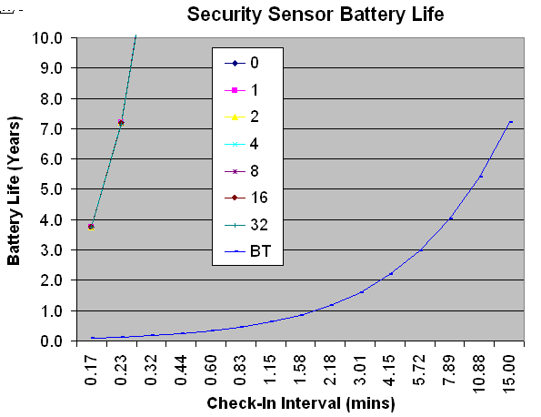
802.15.4 Security Sensor
Any check-in interval exceeding ~14 sec allows sensor to surpass alkaline battery shelf life
Only at 15-min interval does BT reach battery shelf life

Slide 74
Body-Worn Medical Sensors
Heartbeat Sensor
  Battery-operated using CR2032 Li-Coin cell
802.15.4/ZigBee Mode
  Network environment using Guaranteed Time Slot (GTS)
  Network beacons occurring either every
    960ms or 61.44s (closest values to 1 and 60 s)
Sensor has two ongoing processes
  Heartbeat time logging
  Transmit heartrate and other information (8 bytes total)
    Instantaneous and average heart rate
    Body temperature and battery voltage
heartbeat
GTS
Beacon
time
802.15.4
XCVR
Vcc
MCU
Vcc
3Vdc
SPI
4
SPI
IRQ/
INT
IRQ
RESET
OSC1
OSC2
Heartbeat
Sensor
16.000MHz
32.768kHz

Slide 75
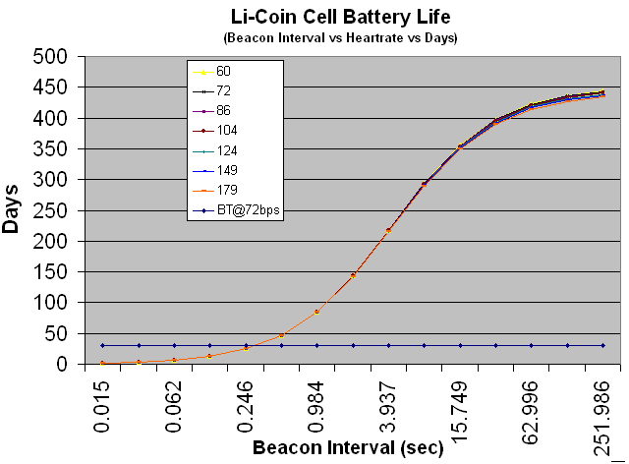
IEEE 802.15.4/ZigBee vs Bluetooth
At beacon interval ~60s, 15.4/ZigBee battery life approx 416 days
802.15.4/ZigBee more battery-effective at all beacon intervals greater than 0.246s
At beacon interval ~1s, 15.4/ZigBee battery life 85 days
Bluetooth 30 days (park mode @ 1.28s)

Slide 76
Summary
IEEE 802.15.4 and ZigBee
  Designer concentrates on end application
    Silicon vendors and ZigBee Alliance take care of transceiver, RF channel and protocol
  Reliable and robust communications
  Flexible network architectures
  Very long primary battery life (months to years to decades)
  Very inexpensive Bill Of Materials
  Low system complexity for the OEM
More Information
  Motorola: www.motorola.com/zigbee
  ZigBee: www.zigbee.org

Slide 77
Low Data Rate Wireless Evolution
First Stage
Second Stage
Third Stage
……… 2002 2003
2004 2005 2006
2007 2008 2009+
Proprietary Dominates
IEEE 802.15.4 Emerges
System Integrator Focus
Leading Edge OEMs
$.1 - $1B Industry
$1,000 - $100 Unit Cost
Proprietary Fades
ZigBee Emerges
Semiconductor Focus
Early Adopter OEMs
$1 - $10B Industry
$100 - $10 Unit Cost
Standards Dominate
IEEE 1451.5 Emerges
OEM Focus
Wireless Ubiquitous
$10 - $100B+ Industry
$10 - $1 Unit Cost

Slide 78
Wireless Networking Standards
Market Name Standard | GPRS/GSM 1xRTT/CDMA | Wi-Fi™ 802.11b | Bluetooth™ 802.15.1 | ZigBee™ 802.15.4
Application Focus | Wide Area Voice & Data | Web, Email, Video | Cable Replacement | Monitoring & Control
System Resources | 16MB+ | 1MB+ | 250KB+ | 4KB - 32KB
Battery Life (days) | 1-7 | .5 - 5 | 1 - 7 | 100 - 1,000+
Network Size | 1 | 32 | 7 | 255 / 65,000
Bandwidth (KB/s) | 64 - 128+ | 11,000+ | 720 | 20 - 250
Transmission Range (meters) | 1,000+ | 1 - 100 | 1 - 10+ | 1 - 100+
Success Metrics | Reach, Quality | Speed, Flexibility | Cost, Convenience | Reliability, Power, Cost

Slide 79
IEEE 802.15.4 Key Features
High Data Reliability
  DSSS, bi-directional, message acknowledgement, low latency
  Beacon mode enables Guaranteed Time Slots (priority comm.)
Advanced Power Management
  Typical monitoring applications good for shelf life of battery
Inherent Data Security
  Data encryption, message authentication, packet freshness
Protocol Simplicity
  Designed for minimal cost & complexity

Slide 80
ZigBee Overview
Specifications Managed by the ZigBee Alliance
  Global consortium of OEMs, IC vendors & tech companies
  Specify device, network and service discovery / pairing
Defining Star, Mesh & Cluster-Tree Networks
  Allows users to balance system cost, reliability & battery life
Defining Security Management
  Extends 32-, 64- & 128-bit AES encryption of 802.15.4
Defining Application Profiles & Brand Compliance
  Ensures product & application interoperability (e.g., AMR & DSM)

Slide 81
Dimensionamento das ligações rádio
Free space loss L = 32.4 + 20 x Log F(MHz) + 20 x Log D(Km)
2.4 GHz => L = 100 + 20 x Log D(Km)
860 MHz => L = 91 + 20 x Log D(Km)
Link budget (2.4 GHz) :
Pr = Pe – 100 - 20 x Log D(Km) + Gae + Gar - Ploss
D(Km) = 10 (Pe – Prmin - 100 + Gae + Gar-Ploss)/20
Zigbee: Prmin= -85 dBm, Ga=0 Ploss=0=> D(Km) = 10 ^{(Pe – 15)/20}
  Pe= 0dBm (1mW) => D= 0,18 Km
  Pe= 10dBm (10mW) => D= 0,56 Km
  Pe= 20dBm (100mW) => D= 1.8 Km

