Slide 1
PROJECT TITLE
PIP2001 Capstone Project
Final review
Batch Number:
Under the Supervision of,
Mr.ASAD MOHAMMED KHAN
Professor / Associate Professor / Assistant Professor
School of Computer Science and Engineering
Presidency University
Roll Number | Student Name
20211CSE0187 | V.V.PRAVEEN
20211CSE0191 | P.DESHIK REDDY
20211CSE0193 | B.HUSSAIN
20211CSE0194 | N.RAVI
Name of the Program: COMPUTER SCIENCE AND ENGINEERING
Name of the HoD: ASIF MOHAMMED
Name of the School Project Coordinators: Dr. Sampath A K / Dr. Abdul Khadar A / Mr. Md Ziaur Rahman

Slide 2
Introduction
Waste management has become a pressing concern in today’s world, especially with the rapid increase in household waste generation. Households contribute significantly to both biodegradable waste, such as food, and non-biodegradable waste, like plastics and glass. Improper disposal of this waste has led to overflowing landfills, environmental pollution, and missed opportunities for recycling.
Our project aims to develop an efficient waste management system that not only tracks the waste generated but also provides users with convenient ways to dispose of their waste, particularly non-biodegradable materials. By offering an on-demand service for plastic waste collection and encouraging responsible disposal of both degradable and non-degradable materials, the system will significantly reduce the volume of waste reaching landfills and promote recycling.

Slide 3
Literature Review
Waste management has been the subject of extensive research over the years, with several systems and methods proposed to address the growing waste crisis. Key studies and developments include:
Traditional Waste Management Systems:
Early systems focused on waste collection and disposal without much emphasis on segregation, recycling, or tracking.
Studies highlighted inefficiencies in manual tracking of waste volumes and the lack of integration between collection and recycling processes.
Smart Waste Management Systems:
Recent literature emphasizes the need for digitized waste management, incorporating IoT devices, sensors, and data analytics to track waste generation.
Research shows that smart tracking systems help reduce operational costs and improve waste collection efficiency.

Slide 4
On-Demand Waste Services:
Studies have explored on-demand waste collection systems that allow households to schedule pickups for non-degradable waste like plastics, addressing issues of convenience and timely disposal.
These systems have been found to increase recycling rates and reduce the volume of non-biodegradable waste in landfills.
Sustainability and Environmental Impact:
Research also underscores the importance of waste reduction in achieving Sustainable Development Goals (SDG), especially SDG 11 (Sustainable Cities and Communities).
A growing body of work supports the idea that tracking waste at the household level can promote responsible consumption and efficient waste management.
This literature highlights the gap in integrated waste management solutions that offer real-time tracking, on-demand services, and public engagement through interactive platforms—all of which our proposed system aims to address.

Slide 5
Existing method Drawback
Manual Tracking of Waste Generation:
Traditional systems lack automated methods to track the waste generated from individual households and municipalities. This makes it difficult to monitor waste production in real time and often leads to inaccurate data collection, limiting proactive waste management strategies.
Ineffective Disposal Practices:
Many existing systems do not provide clear, efficient methods for separating biodegradable and non-biodegradable waste. This results in improper disposal, where recyclable materials are often mixed with organic waste, increasing landfill volumes and hampering recycling efforts.
Lack of Centralized Database:
Current systems often fail to maintain a unified and comprehensive database to store, retrieve, and analyze waste management data. This absence of centralized information leads to poor decision-making by authorities and recycling managers due to insufficient data on waste patterns.

Slide 6
Limited Recycling Collaboration:
Existing systems do not offer a platform for recycling centers or dump managers to express their needs for specific types of waste. This causes inefficiencies in recycling processes, with valuable recyclable waste not being utilized to its full potential.
No Citizen Engagement for Grievances:
Conventional methods usually lack a grievance system that allows citizens to report issues or provide feedback on waste management practices. This lack of direct communication between the public and authorities leads to unresolved problems in waste collection and disposal, resulting in dissatisfaction and inefficiencies.
Lack of On-Demand Services:
Current systems do not offer on-demand services for waste disposal, especially for non-biodegradable waste like plastics. This forces citizens to either stockpile waste at home or dispose of it improperly, contributing to environmental pollution.
These drawbacks emphasize the need for a more advanced, interactive, and data-driven waste management system, which our proposed solution aims to address by integrating modern technology and real-time tracking.

Slide 7
Proposed Method
Our waste management system introduces a modern and efficient approach to handle household waste, addressing the drawbacks of existing methods. The key features of the proposed solution include:
Real-Time Waste Tracking:
The system will track the amount of waste generated from each household and municipality. This real-time data will help authorities monitor waste patterns and take preemptive action to manage waste accumulation.
Efficient Disposal Methods:
Clear guidelines and methods for disposing of biodegradable and non-biodegradable wastes are provided, ensuring proper segregation at the source. Biodegradable waste can be composted, while non-degradable waste, like plastics, will be collected and sent to recycling centers.
Centralized and Robust Database:
A comprehensive database will store all data related to waste generation, disposal, and recycling activities. This will enable easy retrieval, analysis, and monitoring of waste patterns for both authorities and recycling managers.

Slide 8
Interactive Grievance System:
Citizens will have access to an online portal where they can report problems, provide suggestions, and track the progress of their submissions regarding waste management. This system enhances public engagement and ensures that waste management issues are quickly addressed.
On-Demand Plastic Waste Collection:
An on-demand service will be available for households to schedule the collection of non-biodegradable waste, such as plastics, which will be picked up and directed to recycling centers. This ensures convenient and responsible disposal of materials that would otherwise end up in landfills.
Minimalistic and Elegant User Interface:
The system will feature a simple, interactive, and user-friendly interface that makes it easy for households to track their waste generation, schedule collections, and submit grievances or suggestions.

Slide 9
Objectives
Efficient Waste Tracking
Promote Sustainable Waste Disposal
Establish a Centralized Database
Facilitate Recycling Management:
Provide On-Demand Waste Services

Slide 10
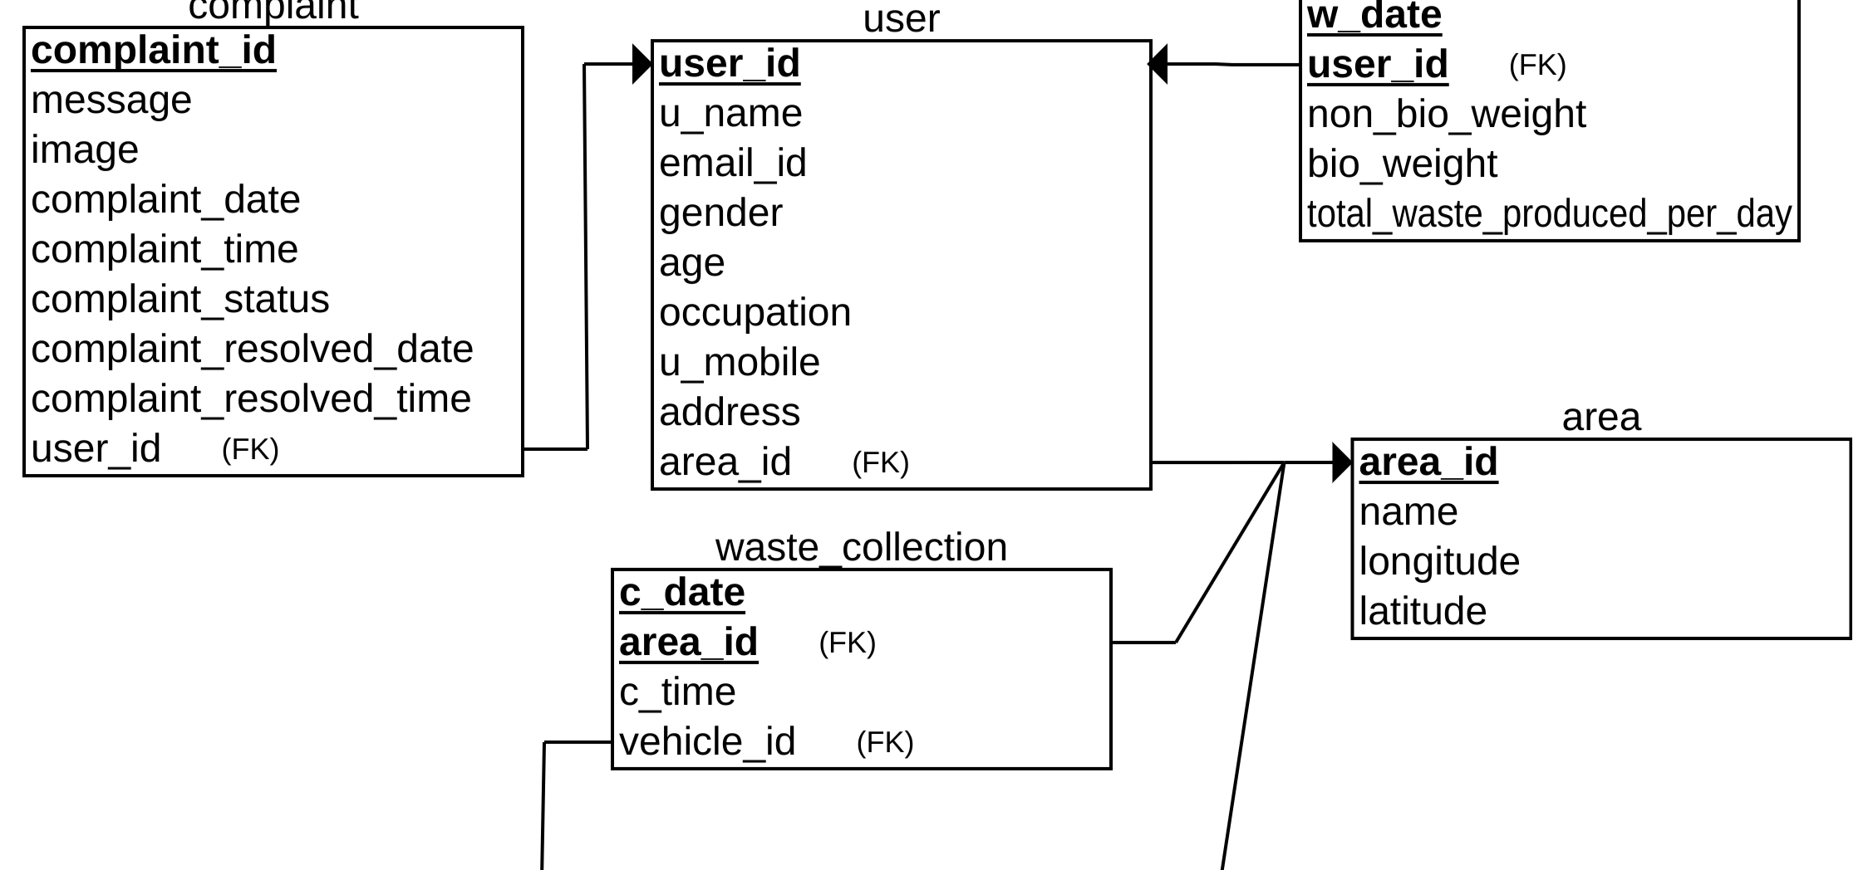
Architecture

Slide 11
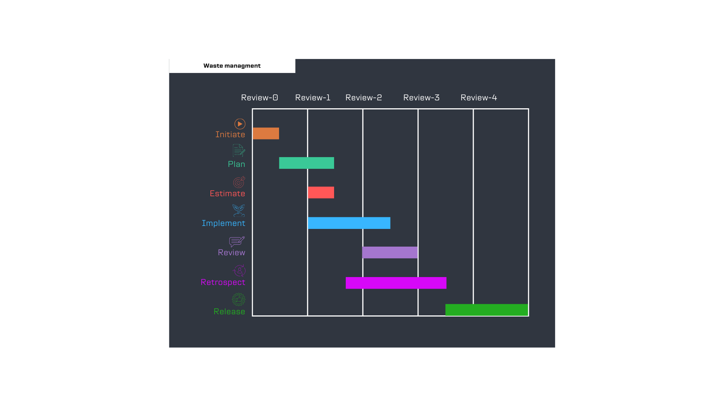
Timeline of Project

Slide 12
Conclusion
In conclusion, the proposed waste management system offers an innovative solution to the pressing challenges of household waste disposal and recycling. By leveraging real-time tracking, clear disposal methods, and an interactive grievance platform, the system enhances efficiency and promotes responsible waste management practices. It empowers citizens to engage actively in waste reduction efforts while providing authorities with valuable data for informed decision-making. Ultimately, this initiative aims to reduce landfill waste, increase recycling rates, and contribute to a cleaner, more sustainable environment for communities.

Slide 13
References
[1] H. Jabar, R. Hassan and A. S. Sadeq, \"A New Smart Waste Managing System,\" 2020 International Conference on Computer Science and Software Engineering (CSASE), Duhok, Iraq, 2020, pp. 209-214, doi: 10.1109/CSASE48920.2020.9142068.
[2] R. Geethamani, P. Rakshana, P. Raveena and R. Ragavi, \"Garbage Management System,\" 2021 7th International Conference on Advanced Computing and Communication Systems (ICACCS), Coimbatore, India, 2021, pp. 1190-1192, doi: 10.1109/ICACCS51430.2021.9441922.
[3] Z. Hisham Che Soh, M. Azeer Al-Hami Husa, S. Afzal Che Abdullah and M. Affandi Shafie, \"Smart Waste Collection Monitoring and Alert System via IoT,\" 2019 IEEE 9th Symposium on Computer Applications & Industrial Electronics (ISCAIE), Malaysia, 2019, pp. 50-54, doi: 10.1109/ISCAIE.2019.8743746.

Slide 14
[4] N. C. A. Sallang, M. T. Islam, M. S. Islam and H. Arshad, \"A CNN-Based Smart Waste Management System Using TensorFlow Lite and LoRa-GPS Shield in Internet of Things Environment,\" in IEEE Access, vol. 9, pp. 153560-153574, 2021, doi: 10.1109/ACCESS.2021.3128314..
[5] M. G. C. P, S. Yadav, A. Shanmugam, H. V and N. Suresh, \"Waste Classification and Segregation: Machine Learning and IOT Approach,\" 2021 2nd International Conference on Intelligent Engineering and Management (ICIEM), London, United Kingdom, 2021, pp. 233-238, doi: 10.1109/ICIEM51511.2021.9445289.

Slide 15
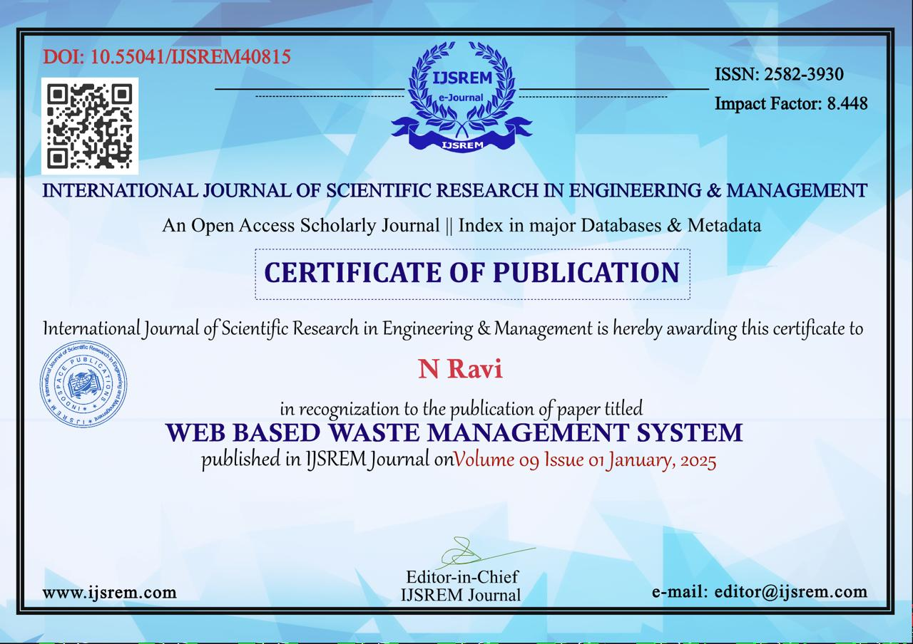
Achievements

Slide 16
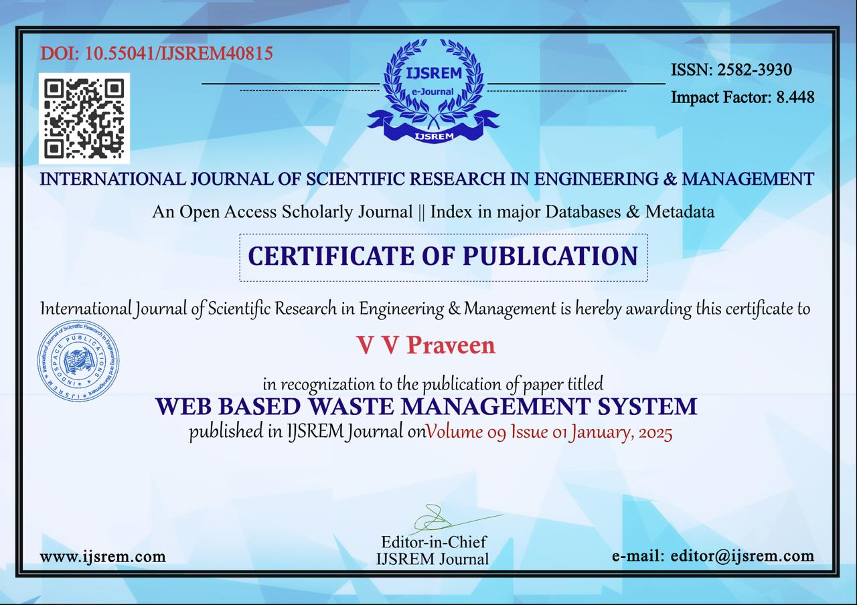

Slide 17
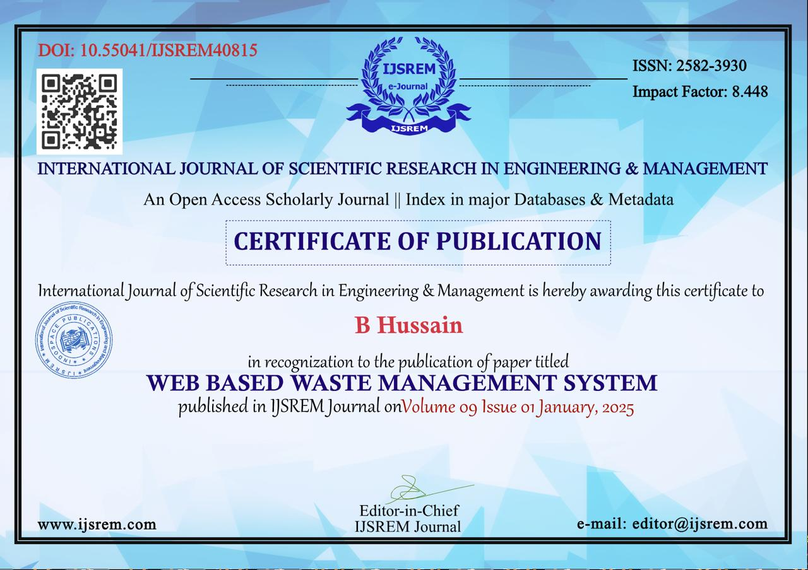

Slide 18
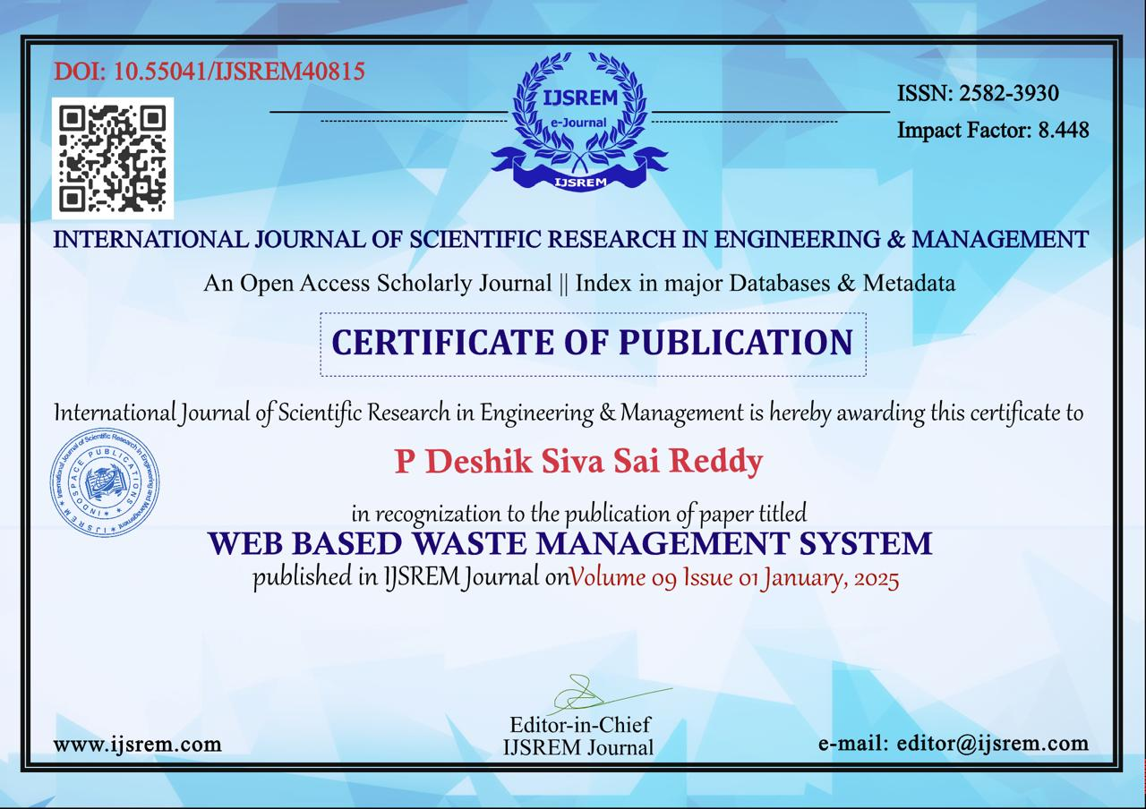

Slide 19

Project work mapping with SDG
These projects can be mapped to Sustainable Development Goal 11 (Sustainable Cities and Communities), as they aim to improve waste management practices within urban environments, ensuring cleaner and more sustainable living spaces. Additionally, the initiative aligns with Sustainable Development Goal 12 (Responsible Consumption and Production) by promoting efficient waste disposal, recycling, and minimizing waste generation. By fostering community engagement and enhancing the efficiency of waste management systems, the project contributes to building resilient cities and sustainable consumption patterns.

Slide 20
Thank You

