Slide 1
Git and Bitbucket
Rahul Valiya Veettil
28th- Sept- 2014

Slide 2
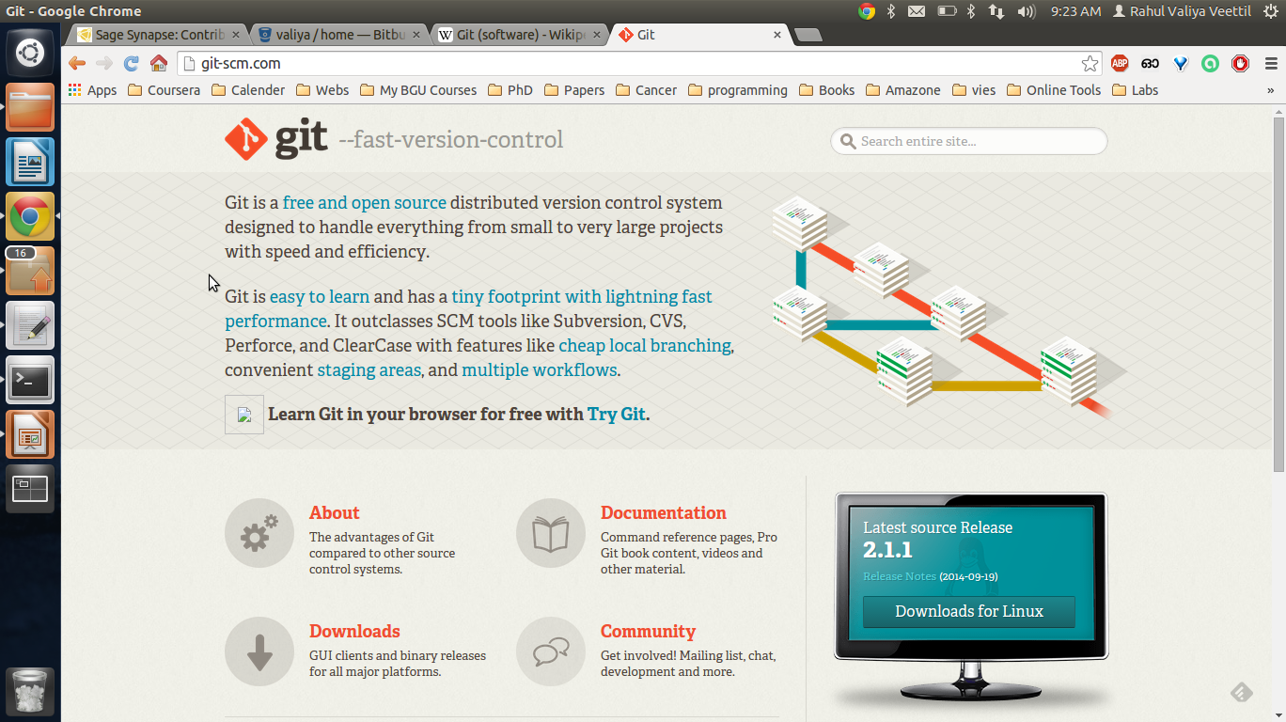
Git
Source code management system for revisions.
Complete history and full version-tracking capabilities.
Free software under GNU general public license.

Slide 3
Installation
Windows
exe file available on Git webpage
Linux
- apt-get install git
HOW TO SET-UP
https://confluence.atlassian.com/display/BITBUCKET/Set+up+Git

Slide 4
Getting a git repository
Create a dir with any name. ex: 'My_project'
Initializing a Repository
  git init --> creates a new subdirectory named .git directory with subdirectories for objects, refs/heads, refs/tags, and template files.
Adding files
  git add hellow_world.py
  git commit -m 'Initial project version'
Cloning a repository
  git clone git://github.com/schacon/grit.git
Log history
- git log

Slide 5
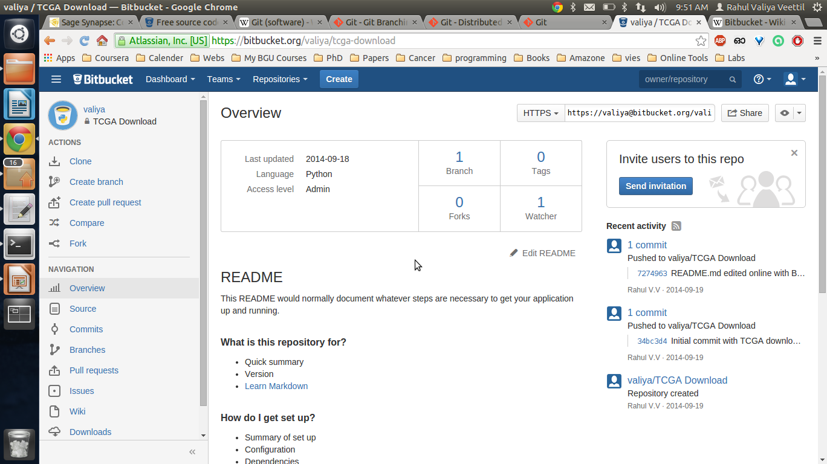
Bitbucket
Web hosting service for revision control system.
Both commercial plans and free accounts (Max 5 users).

Slide 6
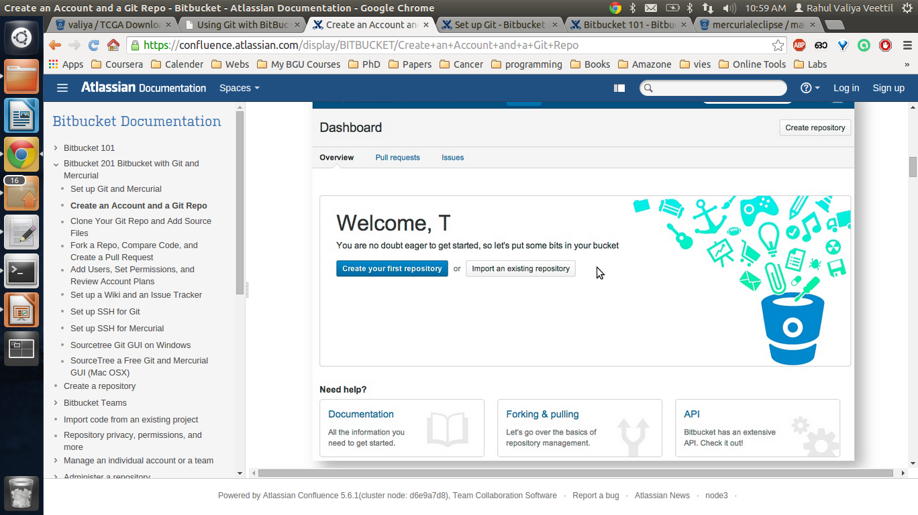
Installation
Open https://bitbucket.org/account/signup/ in your browser and sign-up.

Slide 7
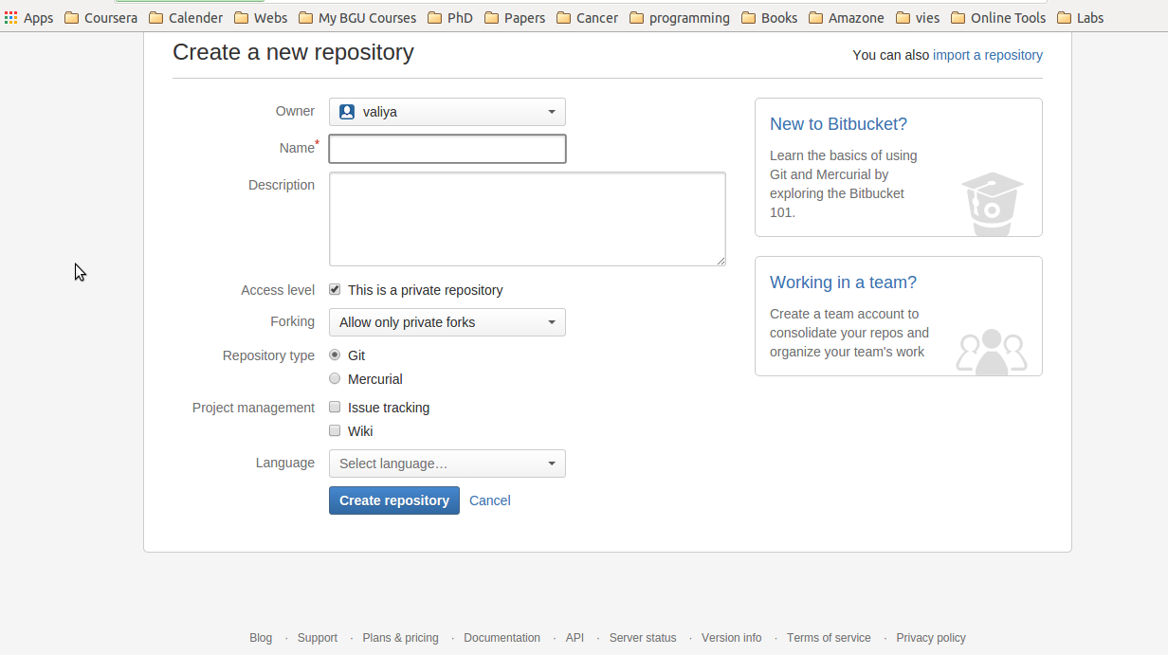
Creating a new project, Ctnd...

Slide 8
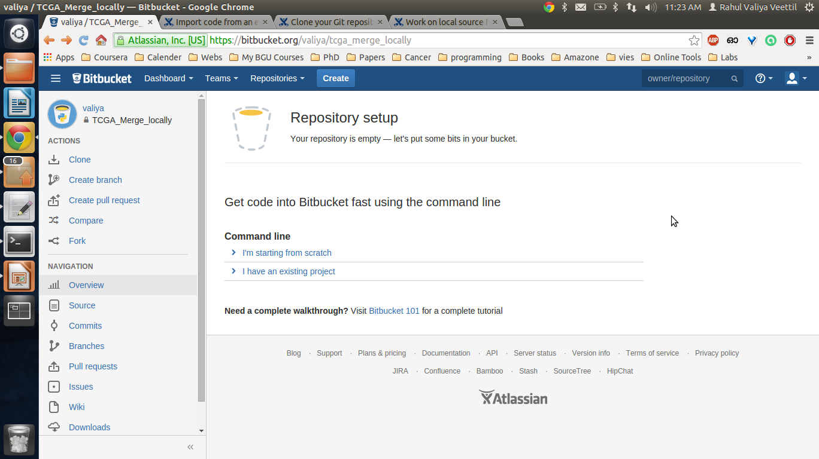
Creating a new project

Slide 9
Creating a new project, Ctnd...
Starting from scratch
mkdir /path/to/your/project
cd /path/to/your/project
git init
git remote add origin https://username@bitbucket.org/valiya/tcga_merge_locally.git

Slide 10
Creating a new project, Ctnd...
echo "I'm very happy today" >> contributors.txt
git add contributors.txt
git commit -m 'Initial commit with contributors'
git push -u origin master

Slide 11
Adding an existing project
cd /path/to/my/repo
git remote add origin https://username@bitbucket.org/username/tcga_merge_locally.git
git push -u origin --all # pushes up the repo and its refs for the first time
git push -u origin --tags # pushes up any tags

Slide 12
Story in a nutshell
git pull origin master – To pull the original master dir from bitbucket
git status - To know the status
Git add hello_world.py
git commit . -m “tiny changes”
Git push origin master

Slide 13
Branching
You diverge from the main line of development
Continue to do work without messing other users.

Slide 14
Summary
Installation instructions for Bitbucket
https://confluence.atlassian.com/display/BITBUCKET/Create+an+Account+and+a+Git+Repo
Cheat sheet
http://byte.kde.org/~zrusin/git/git-cheat-sheet-medium.png
Working with eclipse and git
https://bitbucket.org/mercurialeclipse/main/wiki/Installation%20and%20Configuration
https://confluence.atlassian.com/display/BITBUCKET/Bitbucket+101

