Slide 1
Use Case -1 (Movie RAG)

Slide 2
DATA PREPARATION
Movie_file (20min)
Pyscene detect
** consider audio language is Telugu
Audio file
Transcript + Speaker Diarization
Audio Tags(NER)
Strategy to Combine (Combined Videos)
(start_time, end_time, movie_name, deeplink)
Images/Frames
Image summary
Video Tags (NER)
Visual Cut: Use PySceneDetect to find all possible camera changes.
Audio Glue: Use Speaker Diarization or librosa to see if the audio is continuous across those cuts.
Merge: If the audio is the same (e.g., the same song is playing or the same two people are talking), ignore the visual cuts and keep the segment as one "Short Video."

Slide 3
VECTORIZATION
{
"chunk_id": "<movie_name>_chunk_001",
"video_title": "<movie_name>",
"speaker": "<info from speaker diarization>",
"start_time": "00:00:00",
"end_time": "00:05:48",
"transcript": "When handling PII for EU residents, you must ensure...",
"entities": "GDPR Article 17 — Right to Erasure",
"visual_tags": [<Entities/Objects, Faces/Speaker IDs, Sentiment/Emotions, Actions>, "fight/comedy/humor/romance/action", "laughter", "explosions", "crowd", "vehicles", "guns", etc.,],
"audio_tags": ["loudness", "music mood(romantic/serious, screams, gunshots, laughter, crowd,gunshots, etc.,)",
"deep_link": "https://player.url/vid_0042?t=872" <file path of the chunk video>,
<add any relevant information here>
}
Language
Chunk overalap
{
"chunk_id": "matrix_chunk_042",
"video_title": "The Matrix",
"speaker_map": {"Speaker_01": "Neo", "Speaker_02": "Agent Smith"},
"start_time": "00:45:10",
"end_time": "00:46:05",
"transcript": "No, Mr. Wizard, get me out of here!",
"entities": ["Neo", "Phone Booth", "Agent Smith"],
"visual_tags": ["high_motion", "sunglasses", "rain"],
"genre_weights": {
"action": 0.85,
"emotional": 0.10,
"song": 0.0
},
"audio_tags": ["heavy_rain", "footsteps", "electronic_music"],
"local_path": "./clips/matrix_chunk_042.mp4",
"embedding_visual": [0.123, -0.456, "..."],
"embedding_text": [0.789, 0.012, "..."]
}

Slide 4

RETRIEVAL
User Search (Text)
NER Extraction
Metadata Filtering
Hybrid Search
Relevant Video Links

Slide 5
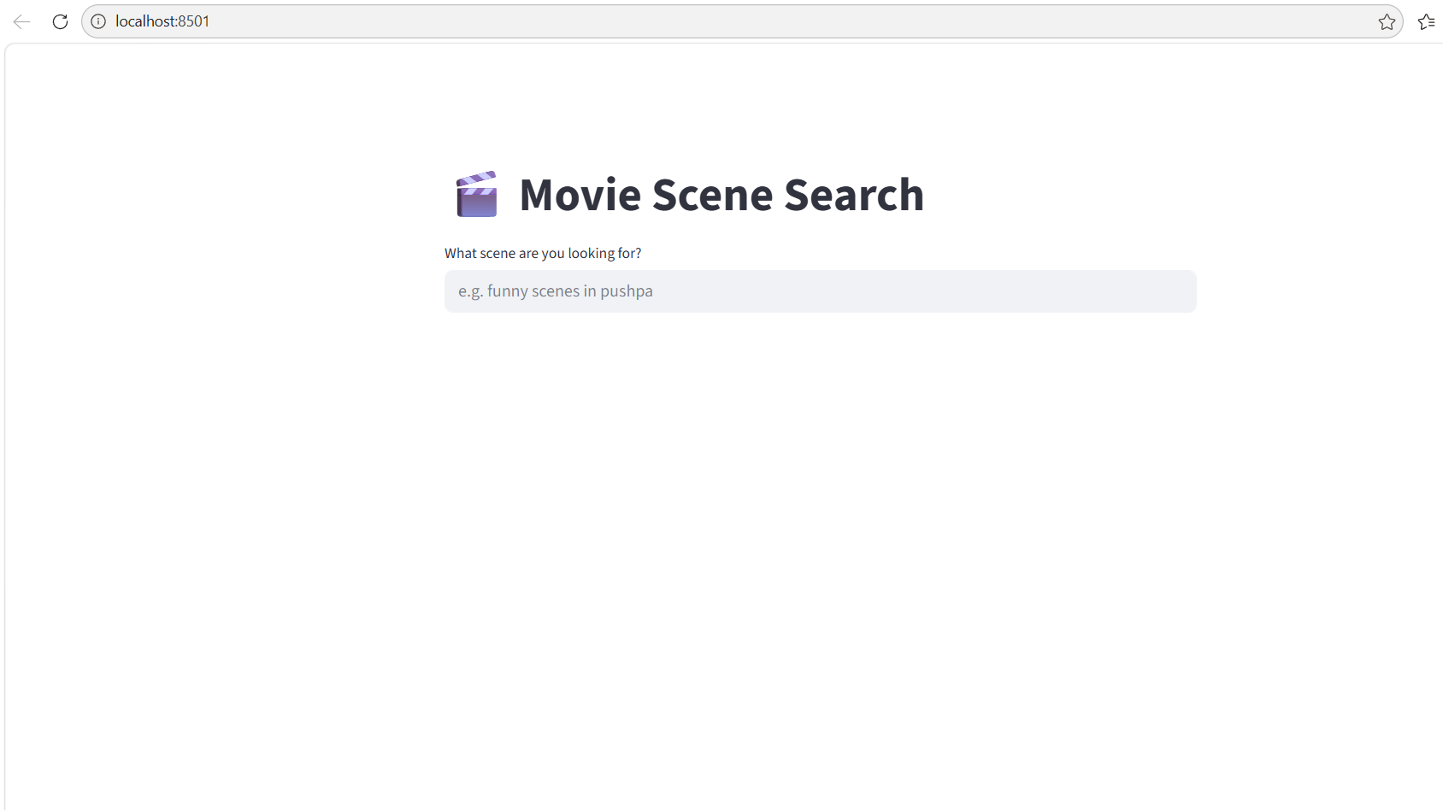
Movie RAG System

Slide 6
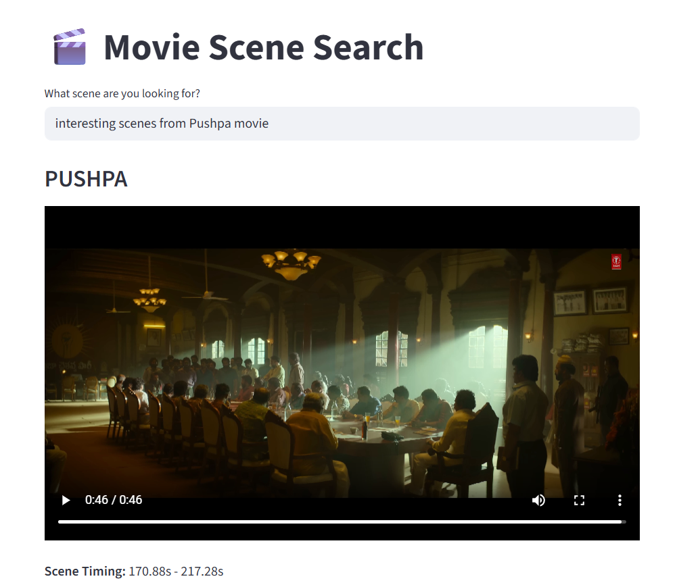
Movie RAG System
GUI has been changed to reflect multiple videos in the default view.
Ran into Quota limit issues.

Slide 7
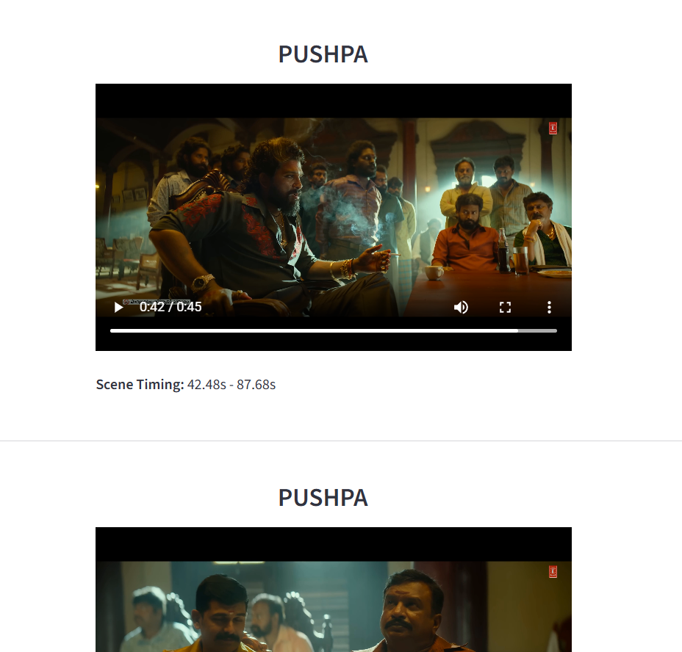
Movie RAG System
GUI has been changed to reflect multiple videos in the default view.
Ran into Quota limit issues.

Slide 8
Use Case -2 (Cricket Broadcasting – Highlight Detection)

Slide 9
Cricket Highlights Generation using AI
Video
Ball Trajectory
Crowd cheer
Batsman/Bowler celebrations
Umpire Gestures
Fielder dived
Special guests
Video
Audio (crowd, stump mic, commentary)
On-screen graphics (“6”, “4”, “wicket”, ”replay” etc.)
Frames (scores, wickets, bowler, batsman, on-screen boards of audience)
Multi-camera Setup
Live feed ingest
Audio
Audio spike (crowd cheer)
Commentator audio intensity
Bat/Ball Impact sound
Ball/Wicket Impact sound
Review
Was it a boundary(6/4)? (score change)
Was it a wicket? (On-screen graphics)
Was there a review? (Bowler Shouting)
Was there a special guest? (Cloud cheer)
Generate Highlight

