Slide 1

School of Computer Science and AI, SR University
Course Code | Course Title | L | R | P | Cr
25CAI004PC206 | AI Assisted Coding | 0 | 0 | 4 | 2
Program Core
Environment Setup
Lecture - 2
1. Python Installation
2. VS Code Installation
3. Create account in GitHub
4. GitHub copilot extension in VS code 5. GitHub Copilot Tutorial
Dr. Venkataramana Veeramsetty
Professor

Slide 2
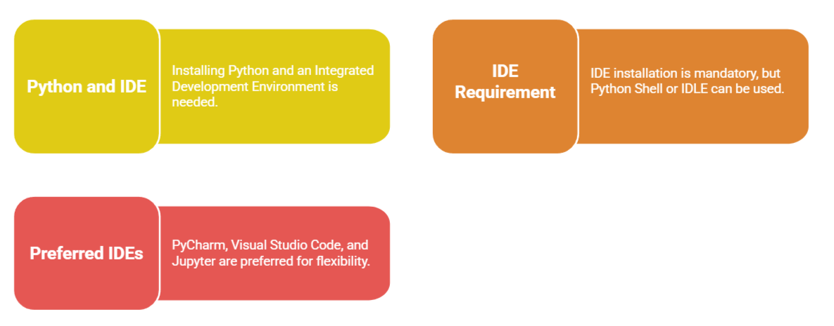
Slide Title
Python Installation

Slide 3
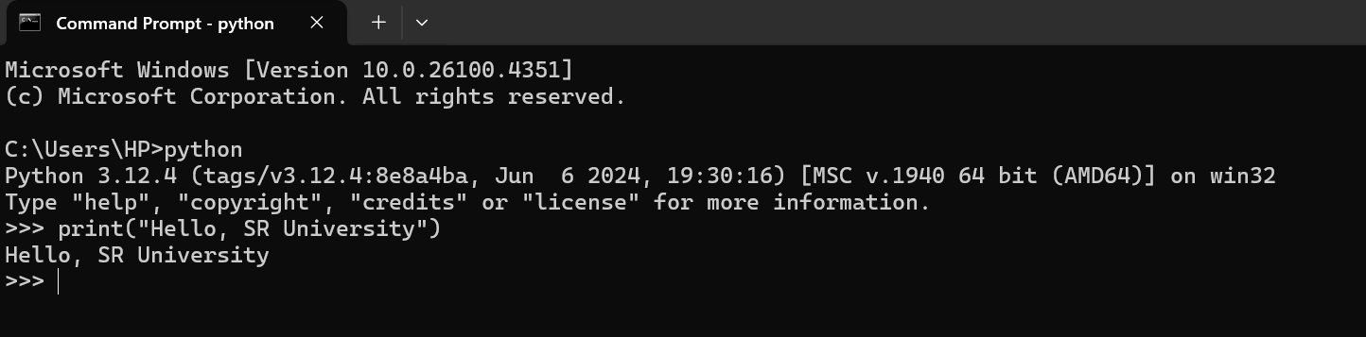
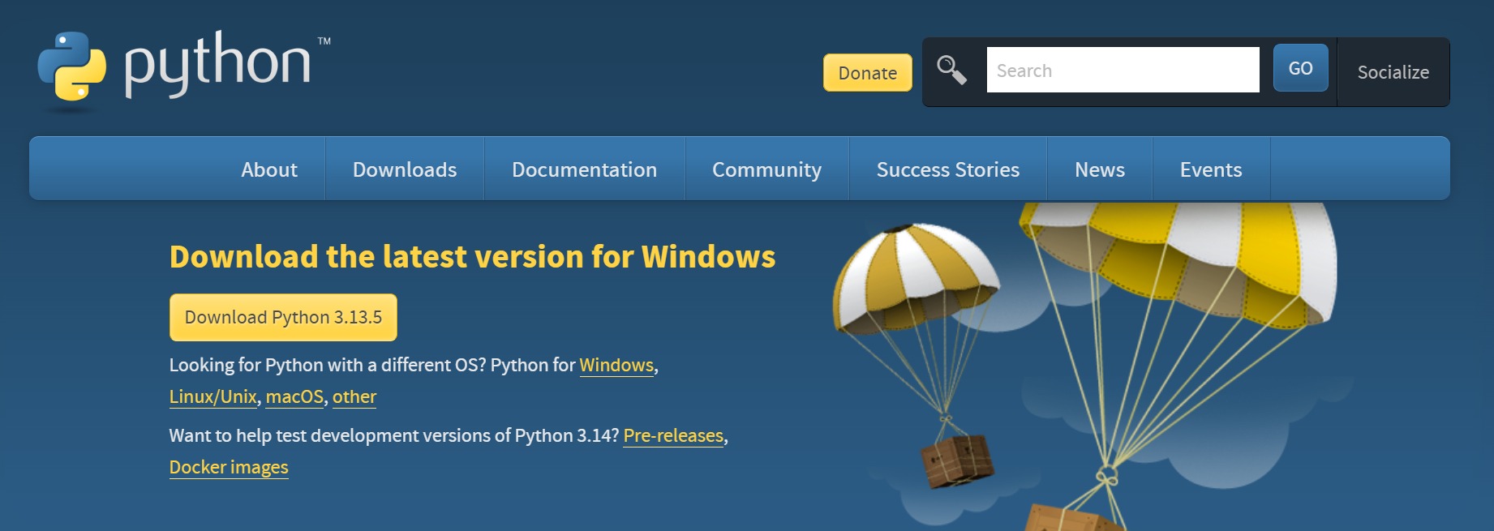
Slide Title
Python Installation
https://www.python.org/downloads/

Slide 4




Slide Title
Python Editors & IDE​

Slide 5
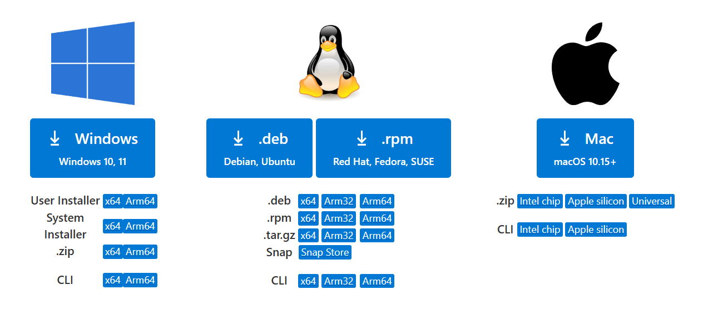
Slide Title
VS Code Installation​
https://code.visualstudio.com/download

Slide 6
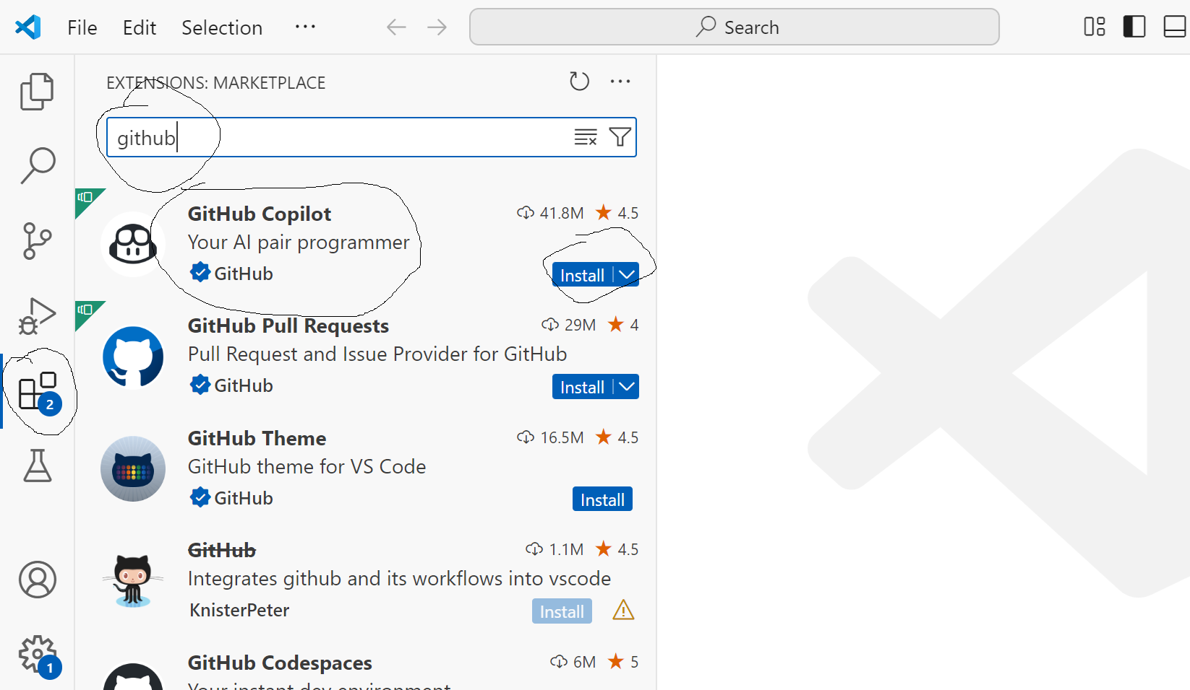
Slide Title
VS Code Extensions​ - GitHub Copilot
You must have GitHub Copilot enabled on your GitHub account via https://github.com/settings/copilot
It works best with popular languages like Python, JavaScript, C++, and more.

Slide 7
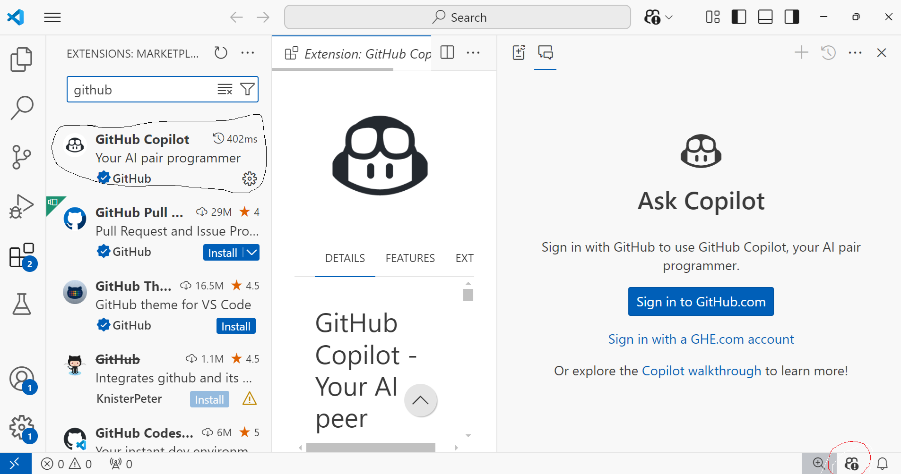
Slide Title
VS Code Extensions​ - GitHub Copilot

Slide 8
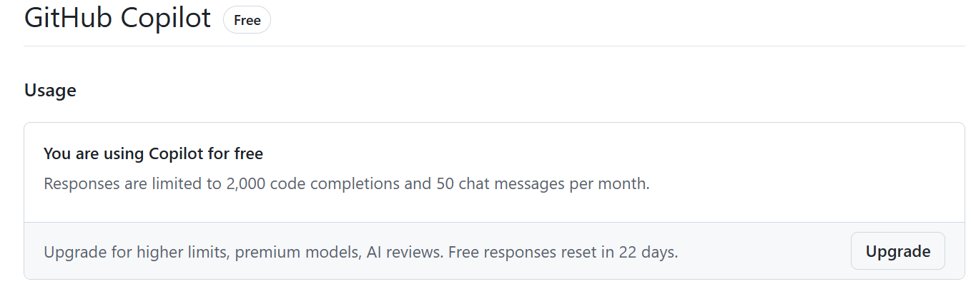
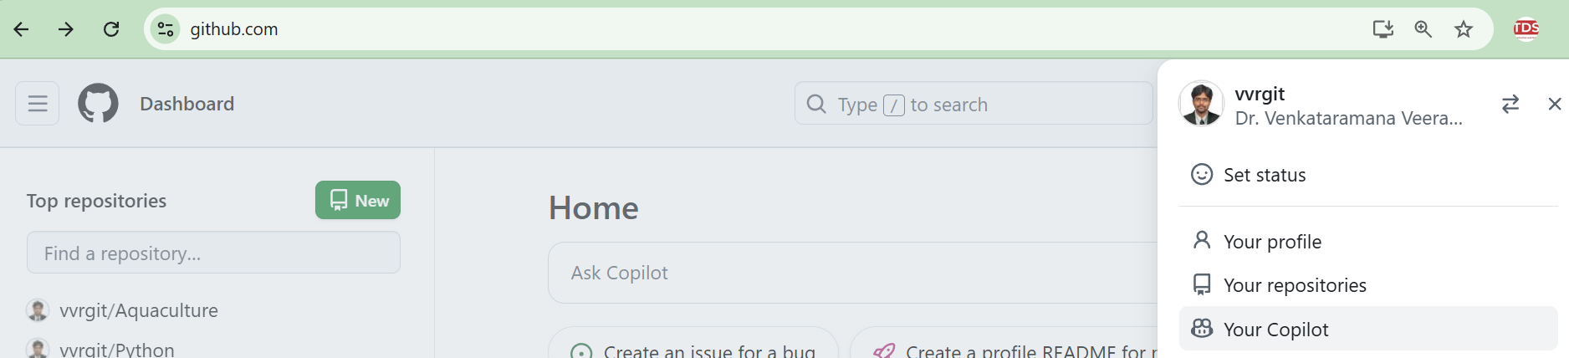
Slide Title
GitHub Copilot Account Details

Slide 9
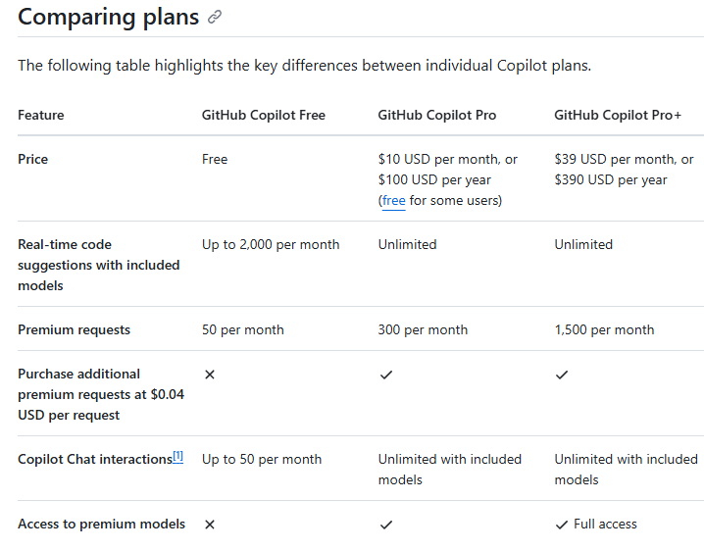
GitHub Copilot Plans
Why and which AI-assisted tools to use !!

Slide 10
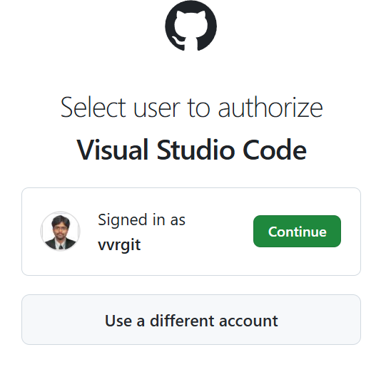
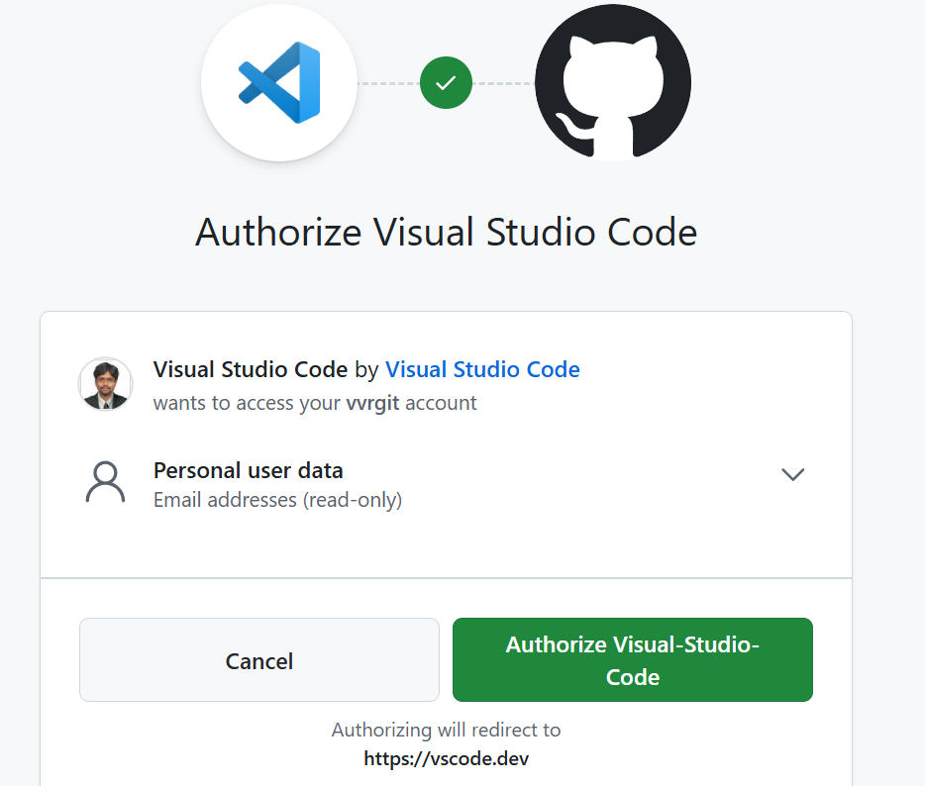
Slide Title
VS Code Extensions​ - GitHub Copilot

Slide 11
Slide Title
VS Code Extensions​

Slide 12
Common slash commands and their usage
/explain - Provides an explanation of the selected code.
/suggest - Offers code suggestions based on the current context.
/tests - Generates unit tests for the selected function or class.
/comment - Converts comments into code snippets.

Slide 13
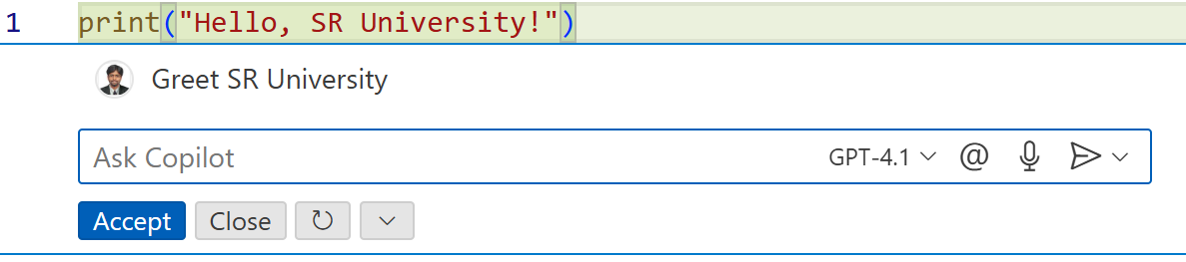
Slide Title
GitHub Copilot Enabled VS Code Tutorials ​
Prompt #1: Greet SR University

Slide 14
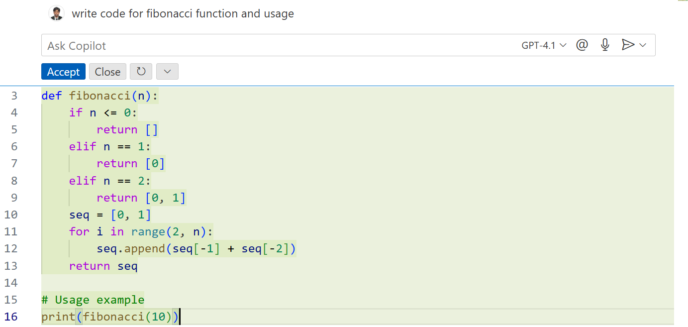
Slide Title
GitHub Copilot Enabled VS Code - Tutorials​
Prompt #2: write code for fibonacci function

Slide 15
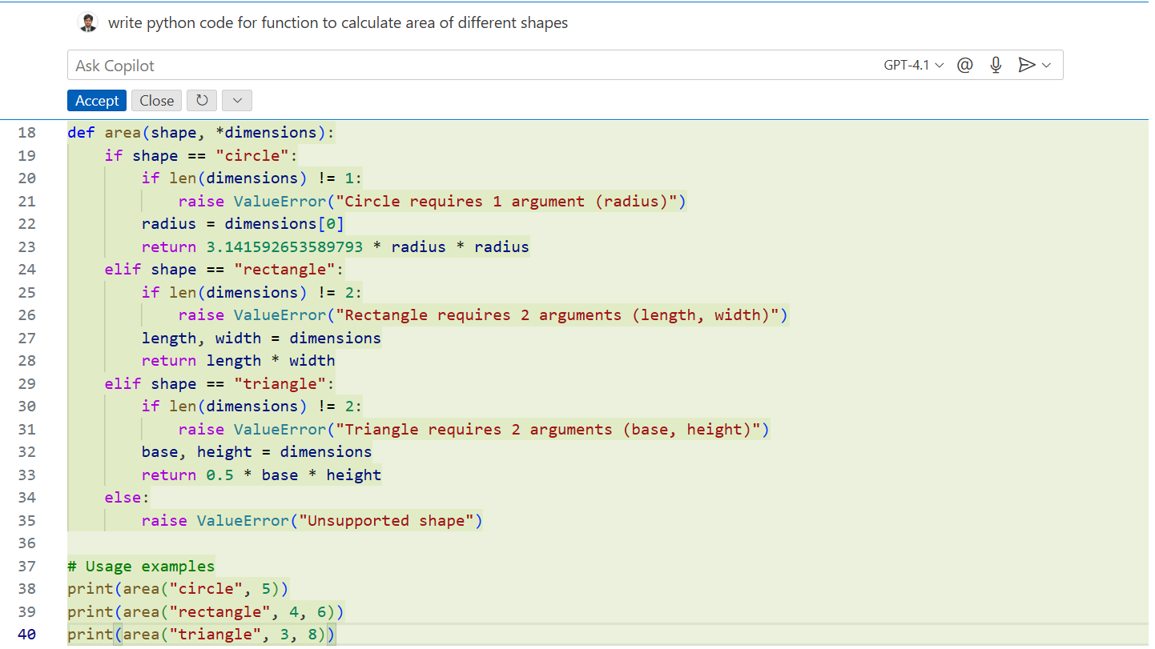
Slide Title
GitHub Copilot Enabled VS Code - Tutorials​
Prompt #3: write python code for function to calculate area of different shapes

Slide 16
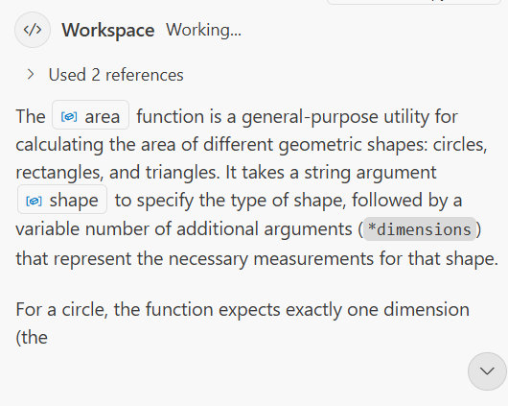
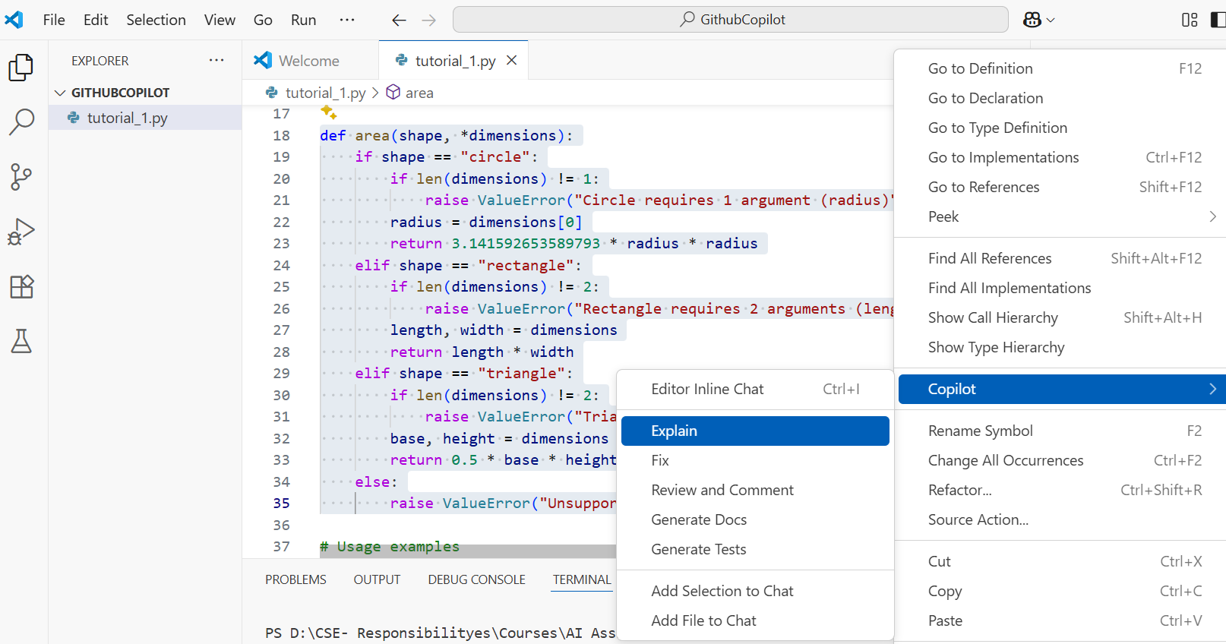
Slide Title
GitHub Copilot – Code Explanation

Slide 17
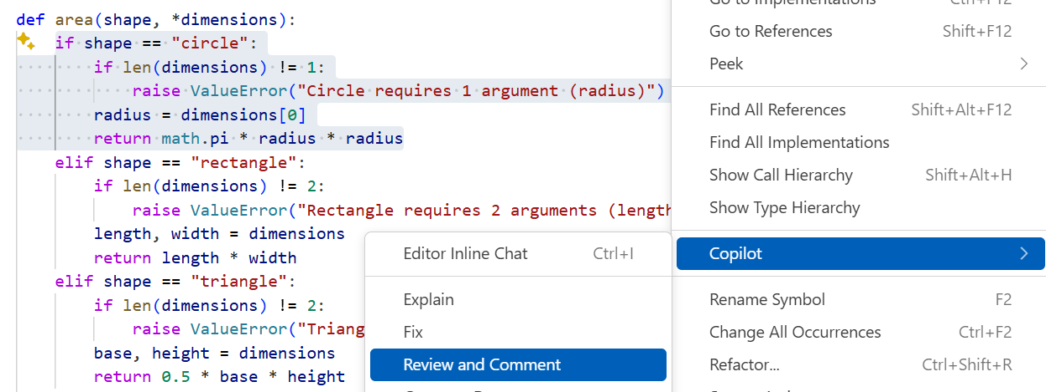
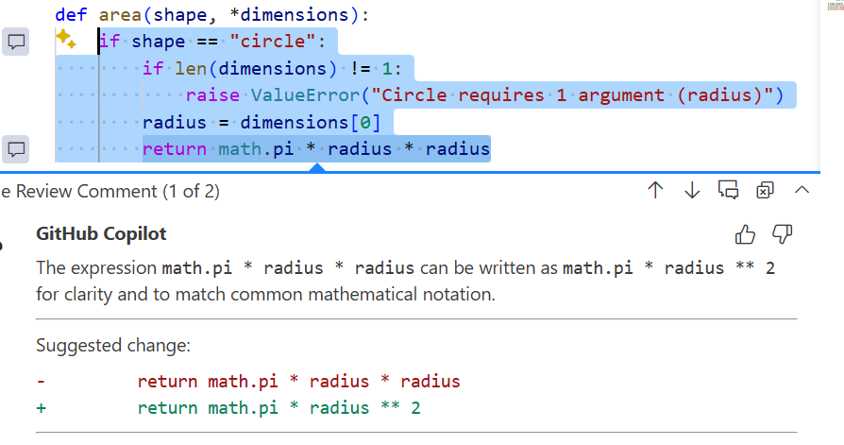
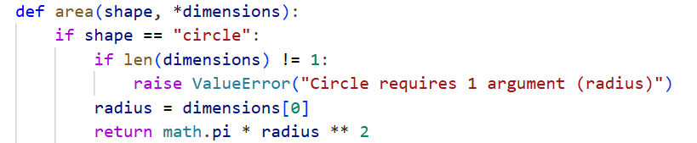
Slide Title
GitHub Copilot – Code Review and Comment

Slide 18
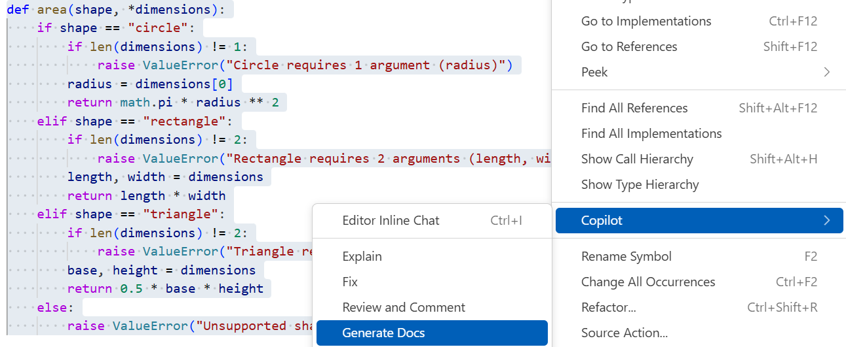
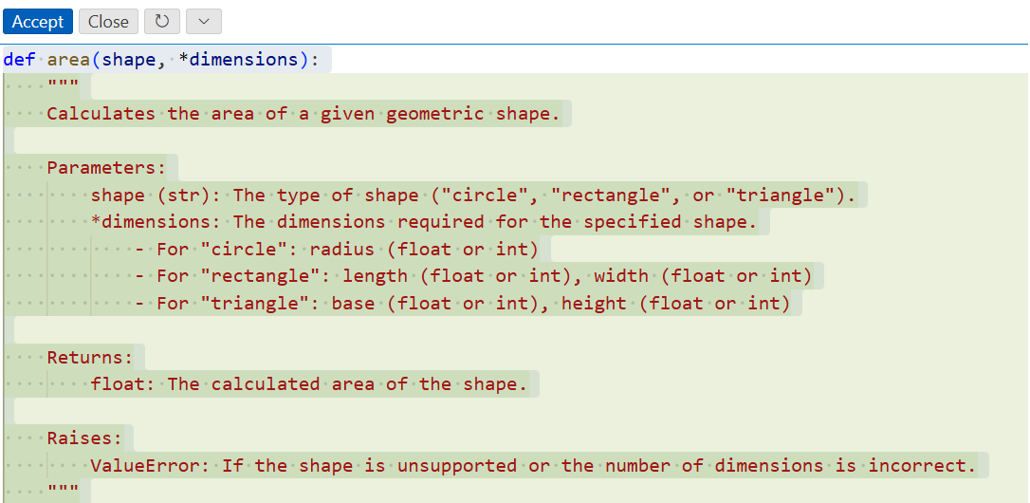
Slide Title
GitHub Copilot – Generate Document

Slide 19
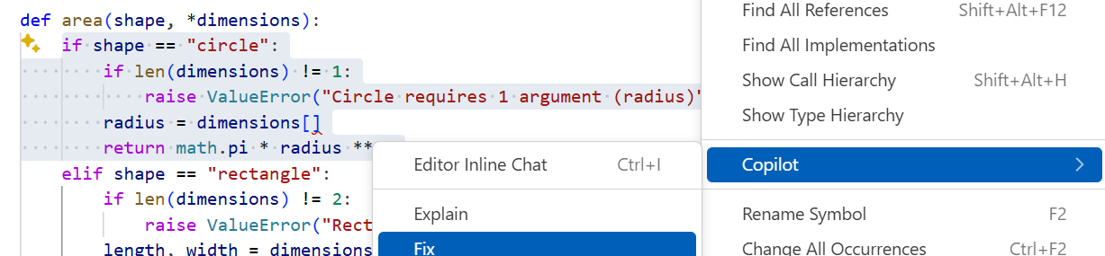
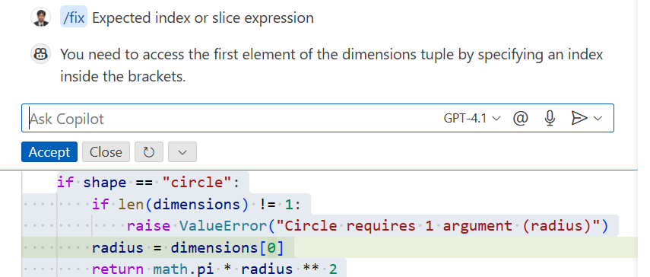
Slide Title
GitHub Copilot – Fix Bug

Slide 20
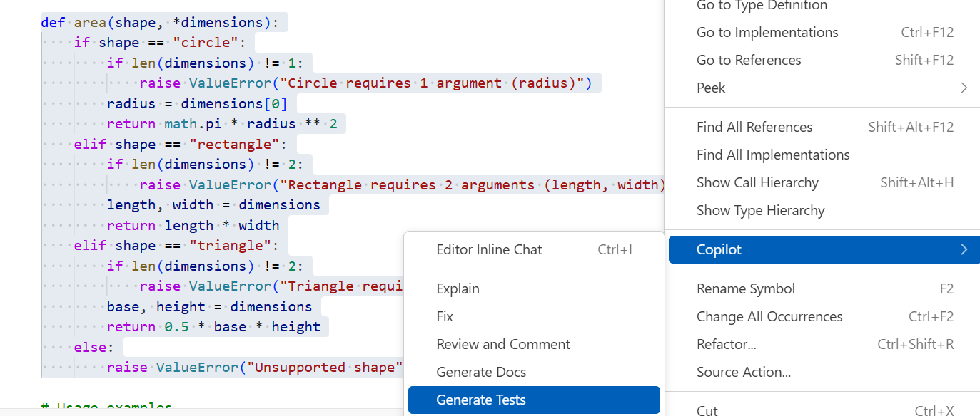
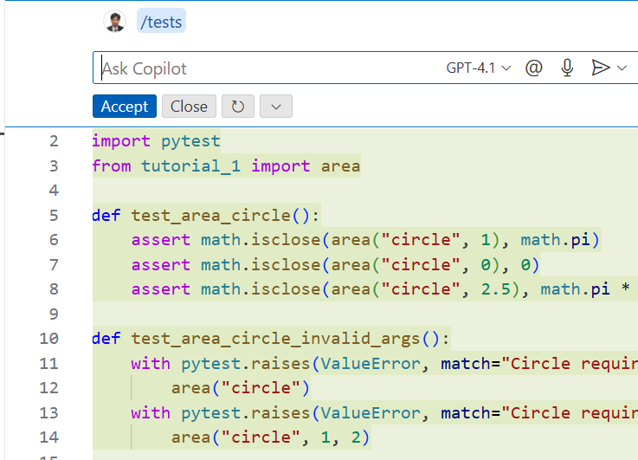
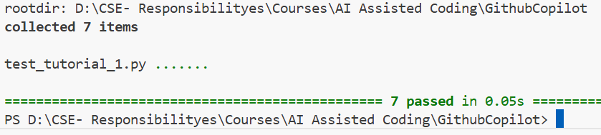
Slide Title
GitHub Copilot – Generate Test Cases

Slide 21
Thank You

