Slide 1

School of Computer Science and AI, SR University
Course Code | Course Title | L | R | P | Cr
25CAI004PC206 | AI Assisted Coding | 0 | 0 | 4 | 2
Program Core
Additional AI Coding Tools
Lecture - 2
1. Google Gemini
2. DeepCode (by Snyk)
3. Sourcegraph Cody
4. Codiga 5. Ponicode (by CircleCI) 6. IBM Watson Code Assistant 7. MutableAI 8. AskCodi 9. Blackbox AI 10. Cerebras-GPT (Open-source) 11. Cursor AI
Dr. Venkataramana Veeramsetty
Professor

Slide 2
Slide Title
AI Coding Tools and API Configurations
Tool Name | Provider/Company | Platform
GitHub Copilot | GitHub + OpenAI | Available as IDE plugin (VS Code, JetBrains), No public API
Amazon CodeWhisperer | AWS | Integrated into AWS Console, supports CLI/ AWS SDK, IAM role-based auth
OpenAI Codex | OpenAI | Access via OpenAI API
Tabnine | Tabnine | Cloud and self-hosted options; supports REST API for snippet generation
Replit Ghostwriter | Replit | Embedded in Replit IDE, No public API
Sourcegraph Cody | Sourcegraph | GraphQL/REST APIs available with Sourcegraph instance
CodeGeeX | BAAI | Hosted on Hugging Face / ModelScope; supports API endpoints for inference
MutableAI | Mutable | Auth via API key; supports RESTful calls with prompt input
Notes:
Google Gemini is Google’s family of advanced multimodal generative AI models (successor to Bard and PaLM 2), now integrated across Google products and available through Google Cloud Vertex AI. While Gemini isn't a code-only model like Codex or CodeWhisperer, its Gemini Pro and Gemini 1.5 variants

Slide 3
Slide Title
AI Coding Tools and API Configurations
Tool Name | Provider/Company | Platform
AskCodi | CodiTech | Uses X-RapidAPI-Key in headers, multiple endpoints (SQL, Python, JS, etc.)
DeepCode | Snyk | Integrated with GitHub/GitLab; API for scanning and reports
Codiga | Codiga.io | REST API for snippets and analysis;
Ponicode | CircleCI | Available via VS Code extension, no standalone API
StarCoder | Hugging Face + ServiceNow | Open-access via Hugging Face Inference API
Code LLaMA | Meta | Open-source; can be deployed locally via Hugging Face or custom servers
IBM Watson Code Assistant | IBM | Available via IBM Cloud API; supports secure enterprise use
Notes:
Google Gemini is Google’s family of advanced multimodal generative AI models (successor to Bard and PaLM 2), now integrated across Google products and available through Google Cloud Vertex AI. While Gemini isn't a code-only model like Codex or CodeWhisperer, its Gemini Pro and Gemini 1.5 variants

Slide 4
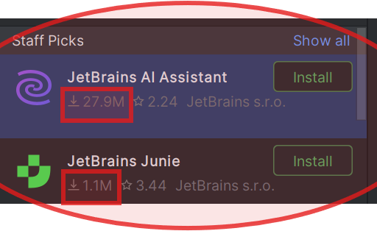
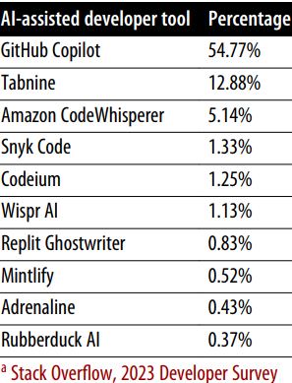
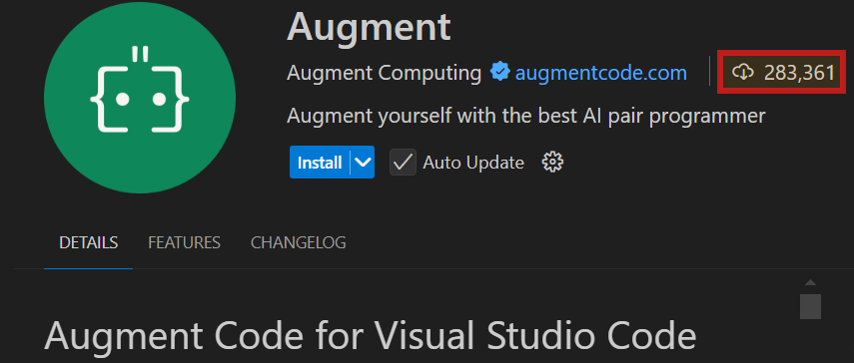
Lab 2: Additional AI coding tools and API configurations

Slide 5
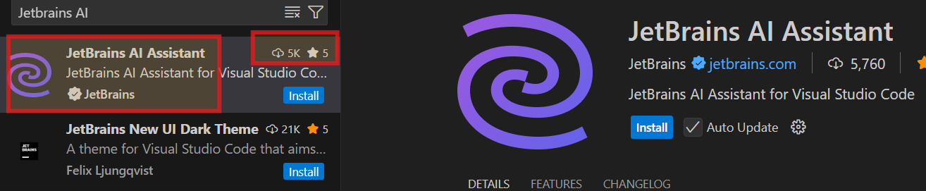
Lab 2: Additional AI assisted coding tools “JetBrains AI assistant”
Extension for VS Code
Extension for PyCharm

Slide 6
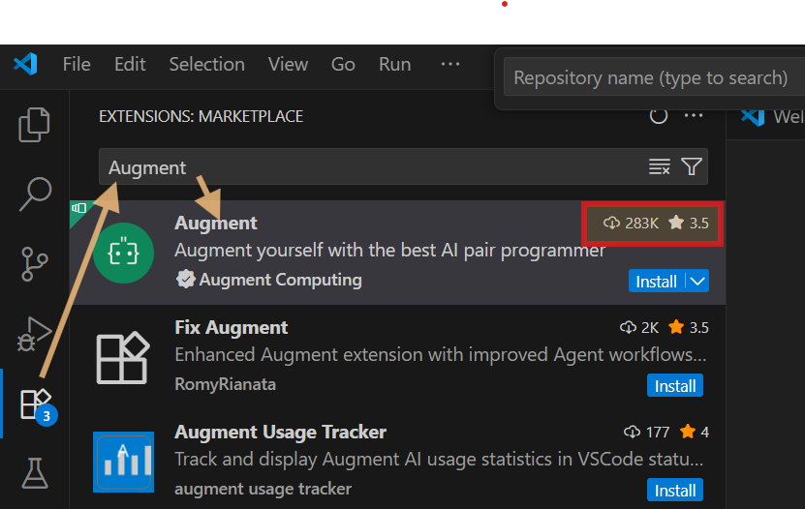
Lab 2: Additional AI assisted coding tools “Augment”

Slide 7
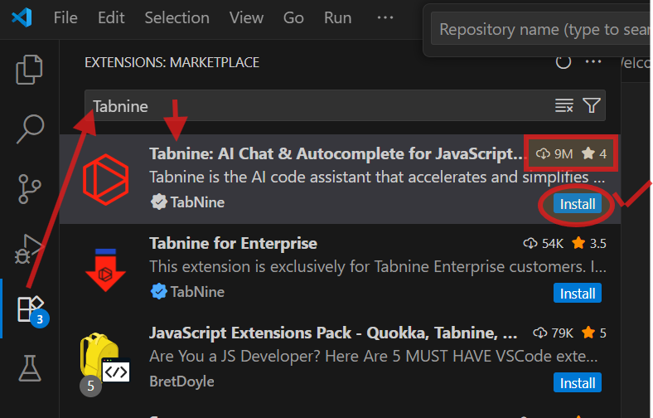
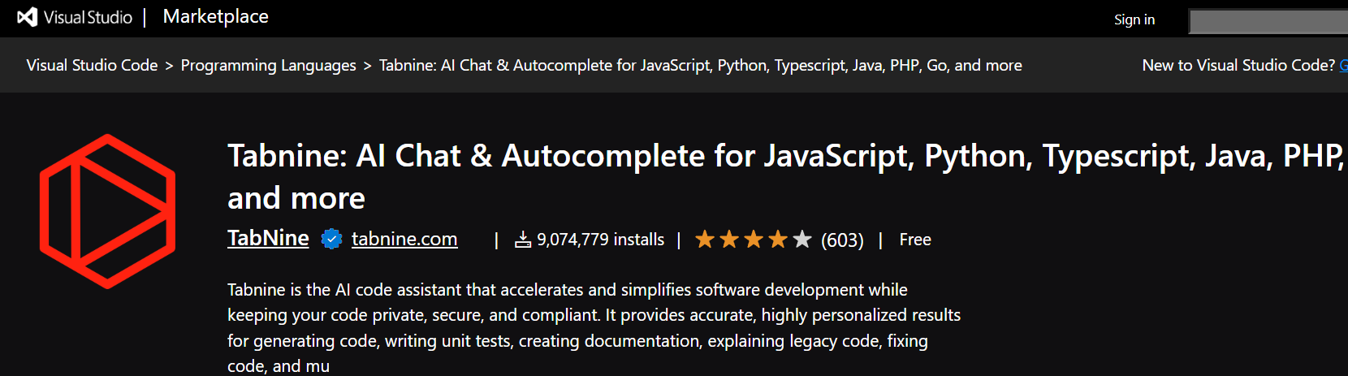
Lab 2: Additional AI assisted coding tools “Tabnine”

Slide 8
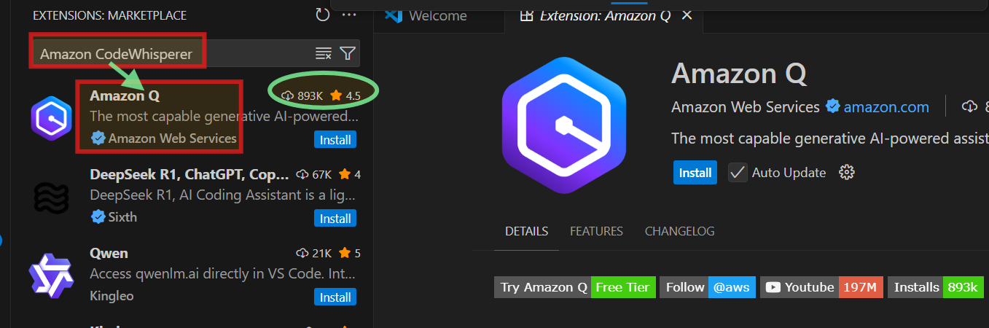
Lab 2: Additional AI assisted coding tools “Amazon CodeWhisperer ”
Amazon CodeWhisperer has now been rebranded and bundled as the Amazon Q and you should install Amazon Q instead of a standalone CodeWhisperer extension.
For IDE VS Code install Amazon Q from the VS Code extension
For IDEs like IntelliJ, PyCharm, etc. use the Amazon Q plugin

Slide 9
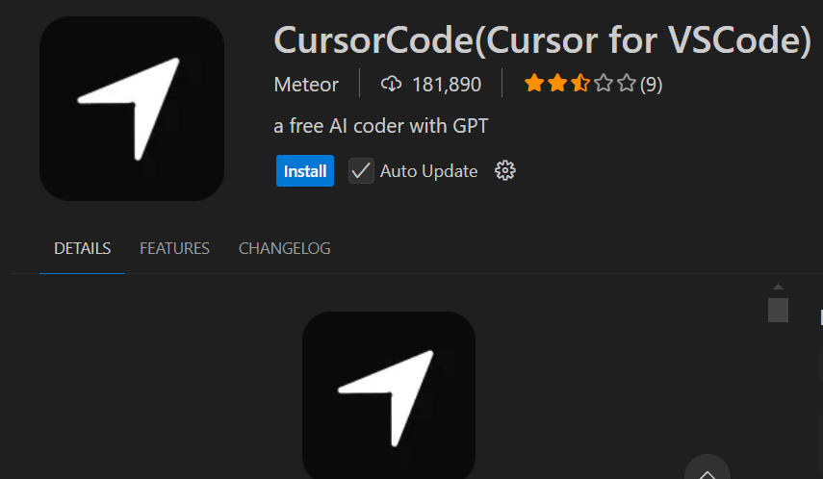
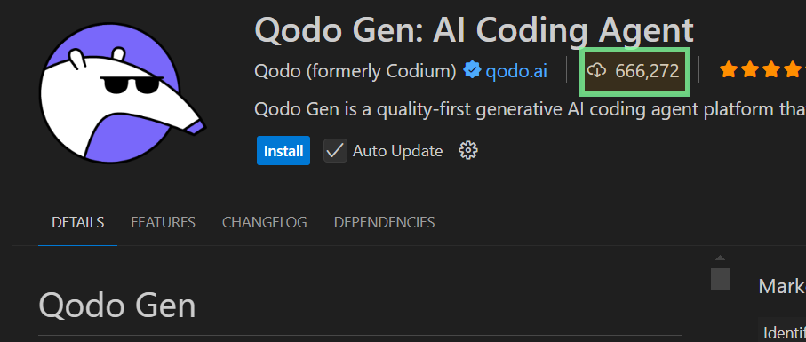
Lab 2: Additional AI assisted coding tools “CursorCode” and Qodo Gen: AI Coding Agent ”

Slide 10
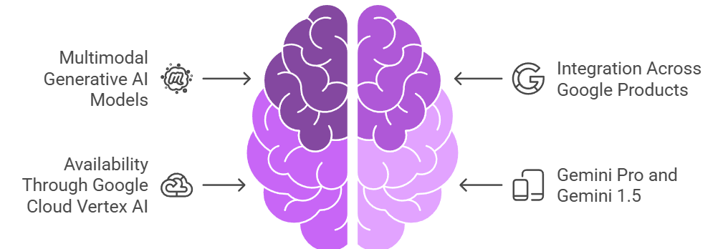

Slide Title
Google Gemini
To access Gemini’s coding features programmatically, developers use the Gemini API on Google Cloud’s Vertex AI.
Languages Supported Python, JavaScript, Java, C++, Go, TypeScript, and more
Notes:
Google Gemini is Google’s family of advanced multimodal generative AI models (successor to Bard and PaLM 2), now integrated across Google products and available through Google Cloud Vertex AI. While Gemini isn't a code-only model like Codex or CodeWhisperer, its Gemini Pro and Gemini 1.5 variants

Slide 11
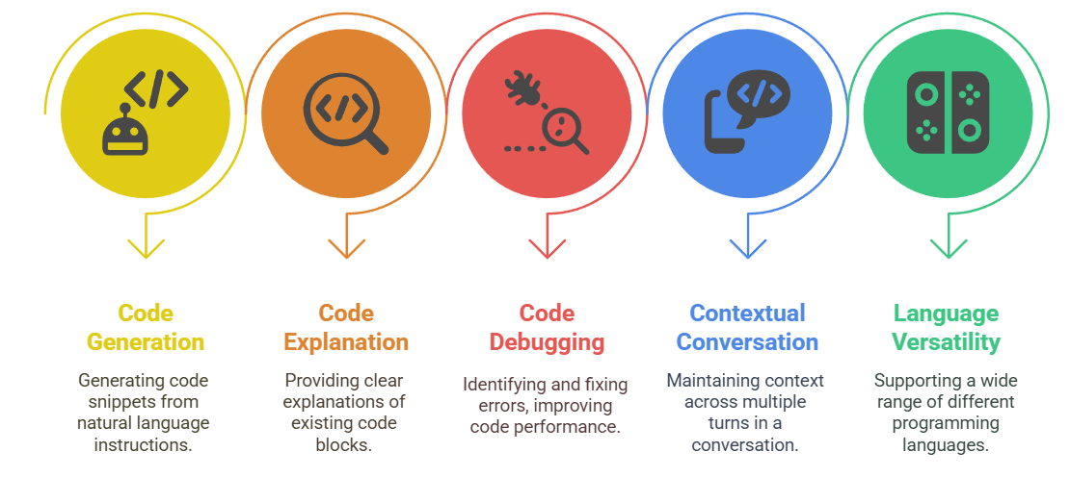
Slide Title
Google Gemini

Slide 12
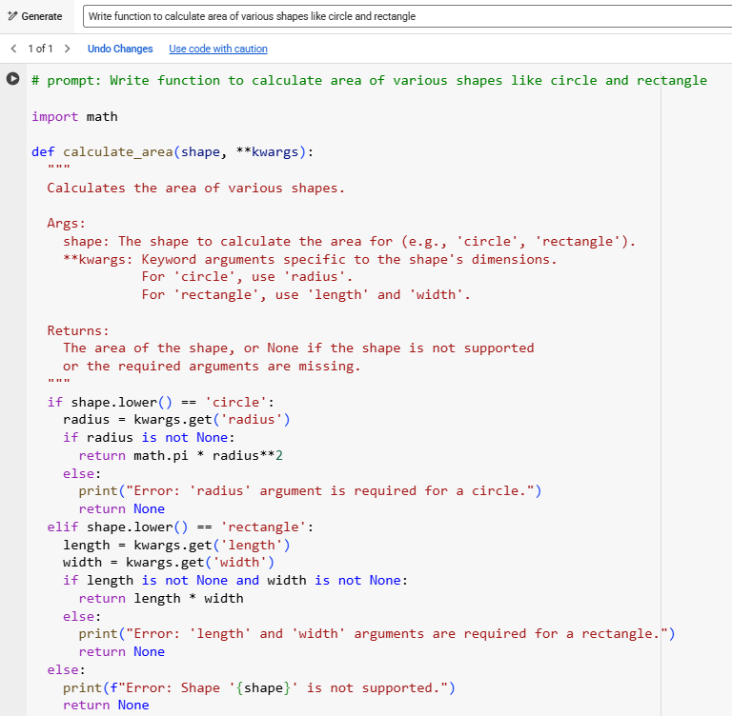

Slide Title
Google Gemini
Open Google Colab with Gmail Account
Select Code Tab and click on Gemini ICON
Prompt
Write function to calculate area of various shapes like circle and rectangle

Slide 13
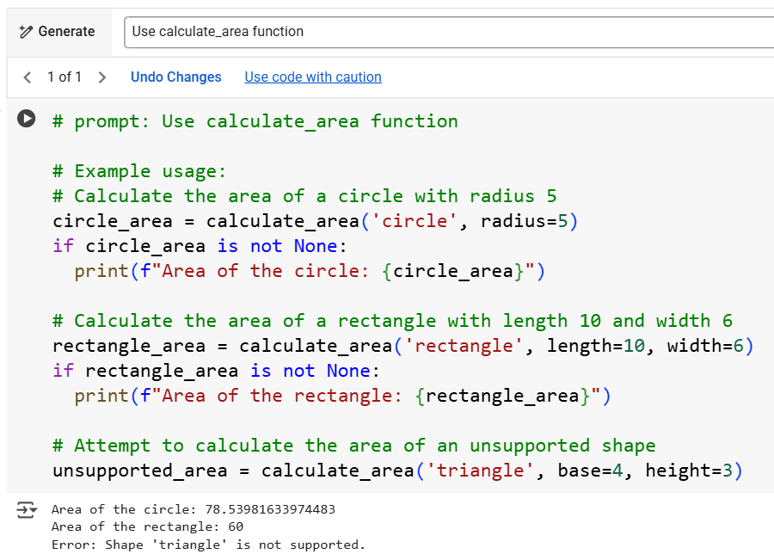
Slide Title
Gemini – Prompt to use function​
Prompt
Use calculate_area function

Slide 14
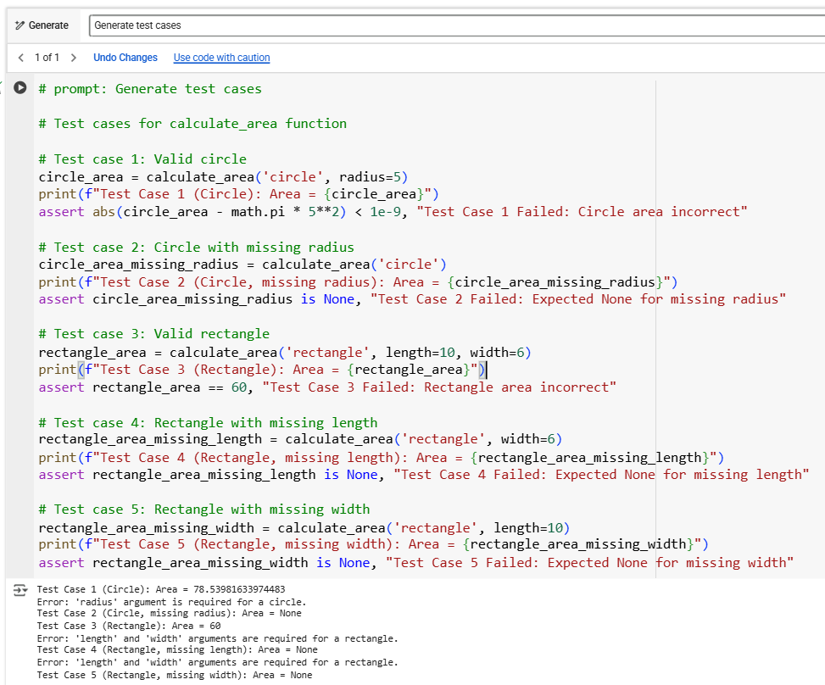
Slide Title
Gemini – Test Case
Prompt
Generate test cases

Slide 15
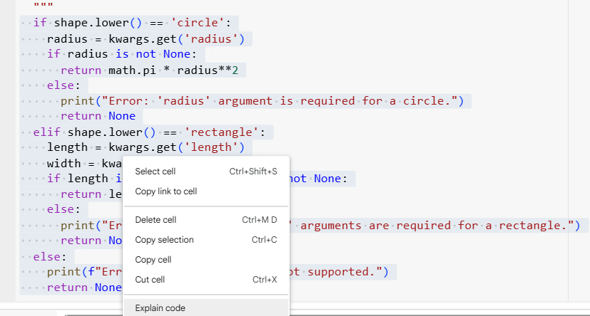
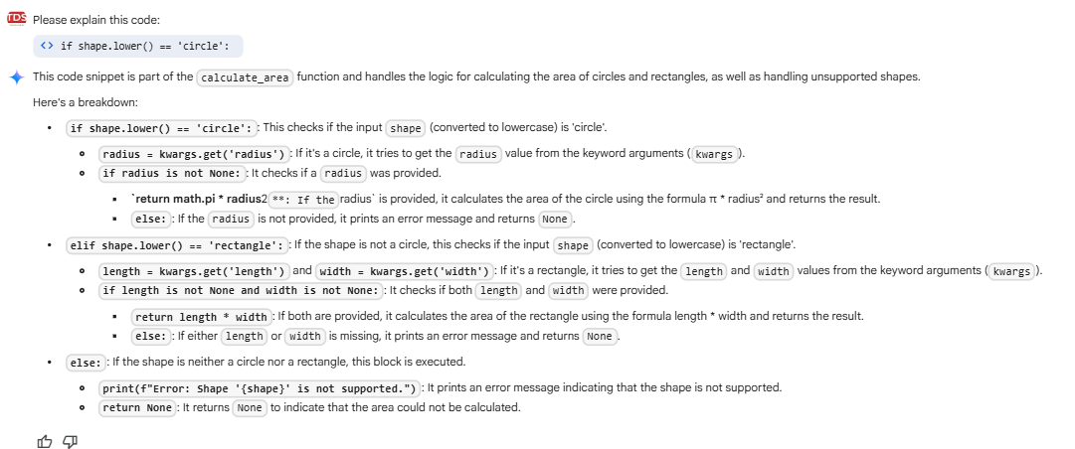
Slide Title
Gemini – Code Explanation
Prompt
Generate test cases

Slide 16
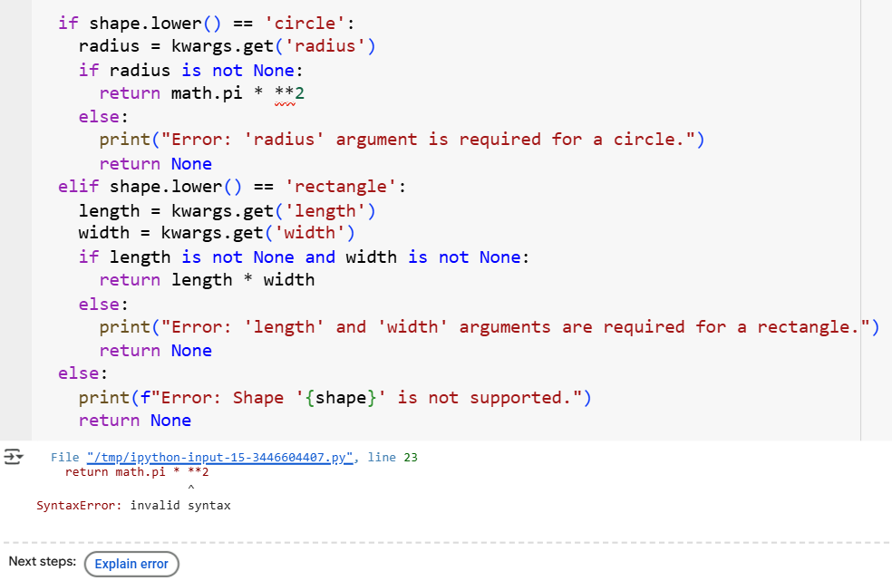
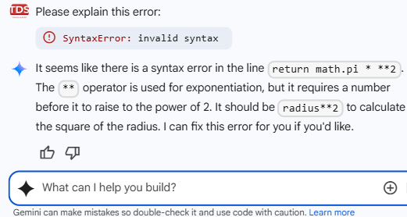
Slide Title
Gemini – Code Debugging

Slide 17
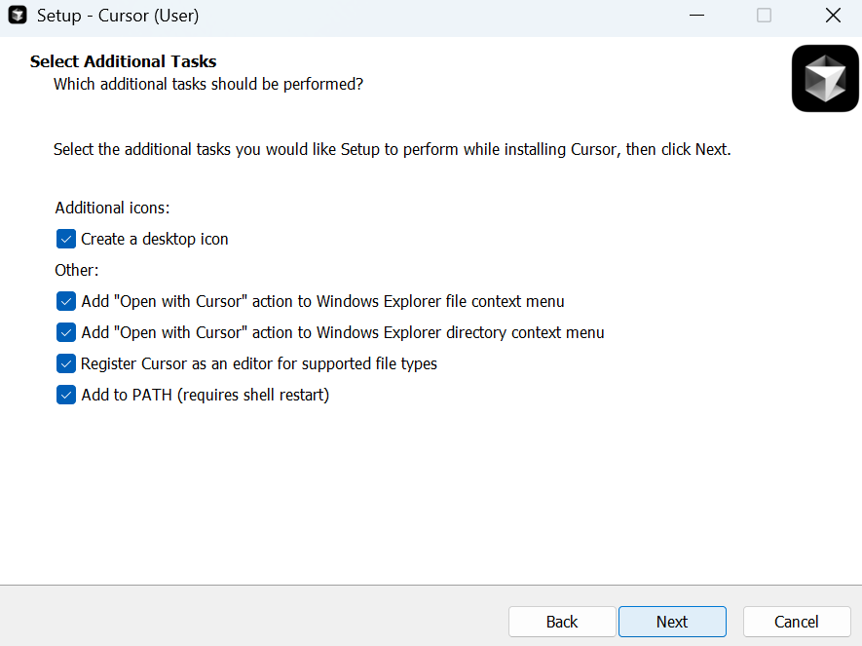
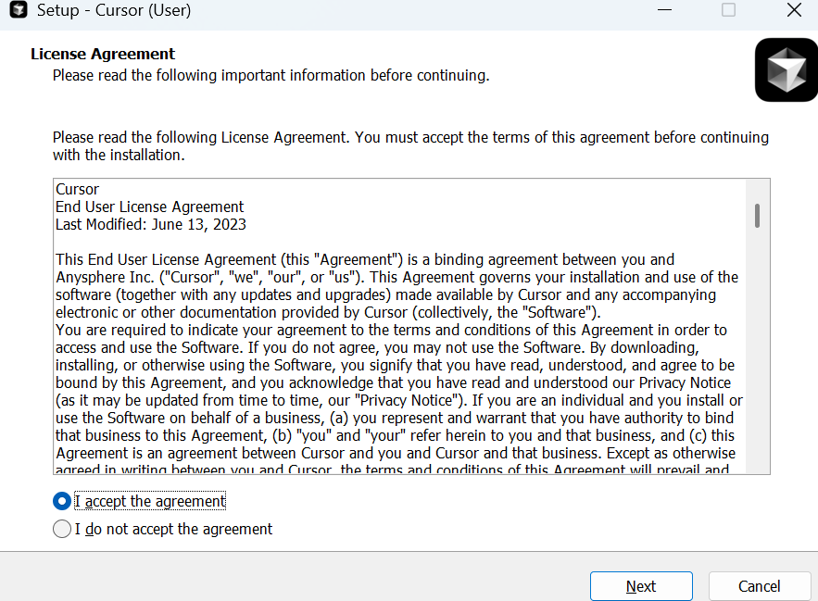
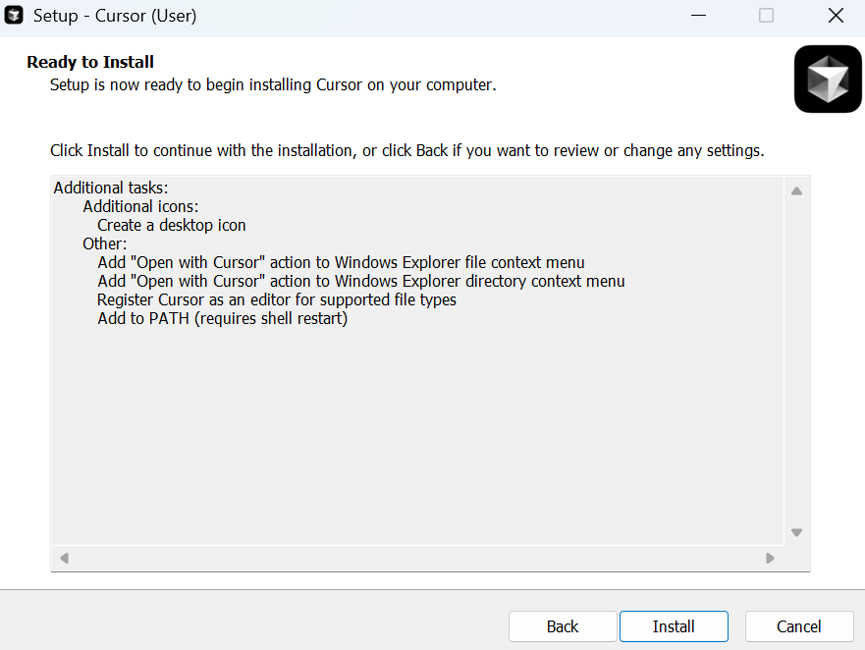
Slide Title
Cursor AI – Installation
Download software using https://cursor.com/agents
Click on installation file

Slide 18
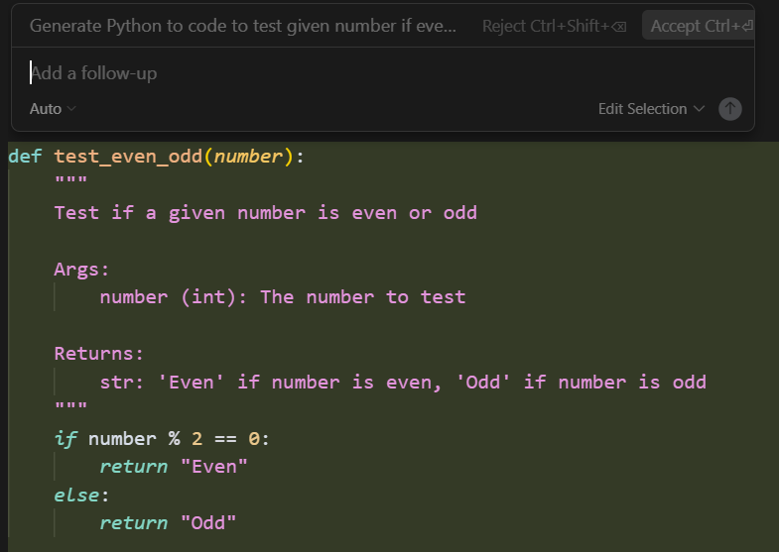
Slide Title
Cursor AI – Code Generation
CTRL + K to generate code in cursor AI
CTRL + L to chat with cursor AI

Slide 19
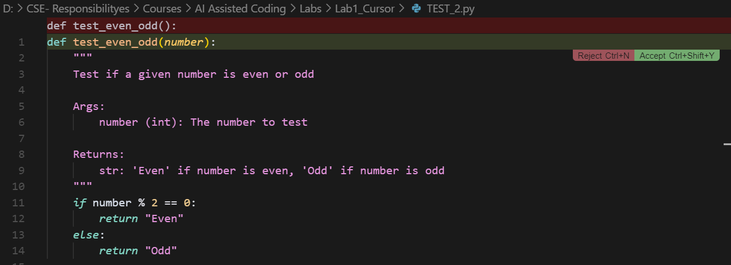
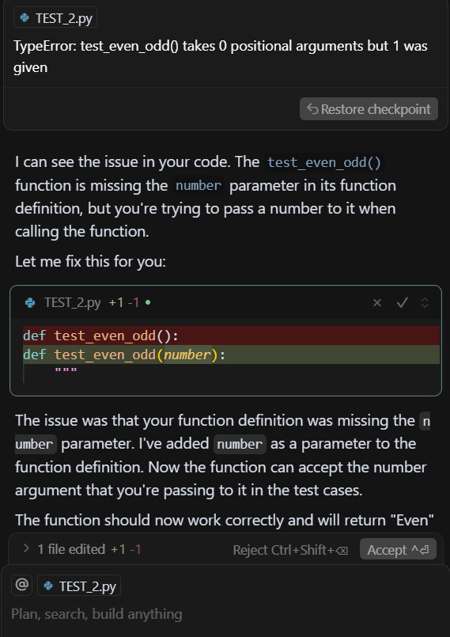
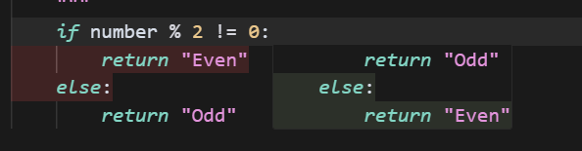
Slide Title
Cursor AI – Code Suggestion and BUG fixing

Slide 20
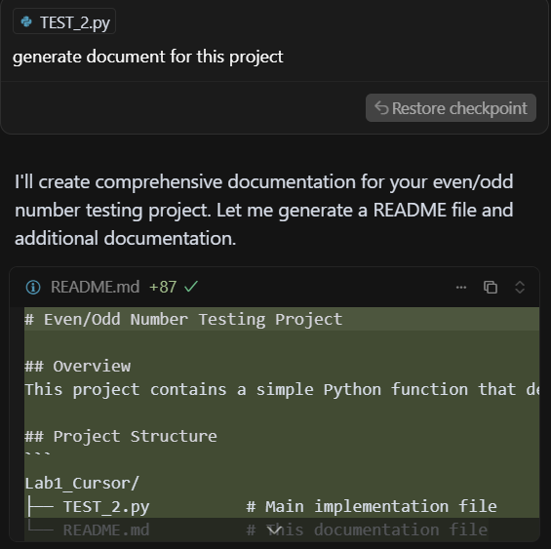
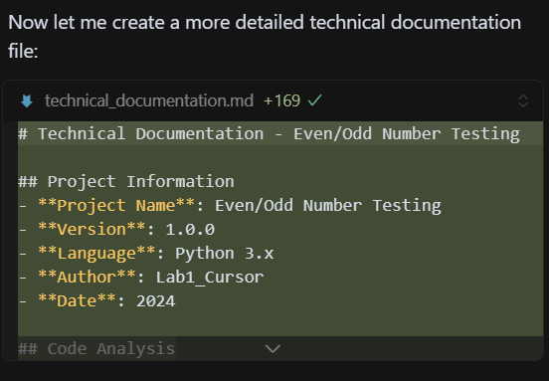
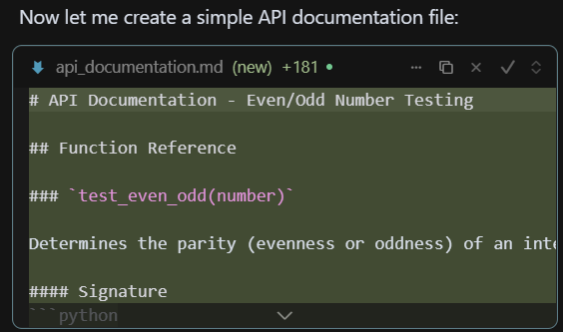
Slide Title
Cursor AI – Document Generation

Slide 21
Thank You

