Slide 1

School of Computer Science and AI, SR University
Course Code | Course Title | L | R | P | Cr
25CAI004PC206 | AI Assisted Coding | 0 | 0 | 4 | 2
Program Core
Data Structures with AI: Implementing fundamental structures
Lecture - 11
Stack (LIFO) Queue Operations Tutorial
Dr. Venkataramana Veeramsetty
Professor

Slide 2
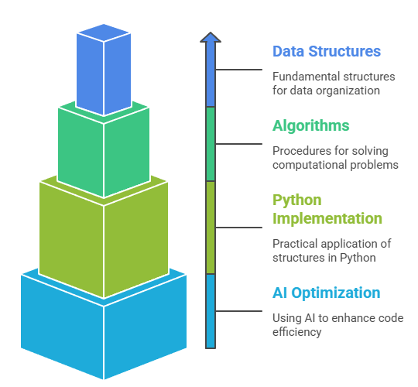
Slide Title
Objectives
Notes:
• Implement fundamental data structures in Python
• Use AI to generate and optimize code
• Compare multiple implementations suggested by AI
• Reinforce problem-solving using AI-powered coding assistance

Slide 3
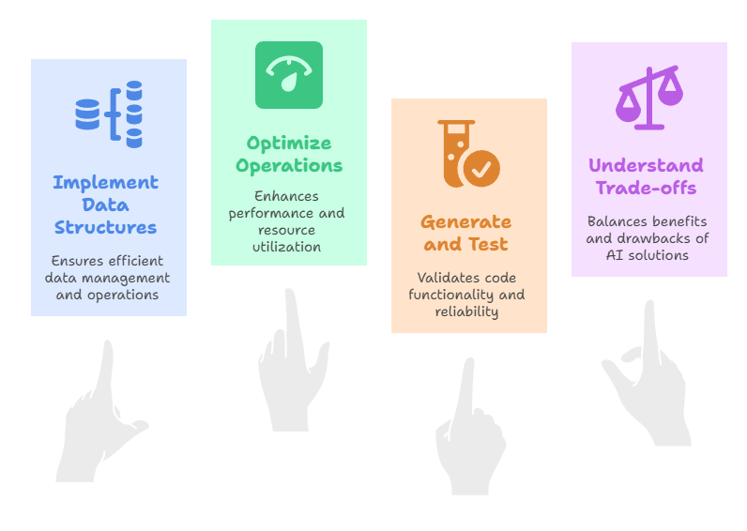
Slide Title
Learning Outcomes
Notes:
• Implement fundamental data structures in Python
• Use AI to generate and optimize code
• Compare multiple implementations suggested by AI
• Reinforce problem-solving using AI-powered coding assistance

Slide 4
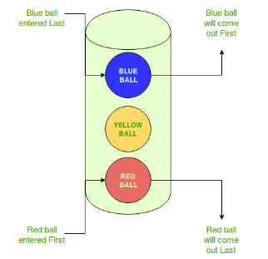
Slide Title
Stack (LIFO)
LIFO is an abbreviation for last in, first out. It is a method for handling data structures where the first element is processed last and the last element is processed first.
Stack is known as a linear data structure. It follows the Last-In-First-Out rule. So, if you push something to the stack then the last value which you pushed, will be the first to pop out. The insertion and deletion operation on the stack will only take place from one end which is the top of the stack.
Where is LIFO used:
Data Structures: Certain data structures like Stacks and other variants of Stacks use LIFO approach for processing data.
Extracting latest information: Sometimes computers use LIFO when data is extracted from an array or data buffer. When it is required to get the most recent information entered, the LIFO approach is used.
Notes:
• Implement fundamental data structures in Python
• Use AI to generate and optimize code
• Compare multiple implementations suggested by AI
• Reinforce problem-solving using AI-powered coding assistance

Slide 5
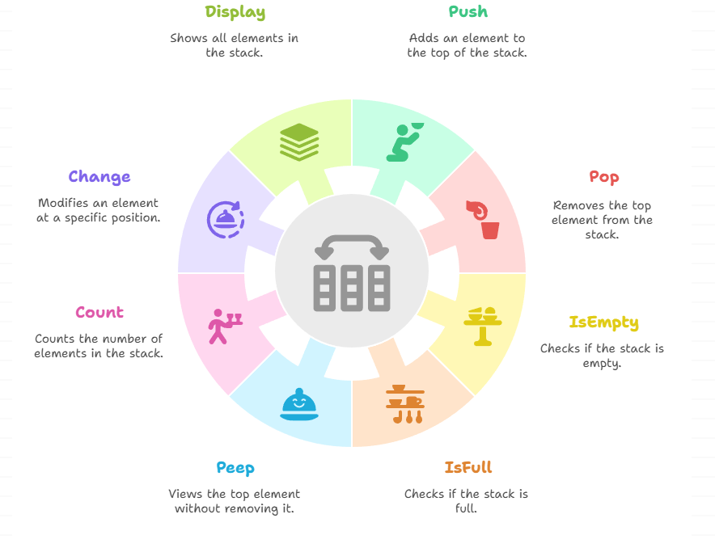
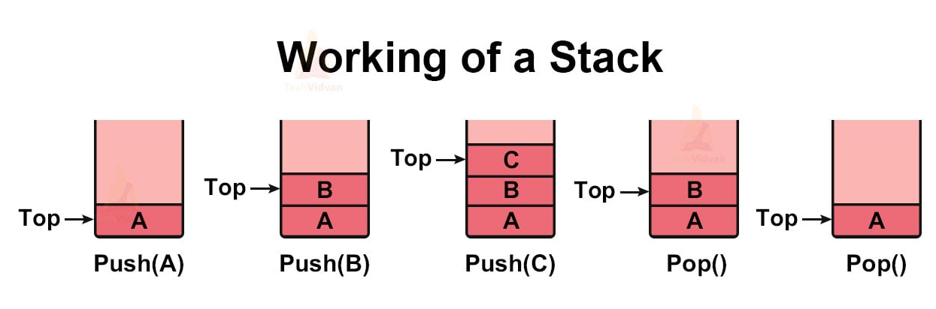
Slide Title
Stack Operations
Notes:
1. Push( ): Inserting an element is defined as Push( ) operation in stack. 2. Popl( ): This operation deletes elements from the stack. 3. IsEmpty( ): It checks whether the stack is empty or not. It returns either true or false. 4. IsFull( ): It checks whether the stack is full or not. IsFull( ) is checked only during actual implementation. 5. peep( ): This operation gives the value of the top data element of the stack without removing it. 6. count( ): It is used to count the number of elements in the stack. 7. change( ): This operation is used to change the element at the given position. 8. display( ): It displays/prints the elements of the stack

Slide 6
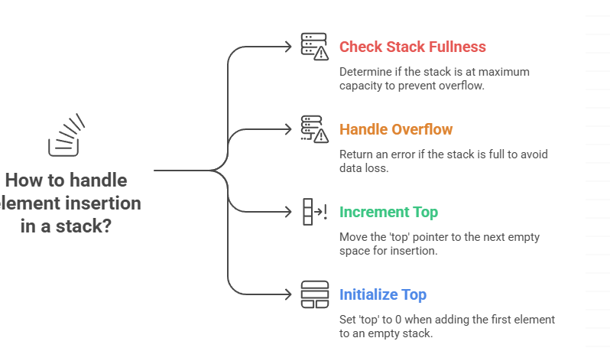
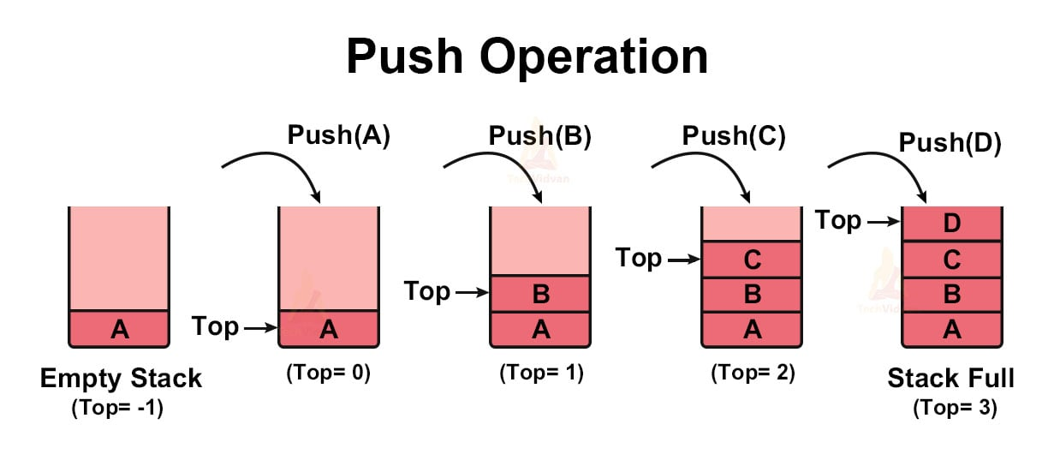
Slide Title
Stack Operations - PUSH
Through this operation, we add new elements to our stack. The push( ) operation goes through the following steps:
The stack can accommodate elements as long as it does not reach its maximum capacity.
Notes:
Through this operation, we add new elements to our stack. The push( ) operation goes through the following steps:
1. Before inserting a new element into the stack, check whether the stack is full or not.
2. If the stack is already full and we try to insert more elements into it, it will return an overflow error.
3. If the stack is not full, increment the ‘top’ to point to the next empty space and insert the new element there.
4. When the stack is empty, ‘top’ points to -1. Once we add a new element, the ‘top’ points to that element and has a value of 0.
5. The stack can accommodate elements as long as it does not reach its maximum capacity.

Slide 7
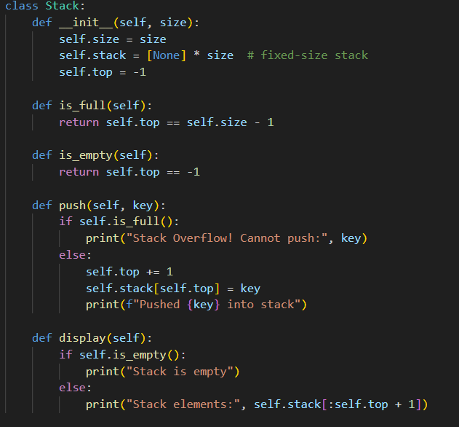
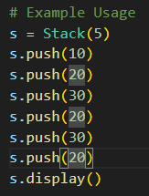
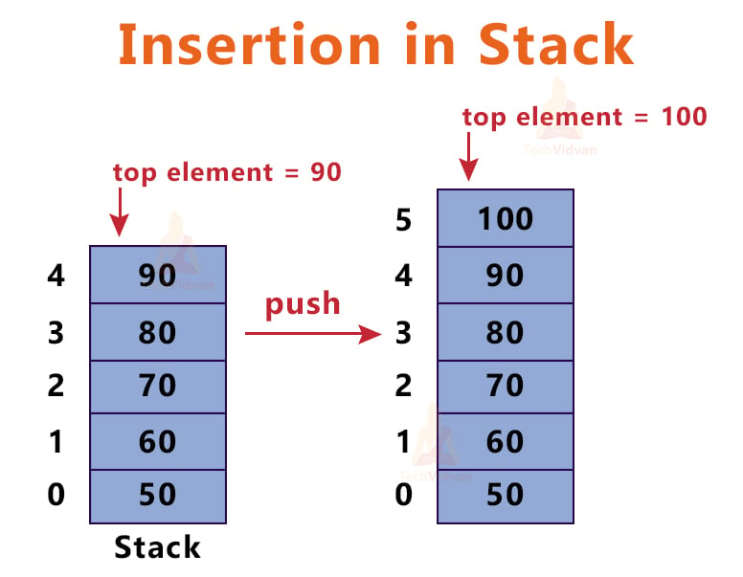
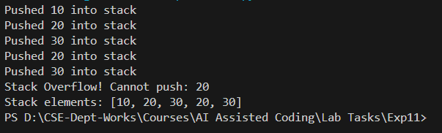
Slide Title
Stack Operations – PUSH - Python
Notes:
Through this operation, we add new elements to our stack. The push( ) operation goes through the following steps:
1. Before inserting a new element into the stack, check whether the stack is full or not.
2. If the stack is already full and we try to insert more elements into it, it will return an overflow error.
3. If the stack is not full, increment the ‘top’ to point to the next empty space and insert the new element there.
4. When the stack is empty, ‘top’ points to -1. Once we add a new element, the ‘top’ points to that element and has a value of 0.
5. The stack can accommodate elements as long as it does not reach its maximum capacity.

Slide 8
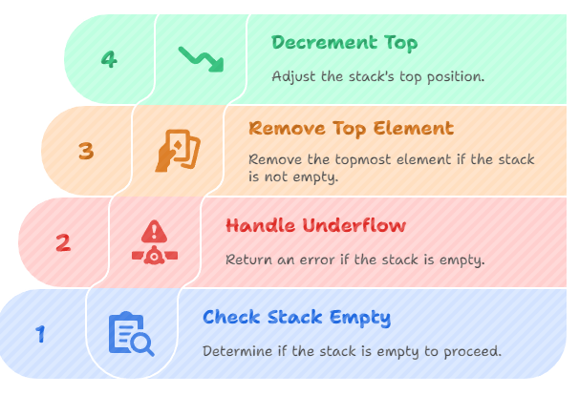
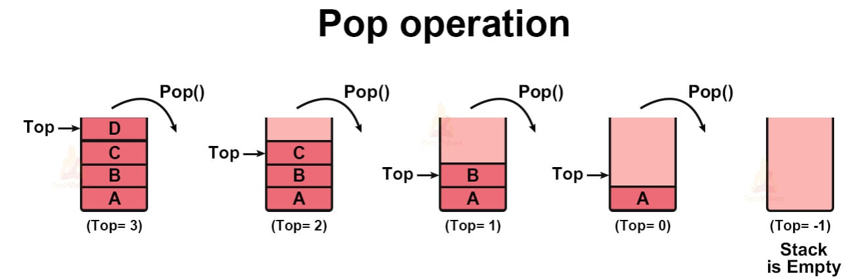
Slide Title
Stack Operations - POP
It helps in removing elements from the top of the stack. The steps involved in the pop operation are:
Notes:
1. The first step is to check whether the stack is empty or not.
2. If the stack is already empty, we cannot remove any element from it. So, we will return an underflow error.
3. If the stack is not empty, remove the topmost element of the stack.
4. Decrement the position of ‘top’ by 1 and return.

Slide 9
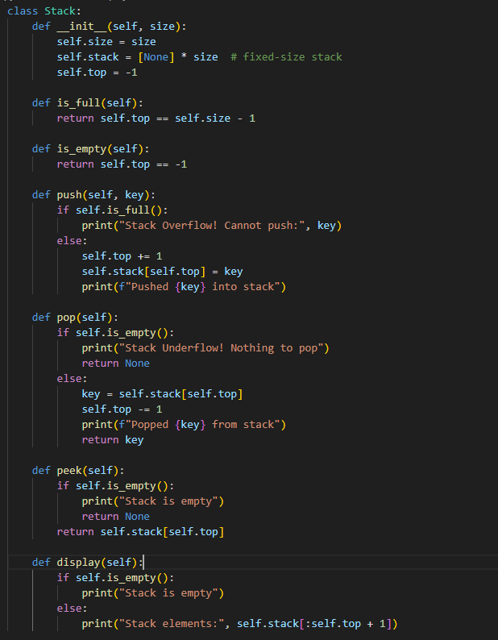
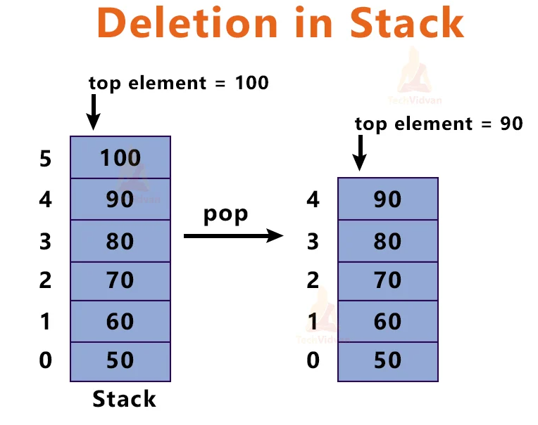
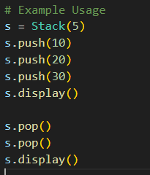
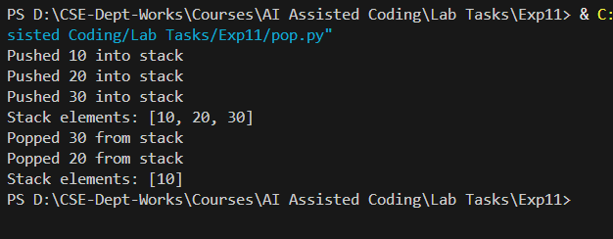
Slide Title
Stack Operations – POP - Python
Notes:
1. The first step is to check whether the stack is empty or not.
2. If the stack is already empty, we cannot remove any element from it. So, we will return an underflow error.
3. If the stack is not empty, remove the topmost element of the stack.
4. Decrement the position of ‘top’ by 1 and return.

Slide 10
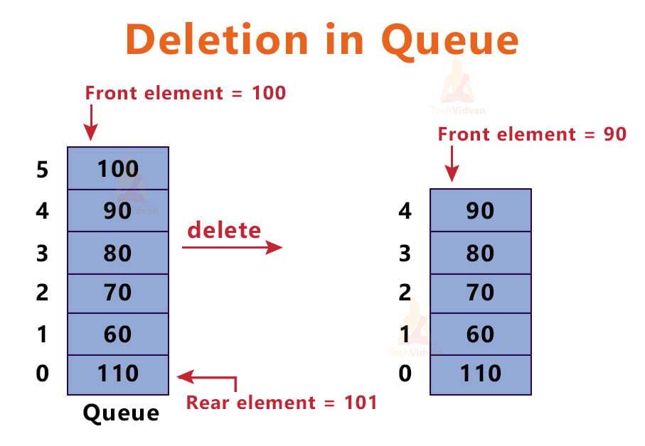
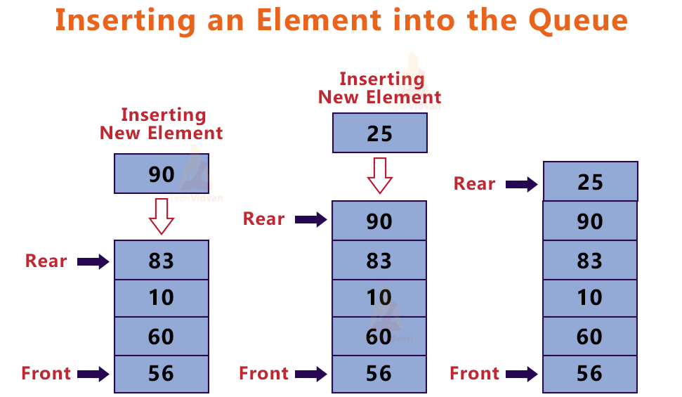
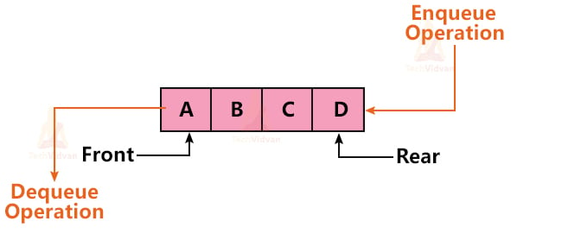
Slide Title
Queue Operations
Queue is known as a linear data structure. It follows the First-In-First-Out rule. So, if you push something to the stack then the first value of the stack will pop out.
In the queue, the insertion operation is done from the rear end(back) and the deletion is done from the front.
In the queue, the order of insertion is the same as the order of deletion of elements because of the FIFO approach.
Front points to the index of the queue from where we can delete an element. Rear points to that index of the queue from where we insert elements.
Notes:
Through this operation, we add new elements to our stack. The push( ) operation goes through the following steps:
1. Before inserting a new element into the stack, check whether the stack is full or not.
2. If the stack is already full and we try to insert more elements into it, it will return an overflow error.
3. If the stack is not full, increment the ‘top’ to point to the next empty space and insert the new element there.
4. When the stack is empty, ‘top’ points to -1. Once we add a new element, the ‘top’ points to that element and has a value of 0.
5. The stack can accommodate elements as long as it does not reach its maximum capacity.

Slide 11
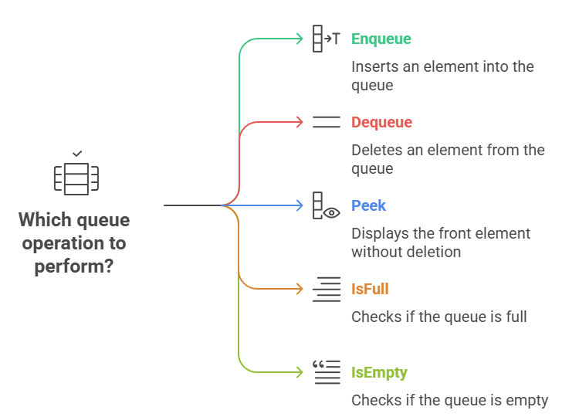
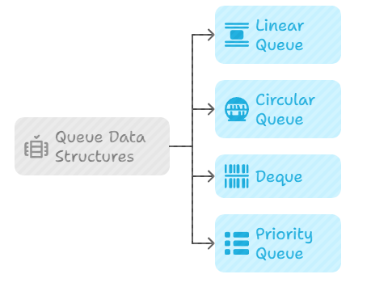
Slide Title
Queue Types and Linear Queue Operations
Notes:
Basic operations on Linear Queue:
The basic operations that we can perform on a queue are:
a. enqueue(): To insert an element into the queue.
b. dequeue(): To delete an element from a queue.
c. peek(): To print/display the element at the front without deleting it.
d. isfull(): To check if the queue is full or not.
e. isempty(): To check if the queue is empty or not.

Slide 12
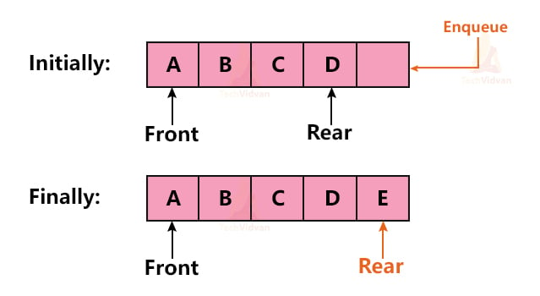
Slide Title
enqueue() Operation in Queue
The queue has two ends pointed by Front and Rear. The enqueue() operation is always performed at the Rear end.
While performing enqueue() operation, we always check whether the queue is full or not. In case the queue is full, we return an overflow error. Otherwise, we insert the element at the rear end and make the Rear point to the next position in the queue.
For example, suppose we have a queue with elements A, B, C, D and we wish to insert E into the queue. We can insert this new element into the queue as follows:
Notes:
Basic operations on Linear Queue:
The basic operations that we can perform on a queue are:
a. enqueue(): To insert an element into the queue.
b. dequeue(): To delete an element from a queue.
c. peek(): To print/display the element at the front without deleting it.
d. isfull(): To check if the queue is full or not.
e. isempty(): To check if the queue is empty or not.

Slide 13
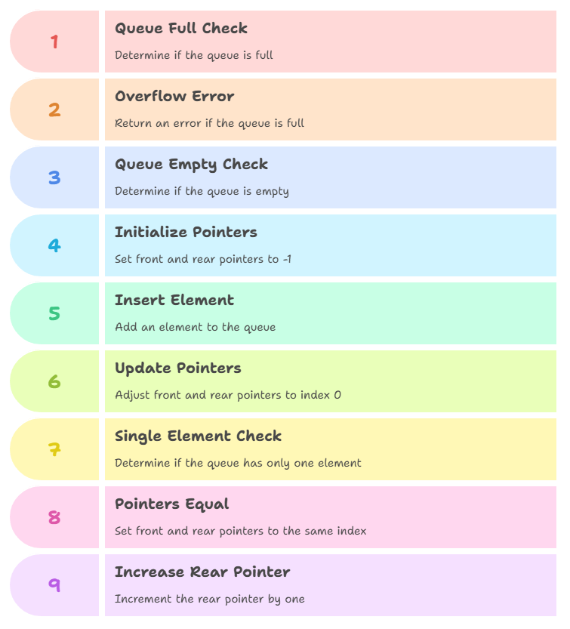
Slide Title
enqueue() Operation in Queue
Notes:
Basic operations on Linear Queue:
The basic operations that we can perform on a queue are:
a. enqueue(): To insert an element into the queue.
b. dequeue(): To delete an element from a queue.
c. peek(): To print/display the element at the front without deleting it.
d. isfull(): To check if the queue is full or not.
e. isempty(): To check if the queue is empty or not.

Slide 14
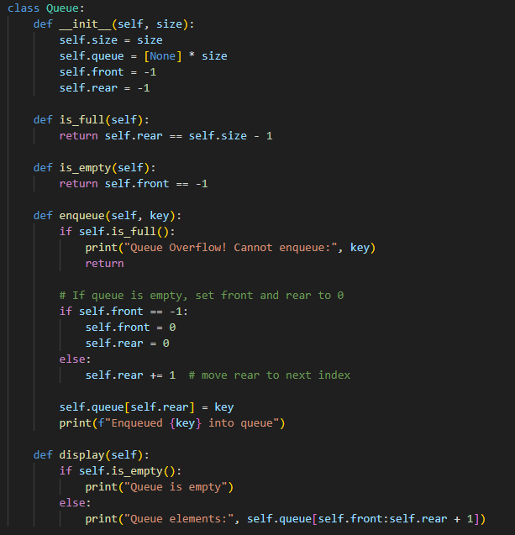
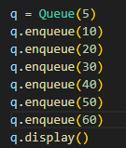
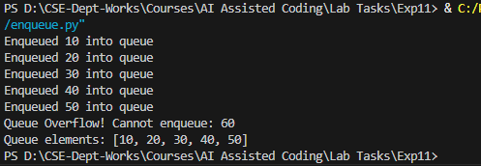
Slide Title
enqueue() Operation in Queue - Python
Notes:
Basic operations on Linear Queue:
The basic operations that we can perform on a queue are:
a. enqueue(): To insert an element into the queue.
b. dequeue(): To delete an element from a queue.
c. peek(): To print/display the element at the front without deleting it.
d. isfull(): To check if the queue is full or not.
e. isempty(): To check if the queue is empty or not.

Slide 15
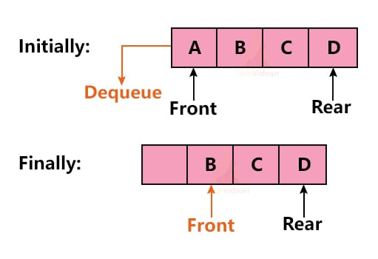
Slide Title
dequeue() Operation
This operation is used to delete an element from the queue. dequeue() operation is always performed at the ‘Front’ of the queue.
While performing dequeue() operation, we always make sure that the queue is not already empty. If the queue is already empty, there is nothing to delete. In that case, we return an underflow error. If the queue is not empty, we delete the front node and move the front pointer to the next node.
If the queue is empty, the Front will be pointing to an invalid index. In this case, we will return the underflow error and exit the program.
If the queue contains only one element, both the Front and Rear will point to the same index. In this case, we will delete the element and make the front and rear point to any invalid index.
Notes:
Basic operations on Linear Queue:
The basic operations that we can perform on a queue are:
a. enqueue(): To insert an element into the queue.
b. dequeue(): To delete an element from a queue.
c. peek(): To print/display the element at the front without deleting it.
d. isfull(): To check if the queue is full or not.
e. isempty(): To check if the queue is empty or not.

Slide 16
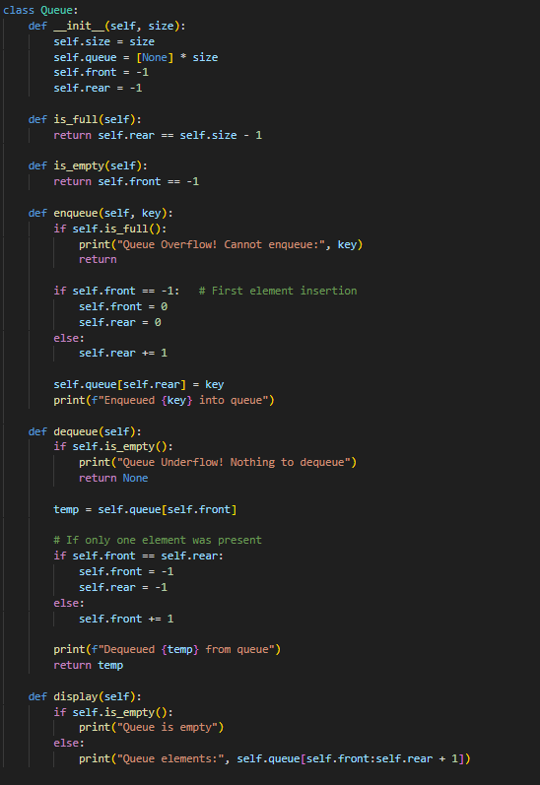
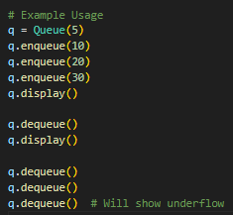
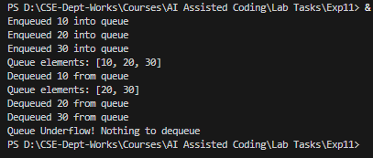
Slide Title
dequeue() Operation in Queue - Python
Notes:
Basic operations on Linear Queue:
The basic operations that we can perform on a queue are:
a. enqueue(): To insert an element into the queue.
b. dequeue(): To delete an element from a queue.
c. peek(): To print/display the element at the front without deleting it.
d. isfull(): To check if the queue is full or not.
e. isempty(): To check if the queue is empty or not.

Slide 17
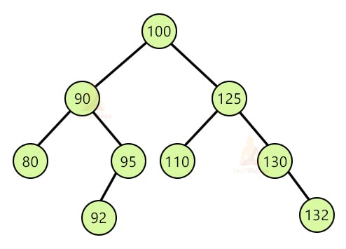
Slide Title
Binary Search Tree in Data Structure
A binary search tree(BST) is a special type of binary tree and is also known as a sorted or ordered binary tree. In a binary search tree:
The value of the left node is less than the value of the parent node.
The value of the right node is greater than the value of the parent node.
A binary search tree usually does not have any duplicate nodes
Notes:
Basic operations on Linear Queue:
The basic operations that we can perform on a queue are:
a. enqueue(): To insert an element into the queue.
b. dequeue(): To delete an element from a queue.
c. peek(): To print/display the element at the front without deleting it.
d. isfull(): To check if the queue is full or not.
e. isempty(): To check if the queue is empty or not.

Slide 18
Slide Title
Representation of Binary Search Tree
A binary search tree(BST) is a special type of binary tree and is also known as a sorted or ordered binary tree. In a binary search tree:
The value of the left node is less than the value of the parent node.
The value of the right node is greater than the value of the parent node.
A binary search tree usually does not have any duplicate nodes
Notes:
Basic operations on Linear Queue:
The basic operations that we can perform on a queue are:
a. enqueue(): To insert an element into the queue.
b. dequeue(): To delete an element from a queue.
c. peek(): To print/display the element at the front without deleting it.
d. isfull(): To check if the queue is full or not.
e. isempty(): To check if the queue is empty or not.

Slide 19
Slide Title
References
https://techvidvan.com/tutorials/binary-search-tree/
https://techvidvan.com/tutorials/stack-in-data-structure/
https://techvidvan.com/tutorials/queue-in-data-structure/
Notes:
Basic operations on Linear Queue:
The basic operations that we can perform on a queue are:
a. enqueue(): To insert an element into the queue.
b. dequeue(): To delete an element from a queue.
c. peek(): To print/display the element at the front without deleting it.
d. isfull(): To check if the queue is full or not.
e. isempty(): To check if the queue is empty or not.

Slide 20
Thank You

