Slide 1

School of Computer Science and AI, SR University
Course Code | Course Title | L | R | P | Cr
25CAI004PC206 | AI Assisted Coding | 0 | 0 | 4 | 2
Program Core
Algorithms with AI Assistance: Sorting and searching
Lecture - 12
Testing Tools Benefits of Testing Tutorial
Dr. Venkataramana Veeramsetty
Professor

Slide 2
Slide Title
Sorting Algorithms
Given a sequence of elements, sorting them means that ordering them in a particular fashion like ascending or descending. In general, when we talk about sorting, we are talking about ordering them in ascending order.
Example
Initial Sequence: 3, 4, 1, 6, 2, 5
After Sorting: 1, 2, 3, 4, 5, 6
The values might be integers, or strings, or even other kinds of objects.
Notes:
• Implement fundamental data structures in Python
• Use AI to generate and optimize code
• Compare multiple implementations suggested by AI
• Reinforce problem-solving using AI-powered coding assistance

Slide 3
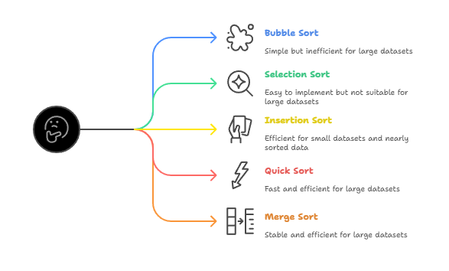
Slide Title
Sorting Algorithms
Notes:
• Implement fundamental data structures in Python
• Use AI to generate and optimize code
• Compare multiple implementations suggested by AI
• Reinforce problem-solving using AI-powered coding assistance

Slide 4
Slide Title
Bubble Sort
Bubble Sort is one of the simplest sorting algorithms. It works by repeatedly iterating through the list, comparing adjacent elements, and swapping if they are in the wrong order.
Initial Array: 6 5 3 1 8 7 2 4
First Iteration:
5 6 3 1 8 7 2 4
5 3 6 1 8 7 2 4
5 3 1 6 8 7 2 4
5 3 1 6 8 7 2 4
5 3 1 6 7 8 2 4
5 3 1 6 7 2 8 4
5 3 1 6 7 2 4 8
Second Iteration:
3 5 1 6 7 2 4 8
3 1 5 6 7 2 4 8
3 1 5 6 7 2 4 8
3 1 5 6 7 2 4 8
3 1 5 6 2 7 4 8
3 1 5 6 2 4 7 8
3 1 5 6 2 4 7 8
Third Iteration:
1 3 5 6 2 4 7 8
1 3 5 6 2 4 7 8
1 3 5 6 2 4 7 8
1 3 5 2 6 4 7 8
1 3 5 2 4 6 7 8
1 3 5 2 4 6 7 8
1 3 5 2 4 6 7 8
Fourth Iteration:
1 3 5 2 4 6 7 8
1 3 5 2 4 6 7 8
1 3 2 5 4 6 7 8
1 3 2 4 5 6 7 8
1 3 2 4 5 6 7 8
1 3 2 4 5 6 7 8
1 3 2 4 5 6 7 8
Fifth Iteration:
1 3 2 4 5 6 7 8
1 2 3 4 5 6 7 8
1 2 3 4 5 6 7 8
1 2 3 4 5 6 7 8
1 2 3 4 5 6 7 8
1 2 3 4 5 6 7 8
Notes:
• Implement fundamental data structures in Python
• Use AI to generate and optimize code
• Compare multiple implementations suggested by AI
• Reinforce problem-solving using AI-powered coding assistance

Slide 5
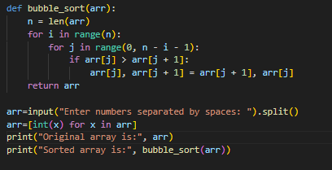
Slide Title
Bubble Sort – Python Implementation
Notes:
• Implement fundamental data structures in Python
• Use AI to generate and optimize code
• Compare multiple implementations suggested by AI
• Reinforce problem-solving using AI-powered coding assistance

Slide 6
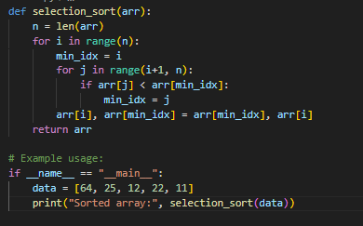
Slide Title
Selection Sort
Initial Array: 3, 4, 1, 6, 2, 5
Index | 0 | 1 | 2 | 3 | 4 | 5
0 | 3 | 4 | 1 | 6 | 2 | 5
1 | 1 | 4 | 3 | 6 | 2 | 5
2 | 1 | 2 | 3 | 6 | 4 | 5
3 | 1 | 2 | 3 | 6 | 4 | 5
4 | 1 | 2 | 3 | 4 | 6 | 5
5 | 1 | 2 | 3 | 4 | 5 | 6
Notes:
• Implement fundamental data structures in Python
• Use AI to generate and optimize code
• Compare multiple implementations suggested by AI
• Reinforce problem-solving using AI-powered coding assistance

Slide 7
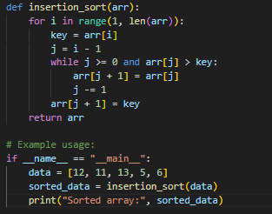
Slide Title
Insertion Sort
Index | 0 | 1 | 2 | 3 | 4 | 5 | Temp
Value | 5 | 4 | 10 | 1 | 6 | 2 | -
0 | 4 | 5 | 10 | 1 | 6 | 2 | 4
1` | 4 | 5 | 10 | 1 | 6 | 2 | 10
2 | 1 | 4 | 5 | 10 | 6 | 2 | 1
3 | 1 | 4 | 5 | 6 | 10 | 2 | 6
4 | 1 | 2 | 4 | 5 | 6 | 10 | 2
Notes:
• Implement fundamental data structures in Python
• Use AI to generate and optimize code
• Compare multiple implementations suggested by AI
• Reinforce problem-solving using AI-powered coding assistance

Slide 8
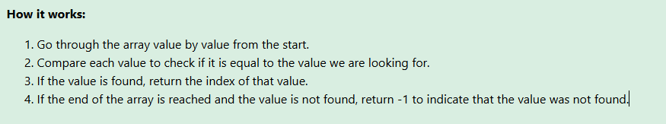



Slide Title
Linear Search
The Linear Search algorithm searches through an array and returns the index of the value it searches for.
Step 1: We start with an array of random values.
Step 2: We look at the first value in the array, is it equal to 11?
Step 3: We move on to the next value at index 1, and compare it to 11 to see if it is equal.
Step 4: We check the next value at index 2.
Step 5: We move on to the next value at index 3. Is it equal to 11?
We have found it!
Value 11 is found at index 3.
Returning index position 3.
Linear Search is finished.
Notes:
• Implement fundamental data structures in Python
• Use AI to generate and optimize code
• Compare multiple implementations suggested by AI
• Reinforce problem-solving using AI-powered coding assistance

Slide 9
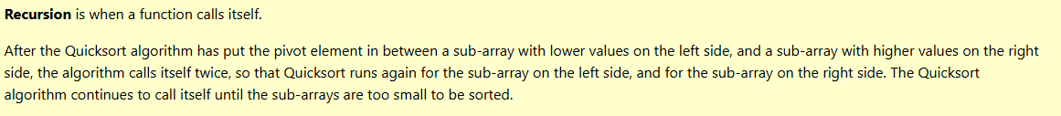
Slide Title
Quicksort
The Quicksort algorithm takes an array of values, chooses one of the values as the 'pivot' element, and moves the other values so that lower values are on the left of the pivot element, and higher values are on the right of it.
In this tutorial the last element of the array is chosen to be the pivot element, but we could also have chosen the first element of the array, or any element in the array really.
Notes:
• Implement fundamental data structures in Python
• Use AI to generate and optimize code
• Compare multiple implementations suggested by AI
• Reinforce problem-solving using AI-powered coding assistance

Slide 10
Slide Title
Quick Sort
Index | 0 | 1 | 2 | 3 | 4 | 5 | Pivot | Swap
Value | 5 (Start) | 4 | 10 | 1 | 6 | 2 (End) | 5 | No
0 | 5 | 4 | 10(Start) | 1 | 6 | 2 (End) | 5
0.1 | 5 | 4 | 2(Start) | 1 | 6 | 10(End) | 5 | Yes
1` | 5 | 4 | 2 | 1(End) | 6 (Start) | 10 | 5 | No
1.1 | 1 | 4 | 2 | 5(End) | 6 (Start) | 10 | 5 | Pivot to end index
Start index moves right till it got values less than or equal to pivot
End index moves left till it got values greater than pivot
Do not Swap start and end (if start index > end Index) and swap pivot element with end element
Swap start and end (if start index < end Index)
Notes:
• Implement fundamental data structures in Python
• Use AI to generate and optimize code
• Compare multiple implementations suggested by AI
• Reinforce problem-solving using AI-powered coding assistance

Slide 11
Slide Title
References
https://workat.tech/problem-solving/tutorial/sorting-algorithms-bubble-insertion-selection-sort-veubp86w3e1r
https://www.youtube.com/watch?v=yCxV0kBpA6M
Notes:
• Implement fundamental data structures in Python
• Use AI to generate and optimize code
• Compare multiple implementations suggested by AI
• Reinforce problem-solving using AI-powered coding assistance

Slide 12
Thank You

