Slide 1

School of Computer Science and AI, SR University
Course Code | Course Title | L | R | P | Cr
25CAI004PC206 | AI Assisted Coding | 0 | 0 | 4 | 2
Program Core
16. Database Design and Queries: Schema design and SQL generation
Lecture - 12
SQL Extensions Connections Queries
Dr. Venkataramana Veeramsetty
Professor

Slide 2
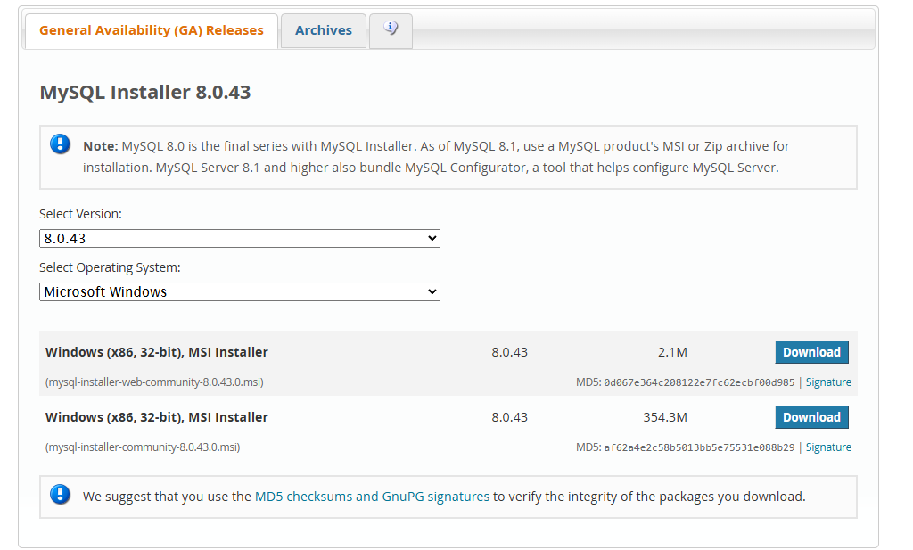
Slide Title
Install mySQL
Install MySQL using https://dev.mysql.com/downloads/installer/
Notes:
• Implement fundamental data structures in Python
• Use AI to generate and optimize code
• Compare multiple implementations suggested by AI
• Reinforce problem-solving using AI-powered coding assistance

Slide 3
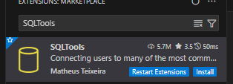
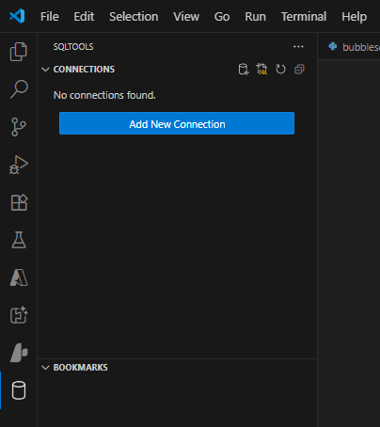

Slide Title
mySQL extension on VS code
1. Add SQLTools Extension
2. Install this driver
3. Add New Connection
Notes:
• Implement fundamental data structures in Python
• Use AI to generate and optimize code
• Compare multiple implementations suggested by AI
• Reinforce problem-solving using AI-powered coding assistance

Slide 4
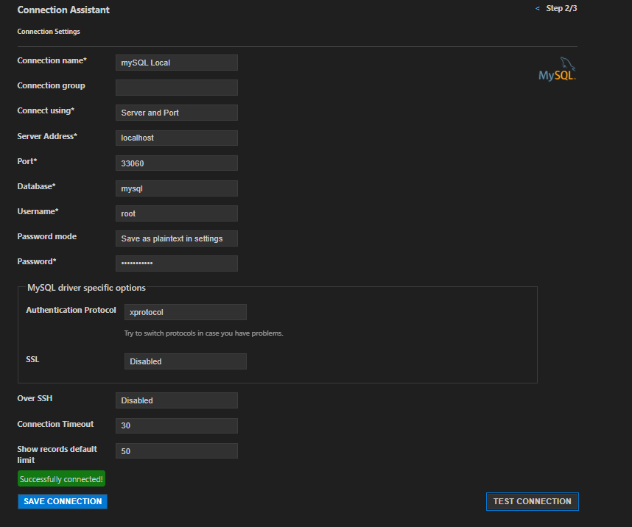

Slide Title
mySQL extension on VS code
4. Click on MySQL
5. Test and Save Connection
Notes:
• Implement fundamental data structures in Python
• Use AI to generate and optimize code
• Compare multiple implementations suggested by AI
• Reinforce problem-solving using AI-powered coding assistance

Slide 5
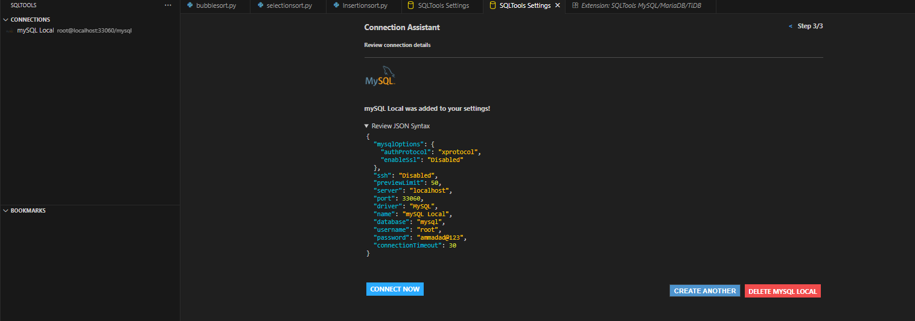
Slide Title
mySQL extension on VS code
5. Click on connect now
Notes:
• Implement fundamental data structures in Python
• Use AI to generate and optimize code
• Compare multiple implementations suggested by AI
• Reinforce problem-solving using AI-powered coding assistance

Slide 6
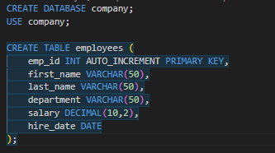
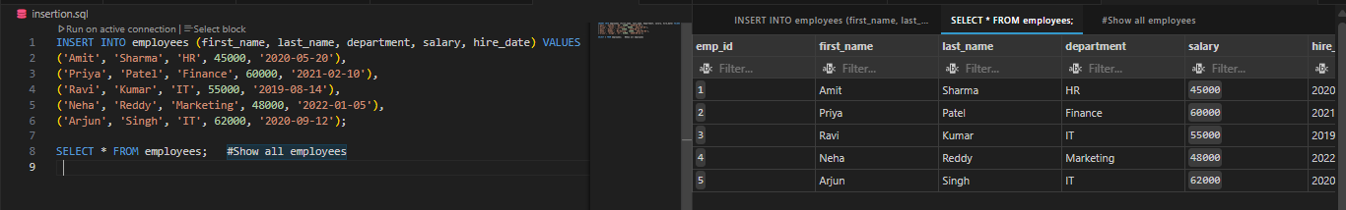
Slide Title
Create a Table and INSERT Data and VIEW Table
Prompt: Create a Sample Database and Table
Prompt: Data Insertion and View Table
Notes:
• Implement fundamental data structures in Python
• Use AI to generate and optimize code
• Compare multiple implementations suggested by AI
• Reinforce problem-solving using AI-powered coding assistance

Slide 7
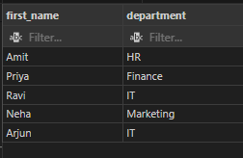
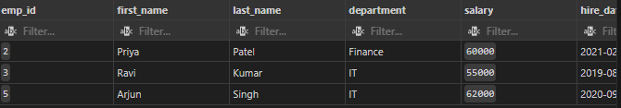
Slide Title
Basic Queries
Prompt: Display employee names and departments
Prompt: Find employees with salary greater than 50,000
Notes:
• Implement fundamental data structures in Python
• Use AI to generate and optimize code
• Compare multiple implementations suggested by AI
• Reinforce problem-solving using AI-powered coding assistance

Slide 8


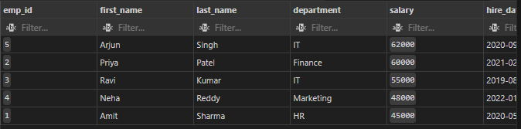
Slide Title
Basic Queries
Prompt: List employees from IT department
Prompt: Order employees by salary descending
Notes:
• Implement fundamental data structures in Python
• Use AI to generate and optimize code
• Compare multiple implementations suggested by AI
• Reinforce problem-solving using AI-powered coding assistance

Slide 9


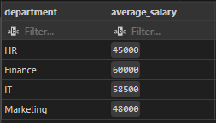
Slide Title
Aggregation and Grouping Queries
Prompt: Find total number of employees
Prompt: Find average salary in each department
Notes:
• Implement fundamental data structures in Python
• Use AI to generate and optimize code
• Compare multiple implementations suggested by AI
• Reinforce problem-solving using AI-powered coding assistance

Slide 10




Slide Title
Aggregation and Grouping Queries
Prompt: Find maximum and minimum salaries
Prompt: Show departments having more than one employee
Notes:
• Implement fundamental data structures in Python
• Use AI to generate and optimize code
• Compare multiple implementations suggested by AI
• Reinforce problem-solving using AI-powered coding assistance

Slide 11
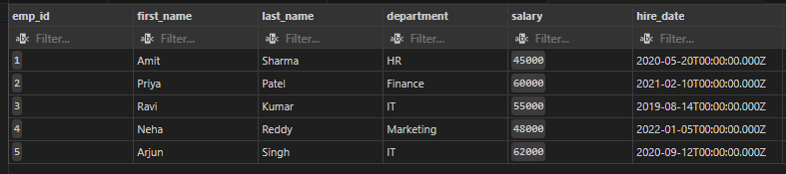
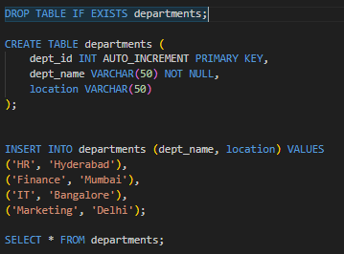
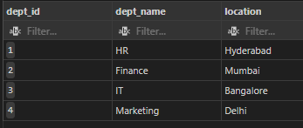
Slide Title
Joins Queries
SELECT * FROM employees;
Prompt: Create departments Table with dept_id as primary key, dept_name and location
SELECT * FROM departments;
Notes:
DROP TABLE IF EXISTS departments;
To Delete Table

Slide 12

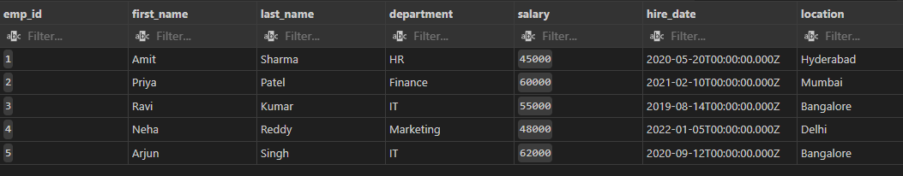
Slide Title
Joins Queries
Prompt: Join employees with departments
Notes:
DROP TABLE IF EXISTS departments;
To Delete Table

Slide 13

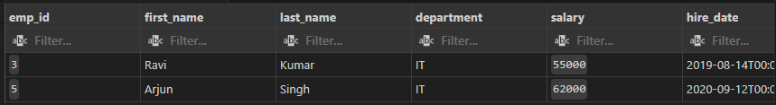
Slide Title
Joins Queries
Prompt: Display employees working in Bangalore
Notes:
DROP TABLE IF EXISTS departments;
To Delete Table

Slide 14

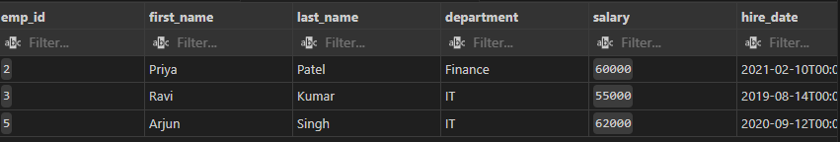
Slide Title
Subqueries
Prompt: Find employees with salary greater than the average salary
Notes:
DROP TABLE IF EXISTS departments;
To Delete Table

Slide 15
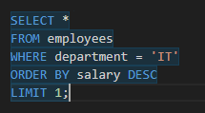

Slide Title
Subqueries
Prompt: Find the highest paid employee in IT department
ChatGpt
Github Copilot
Notes:
DROP TABLE IF EXISTS departments;
To Delete Table

Slide 16
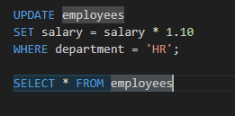
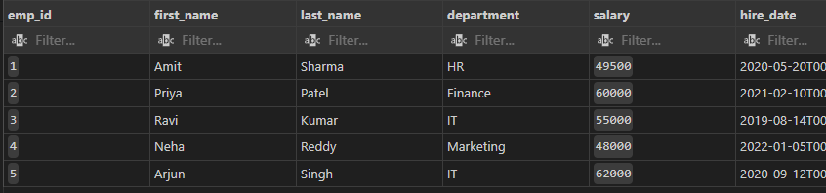
Slide Title
Data Modification
Prompt: Give a 10% salary hike to all employees in the HR department
Github Copilot
Before Increment
After Increment
Notes:
DROP TABLE IF EXISTS departments;
To Delete Table

Slide 17

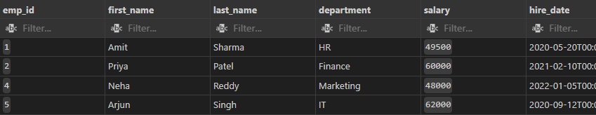
Slide Title
Data Modification
Prompt: Give a 10% salary hike to all employees in the HR department
Github Copilot
Before Record Deletion
After Record Deletion
Notes:
DROP TABLE IF EXISTS departments;
To Delete Table

Slide 18
Assignment
Write a query to find the top 3 highest-paid employees.
Find all employees whose name starts with ‘A’.
Change department names using UPDATE.
Add a new column for email.
Create a projects table and link it with employees using a foreign key.

Slide 19
Slide Title
References
https://www.youtube.com/watch?v=9ADd-_mM5Dw&t=331s
Notes:
• Implement fundamental data structures in Python
• Use AI to generate and optimize code
• Compare multiple implementations suggested by AI
• Reinforce problem-solving using AI-powered coding assistance

Slide 20
Thank You

