Slide 1

School of Computer Science and AI, SR University
Course Code | Course Title | L | R | P | Cr
25CAI004PC206 | AI Assisted Coding | 0 | 0 | 4 | 2
Program Core
18.API Integration: Connecting to external services with error handling
Lecture - 12
SQL Extensions Connections Queries
Dr. Venkataramana Veeramsetty
Professor

Slide 2
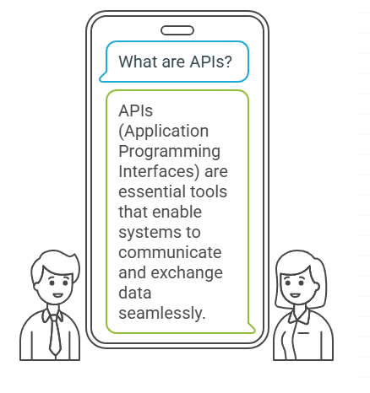
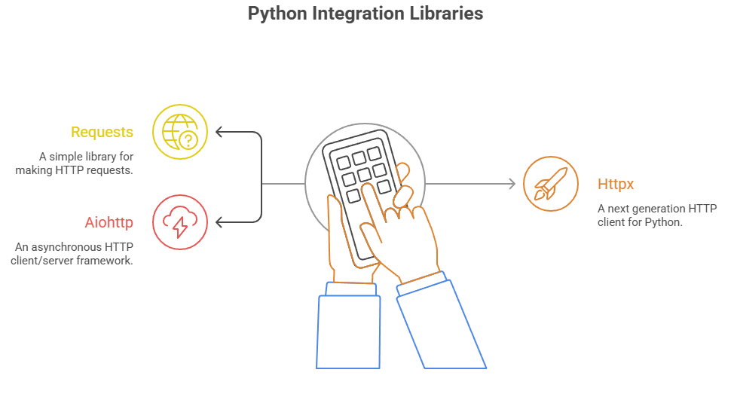
Slide Title
Introduction to API Integration
Notes:
APIs (Application Programming Interfaces) allow systems to communicate and exchange data.
Python simplifies integration via libraries like requests, httpx, aiohttp.

Slide 3
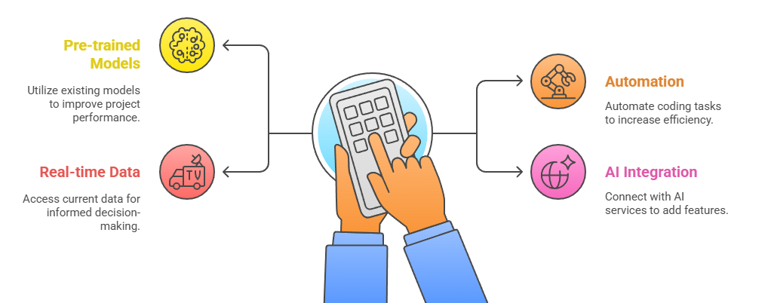
Slide Title
Why API Integration in AI-Assisted Coding?
Notes:
Access pre-trained models Automate repetitive coding tasks Fetch real-time data Integrate with AI services like translation, summarization, etc.

Slide 4
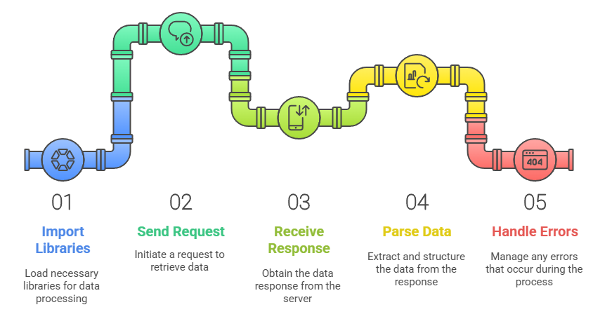
Slide Title
Basic Workflow of API Integration
Notes:
1. Import libraries 2. Send request 3. Receive response 4. Parse data 5. Handle errors

Slide 5
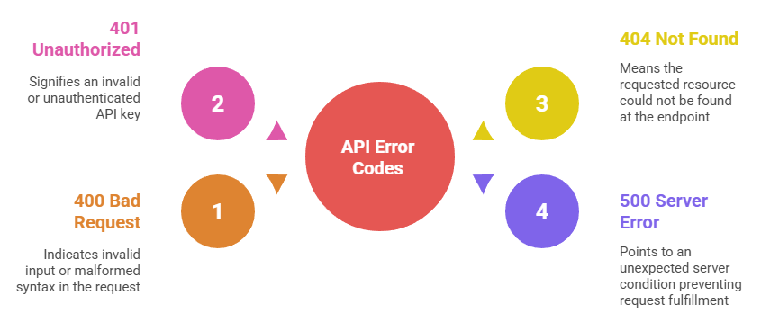
Slide Title
Common API Errors
Notes:
400 Bad Request – Invalid input 401 Unauthorized – Invalid API key 404 Not Found – Wrong endpoint 500 Server Error – Server issue

Slide 6
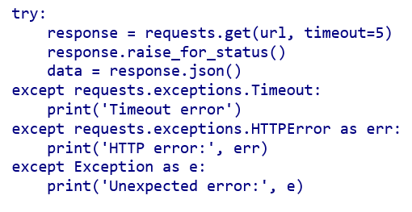
Slide Title
Error Handling Techniques in Python
The 401 Unauthorized error means that the API key you're using is either:
Not activated yet (it can take a few hours after signup for a new API key to become active)
Invalid or incorrect
Has expired
Notes:
400 Bad Request – Invalid input 401 Unauthorized – Invalid API key 404 Not Found – Wrong endpoint 500 Server Error – Server issue

Slide 7
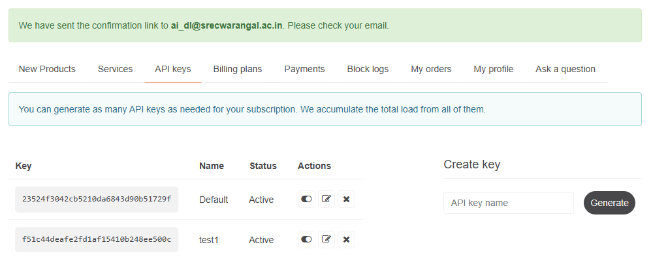
Slide Title
How wo use weather API
First, you'll need to sign up for a free API key at Open Weather Map: https://openweathermap.org/api
Replace your actual API key in the code. And, Install the required requests package
Notes:
400 Bad Request – Invalid input 401 Unauthorized – Invalid API key 404 Not Found – Wrong endpoint 500 Server Error – Server issue

Slide 8
Thank You

