Slide 1

School of Computer Science and AI, SR University
Course Code | Course Title | L | R | P | Cr
25CAI004PC206 | AI Assisted Coding | 0 | 0 | 4 | 2
Program Core
AI-Based Code Completion
Lecture - 6
Introduction How AI-Based Code Completion Works Benefits Challenges Ethical Considerations Tutorials
Dr. Venkataramana Veeramsetty
Professor

Slide 2
Slide Title
Introduction
Code completion is a developer productivity feature in IDEs and code editors. It helps predict and suggest:
Variable names
Functions/methods
Syntax structures
Traditional Auto complete:
Based on static rules, keywords, syntax trees
Doesn’t understand the context deeply
AI-Based Code Completion:
Uses machine learning models (especially large language models) to predict code based on context
Understands semantics, style, imports, and even project structure

Slide 3

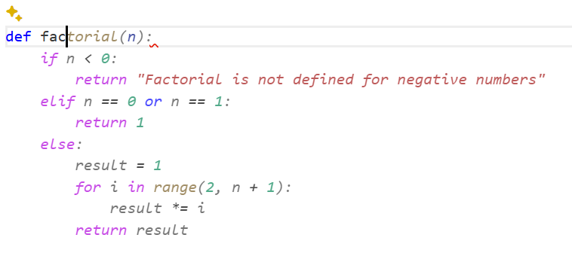
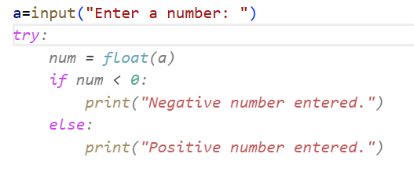
Slide Title
How AI-Based Code Completion Works
AI models like OpenAI Codex (used in GitHub Copilot) are trained on billions of lines of public code. They learn:
Common patterns
API usage
Code structures
When you start writing a piece of code, the model analyzes the current file, previous lines, and suggests the next likely line(s).

Slide 4
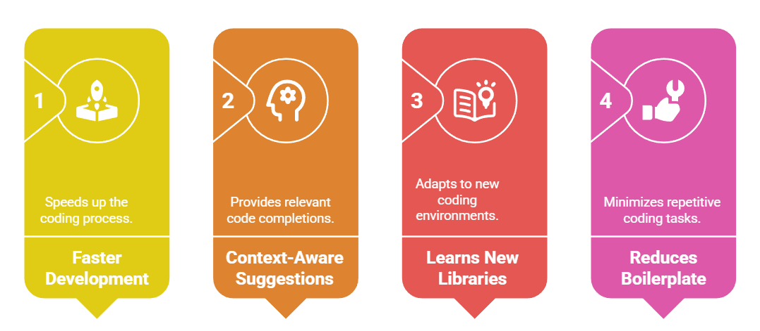
Slide Title
Benefits of AI-Based Code Completion
Notes:
🚀 Faster development
🧠 Context-aware suggestions
📚 Learns new libraries/frameworks easily
🛠️ Reduces boilerplate and repetitive code

Slide 5
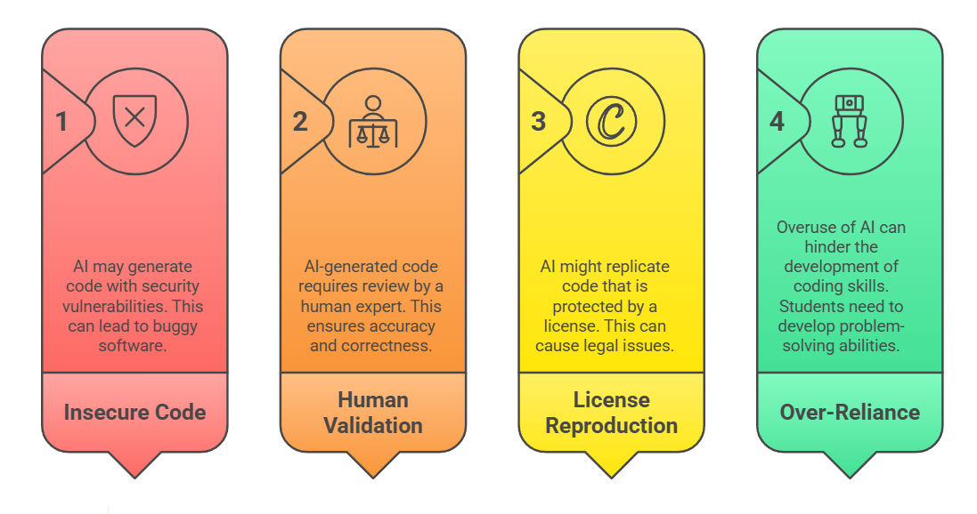
Slide Title
Challenges and Considerations
Notes:
❌ May suggest insecure or buggy code
⚖️ Needs human validation
📄 May accidentally reproduce licensed code
🤖 Becomes a crutch if overused—students must still learn to think like coders

Slide 6
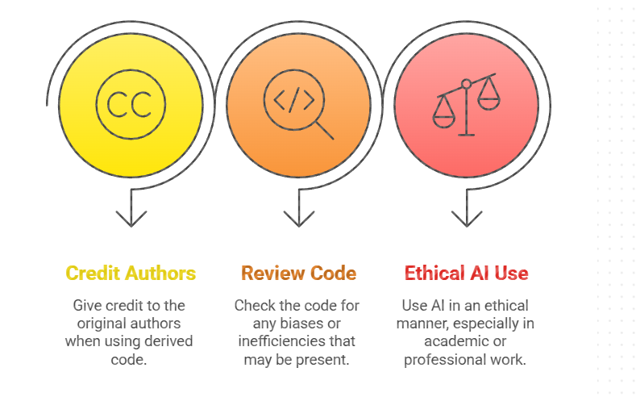
Slide Title
Ethical Considerations in AI Code Completion
Notes:
Credit original authors if code is derived
Review code for biases or inefficiencies
Use AI ethically, especially in academic work

Slide 7
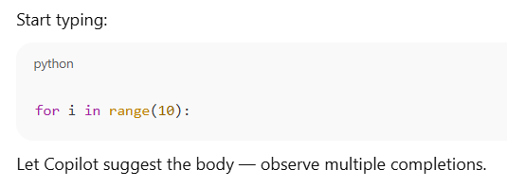
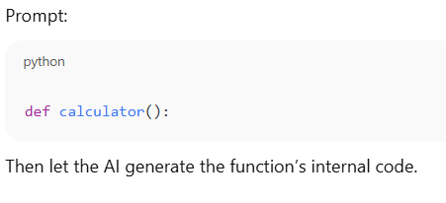
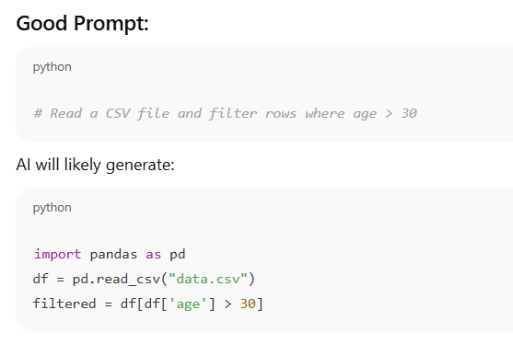
Slide Title
Tasks Based on Code Completion
Task 1: Python Loop
Task 2: BMI Calculator
Task 3: Prompt Engineering for Better Completion

Slide 8
Thank You

