Slide 1

School of Computer Science and AI, SR University
Course Code | Course Title | L | R | P | Cr
25CAI004PC206 | AI Assisted Coding | 0 | 0 | 4 | 2
Program Core
Documentation Génération: Automatic documentation and code comments
Lecture - 10
Introduction Factors How Doc. Generate Tutorial
Dr. Venkataramana Veeramsetty
Professor

Slide 2
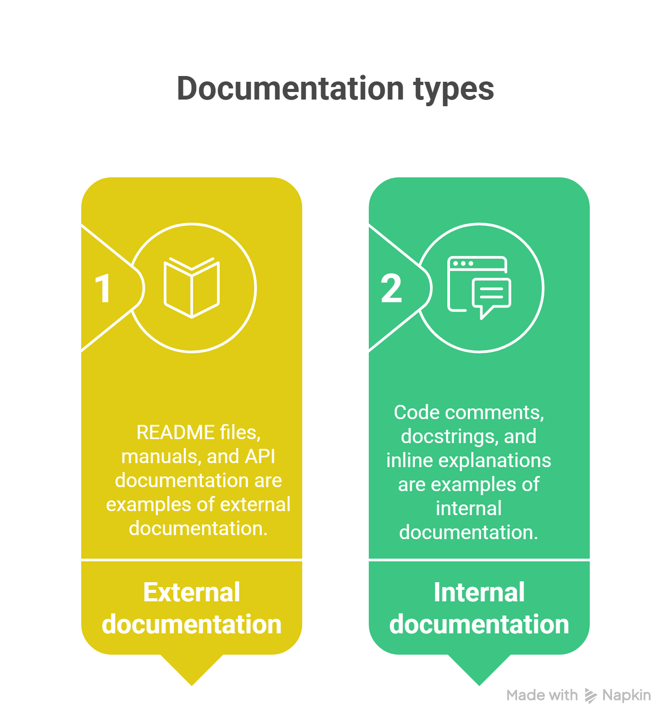
Slide Title
Introduction to Documentation in Coding
Documentation is the backbone of readable and maintainable code.
Good documentation explains what the code does, how to use it, and why certain decisions were made.
GitHub’s report from 2021 showed that sharing information in documentation can make teams up to 55% more productive.
Notes:
Good documentation helps to prevent guessing games and
keeps everyone on the same page. A survey from Stack
Overflow says that 68% of developers bump into these
knowledge roadblocks every week. Plus, GitHub’s report from
2021 showed that sharing information in documentation can
make teams up to 55% more productive.

Slide 3
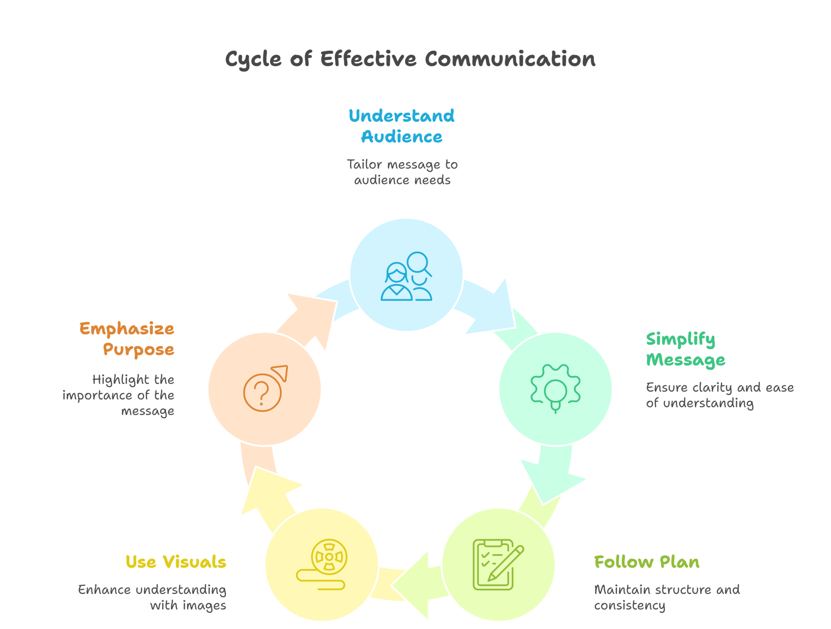
Slide Title
Factors – While Writing Prompt for Documentation
Notes:
Know your audience
Think about who’s going to use your docs. Are they
newbies looking for a guide to get started quickly, or are
they tech wizards needing the nitty-gritty details like API
docs and code snippets? Getting a bead on what your
readers need is key to hitting the mark with your content.
Keep it simple
Nobody likes to wade through jargon or tech-speak that
needs a decoder ring. Keep your words straightforward and
to the point. If your grandparent couldn’t get it, you’re
probably not there yet.
Stick to the plan
Keep your docs looking familiar. Use the same style,
headings, fonts…you name it. Consistency is your friend.
It’s like having a good rhythm in a song. It just flows
better.
The why matters as much as the how
Don’t just lay out the steps. Tell your readers why they’re
doing what they’re doing.
Show, don’t just tell
People understand things faster when they see it in action.
So, throw in real-life examples or scenarios. If you’re
talking to coders, some code examples are gold. For
others, screenshots or step-by-step walkthroughs can be
helpful.
A picture is worth a thousand words
Sometimes, text just doesn’t cut it. Use diagrams,
screenshots, or even videos to get your point across,
especially when you’re dealing with complex stuff.

Slide 4
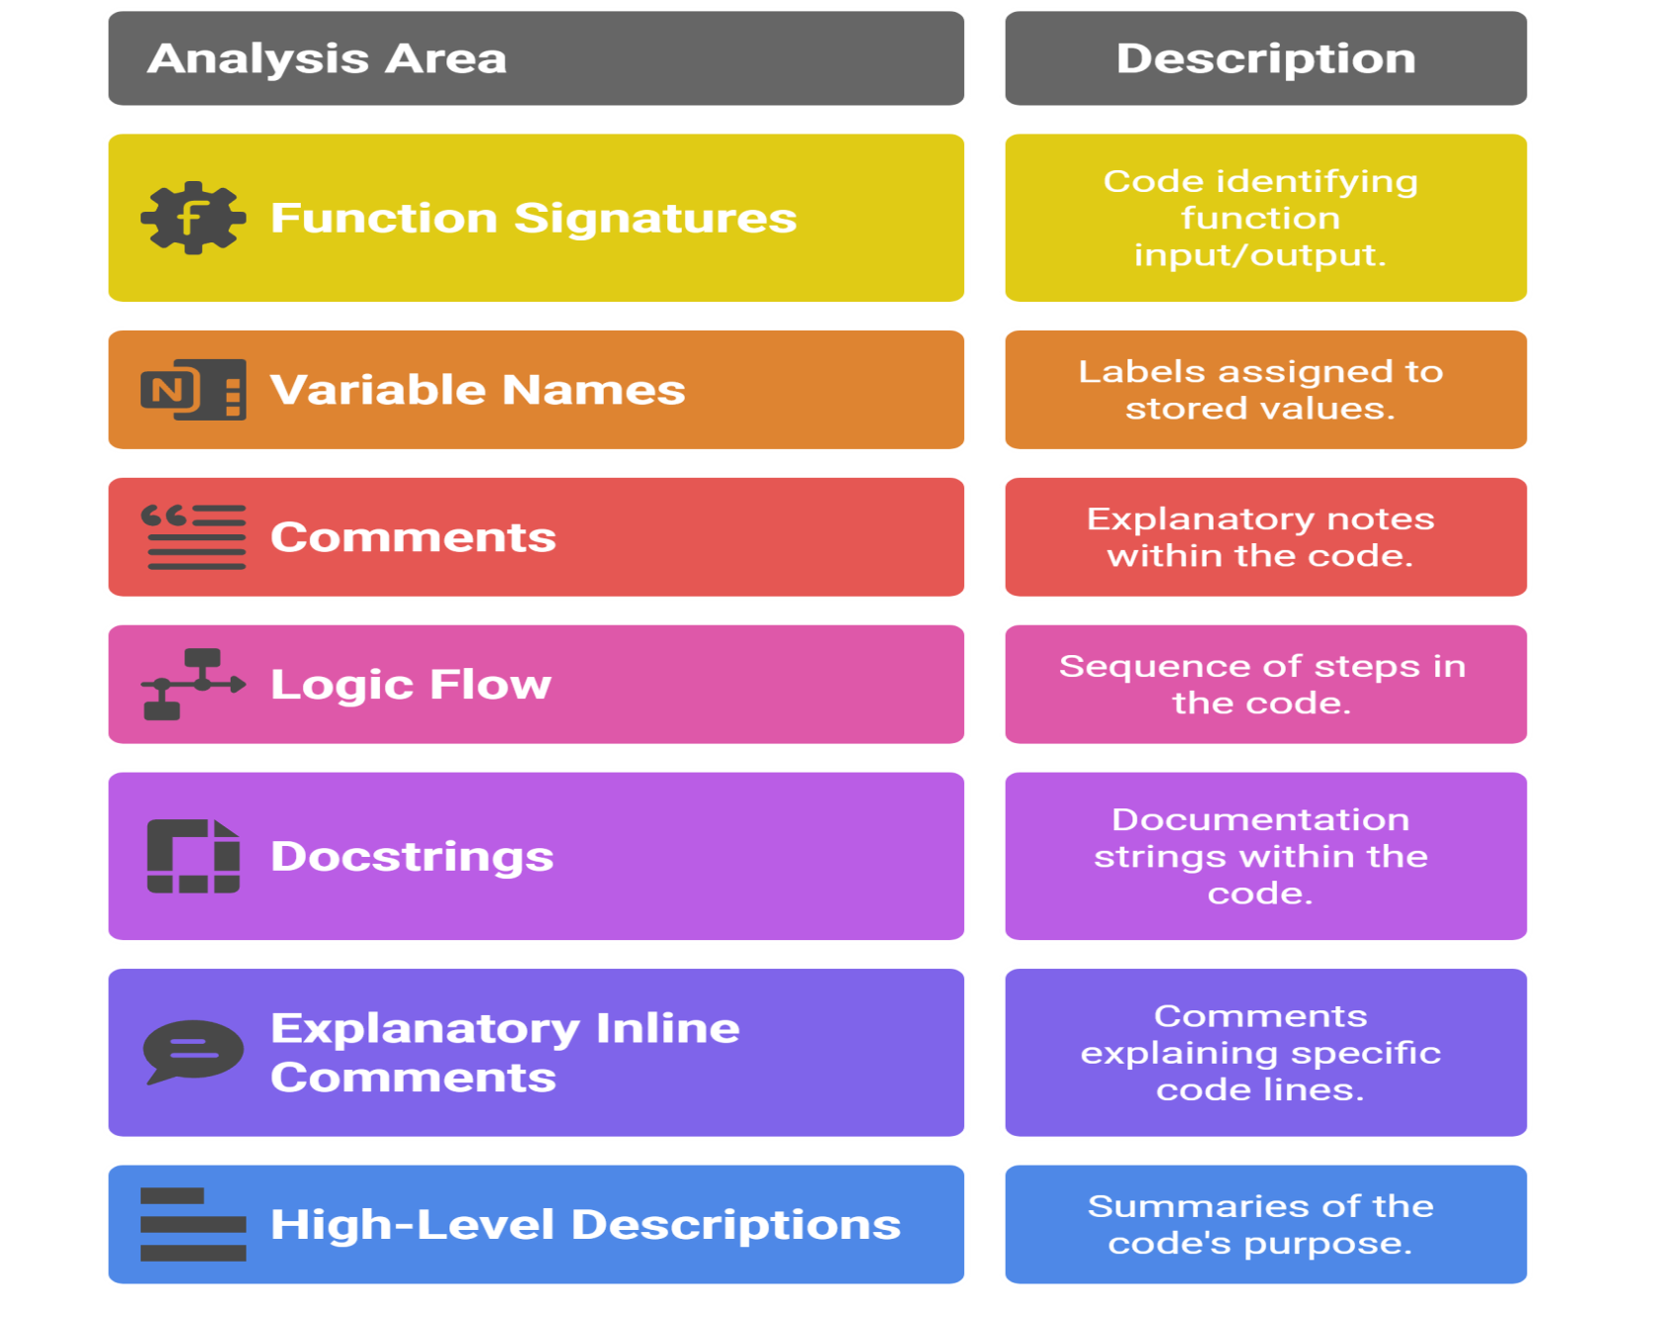
Slide Title
How AI Generates Documentation
Notes:
AI tools analyze:
Function signatures
Variable names
Comments
Logic flow
They then use patterns and training data to generate:
Docstrings (""" """)
Explanatory inline comments
High-level descriptions

Slide 5
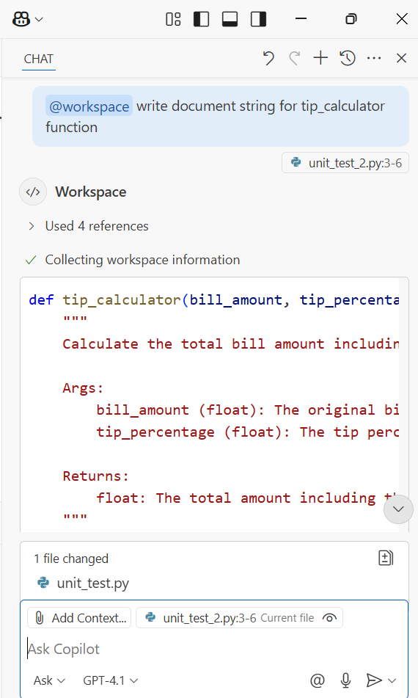
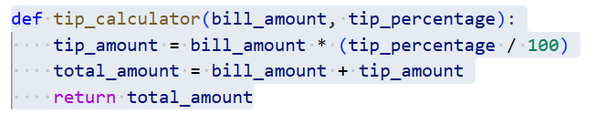
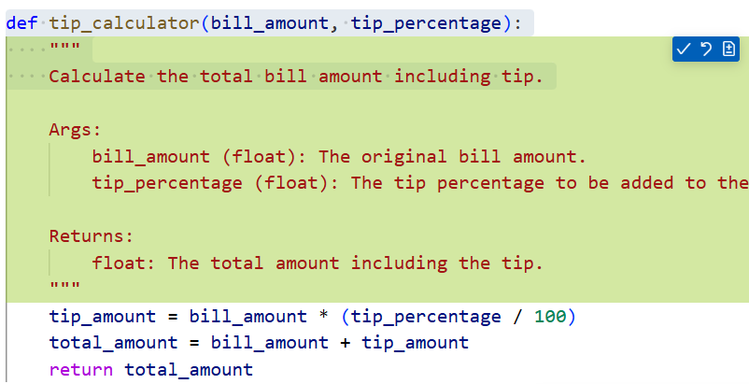
Slide Title
GitHub Copilot - Chatbox

Slide 6
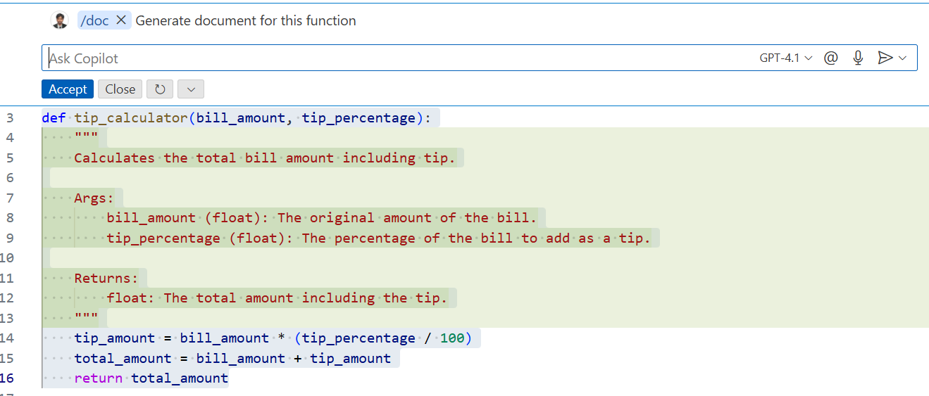
Slide Title
GitHub Copilot - In line

Slide 7
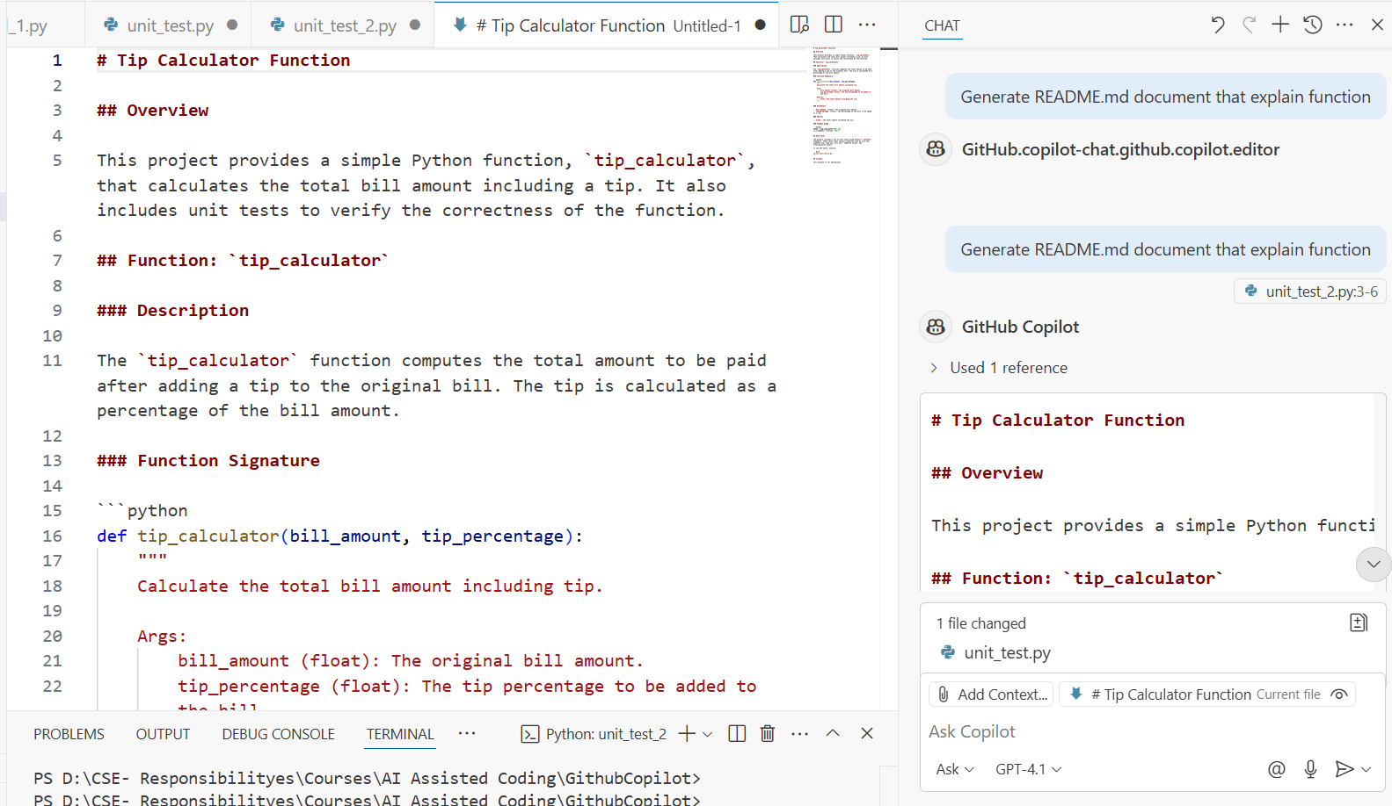
Slide Title
GitHub Copilot - Readme.md
Notes:
AI tools analyze:
Function signatures
Variable names
Comments
Logic flow
They then use patterns and training data to generate:
Docstrings (""" """)
Explanatory inline comments
High-level descriptions

Slide 8
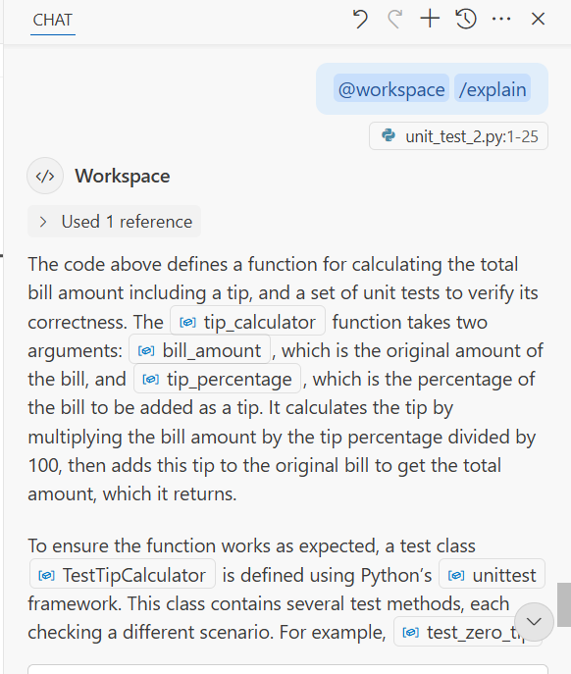
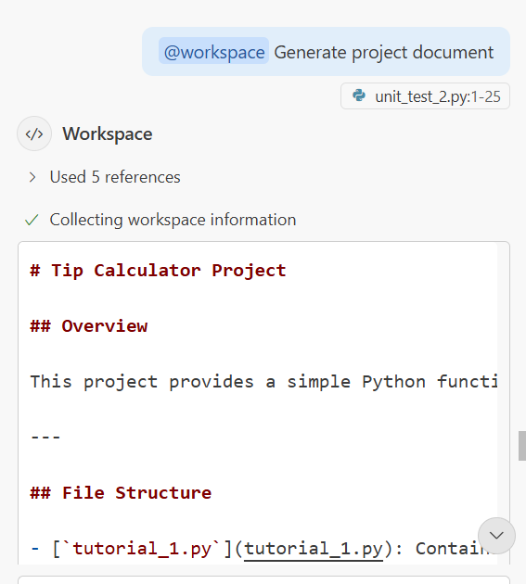
Slide Title
GitHub Copilot - Explain and Document
Notes:
AI tools analyze:
Function signatures
Variable names
Comments
Logic flow
They then use patterns and training data to generate:
Docstrings (""" """)
Explanatory inline comments
High-level descriptions

Slide 9
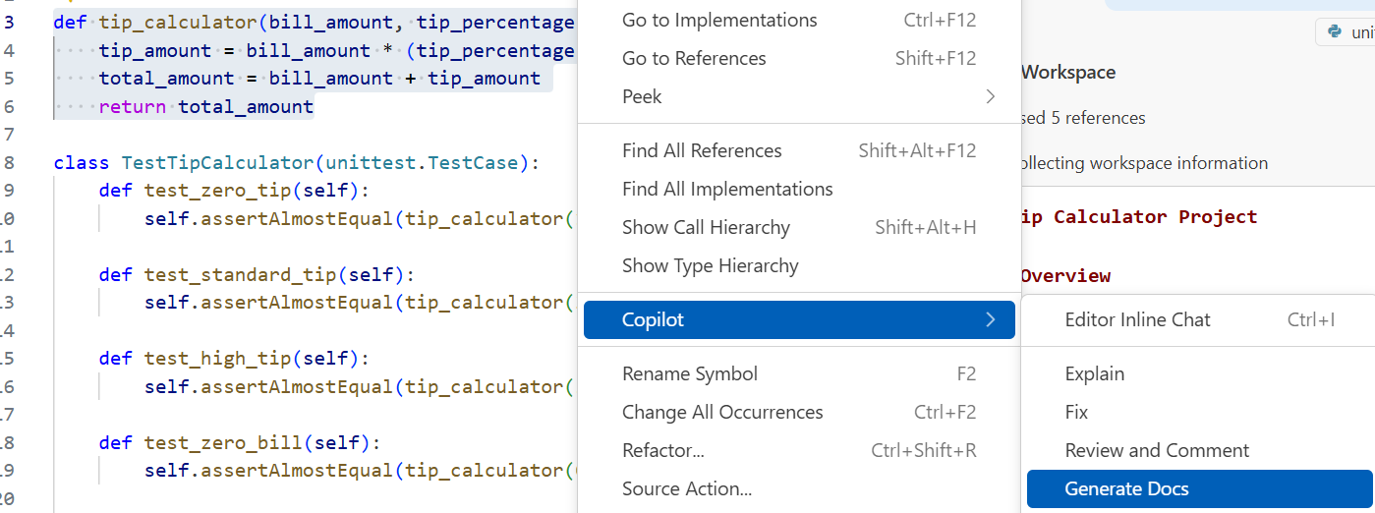
Slide Title
GitHub Copilot - Generate Document
Notes:
AI tools analyze:
Function signatures
Variable names
Comments
Logic flow
They then use patterns and training data to generate:
Docstrings (""" """)
Explanatory inline comments
High-level descriptions

Slide 10
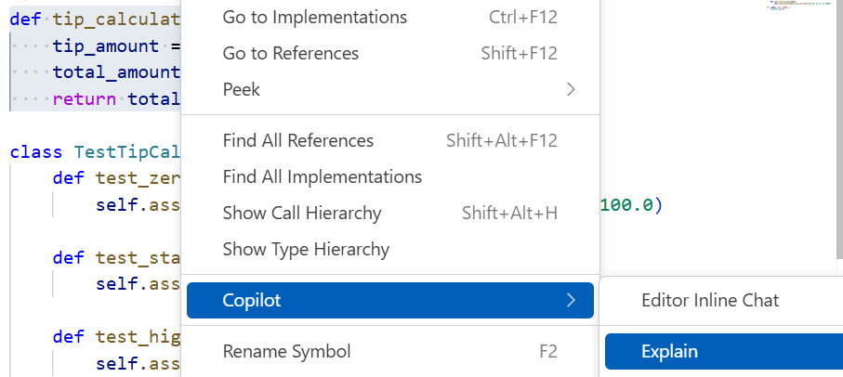
Slide Title
GitHub Copilot - Code Explain

Slide 11
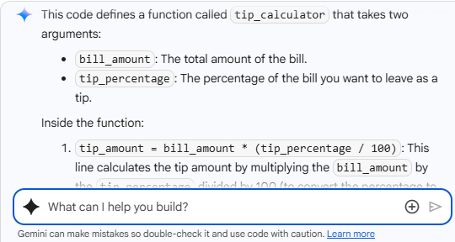
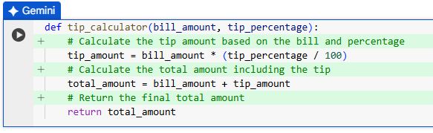
Slide Title
Colab - Code Explain

Slide 12
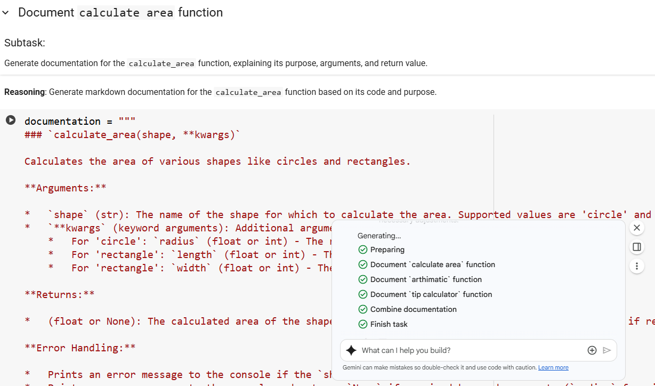
Slide Title
Colab – Document Generation

Slide 13
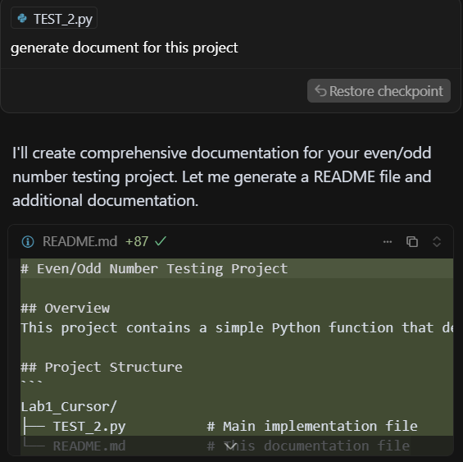
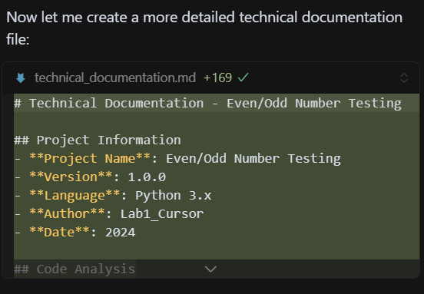
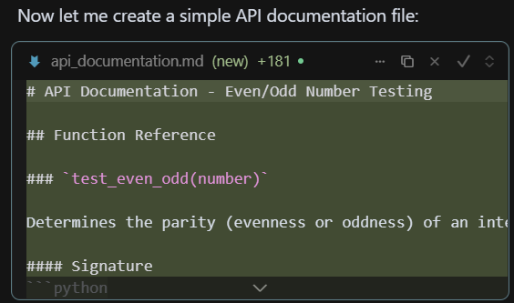
Slide Title
Cursor AI – Document Generation

Slide 14
Thank You

