Slide 1

School of Computer Science and AI, SR University
Course Code | Course Title | L | R | P | Cr
25CAI004PC206 | AI Assisted Coding | 0 | 0 | 4 | 2
Program Core
Prompt Engineering
Lecture - 2
Prompt Engineering? Communication with LLM Challenges Components Best Practices Hallucinations Key Principles Context Management Use Cases Lab Activites
Dr. Venkataramana Veeramsetty
Professor

Slide 2
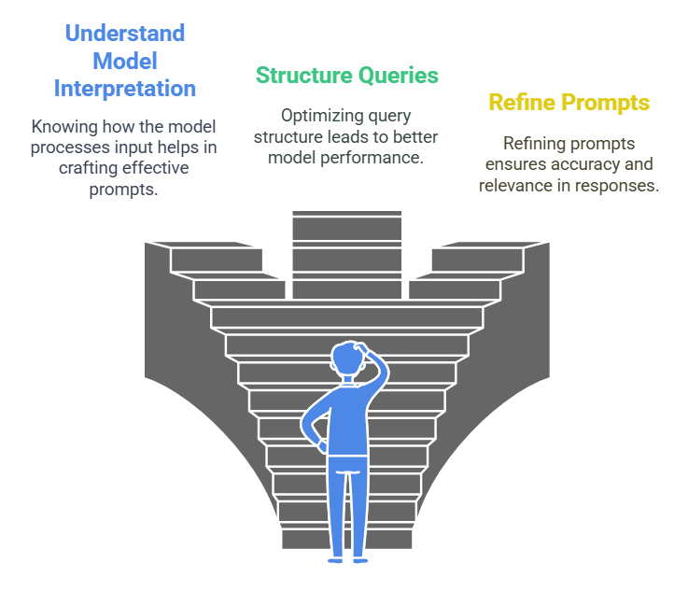
Slide Title
What is Prompt Engineering
Prompt engineering is the practice of designing and refining inputs (prompts) to get the most accurate, relevant, or creative responses from AI language models like ChatGPT, Claude, or Gemini.
It involves understanding how the model interprets input and how to best structure queries to optimize performance.
Notes:
🔹 Key Principles of Prompt Engineering
Clarity: Use clear, unambiguous language. Be specific about what you want the model to do.
Contextual Framing: Provide relevant background, goals, and constraints. More context leads to better outputs.
Instruction-Based Prompts: Give direct instructions like “Summarize this text in 100 words” or “Write a Python function to normalize data.”
Few-shot/Zero-shot Examples:
Zero-shot: "Translate to French: Hello"
Few-shot: Providing examples before asking the model to continue or generate a similar response.
Role-based Prompts: Assign roles to guide behavior (e.g., “You are an expert Python tutor…”).

Slide 3
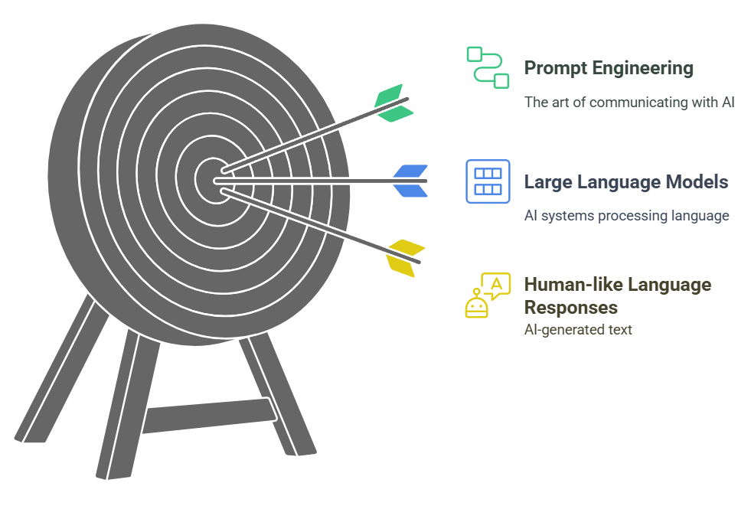
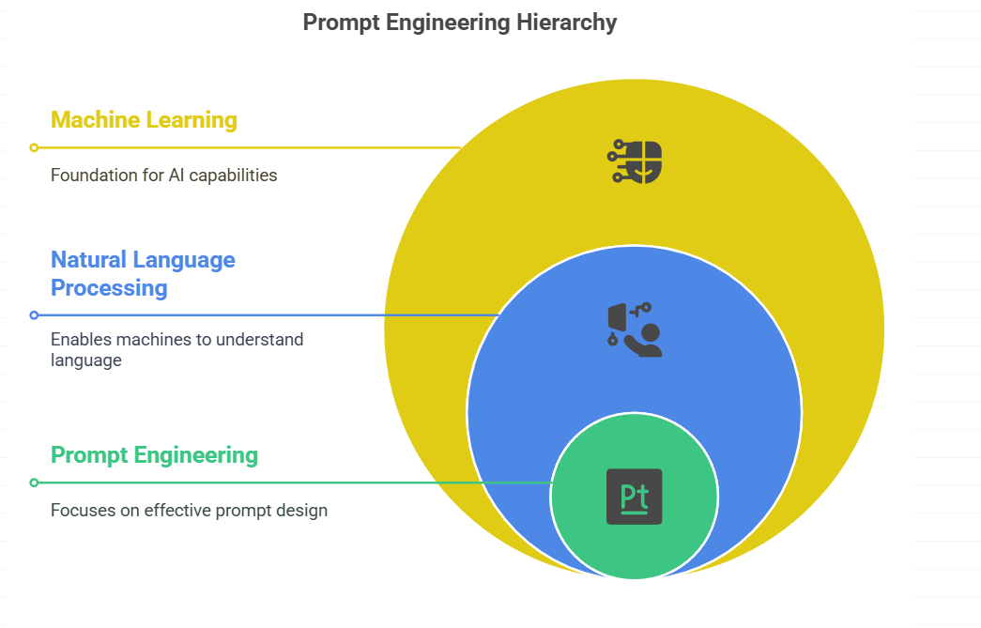
Slide Title
What is Prompt Engineering
Prompt Engineering enabling computers to understand and interpret human language.
Notes:
Prompt engineering is a subfield of machine learning and natural language processing.
Prompt Engineering enabling computers to understand and interpret human language.
The main goal of Prompt Engineering is to figure out how to talk to large language models, Sophisticated AI systems designed to process and generate human-like language responses

Slide 4
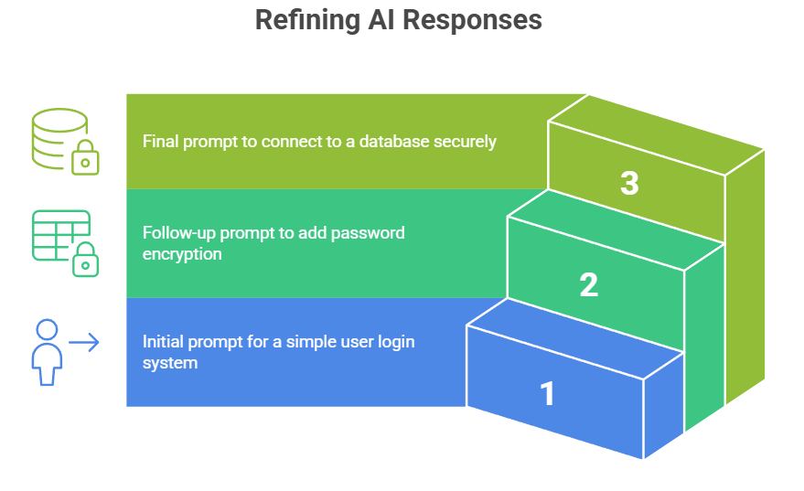
Slide Title
How We Communicate with LLMs
When you ask someone for advice, you’ve got to give them a bit of context
Drop some hints or extra information in your question to make sure the LLM gets what you’re asking
Some times need whole conversation with LLM
According to data from Willis Towers Watson,
the average yearly earnings of a prompt engineer around
$130,000
To develop a web application

Slide 5
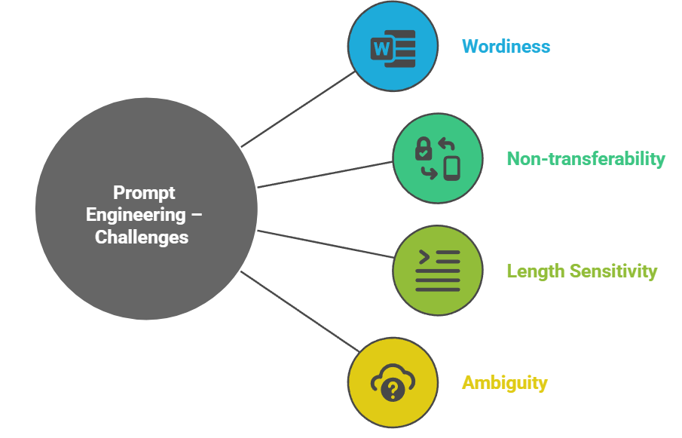
Slide Title
Prompt Engineering - Challenges
Notes:
Wordiness
LLMs can be chatterboxes. Give them a prompt, and they might just run with it, giving you a wordy response when all you wanted was a quick answer. They have a tendency to throw in a bunch of related ideas or facts, making the response longer than necessary. If you’d like an LLM to
get straight to the point, just ask it to be “concise.”
Non-transferability
This means that a prompt that works nicely with one LLM might not be as effective with another. In other words, if you’re switching from ChatGPT to Gemini or GitHub Copilot, you might need to tweak your prompts due to the unique training, design, and specialization of each LLM.
Different models are trained on different datasets and algorithms, leading to distinct understandings and interpretations of prompts.
Length sensitivity
LLMs can get overwhelmed by long prompts and start to overlook or misinterpret parts of your input. It’s as if the LLM’s attention span falters and its responses become somewhat distracted. This is why you should avoid providing detailed requirements in your prompts; keep a prompt to less than a page.
Ambiguity
If your prompt is unclear, the LLM might get confused and serve up responses that are way off base or just plain make-believe. Clarity is key.

Slide 6
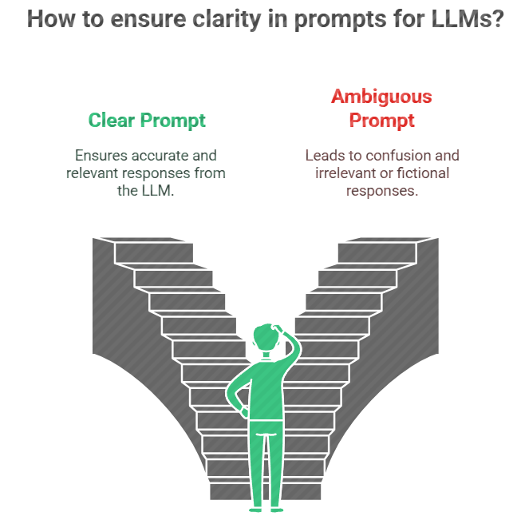
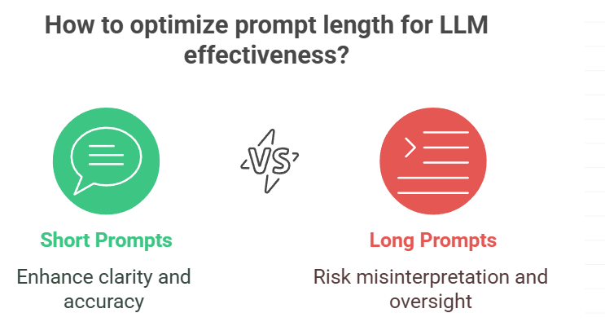
Slide Title
Prompt Engineering – Challenges
Length sensitivity and Ambiguity
Notes:
Length sensitivity
LLMs can get overwhelmed by long prompts and start to overlook or misinterpret parts of your input. Keep a prompt to less than a page.
Ambiguity
If your prompt is unclear, the LLM might get confused and serve up responses that are way off base or just plain make-believe. Clarity is key.

Slide 7
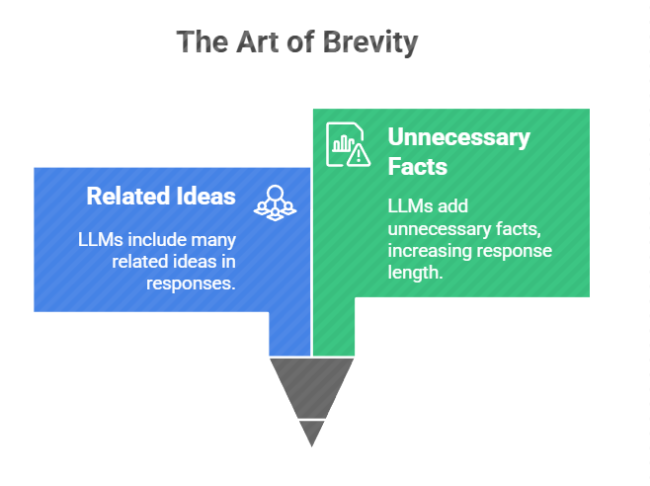
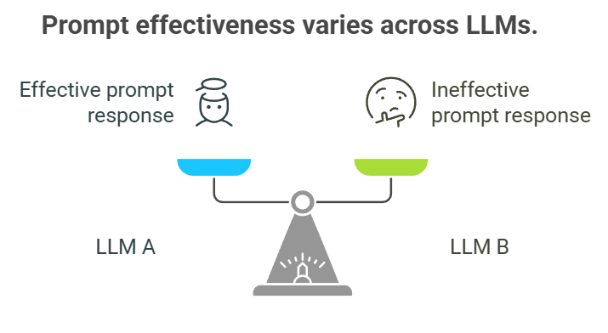
Slide Title
Prompt Engineering – Challenges
Wordiness and
Notes:
Wordiness
LLMs have a tendency to throw in a bunch of related ideas or facts, making the response longer than necessary.

Slide 8
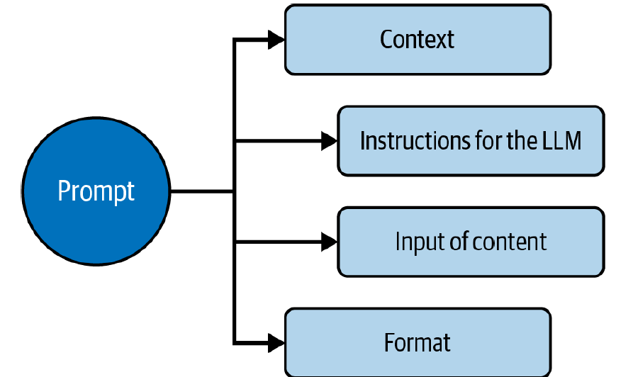
Slide Title
Prompt - Components

Slide 9
Slide Title
Prompt - Components
Context
You’ll often begin your prompt with a sentence or two that provide context.
This leads to responses that are not only more accurate but also contextually relevant, ensuring a more meaningful result.
Context-1: if you want to debug a piece of code, you might use this as the context
Prompt: You are an experienced software engineer specializing in debugging Java applications
Context-2: you want to learn about optimization techniques for a particular algorithm
Prompt: You are a senior software developer with expertise in algorithm optimization.

Slide 10
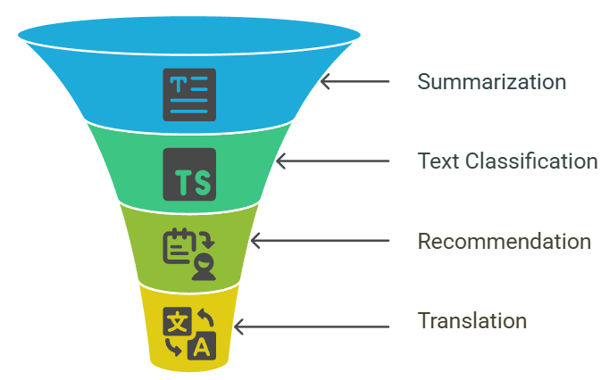
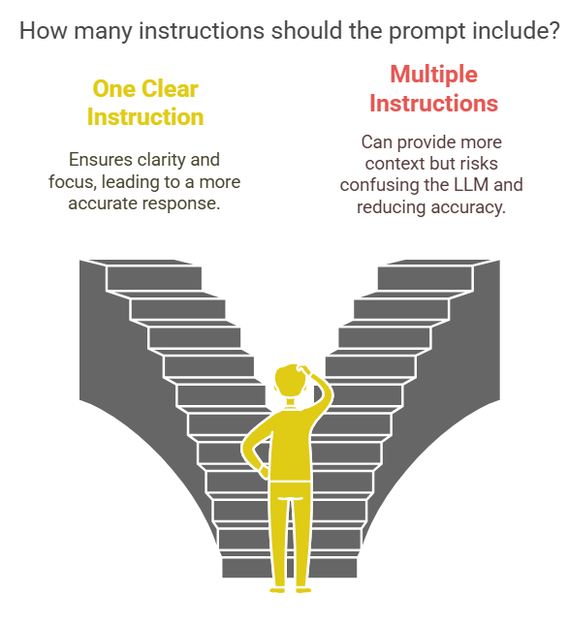
Slide Title
Prompt - Components
Instructions
Instead of throwing a whole list of questions at the LLM all at once, try breaking them down into a series of smaller prompts.
It’s like having a back-and-forth chat instead of Delivering a monologue.
Notes:
Your prompt should include at least one clear instruction.
There’s nothing stopping you from adding more instructions,
but you need to be careful. Loading up your prompt with a
bunch of queries can throw the LLM for a loop and make it
harder to get the answer you’re looking for.
Let’s break down why that happens. First off, when you have
multiple instructions, things can get a bit fuzzy. If they’re not
clear or if they seem to clash with each other, the LLM might
get confused about which one to focus on or how to balance
them all out.
Next, having more instructions means more for the LLM to
juggle. It’s got to process and understand each part of your
prompt and then figure out how to weave all the parts into a
coherent response. That’s a lot of mental gymnastics, and
sometimes it can lead to mistakes or answers that are off.
And don’t forget, LLMs go through instructions one at a time,
in order. So, the way you line up those queries can influence
how they’re interpreted and what kind of answer you get back.
Given all this, a pro tip is to keep it simple. Instead of
throwing a whole list of questions at the LLM all at once, try
breaking them down into a series of smaller prompts. It’s like
having a back-and-forth chat instead of delivering a
monologue.
There are also numerous types of instructions for a prompt. In
the next few sections, we’ll discuss some of the main
instructions used in software development.

Slide 11
Slide Title
Summarization
Summarization can condense a longer piece of text into a shorter version while keeping the main ideas and points intact.
Use case: Code documentation
Description: Provides a concise overview of extensive documentation highlighting key functionalities, dependencies, and structures.
Example Prompt: Summarize the main points of the following documentation to provide a quick overview of the codebase
Use case: Bug reports
Description: Quickly identifies the main issues reported by users in numerous or lengthy
bug reports..
Example Prompt: Summarize the common issues reported in the following bug reports to identify the main problems to be addressed

Slide 12
Slide Title
Summarization
Use case: Research papers
Description: Extracts insights from lengthy research papers or technical articles to update the user on the latest research or technologies.
Example Prompt: Provide a summary of the key findings and technologies discussed in the
following research paper
Use case: Change logs
Description: Enables an understanding of the key changes in a new version of a software
library or tool from lengthy change logs.
Example Prompt: Summarize the key changes in the following change log of version 1.1.2
Use case: Email threads
Description: Extracts the key points of discussions or decisions from long email threads.
Example Prompt: Summarize the main points of discussion from the following email thread

Slide 13
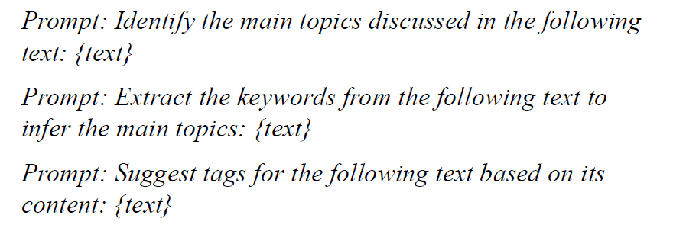
Slide Title
Summarization
Use case: Topic Modeling
Description: Discovers the abstract “topics” that occur in a collection of documents.
Example Prompt:

Slide 14
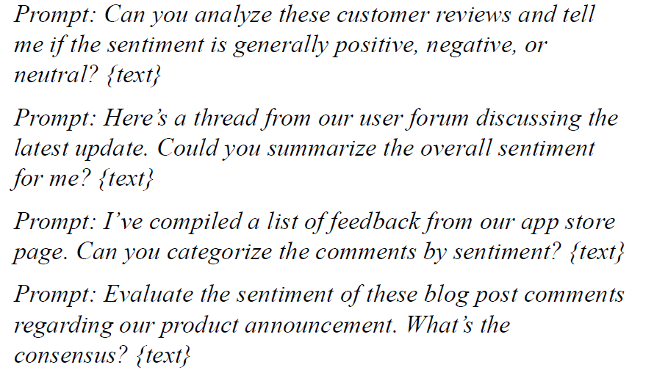
Slide Title
Text Classification
Text classification involves giving a computer a bunch of text that it learns to tag with labels.
For developers, sentiment analysis can be a useful tool to gauge user feedback about an application

Slide 15
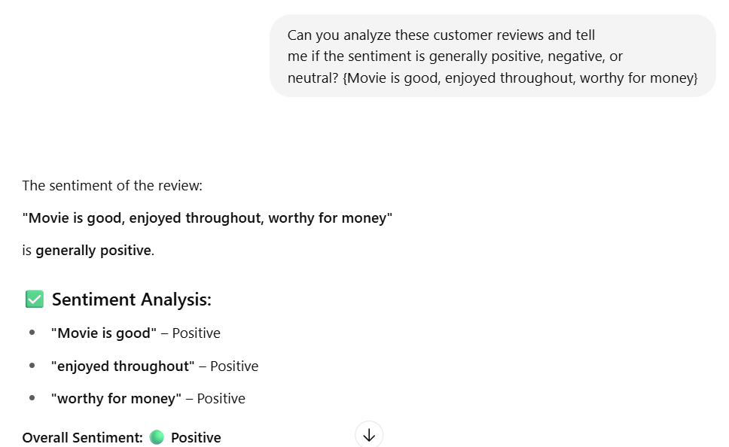
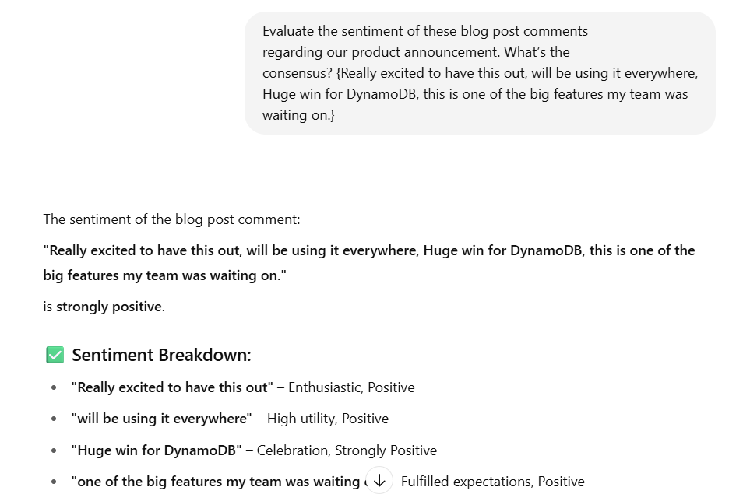
Slide Title
Text Classification
https://aws.amazon.com/blogs/aws/build-the-highest-resilience-apps-with-multi-region-strong-consistency-in-amazon-dynamodb-global-tables/

Slide 16
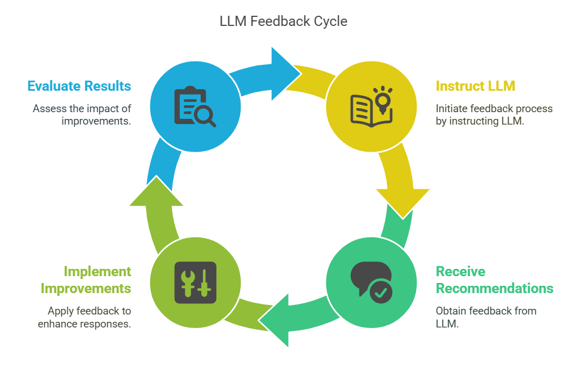
Slide Title
Recommendation
You can instruct an LLM to provide recommendations.
Developers can use such feedback to improve the caliber of responses for activities like squashing bugs, refining code, or using APIs more effectively.
LLM recommendations can be a powerful accelerator for your work, greatly saving time and providing ideas you may not have thought about
If anything, recommendations are a way to kick things off. Do some more digging on your own to get the full picture.

Slide 17
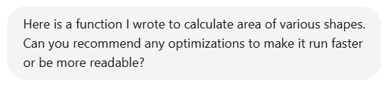
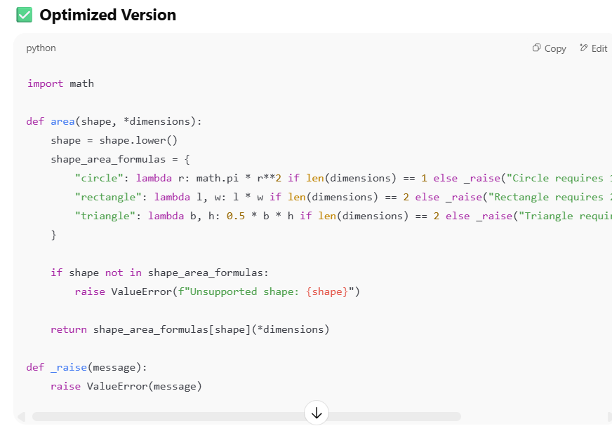
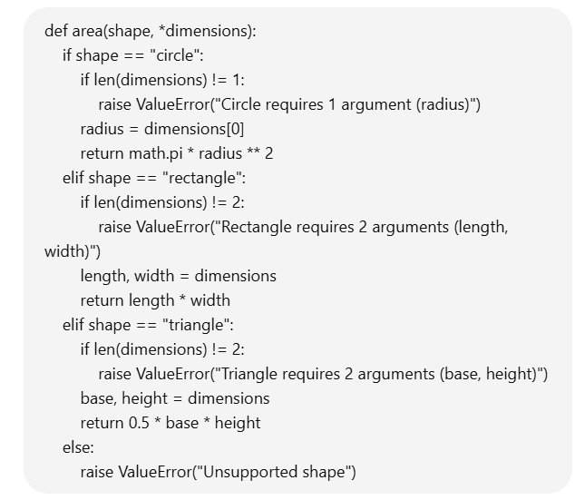
Slide Title
Recommendation

Slide 18
Slide Title
Translation
Localization allows software to speak the local language. users are happier as the software feels tailor-made for them
Localization can be both expensive and time intensive. It requires meticulous quality assurance to maintain the software’s integrity in different languages
Use case-1: Documentation translation
Description: Translates user guides, help files, and other documentation.
Example Prompt: Translate the following user manual paragraph into Spanish.
Use case-2: Error message Translation
Description: Translates error messages that the software might generate.
Example Prompt: Translate the following error messages into German: File not found, Access denied, Network connection lost

Slide 19
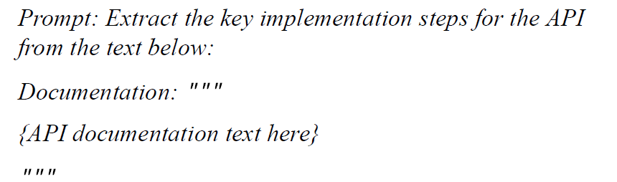
Slide Title
Prompt - Components
Input of Content
When crafting prompts, it’s helpful to use special symbols like ### or """ to clearly separate your instructions from the content or information you want the LLM to work on.

Slide 20
Slide Title
Prompt - Components
Format
Format Type: Table
Example Prompt: Create a table comparing the syntax, performance, and use cases of Python, Java, and C++.
Format Type: List
Example Prompt: List the steps to troubleshoot a slow loading web page.
Format Type: Markdown/HTML
Example Prompt: Explain the differences between GET and POST HTTP methods in Markdown
Format Type: LaTeX
Example Prompt: Express the time complexity of the binary search algorithm in LaTeX notation

Slide 21
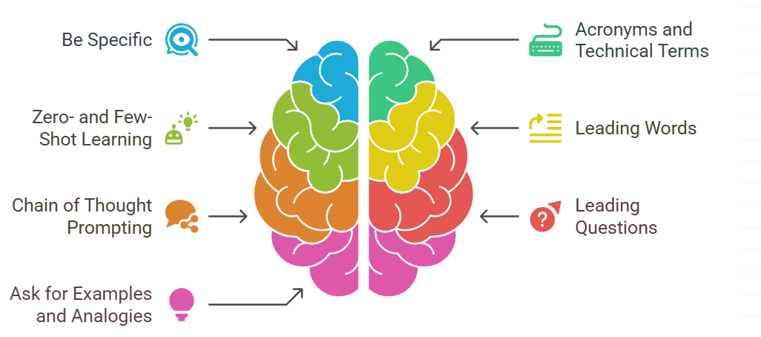
Slide Title
Prompt Engineering – Best Practices

Slide 22
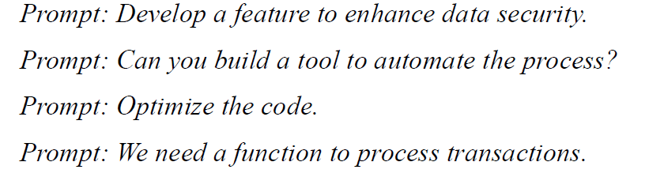
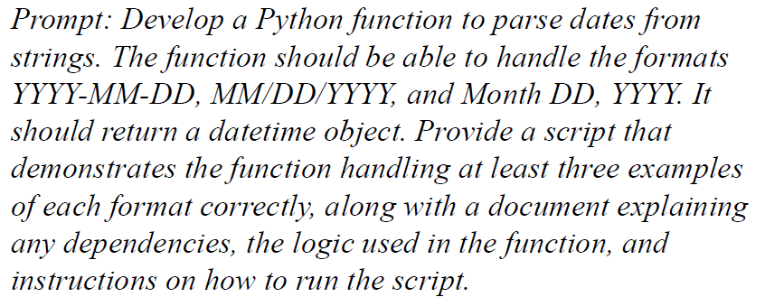
Slide Title
Prompt Engineering – Best Practices – Be Specific
Notes:
Prompt: Develop a SQL query to retrieve from our database
a list of customers who made purchases above $500 in the
last quarter of 2023. The query should return the customer’s
full name, their email address, the total amount spent, and
the date of their last purchase. The results should be sorted
by the total amount spent in descending order. Please
ensure that the query is optimized for performance

Slide 23
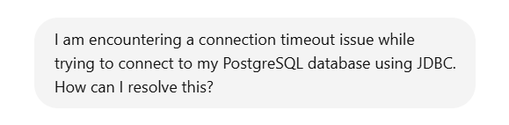

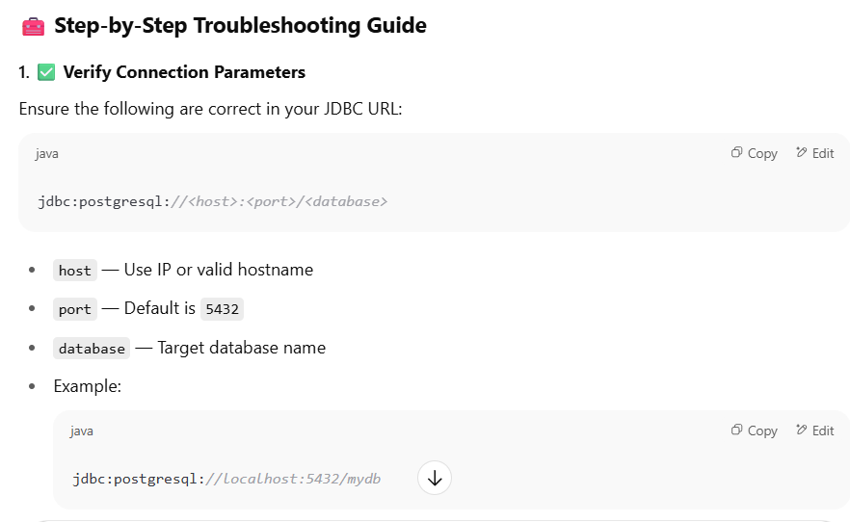
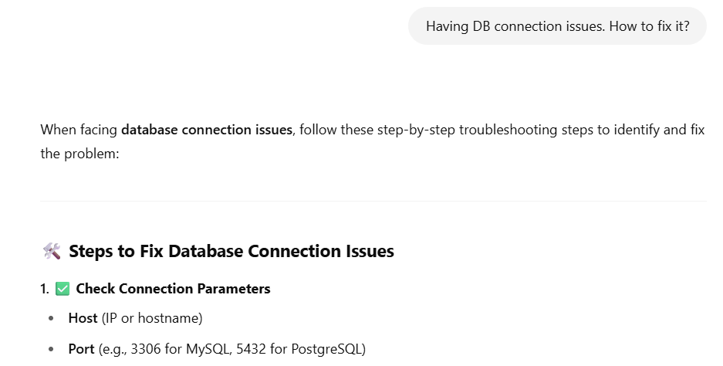
Slide Title
Prompt Engineering – Best Practices – Acronyms and Technical Terms
It’s crucial to be clear with technical terms and acronyms while drafting a prompt. This ambiguity often means different things in different contexts and can lead to unhelpful responses.

Slide 24



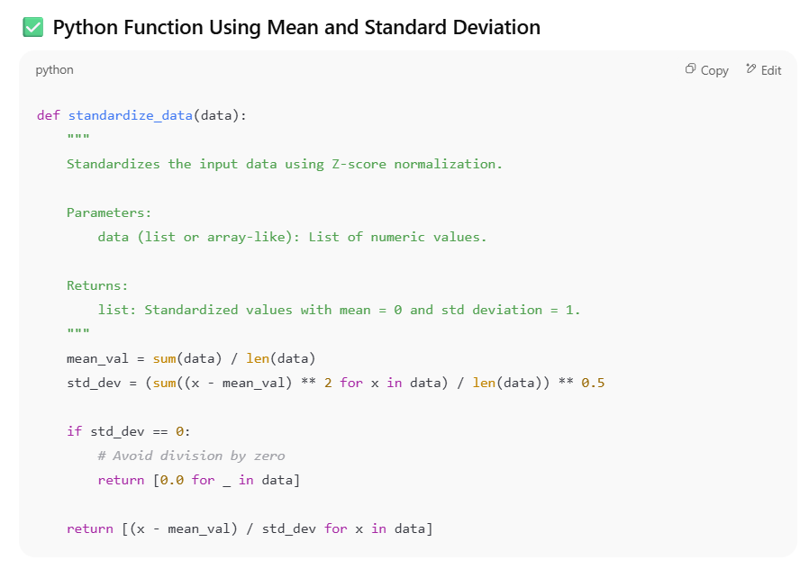
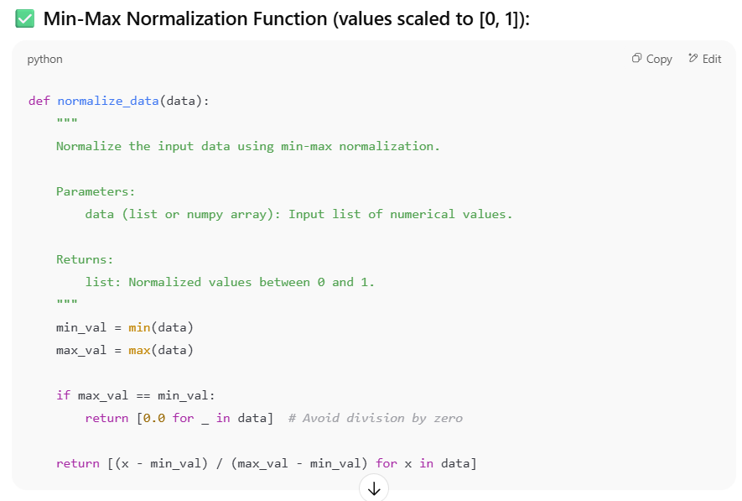
Slide Title
Prompt Engineering – Best Practices – Zero Shot and Few Shots Learning
With zero-shot learning, you provide one prompt and get the answer you want.

Slide 25
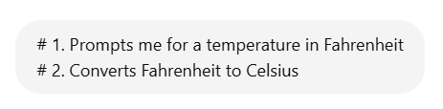

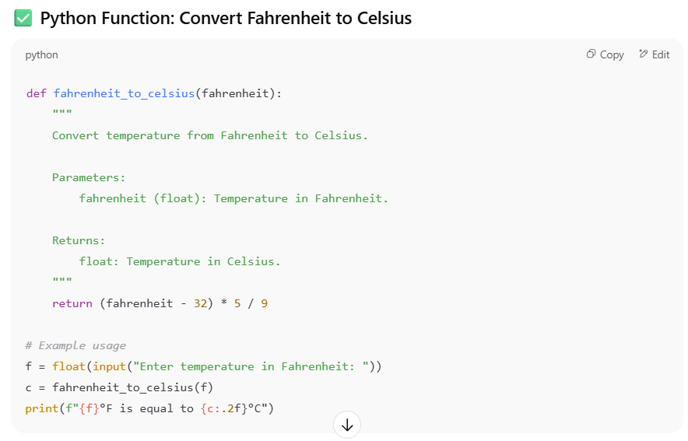
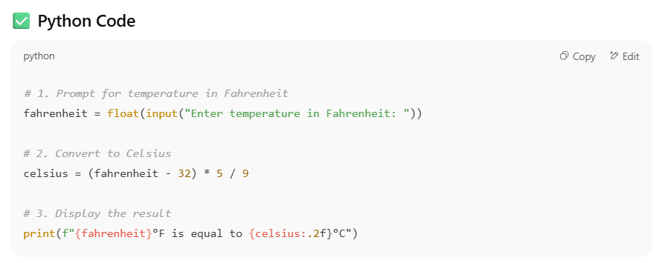
Slide Title
Prompt Engineering – Best Practices – Leading Words

Slide 26
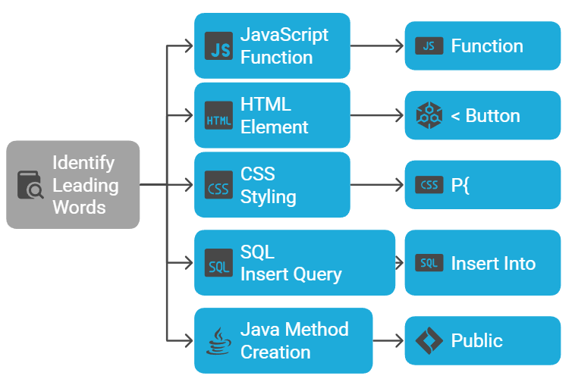
Slide Title
Prompt Engineering – Best Practices – Leading Words

Slide 27
Slide Title
Prompt Engineering – Best Practices – Chain of Thoughts (CoT)
It is Similar to Few Shots Learning
Action description -1: Understand the requirement
Example Prompt: I need to create a web application using Flask. The application should have a user registration and login functionality. Where should I start?.
Action description -2: Set up Flask application
Example Prompt: Let’s begin by setting up a basic Flask application. How can I do that?.
Action description -3: Create user model
Example Prompt: Now that the Flask application is set up, I need to create a user model for handling registration and login. How should I structure this model?.

Slide 28
Slide Title
Prompt Engineering – Best Practices – Chain of Thoughts (CoT)
Action description -4: Implement registration
Example Prompt: With the user model in place, how can I implement a registration page with the necessary fields?
Action description - 5: Implement login
Example Prompt: Now let’s move on to creating a login page. How can I ensure secure login?
Action description -6: Session management
Example Prompt: After a user logs in, how should I manage user sessions to keep users logged in as they navigate through the app?
Action description -7: Logout implementation
Example Prompt: Finally, how can I implement a logout function to securely log users out of the
application?”

Slide 29
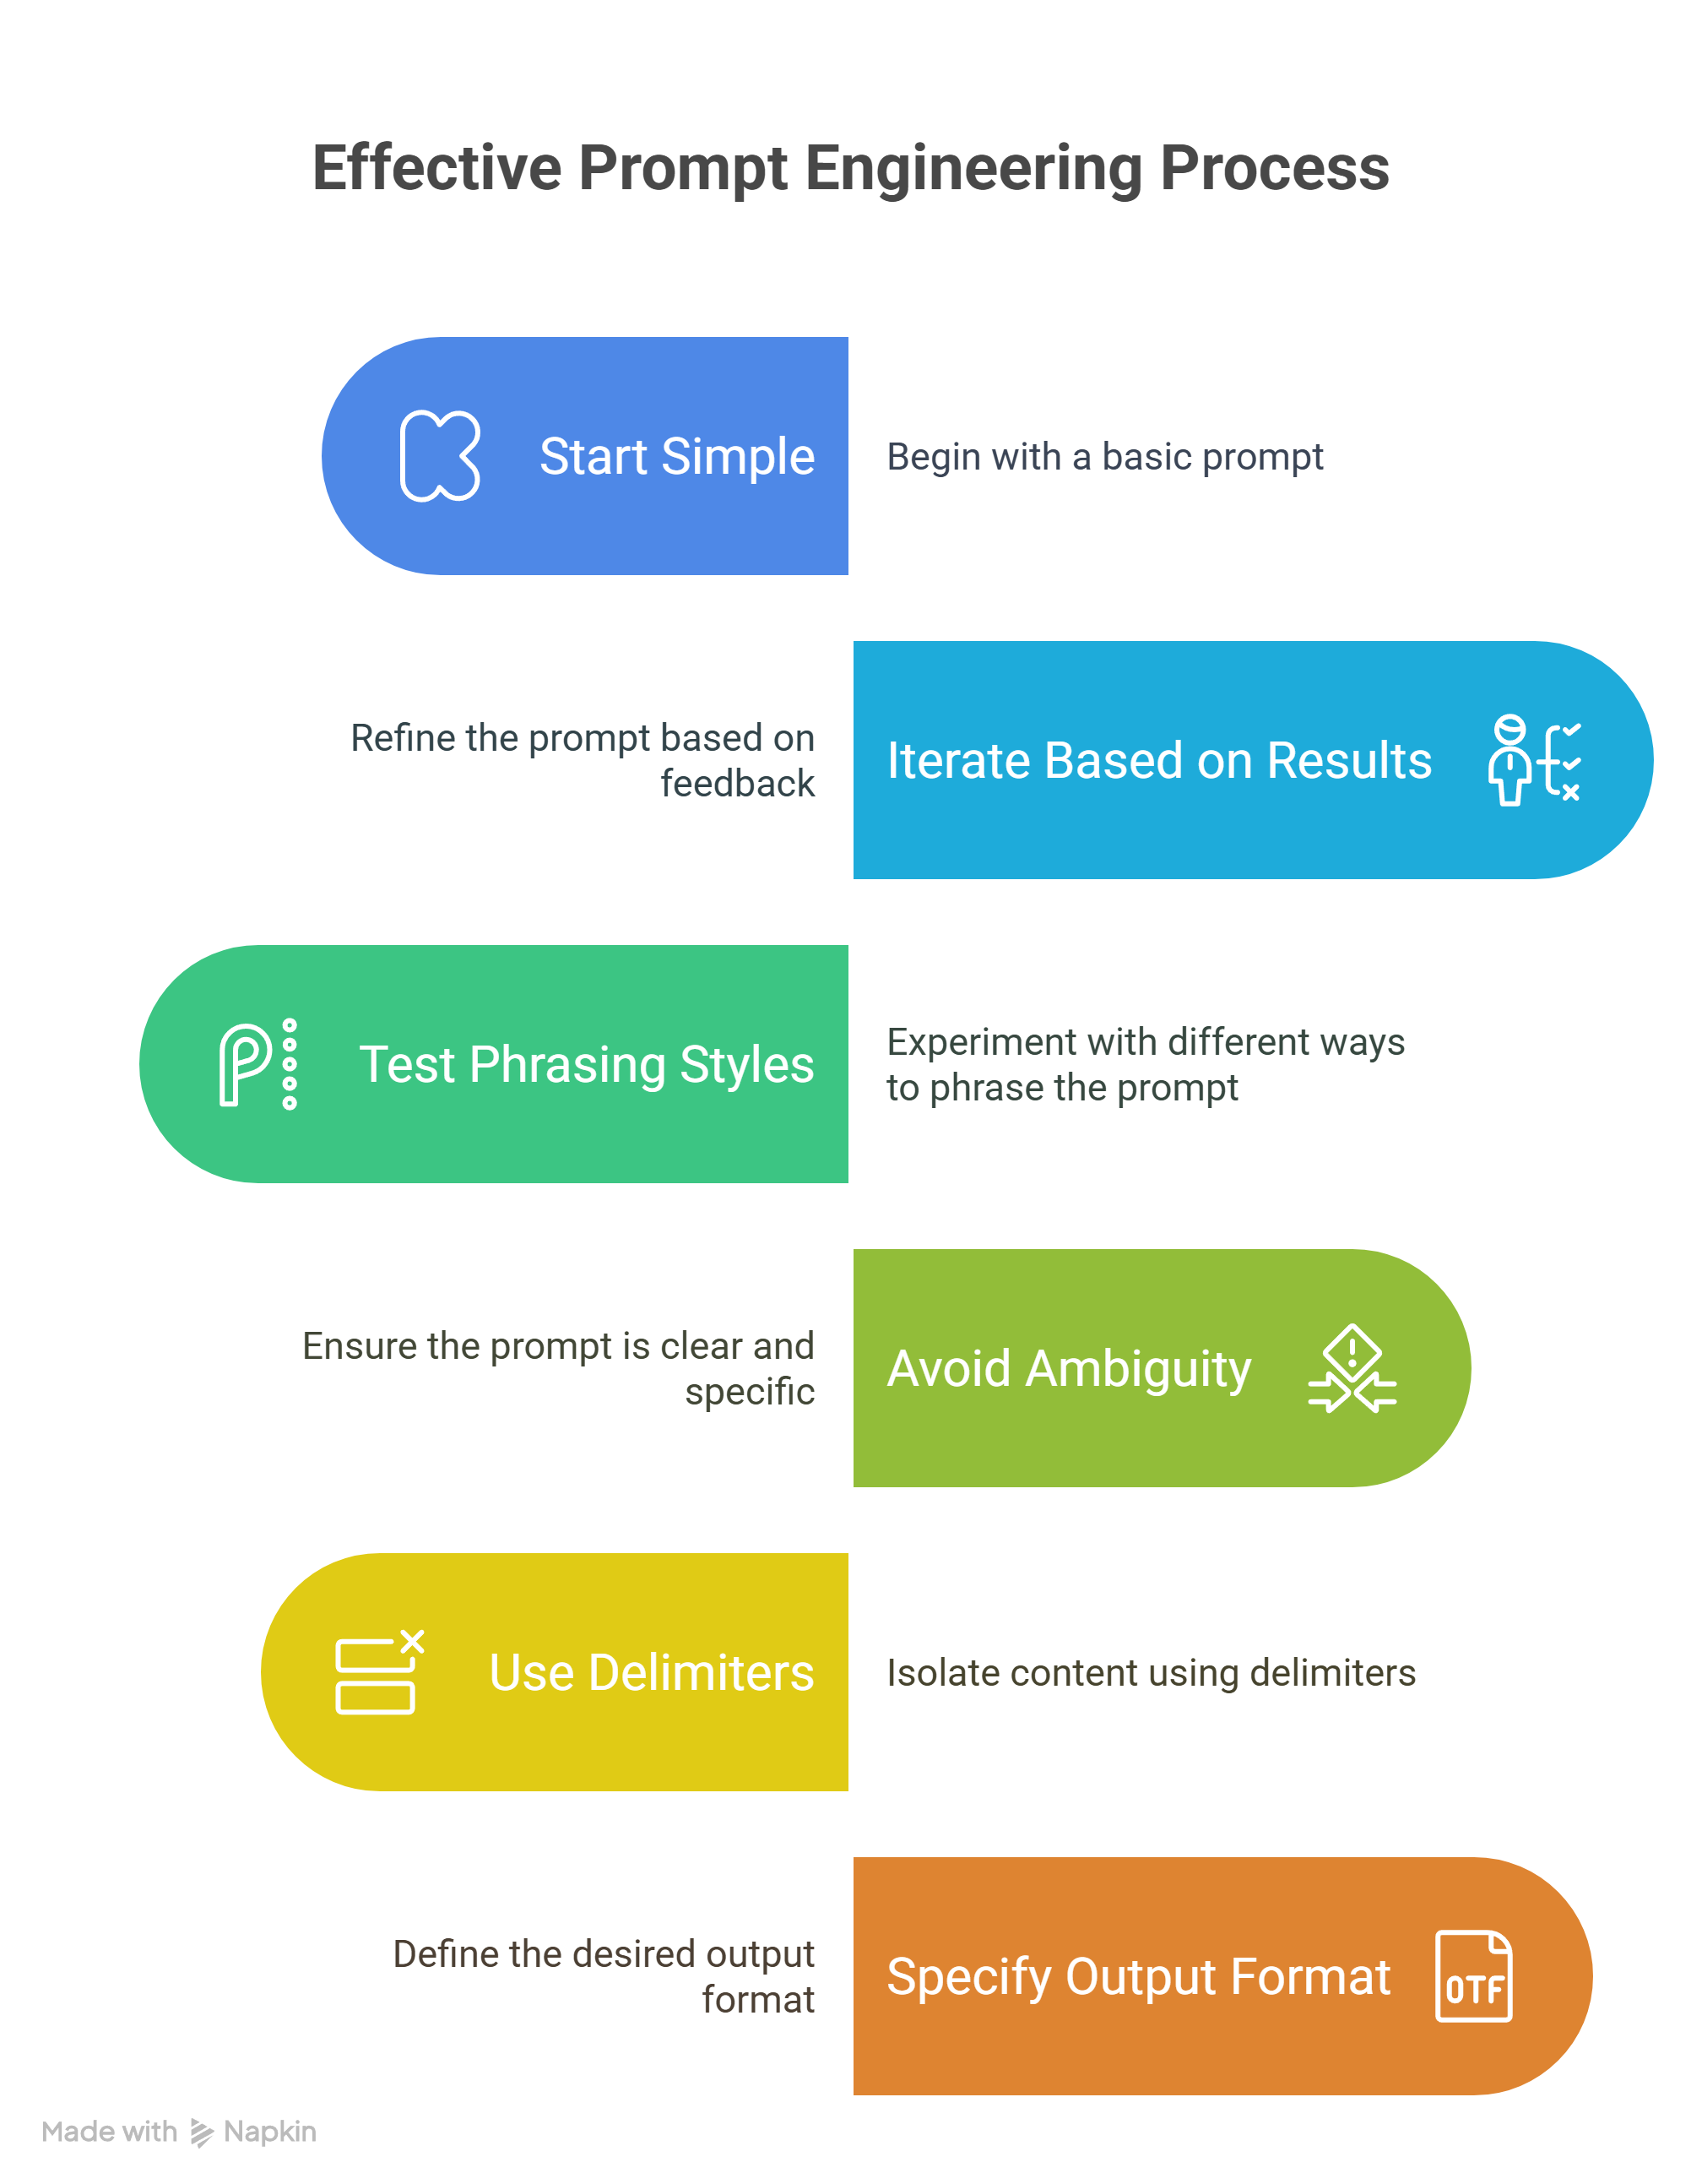
Slide Title
Prompt Engineering – Best Practices – Summary

Slide 30
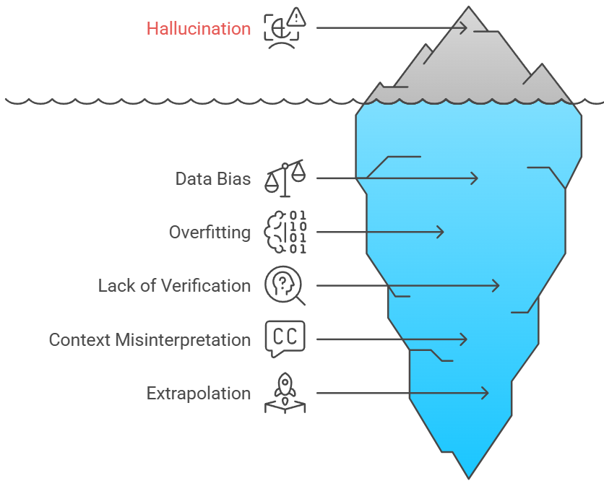
Slide Title
Reducing Hallucinations
Hallucination, means the content generated is false or misleading but the LLM expresses the
response as if it were true
Strategy, Avoid Open-ended Questions like
Prompt: What are the different ways to optimize a database?
Prompt: Which of the following is a method to optimize a database: indexing, defragmenting, or compressing?
Notes:
Lack of ground truth verification
LLMs generate responses based on patterns learned from
training data without the ability to verify the accuracy or
reality of the information.
Overfitting and memorization
LLMs might memorize incorrect or misleading
information in their training datasets, especially if such
data is repetitive or common.
Bias in training data
If the training data contains biases, inaccuracies, or
falsehoods, the model will likely replicate these in its
outputs.
Extrapolation and speculation
Sometimes, LLMs might extrapolate from the patterns
they’ve seen in the data to generate information about
topics or questions that were not adequately covered in the
training data.
Lack of context or misinterpretation
LLMs can misinterpret or lack the necessary context to
accurately respond to certain prompts. They may not fully
understand the nuances or implications of certain queries.
Such language can Slang and idioms
create ambiguity that may lead the
model to misinterpret the intended meaning, especially if it
hasn’t seen enough examples of the slang or idiom in
context during training.

Slide 31
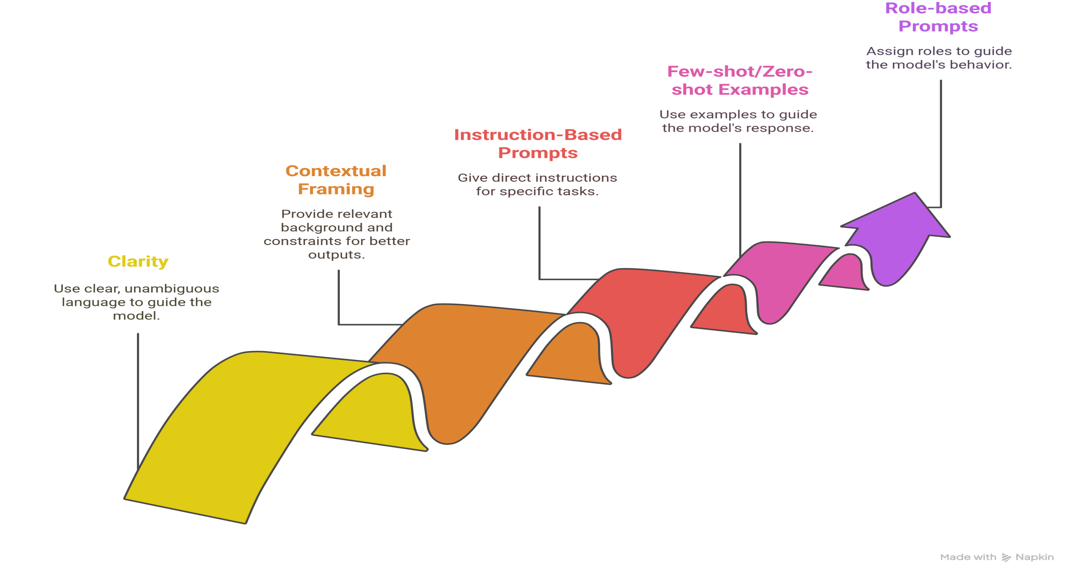
Slide Title
Key Principles of Prompt Engineering

Slide 32
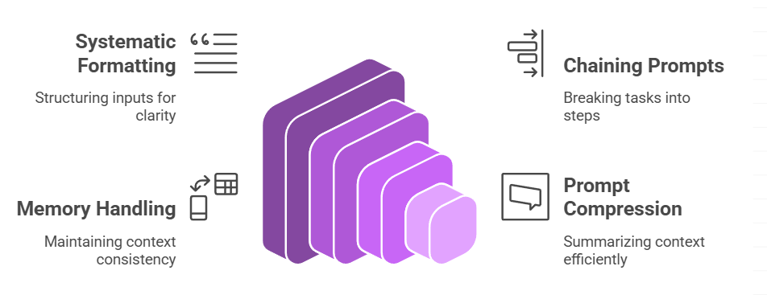
Slide Title
Context Management Techniques
Chaining Prompts (Prompt Chaining): Break complex tasks into multiple steps and feed model outputs as inputs for the next prompt.
Use bullet points, numbered steps, or clearly structured inputs.
Memory and State Handling: For tools with memory, build on earlier interactions and maintain consistent references.
Prompt Compression: Summarize previous context to stay within token limits while preserving key
Notes:
Systematic Formatting: Use bullet points, numbered steps, or clearly structured inputs.
Chaining Prompts (Prompt Chaining): Break complex tasks into multiple steps and feed model outputs as inputs for the next prompt.
Memory and State Handling: For tools with memory, build on earlier interactions and maintain consistent references.
Prompt Compression: Summarize previous context to stay within token limits while preserving key info.

Slide 33
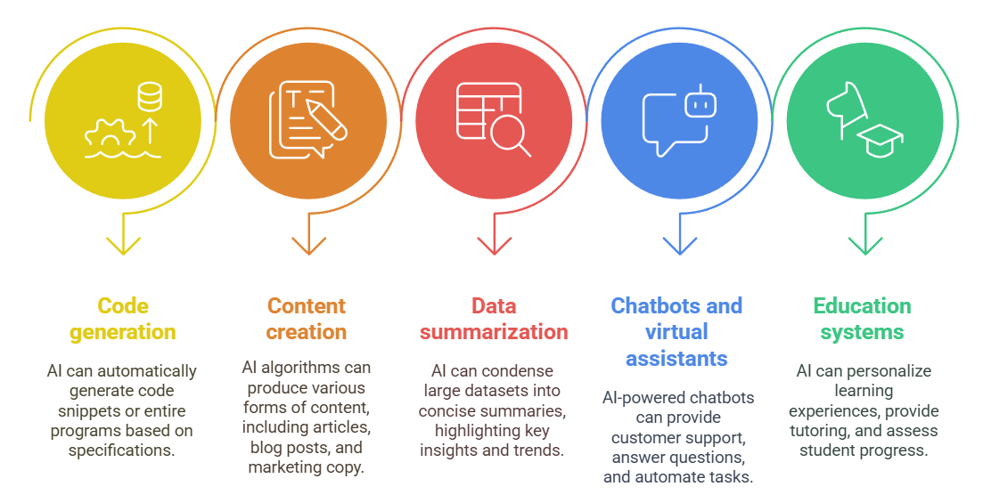
Slide Title
Use Cases
Notes:
Systematic Formatting: Use bullet points, numbered steps, or clearly structured inputs.
Chaining Prompts (Prompt Chaining): Break complex tasks into multiple steps and feed model outputs as inputs for the next prompt.
Memory and State Handling: For tools with memory, build on earlier interactions and maintain consistent references.
Prompt Compression: Summarize previous context to stay within token limits while preserving key info.

Slide 34
Slide Title
Lab Activities
Section 1: Code Génération Prompts
Use a prompt to generate a Python function that calculates the factorial of a number.
Craft a prompt to generate a Python program that checks whether a string is a palindrome.
Design a prompt that generates a script to read a CSV file and print the average of a numeric column.
Section 2: Code Complétion Prompts
Provide a partially written Python function to calculate the sum of even numbers in a list. Create a prompt to complete it.
Write a prompt to complete a class definition for a BankAccount in Python with methods for deposit and withdrawal.
Section 3: Code Explantation Prompts
Create a prompt to explain what a given Python snippet does:
Use a prompt to get a line-by-line explanation of a Python program that uses file I/O and exception handling.
Notes:
Lack of ground truth verification
LLMs generate responses based on patterns learned from
training data without the ability to verify the accuracy or
reality of the information.
Overfitting and memorization
LLMs might memorize incorrect or misleading
information in their training datasets, especially if such
data is repetitive or common.
Bias in training data
If the training data contains biases, inaccuracies, or
falsehoods, the model will likely replicate these in its
outputs.
Extrapolation and speculation
Sometimes, LLMs might extrapolate from the patterns
they’ve seen in the data to generate information about
topics or questions that were not adequately covered in the
training data.
Lack of context or misinterpretation
LLMs can misinterpret or lack the necessary context to
accurately respond to certain prompts. They may not fully
understand the nuances or implications of certain queries.
Such language can Slang and idioms
create ambiguity that may lead the
model to misinterpret the intended meaning, especially if it
hasn’t seen enough examples of the slang or idiom in
context during training.

Slide 35
Slide Title
Lab Activities
Section 4: Code Debugging Prompts
Use a faulty Python code and write a prompt to find and fix the bug
Write a prompt to debug a function that is supposed to sort a list of numbers but doesn't return the correct result.
Section 5: Optimization Prompts
Write a prompt to optimize a Python function that uses nested loops to remove duplicates from a list.
Create a prompt that asks the model to refactor a long function into smaller modular functions for readability.
Section 6: Comparison/Style Prompts
Use a prompt to convert an imperative-style Python loop into a list comprehension.
Ask the model to rewrite a Python function using NumPy for improved performance.
Notes:
Lack of ground truth verification
LLMs generate responses based on patterns learned from
training data without the ability to verify the accuracy or
reality of the information.
Overfitting and memorization
LLMs might memorize incorrect or misleading
information in their training datasets, especially if such
data is repetitive or common.
Bias in training data
If the training data contains biases, inaccuracies, or
falsehoods, the model will likely replicate these in its
outputs.
Extrapolation and speculation
Sometimes, LLMs might extrapolate from the patterns
they’ve seen in the data to generate information about
topics or questions that were not adequately covered in the
training data.
Lack of context or misinterpretation
LLMs can misinterpret or lack the necessary context to
accurately respond to certain prompts. They may not fully
understand the nuances or implications of certain queries.
Such language can Slang and idioms
create ambiguity that may lead the
model to misinterpret the intended meaning, especially if it
hasn’t seen enough examples of the slang or idiom in
context during training.

Slide 36
Thank You

