Slide 1

School of Computer Science and AI, SR University
Course Code | Course Title | L | R | P | Cr
25CAI004PC206 | AI Assisted Coding | 0 | 0 | 4 | 2
Program Core
Advanced Prompt Engineering
Lecture - 2
Learning Techniques Zero Shot One Shot Few Shot Choose Right Prompt Applications
Dr. Venkataramana Veeramsetty
Professor

Slide 2
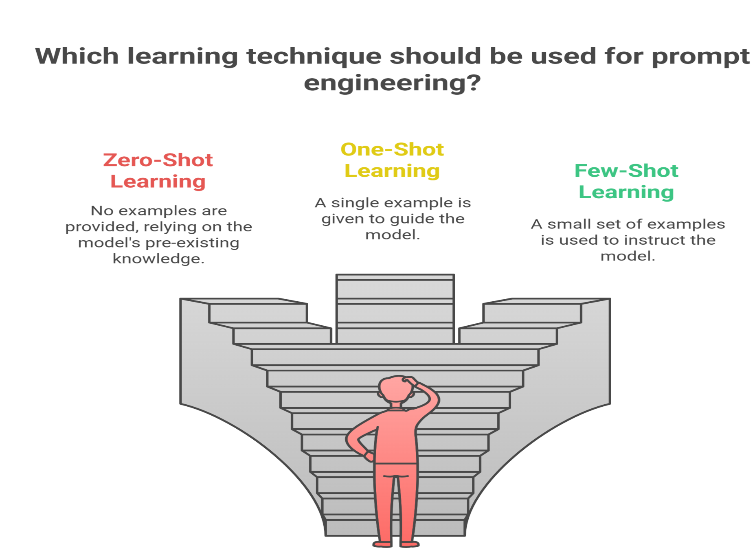
Slide Title
Learning Techniques
In prompt engineering, zero-shot, one-shot, and few-shot learning are techniques used to guide language models like ChatGPT or GPT-4 in solving tasks with varying levels of example-based instruction.

Slide 3
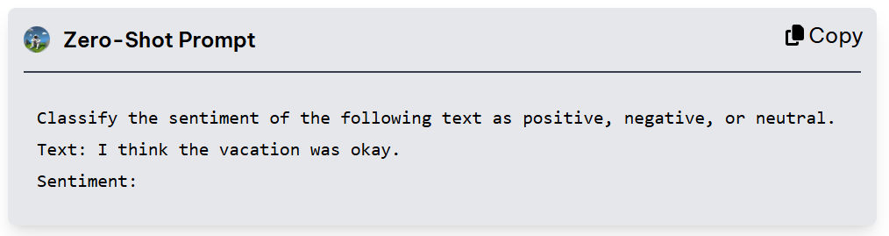
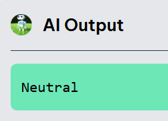
Slide Title
Zero Shot Learning
Definition: The model is given only the task description, without any example.
Goal: See how well the model performs based solely on its general understanding of the task.
Example Prompt: "Translate the sentence into French: 'Good morning.'"
Use Case: Best when the model has already been trained on similar tasks.

Slide 4
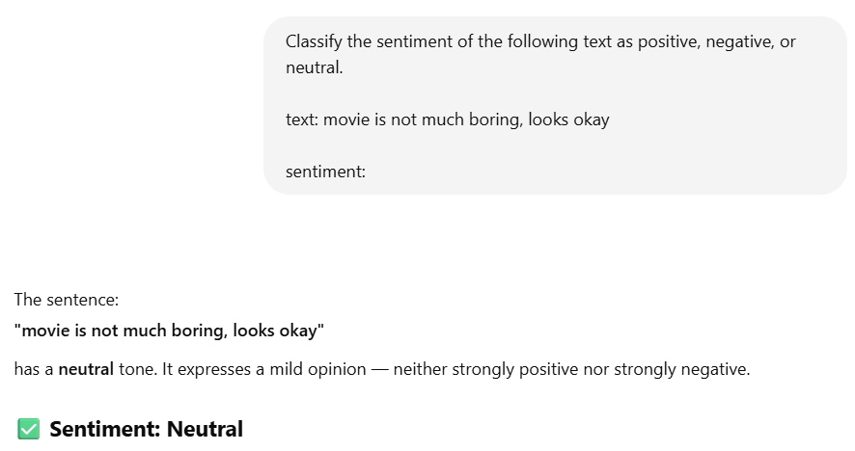
Slide Title
Zero Shot Learning
Zero-shot prompting can work well for simple tasks—especially ones that the model has likely encountered during training
Not enough for more complex tasks.
The lack of examples leaves the model guessing, and the results can be unpredictable or incorrect.

Slide 5
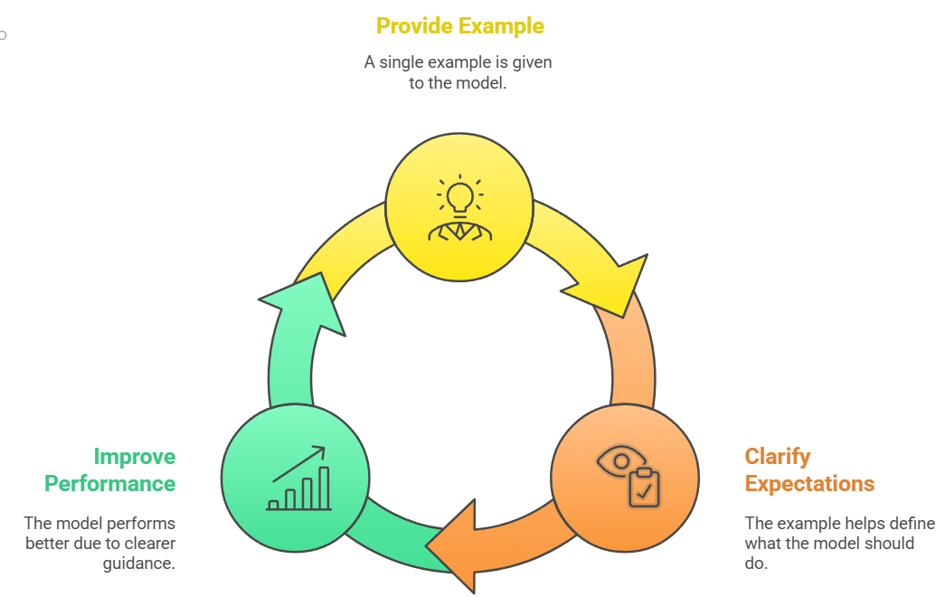
Slide Title
One Shot Learning
One-shot prompting enhances zero-shot prompting by providing a single example before the new task, which helps clarify expectations and improves model performance.
Definition: The model is given one example along with the task.
Goal: Help the model understand the task format and expected output
Example Prompt:
Translate the sentence into French. Example: 'Good night.' → 'Bonne nuit.' Now translate: 'Good morning.'
.

Slide 6
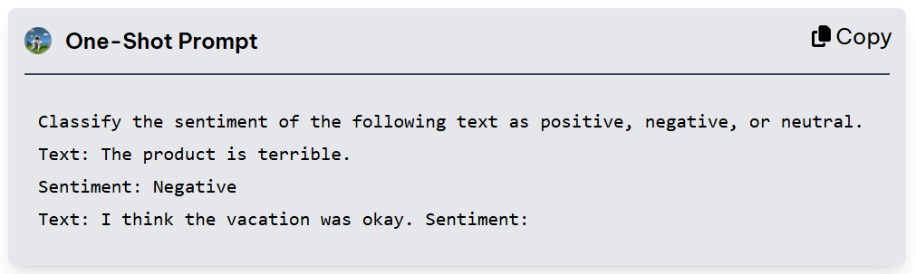
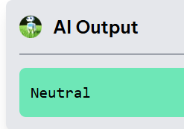
Slide Title
One Shot Learning
One-shot prompting gives the model a starting point with only one example
It might still struggle with nuanced or complex tasks.
More examples are often needed to fully capture the range of possible outputs.

Slide 7
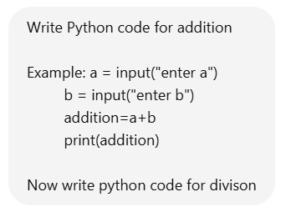
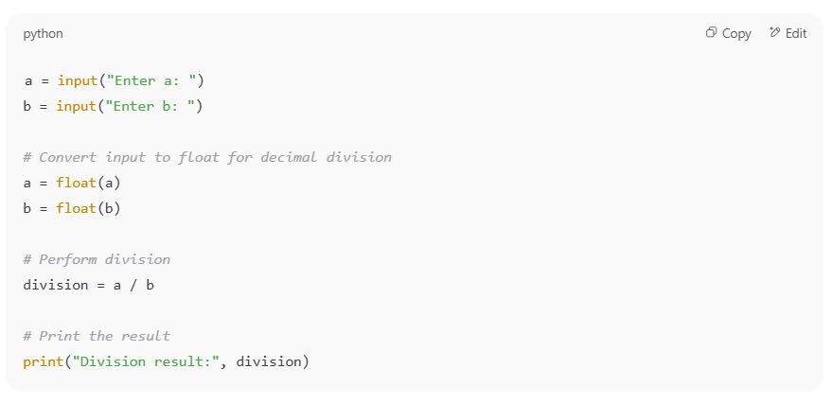
Slide Title
One Shot Learning

Slide 8
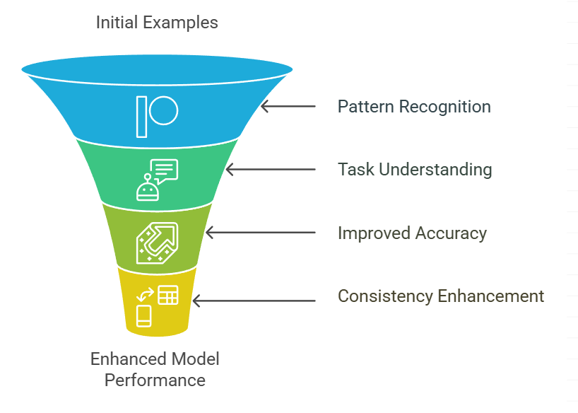
Slide Title
Few Shot Learning
Definition: The model is given a few (2–5 or more) examples before asking it to perform the task. Which helps the model recognize patterns and handle more complex tasks
Goal: Teach the model the pattern using several examples to improve accuracy
.
Example Prompt:
"Translate the following sentences into French:
'Good night.' → 'Bonne nuit.' 'Thank you.' → 'Merci.' 'How are you?' → 'Comment ça va ?' Now translate: 'Good morning.'“
Output: "Bonjour.“

Slide 9
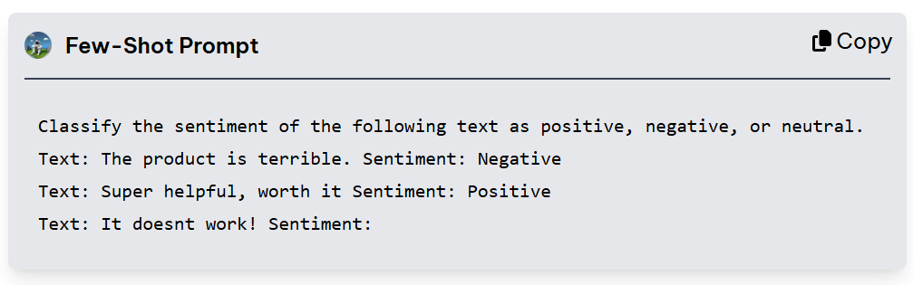
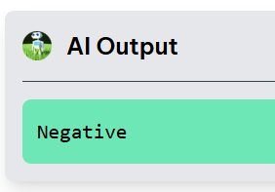
Slide Title
Few Shot Learning
Few-shot prompting helps the model generalize from multiple examples, making it more reliable for tasks that require adherence to specific formats or patterns, such as structured information extraction or content generation

Slide 10
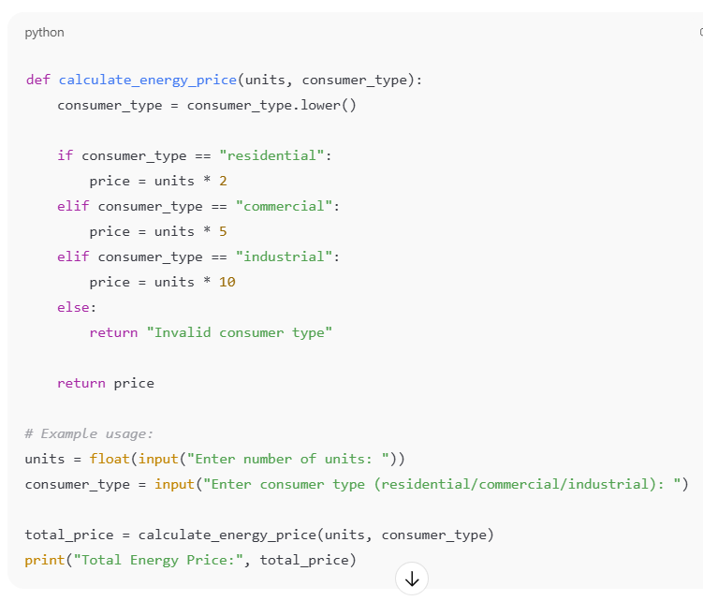
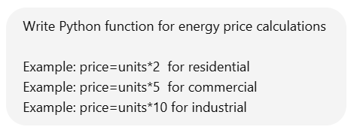
Slide Title
Few Shot Learning

Slide 11
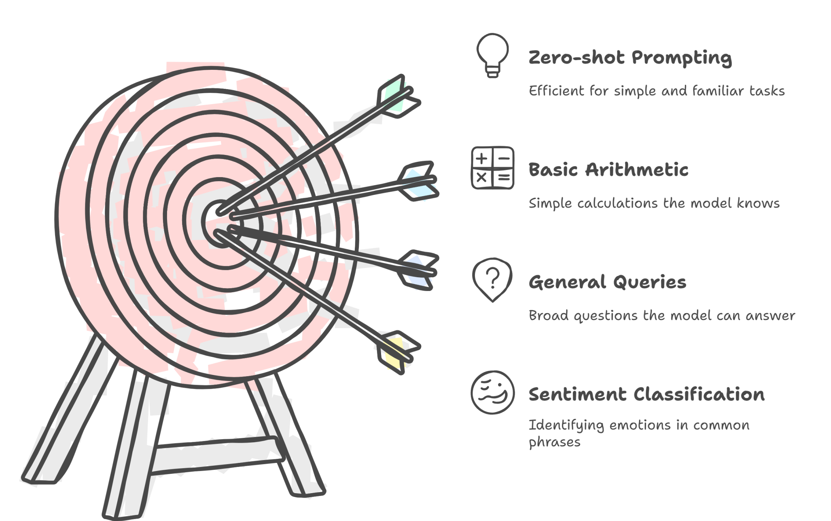
Slide Title
How to Choose the Right Prompting Technique
Selecting the appropriate prompting technique depends on the complexity of the task and the level of guidance the model requires.
Notes:
Zero-shot prompting: Use this when the task is simple, well-understood, or frequently encountered in the model's training data. It's efficient for tasks like basic arithmetic, general queries, or sentiment classification for common phrases.

Slide 12
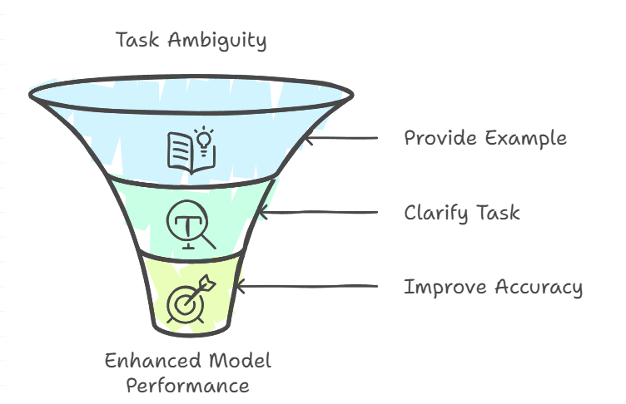
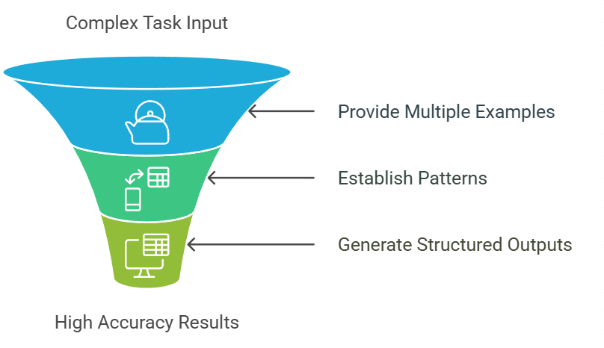
Slide Title
How to Choose the Right Prompting Technique
Notes:
One-shot prompting: This is helpful for tasks that need more specific guidance or when the model struggles with ambiguity. Providing a single example can clarify the task, improving accuracy in tasks like basic classification or structured information extraction.
Few-shot prompting: Best used for complex tasks requiring multiple examples to establish patterns. This technique is ideal for tasks that involve varied inputs, require precise formatting, or demand a higher degree of accuracy, such as generating structured outputs or handling nuanced classifications.

Slide 13
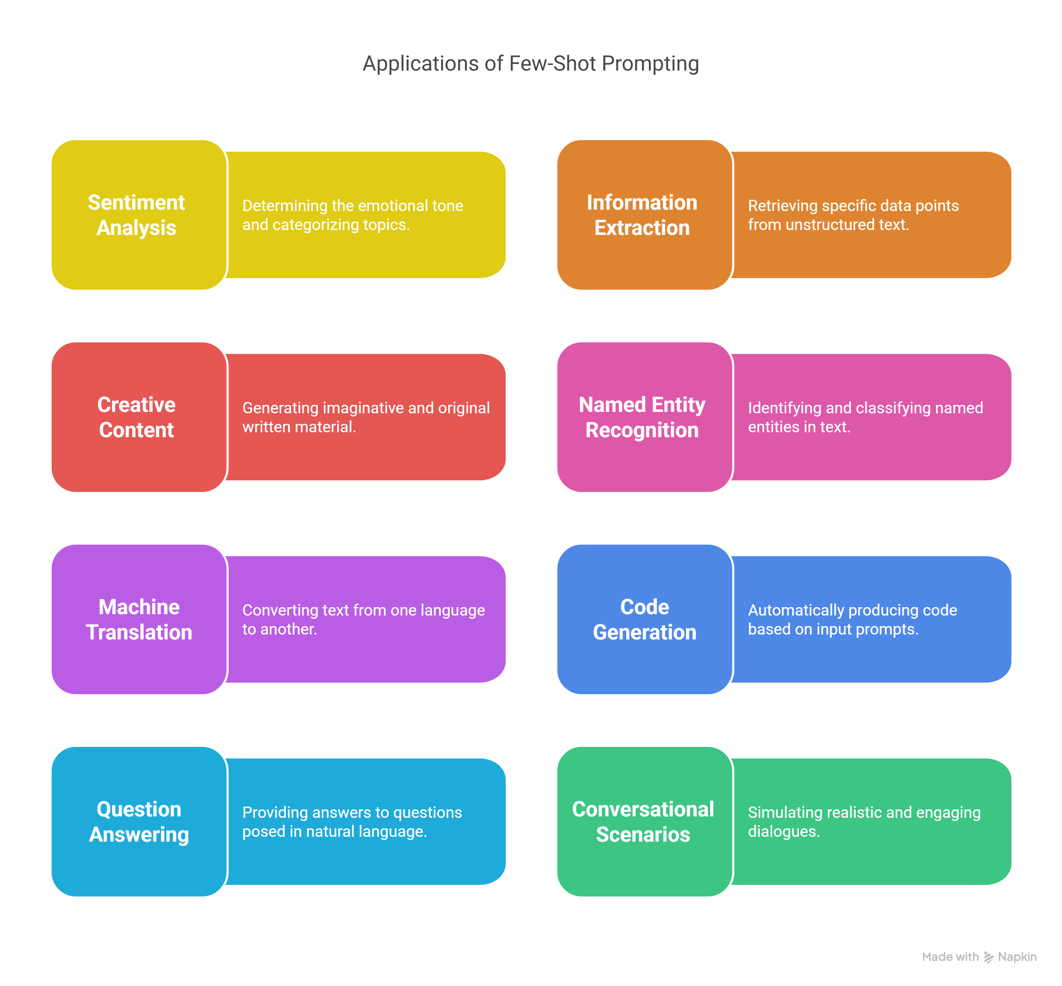
Slide Title
Real-World Applications of Few-Shot Prompting
Notes:
Sentiment analysis and topic categorization1Gao, T., Fisch, A., & Chen, D. (2021). Making Pre-trained Language Models Better Few-shot Learners. Proceedings of the 59th Annual Meeting of the Association for Computational Linguistics and the 11th International Joint Conference on Natural Language Processing, 3816–3830.
Information extraction
Creative content generation
Named entity recognition2Brown, T., Mann, B., Ryder, N., Subbiah, M., Kaplan, J. D., Dhariwal, P., Neelakantan, A., Shyam, P., Sastry, G., Askell, A., & others. (2020). Language Models are Few-Shot Learners. Advances in Neural Information Processing Systems, 33, 1877–1901.
Machine translation3Garcia, X., Constant, N., Parikh, A., & Firat, O. (2021). Few-shot learning for cross-lingual natural language inference. arXiv Preprint arXiv:2104.14690.
Code generation4Chen, M., Tworek, J., Jun, H., Yuan, Q., Pinto, H. P. de O., Kaplan, J., Edwards, H., Burda, Y., Joseph, N., Brockman, G., & others. (2021). Evaluating Large Language Models Trained on Code. arXiv Preprint arXiv:2107.03374.
Question answering systems5Schick, T., & Schütze, H. (2021). Exploiting Cloze-Questions for Few-Shot Text Classification and Natural Language Inference. Proceedings of the 16th Conference of the European Chapter of the Association for Computational Linguistics: Main Volume, 255–269.
Conversational scenarios6Madotto, A., Lin, Z., Zhou, Y., Shin, J., & Fung, P. (2021). Few-shot Bot: Prompt-based Learning for Dialogue Systems. arXiv Preprint arXiv:2110.08118.

Slide 14
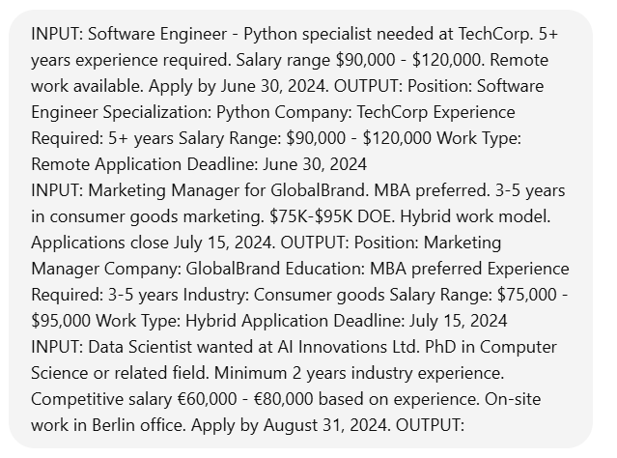
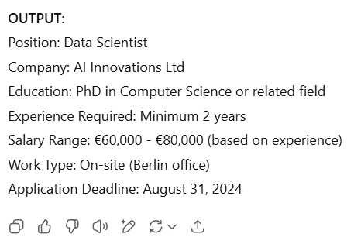
Slide Title
Few-Shot Prompting for Information Extraction
Notes:
INPUT: Software Engineer - Python specialist needed at TechCorp. 5+ years experience required. Salary range $90,000 - $120,000. Remote work available. Apply by June 30, 2024. OUTPUT: Position: Software Engineer Specialization: Python Company: TechCorp Experience Required: 5+ years Salary Range: $90,000 - $120,000 Work Type: Remote Application Deadline: June 30, 2024
INPUT: Marketing Manager for GlobalBrand. MBA preferred. 3-5 years in consumer goods marketing. $75K-$95K DOE. Hybrid work model. Applications close July 15, 2024. OUTPUT: Position: Marketing Manager Company: GlobalBrand Education: MBA preferred Experience Required: 3-5 years Industry: Consumer goods Salary Range: $75,000 - $95,000 Work Type: Hybrid Application Deadline: July 15, 2024
INPUT: Data Scientist wanted at AI Innovations Ltd. PhD in Computer Science or related field. Minimum 2 years industry experience. Competitive salary €60,000 - €80,000 based on experience. On-site work in Berlin office. Apply by August 31, 2024. OUTPUT:

Slide 15
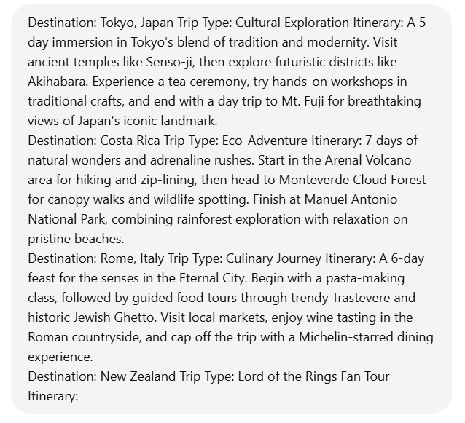

Slide Title
Few-Shot Prompting for Content Creation
This example demonstrates how to use few-shot prompting to create concise travel itinerary descriptions for different types of vacations.
Notes:
Destination: Tokyo, Japan Trip Type: Cultural Exploration Itinerary: A 5-day immersion in Tokyo's blend of tradition and modernity. Visit ancient temples like Senso-ji, then explore futuristic districts like Akihabara. Experience a tea ceremony, try hands-on workshops in traditional crafts, and end with a day trip to Mt. Fuji for breathtaking views of Japan's iconic landmark. Destination: Costa Rica Trip Type: Eco-Adventure Itinerary: 7 days of natural wonders and adrenaline rushes. Start in the Arenal Volcano area for hiking and zip-lining, then head to Monteverde Cloud Forest for canopy walks and wildlife spotting. Finish at Manuel Antonio National Park, combining rainforest exploration with relaxation on pristine beaches. Destination: Rome, Italy Trip Type: Culinary Journey Itinerary: A 6-day feast for the senses in the Eternal City. Begin with a pasta-making class, followed by guided food tours through trendy Trastevere and historic Jewish Ghetto. Visit local markets, enjoy wine tasting in the Roman countryside, and cap off the trip with a Michelin-starred dining experience. Destination: New Zealand Trip Type: Lord of the Rings Fan Tour Itinerary:

Slide 16
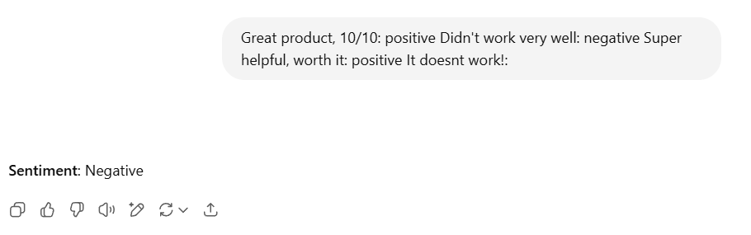
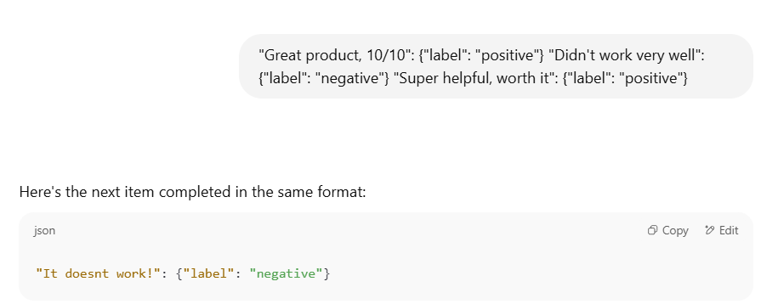
Slide Title
Few-Shot Prompting for Structured Outputs
Structuring outputs is perhaps the most important benefit of few-shot prompting.

Slide 17
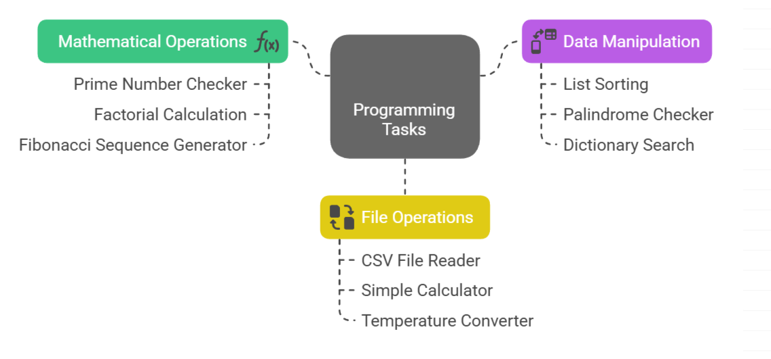
Slide Title
Zero Shot Learning - Python Coding
Notes:
🔟 Zero-Shot Python Prompts
Prime Number Checker ➤ Write a Python function to check if a number is prime.
File Line Counter ➤ Write a Python script to count the number of lines in a text file.
List Sorting ➤ Write a Python program to sort a list of numbers in descending order.
Factorial Calculation ➤ Create a Python function to compute the factorial of a given number.
Palindrome Checker ➤ Write Python code to check whether a given string is a palindrome.
CSV File Reader ➤ Generate Python code to read a CSV file and print its contents.
Simple Calculator ➤ Write a basic Python calculator that performs addition, subtraction, multiplication, and division based on user input.
Fibonacci Sequence Generator ➤ Write a Python function to generate the first N numbers of the Fibonacci sequence.
Dictionary Search ➤ Create a Python script to search for a key in a dictionary and return its value.
Temperature Converter ➤ Write a Python program to convert temperature from Celsius to Fahrenheit.

Slide 18
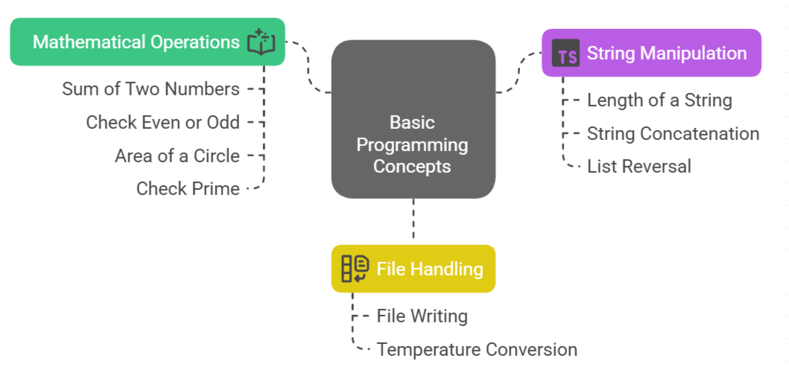
Slide Title
One Shot Learning - Python Coding
Notes:
🔟 Zero-Shot Python Prompts
Prime Number Checker ➤ Write a Python function to check if a number is prime.
File Line Counter ➤ Write a Python script to count the number of lines in a text file.
List Sorting ➤ Write a Python program to sort a list of numbers in descending order.
Factorial Calculation ➤ Create a Python function to compute the factorial of a given number.
Palindrome Checker ➤ Write Python code to check whether a given string is a palindrome.
CSV File Reader ➤ Generate Python code to read a CSV file and print its contents.
Simple Calculator ➤ Write a basic Python calculator that performs addition, subtraction, multiplication, and division based on user input.
Fibonacci Sequence Generator ➤ Write a Python function to generate the first N numbers of the Fibonacci sequence.
Dictionary Search ➤ Create a Python script to search for a key in a dictionary and return its value.
Temperature Converter ➤ Write a Python program to convert temperature from Celsius to Fahrenheit.

Slide 19
Slide Title
References
https://learnprompting.org/docs/basics/few_shot?srsltid=AfmBOoqtygrJQjgkGBAbPhuX4Sqc3uyBMVh1g9KQUFKMxW8FzivYcejF
Brown et al., 2020 – Language Models are Few-Shot Learners (original GPT-3 paper)
Wei et al., 2021 – Finetuned Language Models Are Zero-Shot Learners
Perez et al., 2021 – True Few-Shot Learning with Language Models
https://platform.openai.com/docs/guides/text?api-mode=responses
Notes:
🔟 Zero-Shot Python Prompts
Prime Number Checker ➤ Write a Python function to check if a number is prime.
File Line Counter ➤ Write a Python script to count the number of lines in a text file.
List Sorting ➤ Write a Python program to sort a list of numbers in descending order.
Factorial Calculation ➤ Create a Python function to compute the factorial of a given number.
Palindrome Checker ➤ Write Python code to check whether a given string is a palindrome.
CSV File Reader ➤ Generate Python code to read a CSV file and print its contents.
Simple Calculator ➤ Write a basic Python calculator that performs addition, subtraction, multiplication, and division based on user input.
Fibonacci Sequence Generator ➤ Write a Python function to generate the first N numbers of the Fibonacci sequence.
Dictionary Search ➤ Create a Python script to search for a key in a dictionary and return its value.
Temperature Converter ➤ Write a Python program to convert temperature from Celsius to Fahrenheit.

Slide 20
Thank You

