Slide 1

School of Computer Science and AI, SR University
Course Code | Course Title | L | R | P | Cr
25CAI004PC206 | AI Assisted Coding | 0 | 0 | 4 | 2
Program Core
Ethical Foundations: responsible AI coding practices
Lecture - 6
Challenges in AI Principals Best Practices Responsible AI in Code Generation
Dr. Venkataramana Veeramsetty
Professor

Slide 2
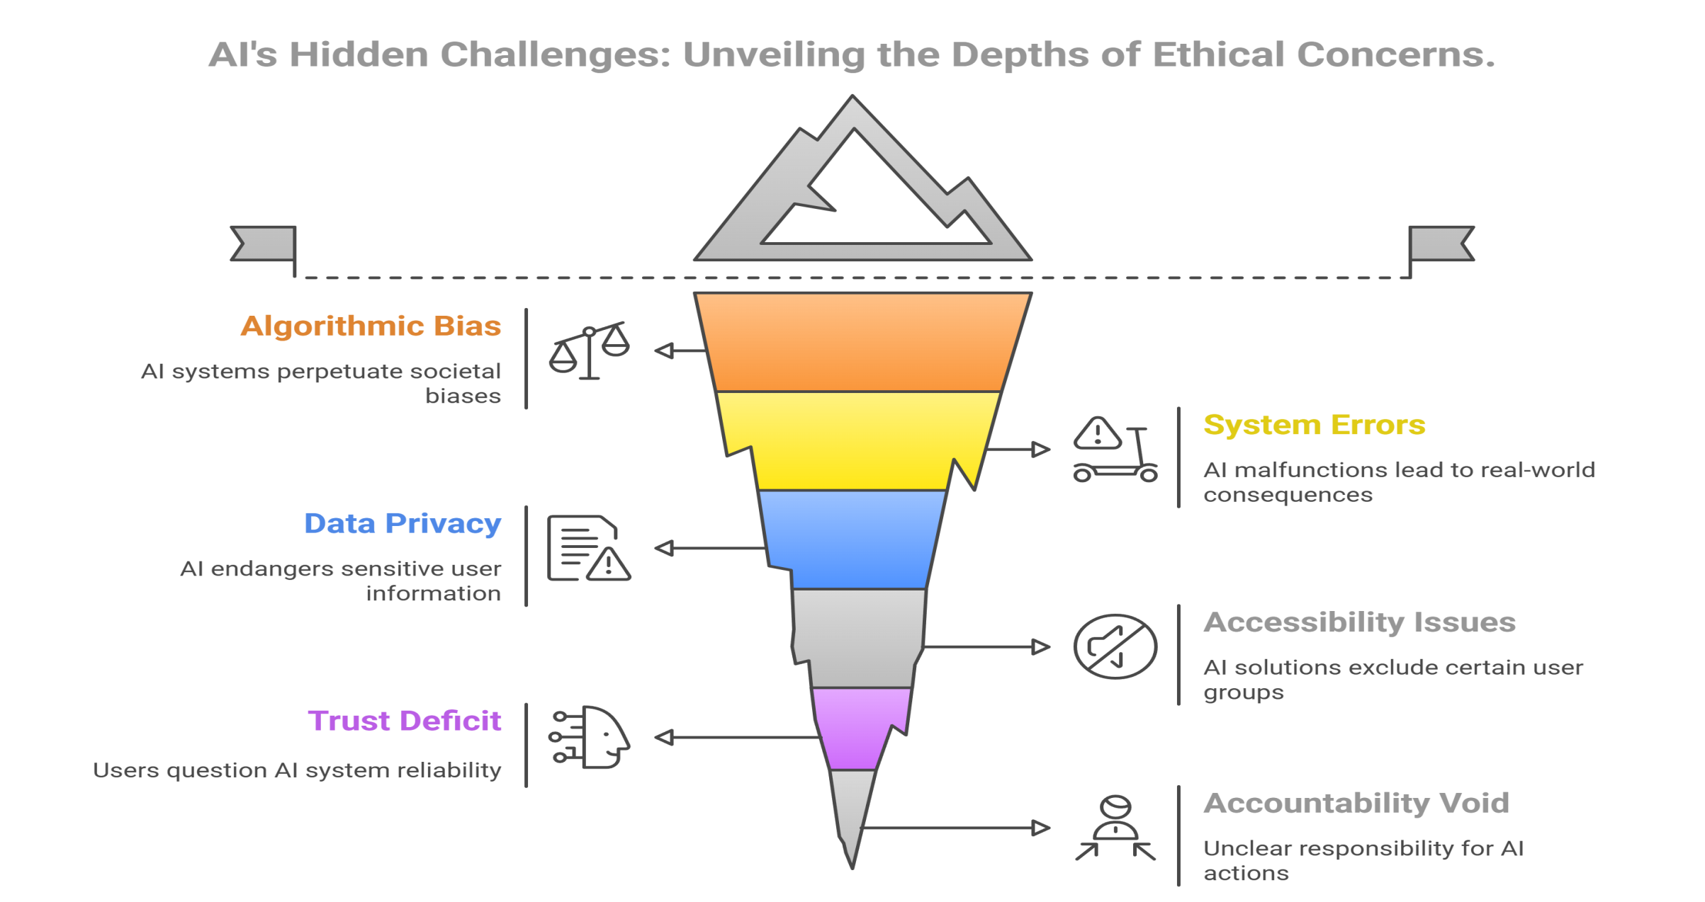
Slide Title
Challenges in AI
Notes:
Bias – Amazon recruitment tool bias against women
Errors – Autonomous vehicle may face collision
Data could be exposed – Medical chat bot my expose sensitive patient data
Solutions may not work for everyone - App without audio
Users must trust a complex system – AI model/system should be user friendly
Who is liable for AI driven systems? - Suspecting an innocent as a criminal based on FR

Slide 3
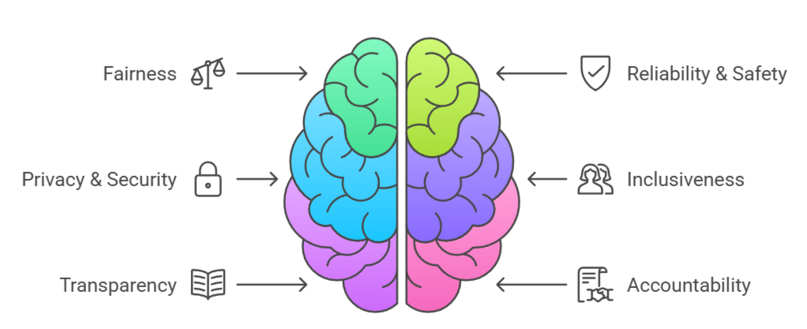
Slide Title
Principals of Responsible AI
Responsible AI coding practices ensure artificial intelligence systems are developed and deployed in a way that upholds human rights, fairness, safety, and accountability.
https://www.microsoft.com/en-us/ai/principles-and-approach

Slide 4
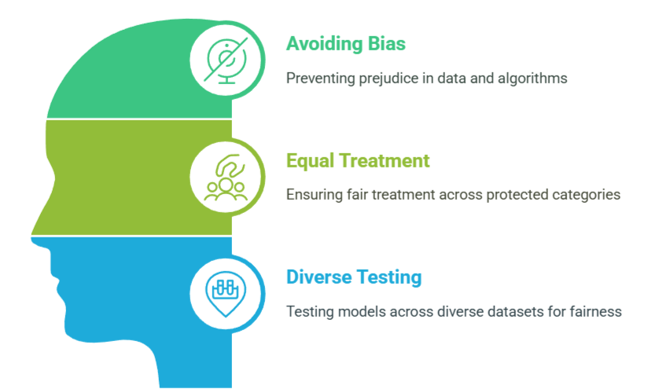
Slide Title
Fairness
Suppose you create a machine learning model to support a loan approval application for a bank. The model should predict whether the loan should be approved or denied without bias.
This bias could be based on gender, ethnicity (region), or other factors that result in an unfair advantage or disadvantage to specific groups of applicants.
Notes:
Avoid bias in data and algorithms.
Ensure equal treatment across race, gender, age, and other protected categories.
Test models across diverse datasets to ensure fairness.

Slide 5
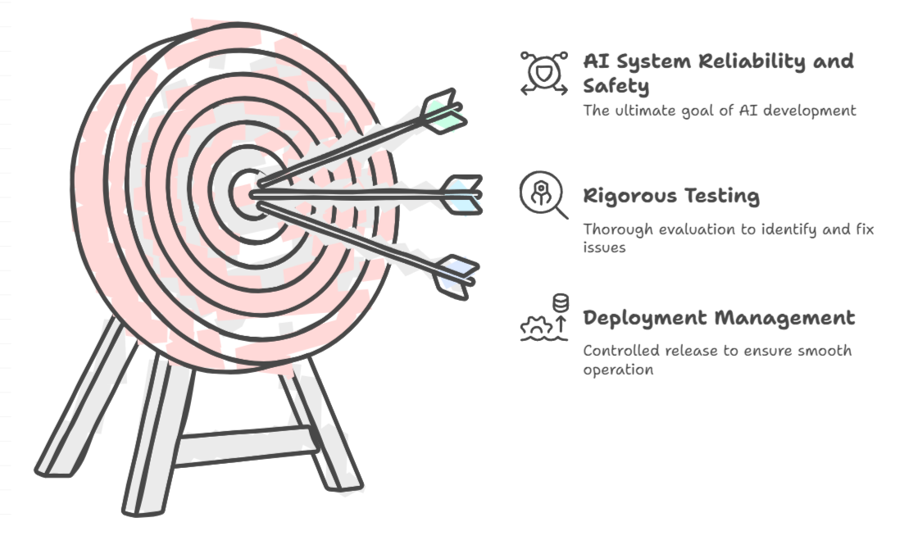
Slide Title
Reliability & Safety
Consider an AI-based software system for an autonomous vehicle
or
A machine learning model that diagnoses patient symptoms and recommends prescriptions.
Unreliability in these kinds of system can result in substantial risk to human life.
Notes:
AI-based software application development must be subjected to rigorous testing and deployment management processes to ensure that they work as expected before release.
Consider an AI-based software system for an autonomous vehicle; or a machine learning model that diagnoses patient symptoms and recommends prescriptions. Unreliability in these kinds of system can result in substantial risk to human life.

Slide 6
Slide Title
Privacy & Security
AI systems should be secure and respect privacy.
The machine learning models on which AI systems are based rely on large volumes of data, which may contain personal details that must be kept private. Even after the models are trained and the system is in production, it uses new data to make predictions or take action that may be subject to privacy or security concerns.
Adhere to data privacy regulations like GDPR (General Data Protection Regulation) and HIPAA (Health Insurance Portability and Accountability Act)
Apply techniques like anonymization, encryption, and differential privacy.

Slide 7
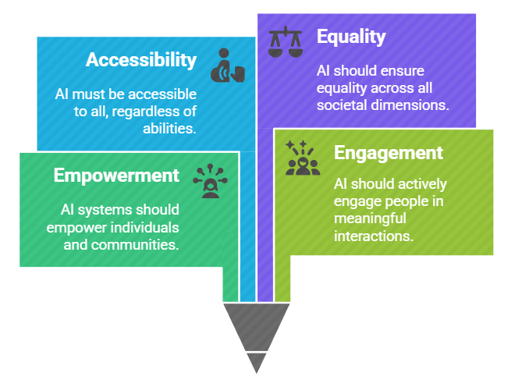
Slide Title
Inclusiveness
AI systems should empower everyone and engage people.
AI should bring benefits to all parts of society, regardless of physical ability, gender, sexual orientation, ethnicity, or other factors.

Slide 8
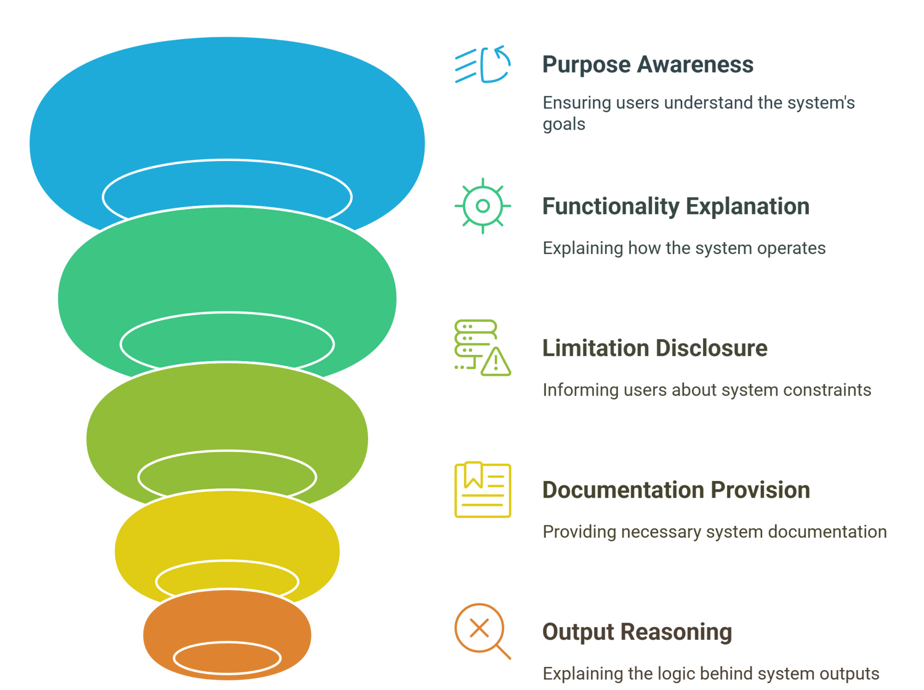
Slide Title
Transparency
Notes:
User should be made fully aware of the purpose of the system, How it works, and what limitations may expected
Provide documentation, logs, and reasoning for outputs.
AI Systems should be easily understandable to users and stakeholders.

Slide 9
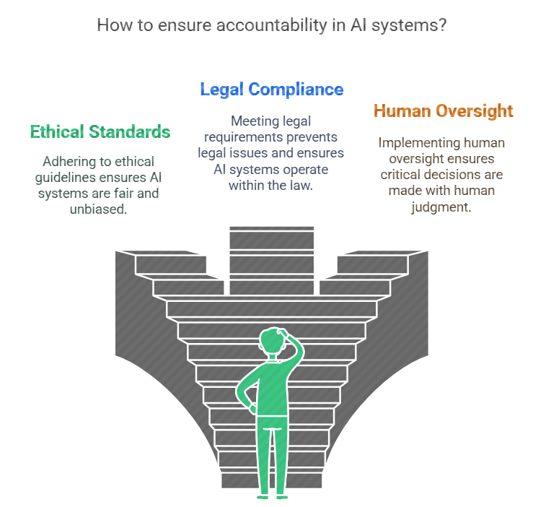
Slide Title
Accountability
Notes:
People should be accountable for AI systems.
Designers and developers of AI-based solution should work within a framework of governance and organizational principles that ensure the solution meets ethical and legal standards that are clearly defined.
Include human oversight, especially for critical decisions.

Slide 10
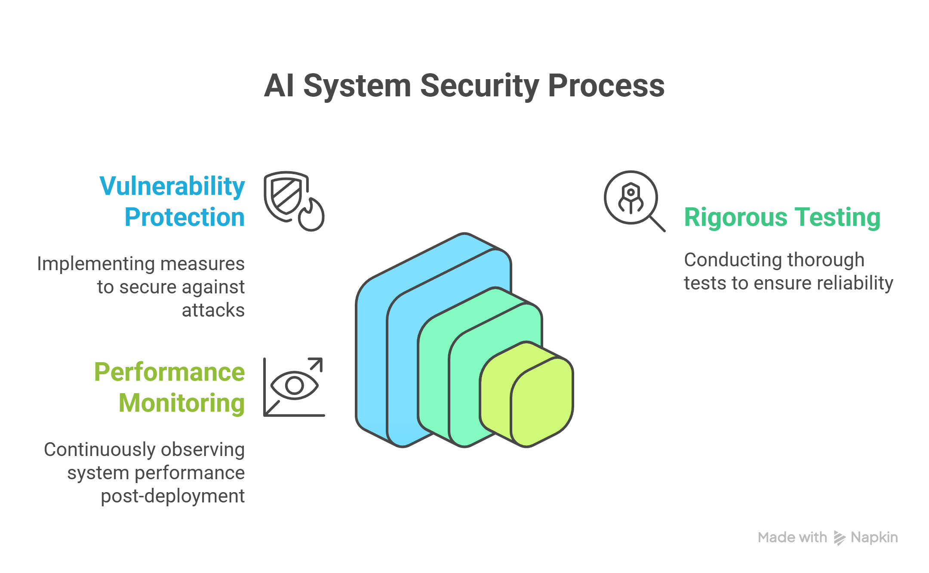
Slide Title
Safety and Security
Notes:
Protect AI systems against adversarial attacks and vulnerabilities.
Conduct rigorous testing before deployment.
Monitor post-deployment performance to detect anomalies.

Slide 11
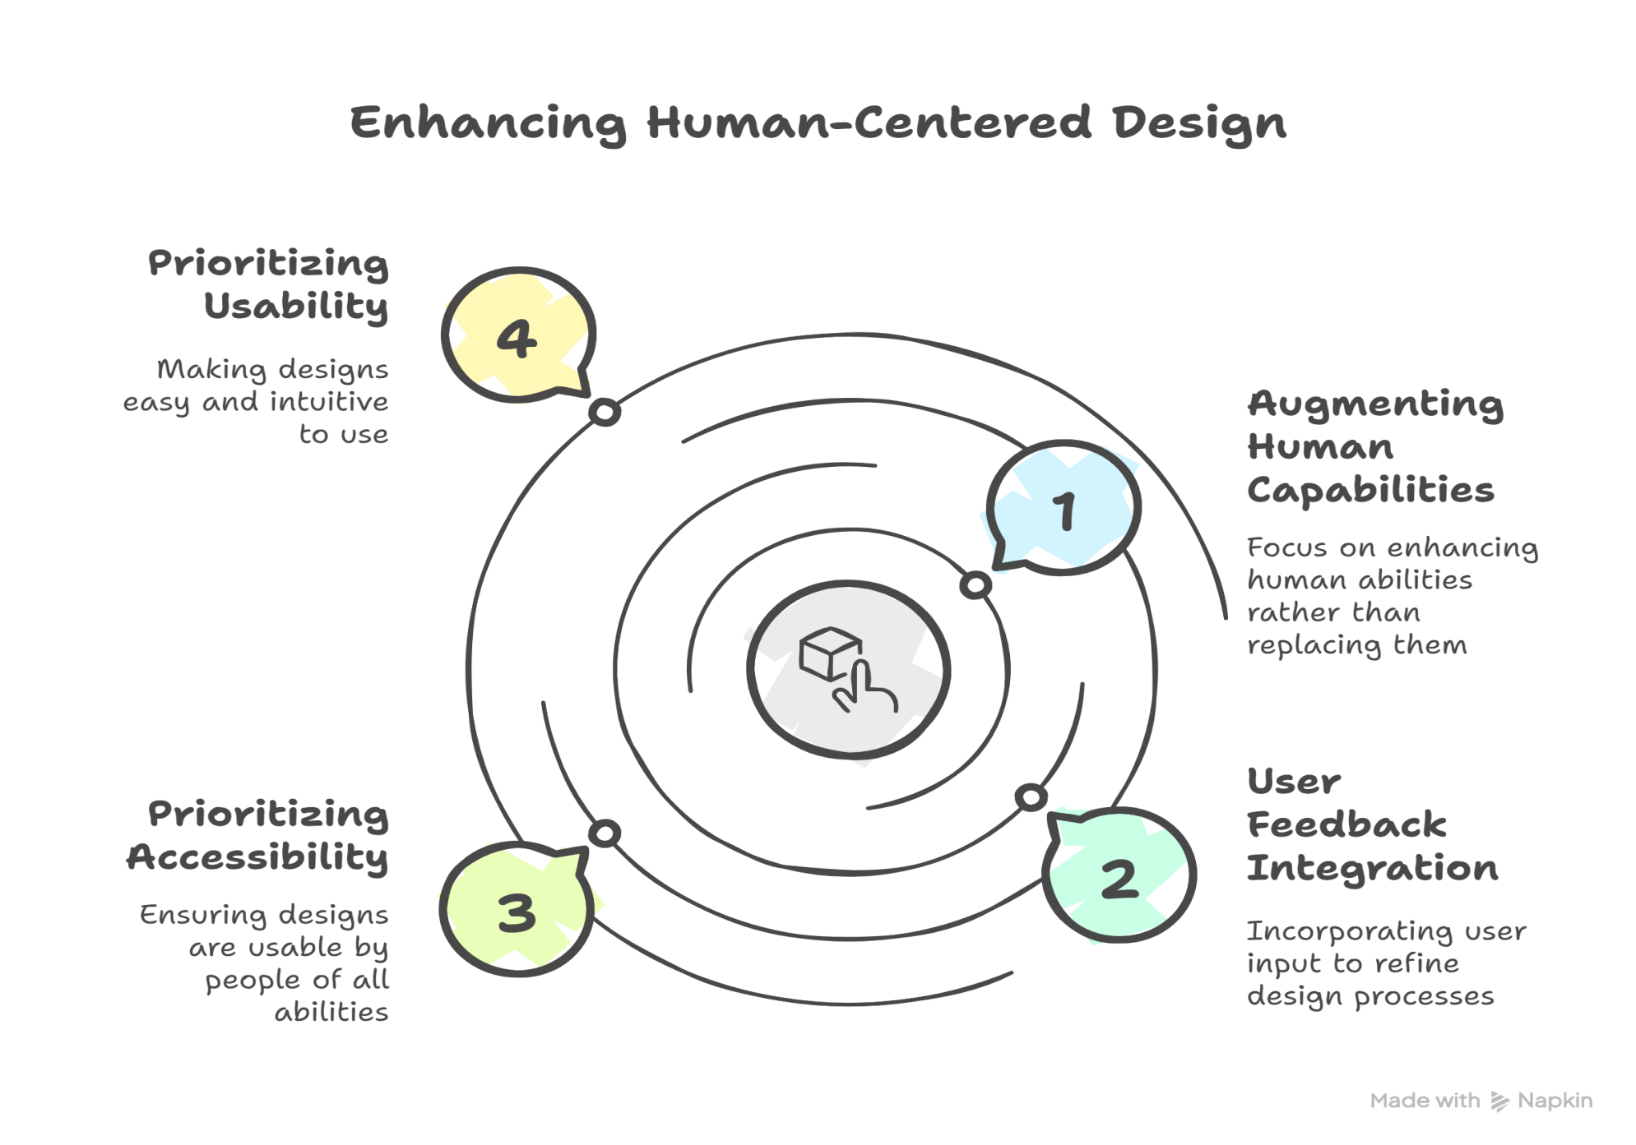
Slide Title
Human-Centered Design
Notes:
Design systems that augment human capabilities, not replace them blindly.
Include user feedback in development cycles.
Prioritize accessibility and usability.

Slide 12
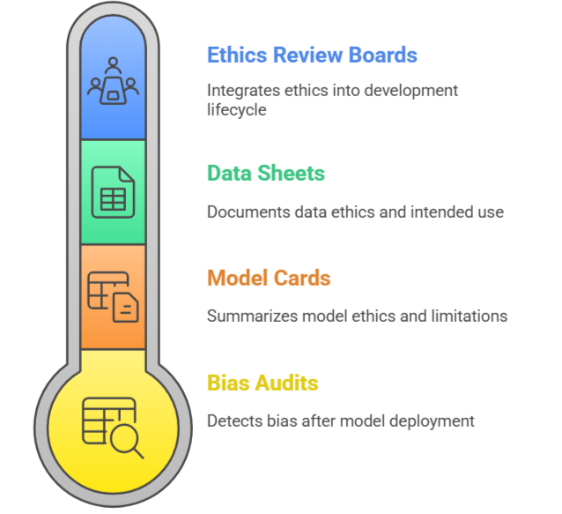
Slide Title
Best Practices for Ethical AI Coding
Notes:
Bias Audits: Regularly review datasets and model outputs.
Model Cards: Provide structured summaries describing model purpose, performance, limitations.
Data Sheets for Datasets: Document data origin, collection methods, intended use.
Ethics Review Boards: Integrate ethics review into the AI development lifecycle.

Slide 13
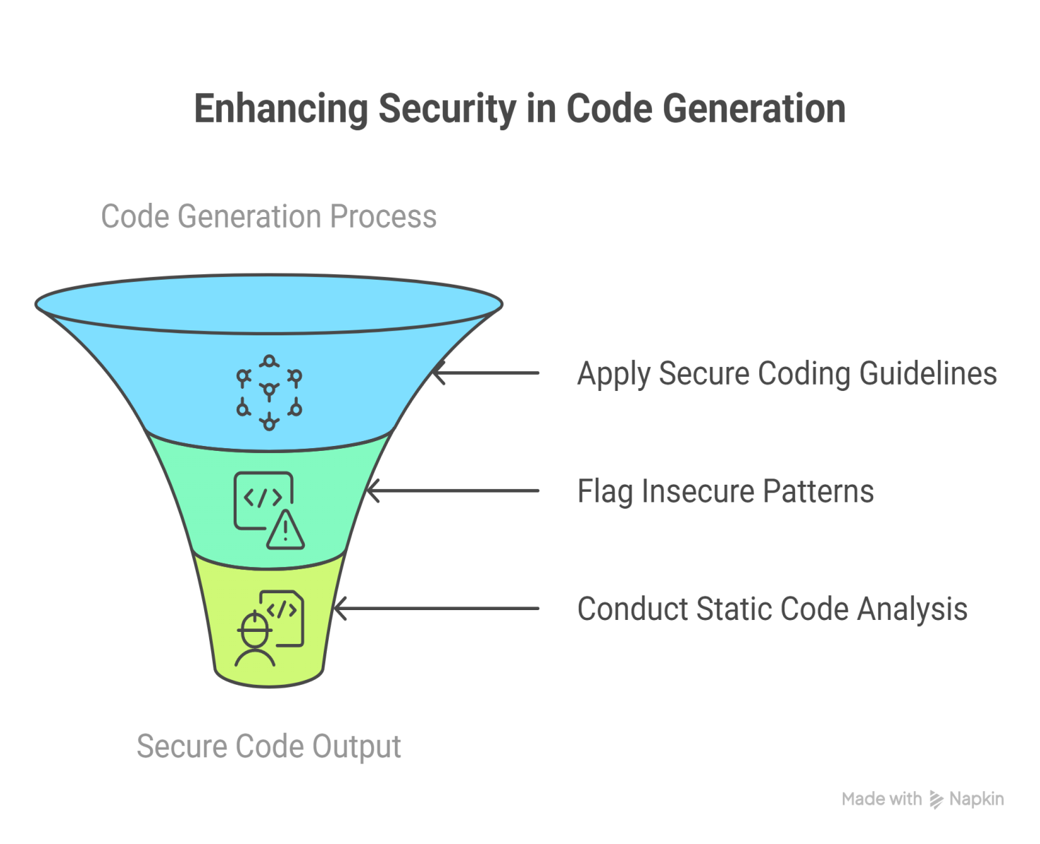
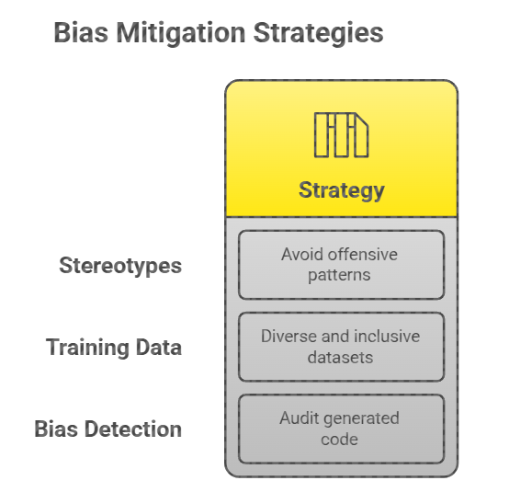
Slide Title
Responsible AI in Code Generation Using AI Tools
Notes:
1. Bias Mitigation in Generated Code
Avoid harmful stereotypes or offensive patterns in comments, variable names, and logic.
Use diverse and inclusive training datasets for code generation tools.
Audit generated code for unintended socio-technical biases.
Security-Aware Code Generation
Implement secure coding guidelines (e.g., OWASP Top 10) in model training and generation.
Flag or reject generation of insecure patterns (e.g., hardcoded credentials, SQL injection vulnerabilities).
Integrate static code analysis tools to review generated code for security issues.

Slide 14
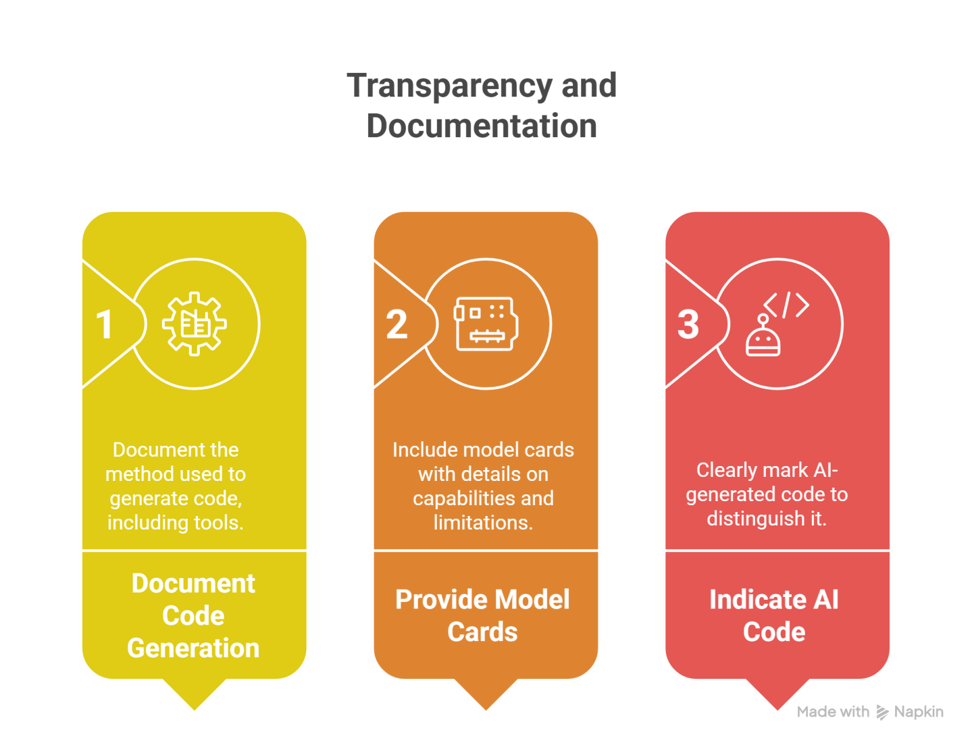
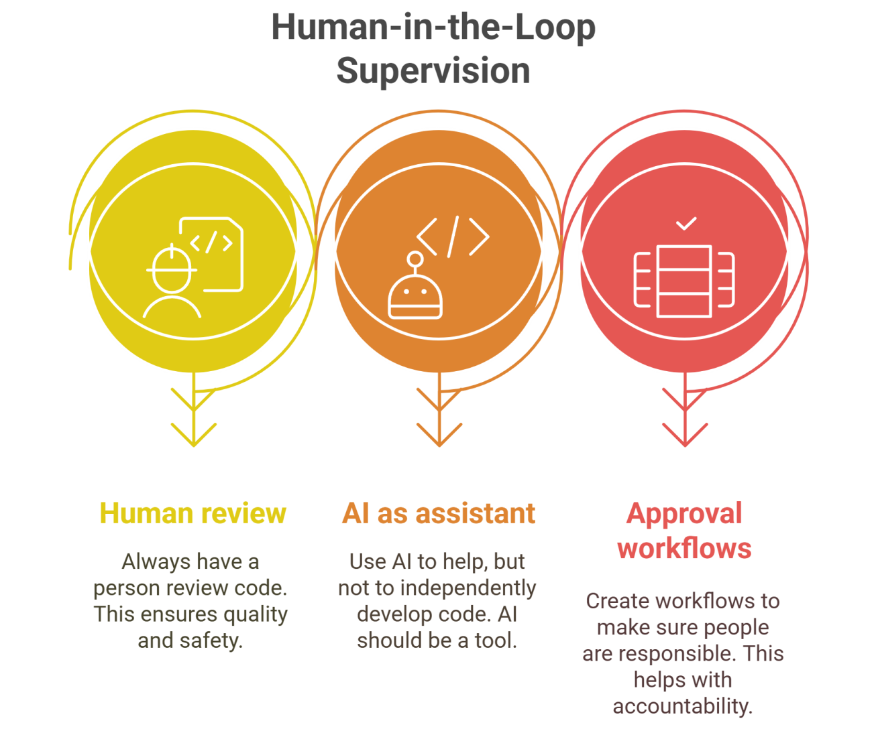
Slide Title
Responsible AI in Code Generation Using AI Tools
Notes:
Transparency and Documentation
Clearly document how code was generated, including the tool used and generation prompts.
Provide model cards or metadata for the AI tool, detailing capabilities, limitations, and risks.
Indicate AI-generated code to differentiate it from human-written code.
Human-in-the-Loop Supervision
Always require human review before deploying AI-generated code.
Use AI tools as assistants, not autonomous developers.
Establish approval workflows to ensure accountability

Slide 15
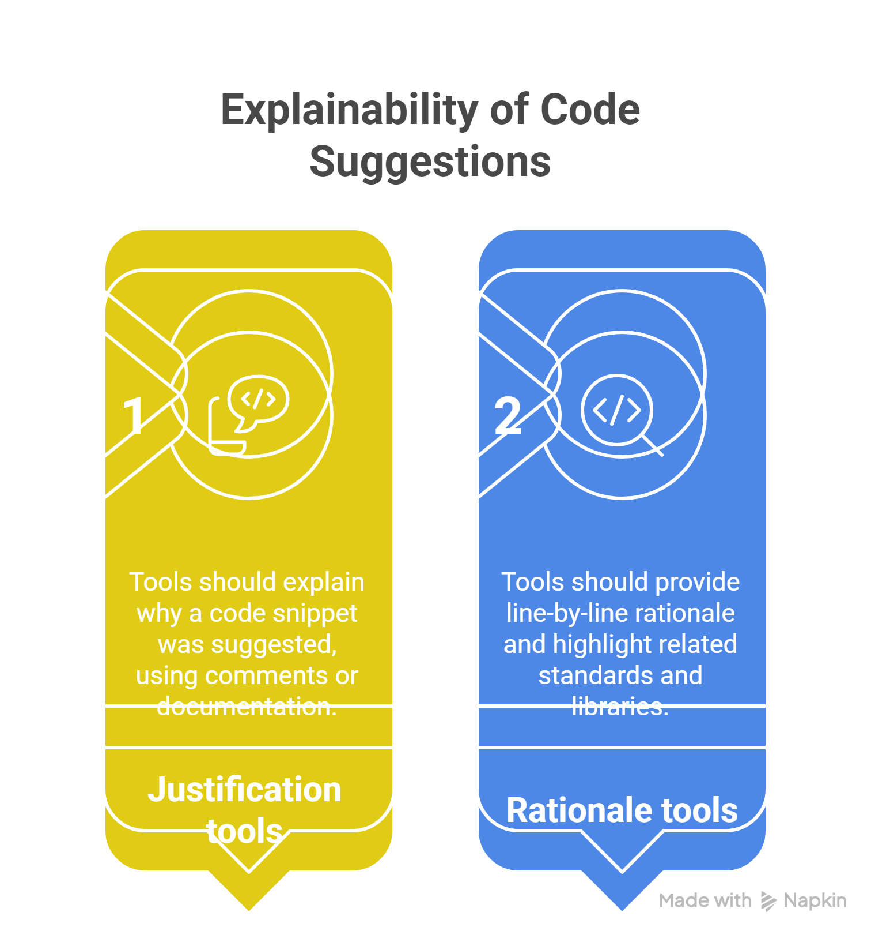
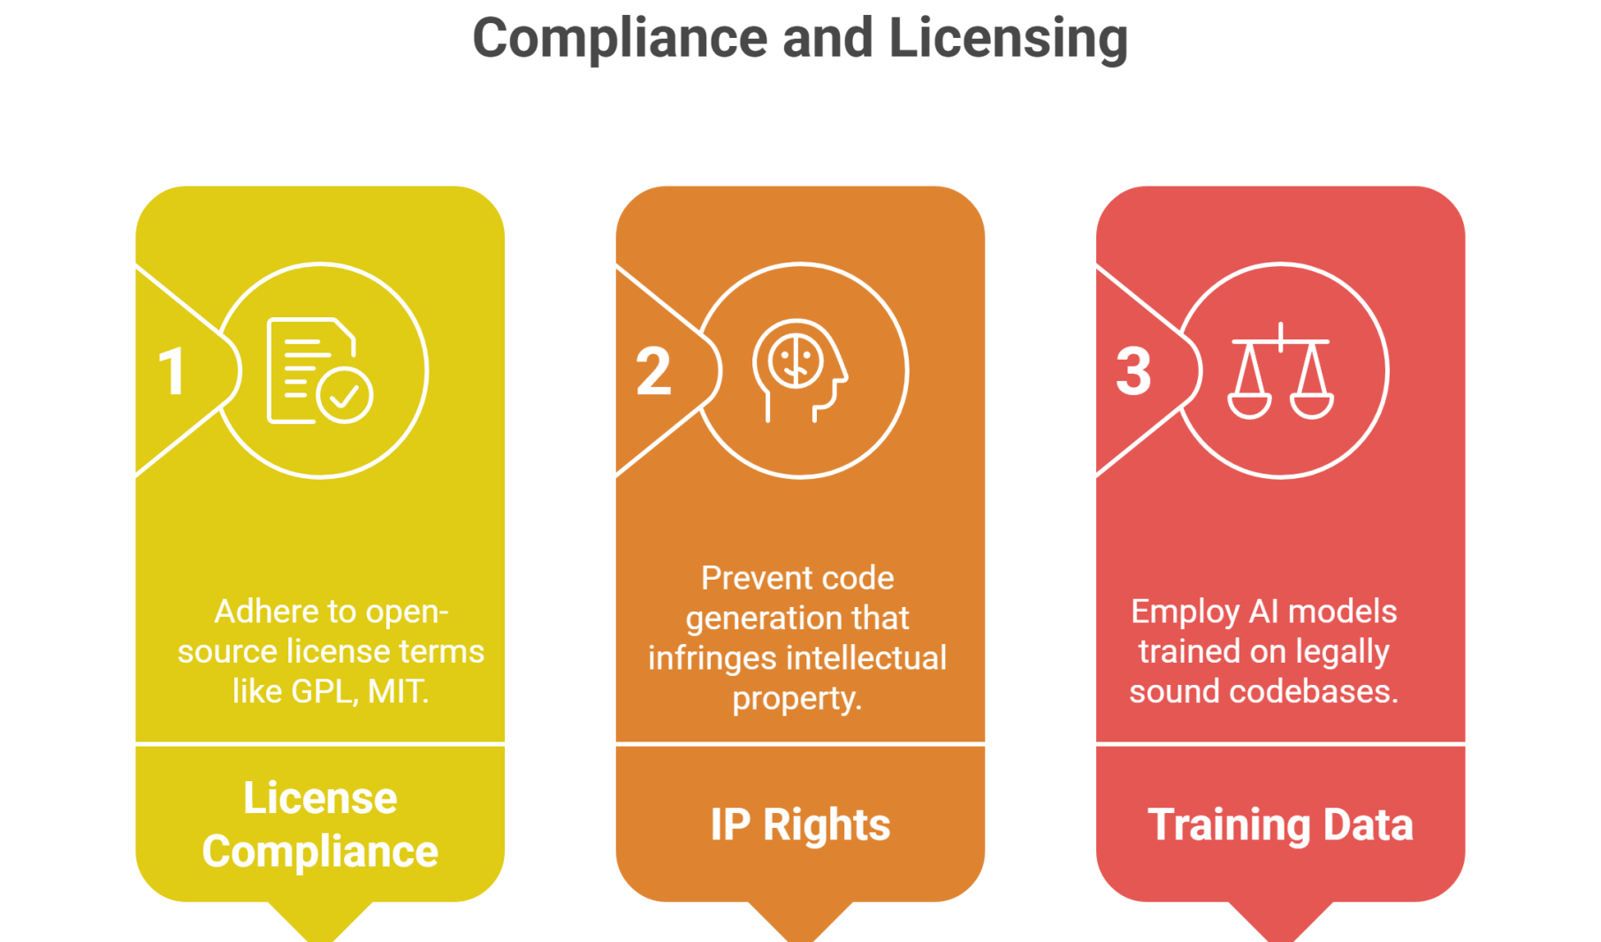
Slide Title
Responsible AI in Code Generation Using AI Tools
Notes:
Explainability of Code Suggestions
Use tools that justify or explain why a code snippet was suggested (e.g., via comments or linked documentation).
Promote tools that provide line-by-line rationale or highlight related standards and libraries
Continuous Monitoring and Feedback Loops
Monitor tool usage to detect harmful or unethical outputs.
Allow users to report problematic code and improve the tool via feedback.
Maintain logs and version control for traceability.
Compliance and Licensing
Ensure generated code respects open-source license terms (e.g., GPL, MIT).
Avoid auto-generating code that violates intellectual property rights.
Use AI models trained on legally permissible codebases.

Slide 16
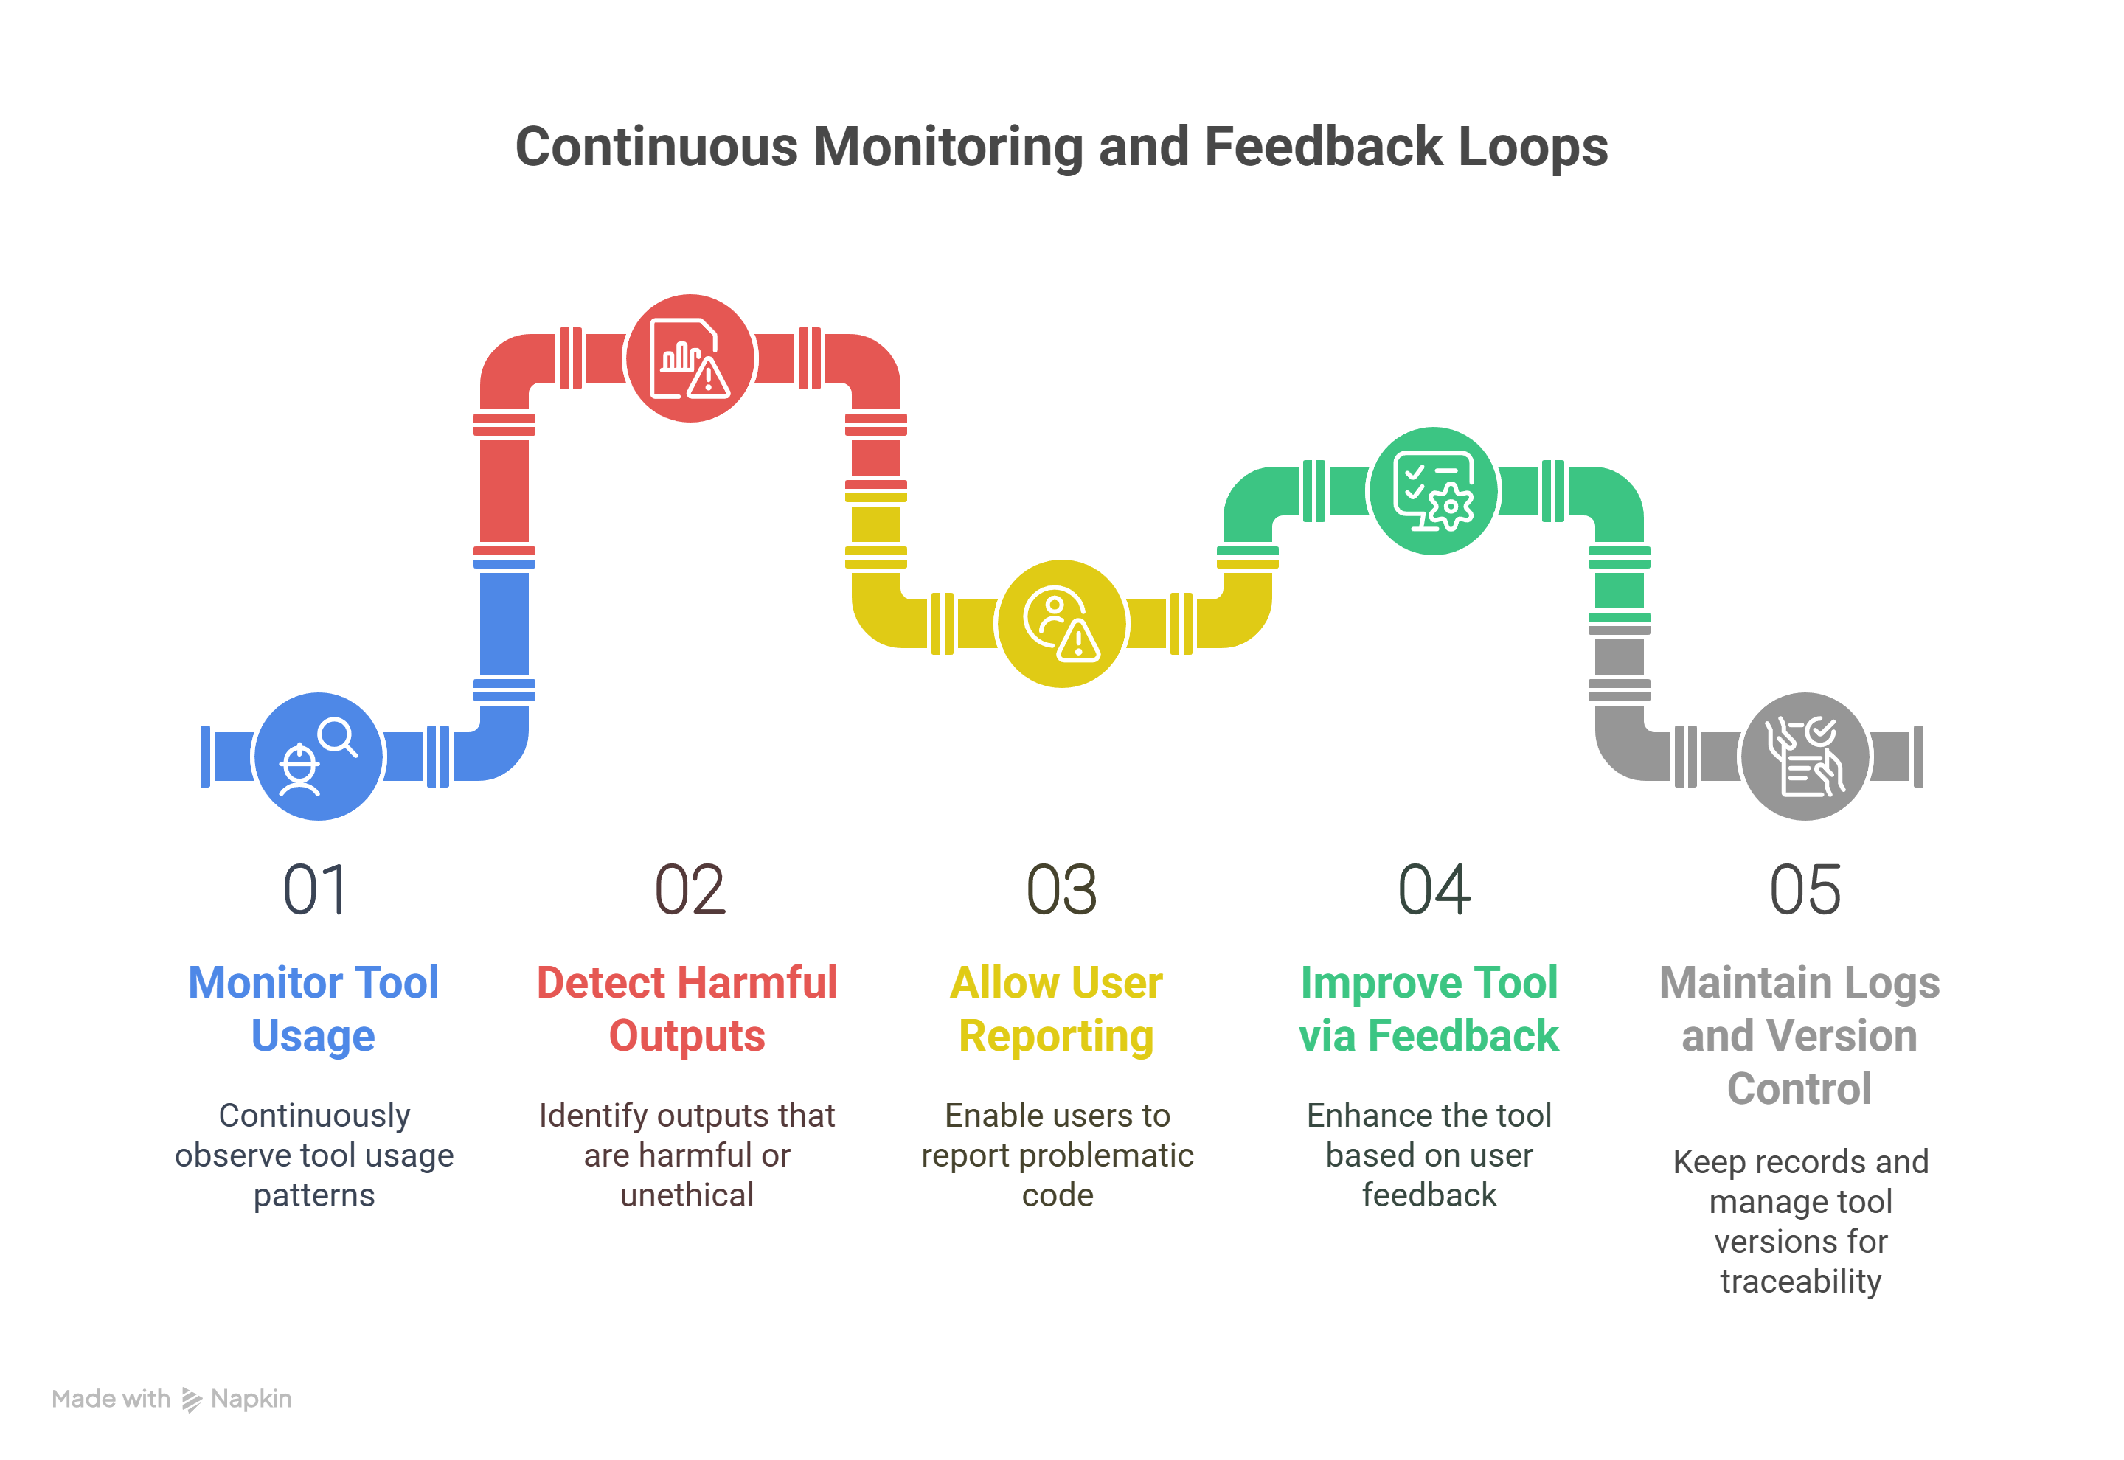
Slide Title
Responsible AI in Code Generation Using AI Tools
Notes:
Explainability of Code Suggestions
Use tools that justify or explain why a code snippet was suggested (e.g., via comments or linked documentation).
Promote tools that provide line-by-line rationale or highlight related standards and libraries
Continuous Monitoring and Feedback Loops
Monitor tool usage to detect harmful or unethical outputs.
Allow users to report problematic code and improve the tool via feedback.
Maintain logs and version control for traceability.

Slide 17
Thank You

