Slide 1

School of Computer Science and AI, SR University
Course Code | Course Title | L | R | P | Cr
25CAI004PC206 | AI Assisted Coding | 0 | 0 | 4 | 2
Program Core
Error Debugging with AI: Systematic approaches to finding and fixing bugs
Lecture - 2
Need of Debugging Types of Bugs Bug Fixing Bug Explanation Suggestion Tutorial
Dr. Venkataramana Veeramsetty
Professor

Slide 2
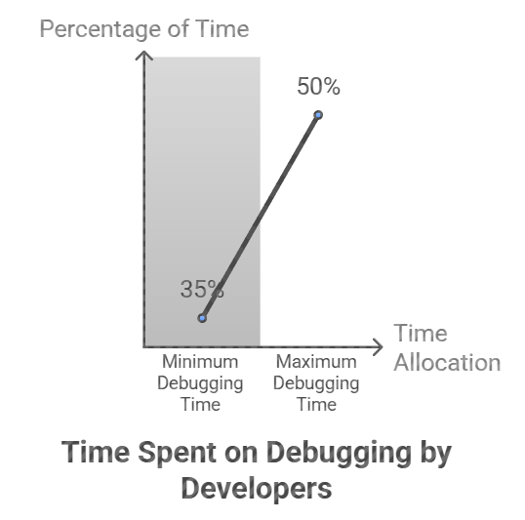
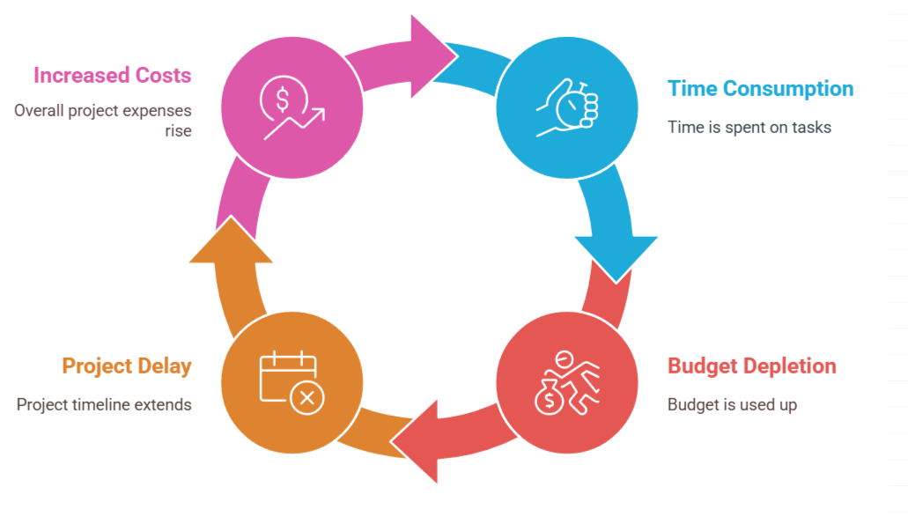
Slide Title
Need of Debugging
Notes:
When creating code, a developer will spend around 35% to
50% of their time on debugging. This is not just a time sink. It
also eats up a big chunk of the budget in a software project.

Slide 3
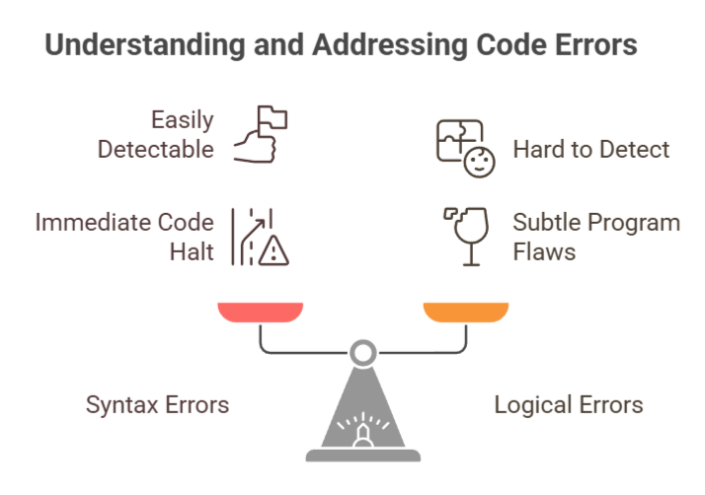
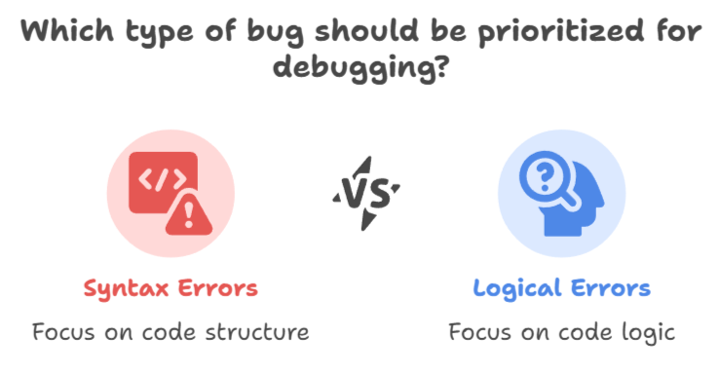
Slide Title
Types of Bugs
Notes:
There are two main types of bugs. First, there are syntax
errors. These pop up when your code doesn’t play by the rules
of the structure of a language. It can be as simple as forgetting
to add a colon at the end of a for loop. A modern IDE like VS
Code should detect and fix many of these types of errors.

Slide 4
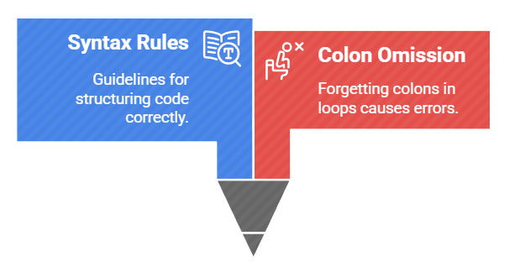
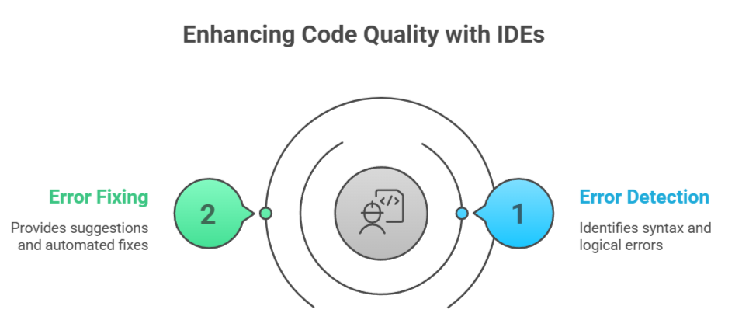
Slide Title
Syntax Bugs
Notes:
There are two main types of bugs. First, there are syntax
errors. These pop up when your code doesn’t play by the rules
of the structure of a language. It can be as simple as forgetting
to add a colon at the end of a for loop. A modern IDE like VS
Code should detect and fix many of these types of errors.

Slide 5
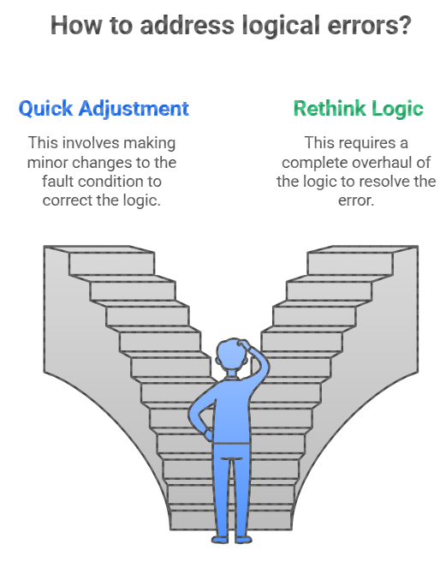
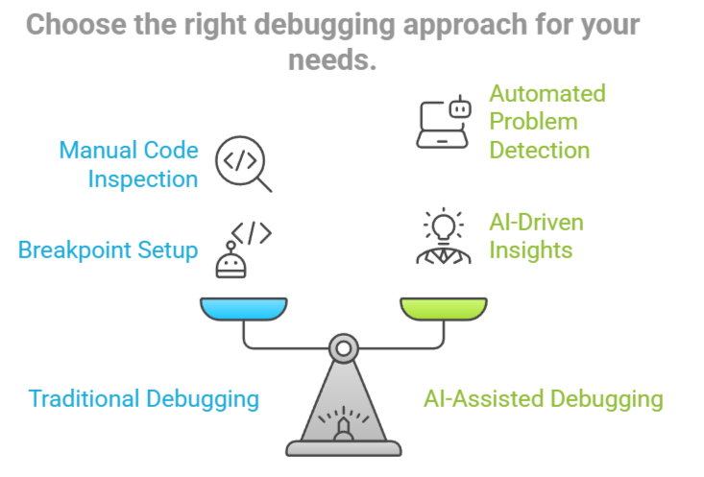
Slide Title
Logical Bugs
Notes:
Next, there are logical errors. These are trickier because they
happen when something in your logic is off. For example,
suppose you have created a program to filter out adult users
from a list based on their age. The only problem is, instead of
excluding everyone aged 18 and above, your code mistakenly
excludes those under 18. So, you end up with a list full of
adults instead of teens. This mix-up is a prime example of a
logical error. Your code is doing the exact opposite of what
you intended. Pinpointing why it’s flagging the under-18
crowd, instead of those 18 and above, can be quite the puzzle
Next, there are logical errors. These are trickier because they happen when something in your logic is off. The fix can range from making a quick adjustment in the fault condition to having to rethink the whole logic
Regardless, using an AI-assisted programming tool is not
something you should start off with when debugging. Often,
traditional approaches should be fine. VS Code provides
powerful debugging features that can detect and resolve
problems. After all, you can easily set up breakpoints to
inspect variable values, walk through the code line by line, and
see what’s exactly happening. These are a lifesaver, especially
in large programs.

Slide 6
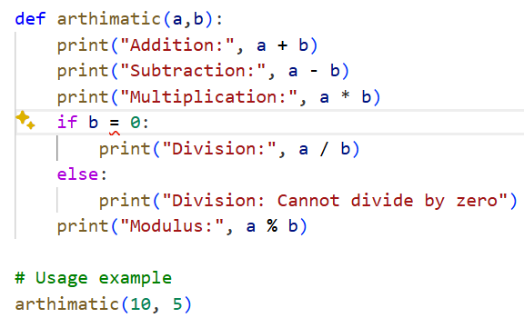
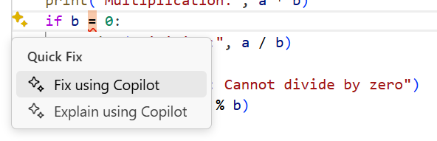
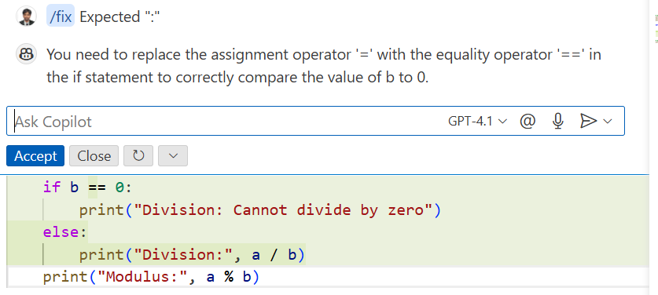
Slide Title
Fix Bug – Using AI Tool
Bug Automatic Identification

Slide 7
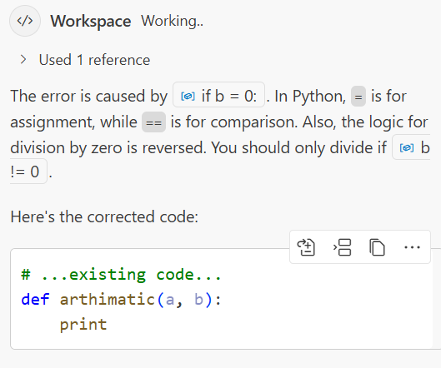
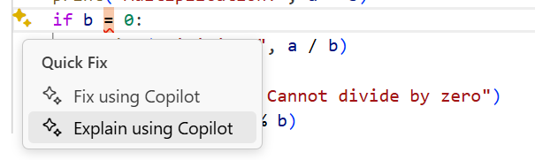
Slide Title
Explain Bug – Using AI Tool

Slide 8
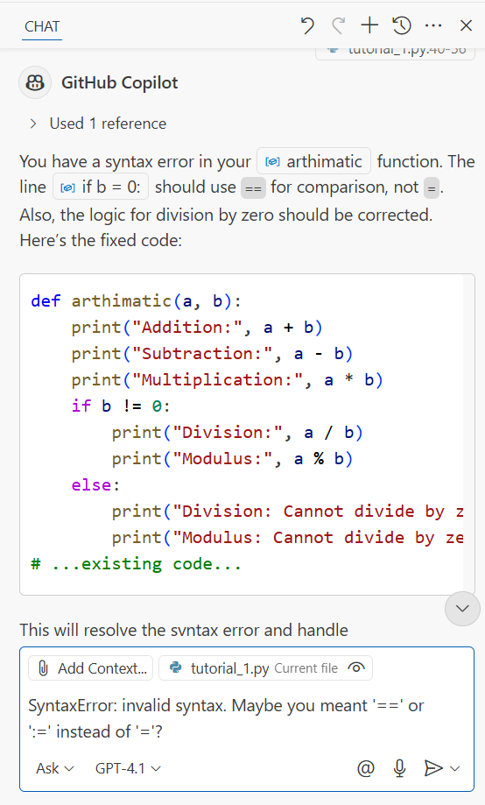
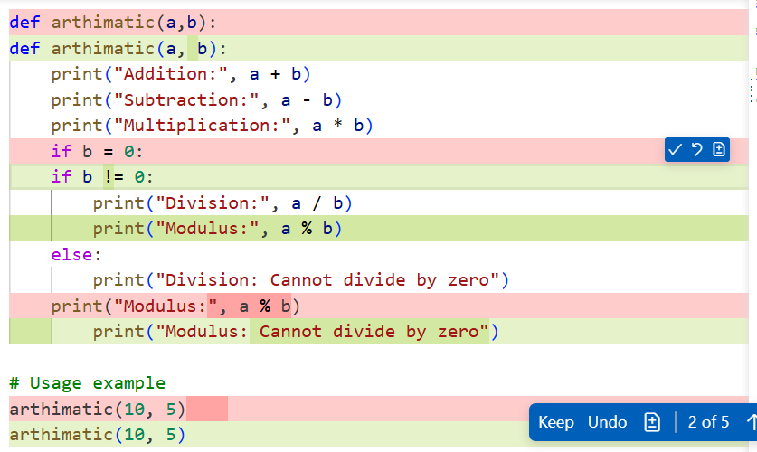
Slide Title
Seeking Suggestion from AI Tool

Slide 9
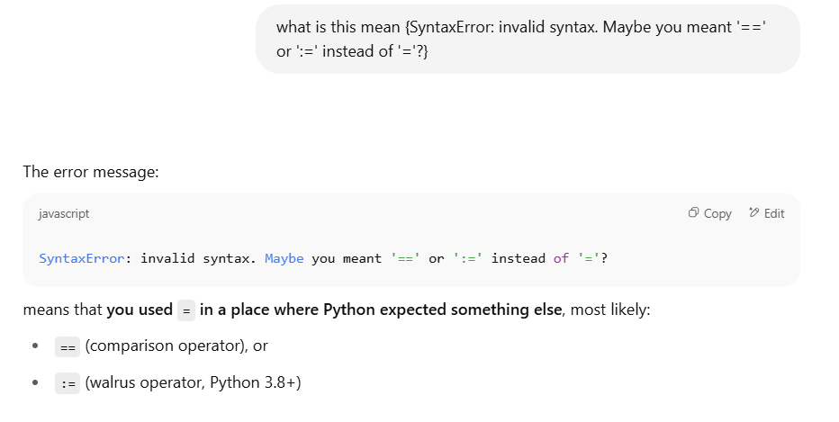
Slide Title
Through on ChatGPT

Slide 10
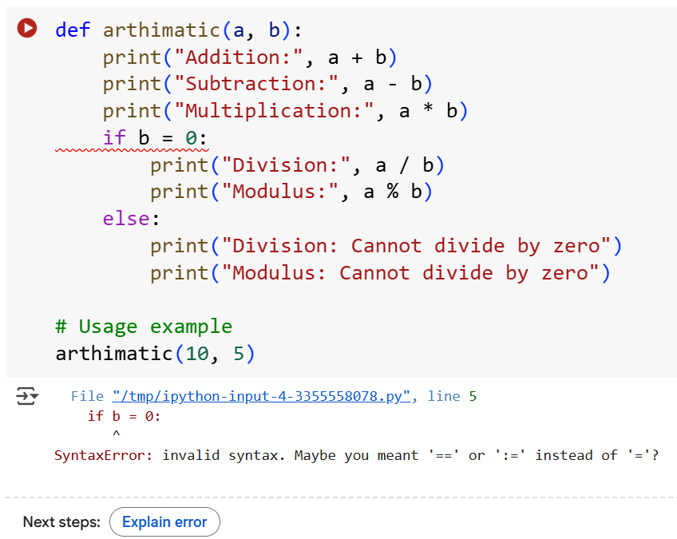
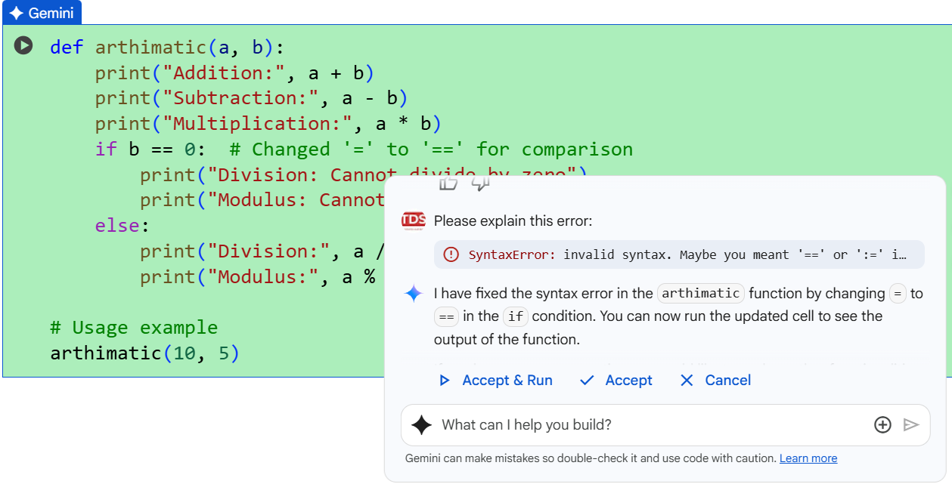
Slide Title
Working on Colab + Gemini

Slide 11
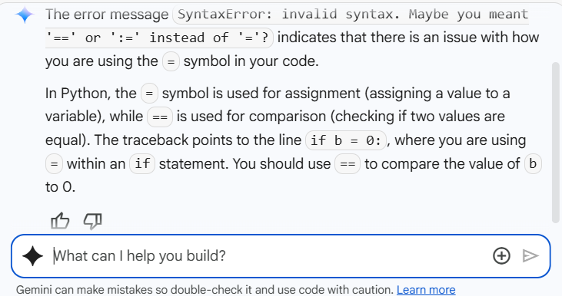
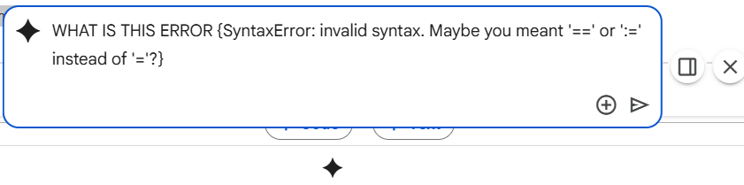
Slide Title
Challenges in AI

Slide 12
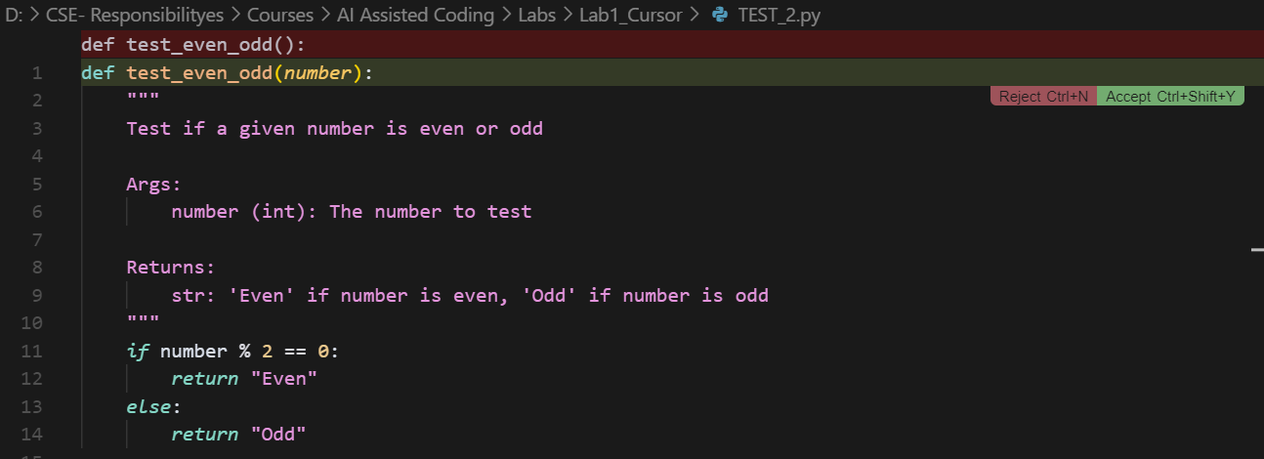
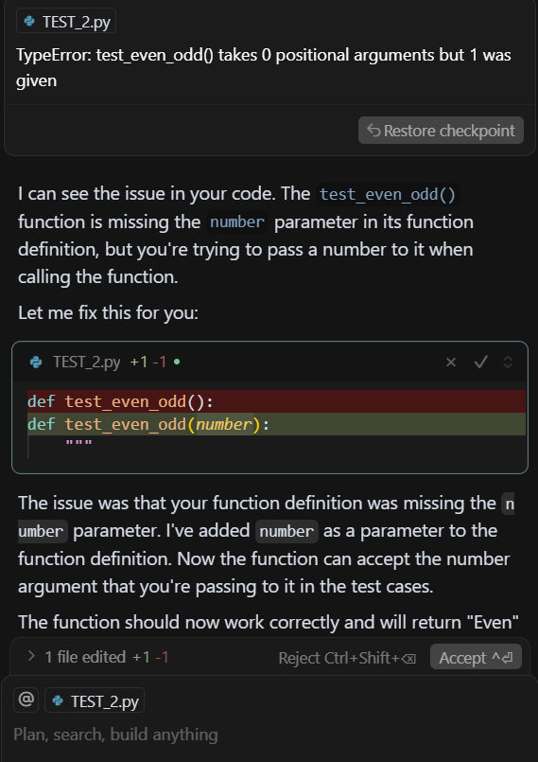
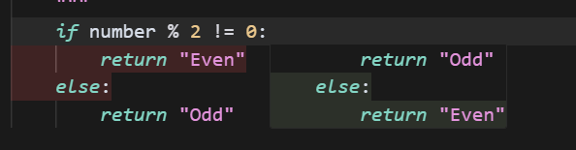
Slide Title
Cursor AI – Code Suggestion and BUG fixing

Slide 13
Thank You

