Slide 1

School of Computer Science and AI, SR University
Course Code | Course Title | L | R | P | Cr
25CAI004PC206 | AI Assisted Coding | 0 | 0 | 4 | 2
Program Core
Test-Driven Development with AI: Generating and working with test cases
Lecture - 2
Testing Tools Benefits of Testing Tutorial
Dr. Venkataramana Veeramsetty
Professor

Slide 2
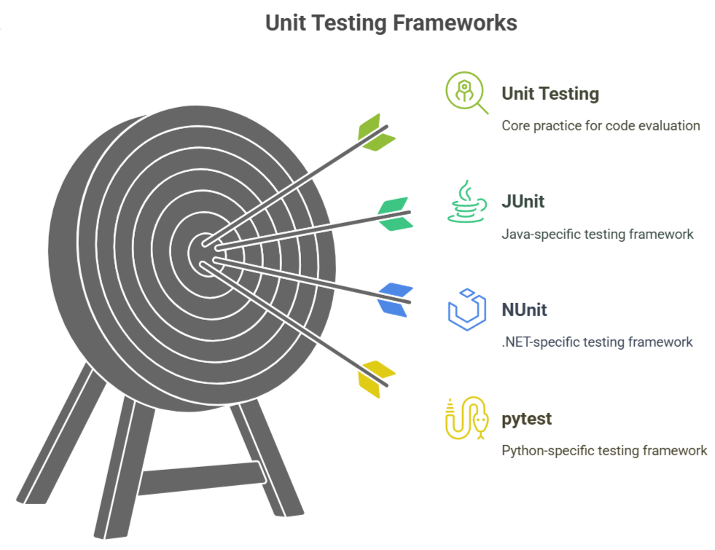
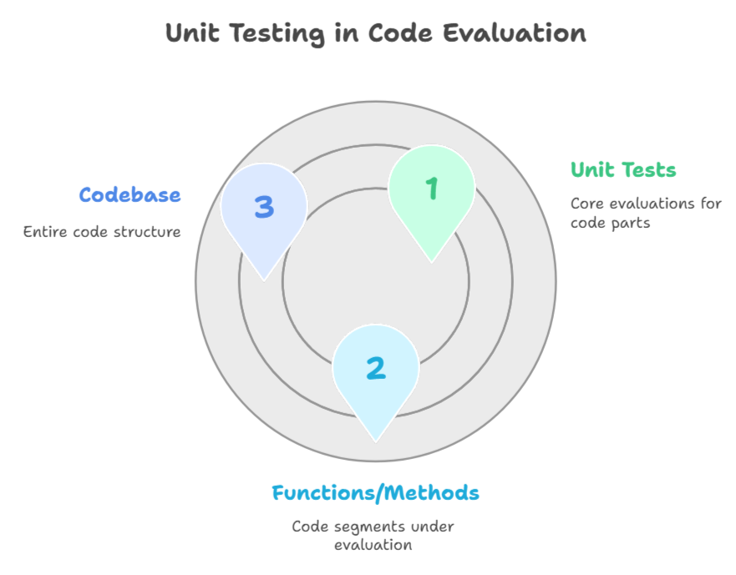
Slide Title
Testing Tools
Notes:
unit tests are mini evaluations for parts of your code,
say for a few functions or methods
Developers often do this
testing themselves using cool tools like JUnit for Java, NUnit
for .NET, or pytest for Python.

Slide 3
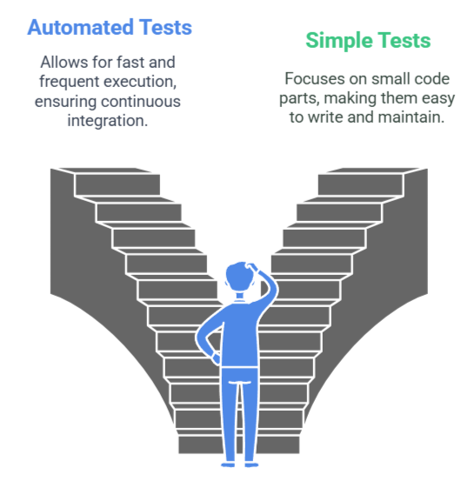
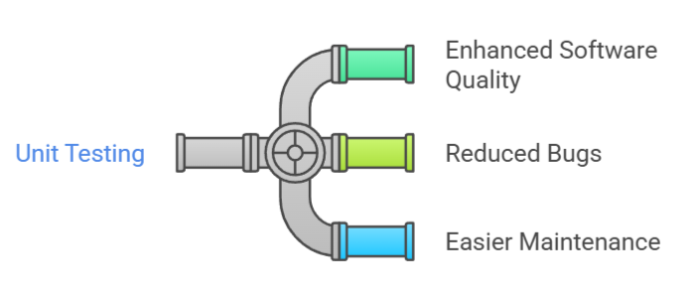
Slide Title
Benefits of Testing
Notes:
Doing unit testing is helpful because it makes your software better, cuts down on pesky bugs, and makes it easier to tweak and fix problems later.
These tests are usually automated, which means they can be run fast and often. If you change your code,
unit tests are great for making sure you haven’t messed up something that was working fine before.
Unit tests are usually straightforward to write. Since they focus on small parts of the code, they shouldn’t be too
complicated. Plus, they’re like a guide to your software.
By checking out the unit tests, other developers can get how certain parts are supposed to work.

Slide 4
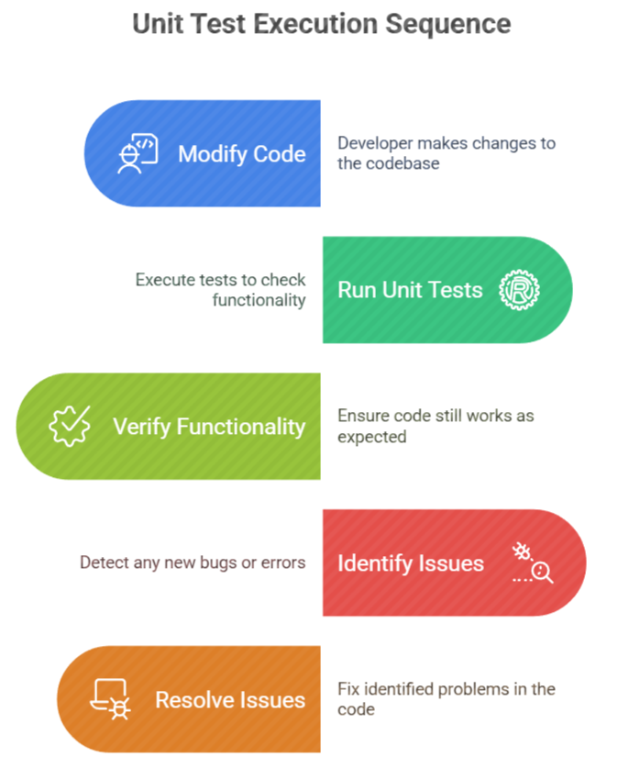
Slide Title
Benefits of Testing
If you change your code, unit tests are great for making sure you haven’t messed up something that was working fine before.
Notes:
If you change your code,
unit tests are great for making sure you haven’t messed up
something that was working fine before.

Slide 5
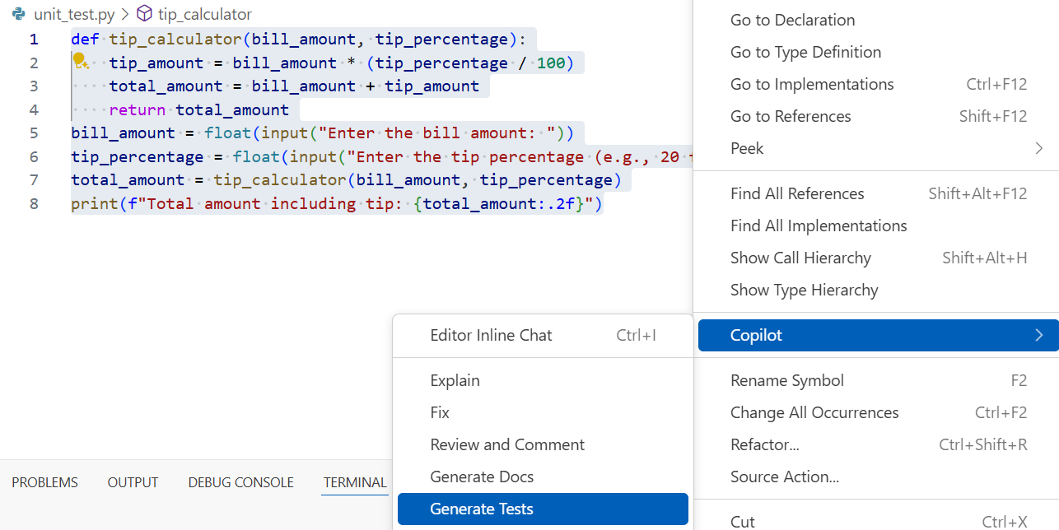
Slide Title
Github Copilot + VS Code
Notes:
If you change your code,
unit tests are great for making sure you haven’t messed up
something that was working fine before.

Slide 6
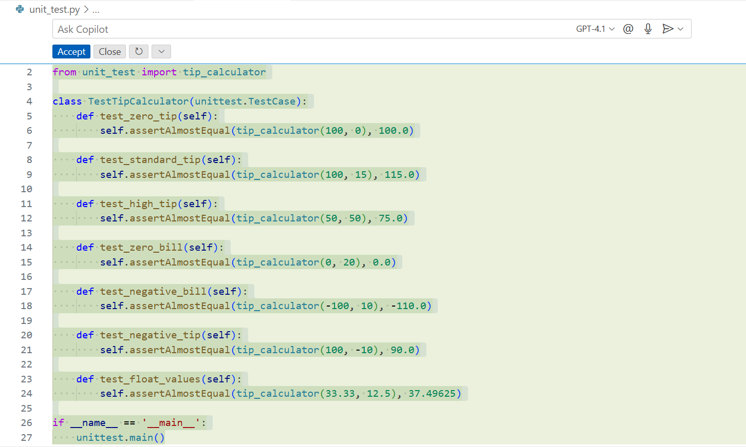
Slide Title
Github Copilot + VS Code
Notes:
If you change your code,
unit tests are great for making sure you haven’t messed up
something that was working fine before.

Slide 7
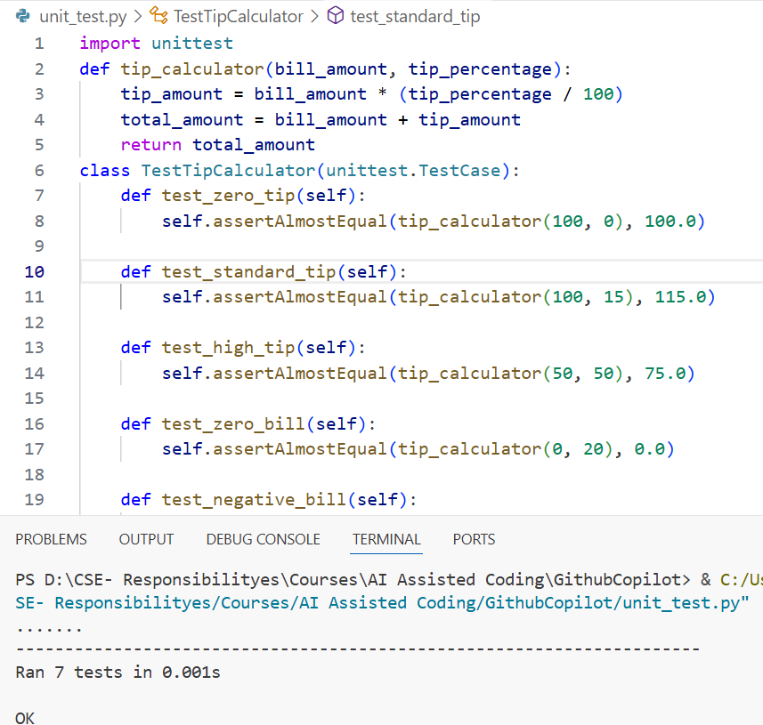
Slide Title
Github Copilot + VS Code
Notes:
If you change your code,
unit tests are great for making sure you haven’t messed up
something that was working fine before.

Slide 8
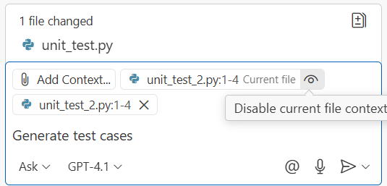
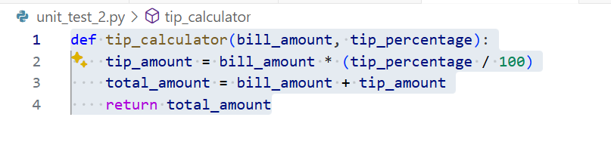
Slide Title
Github Copilot + VS Code
Notes:
If you change your code,
unit tests are great for making sure you haven’t messed up
something that was working fine before.

Slide 9
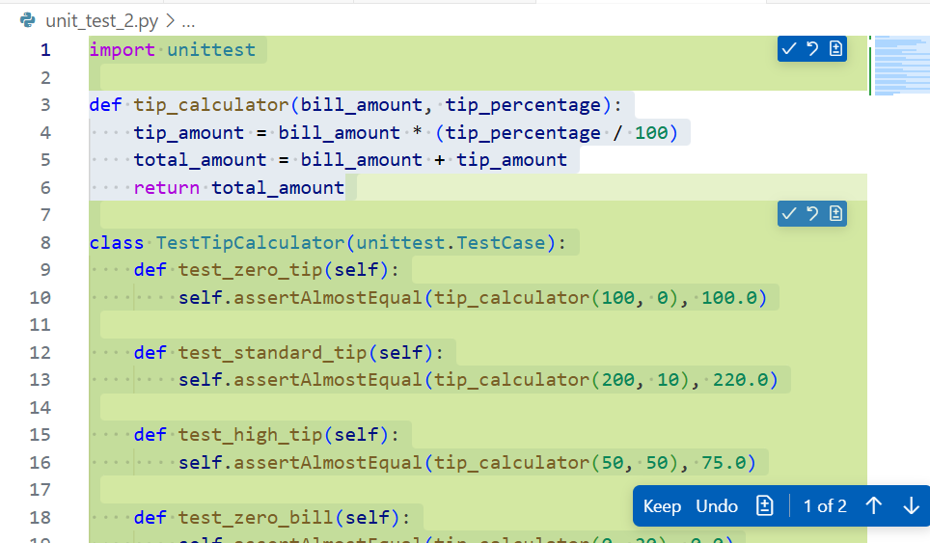
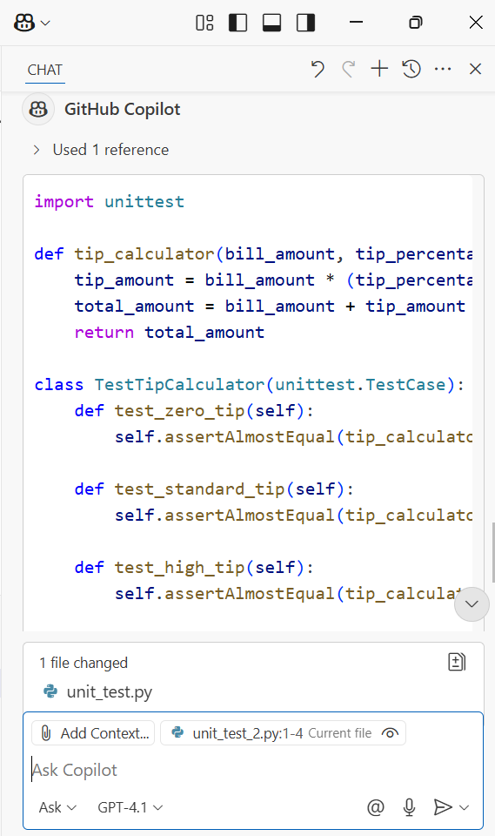
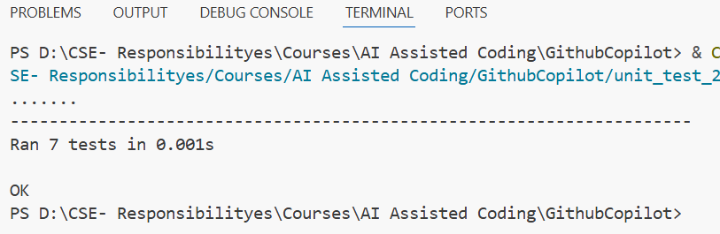
Slide Title
Github Copilot + VS Code
Notes:
If you change your code,
unit tests are great for making sure you haven’t messed up
something that was working fine before.

Slide 10
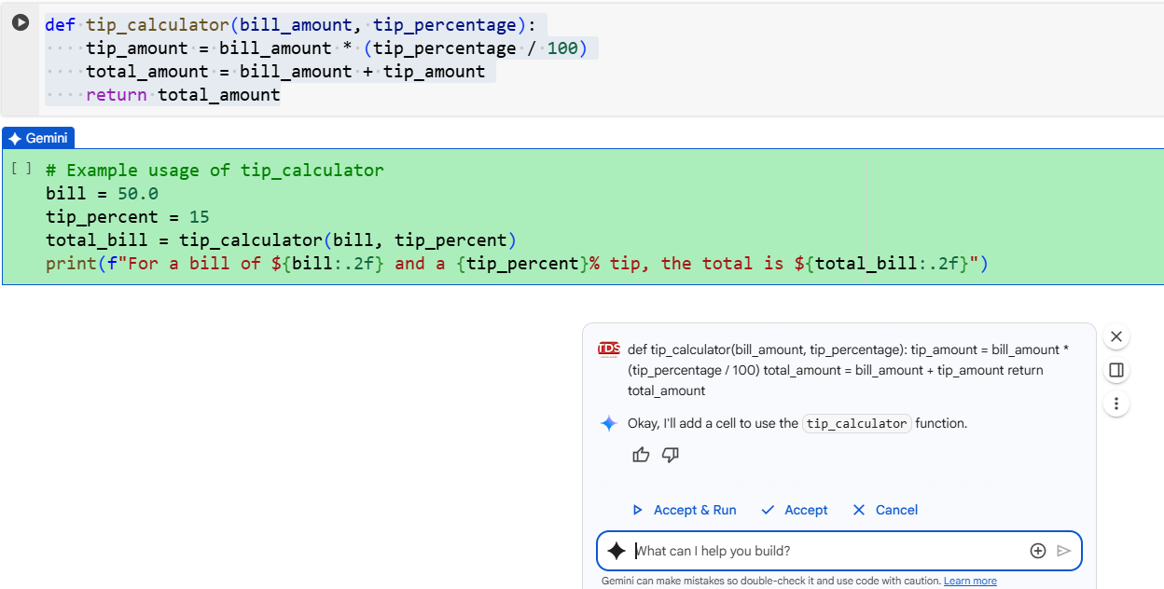
Slide Title
Colab + Gemini
Notes:
If you change your code,
unit tests are great for making sure you haven’t messed up
something that was working fine before.

Slide 11
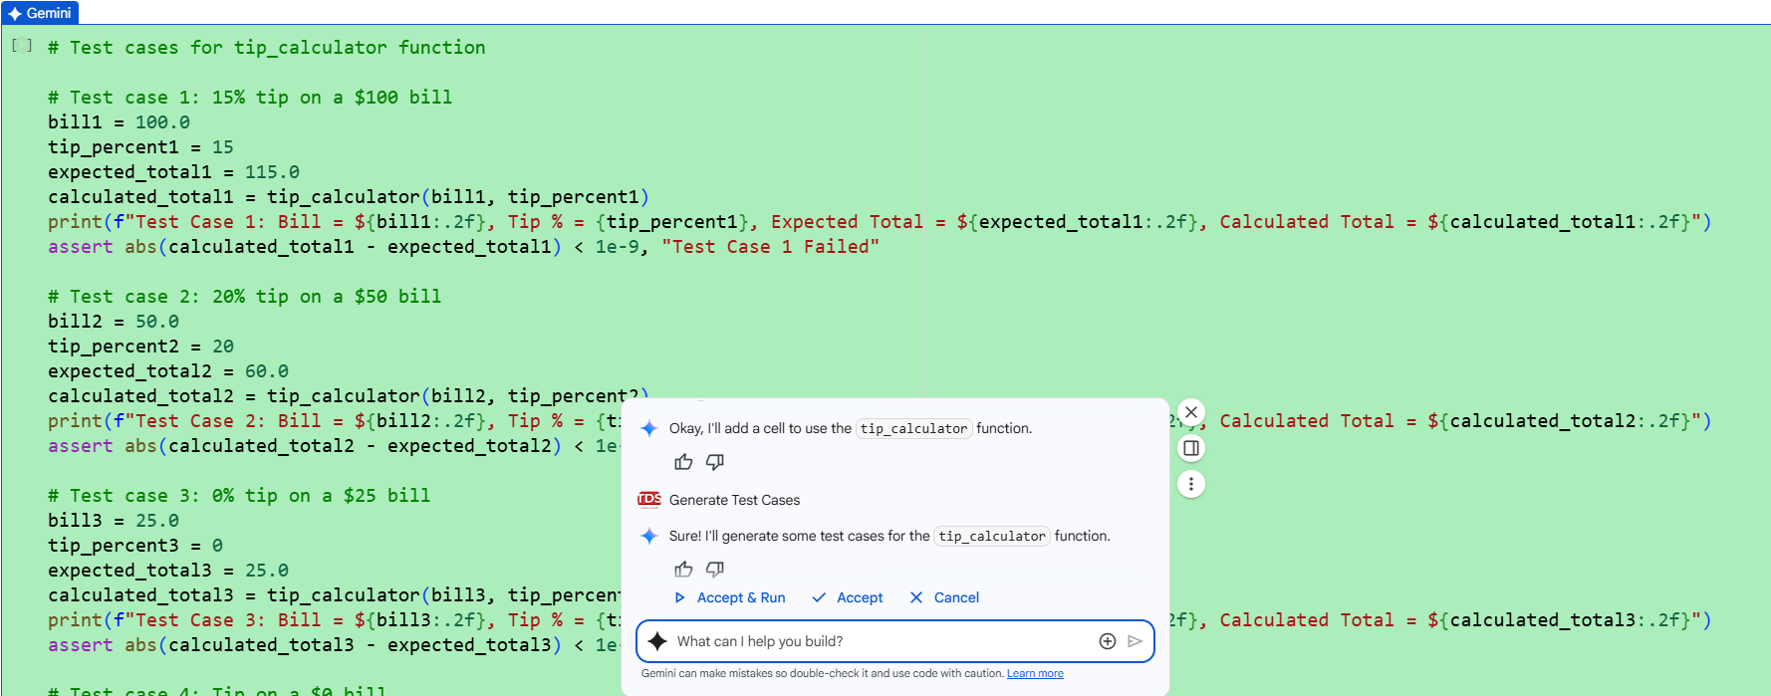

Slide Title
Colab + Gemini
Notes:
If you change your code,
unit tests are great for making sure you haven’t messed up
something that was working fine before.

Slide 12
Thank You

