Slide 1
DEEP NEURAL NETWORKS CONVOLUTIONAL NEURAL NETWORK
Prof. D.M. Vinod Kumar
Dept. of Electrical Engineering
SR University, Warangal

Slide 2
Introduction
Data science is the collection and curetting of mass data for analysis where as AI is the implementing this data in machine for understanding the data.
Data Science is a collection of skills such as Statistical Techniques where as AI Algorithmic Technique.

Slide 3
Deep Learning recognizes the objects in an image.
(i) Artificial Neural Networks (ANN) ---- Pattern Recognition
(ii) Deep Neural Networks (DNN)
(a) Convolutional Neural Networks (CNN)---Image processing
(b) Recursive Neural Network (RNN) Speech Recognition
(c) Deep Belief Network
Applications of DNN:
Self driving cars.
• Face recognition.
• Image classification.
• Object detection.
• Detect object and localize them.

Slide 4
Convolution layers for Computer Vision :
One of the challenges of computer vision problems is that images can be too large.
Example: A 1000 x 1000 image will represent 3 million features (input values) to a fully connected neural network.
If the following layer contains 1000 neurons, then we will have weights of the shape [1000, 3 million] = 3 billion parameters to learn, only in the first layer
That’s so computationally expensive!
One of the solutions is to use convolution layers instead of fully connected layers.

Slide 5
One major problem with computer vision problems is that the input data can get really big.
If we pass such a big input to a neural network, the number of parameters will swell up to a HUGE number (depending on the number of hid.

Slide 6
CNN
Convolution Neural Network (CNN) is Feed forward Neural Network, that is generally used to analyze visual images by processing data with grid like topology.
CNN is also known as ConvNet.

Slide 7
Applications of Deep Learning
Playing Games
Composing Music
Autonomous Driving Cars
Building Robots
Medical Diagnosis

Slide 8
Topology of CNN
CNN is a feed forward NN, that is generally used to analyze visual images by processing data with grid like topology.
A CNN is also know as ConvNet
Convolution neural network is a class of deep learning methods, which has become dominant in various computer vision tasks.
CNN is composed of multiple building blocks, such as convolution layers, ReLU layer and fully connected layer.

Slide 9
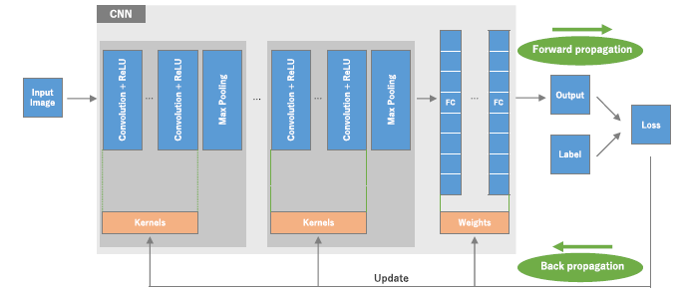
Topology of CNN

Slide 10
Layers in CNN
Input layer accepts the pixel of the image as input in the form of arrays.
Hidden layers carry out FEATURE EXTRACTION (from the image) performing certain calculations and manipulations.
There are multiple hidden layers (FEATURE EXTRACTION )like:
(i) Convolution layer
(ii) ReLU [Rectified Linear Unit]
(iii) Pooling layer (Reduces the dimensionality of Feature map)
Fully connected layer.
(Identifies the object in the image)
(Maps the extracted features into final output, such as classification)

Slide 11
Convolution Process
Convolution Introduction
• A Convolution layer is most famously used for processing 2D images Eg. Convolutional Neural Networks (CNN) are used to identify faces in photos
• To get a general sense, let’s look at Convolution on a 2D image
• To do convolution we will create a tiny square filter, say 3x3 size.
• Each grid (or cell) in the filter is called a ‘weight’
• Move the tiny filter over the entire input image

Slide 12
Convolution Steps to filter input image
For every pixel in the input image:
• Centre the 3x3 filter over it
•Multiply the value of each weight in the filter with the value of the pixel in input image below it.
• Add up those values
• Put the result for that pixel in the output image

Slide 13
IN CNN there are multiple of hidden layers like
Convolutional Layer
ReLU layer (Introduces non-linearity in ConvNet) once the “feature maps” are extracted, the next step is to move them to ReLU layer.
Pooling layer (Pooling is a down sampling operation that reduces the dimensionality of the feature map)
That perform feature extraction from the image.

Slide 14
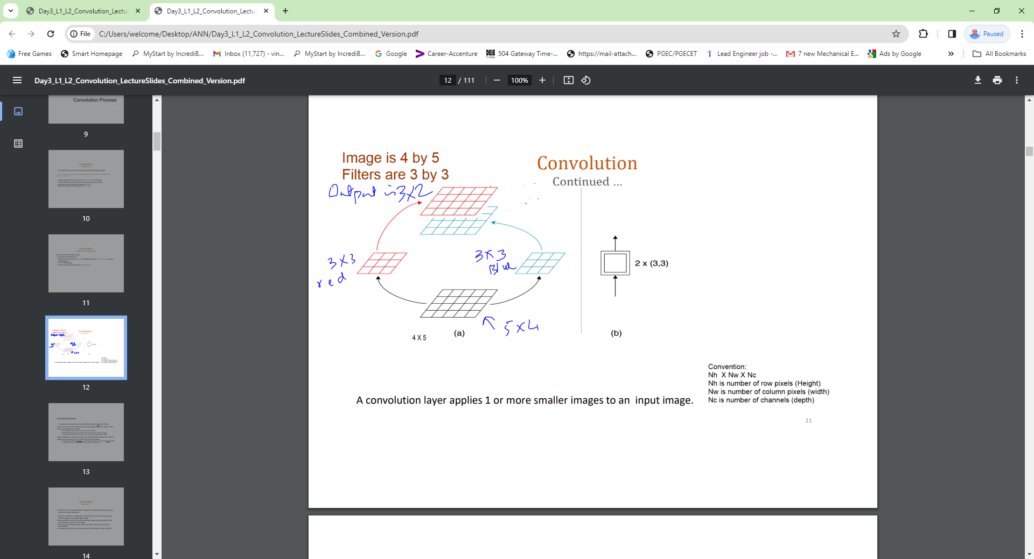

Slide 15
Convolution Continued …
We can have 2,3 or even 300 filters, and each one will follow same process and produce an output image each
• Intuition : Each filter is “looking for” a specific feature in the input image, like
horizontal edge, vertical edge, tiger’s stripe …
•Because the filters scan (move over) the entire image, they can find what they are looking for, anywhere in the image.
•If we use a series of convolution layers, one after the other, they can work hierarchically.
•Each layer using the results of previous layers to help look for larger patterns

Slide 16
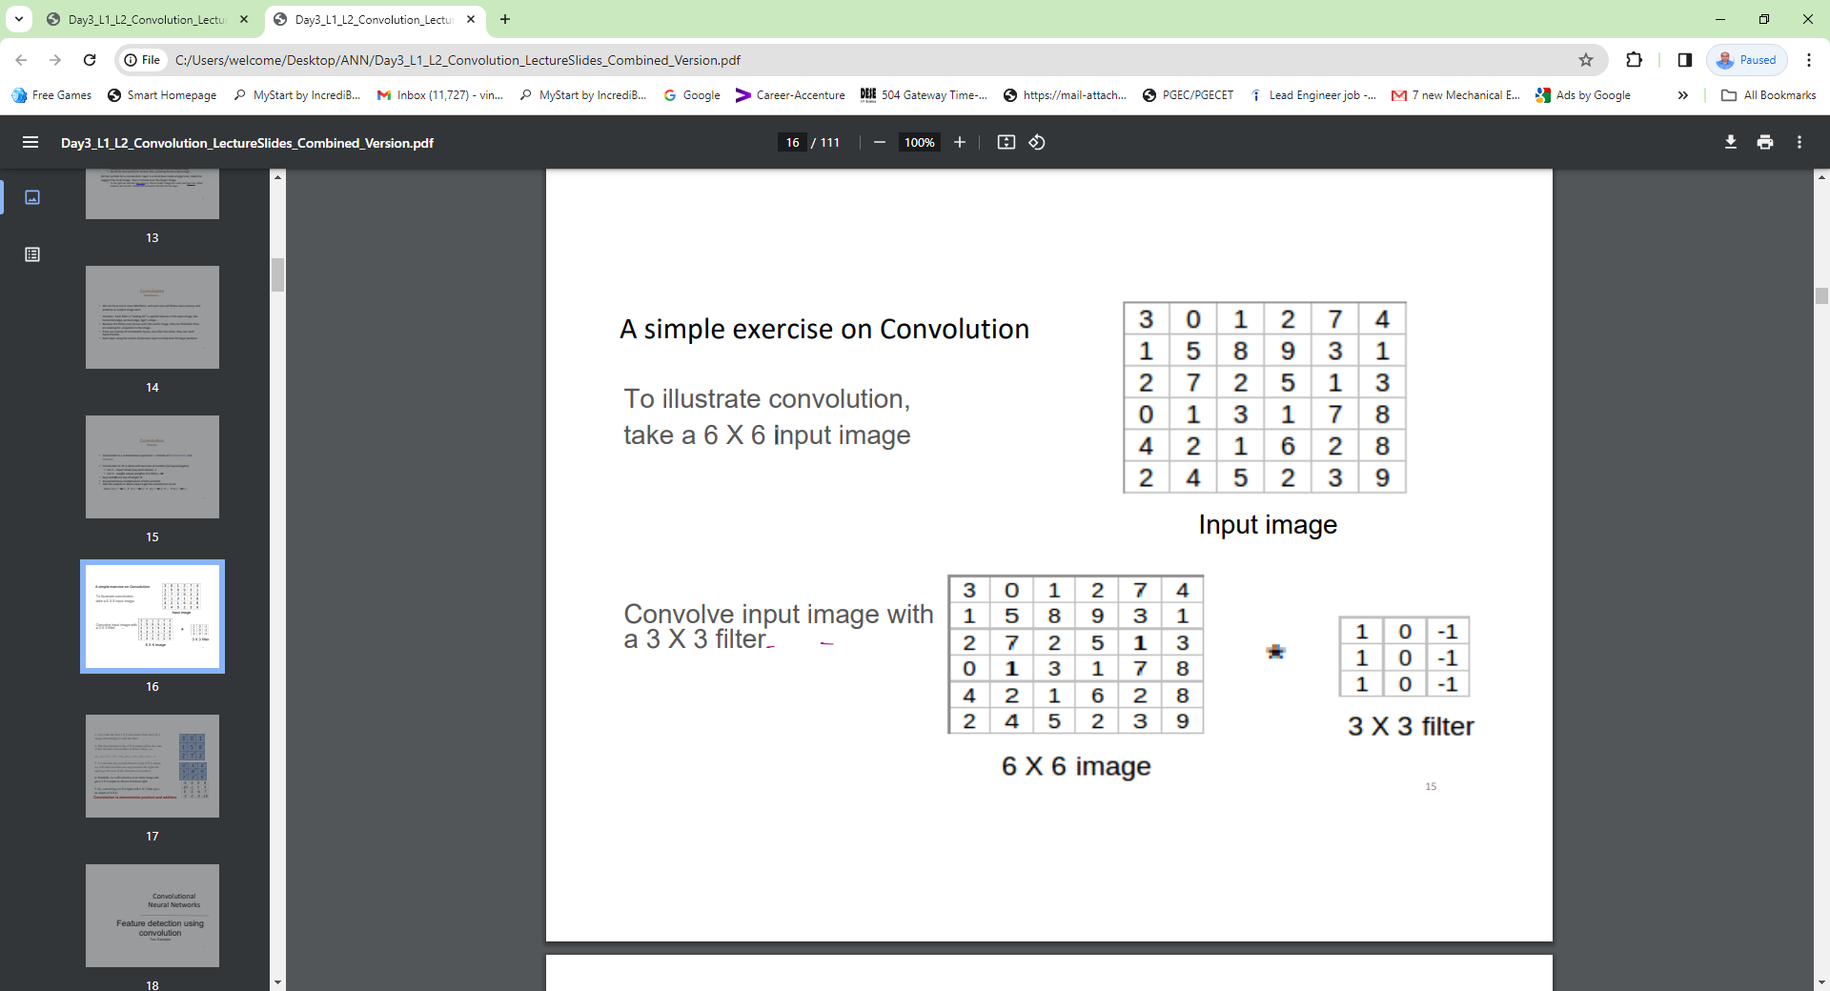

Slide 17
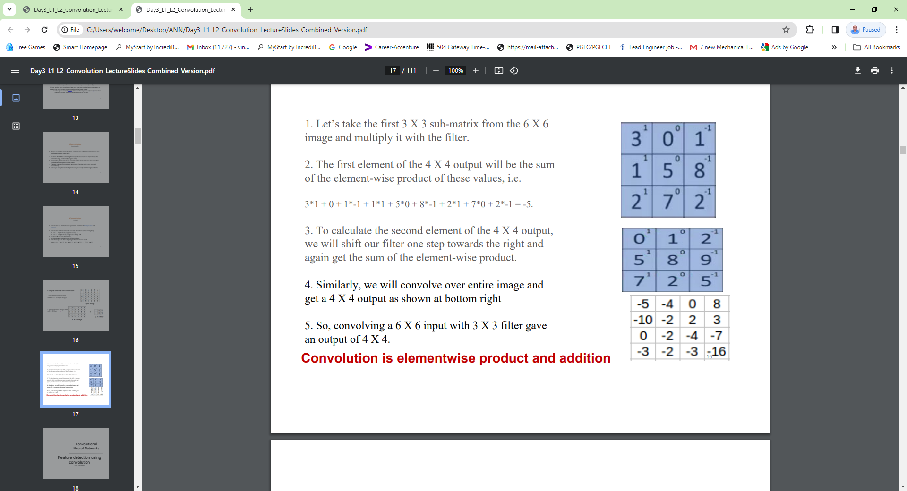

Slide 18
Feature detection using Convolution
•The convolution operation is one of the fundamentals blocks of a CNN.
• Convolution can be used for detecting features in images
•In an image, we can detect features such as vertical lines, diagonal lines, horizontal lines, and more advanced features such
as eyes, nose, beaks, feathers, stripes etc.

Slide 19
Convolution Process (Continued …) Handling multi-channel inputs
CASE : Handling 3D or multi‐Channel Images (such as color image)
•Key thing to note is that the input has multiple channels, say, like 3 channels for a RGB colour image.
•Then, each filter must also have same number of channels, i.e. each filter must have 3 channels for convolving with a RGB color image

Slide 20
Convolution Process
• Convolution is a mathematical operation ‐> Combo of Multiplication and Addition
• Convolution in 1D is done with two lists of numbers (of equal lengths) • List 1 ‐ input values (say pixel values) ‐ I
• List 2 ‐ weight values (weights of a filter) – W
• Say I and W are lists of length ‘n’
• Do elementwise multiplication of list1 and list2
• Add the outputs in above step to get the convolution result Conv = I(1) * W(1) + I(2) * W(2) + I(3) * W(3) + . . + I(n) * W(n)

Slide 21
Convolution layer has a number of filters that perform Convolution Operation.
Convolution is a linear operation --- so we account for non-linearlity by introducing a non-linear function like ReLU.
ReLU activation function is applied to the convolution layer to get a Rectified feature map of the image.
Pooling layer uses multiple filters to detect edges, corners, eyes, features etc.
Fully connected Layer: The flattened matrix form the pooling layer is fed as input to the Fully connected layer to classify the image.

Slide 22
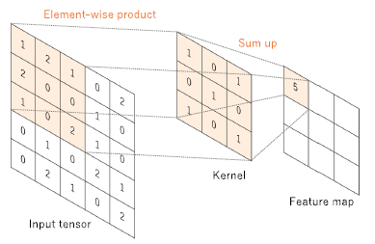
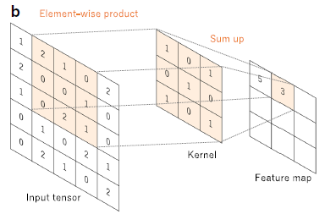
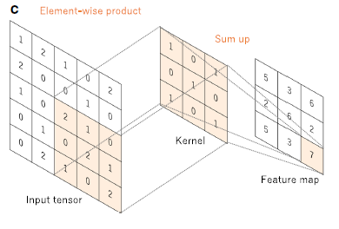
Convolution Operations

Slide 23
FEATURE EXTRACTION
Convolution is one of the main building block of CNN. The term convolution refers to the mathematical combination of the two functions. It merges two sets of information.
In CNN, the convolution is performed on the input data with use of a FILTER or KERNAL (used interchangeably) to produce a feature map.
We execute convolution by sliding the filter over the input. At every location, a matrix multiplication is performed and sum the results on the feature map.
The area of our filter is also called the receptive field,, named after neuron cells. The size of the filter is (3 x 3).

Slide 24
TRAINING
Training a CNN works in the same way as a regular network, using Back Propagation Algorithm (BPA) (Gradient descent).
However, here a bit complex mathematically because of the Convolution Operations.

Slide 25
Using CNN, the four important Hyper parameters we have to decide.
Kernal size
The filter count (how many filters do we want to use)
Stride (how big are the steps of the filter)
Padding.

Slide 26
Convolution Operation form
In CNN every image is represented in the form of arrays and pixel values.

Slide 27
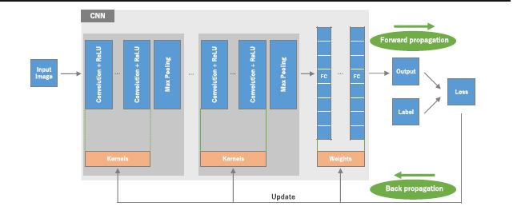
CNN architecture and training process

Slide 28
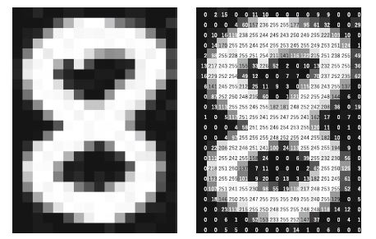
Image

Slide 29
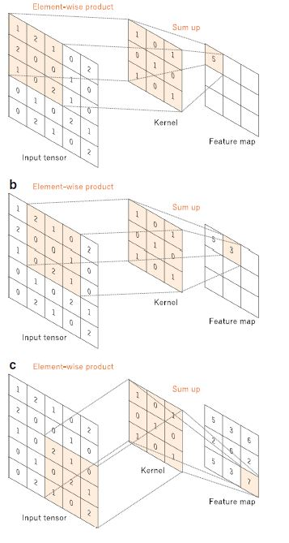
An example of Convolution operation

Slide 30
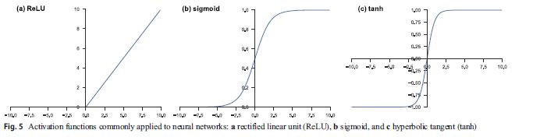
ReLU Function

Slide 31
Convolution operation
6 x 6 IMAGE PIXLES 3 x 3 Filter CONVOLVED FEATURE
3 0 1 2 7 4 1 0 -1 -5 -4 0 8
1 5 8 9 3 1 1 0 -1 -10 -2 2 3
2 7 2 5 1 3 1 0 -1 0 -2 -4 -7
0 1 3 1 7 8 -3 -2 -3 -16
4 2 1 6 2 8
2 4 5 2 3 9
[Sliding the filter matrix
Over the image and computing
DOT product to detect pattern]

Slide 32
After convolution we will get 4 x 4 image
3 1 0 0 1 -1
1 1 5 0 8 -1
2 1 7 0 2 -1
(3 x 1) + (0 x 0) + (1 x -1)+
(1 x 1) + (5 x 0) + (8 x -1)+
(2 x 1) + (7 x 0) + (2 x -1)+
= -5
Similarly we will convolve he entire image and get (4 x 4) output.
-5 -4 0 8
-10 -2 2 3
0 -2 -4 -7
-3 -2 -3 -16

Slide 33
ReLU Layer
Introduces the non-linearity in convolution layer.
Once the “feature maps” are extracted the next step is to move them to ReLU layer.
Y = max (0, x)
ReLU is linear identity for all +ve values
zero for all -ve values

Slide 34
ReLU function
It converges faster.
It is cheap to compute as there is no complicated mathematics. The model can therefore take less time to train or run.
Its sparsely activated. Since ReLU is zero for all negative inputs, its likely for any given unit to not activate at all.
Sparsity results in concise models that often have better predictive power and less over fitting / noise.
Sparse network is faster than dense network.

Slide 35
ReLU Layer
The output of the convolution filter will be passed through a ReLU layer.
Sets all negative pixels to zero (0) and keeps positive values the same.
f(x) = x
f(-3) = 0
f(10) = 10
Perform element wise operation.
Introduces non-linearity to the network.
The output is a rectified feature map.

Slide 36
1 14 -9 4 1 14 0 4
-2 -20 10 6 ReLU 0 0 10 6
-3 3 11 1 0 3 11 1
2 54 -2 80 2 54 0 80
CNN Feature extraction with ReLU function

Slide 37
ReLU Function
x , x > 0
f(x) =
0 , x ≤ 0
= max (0, x)
The derivative of the ReLU function is:
1 , x > 0
f’(x) =
0 , x ≤ 0

Slide 38
The Deep Neural Network is Vulnerable to over fitting , because the model becomes more complicated as it includes more hidden layers.

Slide 39
POOLING LAYER
Pooling is a down sampling operation that reduces the dimensionality of the feature map.
Pooling layers uses different filters to identify the images like edges, corners, body, feathers, eyes, beak etc.,
After a convolution layer once you get the feature maps, it is common to add a pooling layer or a sub-sampling layer or down sampling layer in CNN layers .
The pooling layer is responsible for reducing the spatial size of the convolved feature.
This is to decrease the computational power required to process the data through dimensionality reduction.

Slide 40
Further more, it is useful for extracting dominant features which are rotational and positional invariant, thus maintaining the process of effectively training the model.
POOLING shortens the training time and Controls over-fitting.
There are two types of POOLING
1) Max Pooling and 2) Average Pooling
Max pool performs better than Average pooling.
MAX POOLING performs as a noise suppressant. IT discards the noisy activation altogether and also performs de-noising along with dimensionality reduction.
AVERAGE POOLING simply performs dimensionality reduction as a noise suppressing mechanism.

Slide 41
SUM POOLING

Slide 42
POOLING LAYER
Rectified Feature Map Pooled Feature Map
4 2 7
6 8 5 Max Pooling with 2 x2 filter 6 8
4 0 7 4 7
2 3 1 and STRIDE 2
For example: MAX (2 7 8 5) = 8
MAX (0 7 3 1) = 7
Filter size = 2 Hyper parameters for pooling layer
Stride = 2

Slide 43
Hyper parameters for Pooling Layer
Filter size
Stride and
Max or Average Pooling

Slide 44
STRIDE
Stride is the number of pixels shifts over the input matrix.
Stride is the size of the step the convolution filter moves each time.
A stride size is usually ONE, meaning the filter slides pixel by pixel.
By increasing the stride size , your filter is sliding over the input with a larger interval and thus has less overlap between the cells.
Larger the Stride will produce smaller FEATURE MAP.

Slide 45
PADDING
Because the size of the feature map is always smaller than the input, we have to do something to prevent our feature map from shrinking. This is where we use PADDING.
A layer of zero-value pixels is added to surround the input with zeros, so that our feature map will not shrink.
We have seen that convolving an input of (6 x 6) dimension with a (3 x 3) filter results (4 x 4) output.
Input n x n
Filter size f x f
Output (n-f +1) x (n-f +1)

Slide 46
There are primarily TWO disadvantages:
Every time we apply a Convolution operation, the size of the image shrinks.
Pixels present in the corner of the image are used only a few number of times during convolution as compared to the central pixel. Hence we do not focus too much on the corners since, that can lead to information loss.

Slide 47
PADDING
Pad the picture with ZEROs (ZERO padding) so that it fits.
Drop the part of the image where the filter did not fit. This is called valid padding which keeps by valid part of the image.
A nice feature of the ZERO-PADDING is that it allows us to control the size of the feature maps.
Adding zero-padding is called “Wide Convolution” and not using zero-padding is called “narrow convolution”
To overcome these issues, we can pad the image with an additional border, i.e., we add one pixel all around the edges. This means that the input will be an (8 x 8) matrix, instead of (6 x 6) matrix which is the original shape of the image. This is where padding comes to the fore:

Slide 48
PADDING
Input n x n
Padding p
Filter size f x f
Output (n+2p-f+1) x (n+2p-f +1)

Slide 49
There are TWO common choices for padding:
Valid: It means no padding. If we are using valid padding the output will be (n-f+1) x (n-f+1)
Same: Here we apply padding so that the output size is the same as the input size i.e, n+2p-f+1 = n
p = (f-1)/2
In padding we do not lose a lot of information and the image does not shrink either.

Slide 50
FILTERS
The basic idea of CNN (ConvNet) is to devise a solution for reducing the number of parameters allowing a network to be deeper with less parameters.
Using more “filters” , we can preserve the spatial dimension better.
The more number of filters we have, the more image features get extracted and the better our network becomes at recognizing patterns in unseen images.
Filter, which is set of weights and the filter is symmetrically applied to the input data to create a FEATURE MAP.
The Learnable parameters in CNN are KERNALS & WEIGHTS.

Slide 51
Convolution has nice property of being “translational variant”. Intuitively, this means that each convolution filter represents a “feature” of interest (e.g., pixels in letters) and the CNN algorithm learns which features comprise the resulting reference (i.e., alphabet).

Slide 52
Fully Connected Layer
The output feature maps of the pooling layer is typically flattened i.e., transformed into a one-dimentional (1D) array of numbers (or vectors) and connected to one or more fully connected layers, also known as dense layers, in which every input is connected to every output by a learnable weight.
The input to the fully connected layer are mapped by a sub-set of fully connected layers to the final outputs of the network, such as probabilities for each class in classification tasks.
The final fully connected layer typically has the same number of output nodes as the number of classes.
Each fully connected layer if followed by a non-linear function, such as ReLU.

Slide 53
LAST LAYER ACTIVATION FUCNTION
The last layer activation function applied is different from the other layers.
An appropriate activation function needs to be selected according to each task.
An activation function applied to the multi-class classification task is SOFTMAX function which normalizes out put real values from the last fully connected layer to target class probabilities, where each value ranges between 0 and 1 and values sum to 1.

Slide 54
List of Commonly applied last layer activation functions for various tasks
Task Activation function
Binary Classification Sigmoid
Multiclass single-class classification Softmax
Multiclass multi-class classification Sigmoid
Regression to continuous values Identity

Slide 55
Parameters and Hyper parameters in CNN
Layer Parameters Hyper parameters
Convolution layer Kernels Kernel size, number of kernels, stride, padding, activation function
Pooling layer none pooling method, filter size, stride, padding
Fully connected layers Weights Number of weights and activation function

Slide 56
Soft max Activation function:
The soft max activation function is normally applied to the very last layer in a neural net, instead of using ReLU, Sigmoid, tanh or other activation function.
The soft max is useful because, it converts the output of the last layer in neural net into what is essentially a “Probability distribution”.
Output of Soft max transform are always in the range [0,1] and add up 1. Hence they form “Probability distribution”
Properties of Soft max:
The calculated probabilities will be in the range of 0 to 1.
The sum of all probabilities equal to 1.

Slide 57
The name "softmax" is misleading; the function is not a smooth maximum (a smooth approximation to the maximum function), but is rather a smooth approximation to the arg max function: the function whose value is which index has the maximum. In fact, the term "softmax" is also used for the closely related LogSumExp function, which is a smooth maximum. For this reason, some prefer the more accurate term "softargmax", but the term "softmax" is conventional in machine learning.^{[3][4]} For this section, the term "softargmax" is used to emphasize this interpretation.

Slide 58
Softmax function
Formally, instead of considering the arg max as a function with categorical output {1,......., n} (corresponding to the index), consider the arg max function with one-hot representation of the output (assuming there is a unique max arg):
Arg max (z1, ...., zn) = (y1,....yn) = [0,....1,0,....,0)
where the output coordinate yi=1 if and only if {i} is the arg max of { (z1 ,....,zn}, meaning zi is the unique maximum value of { (z1,....zn}. For example, in this encoding {arg max} (1,5,10) = (0,0,1)} since the third argument is the maximum.

Slide 59
Soft max Probability Distribution
Softmax Output Layers often, we want our output vector to be a probability distribution over a set of mutually exclusive labels. For example, let’s say we want to build a neural network to recognize handwritten digits from the MNIST dataset. Each label (0 to 9) is mutually exclusive, but it’s unlikely that we will be able to recognize digits with 100% confidence.

Slide 60
Softmax function
Using a probability distribution gives us a better idea of how confident we are in our predictions. As a result, the desired output vector is of
9
the form below, where ∑pi = 1: p0 p1 p2 p3 . . . p9 . This is
i = 0
achieved by using a special output layer called a softmax layer. Unlike in other kinds of layers, the output of a neuron in a softmax layer depends on the outputs of all the other neurons in its layer. This is because we require the sum of all the outputs to be equal to 1.

Slide 61

Softmax function
Letting zi be the logit of the i th softmax neuron, we can achieve this normalization by setting its output to:
A strong prediction would have a single entry in the vector close to 1, while the remaining entries were close to 0. A weak prediction would have multiple possible labels that are more or less equally likely

Slide 63
Softmax
The softmax function, also known as softargmax^{[1]:184} or normalized exponential function,^{[2]:198} is a generalization of the logistic function to multiple dimensions. It is used in multinomial logistic regression and is often used as the last activation function of a neural network to normalize the output of a network to a probability distribution over predicted output classes.

Slide 64
Softmax
The softmax function takes as input a vector z of K real numbers, and normalizes it into a probability distribution consisting of K probabilities proportional to the exponentials of the input numbers. That is, prior to applying softmax, some vector components could be negative, or greater than one; and might not sum to 1; but after applying softmax, each component will be in the interval {\displaystyle (0,1)}, and the components will add up to 1, so that they can be interpreted as probabilities. Furthermore, the larger input components will correspond to larger probabilities.

Slide 66
Convolution layer + ReLU layer + Max Pooling =
Feature extraction in multiple hidden layers
Flatten + Fully connected Layer +Soft max = Classification in output
layer
Training: Training a CNN works in the same way as a regular neural network, using BACK PROPAGATION or Gradient Descent. However, here this is a bit more mathematically complex because of the convolution operations.

Slide 67
More Edge detection:
We can use the following filters to detect different edges:
Vertical Horizontal
1 0 -1 1 1 1
1 0 -1 0 0 0
1 0 -1 -1 -1 -1
Sobel Filter Scharr Filter
1 0 -1 3 0 3
2 0 -2 10 0 -10
1 0 -1 3 0 -3

Slide 68
The Sobel filter puts a little bit more weight on the central pixels.
Instead of using these filters, we can create our own as well and treat them as parameter which the model will learn using BPA.

Slide 69
Flatten + Fully Connected Layer + Soft max
Flattening:
Pooling Feature Flattening
6 8 6
4 7 8
4
7
The flattened matrix from the pooling layer is fed as input to the Fully connected layer to classify the image.

Slide 70
The last layers in the CNN are Fully connected, meaning that neurons of preceding layers are connected to every neuron in subsequent layers.
This minimises high level reasoning, where all possible pathways from the input to input are considered.

Slide 71
Convolutions over Volume
The image is broken down into 3 colour channels which is R , G , B.
Each of those colour channels are mapped to the image’s pixel.
Then the computer recognizes the value associated with each pixel and determine the size of the image.
However, for black-white images, there is only one channel.
Input : 6 x 6 x 3
Filter : 3 x 3 x 3
The dimensions above represent the height, width and channels in the input and filter.
Keep in mind the number of channels in the input and filter should be same.
This will result in an output of (4 x 4).

Slide 72
Softmax Output Layers Oftentimes, we want our output vector to be a probability distribution over a set of mutually exclusive labels. For example, let’s say we want to build a neural network to recognize handwritten digits from the MNIST dataset. Each label (0 through 9) is mutually exclusive, but it’s unlikely that we will be able to recognize digits with 100% confidence.
Using a probability distribution gives us a better idea of how confident we are in our predictions. As a result, the desired output vector is of the form below, where ∑i = 0, 9 pi = 1: p0 p1 p2 p3 . . . p9 This is achieved by using a special output layer called a softmax layer. Unlike in other kinds of layers, the output of a neuron in a softmax layer depends on the outputs of all the other neurons in its layer. This is because we require the sum of all the outputs to be equal to 1.
Letting zi be the logit of the i th softmax neuron, we can achieve this normalization by setting its output to: yi = e z i ∑ j e z j A strong prediction would have a single entry in the vector close to 1, while the remaining entries were close to 0. A weak prediction would have multiple possible labels that are more or less equally likely

Slide 73
Since there are THREE channels in the input, the FILTER will consequently also have THREE layers. After convolution, the output shape is a (4 x 4) matrix.

Slide 74
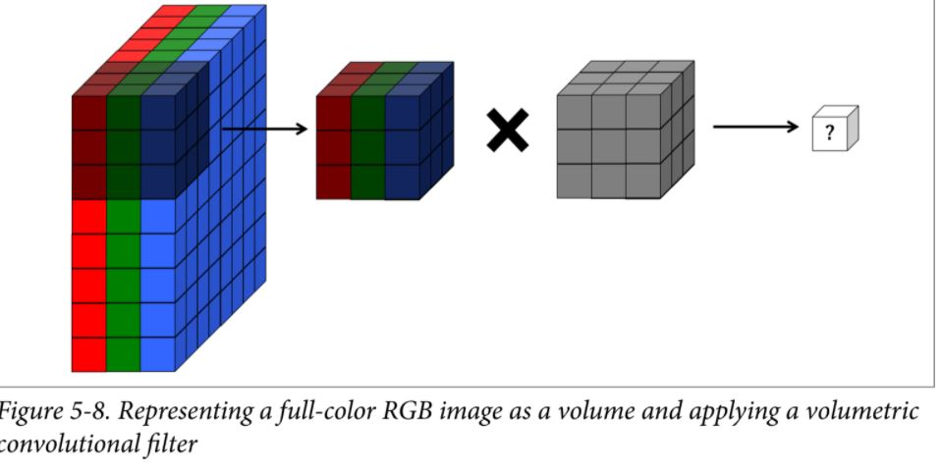
Convolution over volume

Slide 75
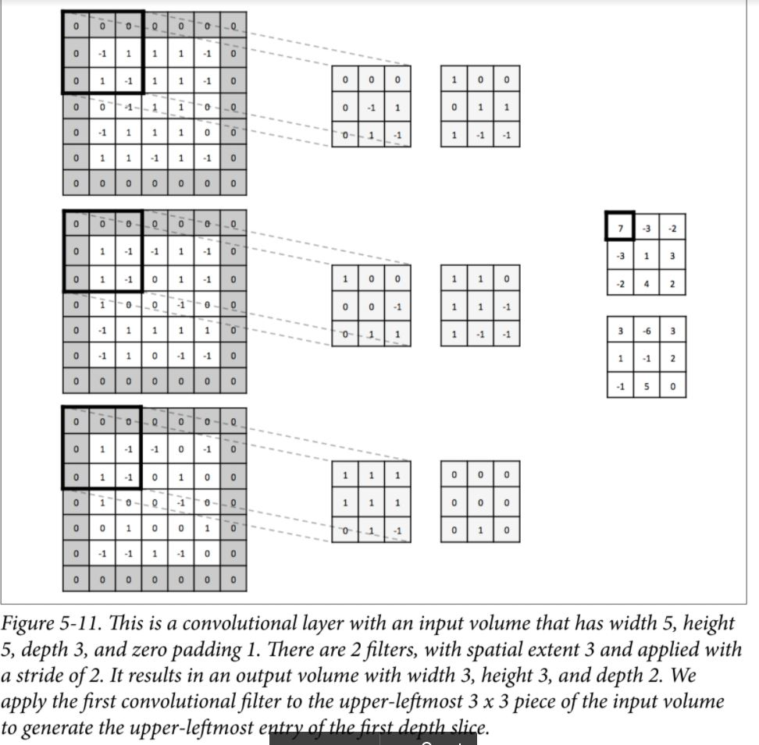

Slide 76
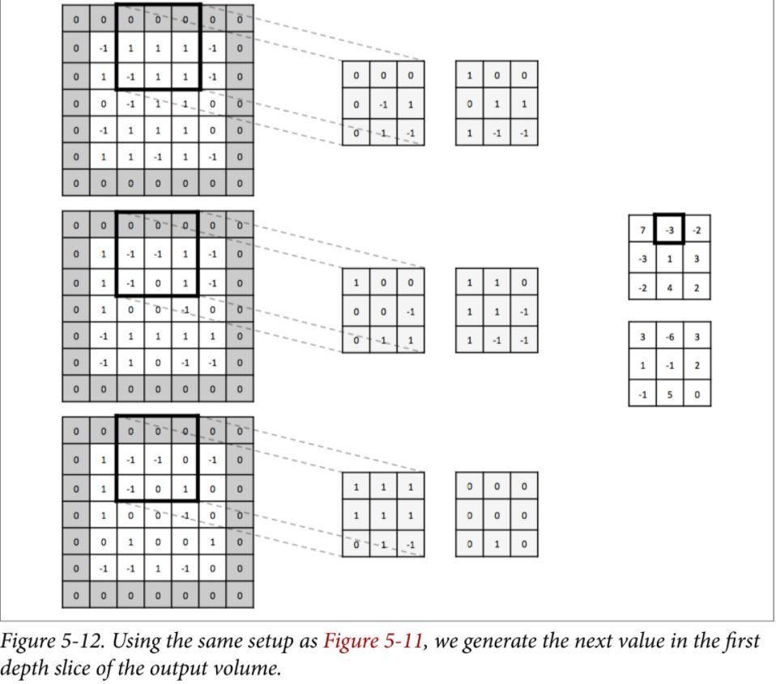

Slide 77
