Slide 1


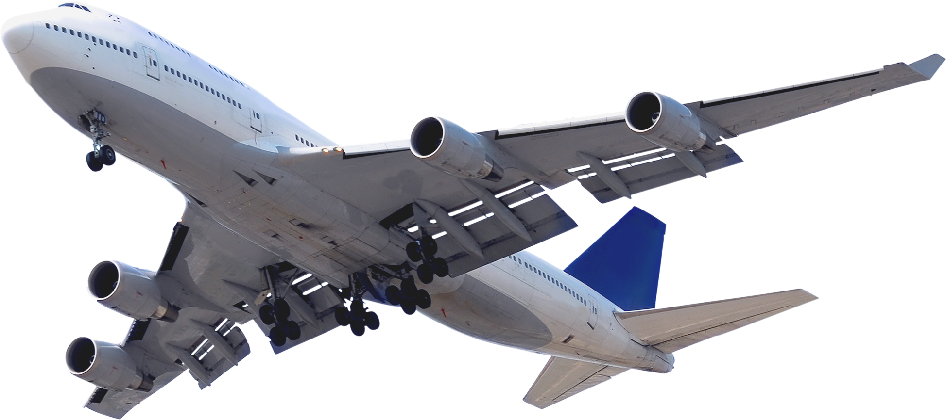


SkySolve
SMARTER CONVERSATIONS. HAPPIER TRAVELERS
Transforming Airline Customer Service with AI
Team 7

Slide 2

Problem Statement
  Airline customer service struggles with:
    Long call handling times
    Repetitive issues
    Manual call summarization
    Low agent productivity
  Customer expectations for fast, efficient support are rising

Slide 3


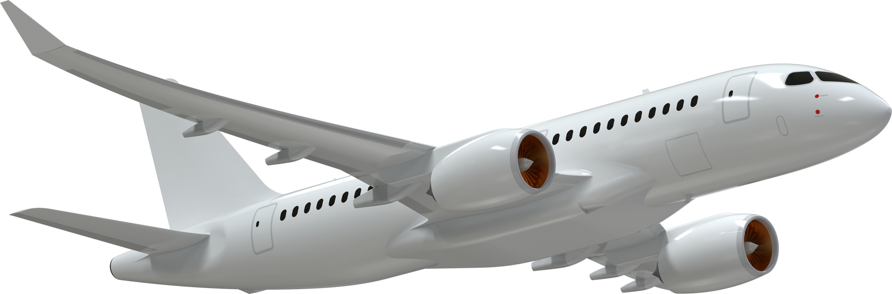


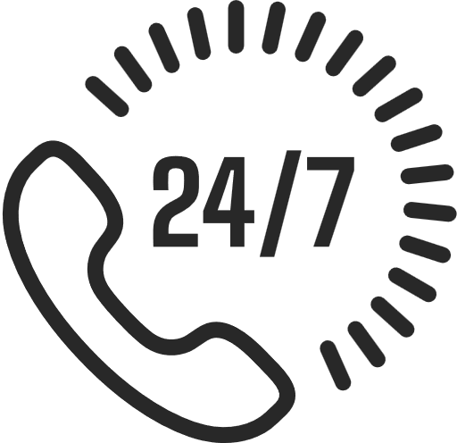
Real-time Transcription: Converts speech to text in real-time
Smart Summarization: Summarizes the conversation highlighting the problem and recommended solution
CRM Integration: Automatically updates airline CRM systems with summaries and metadata, reducing manual agent effort.
Resolution Recommendations: AI suggests the best next steps based on historical data, previous case resolutions, and customer queries.
Multi-Language Support: Seamless support for global airlines with multilingual transcription and summarization. (PROPOSED SCOPE FOR FUTURE)
Key Capabilities

Slide 4
Value Proposition
Pain Point :
Long call duration
Repetitive Queries
Agent Burnout
Rising Expectations
How we Solve It :
Real-time transcription cuts handling time
AI suggests resolutions based on past data
Summarization & CRM integration reduce workload
Fast responses, 24/7 capability (future-ready):

Slide 5
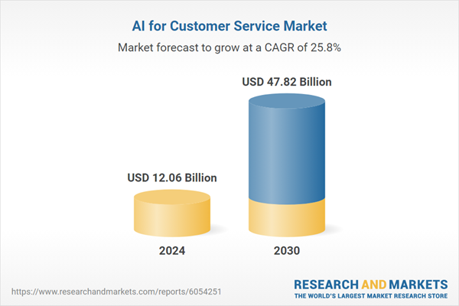
AI in Customer Service Market Growth
The global AI for customer service market is experiencing robust expansion, reflecting a compound annual growth rate (CAGR) of 25.8% during the period of 2024 to 2030.
The TAM encompasses the broader AI-driven customer service market across all industries.
This market is projected to grow to USD 47.82 billion by 2030,with a CAGR of 25.8%
Sources: AI in Customer Service Market Report 2025-2030

Slide 6
Competitive Analysis
Details | Our Solution | Observe.ai | LivePerson | NICE CXone
Objective | Airline call support automation | Agent coaching & QA | Omnichannel automation | Contact center analytics
Real-time Transcription | ✅ Yes | ✅ Yes | ❌ No | ✅ Yes
Smart Summarization | ✅ Yes | ✅ Yes | ❌ No | ✅ Yes
CRM Integration | ✅ Native (airline-specific) | ✅ Partial | ✅ Limited | ✅ Yes
Resolution Suggestions | ✅ AI-driven | ❌ No | ✅ Limited (chatbot) | ✅ Yes
Multilingual Support | 🔜 Planned | ✅ Yes | ✅ Yes | ✅ Yes
Airline-Focused Design | ✅ Yes | ❌ No | ❌ No | ❌ No

Slide 7
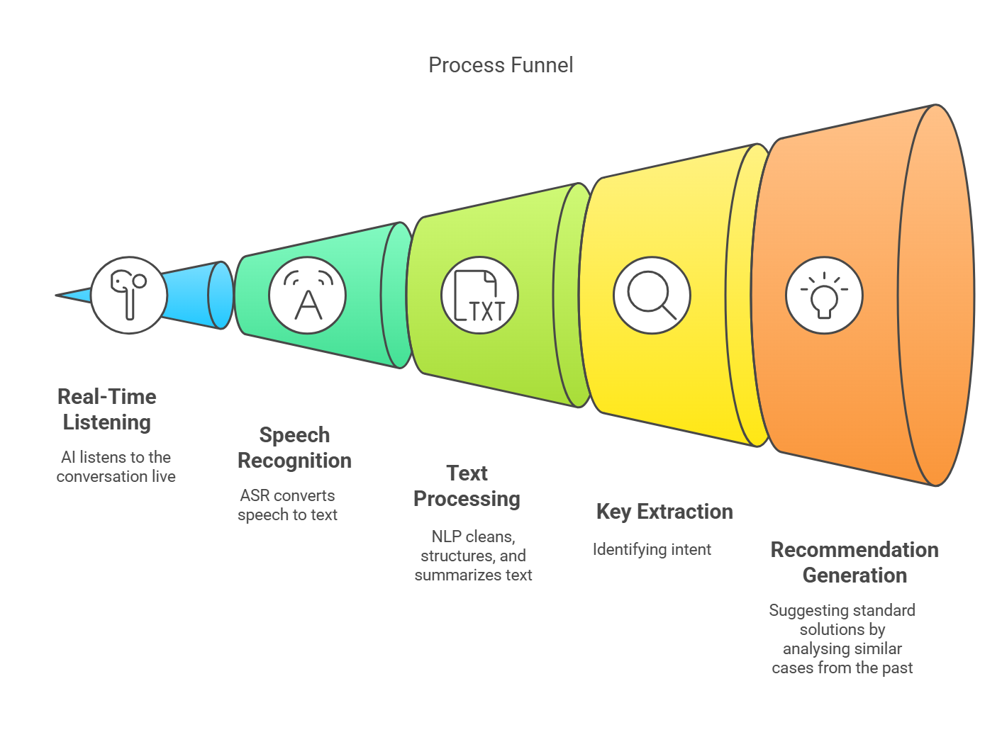
Technology Overview

Slide 8
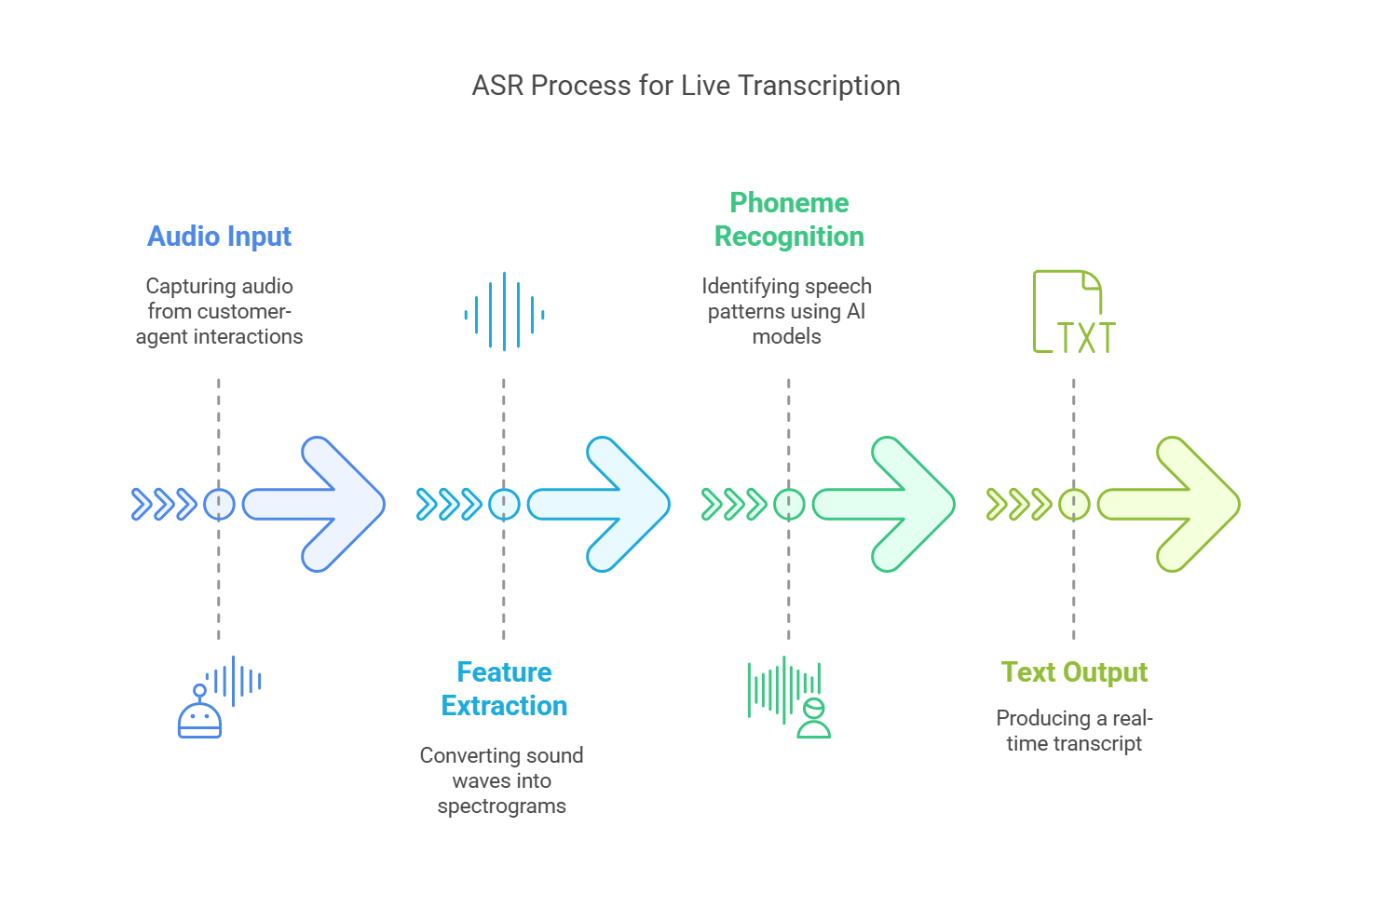
Technology Overview
Automatic Sound Recognition

Slide 9
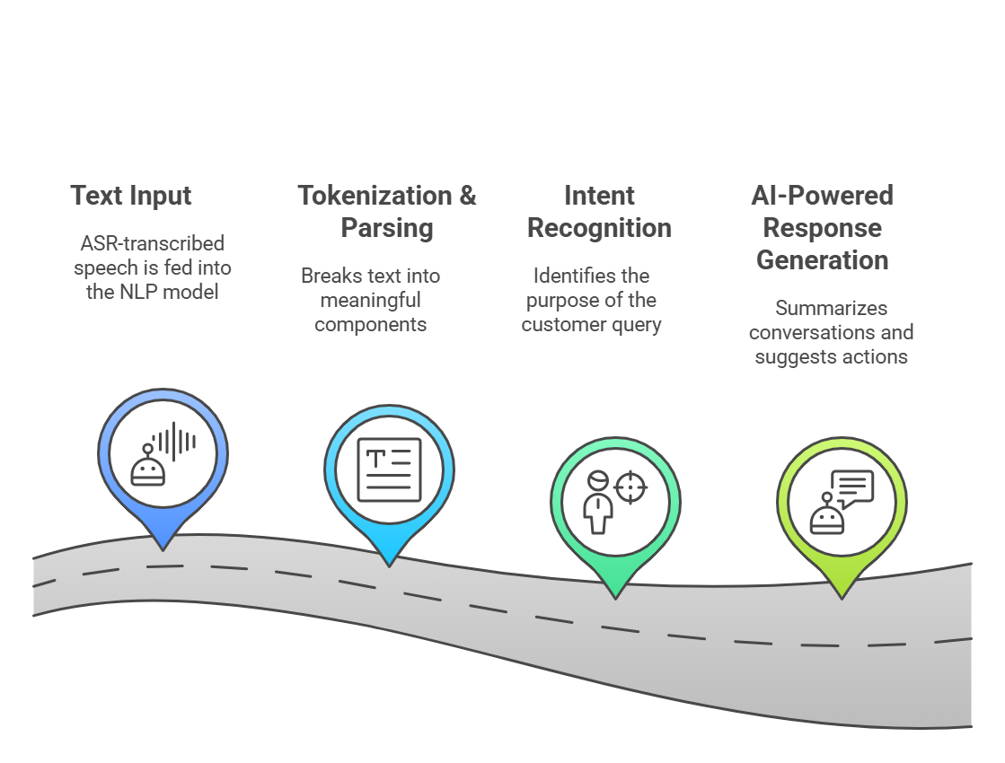
Technology Overview
Natural Language Processing

Slide 10
Technology Overview

Slide 11
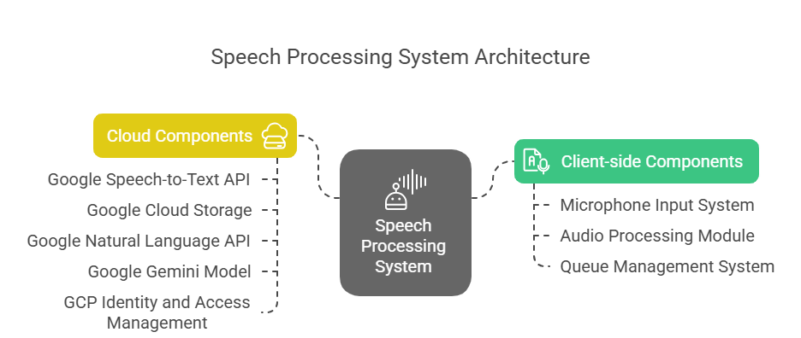
Solution Architecture for Audio Transcription

Slide 12
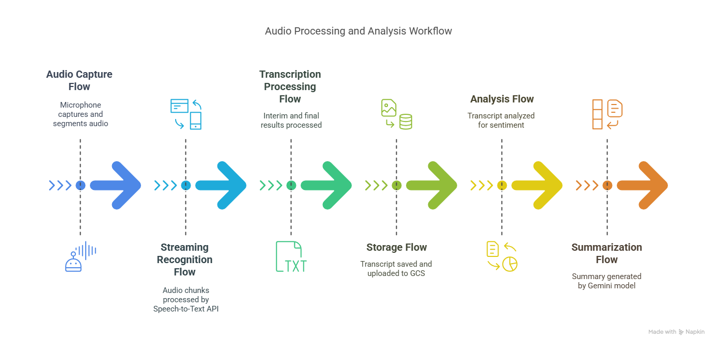
Data Flow for Audio Transcription

Slide 13
Thank You

