Slide 1


Slide 2


Slide 3
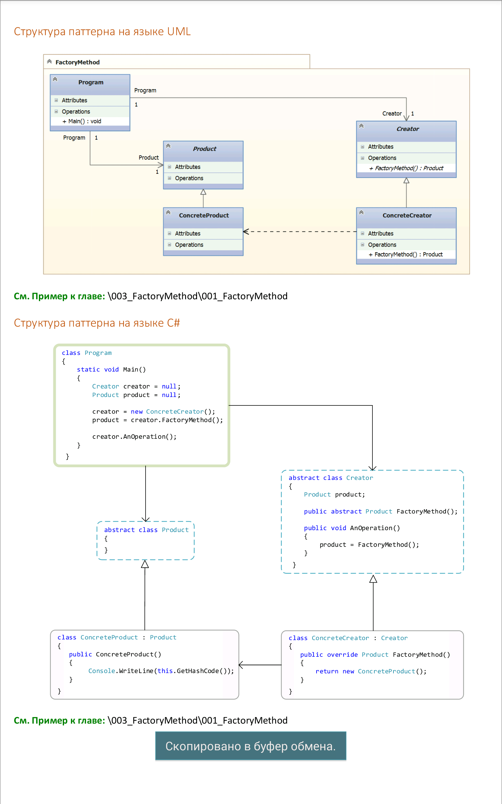

Slide 5
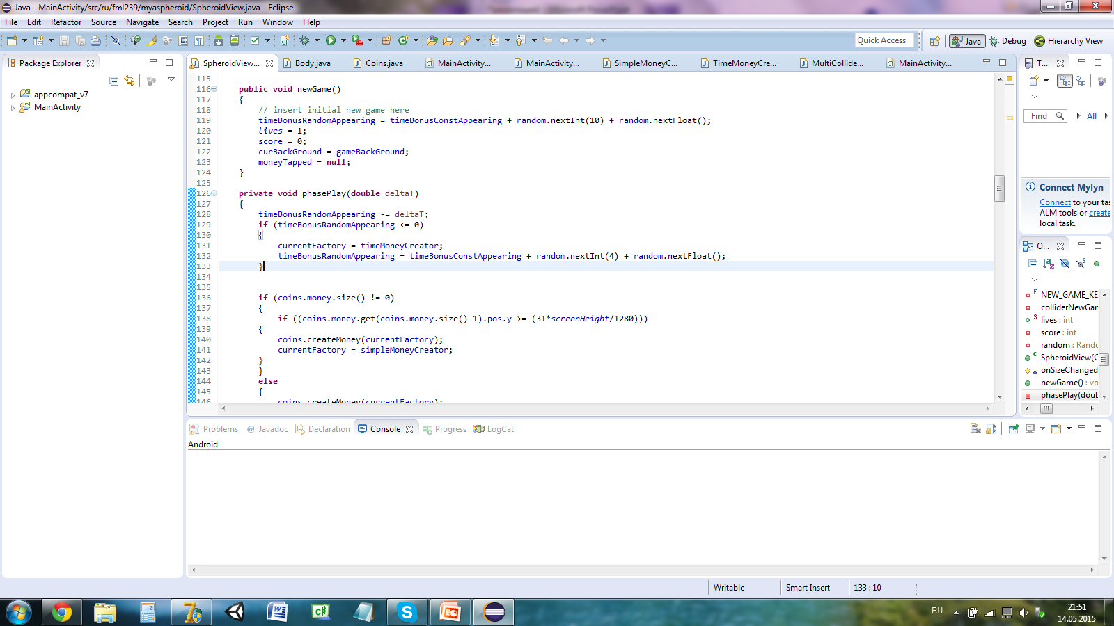
coins.createMoney(currentFactory);

Slide 6
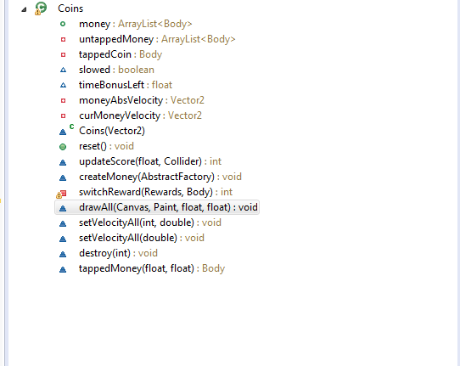

Slide 7
