Slide 1


Framework
January 2019
1

Slide 2
Agenda
Reference Architecture
Why Framework
Notes:
Slide Number

Slide 3
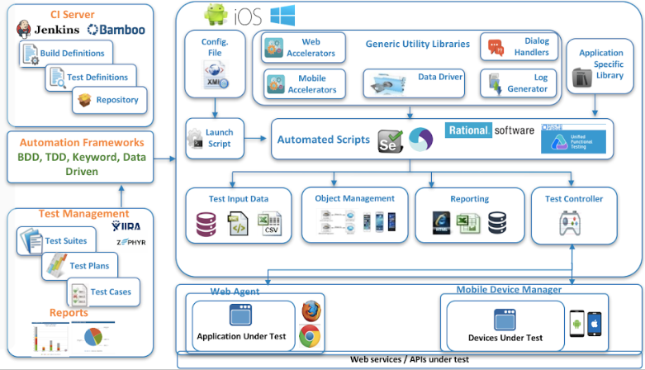
Reference Architecture

Slide 4
Why Framework
Jumpstart automation with 20% to 30% effort saving.
Reusability of the code increases from 30% to 80%.
Maintainability of test scripts will increase
One Framework from GUI and Non GUI test automation
Supports multiple data sources
Integrations with TM,DM and CI tools
Real time reporting on the test suite execution

