Slide 1


Page Object Model Framework
January 2019
1

Slide 2
Agenda
What is Page Object Model?
Why Page Object Model?
How to implement POM?
What is Page Factory?
Advantages of POM
Notes:
Slide Number

Slide 3
Page Object Model
Page Object Model is a Design Pattern which has become popular in Selenium Test Automation. It is widely used design pattern in Selenium for enhancing test maintenance and reducing code duplication. Page object model (POM) can be used in any kind of framework.

Slide 4
Why Page Object Model
It is a approach to script maintenance to create a separate class file which would find web elements, fill them or verify them.
This class can be reused in all the scripts using that element.
In future, if there is a change in the web element, we need to make the change in just 1 class file and not 10 different scripts.

Slide 5
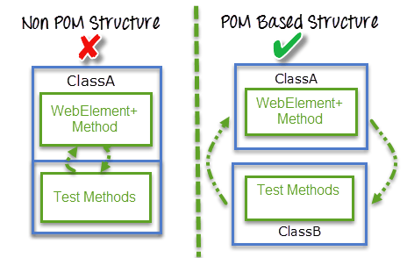
Why Page Object Model

Slide 6
Why Page Object Model
1. A page object is an object-oriented class that serves as an interface to a page of our
Application Under Test(AUT).
2. The tests then use the methods of this page object class whenever they need to interact
with the User Interface (UI) of that page.
3. The benefit is that if the UI changes for the page, the tests themselves don’t need to
change, only the code within the page object needs to change. Subsequently, all changes
to support that new UI is located in one place.

Slide 7
How to implement POM
It is the basic structure of Page object model (POM) where all Web Elements of the Web screen and the method that operate on these Web Elements are maintained inside a class file.A task like verification should be separate as part of Test methods.

Slide 8
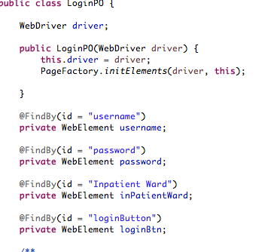
How to implement POM

Slide 9
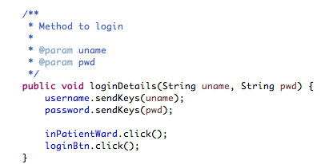
How to implement POM

Slide 10
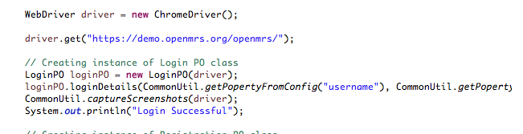
How to implement POM

Slide 11
What is Page Factory
Page Factory is an inbuilt Page Object Model concept for Selenium WebDriver but it is very optimized.
Here as well, we follow the concept of separation of Page Object Repository and Test Methods. Additionally, with the help of PageFactory class, we use annotations @FindBy to find WebElement. We use initElements method to initialize web elements
@FindBy can accept tagName, partialLinkText, name, linkText, id, css, className, xpath as attributes.

Slide 12
Page Object and Page Factory
PageObject | PageFactory
Page Object is a class that represents a web page and hold the functionality and members. | Page Factory is a way to initialize the web elements you want to interact with within the page object when you create an instance of it.

Slide 13
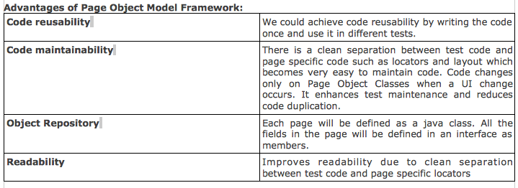
Advantages of POM

