Slide 1


Introduction to TestNG
January 2019
1

Slide 2
Agenda
JUnit quick overview
Why TestNG
TestNG vs JUnit
TestNG overview

Slide 3
JUnit quick overview
Strengths :
Simple to understand : test methods
setUp() and clearDown() methods for initialization and clean up
Text and graphical result

Slide 4
JUnit quick overview
Problems :
No dependent test methods
Data driven support is not there
We cant prepare the suites and run them
Cant divide the tests in to different groups and run the required group only
Lack of Listeners support

Slide 5
Why TestNG
Testing New Generation :
No need to extend base class
No need to start your test method with “test”
Configuration methods can called by any name u want , not just setUp() and tearDown() and you can be invoke either around methods or classes
Test methods can receive parameters
Annotations based

Slide 6
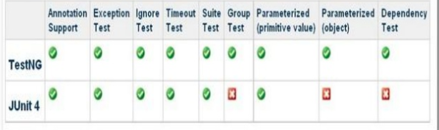
TestNG vs JUnit

Slide 7
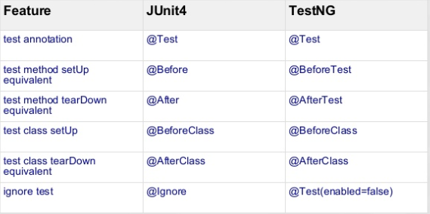
TestNG vs JUnit
Similarities :

Slide 8
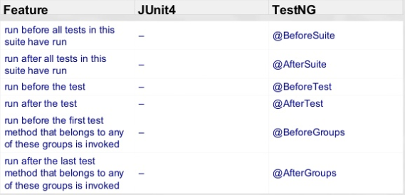
TestNG vs JUnit
Differences :

Slide 9
TestNG overview
TestNG is a testing framework , that supports :
UnitTesting
Integration Testing
Annotations
Parameters
Assertions
Groups
Dependencies

Slide 10
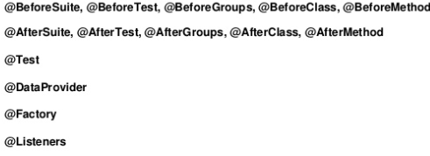
Annotations

Slide 11
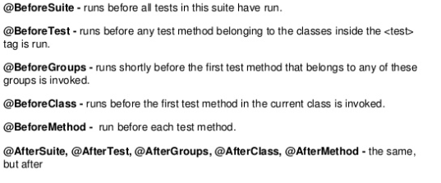
Annotations

Slide 12
Parameters
Parameters can be passed to test methods
There are 2 ways to set parameters : with
1. testing.xml and
2. Programmatically

Slide 13
Parameters from testng.xml

Slide 14
Parameters from DataProvider

Slide 15
Assertions
Soft Assertions
Hard Assertions

Slide 16
Groups
‘Groups‘ is one more annotation of TestNG which can be used in the execution of multiple tests
Each test method is tagged with any number of groups
@Test // No groups
@ Test (groups =“group1”)
@Test (groups ={“g1”, “g2”, …})
A group therefore contains any number of test methods

Slide 17
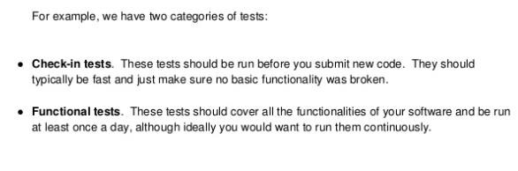
Groups

Slide 18
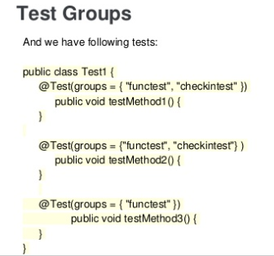
Groups

Slide 19
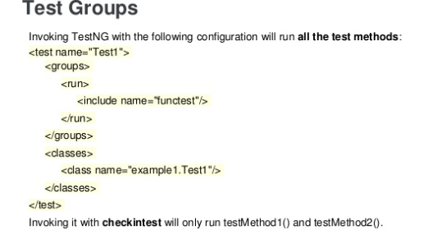
Groups

Slide 20
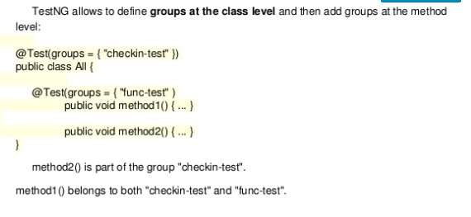
Groups

Slide 21
Timeout
@Test(timeout=1000
testing.xml <suite/test> timeout attribute
The test case will be failed if time period is exceeded

Slide 22
Dependencies
Sometimes we need to run test methods to be invoked in certain order .
To make sure a certain number of test methods have to complete and and succeeded before running more test methods
Dependencies can specify either with annotations or from xml

Slide 23
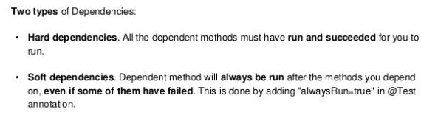
Dependencies

Slide 24
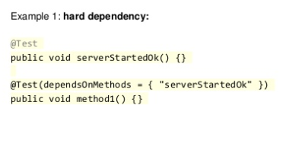
Dependencies

Slide 25
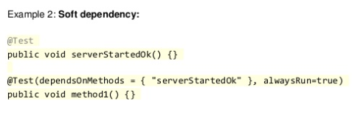
Dependencies

Slide 26
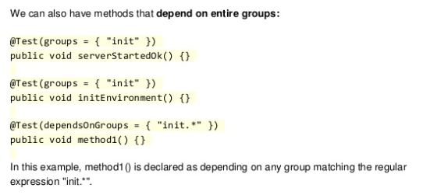
Dependencies

Slide 27
TestNG Plugin for Eclipse
To install it:
Click "Help -> Install New Software..." on top level menu
Paste the url http://beust.com/eclipse-beta to Work with: text field and press enter.
Select the plugins
Click "Next" button and accept the license to complete the installation.
Restart Eclipse

Slide 28
TestNG dependency for Maven
<dependency>
<groupId>org.testng</groupId>
<artifactId>testng</artifactId>
<version>6.14.3</version>
<scope>compile</scope>
</dependency>

Slide 29
References
https://testng.org/doc/index.html
http://www.mkyong.com/unittest/junit-4-vs-testng-comparison/

