Slide 1
⋆˚࿔
DEVOPS CAPSTONE PRESENTATION
CareDesk
Automated Cloud Delivery Platform
Ankita Tripathi
ankita.24bcs10062

Slide 2
The Real-World Problem
Why traditional clinic booking systems fail.
01
02
Fragile Updates
Inconsistent Setup
Manual deployments cause costly downtime.
Code breaks across different machines.
CareDesk
02

Slide 3
The Mental Model
01
02
03
Docker
CI / CD
Kubernetes
Standardized shipping
containers.
Automated security
checkpoint.
Intelligent air traffic
controller.
CareDesk
03

Slide 4
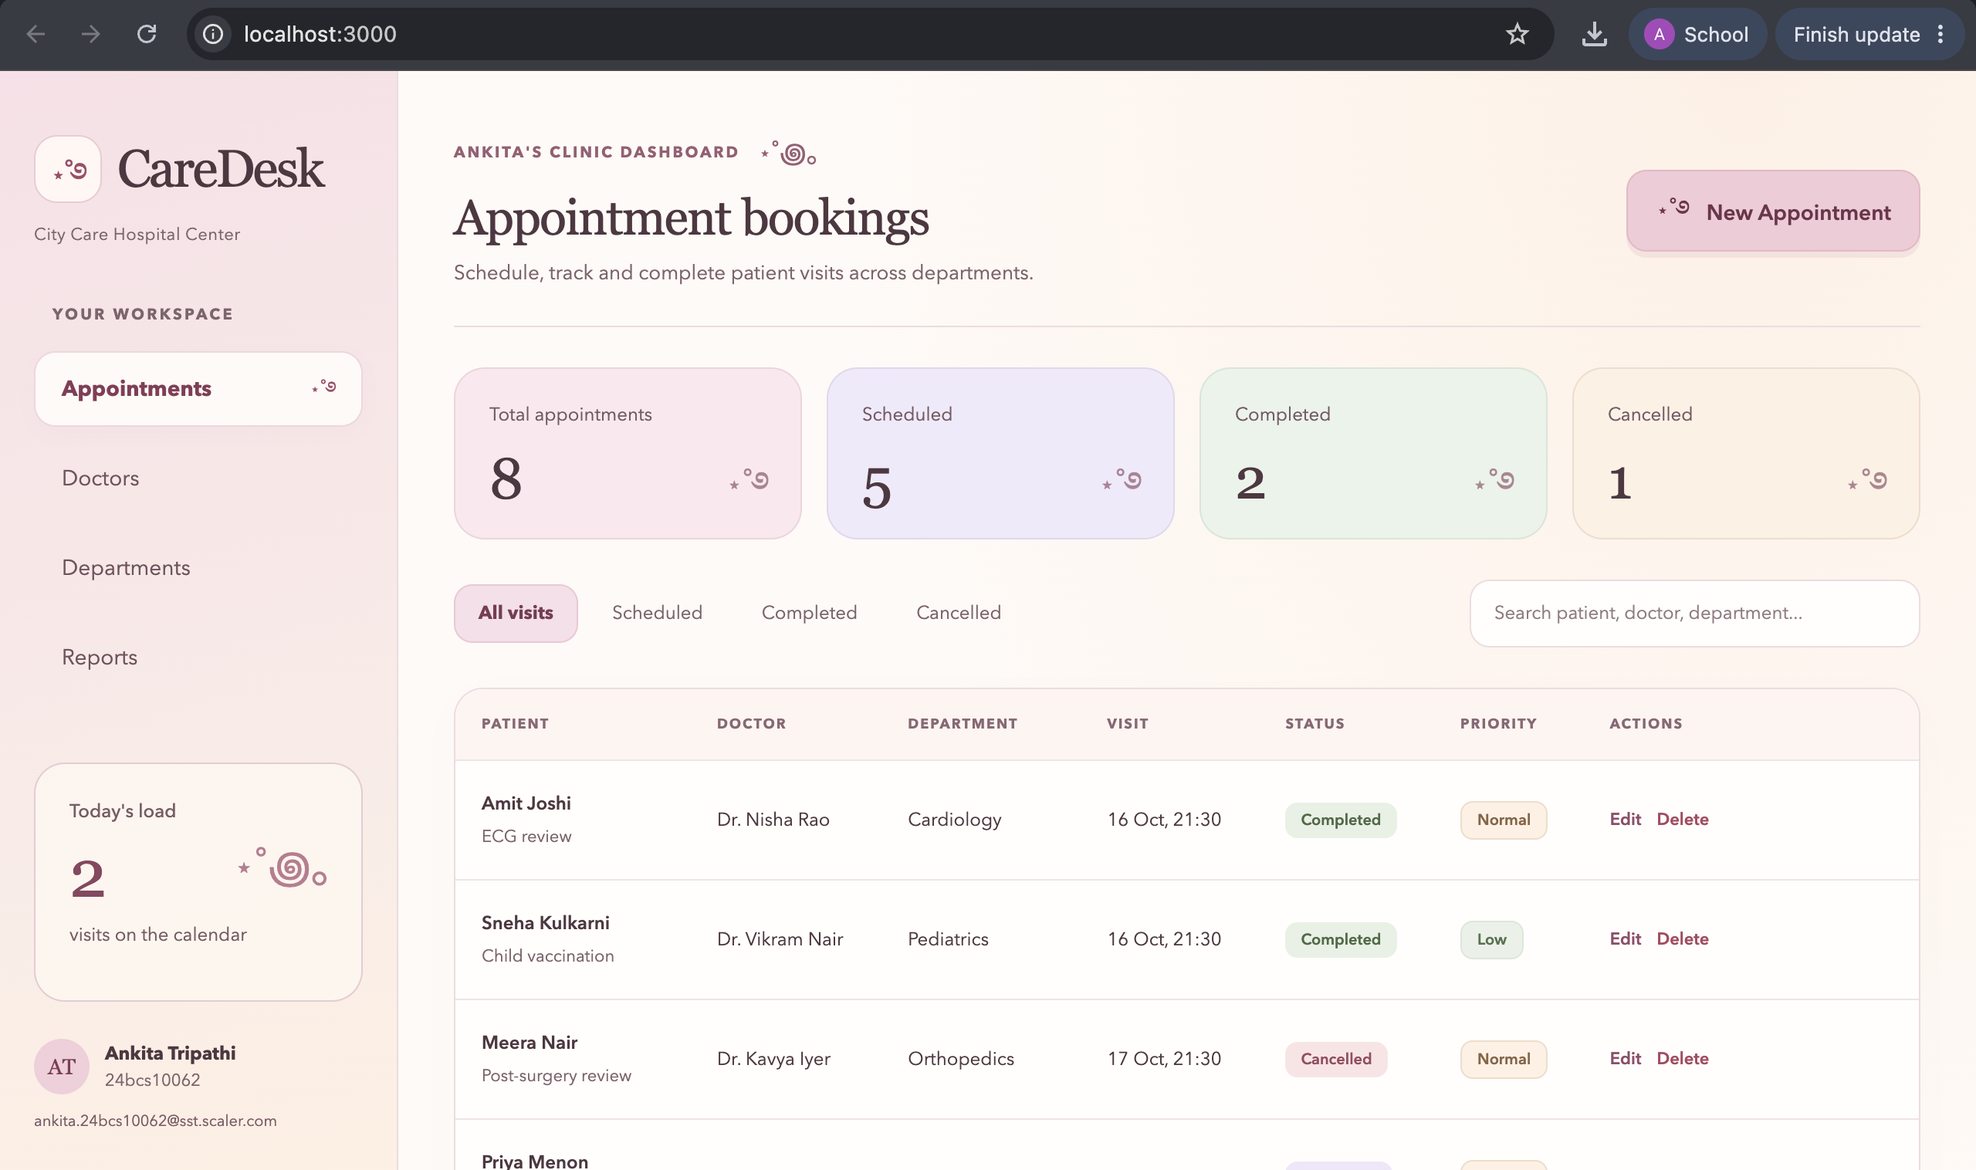
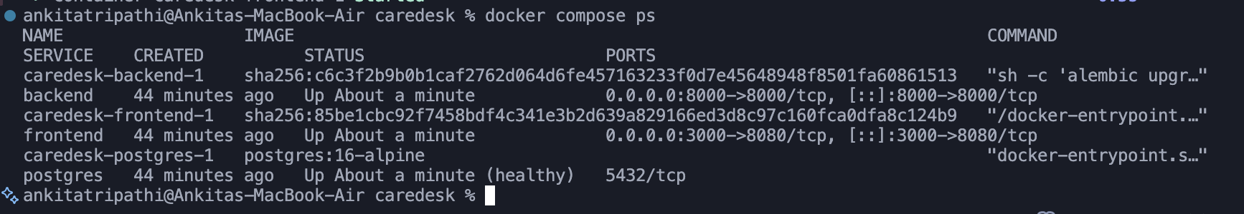
Local
Development
01
Spins up Postgres, FastAPI & React.
02
Identical environment across all machines.
03
Managed entirely via docker-compose.yml.
CareDesk
04
Notes:
Screenshot source: caredesk-main.zip / images / m4-localhost-browser.png
Screenshot source: caredesk-main.zip / images / m4-docker-compose.png

Slide 5
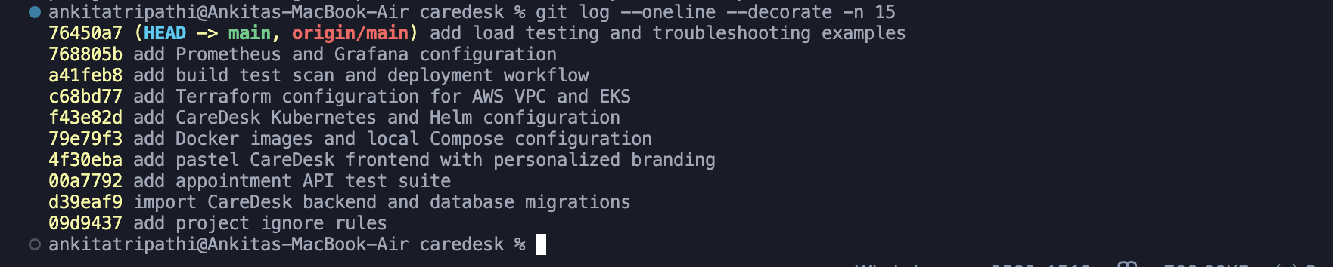
Structured
Codebase
01
19 progressive, documented commits.
02
Strict .gitignore blocks secret leaks.
Git commit history
03
Cleanly split into backend, frontend & IaC.
CareDesk
05
Notes:
Screenshot source: caredesk-main.zip / images / m3-git-log.png

Slide 6
Strategic Decisions
COMPUTE
AUTOMATION
SECURITY
AWS EKS
vs EC2
Actions
vs Jenkins
Trivy
vs Manual
Built for automated
scaling.
Zero maintenance
overhead.
Automated vulnerability
blocking.
CareDesk
06

Slide 7
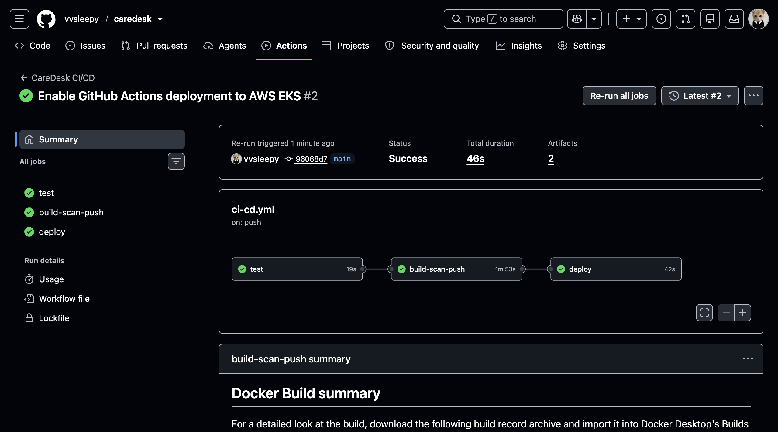
Automated
CI / CD
01
Passes 12/12 pytest cases first.
02
Trivy strictly blocks HIGH/CRITICAL CVEs.
03
Publishes SHA-tagged images to GHCR.
GitHub Actions workflow
CareDesk
07
Notes:
Screenshot source: caredesk-main.zip / images / m5-ci-pipeline.png

Slide 8
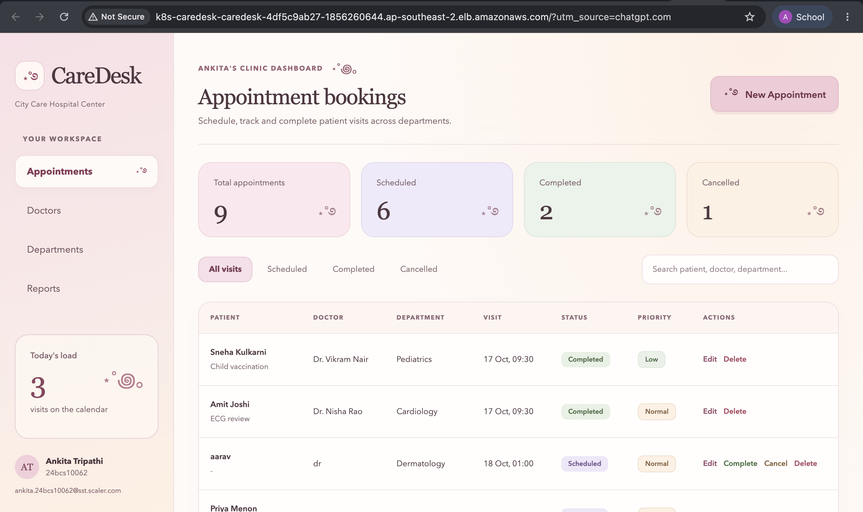
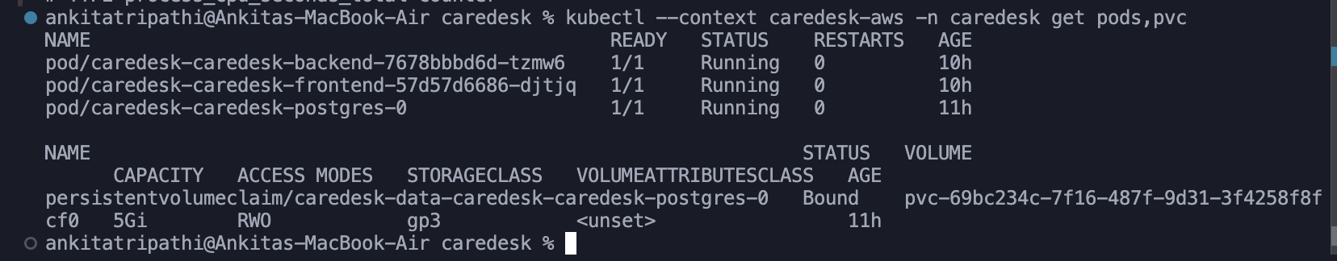
Production
Cloud
01
AWS EKS managed via
Terraform.
02
Custom Helm chart deploys app replicas.
03
Traffic routed via Network Load Balancer.
CareDesk
08
Notes:
Screenshot source: caredesk-main.zip / images / m8-aws-ingress.png
Screenshot source: caredesk-main.zip / images / m8-k8s-pods.png

Slide 9
Measurable Results
0
3m
100%
Security Vulnerabilities
Automated Release Time
Live Observability
CareDesk
09

Slide 10
⋆˚࿔
Thank You
Ankita Tripathi
ankita.24bcs10062
github.com/vvsleepy/caredesk

