Slide 1
EXPLORATORY DATA ANALYSIS ON
Telecom Churn Data
Guided by:
Mr. Krishna Swami Jalla
Co founder of Surge Classes

Slide 2


Team Presentation
Nallaparaju Renu Sathvika
3/4 AIDS
Roshan Baig 3/4 CSE
N V V S N Murthy 3/4 CSE
Kamisetty N V Satish 3/4 ECE

Slide 3
Background
With the enormous increase in the number of customers using telephone services, the marketing division for a telco company wants to attract more new customers and avoid contract termination from existing customers (churn rate). For the telco company to expand its clientele, its growth rate (number of new customers) must exceed its churn rate (number of customers existing). Some of the factors that caused existing customers to leave their telco companies are better price offers, faster internet services, and a more secure online experience from other companies.
A high churn rate will adversely affect a company’s profits and impede growth. Our churn prediction would be able to provide clarity to the telco company on how well it is retaining its existing customers and understand what are the underlying reasons that are causing existing customers to terminate their contract (high churn rate).

Slide 4
Problem Statement
To analyse whether a particular customer will switch to another telecom provider or not. In telecom terminology, this is referred to as churning and not churning, respectively.
Business Objective
The Telcom company can use our analysis to measure if it is providing a useful product compared with the product provided by its competitors. Since the cost of acquiring new customers is much higher than retaining its existing customers, the company can use the churn rate analysis to provide discounts, special offers, and superior products to keep current customers.

Slide 5
About the Dataset:
Target Variable is Churn which specifies if a customer has churned or not.
Telecom churn dataset contains 7043 records and 21 features
The data set includes information about:
Customers who left within the last month – the column is called Churn Services that each customer has signed up for – phone, multiple lines, internet, online security, online backup, device protection, tech support, and streaming TV and movies
Customer account information – how long they’ve been a customer, contract, payment method, paperless billing, monthly charges, and total charges
Demographic info about customers – gender, if they have partners and dependents

Slide 6
Exploratory Data Analysis
Exploratory Data Analysis is an approach to analyze the data using visual techniques. It is used to discover trends, patterns, or to check assumptions with the help of statistical summary and graphical representations. .
Data Visualization is the process of analyzing data in the form of graphs or maps, making it a lot easier to understand the trends or patterns in the data. There are various types of visualizations –
Univariate analysis: This type of data consists of only one variable. The analysis of univariate data is thus the simplest form of analysis since the information deals with only one quantity that changes. It does not deal with causes or relationships and the main purpose of the analysis is to describe the data and find patterns that exist within it.
Bi-Variate analysis: This type of data involves two different variables. The analysis of this type of data deals with causes and relationships and the analysis is done to find out the relationship among the two variables.
Multi-Variate analysis: When the data involves three or more variables, it is categorized under multivariate.

Slide 7
ANALYSIS ON NUMERICAL FEATURES

Slide 8
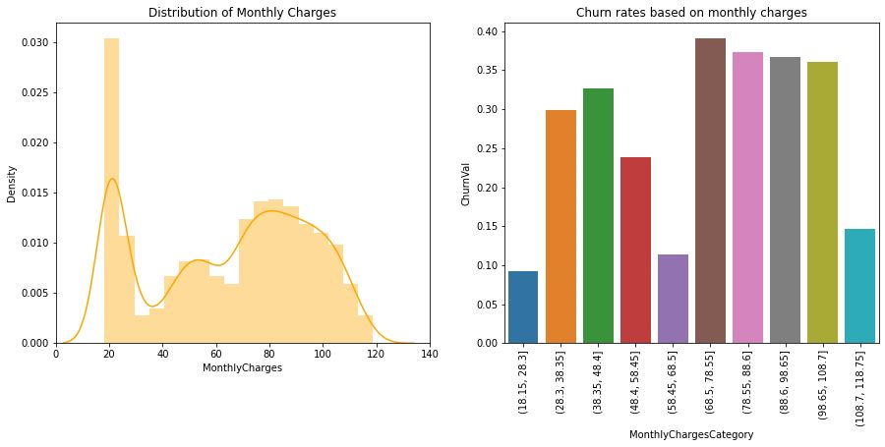
Churn vs Monthly Charges
High Churning is observed when monthly charges is high

Slide 9
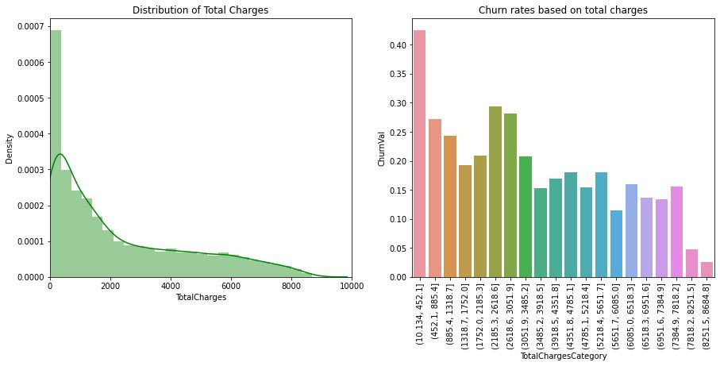
Churn vs Total Charges
High Churning is observed when total charges is low

Slide 10
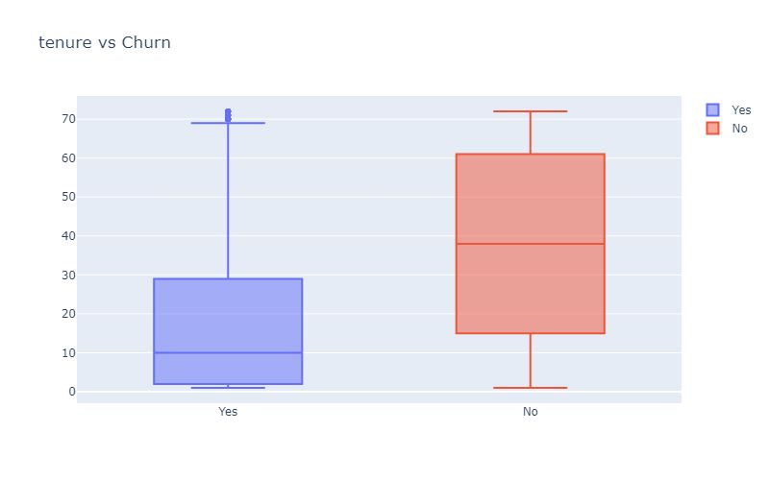
Most customers who are using the service for the long do not want to switch.

Slide 11
UNIVARIATE ANALYSIS ON CATEGORICAL FEATURES

Slide 12
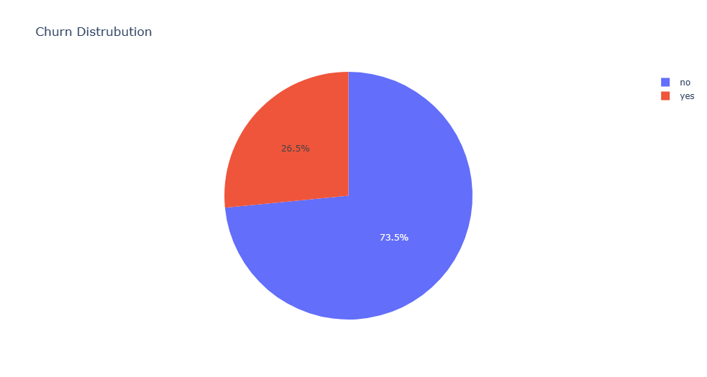
Out of 7043 customers,
26.5% of the customers are churned nearly 1900 customers

Slide 13
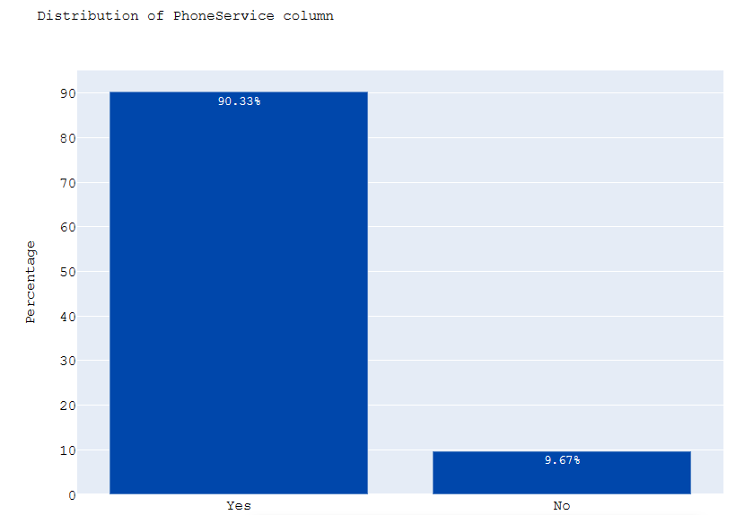
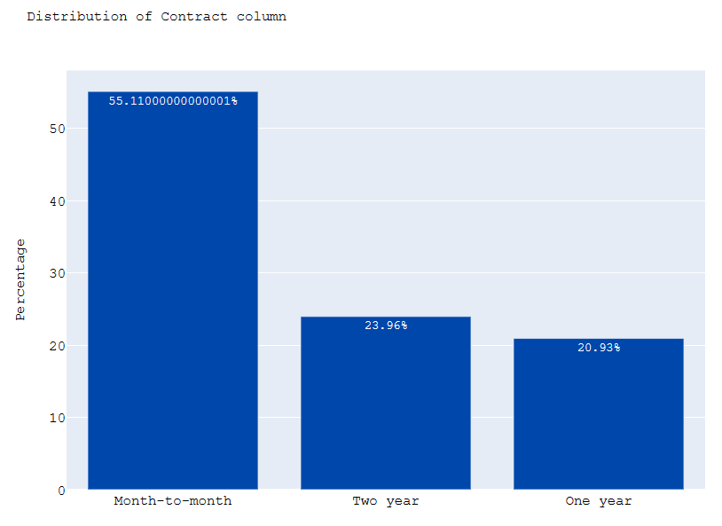
Distribution of phone service column
Distribution of contract column
most of the people have landline service along with internet service
most of the customers were chosen month to month plan

Slide 14
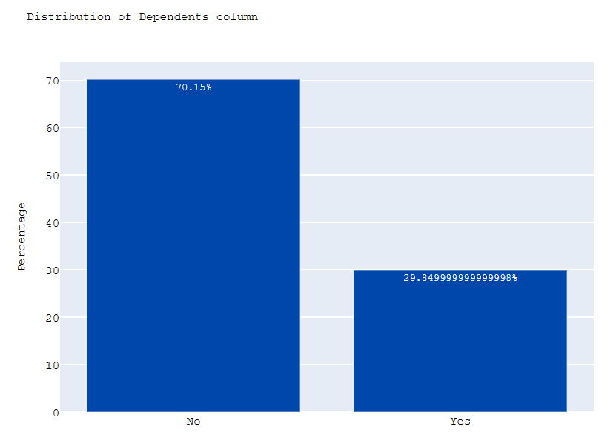
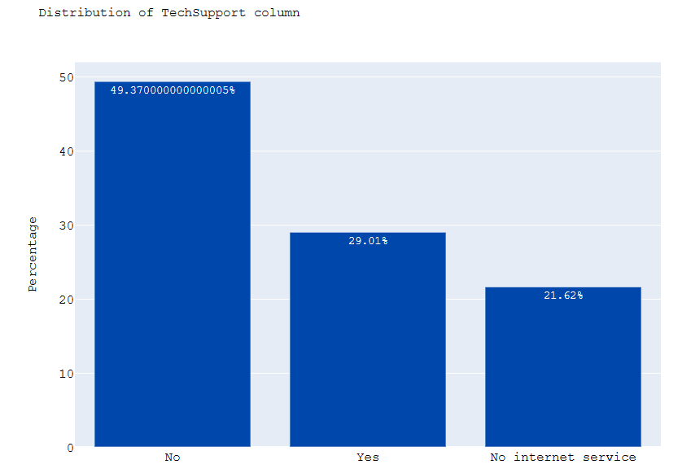
Distribution of Dependents column
Distribution of TechSupport Column
most of the customers do not have dependents like children/retired parents
most of the customers did not opt for tech support

Slide 15
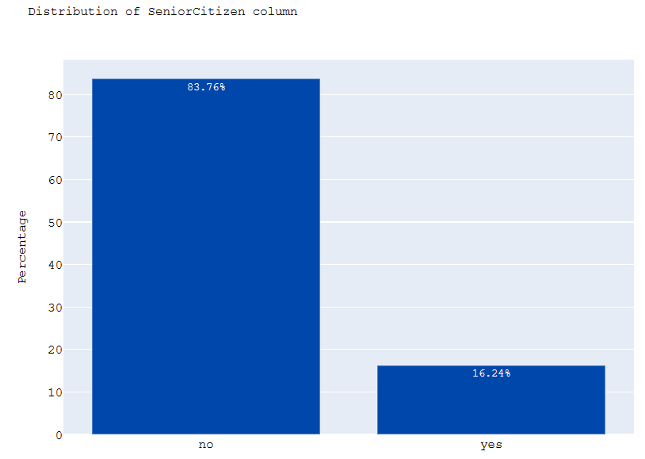
Distribution of Senior citizen column
most of the customers are not senior citizen

Slide 16
BIVARIATE ANALYSIS

Slide 17
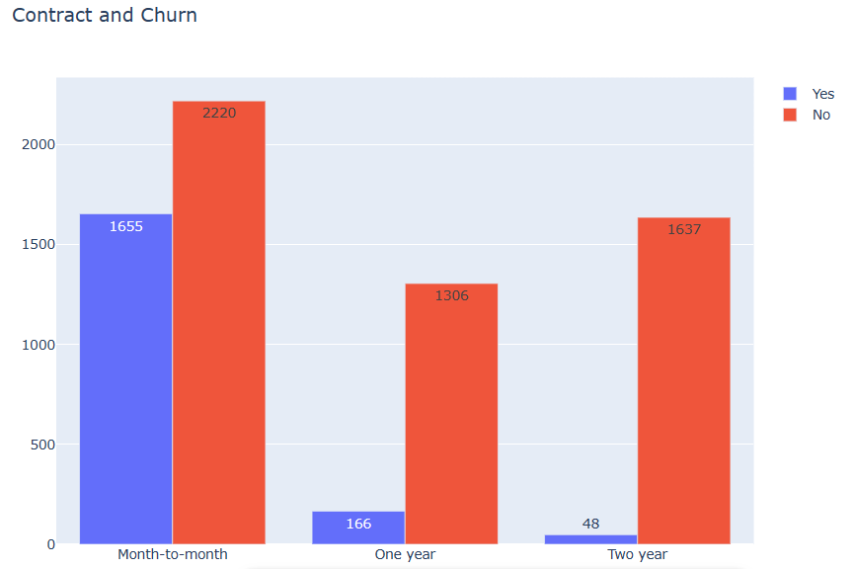
The customers who take contract for long period are less willing to churn

Slide 18
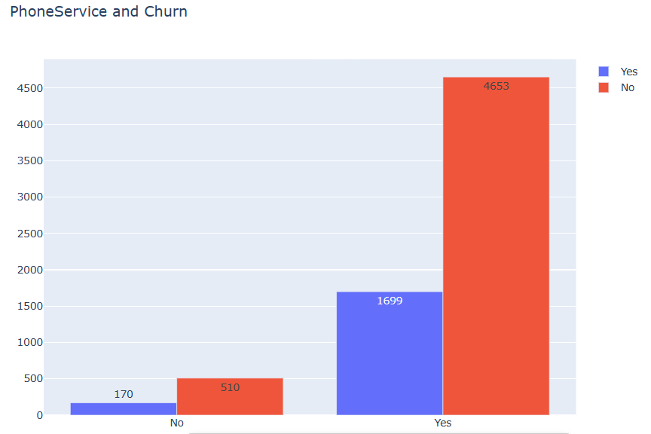
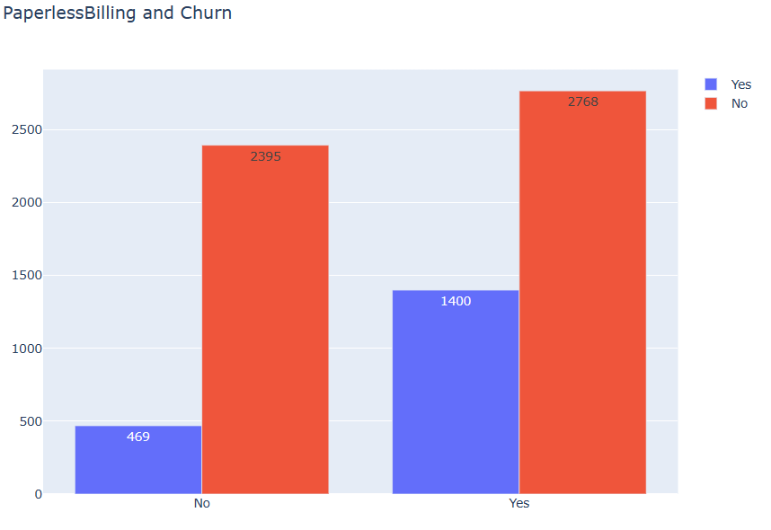
The customers using phone services are willing to churn than comparing with who are not using phone services
The customers who choose paperless billing are more willing to churn

Slide 19
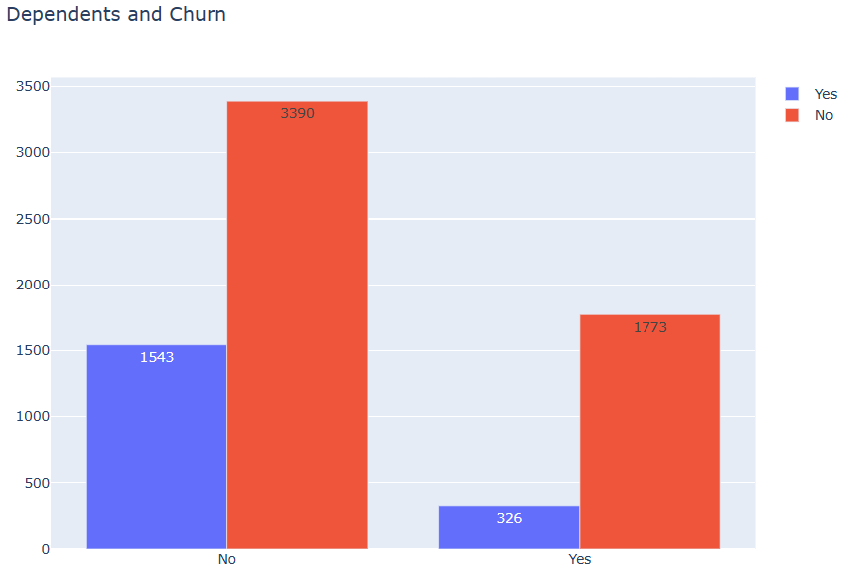
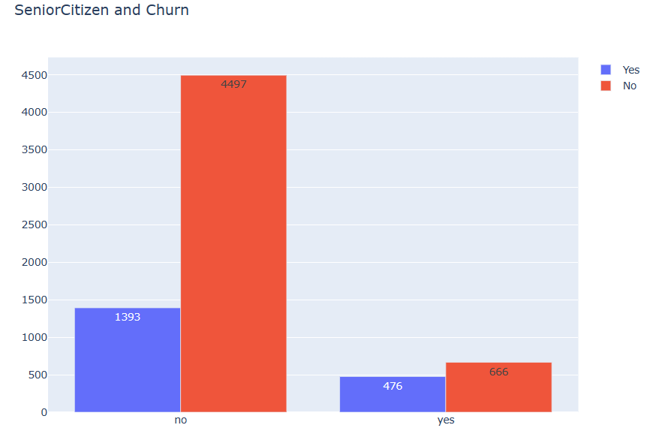
Most of the customers who have dependence are less willing to churn
Most of the customer who are not senior citizens are willing to churn

Slide 20
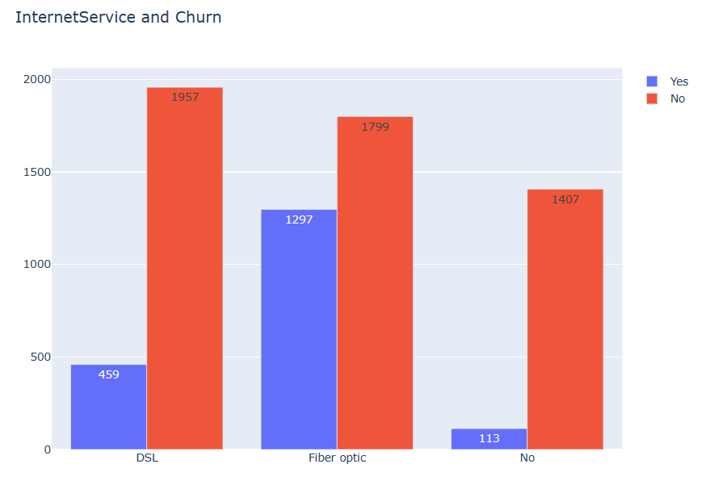
Most of the customers who are using services in fiber optics are more willing to churn

Slide 21
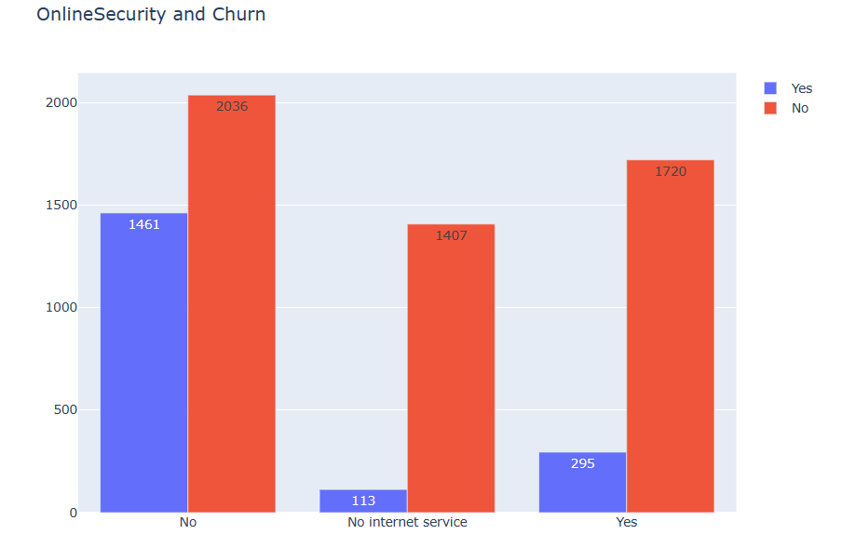
Most of the customers who are not having online security are less willing to churn

Slide 22
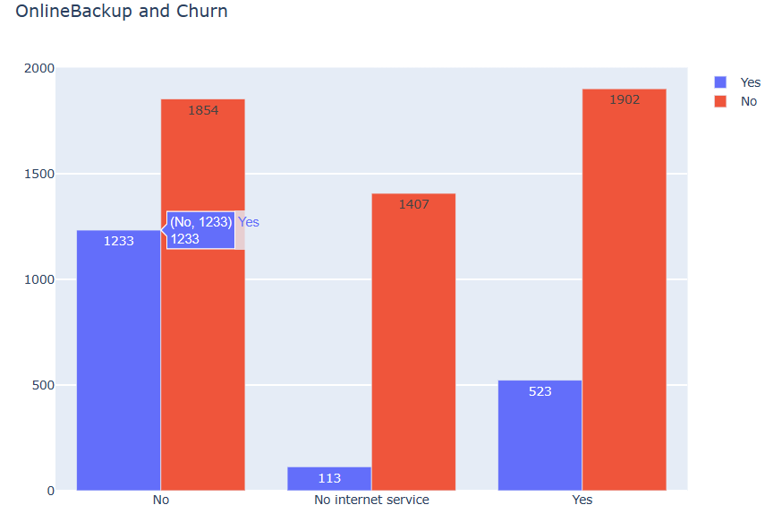
Most of the customers who are not having online backup are willing to churn

Slide 23
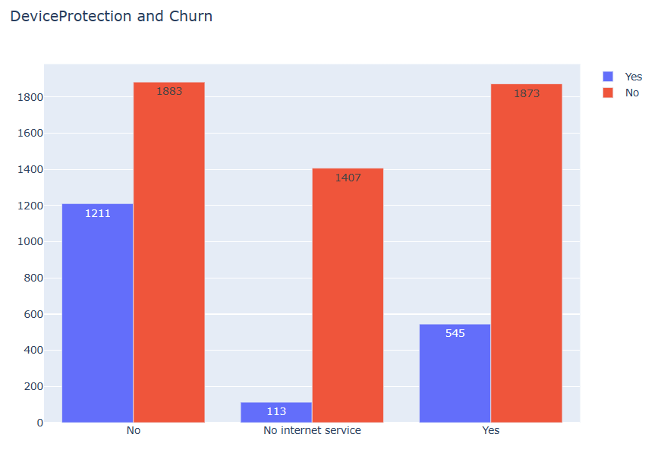
Most of the customers who are not having device protection are willing to churn

Slide 24
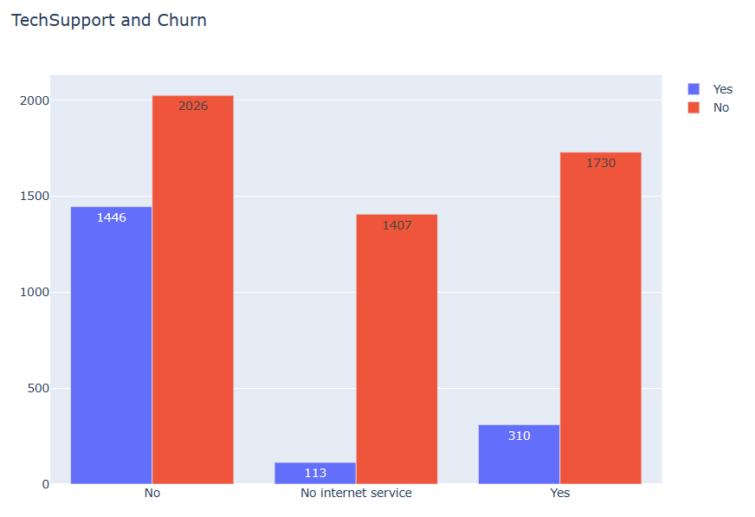
Most of the customers who are not having tech support are willing to churn

Slide 25
MULTIVARIATE ANALYSIS

Slide 26
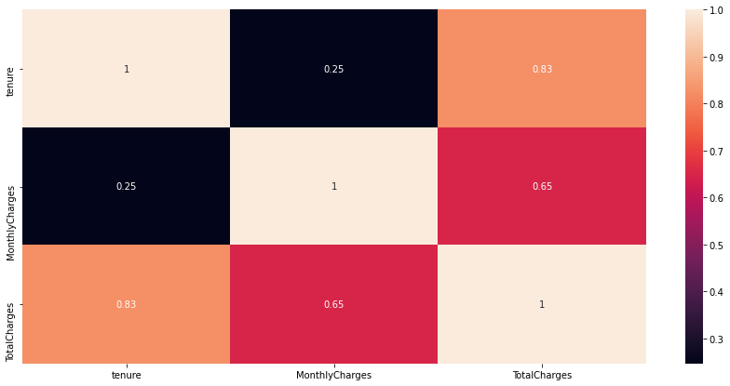
Correlation between numerical features
Total Charges and Tenure are highly correlated (positive correlation)

Slide 27
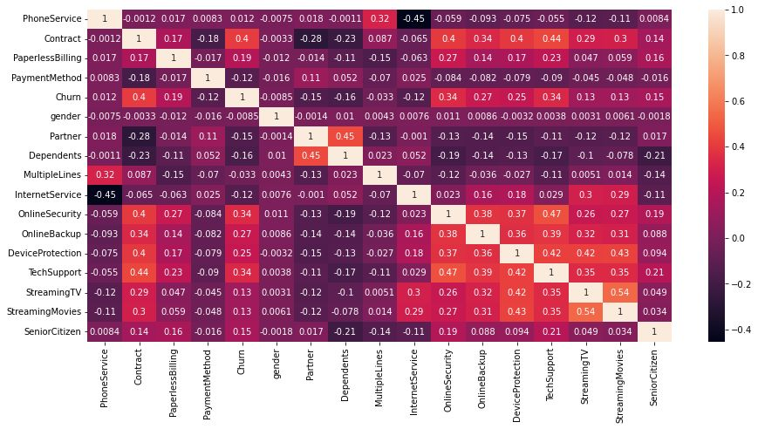
Correlation between Categorical features
No two variables are highly correlated

Slide 28
ASSOCIATION ANALYSIS

Slide 29
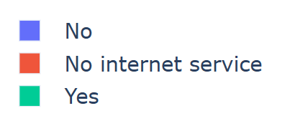
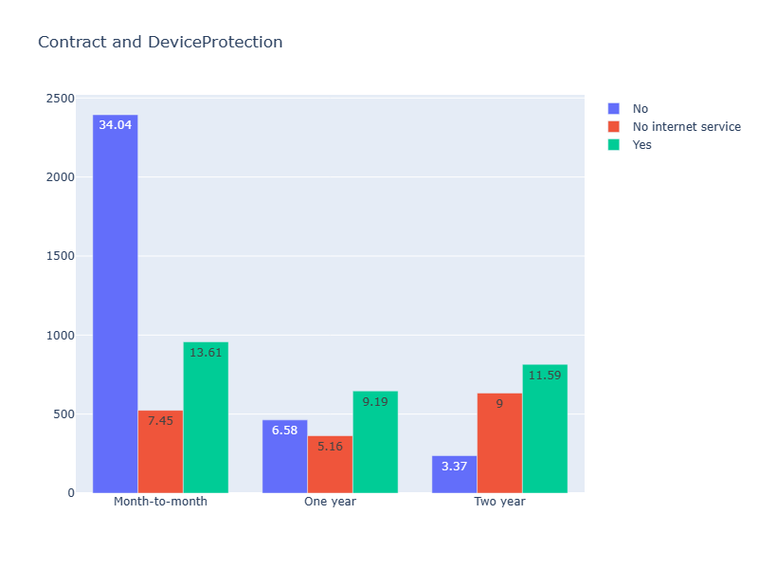
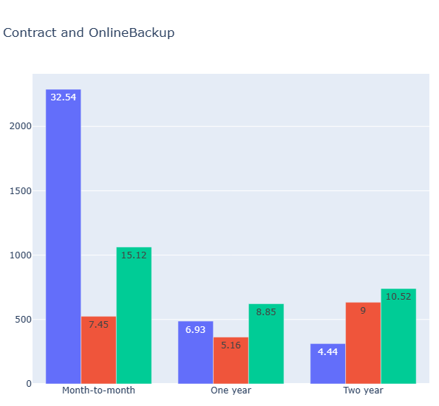
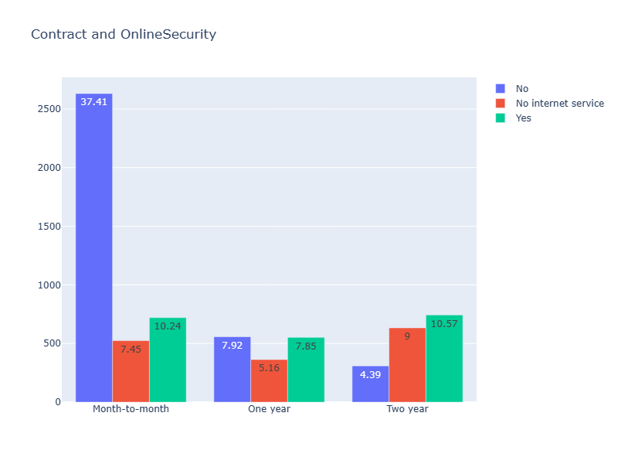
From the data we find association between the categories i.e., contract and services
Customer how took two years contract are willing to take device protection , online Backup, Online security when compared to month to month contract

Slide 30
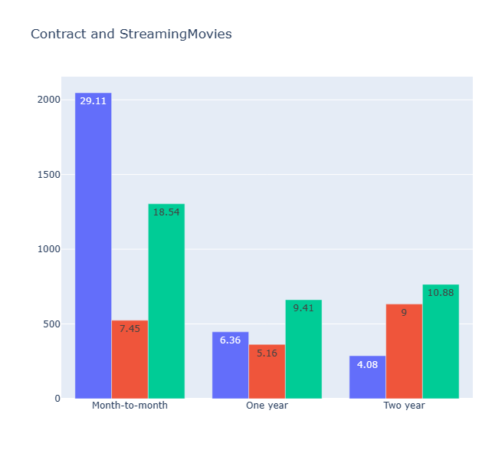
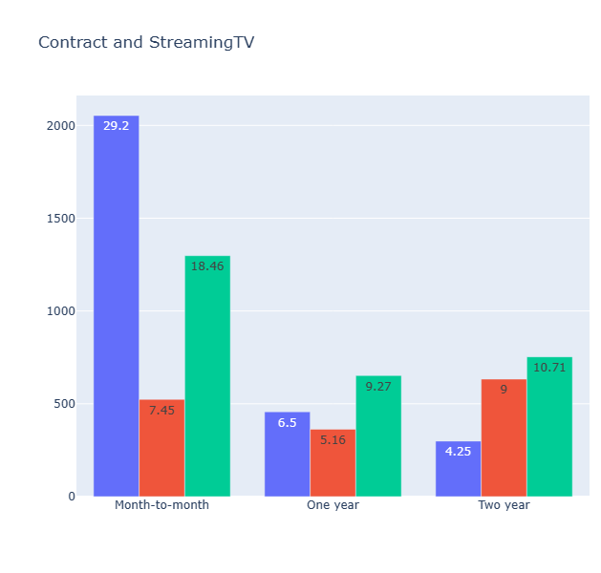
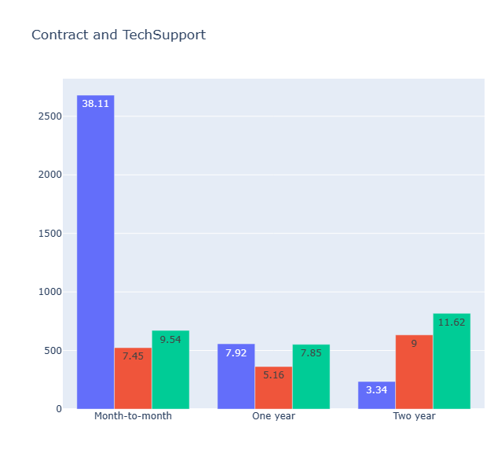
Customer how took two years contract are willing to take services like streaming movies , Streaming TV, Tech support when compared to month to month contract

Slide 31
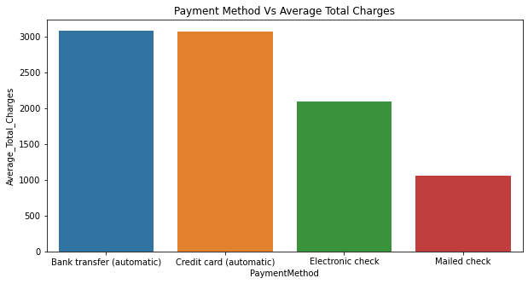
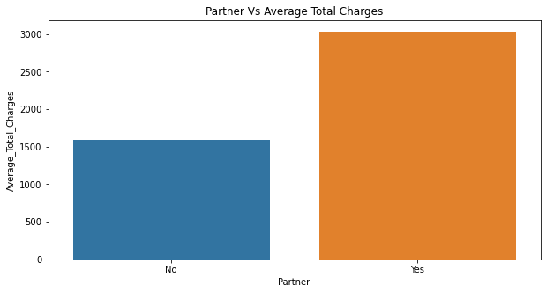
Customers who use Bank Transfer and credit card has paying high total charges
Customers who has partners are paying high total chargers

Slide 32
Conclusions
Through the plots like bar plot, histogram , we can summarise that the variables Dependents, Monthly Charges, Total Charges, Senior Citizen, Online Security, Online Backup, Device Protection, Tech Support show major impact on whether the customer is willing to shift to another telecom service or not.

Slide 33
References
https://towardsdatascience.com/5-outlier-detection-methods-that-every-data-enthusiast-must-know-f917bf439210
Telco Customer ChurnRate Analysis | by Shuheng.Ma | Towards Data Science
https://plotly.com/python/getting-started/#:~:text=The%20plotly%20Python%20library%20is,the%20Plotly%20JavaScript%20library%20(plotly.
https://seaborn.pydata.org/

Slide 34

Thank You

