Slide 1

Know what you're signing – in Minutes, not Hours
Loom Link: https://www.loom.com/share/04c06fc1a08043f5967d48c1e8d29fed
A proposal for Atliq Executive Team
Vaibhav Soni, AI Product Manager · 12 October 2026
Notes:
KD, thank you for the time. In the next 12 minutes I want to show you what we found when we looked at how AtliQ reviews contracts, what we built, how we tested it, and the one decision I need from you at the end: a two-week pilot. One promise up front: you still sign every contract. ACA's job is to make sure you know exactly what you are signing.

Slide 2



ACA finds the real risks in under a minute – you decide
ACA- Auto Contract Analyzer
The problem
THE ASK
You review ~9 contracts a month alone, 3–4 hours each, from memory. The costly risks hide in contracts AtliQ already signed.
Approve a two-week pilot
The solution
Every client and partner contract goes through ACA before you read it.
You confirm the commitments register once (~45 minutes).
We measure your time per contract and how useful each flag was.
ACA checks every clause against your positions, every signed contract and past incidents, then shows the top 3 risks with the exact clauses side by side.
The proof
Tested on 40 contracts, 25 written to break it: 40 / 40 correct, 10 / 10 hidden conflicts caught, 0 data leaks.
Running cost: about $0.20 per contract
Notes:
If you remember one slide, it is this one. The problem is not that you read slowly. It is that the risks that hurt us sit in contracts we signed a year or three ago. ACA reads the draft against everything AtliQ has already promised and shows you the three things that matter, with the clauses side by side. We tested it hard. The ask is a two-week pilot.

Slide 3
You review every contract alone, late at night, from memory
THE PROBLEM
“I review every contract myself and I am unable to remember what we have promised other clients. So I either slow the deals down or sign something that hurts AtliQ.”
~9
3–4 hrs
contracts a month, and growing
per client-paper contract
– Your words, from our discovery interview
Your own note (Sept 2026): “I review everything myself, usually after 10 pm, and the only system is my memory of how the last negotiation went.”
1 Week – 1 Month
0
a deal waits in the queue
people besides you who can review
Notes:
This is the situation in your own words. Nine contracts a month, three to four hours each for client paper, reviews after 10 pm, and deals waiting a week to a month. There is no legal team, so everything waits on you.

Slide 4




The misses are expensive – the next one is in the queue
WHAT IT HAS ALREADY COST
Brightwater
ShopSwift
Harrington
Gulf Crown
$23.2k + 2 weeks
$55k slipped
Live HIPAA exposure
₹1.2L counsel, still blocked
Signed from a phone at quarter end. Uncapped delay damages: $9k credit, $14.2k counsel fees, two weeks of senior time.
Sat in the review queue for 9 days. The client's budget moved to the next quarter.
Patient data was forwarded to Pune before any BAA was signed. Nobody has raised it yet.
Counsel cannot advise on one contract in isolation. Needs every signed restriction, and there is no list.
Notes:
Four stories from our own files. Brightwater cost about 23 thousand dollars and two weeks. ShopSwift lost a quarter while it sat in the queue. Harrington is live today: patient data reached Pune before a BAA. And on Gulf Crown, counsel told us she cannot advise without seeing every restriction we have signed, and we have no such list.

Slide 5
Most of the real risk is not in the contract on your desk
DISCOVERY INSIGHT
We read all 15 drafts in today's queue against all 17 signed contracts.
Examples you can't see from the draft alone
Gulf Crown, BlueOrchid, TravelHub
break the Al Noor GCC hotel non-compete (binds AtliQ Inc too, until Sept 2029)
Datavane
breaks CloudSpan's India + GCC exclusivity
Lakeshore
undercuts Crestline's lowest-price promise ($72 vs $85/hr)
Rheinwerk
asks us to own PipeKit, which we gave to Northwind
7 break a promise in another contract
5 carry one-sided or missing terms
3 safe to sign as they are
Notes:
This was the turning point in discovery. Seven of the fifteen drafts break a promise sitting in another signed contract. Only three are safe as written. You cannot see any of the seven conflicts by reading the draft alone. That is why reviewing faster does not fix this.

Slide 6

AtliQ has no memory of what it has promised – only yours
ROOT CAUSE
WHY 1
WHY 2
WHY 3
WHY 4
WHY 5
Deals don't close
Contracts wait 1 week – 1 month for you
Each needs 3–4 hours of your reading
The real risk sits in past contracts
17 signed contracts in 6 places: inboxes, drives, a laptop
Root cause
There is no step after signing that records what AtliQ committed to and the positions you negotiated. So every review starts from scratch and from memory, and real risks like conflicts and one-sided indemnity get missed under time pressure.
Notes:
Five whys took us from 'deals do not close' to the root cause. The problem is not reading speed. AtliQ has no institutional memory of its contracts. Our tracker even has the restrictive-clauses column blank for Al Noor, CloudSpan, Crestline and Northwind, the four contracts that matter most.

Slide 7



Focus on review, with hard lines around what AI may do
THE OPPORTUNITY WE CHOSE
Of the 10 steps from inbox to signature, most of the time and every costly miss sits in one step: reviewing. That's where ACA works.
AI reads and compares
Fixed rules check
Only you, never AI
Reads every clause
Extracts promises from signed contracts
Compares with your positions and incidents
Finds conflicts with past promises
Right AtliQ entity, law and invoicing
BAA, DPA and insurance before data moves
Liability above 1x the deal value
Regulations by country (confirm with counsel)
Sign or approve a contract
Send anything to a client
Decide a restriction has ended
Give legal advice
Notes:
On the opportunity map, the review step is where the hours and the misses are. We split the work three ways. The AI reads and compares, which is what language models are good at. Fixed rules handle things that must never be fuzzy, like which entity signs. And there is a list of things the AI never does on its own: it never signs, never sends anything to a client, and never decides a restriction has expired.

Slide 8






How ACA turns a 4-hour read into a 1-minute brief
THE SOLUTION
Contract arrives
Privacy gate
4 checks at once
Fixed rules
Citation check
You decide
Upload or forwarded email
IDs and bank details masked; patient records removed before the AI reads it
Key terms · your positions · past promises · fairness
Entity, law, caps, BAA, regulations
No source, no flag
Top 3 risks, ranked; you sign
The commitments register: AtliQ's memory
ACA extracted ~50 promises from the 17 signed contracts: non-competes, exclusivity, pricing promises, IP handed over, no-hire. You confirm each one once; every new draft is checked against them.
Notes:
Here is the whole flow. A contract arrives by upload or forwarded email. Before anything leaves AtliQ, we mask IDs, addresses and bank details, and any patient records pasted into the contract are removed before the AI reads it. Then four AI checks run at once, fixed rules run on top, and a citation check removes any flag whose quote cannot be found word for word. You get the top three risks. Underneath it all is the commitments register, AtliQ's memory of what it has promised.

Slide 9
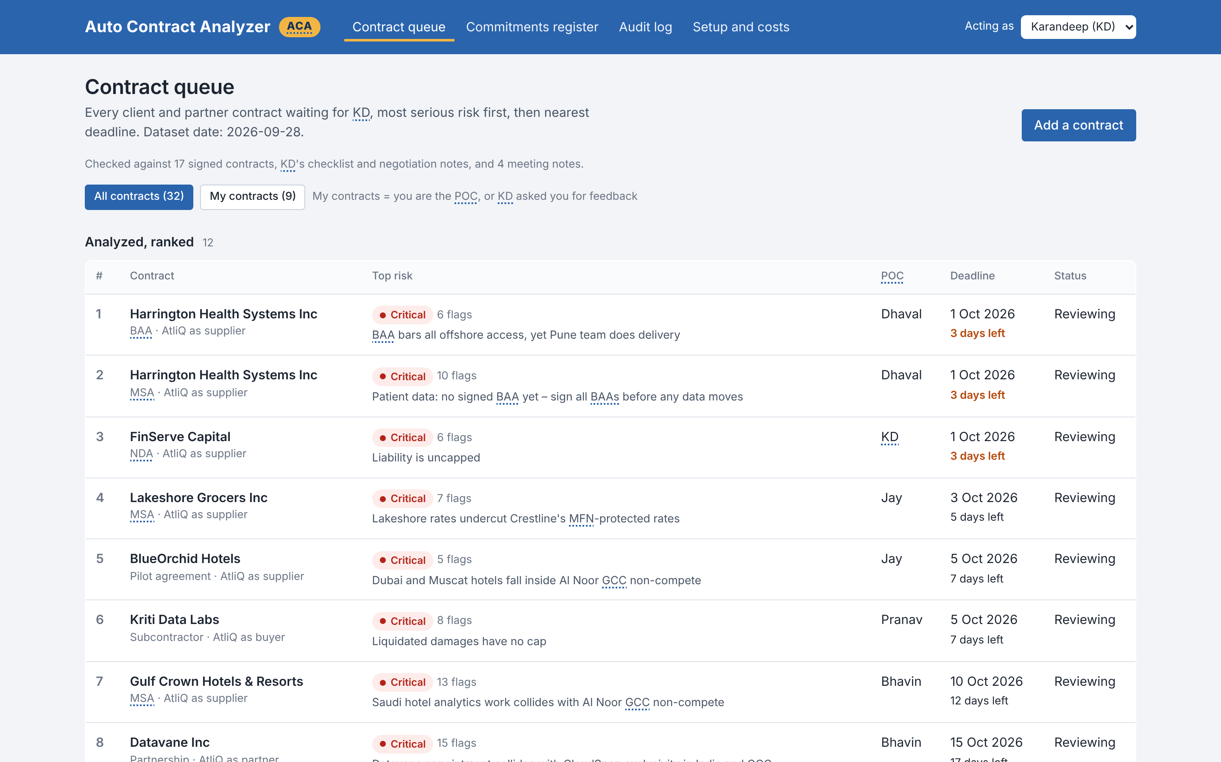
Your morning view: every contract, most serious risk first
WALKTHROUGH 1 OF 4 · THE QUEUE
1
Ranked for you
Critical conflicts and nearest deadlines rise to the top. No more whiteboard queue.
2
One-line top risk
e.g. “Saudi hotel analytics collides with Al Noor GCC non-compete”.
3
Everyone sees their own
Bhavin, Dhaval, Jay and Pranav filter to their contracts and see where you asked for feedback.
Notes:
This is the live prototype. Twelve contracts from today's queue, already analyzed, ranked by the most serious risk and then the deadline. Harrington is at the top because of the patient-data issue; Gulf Crown shows the Al Noor conflict in one line.

Slide 10
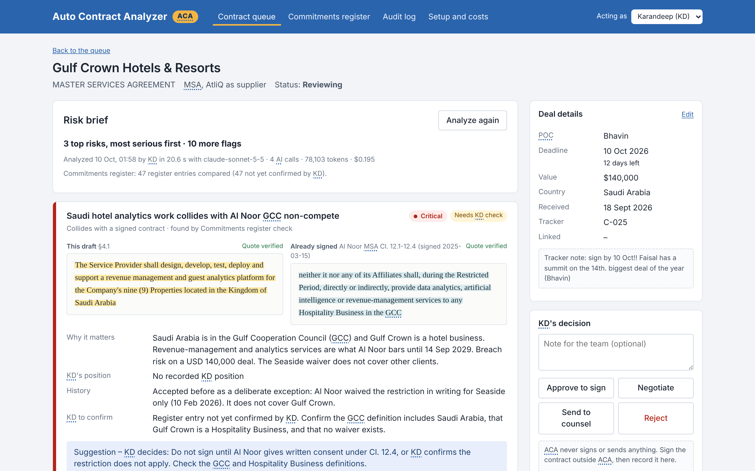
Each risk shows the draft clause next to what it breaks
WALKTHROUGH 2 OF 4 · THE RISK BRIEF
1
Side by side, verified
Gulf Crown §4.1 next to Al Noor MSA §12, both checked word for word.
2
Why it matters, history
Breach risk on $140k; the Seaside waiver does not cover it.
3
You decide
“Suggestion – KD decides”. Approve, negotiate, counsel or reject is yours; ACA never signs.
Notes:
This is Gulf Crown, Bhavin's biggest deal of the year, due on the 10th. On the left is the draft clause, on the right the Al Noor clause it breaks. Both are marked 'quote verified'. ACA explains why it matters, notes that the Seaside waiver does not cover it, and suggests: do not sign until Al Noor consents. The decision buttons are yours alone.

Slide 11
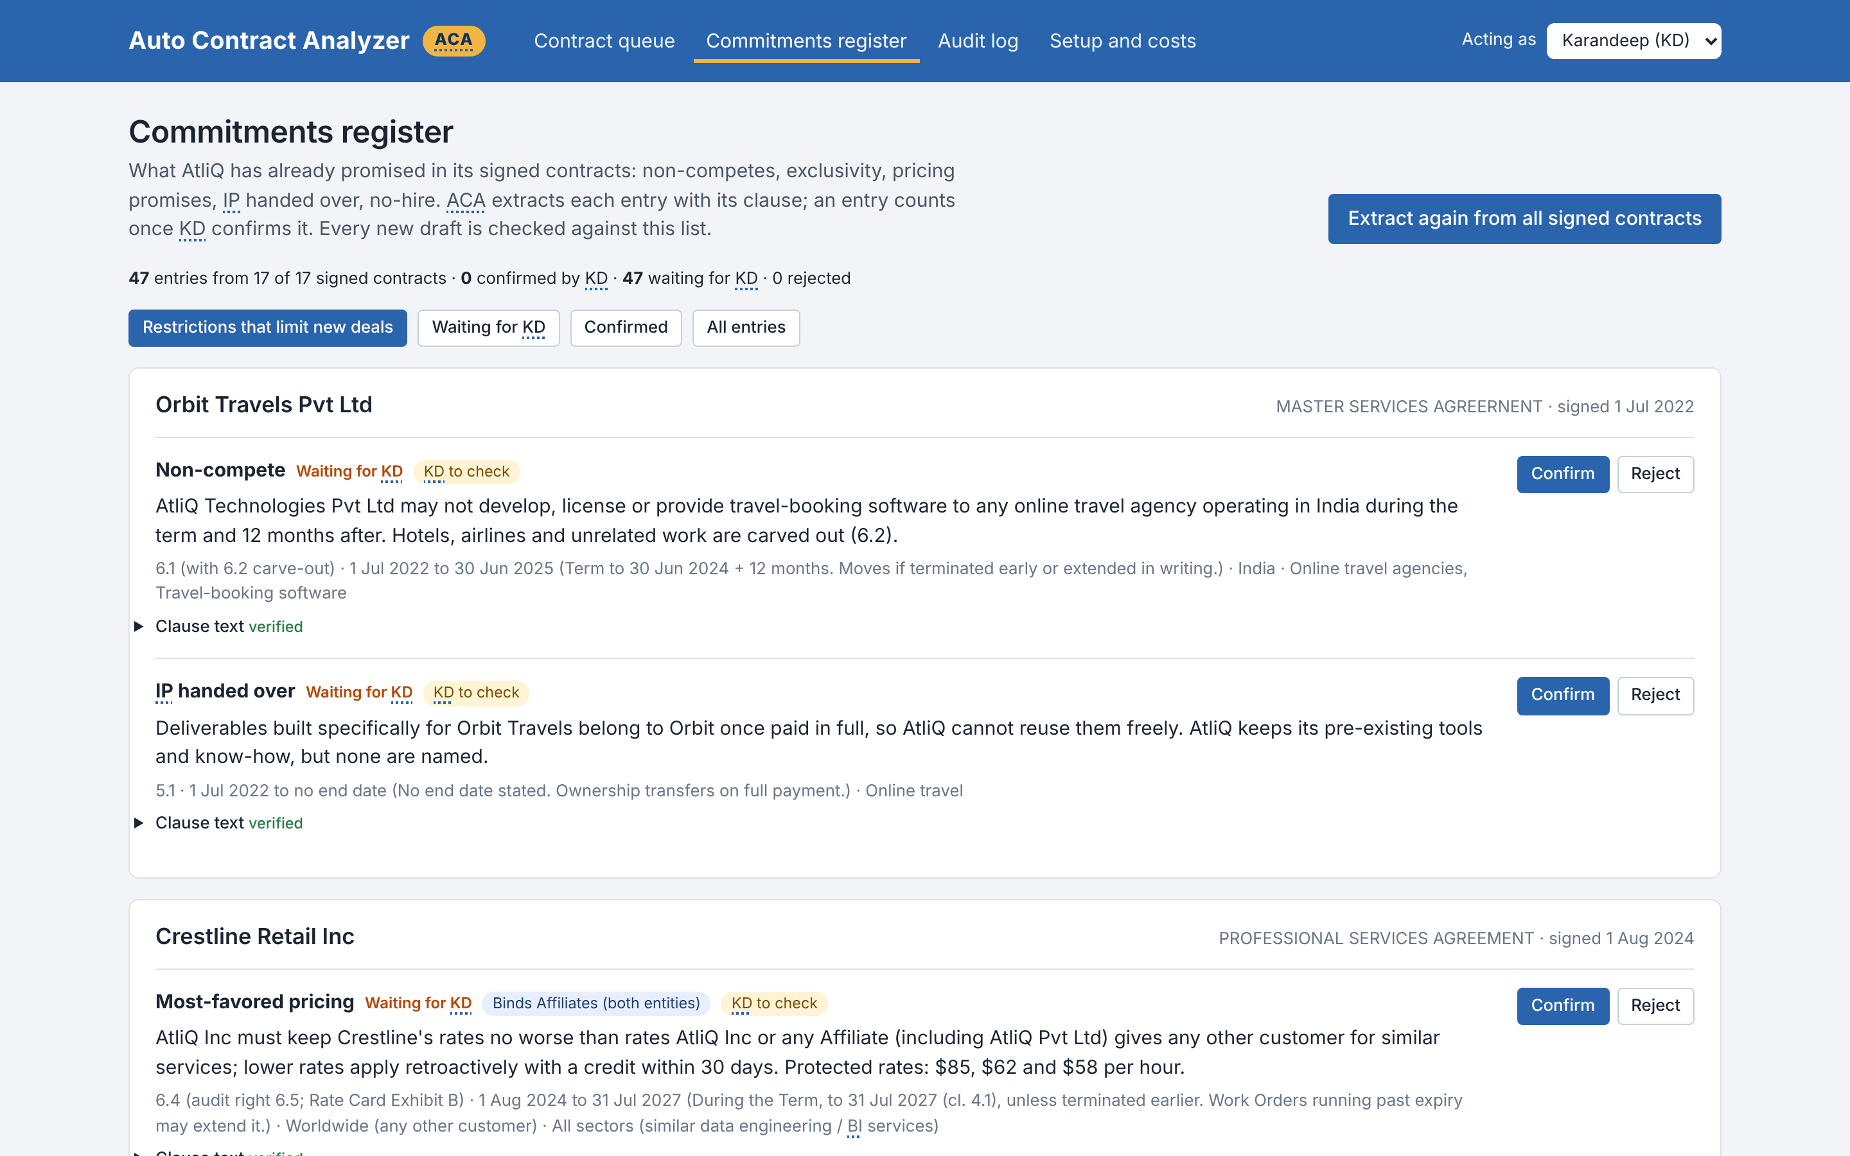
AtliQ's promises in one place – and nothing sensitive leaks
WALKTHROUGH 3 OF 4 · MEMORY AND PRIVACY
What leaves AtliQ
Before
CIN U72900MH2019PTC321456, registered office at 4th Floor, Baner Business Bay, Pune
Sent to the AI
CIN [ATLIQ_PVT_LTD_CIN], registered office at [ATLIQ_PVT_LTD_ADDRESS]
Patient records in a contract are removed before the AI reads it
“What left AtliQ” shows the exact text
0 leaks across 40 tests
Commitments register: you confirm each entry once; until then it is marked “Waiting for KD”.
Notes:
The register is the memory we never had: each promise with its clause, its region and sector, and its end date. Nothing counts until you confirm it. On privacy: company IDs, addresses, bank details and emails are swapped for placeholders before anything goes to the AI, any patient records pasted into a contract are removed before the AI reads it, and there is a screen that shows exactly what left AtliQ.

Slide 12
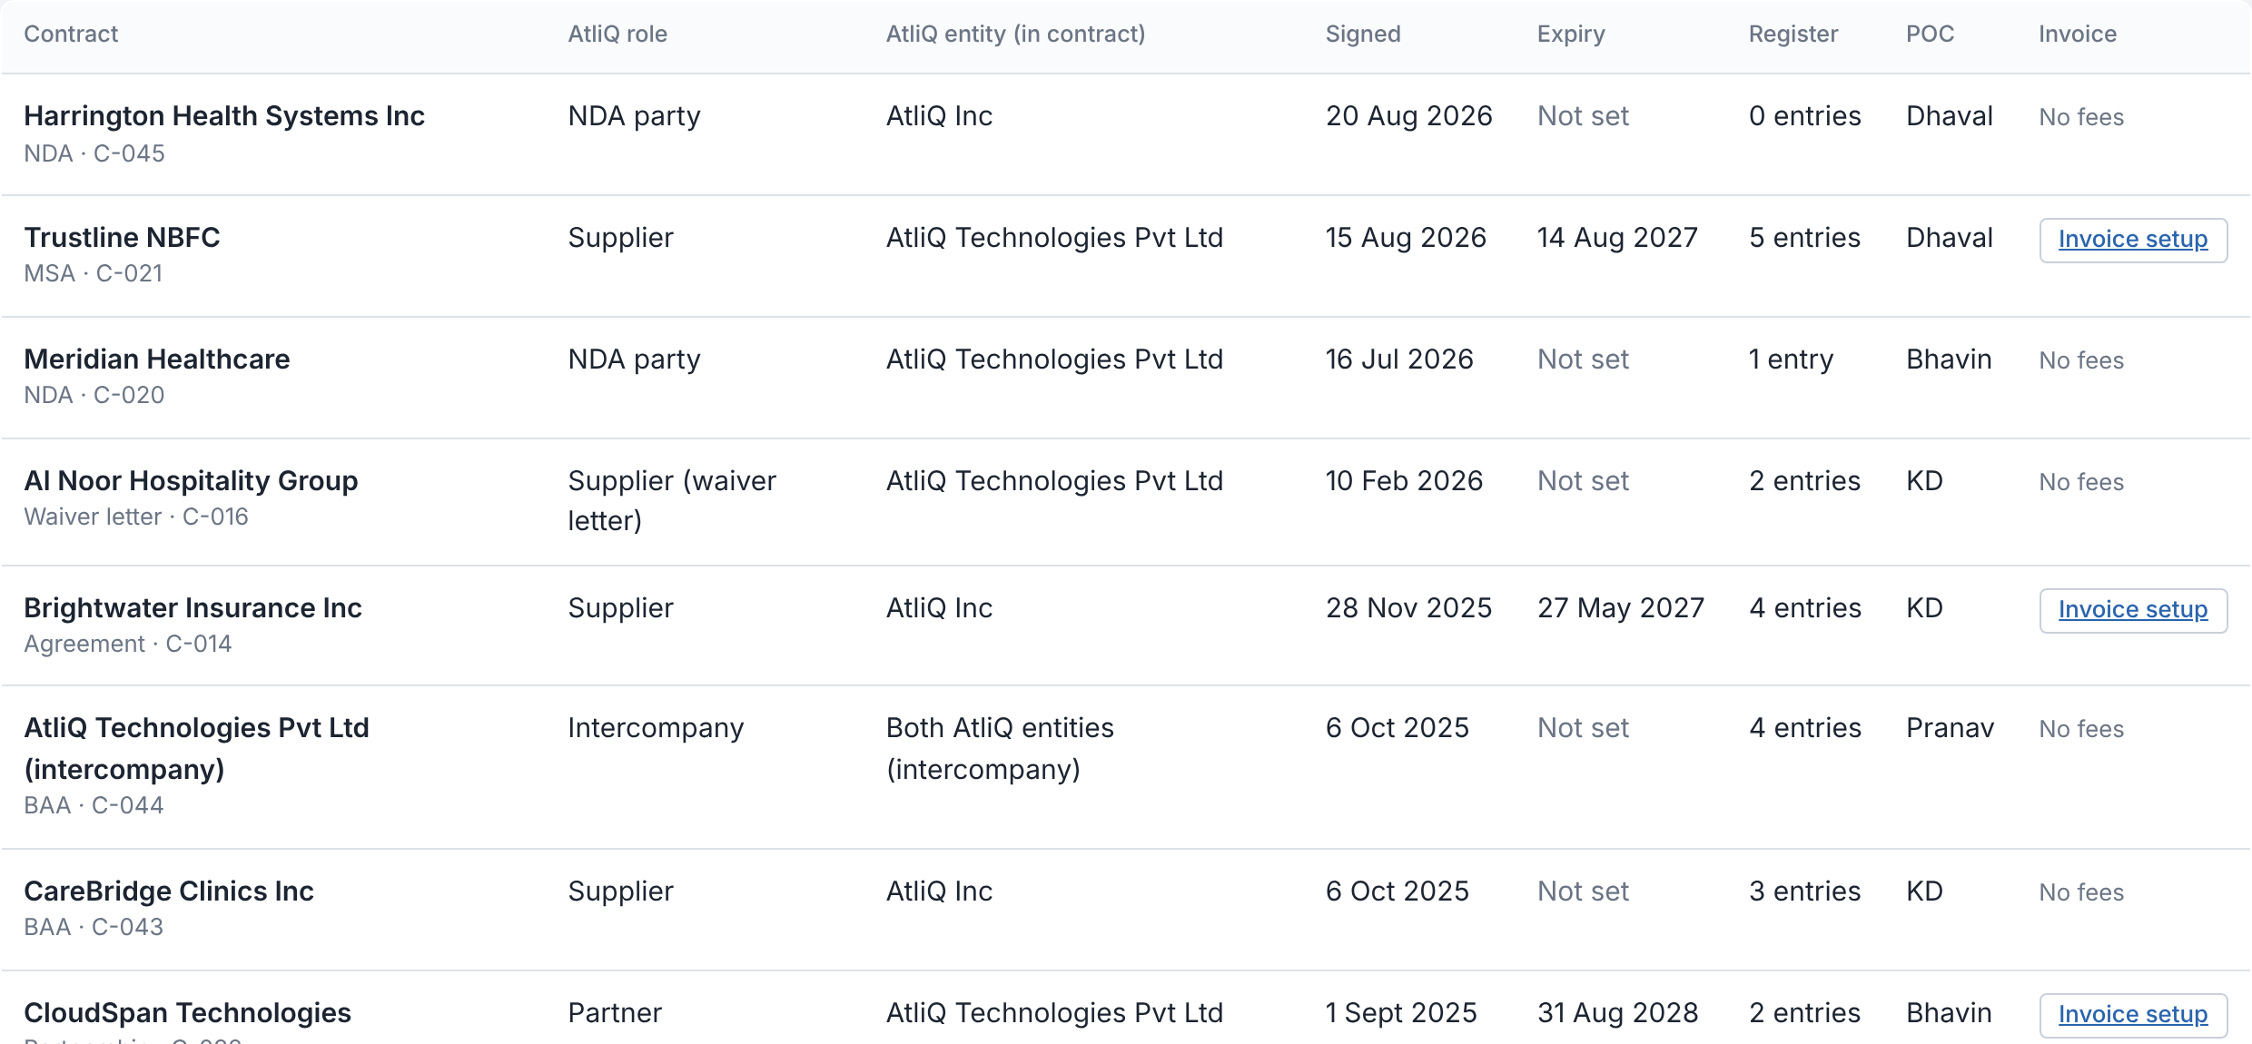
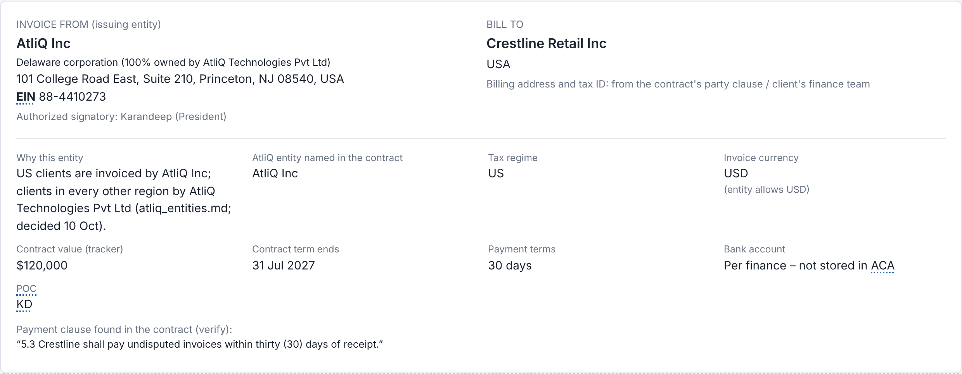
After signing: one history, invoices from the right entity
WALKTHROUGH 4 OF 4 · AFTER YOU SIGN
Signed Contract History
Invoice setup
Every signed contract with its date, expiry, AtliQ entity and register entries. New signatures feed the register automatically.
US clients are invoiced by AtliQ Inc; everyone else by AtliQ Technologies Pvt Ltd. ACA warns when a contract names the other entity, which delayed payments twice in 2025.
Notes:
After you sign, the contract moves into the Signed Contract History, and its new promises go into the register, so the memory keeps itself up to date. And because entity mismatches delayed payments twice last year, every signed contract has an invoice setup for finance: US clients from AtliQ Inc, everyone else from the Pvt Ltd, with a warning when the contract says otherwise. It is a draft for finance; ACA never issues invoices.

Slide 13
We tried to break it with 25 contracts written to fool it
HOW IT HANDLES EDGE CASES
Hidden conflicts
Must not flag
40 / 40
4 / 4 caught
4 / 4 left alone
GCC hotels only in an annex · hotel group behind a real-estate company · Crestline undercut via free hours
Orbit's expired non-compete · Europe-only platform · de-identified health data · clean long MSA
test contracts with the expected result, including your 15 drafts
10 / 10 hidden conflicts caught
0 clean contracts over-flagged
2 bugs found and fixed before this meeting
Disguised terms
Robustness and safety
6 / 6 caught
7 / 7 handled
Penalty renamed “service credits” · carve-outs that empty the cap · “mutual” NDA with one-way clauses
Hidden instructions to the AI · SSN and bank numbers · OCR errors · invoice uploaded by mistake
Notes:
We did not only test the happy path. We wrote 25 contracts designed to fool it: conflicts hidden in annexes, penalties renamed as service credits, liability caps emptied by carve-outs, instructions to the AI hidden in the text. All 40 cases now give the expected result. The first run found two real bugs, one over-flag on de-identified health data and one bank routing number that was not masked. Both are fixed.

Slide 14

One North Star: your review hours saved each month
HOW WE'LL KNOW IT WORKS
ACA analysis time
< 5 min
NORTH STAR
measured 4–46 s
≥ 10 hours
Flags you mark wrong
≤ 20%
Pilot metrics tab: your useful, dismissed and wrong clicks
of your review time saved every month: from 3–4 hours to under 1 hour per contract (~60%).
Signed conflicts · uncapped damages · data leaks · AI sign actions
0
guardrail metrics
Co-metric: every contract decided within 3 days, every flag cited (today: 1 week to 1 month)
Outside counsel spend
≤ $5k / yr
even as volume grows
Notes:
We will judge ACA on one number: your review hours saved per month, at least ten, by getting your time per contract under an hour. The co-metric is that every contract is decided within three days. Underneath: analysis under five minutes, which we already beat; no more than 20 percent of flags marked wrong by you, with useful and dismissed flags both counted as correct and shown on the Pilot metrics tab; and zero signed conflicts, uncapped damages, leaks or AI sign actions.

Slide 15
About $54 a month to run, about $700 a month back
THE BUSINESS CASE
$0.20
per contract review (measured; estimate $0.16)
$696 / month
saved at today's volume: 43%, about 13x the running cost
36 years
of running costs = one avoided Brightwater ($23.2k)
Notes:
The money. Each review costs about twenty cents in AI. Running ACA in production is about 54 dollars a month, mostly hosting. Valuing your time at a conservative 50 dollars an hour, we save about 700 dollars a month at today's volume, around 13 times the cost. And that ignores the big one: a single avoided Brightwater pays for 36 years of ACA.

Slide 16
Every way ACA could fail has a guardrail – all tested
RISKS AND GUARDRAILS
What could go wrong | Guardrail | Tested
Misses a conflict with a past promise | Register check tuned to catch everything; unsure cases marked “Needs KD check”; you confirm each register entry | 10 / 10 caught
Makes something up | No source, no flag: every quote is checked word for word against the contract | 134 / 134 verified
Confidential data leaves AtliQ | IDs, bank and address details masked; patient records removed before the AI reads it; leak check blocks the call | 0 leaks in 40 tests
Someone hides instructions for the AI | Hidden instructions are flagged to you and cannot change the result | 3 / 3 resisted
Too many flags, people stop listening | Top 3 only; you mark flags useful, dismissed or wrong; target ≤ 20% wrong | 0 clean contracts flagged
AI decides instead of you | ACA never signs, approves or sends; only you record a decision; audit log can't be edited | No such code exists
Kill switch: Karandeep (KD) alone can stop ACA with a STOP / START toggle. While ACA is stopped, no contract is sent to it, the Top risk column shows "ACA Disabled", and POCs review each contract by hand against all compliance points.
Notes:
These are the ways this could go wrong and what stops each one. The two that matter most to you: ACA cannot invent a risk, because every quote is checked word for word, and it cannot decide anything, because there is no code that signs or sends. The kill switch is a toggle that only Karandeep can use. Press STOP and no contract goes to ACA; the Top risk column shows ACA Disabled, and the POC checks each contract by hand against all compliance points. Press START to turn ACA back on. Any data leak, AI sign action or edited audit log should trigger STOP straight away.

Slide 17



Three decisions to start the pilot this week
WHAT I NEED FROM YOU
1
2
3
Confirm the register
Run a 2-week pilot
Act on today's findings
Spend ~45 minutes confirming the ~50 promises ACA found. Only you can; it becomes AtliQ's memory.
Every client and partner contract goes through ACA before you read it. You mark each top flag useful, dismissed or wrong, and the Pilot metrics tab shows the results to everyone.
Harrington: US counsel before any signature.
Gulf Crown, BlueOrchid, TravelHub: no signature without Al Noor's consent.
After the pilot we bring you the numbers: your hours per contract, decision time and flag usefulness. Then go or no-go.
Notes:
So, three things. First, 45 minutes of your time to confirm the register, because only you can say what we promised. Second, a two-week pilot where every contract goes through ACA before you read it, and you mark which flags were useful, dismissed or wrong. Third, two things ACA has already found that should not wait: Harrington needs US counsel before anything is signed, and three hotel deals need Al Noor's consent. After two weeks I come back with the numbers and you decide go or no-go.

Slide 18

You still sign every contract. ACA makes sure you know what you're signing.
THANK YOU
Live prototype: ai-pm-capstone-project-for-contract.vercel.app
Code: github.com/vvsoni2020/AI-PM-Capstone-Project-for-Contract-Analyzer
Notes:
Thank you. Happy to take questions, and I can show any contract from today's queue live.

Slide 19
Abbreviations used in this deck and in ACA
BACKGROUND · GLOSSARY
Short form | Full form
ACA | Auto Contract Analyzer (this prototype)
AI | Artificial Intelligence
API | Application Programming Interface
KD | Karandeep, AtliQ's CEO, who signs every contract
PM | Product Manager
POC | Point of Contact (owner of a deal)
MSA | Master Services Agreement
SOW | Statement of Work
NDA | Non-Disclosure Agreement
BAA | Business Associate Agreement (US healthcare)
PHI | Protected Health Information
Short form | Full form
HIPAA | Health Insurance Portability and Accountability Act (US)
DPA | Data Processing Agreement
GDPR | General Data Protection Regulation (EU, UK)
LD | Liquidated Damages: a fixed penalty for delay
MFN | Most-Favored-Nation: no other customer gets a better price
GCC | Gulf Cooperation Council: Saudi Arabia, UAE and 4 other Gulf states
UAE | United Arab Emirates
IP | Intellectual Property
CIN | Corporate Identification Number (India)
SSN | Social Security Number (US)
OCR | Optical Character Recognition: turning a scan into text
In the app, an abbreviation is underlined with a dotted line the first time it appears on each page: hover over it (or tap on a phone) to see the full form.
Notes:
Background slide, not presented. It lists every abbreviation used in the deck, the video and ACA. In the app, hovering over the first underlined use of an abbreviation on each page shows its full form.

