Slide 1
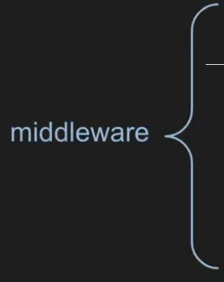



app.use()
app.use()
app.use()
app.get(“/posts”)
app.use()

