Slide 1
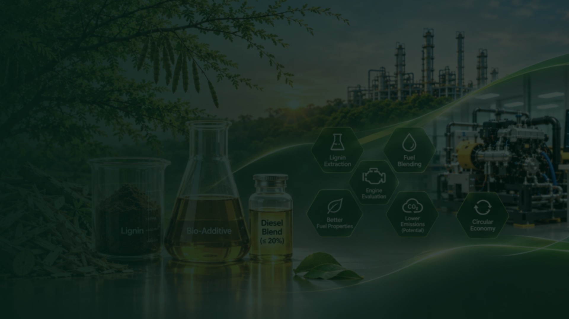
RESEARCH · BIOENERGY · R&D PARTNERSHIP PITCH · 2026
Extraction and Utilisation of Lignin as a Bio‑Additive in a Compression Ignition Engine
Fuelled with diesel fuel — an approach to improve fuel properties.
A research pathway from managed biomass to measured fuel blends.
FEEDSTOCK Prosopis juliflora
STAGE Planning & validation
LOCATION KARE · Tamil Nadu
PRESENTED BY
Srinath Vatchavari Venkateshan
Team: Aarya Brat Shankar · R. Bhuvaneshwaran
Mentor: Dr. S. K. Gowthaman · Kalasalingam Academy of Research and Education
Research concept · Experimental results are not yet claimed
Research concept, IP & copyright: Srinath Vatchavari Venkateshan.
Website design & development: Srinath Vatchavari Venkateshan.
REGen Pavilion · Lignin bio-additive research
Research concept · No results claimed
01 / 13

Slide 2
01 · THE OPPORTUNITY
Why lignin, and why this feedstock?
Diesel remains central to transport, farming and industry. New fuel components must earn their place through measurement, not assertion.
01
02
03
THE CHALLENGE
Diesel is hard to displace, and alternative fuel components face strict quality, compatibility and engine requirements.
THE MATERIAL
Lignin is a carbon-rich aromatic polymer in plant cell walls. It can be separated and studied as a source of fuel-related products.
THE IDEA
Recover lignin from managed Prosopis juliflora, convert it into a liquid product, and test whether it can work as a diesel bio-additive.
MAIN QUESTION
Can a lignin-derived product be made stable and suitable for limited diesel blending — while meeting fuel-quality and engine requirements?
FEEDSTOCK BOUNDARY Use only Prosopis juliflora collected through authorised removal or management. The project must not encourage planting or spreading this invasive species.
REGen Pavilion · Lignin bio-additive research
Research concept · No results claimed
02 / 13

Slide 3
02 · EVIDENCE & RESEARCH GAP
What published research tells us
The literature supports investigation — not a performance claim.
2015 APPLIED ENERGY
2024 SAE TECHNICAL PAPER
2026 FUEL
Lignin as a stabiliser in fuel–water emulsions for a diesel engine. Useful background, but not the same as a lignin-derived pyrolysis liquid.
A lignin-based fuel tested in a small CI engine reported fuel-system and deposit challenges. Compatibility testing is essential.
Ignition-quality assessment of lignin-ethanol oil in a small CI engine. Supports further research; does not prove suitability for road diesel engines.
THE GAP
Our study must connect one selected feedstock, lignin recovery, product chemistry, diesel-blend stability and engine testing in one measured workflow.
Key lesson: lignin is not automatically a ready-to-use diesel additive. Separation, upgrading and compatibility checks come first.
REGen Pavilion · Lignin bio-additive research
Research concept · No results claimed
03 / 13

Slide 4
03 · OBJECTIVES
A five-stage evidence chain
Each stage is designed to produce a record that the next stage can rely on.
01
02
03
04
05
RECOVER
Study a suitable method to recover lignin from authorised Prosopis juliflora biomass.
CHARACTERISE
Measure lignin yield, purity and key chemical features.
CONVERT
Study controlled conversion of recovered lignin into a liquid product.
SCREEN
Measure fuel properties and check blend stability before engine trials.
VALIDATE
Compare selected blends with diesel in a supervised CI-engine programme.
PROPOSED NOVELTY
A feedstock-specific, end-to-end evidence chain: recovered lignin → measured blend → supervised engine assessment.
BEFORE SUBMISSION
Novelty must be confirmed through a formal literature and patent search. The project remains exploratory.
REGen Pavilion · Lignin bio-additive research
Research concept · No results claimed
04 / 13

Slide 5
04 · METHODOLOGY
From managed biomass to measured evidence
Eight proposed stages. None is complete at the time of publication; all measurements are planned references.
1
MANAGED BIOMASS
2
PREPARATION
3
LIGNIN RECOVERY
4
CHARACTERISATION
Prosopis juliflora, authorised and traceable
Clean, dry, reduce size and control moisture
Select and optimise the recovery method
Yield, purity and chemical structure
5
CONVERSION
6
LIQUID PRODUCT
7
BLEND SCREENING
8
ENGINE EVALUATION
Controlled conversion study
Separate and analyse the product
Stability and fuel-property gates
Only after safety and lab approval
Important: raw lignin and untreated conversion liquid are not assumed to be directly suitable for diesel blending.
REGen Pavilion · Lignin bio-additive research
Research concept · No results claimed
05 / 13

Slide 6
05 · VALIDATION PLAN
What will be measured
The measurement plan is the core of the proposal: every later claim depends on these records.
STAGE | MEASUREMENTS | WHY IT MATTERS
Lignin | Recovery yield, purity, chemical structure | Checks whether the separation method works.
Liquid product | Density, viscosity, heating value, flash point, acidity, water, composition | Shows whether the product has useful fuel-related properties.
Blend screening | Visual separation, storage stability, viscosity, material compatibility | Checks whether the blend remains uniform and suitable for further tests.
Engine study | Performance, combustion, fuel use, emissions, deposits | Compares the selected blend with baseline diesel.
BLEND RANGE
Screening up to a maximum of 20% by volume. A research boundary — not a proven safe or optimal blend.
CONTROL
Baseline diesel as the reference. Only blends that pass laboratory screening proceed.
GATE
Engine testing requires a qualified lab, approved risk assessment and a supervised protocol.
No engine result, emissions reduction or fuel-economy improvement is claimed at this stage.
REGen Pavilion · Lignin bio-additive research
Research concept · No results claimed
06 / 13

Slide 7
06 · EVIDENCE STANDARD
Every number is measured before it is claimed.
This is a research record, not a results announcement.
NOT CLAIMED TODAY
WILL BE MEASURED
HOW WE PROTECT THE RECORD
× Emissions reduction
× Engine-performance improvement
× Commercial or policy benefit
× Funding or partnership secured
• Lignin yield and purity
• Product composition and fuel properties
• Blend stability and compatibility
• Performance, combustion and emissions (gated)
• Documented methods and records
• Baseline comparison with diesel
• Qualified lab and approved risk assessment
• Results published only after review
Evidence gate: no result leaves the project until its method, baseline and review are documented.
REGen Pavilion · Lignin bio-additive research
Research concept · No results claimed
07 / 13

Slide 8
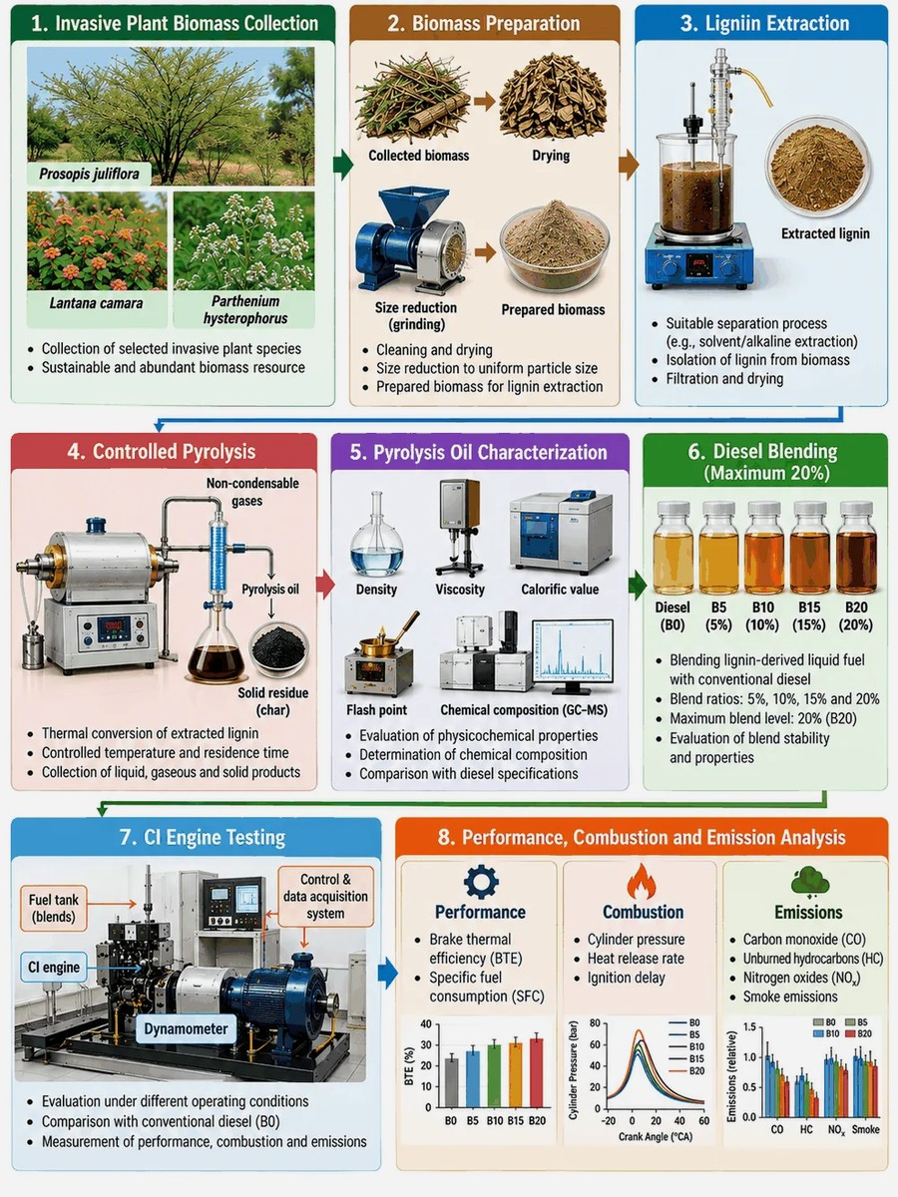
07 · RESEARCH IMPACT
Waste-to-value, to be evaluated
Impact is a hypothesis to test, not a headline to assert.
CIRCULAR USE
Could biomass residues support a more circular use of plant material? To be evaluated.
LOCAL FEEDSTOCK
Could a managed, locally available species provide a traceable feedstock? To be assessed.
CAPABILITY
Builds methods, records and analytical capability for lignin-to-fuel research.
EVIDENCE
A documented feedstock-to-property dataset that later studies can scrutinise.
No commercial, market or policy benefit is claimed. Environmental claims require measurement and independent review.
Illustrative project imagery — not experimental results.
REGen Pavilion · Lignin bio-additive research
Research concept · No results claimed
08 / 13

Slide 9
08 · COLLABORATION MODEL
The partnership we need
One project, five kinds of support. Proposed partners only — no commitment is implied.
BIOMASS & ENVIRONMENT
CHEMISTRY / MATERIALS LAB
BIOENERGY / PROCESS LAB
Authorised feedstock access, ecological safeguards and traceability.
Lignin recovery, purity, structure and analytical testing.
Conversion route, product separation and upgrading research.
ENGINE TEST CENTRE
INDUSTRY PARTNER
Fuel compatibility, supervised CI-engine evaluation and emissions.
Technical mentoring, application needs, co-funding or in-kind support.
First step: a technical meeting and feasibility review. Formal collaboration will be documented separately.
REGen Pavilion · Lignin bio-additive research
Research concept · No results claimed
09 / 13

Slide 10
09 · FUNDING PATHWAY
A realistic route to research funding
Sequenced for a student-led project with faculty and laboratory support.
ANRF / DST — FIRE
ANRF — ADVANCED RESEARCH GRANT
INSTITUTIONAL PARTNERSHIPS
Connects academic research with industry. The scheme page describes a 50% monetary match by DST-SERB. Requires an eligible academic partner and an industry partner; the academic lead must meet eligibility rules.
A competitive, investigator-led route for strong research questions in engineering, environment and related fields. A qualified faculty researcher should lead the application.
Large ANRF catalytic programmes are institution-led and require substantial multi-partner commitments. They are not a direct student grant route.
RECOMMENDED SEQUENCE
01
Secure faculty PI + host lab
02
Complete feasibility and baseline data
03
Obtain industry / lab support letters
04
Build a costed, milestone-based proposal
05
Apply when an eligible call is open
→
→
→
→
Funding note: a million-USD-scale programme is a long-term consortium ambition only. It is not a current award, confirmed budget or guaranteed outcome.
REGen Pavilion · Lignin bio-additive research
Research concept · No results claimed
10 / 13

Slide 11
10 · 24-MONTH PLAN
From feasibility to validation
A staged plan with evidence gates — not a promise of results.
0–3 MONTHS
4–8 MONTHS
9–13 MONTHS
14–18 MONTHS
19–24 MONTHS
SCOPE & SETUP
Faculty PI, literature and patent review, feedstock permission, laboratory plan.
LIGNIN RECOVERY
Compare methods; record yield, purity and repeatability.
CONVERSION & ANALYSIS
Prepare liquid-product samples; analyse composition and key properties.
BLEND SCREENING
Stability, viscosity, compatibility and fuel-quality gates.
VALIDATION & SCALE-UP CASE
Supervised engine tests, LCA, techno-economics and next proposal.
BUDGET HEADS TO COST
✓ Feedstock collection & preparation
✓ Extraction chemicals, glassware & consumables
✓ Analytical testing & instrument access
✓ Conversion / upgrading facility access
✓ Blend stability & fuel-property tests
✓ Engine test time, safety & emissions analysis
✓ Personnel, travel, contingency & overheads
Budget to be costed after the PI, host laboratory and testing partners are confirmed.
REGen Pavilion · Lignin bio-additive research
Research concept · No results claimed
11 / 13

Slide 12
11 · CREDIT, OWNERSHIP & NEXT STEP
Let's build the evidence together
A focused first conversation is the right next step — not a request for a commitment today.
WHAT WE ARE SEEKING
PROJECT OWNERSHIP & CREDIT
✓
An eligible faculty Principal Investigator
Research concept, direction, outputs, documents, intellectual property and copyright are owned and managed solely by Srinath Vatchavari Venkateshan.
Aarya Brat Shankar and R. Bhuvaneshwaran are acknowledged supporting contributors. Dr. S. K. Gowthaman advises as faculty mentor. Acknowledgement, authorship credit or mentorship does not confer ownership, copyright or other rights.
Website design & development: Srinath Vatchavari Venkateshan.
Any separate written agreement signed by the owner takes precedence.
✓
A host laboratory for lignin recovery and analysis
✓
Access to fuel-property and blend-stability testing
✓
A qualified engine-testing collaborator
✓
An industry mentor and future funding partner
FIRST STEP
A technical meeting and feasibility review.
Email: 9926009061@klu.ac.in
KARE · Krishnankoil, Tamil Nadu · github.com/vvsrinath
REGen Pavilion · Lignin bio-additive research
Research concept · No results claimed
12 / 13

Slide 13
12 · REFERENCES & SOURCES
Evidence trail
Selected references and official funding sources. Full abstracts and poster are available on the project site.
01
Terauchi et al. (2024).
Experimental Study of Lignin Fuels for CI Engines. SAE Technical Paper. doi:10.4271/2024-37-0022
02
Fuel (2026).
Ignition quality assessment of alternative marine fuels using a small CI engine, 413, 138117.
03
Applied Energy (2015).
Performance, combustion, and emissions in a diesel engine operated with fuel-in-water emulsions based on lignin. doi:10.1016/j.apenergy.2015.05.036
04
Yang et al. (2007).
Characteristics of hemicellulose, cellulose and lignin pyrolysis. Fuel, 86, 1781–1788. doi:10.1016/j.fuel.2006.12.013
05
ANRF / DST-SERB.
Fund for Industrial Research Engagement (FIRE) and Advanced Research Grant information. Verify live call dates and eligibility before applying.
Sources checked 1 November 2026. Verify live call dates, eligibility and applicable rules before submission.
REGen Pavilion · Lignin bio-additive research
Research concept · No results claimed
13 / 13

