Slide 1


Slide 2
Agenda
Problem Statement 03
Data Mining - 01 04
Data Mining - 02 05
Exploratory Data Analysis (EDA) 06
Data Visualization 07
Algorithms Used 08
Analysis of Results 09
Conclusion & Future Work 10

Slide 3
Problem Statement
A lending company needs to decide whether to approve Credit Card applications or not. They have data about past applicants including information like the person's age, income, credit score etc. as well as whether those applicants were approved for a loan.
The lending company wants to use this past data to build a system that can automatically decide whether new applicants should get a Credit Card approval or not.
The main goals are to:
Accurately predict if an applicant is likely to repay the loan or not based on their information. This will help make good lending decisions.
Make sure the decisions are fair and unbiased towards all applicants.
Speed up the loan approval process and reduce manual work.

Slide 4
Data Mining - 01
Firstly we load the dataset and find the different types of data available in that particular set. In my dataset there are 3 different types of data namely int64, float64,object.
The shape of the Data Set is 690,16( Rows, Columns)
There are no duplicate values in my data set so there is no need to delete any.
The Ratio proportion of the dataset is balanced with 1.25 : 1 , hence there is no need to do any sampling technique.
There are no null values in my dataset which is found by using isnull() function.
Using encoding technique namely label encoder all the Numerical type data is converted to Categorical data.

Slide 5
Data Mining - 02
In my dataset there are 2 attributes namely Ethnicity and ZipCode which does not effect the target variable so they were deleted.
After conversion of numerical data to categorical data with the help of target variable dependent and independent variables are found.
After finding independent and dependent variables splitting of data is done.
Finally scaling techniques were used to Normalize the data.

Slide 6
Exploratory Data Analysis (EDA)
Outliers were checked and removed from the given data set.
In the dataset the target variable is “Approved” because based on that we will be able to know whether an employee got approved to the loan or not.
And all the remaining variables are independent variables.
After identifying the necessary differentiating target and other variables splitting of data is done by using train_test_split() method from sklearn module.
After obtaining the train and test data , it is normalized by fit_transform() method from MinMaxScaler.

Slide 7
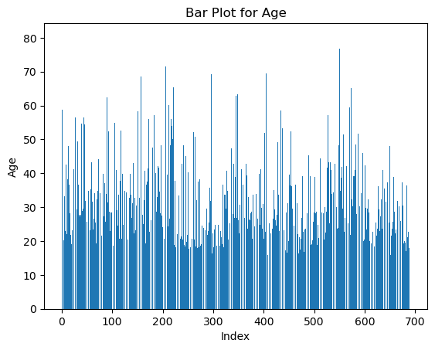
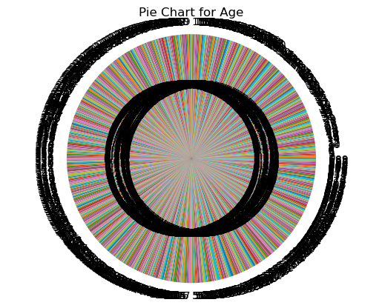
Data Visualization

Slide 8
Algorithms Used
My problem is a classification problem.
There are total seven algorithms in classification problem
Logistic Regression
Decision Tree Classification
Random Forest
Extra Trees Classification
KNN Algorithm
SVM Algorithm
Naïve Baye’s Algorithm
From the 7 algorithm, In KNN algorithm there is need to find the highest accuracy k value and there is a need to best SVM Model to find more accurate algorithm.

Slide 9
Analysis of Results
From KNN Algorithm k=3 gives the best Accuracy about 87.4%.
From SVM Algorithm kernel is polynomial that is kernel = “poly”.
From KNN and SVM by comparing all the algorithms KNN Algorithm is found to give best accuracy of all.
Best Algorithm is KNN Algorithm and the Accuracy is 87.4%.

Slide 10
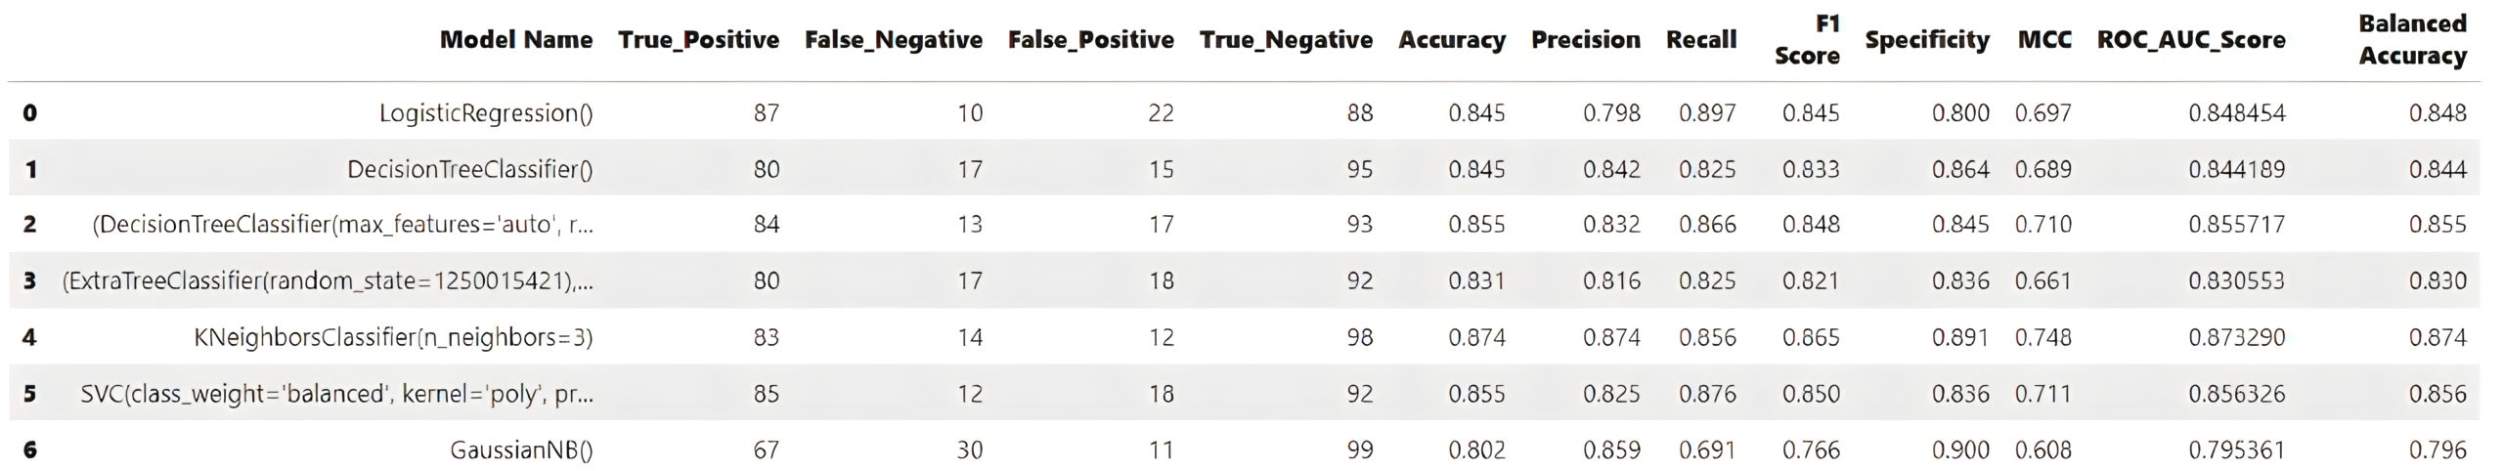
Conclusion and Future Work
After evaluating various algorithms, by observation KNN Algorithm is found to be the best and produced highest accuracy among all.
Therefore we will utilize the KNN Algorithm to predict the Credit Card Approval.

Slide 11
Thank You
Q & A
Student Name : K VVSS GOWTHAM
Roll Number : 21B91A05G7
SRKR Engineering College
Mobile: 9346782544
Email: 21b91a05g7@srkrec.ac.in
Bhimavaram - India

