Slide 1

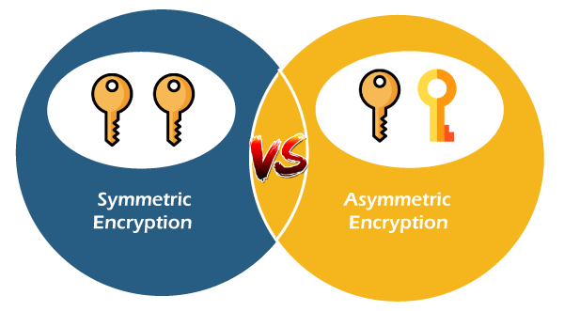
School of Computer science and engineering (CAT-3, BSCS, Sem III
Course Code:- BSCS2470 Course Name:Cryptographic and Network Security
Introduction to Symmetric and Asymmetric key and Authentication.
Section- I
Admission Number & Name of the Students
(1)20SCSE1100027 Priyanshu Kumar Singh.
(2)20SCSE1100009 Parth Sarthi.
(3)20SCSE1100013 Vidhi Tyagi.
Program Name: B.sc(CSE)

Slide 2
Table Of Content
Symmetric-key & Asymmetric-key
Comparison between two categories of cryptography
AES Algorithm & DES Algorithm
Encryption Algorithm
Asymmetric Encryption
RSA algorithm
Authentication
Message Authentication Codes
Password Authentication
Digital Certificates
Program Name: B.sc(CSE)

Slide 3
Symmetric-key
In symmetric-key cryptography, the same key is used by the sender (for encryption) and the receiver (for decryption).
The key is shared.
Algorithm: DES,3DES
Advantages:-
Simple.
Faster.
Disadvantages:-
Key must exchanges in secure way.
Easy for hacker to get a key as it is passed in unsecure way.
Program Name: B.sc(CSE)

Slide 4
Asymmetric-key
An asymmetric-key (or public-key) cipher uses two keys: one private (To encrypt data) and one public(To decrypt data).
Uses a pair of keys for encryption
Public key for encryption
Private key for decryption
Messages encoded using public key can only be decoded by the private key
Secret transmission of key for decryption is not required
Every entity can generate a key pair and release its public key
Program Name: B.sc(CSE)

Slide 5
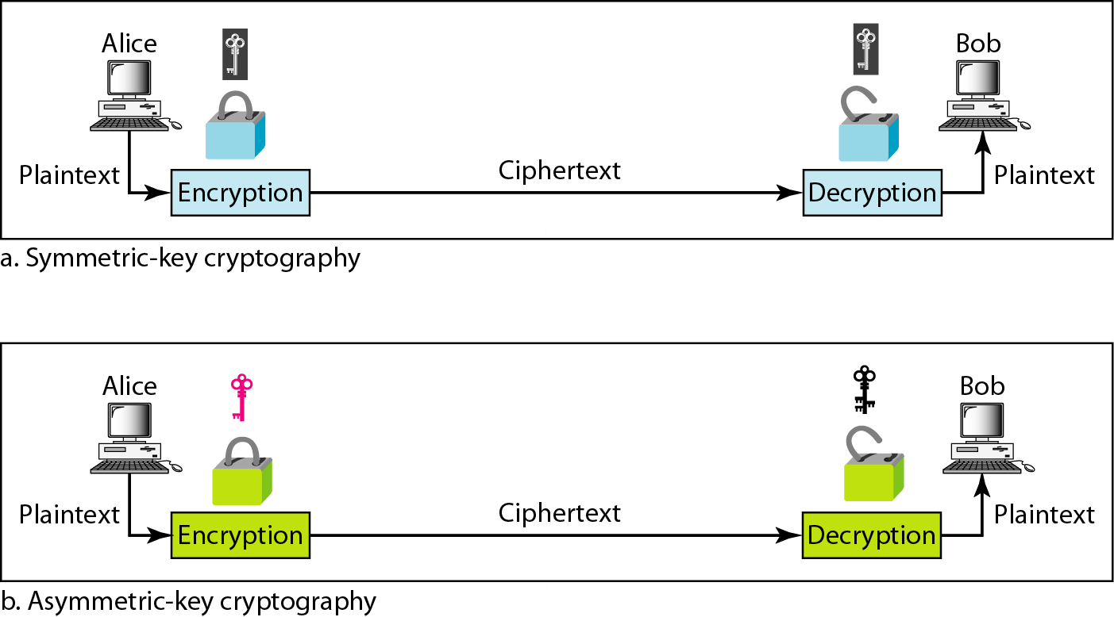
Comparison between two categories of cryptography
.
Program Name: B.sc(CSE)

Slide 6
AES Algorithm
1. AES encrypts 128 bit blocks with 128 AES encrypts 128 bit blocks with 128-bit, 192 bit, 192-bit or 256 bit or 256-bit keys using 10, 12, or 14 rounds, respectively.
2. Is not a Is not a Feistel Feistel cipher all 128 bits are encrypted
3. Each round = 4 steps of Each round = 4 steps of SubBytes , ShiftRows , MixColumns, and AddRoundKey.
4. Last round has only 3 steps. No MixColumns.
5. Decryption is not the same as encryption (as in DES).
Decryption consists of inverse steps.
Program Name: B.sc(CSE)

Slide 7
DES Algorithm
Data Encryption Standard (DES)
Goal of DES is to completely scramble the data and key so that every bit of cipher text depends on every bit of data and ever bit of key.
DES is a block Cipher Algorithm.
Encodes plaintext in 64 bit chunks.
It is the most used algorithm.
Program Name: B.sc(CSE)

Slide 8
Encryption Algorithm
.
Algorithm | Type | Key Size | Features
DES | Block Cipher | 56 bits | Most Common, Not strong enough
TripleDES | Block Cipher | 168 bits (112 effective) | Modification of DES, Adequate Security
Blowfish | Block Cipher | Variable (Up to 448 bits) | Excellent Security
AES | Block Cipher | Variable (128, 192, or 256 bits) | Replacement for DES, Excellent Security
Program Name: B.sc(CSE)

Slide 9
Asymmetric Encryption
Two most popular algorithms are RSA & Diffie Hellman Key
RSA
Developed by Ron Rivest, Adi Shamir, Len Adelman.
Both public and private key are interchangable.
Diffie Hellman key
Developed by Whitefield Hellman and Diffie Hellman.
Less common than RSA.
.
Program Name: B.sc(CSE)

Slide 10
RSA algorithm
Choose two large prime numbers p & q
Compute n=pq and z=(p-1)(q-1)
Choose number e, less than n, which has no common factor (other than 1) with z
Find number d, such that ed – 1 is exactly divisible by z
Keys are generated using n, d, e
Public key is (n,e)
Private key is (n, d)
Encryption: c = m^{e} mod n
m is plain text
c is cipher text
Decryption: m = c^{d} mod n
Public key is shared and the private key is hidden
Program Name: B.sc(CSE)

Slide 11
RSA algorithm
Problem-01:
In a RSA cryptosystem, a participant A uses two prime numbers p = 13 and q = 17 to generate her public and private keys. If the public key of A is 35, then the private key of A is _______.
Solution-
Given-
Prime numbers p = 13 and q = 17
Public key = 35
Step-01:
Calculate ‘n’ and toilent function Ø(n).
Value of n,
n = p x q
n = 13 x 17
∴ n = 221
Toilent function,
Ø(n) = (p-1) x (q-1)
Ø(n) = (13-1) x (17-1)
∴ Ø(n) = 192
Program Name: B.sc(CSE)

Slide 12
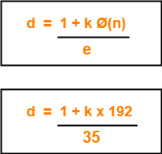
RSA algorithm
Step-02:
We are already given the value of e = 35.
Thus, public key = (e , n) = (35 , 221)
Step-03:
Determine ‘d’ such that-
Here,
The least value of ‘k’ which gives the integer value of ‘d’ is k = 2.
On substituting k = 2, we get d = 11.
Thus, private key of participant A = (d , n) = (11, 221).
Program Name: B.sc(CSE)

Slide 13
Authentication
.
Authentication is the process of validating the identity of a user or the integrity of a piece of data.
There are three technologies that provide authentication
Message Authentication Codes
Digital Signatures
Public Key Infrastructure
There are two types of user authentication:
Identity presented by a remote or application participating in a session
Sender’s identity is presented along with a message.x
Program Name: B.sc(CSE)

Slide 14
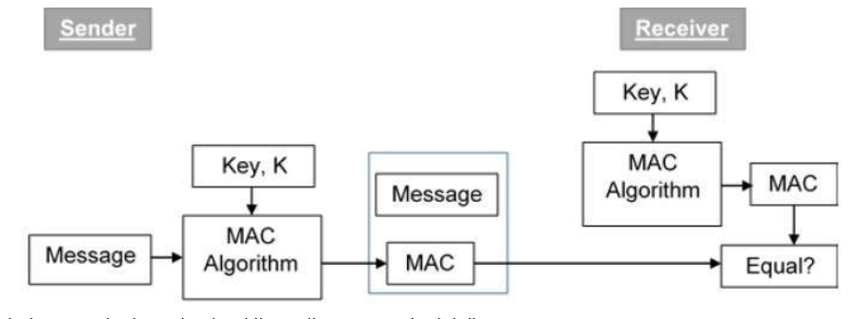
Message Authentication Codes
MAC algorithm is a symmetric key cryptographic technique to provide message authentication. For establishing MAC process, the sender and receiver share a symmetric key K.
Essentially, a MAC is an encrypted checksum generated on the underlying message that is sent along with a message to ensure message authentication.
Program Name: B.sc(CSE)

Slide 15
Password Authentication
Password is secret character string only known to user and server.
Message Digests commonly used for password authentication.
Stored hash of the password is a lesser risk.
Hacker can not reverse the hash except by brute force attack.
Problems with password based authentication.
Attacker learns password by social engineering.
Attacker cracks password by brute-force and/or guesswork.
Eavesdrops password if it is communicated unprotected over the network.
Replays an encrypted password back to the authentication server.
Program Name: B.sc(CSE)

Slide 16
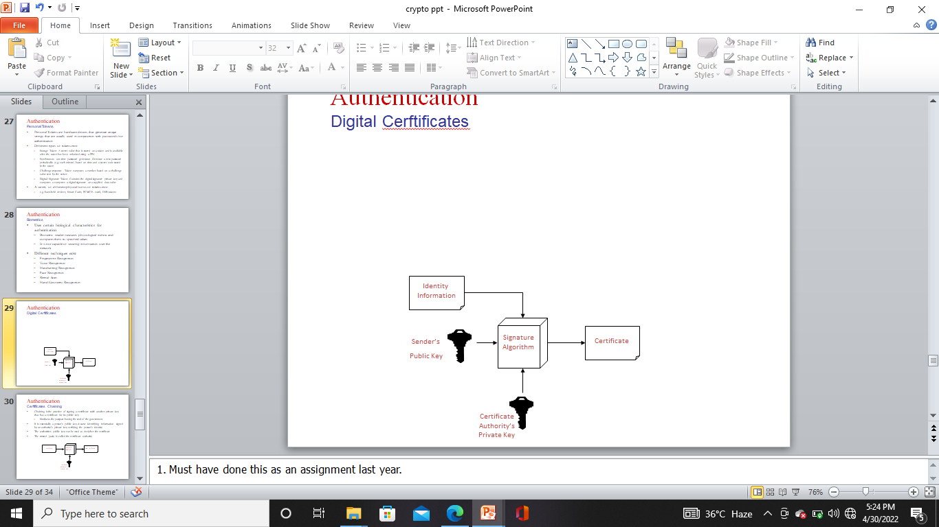
Digital Cerftificates
A digital certificate is a signed statement by a trusted party that another party’s public key belongs to them.
This allows one certificate authority to be authorized by a different authority (root CA).
Top level certificate must be self signed.
Any one can start a certificate authority.
Name recognition is key to some one recognizing a certificate authority
Verisign is industry standard certificate authority
Program Name: B.sc(CSE)

Slide 17


