Slide 1
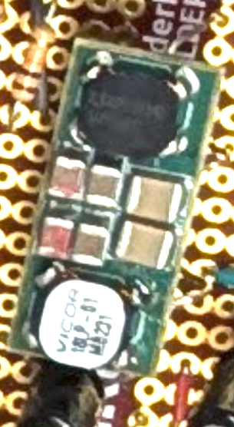
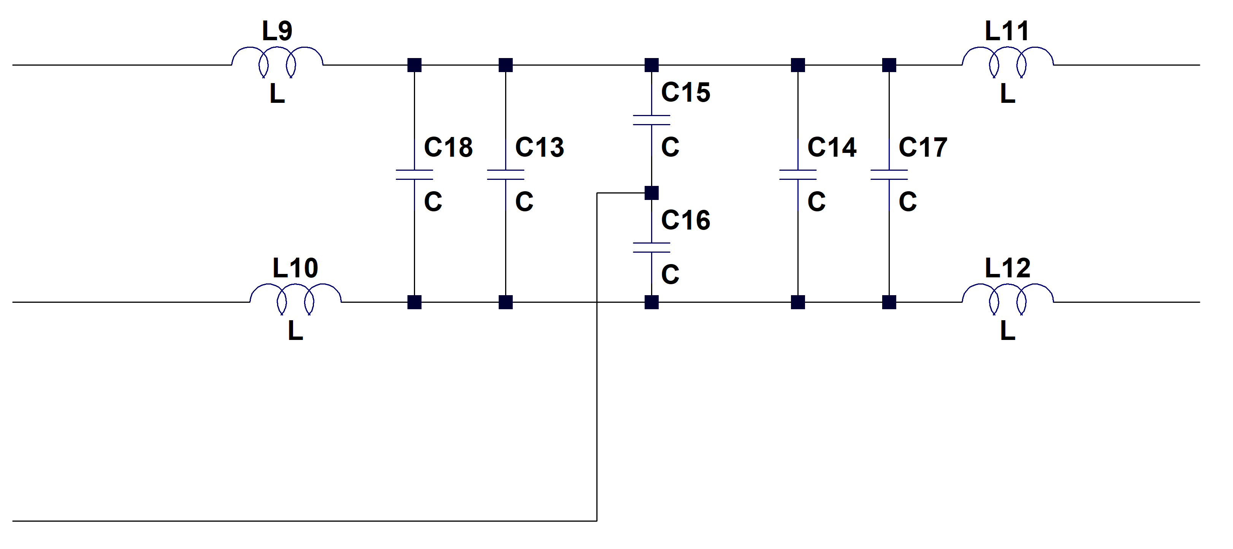
Objective: Reverse-engineer this unknown “black-box” filter.
Step 1. ASSUME the black box is a circuit containing the following, just based off visual inspection of components
Common-Mode Capacitors
IN+
OUT+
STEP 2
Common-Mode Choke
(Fancy transformer)
Common-Mode Choke
(Fancy transformer)
IN-
OUT-
Differential-Mode Capacitors
Differential-Mode Capacitors
CHASSIS
Step 2. Look up part number on those 4-terminal, black components.
Part number is CTX01-17342
Looking up datasheet shows they’re common-mode chokes
Model this as an ideal transformer, and use datasheet to enter assign inductance, equivalent turns ratio, and coupling factor of 1 (which is a K-statement in LTSPICE)
STEP 3
Step 3. These are capacitors. Don’t know what the values are, but start off with “educated guess”
Differential-mode and common-mode filters observed
Just a hunch. Start by guessing that differential-mode caps are between 1uF and 10uF
Start by guessing common-mode filter caps are between 0.01uF through 1uF
Step 4. Slowly add non-idealities, like series inductances, parallel capacitances, and resistive losses
Step 5. “Fudge-factor” simulation until results roughly match datasheet. This requires a bit of practice, and knowing when your model is “good enough” just also takes practice and experience. More practice = “ you get better”

