Slide 1
Power Electronics Notes
Vien Vu

Slide 2
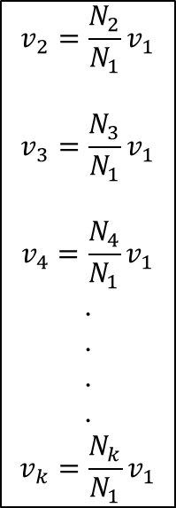
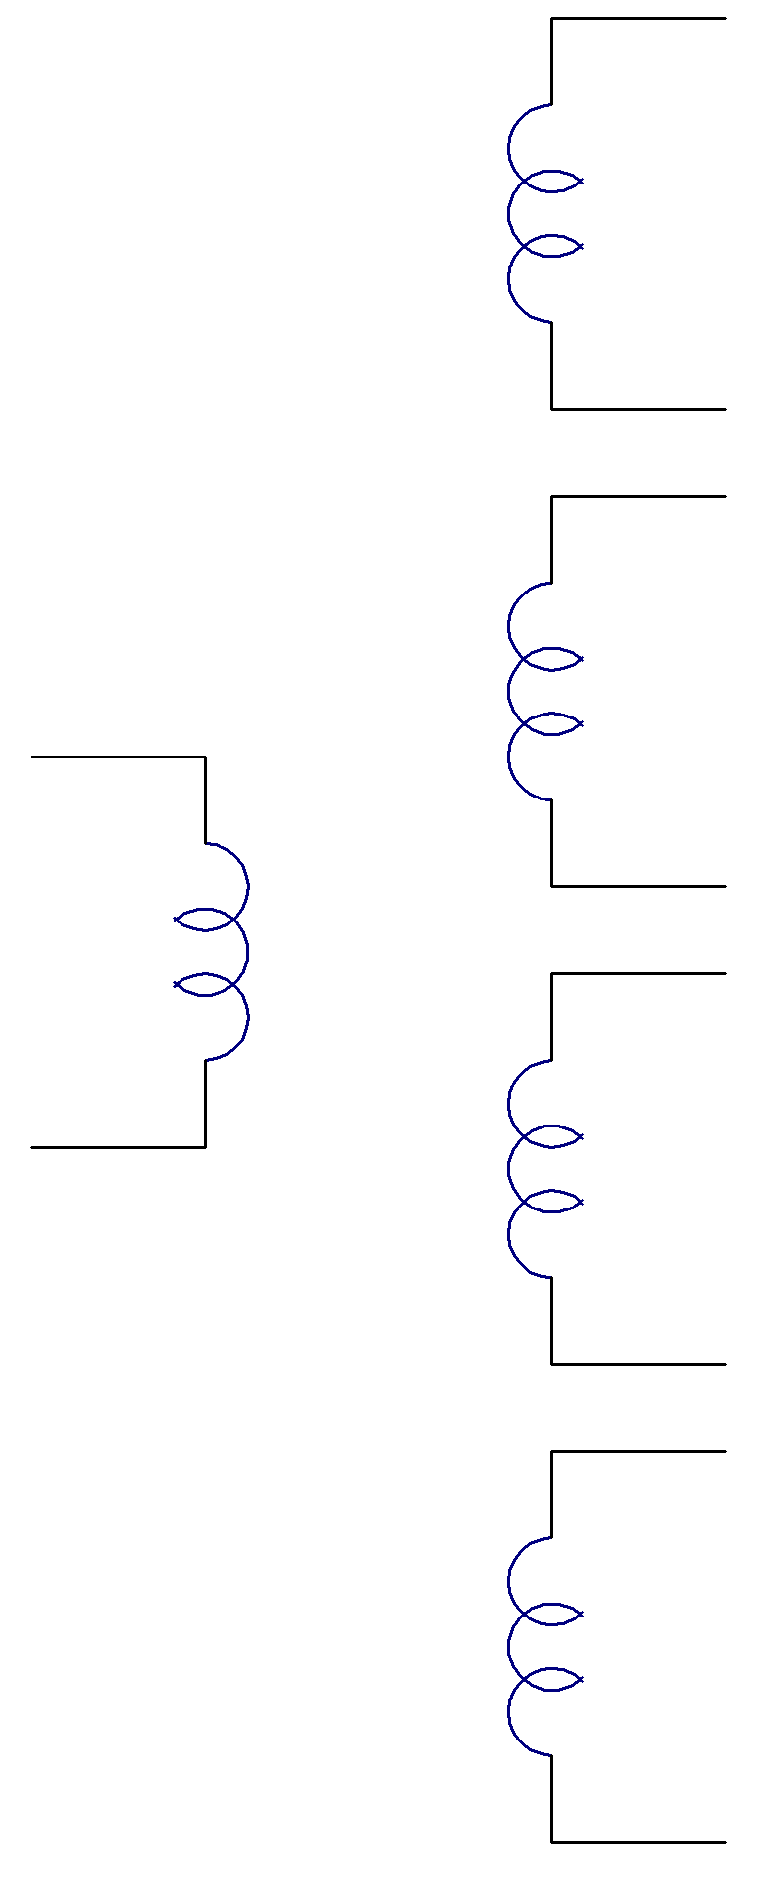
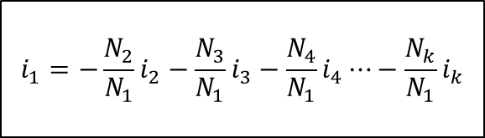
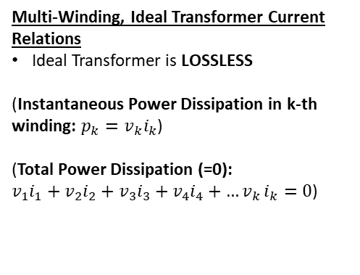
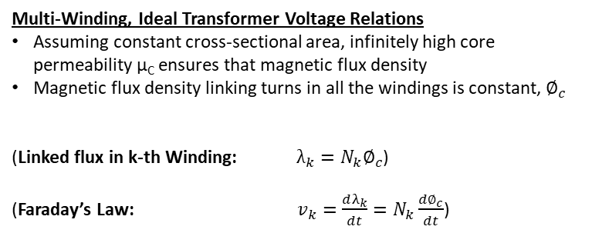
Ideal Transformers with Multiple Windings
i₂
Multi-Winding, Ideal Transformer Voltage Relations
Assuming constant cross-sectional area, infinitely high core permeability µ_{C} ensures that magnetic flux density
Magnetic flux density linking turns in all the windings is constant, $∅_{c}$
(Linked flux in k-th Winding: $λ_{k}=N_{k}∅_{c}$)
(Faraday’s Law: $v_{k}=\frac{dλ_{k}}{dt}=N_{k}\frac{d∅_{c}}{dt}$)
Multi-Winding, Ideal Transformer Current Relations
Ideal Transformer is LOSSLESS
(Instantaneous Power Dissipation in k-th winding: $p_{k}=v_{k}i_{k}$)
(Total Power Dissipation (=0):
$v_{1}i_{1}+v_{2}i_{2}+v_{3}i_{3}+v_{4}i_{4}+{…v}_{k}i_{k}=0$)
N₂
V₂
i₃
N₃
V₃
IDEAL TRANSFORMER VOLTAGE EQUATIONS
IDEAL TRANSFORMER CURRENT EQUATIONS
i₁
$$v_{2}=\frac{N_{2}}{N_{1}}v_{1}$$
$$v_{3}=\frac{N_{3}}{N_{1}}v_{1}$$
$$v_{4}=\frac{N_{4}}{N_{1}}v_{1}$$
.
.
.
.
$$v_{k}=\frac{N_{k}}{N_{1}}v_{1}$$
$$i_{1}=−\frac{N_{2}}{N_{1}}i_{2}−\frac{N_{3}}{N_{1}}i_{3}−\frac{N_{4}}{N_{1}}i_{4}⋯−\frac{N_{k}}{N_{1}}i_{k}$$
V₁
N₁
i₄
N₄
V₄
i_{k}
N_{k}
V_{k}

Slide 3

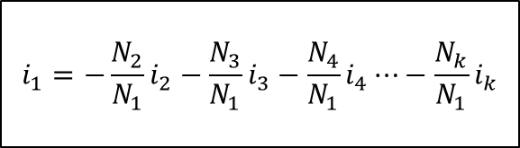

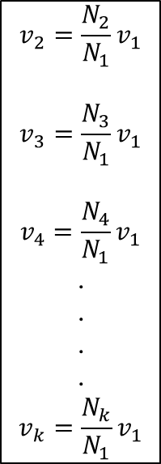






Ideal Transformers with Multiple Windings
Dot Side
i₂
$$v_{2}=\frac{N_{2}}{N_{1}}v_{1}$$
IDEAL TRANSFORMER VOLTAGE EQUATIONS
$$v_{2}=\frac{N_{2}}{N_{1}}v_{1}$$
$$v_{3}=\frac{N_{3}}{N_{1}}v_{1}$$
$$v_{4}=\frac{N_{4}}{N_{1}}v_{1}$$
.
.
.
.
$$v_{k}=\frac{N_{k}}{N_{1}}v_{1}$$
Winding #1 (Assumed to be input/driven winding)
Dot Side
Dot Side
i₃
i₁
$$⋯⋯$$
$$v_{3}=\frac{N_{3}}{N_{1}}v_{1}$$
V₁
$$−\frac{N_{2}}{N_{1}}i_{2}$$
$$−\frac{N_{3}}{N_{1}}i_{3}$$
$$−\frac{N_{4}}{N_{1}}i_{4}$$
$$−\frac{N_{k}}{N_{1}}i_{k}$$
Dot Side
i_{k}
IDEAL TRANSFORMER CURRENT EQUATIONS
$$v_{k}=\frac{N_{k}}{N_{1}}v_{1}$$
$$i_{1}=−\frac{N_{2}}{N_{1}}i_{2}−\frac{N_{3}}{N_{1}}i_{3}−\frac{N_{4}}{N_{1}}i_{4}⋯−\frac{N_{k}}{N_{1}}i_{k}$$
EQUIVALENT CIRCUIT MODEL OF
MULTI-WINDING, IDEAL TRANSFORMER

Slide 4
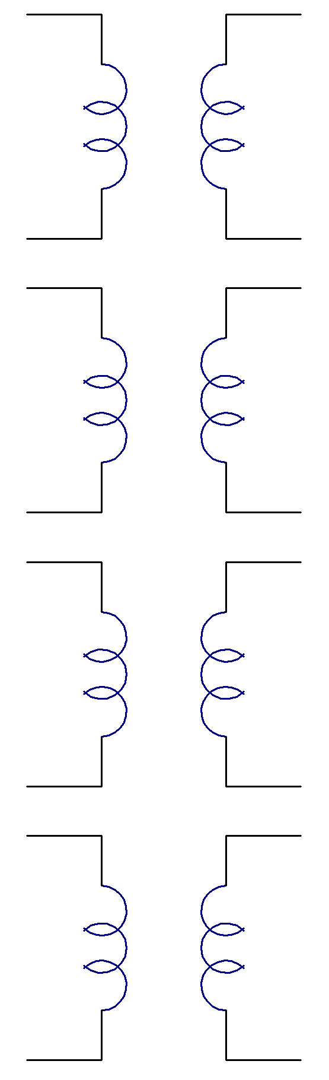
Ideal Transformers with Multiple Windings
i₂
i₂
N₂
V₂
V₁
N₁
N₂
V₂
All Winding #1’s in parallel
i₃
i₃
N₃
V₃
V₁
N₁
N₃
V₃
i₁
EQUIVALENT!
V₁
N₁
i₄
i₄
N₄
V₄
V₁
N₁
N₄
V₄
i_{k}
i_{k}
N_{k}
V_{k}
V₁
N₁
N_{k}
V_{k}

Slide 5
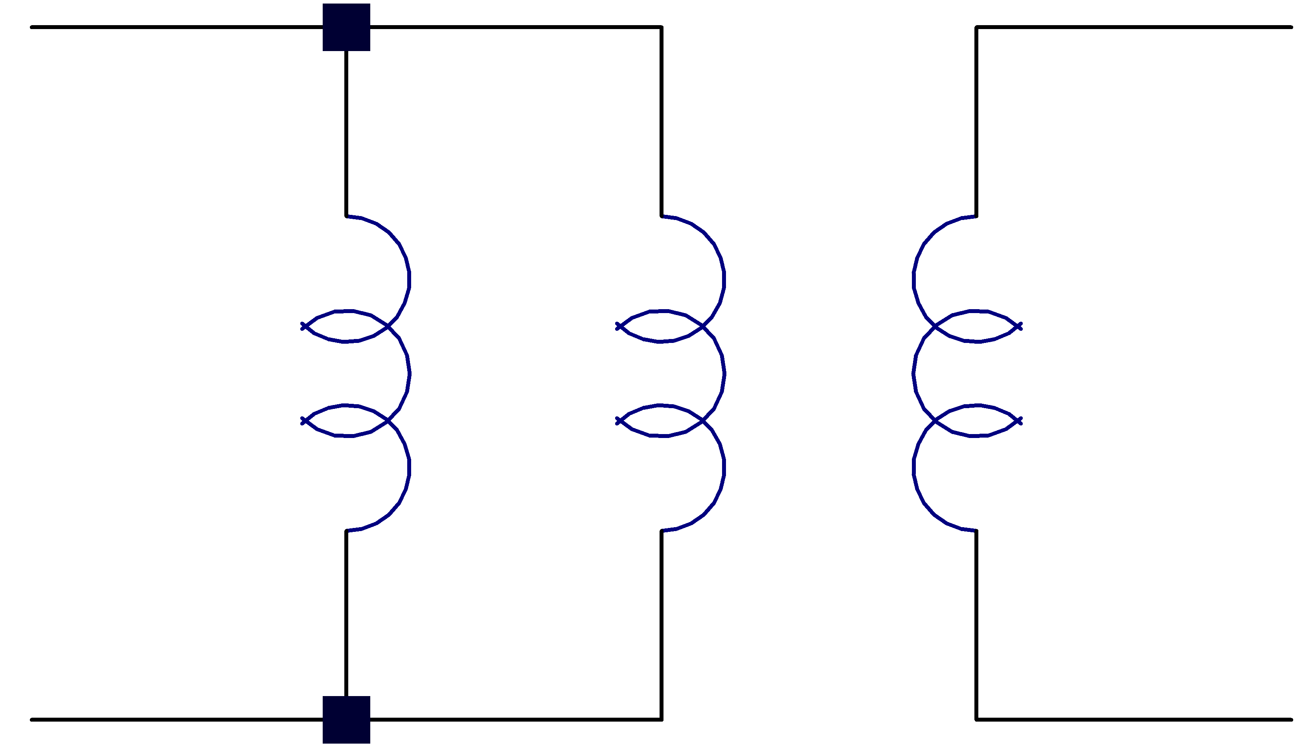




Transformer Circuit Model with Finite Core Permeability µ_{C}
Finite (Non-infinite) Core Permeability µ_{C}:
Lots of fancy math and/or use magnetic circuits to show that the effect of a finite µ_{C} is that there is a finite, non-infinite, magnetizing inductor L_{µ} in parallel with one of the windings of an ideal transformer
Magnetizing inductor stores energy, as opposed to direct power transfer properties of ideal transformers
In the limit that µ_{C}, magnetizing inductor L_{µ}, becomes infinitely large, like an AC-open-circuit, and the transformer behaves like an ideal transformer that transforms voltages/currents, performs lossless power transfer, and does not store energy
(Ideal)
(Ideal)
1:n
1:n
i_{µ1}
i₁
i₁
V₁
L_{µ1}
V₂
EQUIVALENT!
V₁
i_{µ2}
L_{µ2} = n²L_{µ1}
V₂
i₂
i₂
Ideal Transformer Equations
Ideal Transformer Equations
$$v_{2}=nv_{1}$$
$$v_{2}=nv_{1}$$
$$i_{2}=−\frac{i_{1}}{n}$$
$$i_{2}=−\frac{i_{1}}{n}$$

Slide 6
Flyback Converter
Buck-boost converter (V_{out} can be greater or less than V_{in}), but with transformer. Provides following advantages
  Isolation
  Transformer turns ratio provides additional “knob” or degree of freedom to achieve wider range of voltage conversion ratios
  Can use multiple windings for multiple outputs
  Simple – few parts
Flyback converter basic operation
  Flyback transformer constructed such that there is an equivalent, magnetizing inductance on one of the windings, which is used as an energy storage element
  Store energy in transformer magnetizing inductance when switch is ON
  Deliver energy to load when switch is OFF

Slide 7
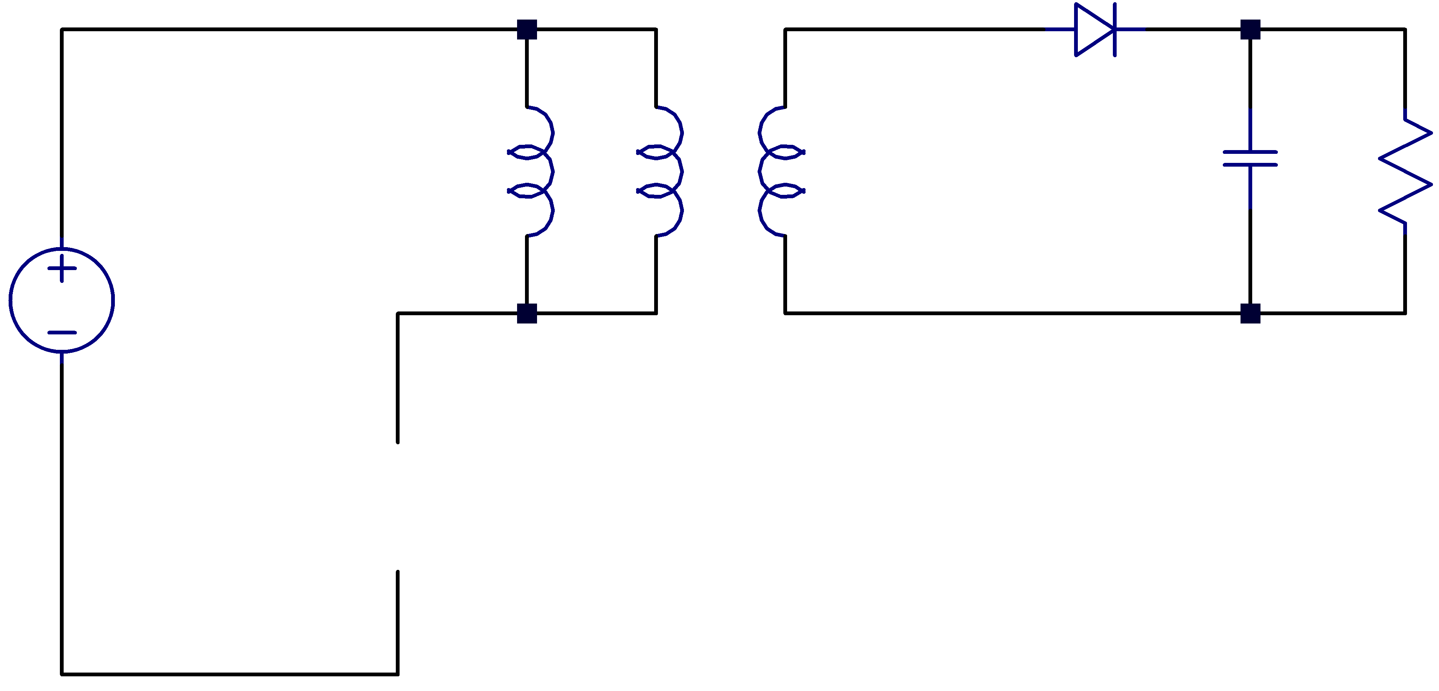
Basic Flyback Converter
(Ideal)
1:n
i_{µ1}
i₁
i_{C}
i_{R}
V₁
L_{µ1}
V₂
C
R
V_{OUT}
i₂
V_{IN}
SW
Switching Frequency T_{s}:
On Time = t₁ or DT_{s}

Slide 8
Basic Flyback Converter at Periodic Steady-State:
Continuous Conduction Mode (CCM)
(Ideal)
1:n
i_{µ1}
i₁
i_{C}
i_{R}
V₁
L_{µ1}
V₂
C
R
V_{OUT}
i₂
V_{IN}
Overview:
Store magnetic energy in magnetizing inductance when switch is closed
Transfer energy to load when switch is open
Provide galvanic isolation and use turns ratio for flexibility in achieving high voltage conversion ratios
Assumptions:
Periodic steady-state condition reached
Large C, so that V_{out} ~ constant over switching cycle
R is small enough, and hence I_{out} is high enough, so that magnetizing current DOES NOT decay to zero during switching cycle (called continuous conduction mode i.e. CCM)
SW
Switching Frequency T_{s}:
On Time = t₁ or DT_{s}

Slide 9
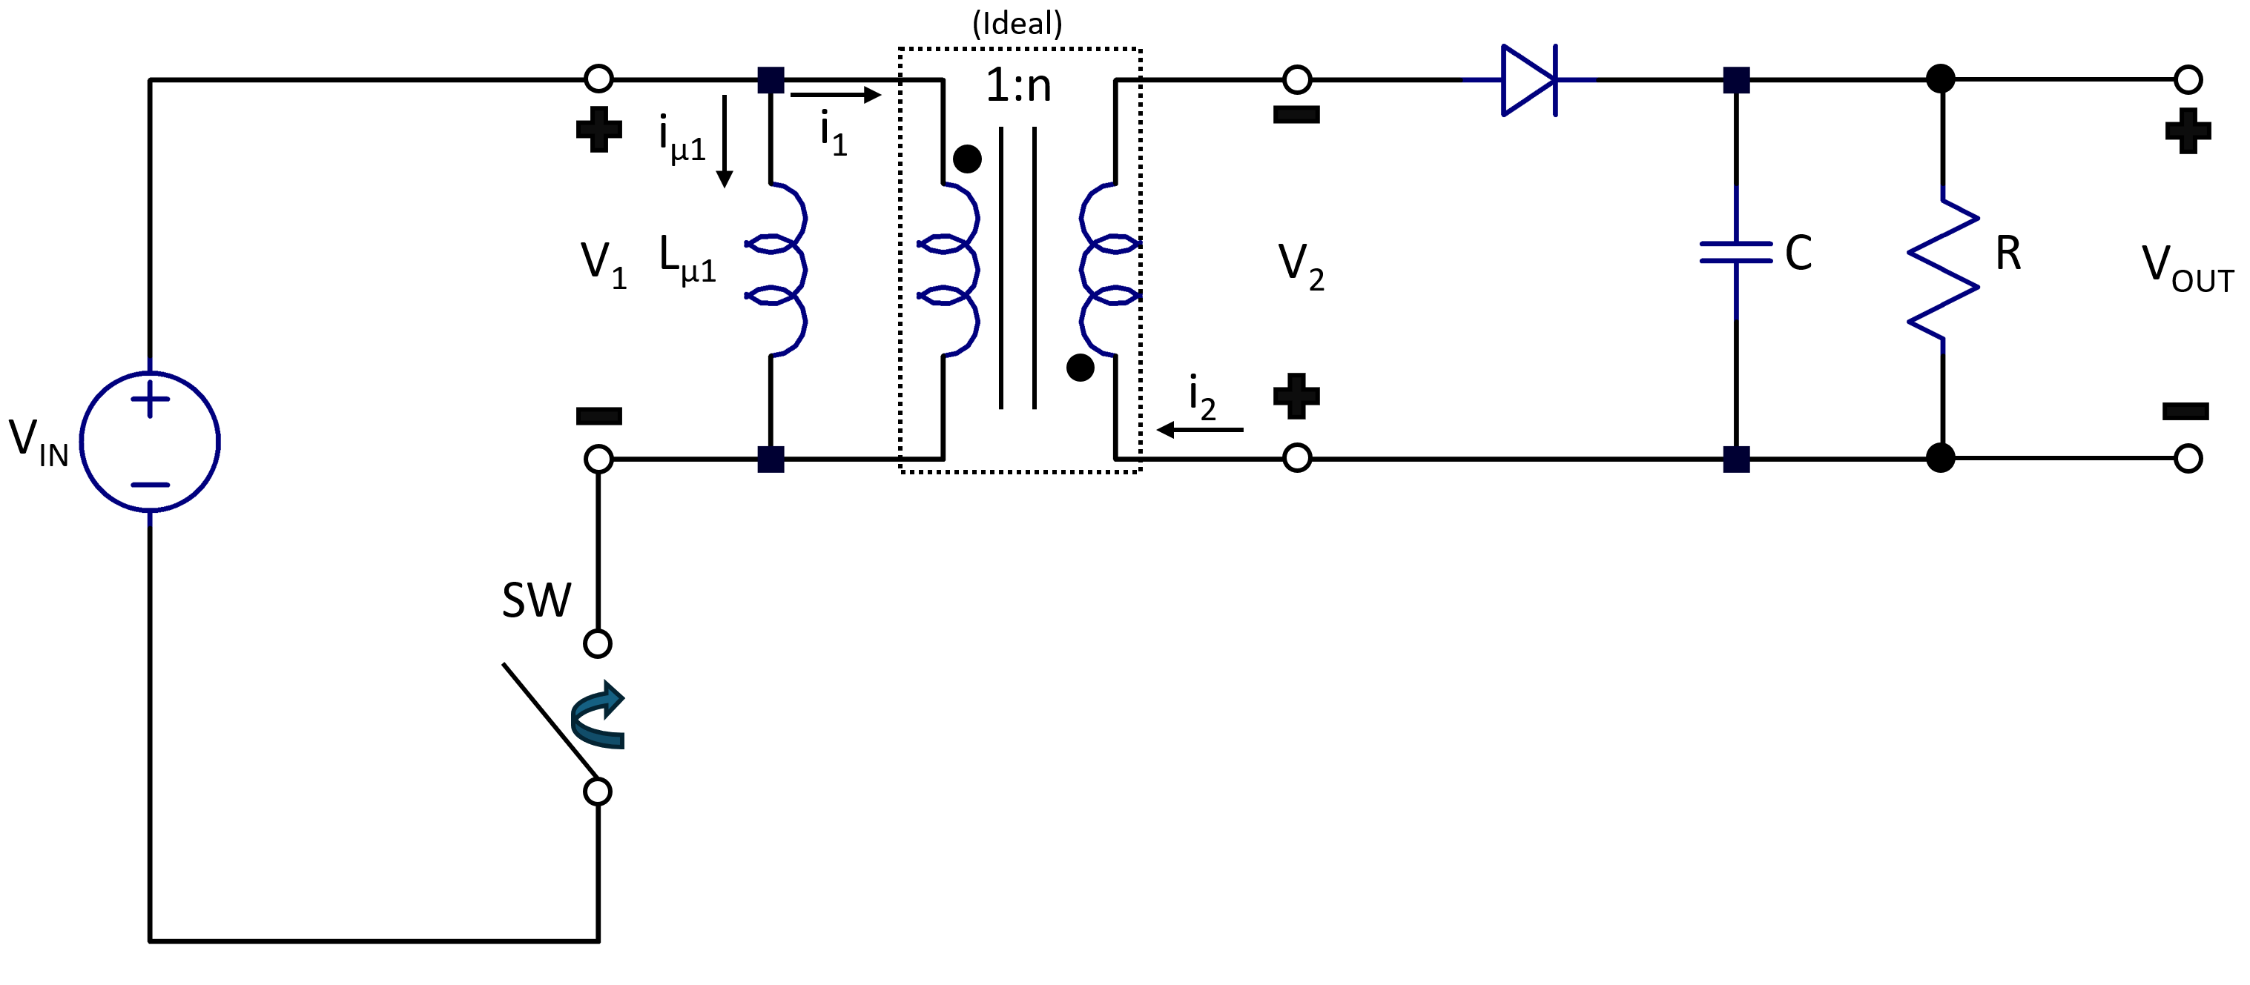
































Basic Flyback Converter at Periodic Steady-State: Continuous Conduction Mode (CCM)
$$I_{{pk}_{1}}=I_{0}+\frac{V_{IN}}{L_{μ_{1}}}t_{1}$$
$$V_{1}$$
$$I_{μ_{1}}$$
$$\frac{V_{IN}}{L_{μ_{1}}}$$
$$−\frac{(V_{OUT}+V_{F})}{{nL}_{μ_{1}}}$$
$$I_{2}$$
$$I_{{pk}_{2}}=\frac{I_{{pk}_{1}}}{n}=\frac{I_{0}}{n}+\frac{V_{IN}}{{nL}_{μ_{1}}}t_{1}$$
$$V_{IN}$$
$$−\frac{(V_{OUT}+V_{F})}{{n^{2}L}_{μ_{1}}}$$
$$I_{0}$$
$$\frac{I_{0}}{n}$$
$$t_{1}$$
$$t_{2}$$
$$t$$
$$t_{1}$$
$$t_{2}$$
$$t$$
$$t_{1}$$
$$t_{2}$$
$$t$$
$$t_{1}$$
$$t_{2}$$
$$t$$
$$−\frac{(V_{OUT}+V_{F})}{n}$$
$$V_{2}$$
$$I_{1}$$
$${nV}_{IN}$$
$$t_{1}$$
$$t_{2}$$
$$t$$
$$t_{1}$$
$$t_{2}$$
$$t$$
$$−I_{0}$$
$${−I}_{{pk}_{1}}=$$
$$−\left(I_{0}+\frac{V_{IN}}{L_{μ_{1}}}t_{1}\right)$$
$$\frac{(V_{OUT}+V_{F})}{{nL}_{μ_{1}}}$$
$$−V_{OUT}+V_{F}$$

Slide 10



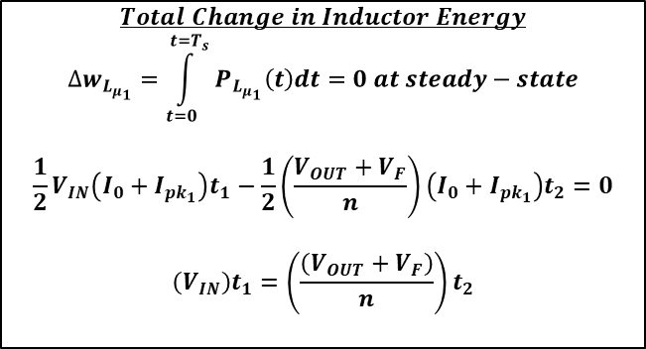

















Energy Balance for Magnetizing Inductance at Periodic Steady-State (CCM)
$$I_{{pk}_{1}}=I_{0}+\frac{V_{IN}}{L_{μ_{1}}}t_{1}$$
$$P_{{pk}_{1}}=I_{{pk}_{1}}×V_{IN}$$
$$V_{1}$$
$$I_{μ_{1}}$$
$$\frac{V_{IN}}{L_{μ_{1}}}$$
$$−\frac{(V_{OUT}+V_{F})}{{nL}_{μ_{1}}}$$
$$P_{L_{μ_{1}}}(t)$$
$$V_{IN}$$
$$P_{0}=I_{0}×V_{IN}$$
$$I_{0}$$
$$t$$
$$t_{1}$$
$$t_{2}$$
$$t$$
$$t_{1}$$
$$t_{2}$$
$$t$$
$$t_{1}$$
$$t_{2}$$
$$P_{F}=−I_{0}×\frac{(V_{OUT}+V_{F})}{n}$$
$$−\frac{(V_{OUT}+V_{F})}{n}$$
$$P_{{pk}_{2}}=−I_{{pk}_{1}}×\frac{(V_{OUT}+V_{F})}{n}$$
$$Total Change in Inductor Energy$$
$$∆w_{L_{μ_{1}}}=\int_{t=0}^{t=T_{s}}{P_{L_{μ_{1}}}\left(t\right)dt}=0 at steady−state$$
$$\frac{1}{2}V_{IN}\left(I_{0}+I_{{pk}_{1}}\right)t_{1}−\frac{1}{2}\left(\frac{V_{OUT}+V_{F}}{n}\right)\left(I_{0}+I_{{pk}_{1}}\right)t_{2}=0$$
$$\left(V_{IN}\right)t_{1}=\left(\frac{\left(V_{OUT}+V_{F}\right)}{n}\right)t_{2}$$
Overview:
Energy balance for magnetizing inductance over one switching cycle yields same result as if Volt-second balance were applied
Consistent ✓

Slide 11

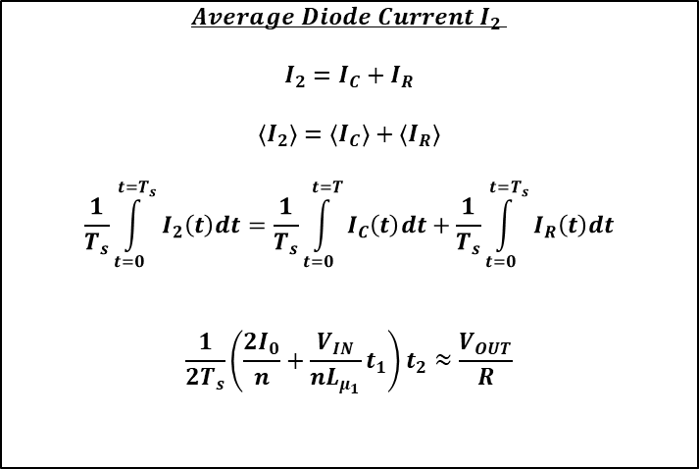





Output Capacitor Charge Balance at Periodic Steady-State (CCM)
$$Average Diode Current{ I}_{2}$$
$$I_{2}=I_{C}+I_{R}$$
$$\left\langle I_{2}\right\rangle =\left\langle I_{C}\right\rangle +\left\langle I_{R}\right\rangle$$
$$\frac{1}{T_{s}}\int_{t=0}^{t=T_{s}}{I_{2}\left(t\right)dt}=\frac{1}{T_{s}}\int_{t=0}^{t=T}{I_{C}\left(t\right)dt}+\frac{1}{T_{s}}\int_{t=0}^{t=T_{s}}{I_{R}\left(t\right)dt}$$
$$\frac{1}{2T_{s}}\left(\frac{{2I}_{0}}{n}+\frac{V_{IN}}{nL_{μ_{1}}}t_{1}\right)t_{2}≈\frac{V_{OUT}}{R}$$
$$I_{2}$$
$$I_{{pk}_{2}}=\frac{I_{{pk}_{1}}}{n}=\frac{I_{0}}{n}+\frac{V_{IN}}{{nL}_{μ_{1}}}t_{1}$$
0 at periodic steady-state
$$−\frac{(V_{OUT}+V_{F})}{{n^{2}L}_{μ_{1}}}$$
0 at periodic steady-state
$$\frac{I_{0}}{n}$$
$$t_{1}$$
$$t_{2}$$
$$t$$

Slide 12
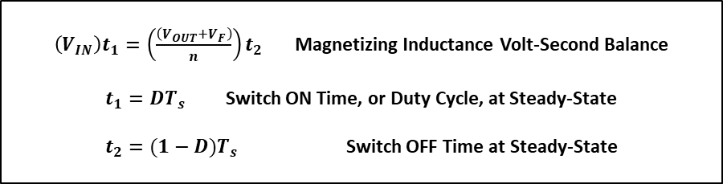
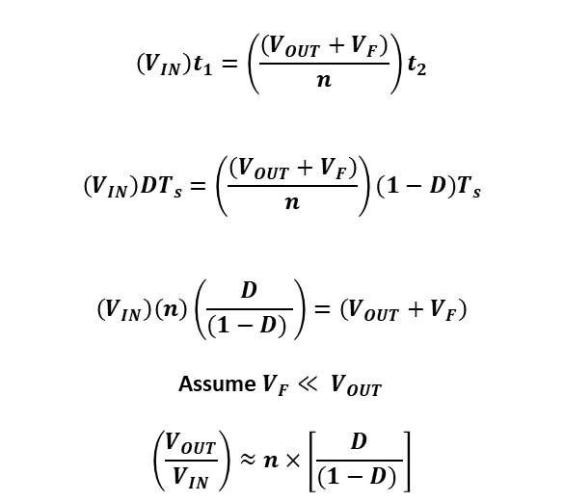
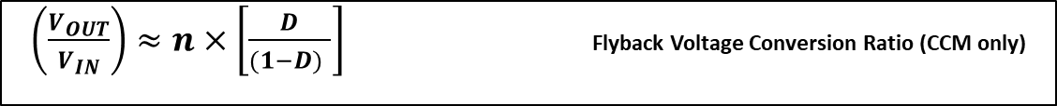
Output Voltage at Periodic Steady-State (CCM)
$\left(V_{IN}\right)t_{1}=\left(\frac{\left(V_{OUT}+V_{F}\right)}{n}\right)t_{2}$ Magnetizing Inductance Volt-Second Balance
$t_{1}=DT_{s}$ Switch ON Time, or Duty Cycle, at Steady-State
$t_{2}=(1−D)T_{s}$ Switch OFF Time at Steady-State
$$\left(V_{IN}\right)t_{1}=\left(\frac{\left(V_{OUT}+V_{F}\right)}{n}\right)t_{2}$$
$$\left(V_{IN}\right)DT_{s}=\left(\frac{\left(V_{OUT}+V_{F}\right)}{n}\right)(1−D)T_{s}$$
$$\left(V_{IN}\right)\left(n\right)\left(\frac{D}{(1−D) }\right)=\left(V_{OUT}+V_{F}\right)$$
Assume $V_{F}≪ V_{OUT}$
$$\left(\frac{V_{OUT}}{V_{IN}}\right)≈n×\left[\frac{D}{(1−D) }\right]$$
$\left(\frac{V_{OUT}}{V_{IN}}\right)≈n×\left[\frac{D}{(1−D) }\right]$ Flyback Voltage Conversion Ratio (CCM only)

Slide 13
Basic Flyback Converter at Periodic Steady-State:
Discontinuous Conduction Mode (DCM)
(Ideal)
1:n
i_{µ1}
i₁
i_{C}
i_{R}
V₁
L_{µ1}
V₂
C
R
V_{OUT}
i₂
V_{IN}
Overview:
Store magnetic energy in magnetizing inductance when switch is closed
Transfer energy to load when switch is open
Provide galvanic isolation and use turns ratio for flexibility in achieving high voltage conversion ratios
Assumptions:
Periodic steady-state condition reached
Large C and large enough R, so that V_{out} ~ constant over switching cycle
Magnetizing inductance L_{µ1}/ L_{µ2} are small enough, and switching period T_{s} is long enough, so that magnetizing currents decay to zero during switching cycle (called discontinuous conduction mode i.e. DCM)
SW
Switching Frequency T_{s}:
On Time = t₁ or DT_{s}

Slide 14


































Basic Flyback Converter at Periodic Steady-State: Discontinuous Conduction Mode (DCM)
$$I_{{pk}_{1}}=\frac{V_{IN}}{L_{μ_{1}}}t_{1}$$
$$I_{{pk}_{2}}=\frac{I_{{pk}_{1}}}{n}=\frac{V_{IN}}{{nL}_{μ_{1}}}t_{1}$$
$$V_{1}$$
$$I_{μ_{1}}$$
$$I_{2}$$
$$\frac{V_{IN}}{L_{μ_{1}}}$$
$$−\frac{(V_{OUT}+V_{F})}{{nL}_{μ_{1}}}$$
$$−\frac{(V_{OUT}+V_{F})}{{n^{2}L}_{μ_{1}}}$$
$$V_{IN}$$
$$0V$$
$$t_{1}$$
$$t_{2}$$
$$t_{3}$$
$$t$$
$$t_{1}$$
$$t_{2}$$
$$t_{3}$$
$$t$$
$$t_{1}$$
$$t_{2}$$
$$t_{3}$$
$$t$$
$$t_{1}$$
$$t_{2}$$
$$t_{3}$$
$$t$$
$$−\frac{(V_{OUT}+V_{F})}{n}$$
$$V_{2}$$
$$I_{1}$$
$${nV}_{IN}$$
$$0V$$
$$t_{1}$$
$$t_{2}$$
$$t_{3}$$
$$t_{1}$$
$$t_{2}$$
$$t_{3}$$
$$t$$
$$t$$
$$\frac{(V_{OUT}+V_{F})}{{nL}_{μ_{1}}}$$
$$−V_{OUT}+V_{F}$$
$${−I}_{{pk}_{1}}=−\frac{V_{IN}}{L_{μ_{1}}}t_{1}$$

Slide 15





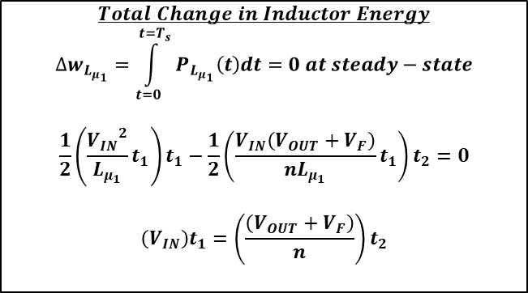

Energy Balance for Magnetizing Inductance at Periodic Steady-State (DCM)
$P_{{pk}_{1}}=$ $\frac{{V_{IN}}^{2}}{L_{μ_{1}}}t_{1}$
$$I_{{pk}_{1}}=\frac{V_{IN}}{L_{μ_{1}}}t_{1}$$
$$V_{1}$$
$$I_{μ_{1}}$$
$$P_{L_{μ_{1}}}(t)$$
$$\frac{V_{IN}}{L_{μ_{1}}}$$
$$−\frac{(V_{OUT}+V_{F})}{{nL}_{μ_{1}}}$$
$$V_{IN}$$
$$t_{2}$$
$$0V$$
$$t_{1}$$
$$t_{2}$$
$$t_{3}$$
$$t$$
$$t_{1}$$
$$t_{2}$$
$$t_{3}$$
$$t$$
$$t_{1}$$
$$t_{3}$$
$$t$$
$$−\frac{(V_{OUT}+V_{F})}{n}$$
$P_{{pk}_{2}}=$ $−\left(\frac{V_{IN}\left(V_{OUT}+V_{F}\right)}{nL_{μ_{1}}}\right)t_{1}$
$$Total Change in Inductor Energy$$
$$∆w_{L_{μ_{1}}}=\int_{t=0}^{t=T_{s}}{P_{L_{μ_{1}}}\left(t\right)dt}=0 at steady−state$$
$$\frac{1}{2}\left(\frac{{V_{IN}}^{2}}{L_{μ_{1}}}t_{1}\right)t_{1}−\frac{1}{2}\left(\frac{V_{IN}\left(V_{OUT}+V_{F}\right)}{nL_{μ_{1}}}t_{1}\right)t_{2}=0$$
$$\left(V_{IN}\right)t_{1}=\left(\frac{\left(V_{OUT}+V_{F}\right)}{n}\right)t_{2}$$
Overview:
Energy balance for magnetizing inductance over one switching cycle yields same result as if Volt-second balance were applied
Consistent ✓

Slide 16

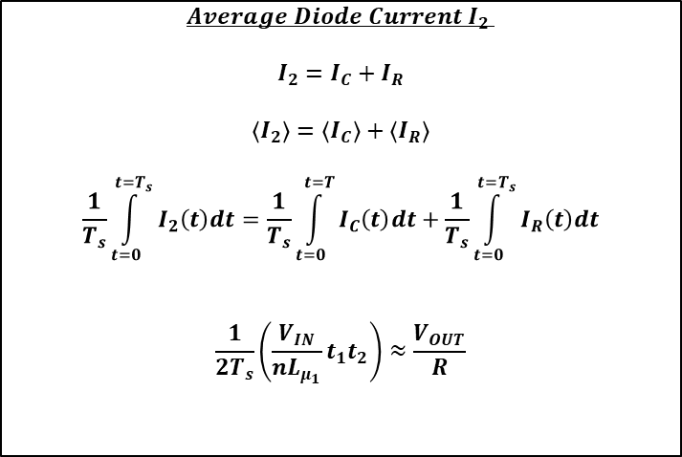


Output Capacitor Charge Balance at Periodic Steady-State (DCM)
$$I_{{pk}_{2}}=\frac{I_{{pk}_{1}}}{n}=\frac{V_{IN}}{{nL}_{μ_{1}}}t_{1}$$
$$Average Diode Current{ I}_{2}$$
$$I_{2}=I_{C}+I_{R}$$
$$\left\langle I_{2}\right\rangle =\left\langle I_{C}\right\rangle +\left\langle I_{R}\right\rangle$$
$$\frac{1}{T_{s}}\int_{t=0}^{t=T_{s}}{I_{2}\left(t\right)dt}=\frac{1}{T_{s}}\int_{t=0}^{t=T}{I_{C}\left(t\right)dt}+\frac{1}{T_{s}}\int_{t=0}^{t=T_{s}}{I_{R}\left(t\right)dt}$$
$$\frac{1}{2T_{s}}\left(\frac{V_{IN}}{{nL}_{μ_{1}}}t_{1}t_{2}\right)≈\frac{V_{OUT}}{R}$$
$$I_{2}$$
0 at periodic steady-state
$$−\frac{(V_{OUT}+V_{F})}{{n^{2}L}_{μ_{1}}}$$
0 at periodic steady-state
$$t_{1}$$
$$t_{2}$$
$$t_{3}$$
$$t$$

Slide 17
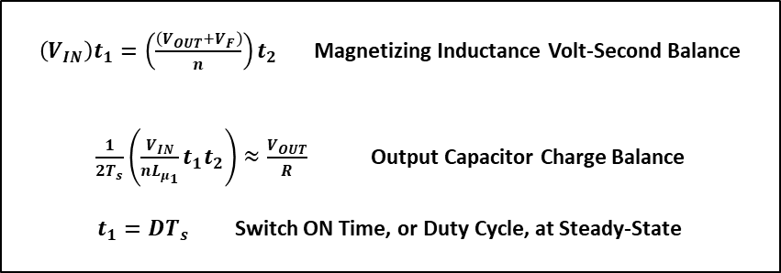
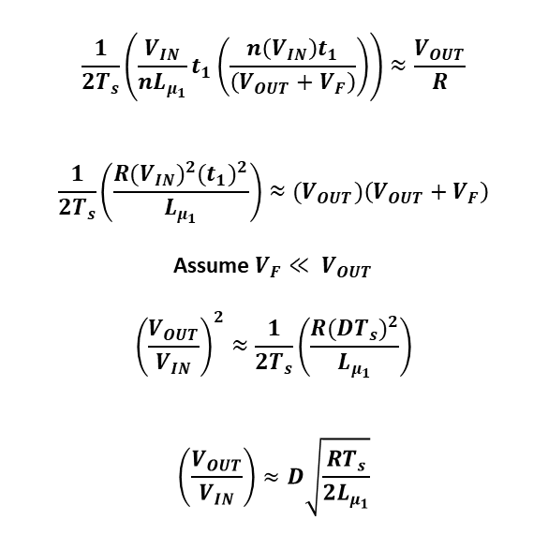
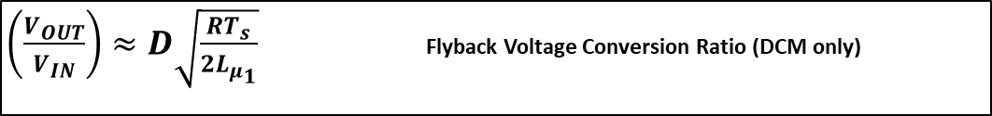
Output Voltage at Periodic Steady-State (DCM)
$\left(V_{IN}\right)t_{1}=\left(\frac{\left(V_{OUT}+V_{F}\right)}{n}\right)t_{2}$ Magnetizing Inductance Volt-Second Balance
$\frac{1}{2T_{s}}\left(\frac{V_{IN}}{{nL}_{μ_{1}}}t_{1}t_{2}\right)≈\frac{V_{OUT}}{R}$ Output Capacitor Charge Balance
$t_{1}=DT_{s}$ Switch ON Time, or Duty Cycle, at Steady-State
$$\frac{1}{2T_{s}}\left(\frac{V_{IN}}{{nL}_{μ_{1}}}t_{1}\left(\frac{n\left(V_{IN}\right)t_{1}}{\left(V_{OUT}+V_{F}\right)}\right)\right)≈\frac{V_{OUT}}{R}$$
$$\frac{1}{2T_{s}}\left(\frac{{R(V_{IN})}^{2}{(t_{1})}^{2}}{L_{μ_{1}}}\right)≈{(V}_{OUT})\left(V_{OUT}+V_{F}\right)$$
Assume $V_{F}≪ V_{OUT}$
$${\left(\frac{V_{OUT}}{V_{IN}}\right)}^{2}≈\frac{1}{2T_{s}}\left(\frac{R{(DT_{s})}^{2}}{L_{μ_{1}}}\right)$$
$$\left(\frac{V_{OUT}}{V_{IN}}\right)≈D\sqrt{\frac{RT_{s}}{2L_{μ_{1}}}}$$
$\left(\frac{V_{OUT}}{V_{IN}}\right)≈D\sqrt{\frac{RT_{s}}{2L_{μ_{1}}}}$ Flyback Voltage Conversion Ratio (DCM only)

Slide 18
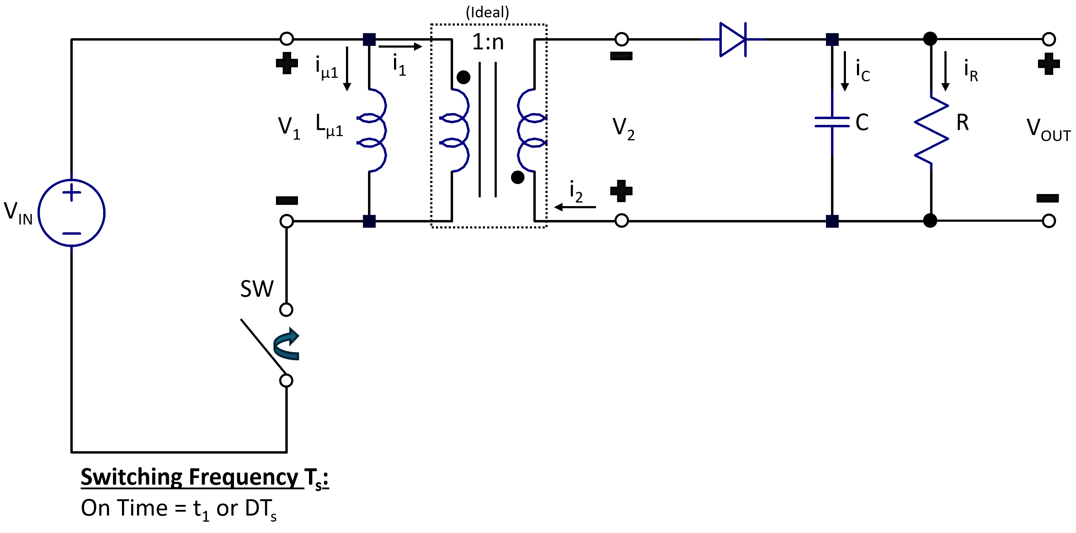

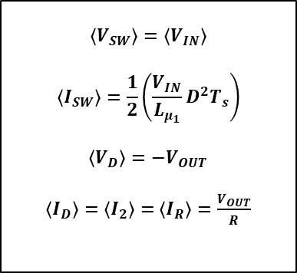









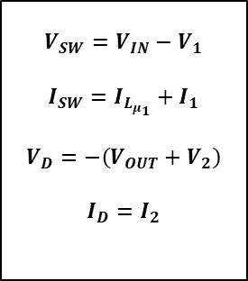

Power Stage Average Modeling (DCM)
V_{D}
$$V_{IN}+\frac{(V_{OUT}+V_{F})}{n}$$
$$V_{SW}$$
$$V_{D}$$
i_{D}
$$V_{IN}$$
$$0V$$
$$V_{F}$$
V_{SW}
$$t_{1}$$
$$t_{2}$$
$$t_{3}$$
$$t$$
$$t_{1}$$
$$t_{2}$$
$$t_{3}$$
$$t$$
i_{SW}
$$−V_{OUT}$$
$$−\left(V_{OUT}+{nV}_{IN}\right)$$
$$I_{{pk}_{1}}=\frac{V_{IN}}{L_{μ_{1}}}t_{1}$$
$$I_{{pk}_{2}}=\frac{I_{{pk}_{1}}}{n}=\frac{V_{IN}}{{nL}_{μ_{1}}}t_{1}$$
Instantaneous
Switch/Diode Eqns
Averaged
Switch/Diode Eqns
$$I_{SW}$$
$$I_{D}$$
$$\frac{V_{IN}}{L_{μ_{1}}}$$
$$−\frac{(V_{OUT}+V_{F})}{{n^{2}L}_{μ_{1}}}$$
$$V_{SW}=V_{IN}−V_{1}$$
$$I_{SW}=I_{L_{μ_{1}}}+I_{1}$$
$$V_{D}=−\left(V_{OUT}+V_{2}\right)$$
$$I_{D}=I_{2}$$
$$\left\langle V_{SW}\right\rangle =\left\langle V_{IN}\right\rangle$$
$$\left\langle I_{SW}\right\rangle =\frac{1}{2}\left(\frac{V_{IN}}{L_{μ_{1}}}D^{2}T_{s}\right)$$
$$\left\langle V_{D}\right\rangle =−V_{OUT}$$
$\left\langle I_{D}\right\rangle =\left\langle I_{2}\right\rangle =$ $\left\langle I_{R}\right\rangle =\frac{V_{OUT}}{R}$
Periodic Steady-State
Averaging
$$t_{1}$$
$$t_{2}$$
$$t_{3}$$
$$t$$
$$t_{1}$$
$$t_{2}$$
$$t_{3}$$
$$t$$

Slide 19
(Ideal)
1:n
i_{µ1}
i₁
i_{C}
i_{R}
V₁
L_{µ1}
V₂
C
R
V_{OUT}
i₂
V_{IN}
SW

Slide 20





Power Stage Average Modeling (CCM)
Peak Magnetizing Inductor Current:
$$I_{{pk}_{1}}=I_{0}+\frac{V_{IN}}{L_{μ_{1}}}t_{1}$$
$$−\frac{(V_{OUT}+V_{F})}{{nL}_{μ_{1}}}$$
$$I_{μ_{1}}$$
$$\frac{V_{IN}}{L_{μ_{1}}}$$
$$V_{1}$$
$$V_{IN}$$
$$\left\langle I_{μ_{1}}\right\rangle$$
$$I_{0}$$
$$\left\langle V_{1}\right\rangle$$
$$t_{1}$$
$$t_{2}$$
$$t$$
$$t_{1}$$
$$t_{2}$$
$$t$$
$$T_{s}$$
$$−\frac{(V_{OUT}+V_{F})}{n}$$

