Slide 1
Flyback Converter Analysis and Simulation
Vien Vu

Slide 2
Flyback Converter
Buck-boost converter (V_{out} can be greater or less than V_{in}), but with transformer. Provides following advantages
Isolation
Transformer turns ratio provides additional “knob” or degree of freedom to achieve wider range of voltage conversion ratios
Can use multiple windings for multiple outputs
Simple – few parts
Flyback converter basic operation
Flyback transformer constructed such that there is an equivalent, magnetizing inductance on one of the windings, which is used as an energy storage element
Store energy in transformer magnetizing inductance when switch is ON
Deliver energy to load when switch is OFF

Slide 3
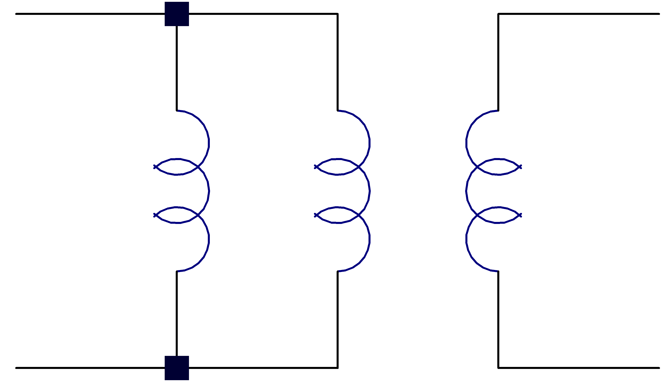




Transformer Circuit Model
(Ideal)
(Ideal)
1:n
1:n
i_{µ1}
i₁
i₁
V₁
L_{µ1}
V₂
EQUIVALENT!
V₁
i_{µ2}
L_{µ2} = n²L_{µ1}
V₂
i₂
i₂
Ideal Transformer Equations
Ideal Transformer Equations
$$v_{2}=nv_{1}$$
$$v_{2}=nv_{1}$$
$$i_{2}=−\frac{i_{1}}{n}$$
$$i_{2}=−\frac{i_{1}}{n}$$

Slide 4
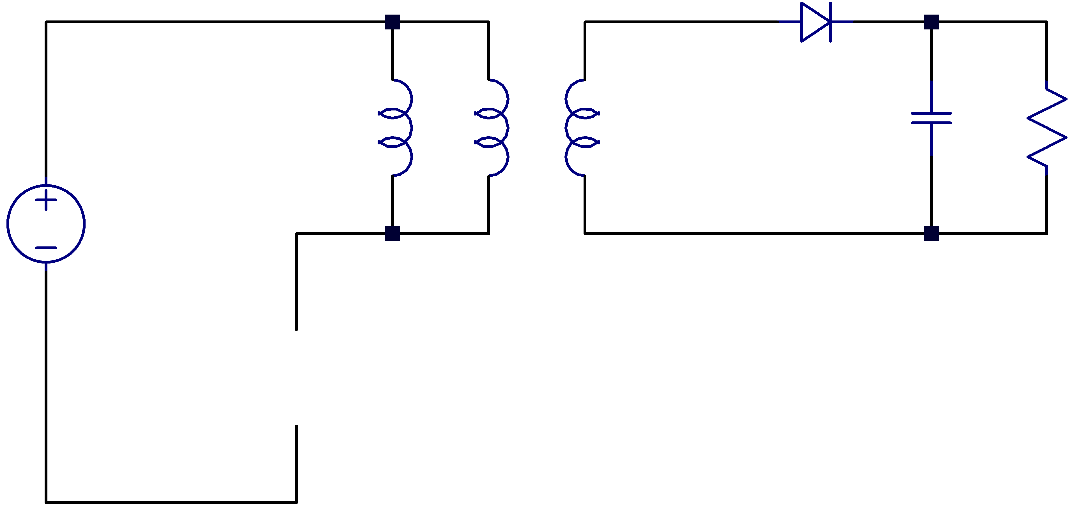
Basic Flyback Converter
(Ideal)
1:n
i_{µ1}
i₁
i_{C}
i_{R}
V₁
L_{µ1}
V₂
C
R
V_{OUT}
i₂
V_{IN}
SW
Switching Frequency T_{s}:
On Time = t₁ or DT_{s}

Slide 5
Basic Flyback Converter at Periodic Steady-State: Continuous Conduction Mode (CCM)
(Ideal)
1:n
i_{µ1}
i₁
i_{C}
i_{R}
V₁
L_{µ1}
V₂
C
R
V_{OUT}
i₂
V_{IN}
Overview:
Store magnetic energy in magnetizing inductance when switch is open
Transfer energy to load when switch is open
Provide galvanic isolation and use turns ratio for flexibility in achieving high voltage conversion ratios
Assumptions:
Periodic steady-state condition reached
Large C, so that V_{out} ~ constant over switching cycle
R is small enough, and hence I_{out} is high enough, so that magnetizing current DOES NOT decay to zero during switching cycle (called continuous conduction mode i.e. CCM)
SW
Switching Frequency T_{s}:
On Time = t₁ or DT_{s}

Slide 6
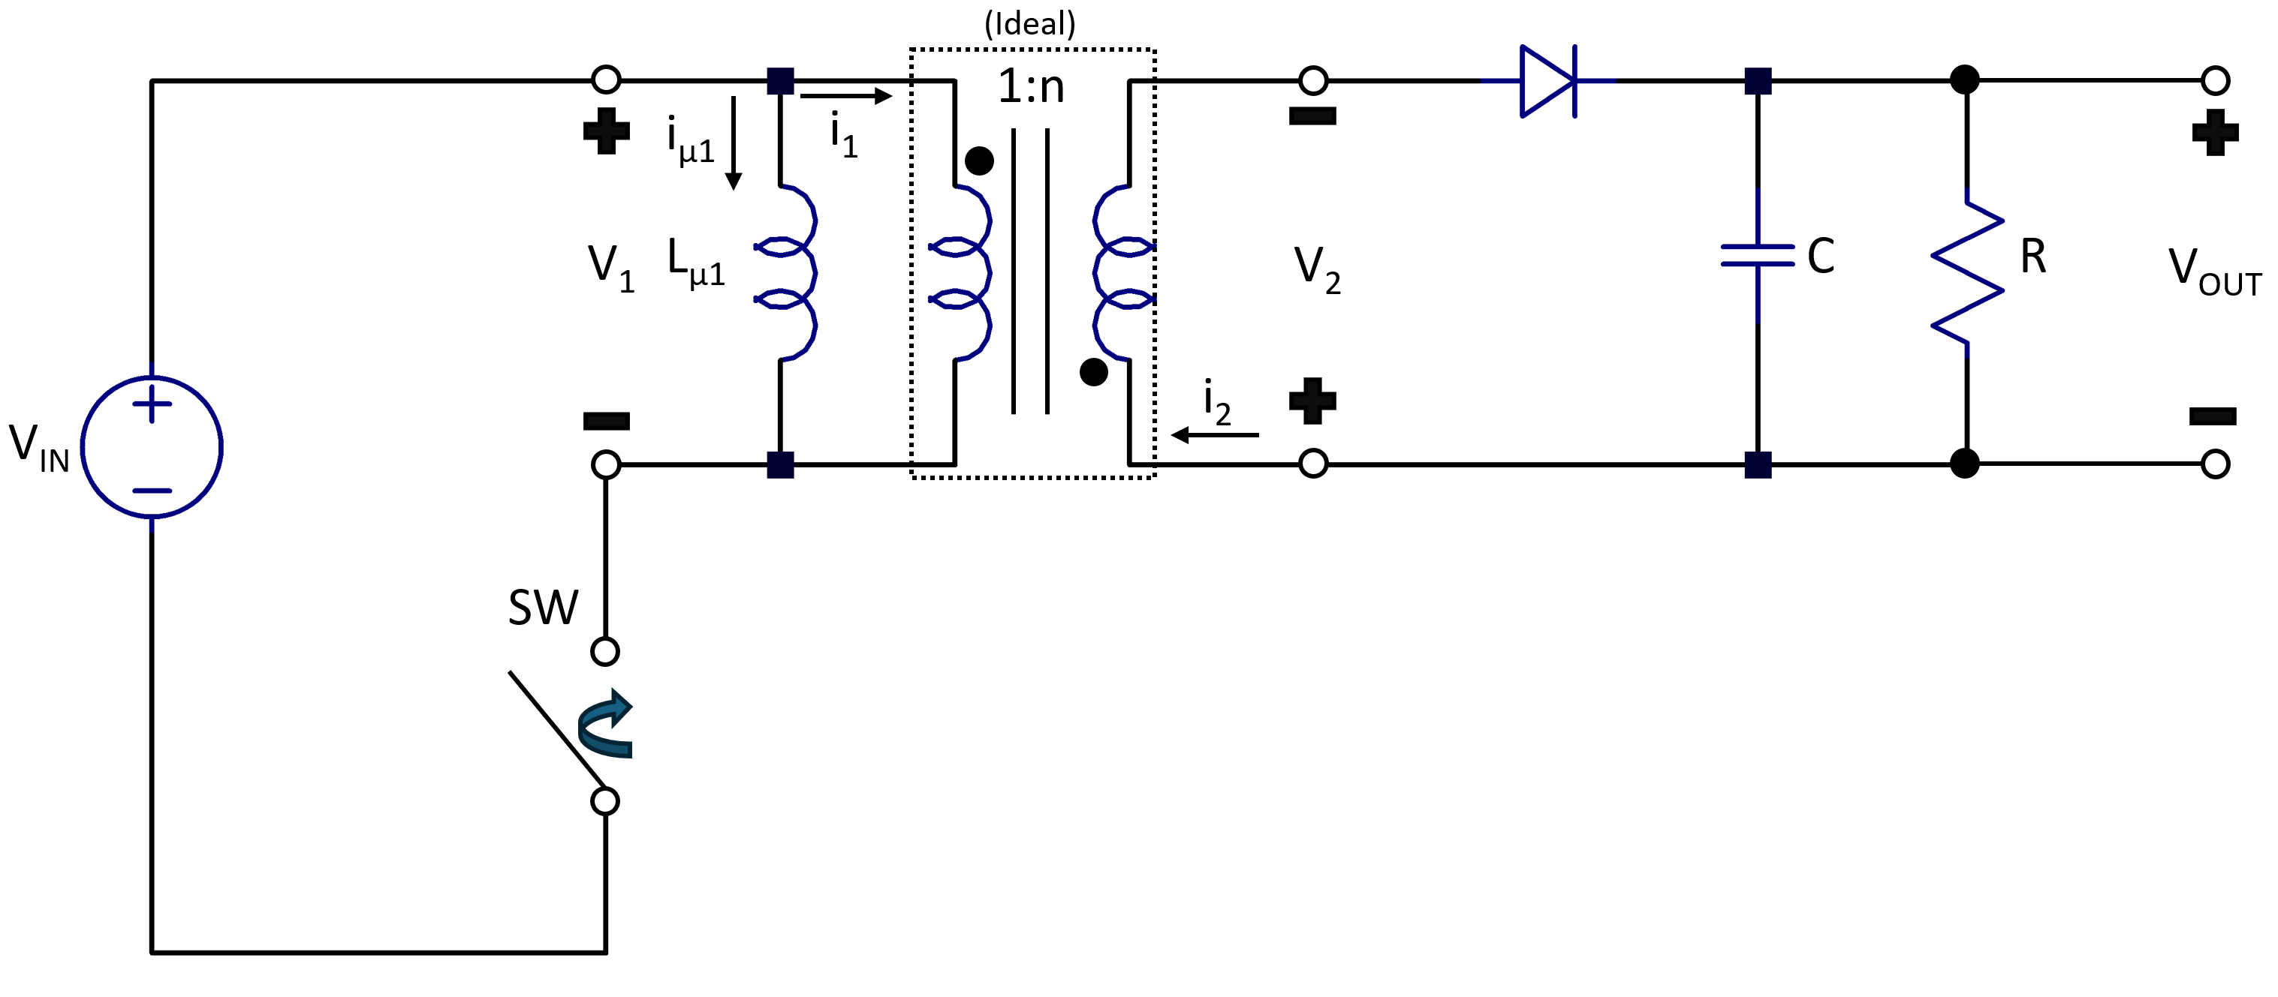
































Basic Flyback Converter at Periodic Steady-State: Continuous Conduction Mode (CCM)
$$I_{{pk}_{1}}=I_{0}+\frac{V_{IN}}{L_{μ_{1}}}t_{1}$$
$$V_{1}$$
$$I_{μ_{1}}$$
$$\frac{V_{IN}}{L_{μ_{1}}}$$
$$−\frac{(V_{OUT}+V_{F})}{{nL}_{μ_{1}}}$$
$$I_{2}$$
$$I_{{pk}_{2}}=\frac{I_{{pk}_{1}}}{n}=\frac{I_{0}}{n}+\frac{V_{IN}}{{nL}_{μ_{1}}}t_{1}$$
$$V_{IN}$$
$$−\frac{(V_{OUT}+V_{F})}{{n^{2}L}_{μ_{1}}}$$
$$I_{0}$$
$$\frac{I_{0}}{n}$$
$$t_{1}$$
$$t_{2}$$
$$t$$
$$t_{1}$$
$$t_{2}$$
$$t$$
$$t_{1}$$
$$t_{2}$$
$$t$$
$$t_{1}$$
$$t_{2}$$
$$t$$
$$−\frac{(V_{OUT}+V_{F})}{n}$$
$$V_{2}$$
$$I_{1}$$
$${nV}_{IN}$$
$$t_{1}$$
$$t_{2}$$
$$t$$
$$t_{1}$$
$$t_{2}$$
$$t$$
$$−I_{0}$$
$${−I}_{{pk}_{1}}=$$
$$−\left(I_{0}+\frac{V_{IN}}{L_{μ_{1}}}t_{1}\right)$$
$$\frac{(V_{OUT}+V_{F})}{{nL}_{μ_{1}}}$$
$$−V_{OUT}+V_{F}$$

Slide 7



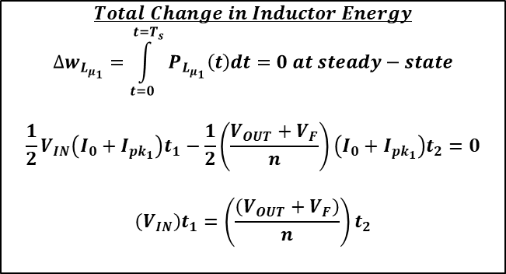

















Energy Balance for Magnetizing Inductance at Periodic Steady-State (CCM)
$$I_{{pk}_{1}}=I_{0}+\frac{V_{IN}}{L_{μ_{1}}}t_{1}$$
$$P_{{pk}_{1}}=I_{{pk}_{1}}×V_{IN}$$
$$V_{1}$$
$$I_{μ_{1}}$$
$$\frac{V_{IN}}{L_{μ_{1}}}$$
$$−\frac{(V_{OUT}+V_{F})}{{nL}_{μ_{1}}}$$
$$P_{L_{μ_{1}}}(t)$$
$$V_{IN}$$
$$P_{0}=I_{0}×V_{IN}$$
$$I_{0}$$
$$t$$
$$t_{1}$$
$$t_{2}$$
$$t$$
$$t_{1}$$
$$t_{2}$$
$$t$$
$$t_{1}$$
$$t_{2}$$
$$P_{F}=−I_{0}×\frac{(V_{OUT}+V_{F})}{n}$$
$$−\frac{(V_{OUT}+V_{F})}{n}$$
$$P_{{pk}_{2}}=−I_{{pk}_{1}}×\frac{(V_{OUT}+V_{F})}{n}$$
$$Total Change in Inductor Energy$$
$$∆w_{L_{μ_{1}}}=\int_{t=0}^{t=T_{s}}{P_{L_{μ_{1}}}\left(t\right)dt}=0 at steady−state$$
$$\frac{1}{2}V_{IN}\left(I_{0}+I_{{pk}_{1}}\right)t_{1}−\frac{1}{2}\left(\frac{V_{OUT}+V_{F}}{n}\right)\left(I_{0}+I_{{pk}_{1}}\right)t_{2}=0$$
$$\left(V_{IN}\right)t_{1}=\left(\frac{\left(V_{OUT}+V_{F}\right)}{n}\right)t_{2}$$
Overview:
Energy balance for magnetizing inductance over one switching cycle yields same result as if Volt-second balance were applied
Consistent ✓

Slide 8

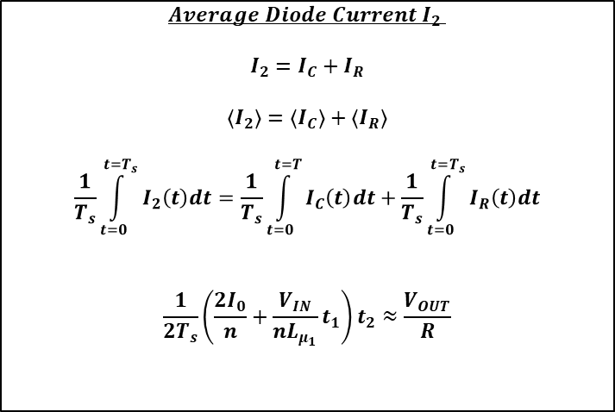





Output Capacitor Charge Balance at Periodic Steady-State (CCM)
$$Average Diode Current{ I}_{2}$$
$$I_{2}=I_{C}+I_{R}$$
$$\left\langle I_{2}\right\rangle =\left\langle I_{C}\right\rangle +\left\langle I_{R}\right\rangle$$
$$\frac{1}{T_{s}}\int_{t=0}^{t=T_{s}}{I_{2}\left(t\right)dt}=\frac{1}{T_{s}}\int_{t=0}^{t=T}{I_{C}\left(t\right)dt}+\frac{1}{T_{s}}\int_{t=0}^{t=T_{s}}{I_{R}\left(t\right)dt}$$
$$\frac{1}{2T_{s}}\left(\frac{{2I}_{0}}{n}+\frac{V_{IN}}{nL_{μ_{1}}}t_{1}\right)t_{2}≈\frac{V_{OUT}}{R}$$
$$I_{2}$$
$$I_{{pk}_{2}}=\frac{I_{{pk}_{1}}}{n}=\frac{I_{0}}{n}+\frac{V_{IN}}{{nL}_{μ_{1}}}t_{1}$$
0 at periodic steady-state
$$−\frac{(V_{OUT}+V_{F})}{{n^{2}L}_{μ_{1}}}$$
0 at periodic steady-state
$$\frac{I_{0}}{n}$$
$$t_{1}$$
$$t_{2}$$
$$t$$

Slide 9
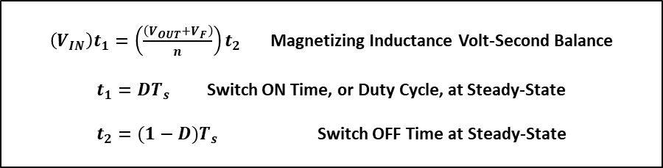
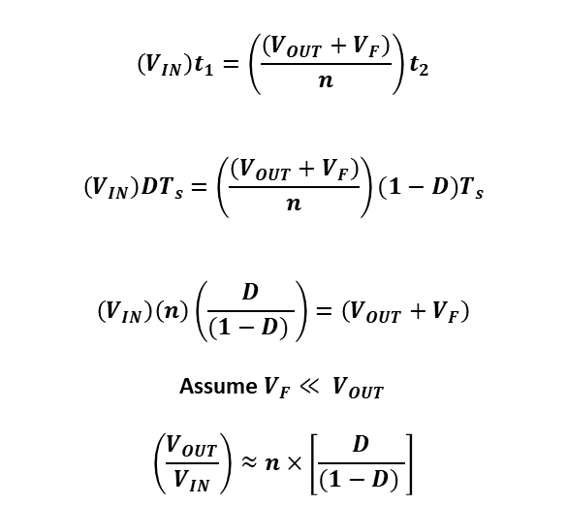
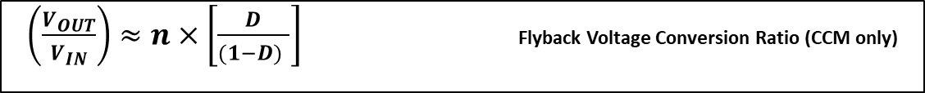
Output Voltage at Periodic Steady-State (CCM)
$\left(V_{IN}\right)t_{1}=\left(\frac{\left(V_{OUT}+V_{F}\right)}{n}\right)t_{2}$ Magnetizing Inductance Volt-Second Balance
$t_{1}=DT_{s}$ Switch ON Time, or Duty Cycle, at Steady-State
$t_{2}=(1−D)T_{s}$ Switch OFF Time at Steady-State
$$\left(V_{IN}\right)t_{1}=\left(\frac{\left(V_{OUT}+V_{F}\right)}{n}\right)t_{2}$$
$$\left(V_{IN}\right)DT_{s}=\left(\frac{\left(V_{OUT}+V_{F}\right)}{n}\right)(1−D)T_{s}$$
$$\left(V_{IN}\right)\left(n\right)\left(\frac{D}{(1−D) }\right)=\left(V_{OUT}+V_{F}\right)$$
Assume $V_{F}≪ V_{OUT}$
$$\left(\frac{V_{OUT}}{V_{IN}}\right)≈n×\left[\frac{D}{(1−D) }\right]$$
$\left(\frac{V_{OUT}}{V_{IN}}\right)≈n×\left[\frac{D}{(1−D) }\right]$ Flyback Voltage Conversion Ratio (CCM only)

Slide 10
Basic Flyback Converter at Periodic Steady-State: Discontinuous Conduction Mode (DCM)
(Ideal)
1:n
i_{µ1}
i₁
i_{C}
i_{R}
V₁
L_{µ1}
V₂
C
R
V_{OUT}
i₂
V_{IN}
Overview:
Store magnetic energy in magnetizing inductance when switch is open
Transfer energy to load when switch is open
Provide galvanic isolation and use turns ratio for flexibility in achieving high voltage conversion ratios
Assumptions:
Periodic steady-state condition reached
Large C and large enough R, so that V_{out} ~ constant over switching cycle
Magnetizing inductance L_{µ1}/ L_{µ2} are small enough, and switching period T_{s} is long enough, so that magnetizing currents decay to zero during switching cycle (called discontinuous conduction mode i.e. DCM)
SW
Switching Frequency T_{s}:
On Time = t₁ or DT_{s}

Slide 11


































Basic Flyback Converter at Periodic Steady-State: Discontinuous Conduction Mode (DCM)
$$I_{{pk}_{1}}=\frac{V_{IN}}{L_{μ_{1}}}t_{1}$$
$$I_{{pk}_{2}}=\frac{I_{{pk}_{1}}}{n}=\frac{V_{IN}}{{nL}_{μ_{1}}}t_{1}$$
$$V_{1}$$
$$I_{μ_{1}}$$
$$I_{2}$$
$$\frac{V_{IN}}{L_{μ_{1}}}$$
$$−\frac{(V_{OUT}+V_{F})}{{nL}_{μ_{1}}}$$
$$−\frac{(V_{OUT}+V_{F})}{{n^{2}L}_{μ_{1}}}$$
$$V_{IN}$$
$$0V$$
$$t_{1}$$
$$t_{2}$$
$$t_{3}$$
$$t$$
$$t_{1}$$
$$t_{2}$$
$$t_{3}$$
$$t$$
$$t_{1}$$
$$t_{2}$$
$$t_{3}$$
$$t$$
$$t_{1}$$
$$t_{2}$$
$$t_{3}$$
$$t$$
$$−\frac{(V_{OUT}+V_{F})}{n}$$
$$V_{2}$$
$$I_{1}$$
$${nV}_{IN}$$
$$0V$$
$$t_{1}$$
$$t_{2}$$
$$t_{3}$$
$$t_{1}$$
$$t_{2}$$
$$t_{3}$$
$$t$$
$$t$$
$$\frac{(V_{OUT}+V_{F})}{{nL}_{μ_{1}}}$$
$$−V_{OUT}+V_{F}$$
$${−I}_{{pk}_{1}}=−\frac{V_{IN}}{L_{μ_{1}}}t_{1}$$

Slide 12





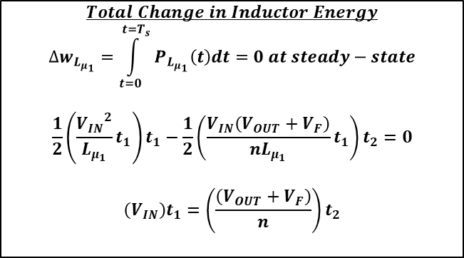

Energy Balance for Magnetizing Inductance at Periodic Steady-State (DCM)
$P_{{pk}_{1}}=$ $\frac{{V_{IN}}^{2}}{L_{μ_{1}}}t_{1}$
$$I_{{pk}_{1}}=\frac{V_{IN}}{L_{μ_{1}}}t_{1}$$
$$V_{1}$$
$$I_{μ_{1}}$$
$$P_{L_{μ_{1}}}(t)$$
$$\frac{V_{IN}}{L_{μ_{1}}}$$
$$−\frac{(V_{OUT}+V_{F})}{{nL}_{μ_{1}}}$$
$$V_{IN}$$
$$t_{2}$$
$$0V$$
$$t_{1}$$
$$t_{2}$$
$$t_{3}$$
$$t$$
$$t_{1}$$
$$t_{2}$$
$$t_{3}$$
$$t$$
$$t_{1}$$
$$t_{3}$$
$$t$$
$$−\frac{(V_{OUT}+V_{F})}{n}$$
$P_{{pk}_{2}}=$ $−\left(\frac{V_{IN}\left(V_{OUT}+V_{F}\right)}{nL_{μ_{1}}}\right)t_{1}$
$$Total Change in Inductor Energy$$
$$∆w_{L_{μ_{1}}}=\int_{t=0}^{t=T_{s}}{P_{L_{μ_{1}}}\left(t\right)dt}=0 at steady−state$$
$$\frac{1}{2}\left(\frac{{V_{IN}}^{2}}{L_{μ_{1}}}t_{1}\right)t_{1}−\frac{1}{2}\left(\frac{V_{IN}\left(V_{OUT}+V_{F}\right)}{nL_{μ_{1}}}t_{1}\right)t_{2}=0$$
$$\left(V_{IN}\right)t_{1}=\left(\frac{\left(V_{OUT}+V_{F}\right)}{n}\right)t_{2}$$
Overview:
Energy balance for magnetizing inductance over one switching cycle yields same result as if Volt-second balance were applied
Consistent ✓

Slide 13

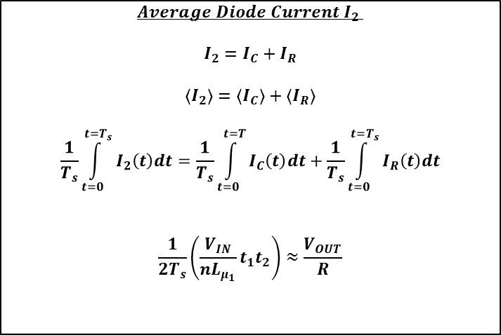


Output Capacitor Charge Balance at Periodic Steady-State (DCM)
$$I_{{pk}_{2}}=\frac{I_{{pk}_{1}}}{n}=\frac{V_{IN}}{{nL}_{μ_{1}}}t_{1}$$
$$Average Diode Current{ I}_{2}$$
$$I_{2}=I_{C}+I_{R}$$
$$\left\langle I_{2}\right\rangle =\left\langle I_{C}\right\rangle +\left\langle I_{R}\right\rangle$$
$$\frac{1}{T_{s}}\int_{t=0}^{t=T_{s}}{I_{2}\left(t\right)dt}=\frac{1}{T_{s}}\int_{t=0}^{t=T}{I_{C}\left(t\right)dt}+\frac{1}{T_{s}}\int_{t=0}^{t=T_{s}}{I_{R}\left(t\right)dt}$$
$$\frac{1}{2T_{s}}\left(\frac{V_{IN}}{{nL}_{μ_{1}}}t_{1}t_{2}\right)≈\frac{V_{OUT}}{R}$$
$$I_{2}$$
0 at periodic steady-state
$$−\frac{(V_{OUT}+V_{F})}{{n^{2}L}_{μ_{1}}}$$
0 at periodic steady-state
$$t_{1}$$
$$t_{2}$$
$$t_{3}$$
$$t$$

Slide 14
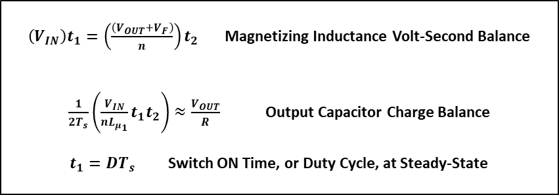
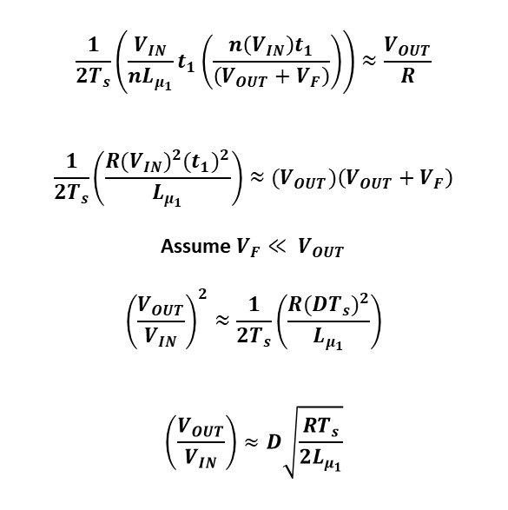
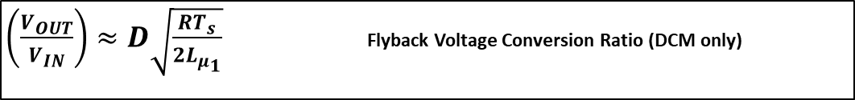
Output Voltage at Periodic Steady-State (DCM)
$\left(V_{IN}\right)t_{1}=\left(\frac{\left(V_{OUT}+V_{F}\right)}{n}\right)t_{2}$ Magnetizing Inductance Volt-Second Balance
$\frac{1}{2T_{s}}\left(\frac{V_{IN}}{{nL}_{μ_{1}}}t_{1}t_{2}\right)≈\frac{V_{OUT}}{R}$ Output Capacitor Charge Balance
$t_{1}=DT_{s}$ Switch ON Time, or Duty Cycle, at Steady-State
$$\frac{1}{2T_{s}}\left(\frac{V_{IN}}{{nL}_{μ_{1}}}t_{1}\left(\frac{n\left(V_{IN}\right)t_{1}}{\left(V_{OUT}+V_{F}\right)}\right)\right)≈\frac{V_{OUT}}{R}$$
$$\frac{1}{2T_{s}}\left(\frac{{R(V_{IN})}^{2}{(t_{1})}^{2}}{L_{μ_{1}}}\right)≈{(V}_{OUT})\left(V_{OUT}+V_{F}\right)$$
Assume $V_{F}≪ V_{OUT}$
$${\left(\frac{V_{OUT}}{V_{IN}}\right)}^{2}≈\frac{1}{2T_{s}}\left(\frac{R{(DT_{s})}^{2}}{L_{μ_{1}}}\right)$$
$$\left(\frac{V_{OUT}}{V_{IN}}\right)≈D\sqrt{\frac{RT_{s}}{2L_{μ_{1}}}}$$
$\left(\frac{V_{OUT}}{V_{IN}}\right)≈D\sqrt{\frac{RT_{s}}{2L_{μ_{1}}}}$ Flyback Voltage Conversion Ratio (DCM only)

Slide 15
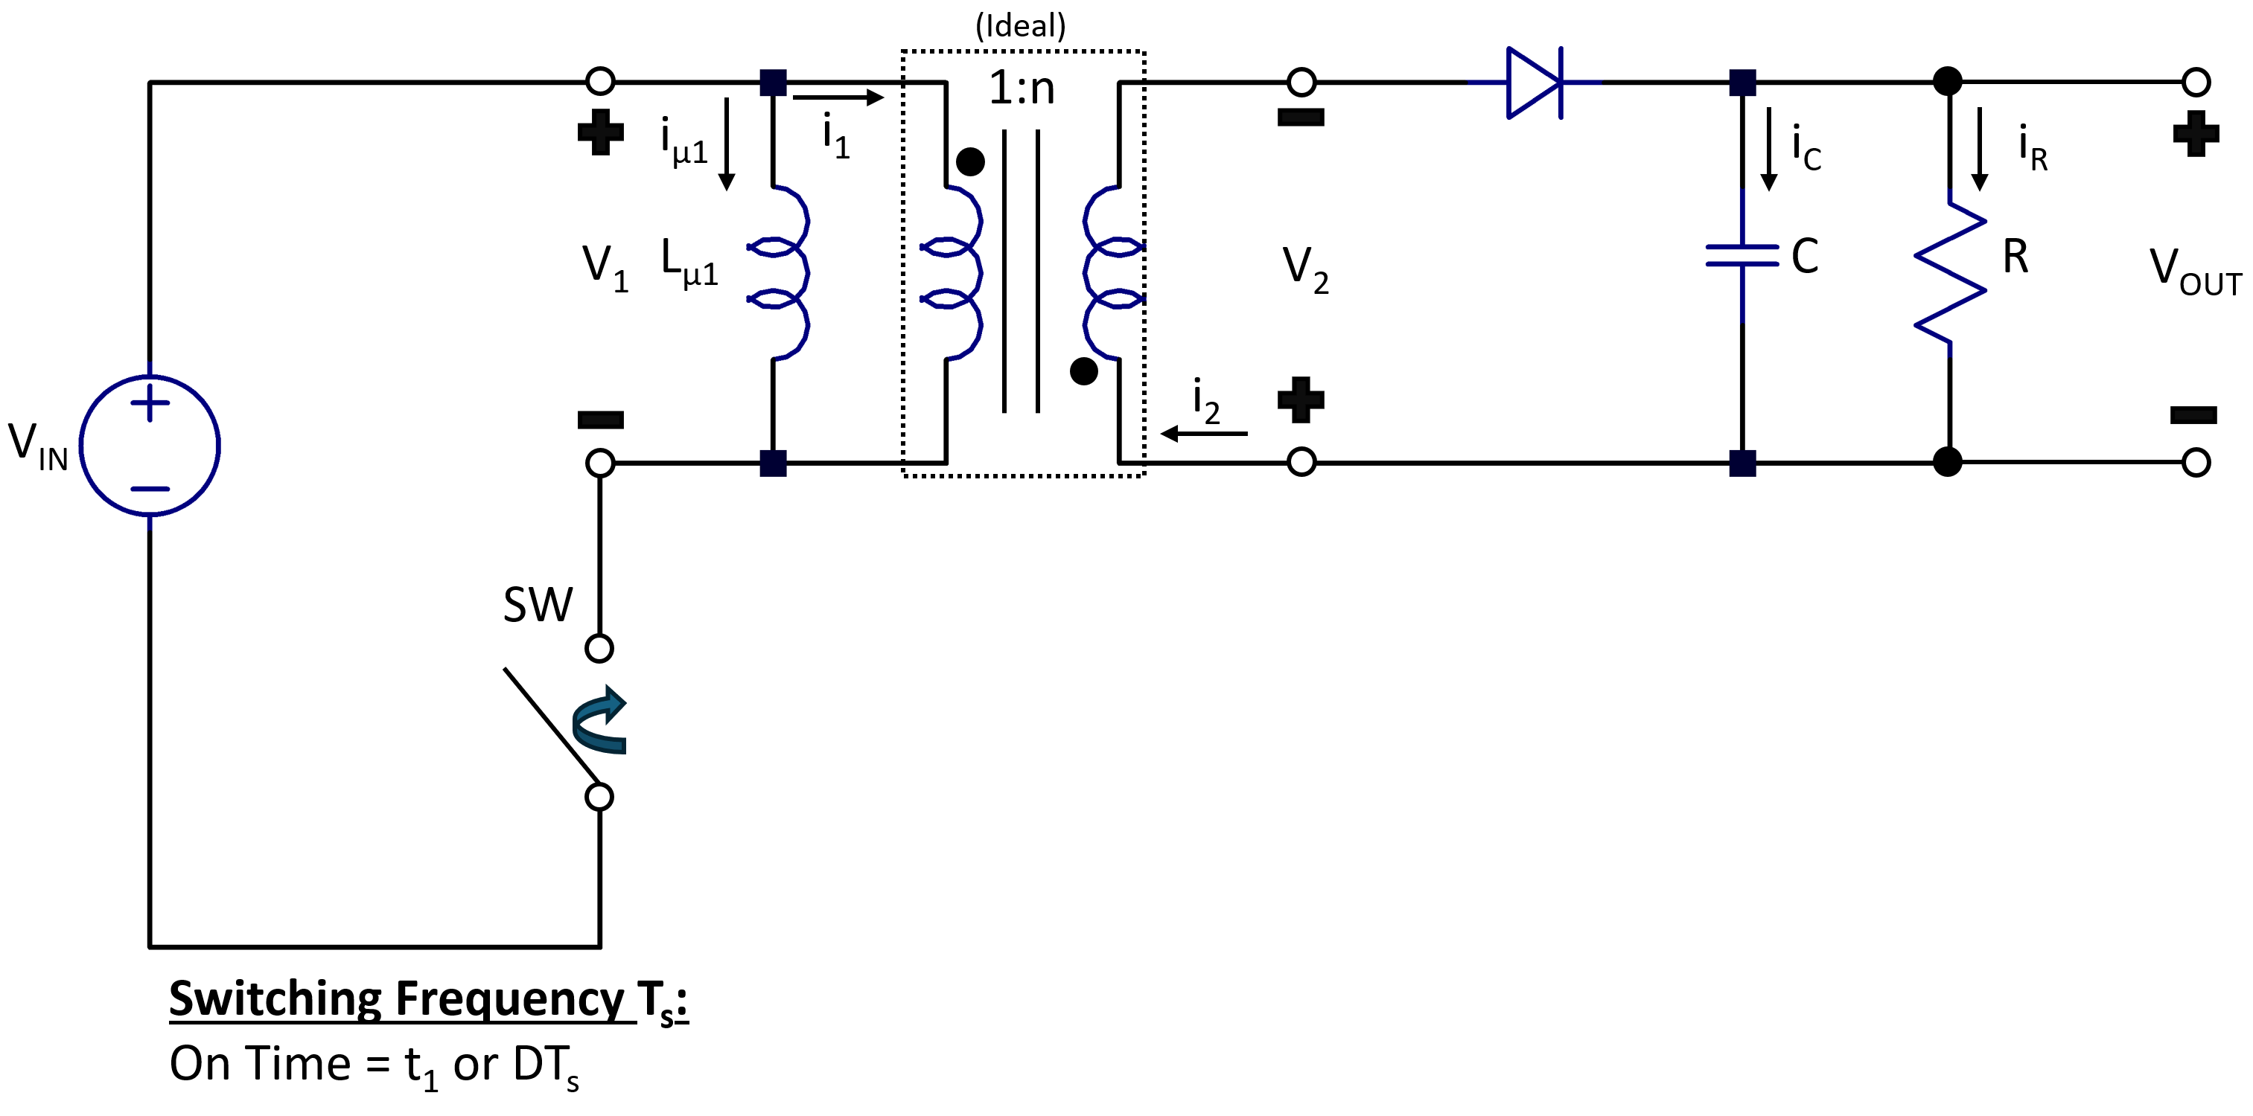

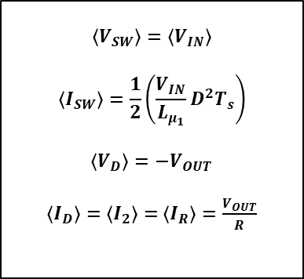









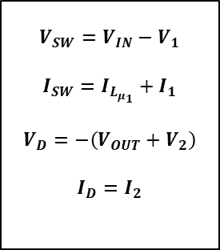

Power Stage Average Modeling (DCM)
V_{D}
$$V_{IN}+\frac{(V_{OUT}+V_{F})}{n}$$
$$V_{SW}$$
$$V_{D}$$
i_{D}
$$V_{IN}$$
$$0V$$
$$V_{F}$$
V_{SW}
$$t_{1}$$
$$t_{2}$$
$$t_{3}$$
$$t$$
$$t_{1}$$
$$t_{2}$$
$$t_{3}$$
$$t$$
i_{SW}
$$−V_{OUT}$$
$$−\left(V_{OUT}+{nV}_{IN}\right)$$
$$I_{{pk}_{1}}=\frac{V_{IN}}{L_{μ_{1}}}t_{1}$$
$$I_{{pk}_{2}}=\frac{I_{{pk}_{1}}}{n}=\frac{V_{IN}}{{nL}_{μ_{1}}}t_{1}$$
Instantaneous
Switch/Diode Eqns
Averaged
Switch/Diode Eqns
$$I_{SW}$$
$$I_{D}$$
$$\frac{V_{IN}}{L_{μ_{1}}}$$
$$−\frac{(V_{OUT}+V_{F})}{{n^{2}L}_{μ_{1}}}$$
$$V_{SW}=V_{IN}−V_{1}$$
$$I_{SW}=I_{L_{μ_{1}}}+I_{1}$$
$$V_{D}=−\left(V_{OUT}+V_{2}\right)$$
$$I_{D}=I_{2}$$
$$\left\langle V_{SW}\right\rangle =\left\langle V_{IN}\right\rangle$$
$$\left\langle I_{SW}\right\rangle =\frac{1}{2}\left(\frac{V_{IN}}{L_{μ_{1}}}D^{2}T_{s}\right)$$
$$\left\langle V_{D}\right\rangle =−V_{OUT}$$
$\left\langle I_{D}\right\rangle =\left\langle I_{2}\right\rangle =$ $\left\langle I_{R}\right\rangle =\frac{V_{OUT}}{R}$
Periodic Steady-State
Averaging
$$t_{1}$$
$$t_{2}$$
$$t_{3}$$
$$t$$
$$t_{1}$$
$$t_{2}$$
$$t_{3}$$
$$t$$

Slide 16





Power Stage Average Modeling (CCM)
Peak Magnetizing Inductor Current:
$$I_{{pk}_{1}}=I_{0}+\frac{V_{IN}}{L_{μ_{1}}}t_{1}$$
$$−\frac{(V_{OUT}+V_{F})}{{nL}_{μ_{1}}}$$
$$I_{μ_{1}}$$
$$\frac{V_{IN}}{L_{μ_{1}}}$$
$$V_{1}$$
$$V_{IN}$$
$$\left\langle I_{μ_{1}}\right\rangle$$
$$I_{0}$$
$$\left\langle V_{1}\right\rangle$$
$$t_{1}$$
$$t_{2}$$
$$t$$
$$t_{1}$$
$$t_{2}$$
$$t$$
$$T_{s}$$
$$−\frac{(V_{OUT}+V_{F})}{n}$$

