Slide 1

DATATHON 2020
Team - 6

Slide 2

Team Members
Ted
Lama
Vaishnavi

Slide 3

How can we systematically leverage ALL provided data to make predictions?
Wealth of data across multiple disciplines:
Diet, medication, prior health history
Need to identify which factors are most informative across all datasets.
Solution: create a systematic feature engineering pipeline to identify most informative features across ALL data.
Challenge statement

Slide 4
Data Pipeline
Preprocessing
Feature Selection
Machine Learning Model

Slide 5
Preprocessing
Discrete Data
Continuous
Removed uninformative data (lost of Nas, unanswered, etc)
Removed features with high homogeneity (15% are of one category
Universal normalization (except for age)
Log10 transformation
Z-score

Slide 6
Feature selection
Smoking history
Survival Data
Vitamins & Minerals
Weights for Features
L1 Logistic Regression
Women Health
Top 10 highest and lowest coefficents selected for final model
Lifestyle Datasets
Background and helpful info
Beverages
Current Lifestyle

Slide 7
Machine Learning Model
Random Forest
Selected Features
Gradient Boosted Tree
ANN

Slide 8

Performance
Training ROC: 0.77
Test ROC: 0.76
10

Slide 9
Use Cases
Features were selected from a broad set of variables:
These might be important factors for predicting survival
Top Performing Features: Age, Primary Site of Cancer, Smoking, and BMI
The questionnaire is rich in information, but may be difficult to acquire based on feature specificity
Metabolic measurements, food consumed, exercise may be hard to quantify consistently across different contexts.
Our model quantifies the importance of all the varibles in the data
Clinicians can begin designing more targeted studies to better understand lifestyle and cancer mortality.

Slide 10
Future Work
Future Work
Cancer Monitor App: takes our most informative features about cancer mortality and provides lifestyle adjustments to improve survival.
User will input the features into the app’s checklist selection interface
App will output a likelihood of developing
Could easily develop a mobile app using Django or flask python web development apps
Data could be stored in cloud platform
AWS, Azure, Google Cloud, etc.

Slide 11
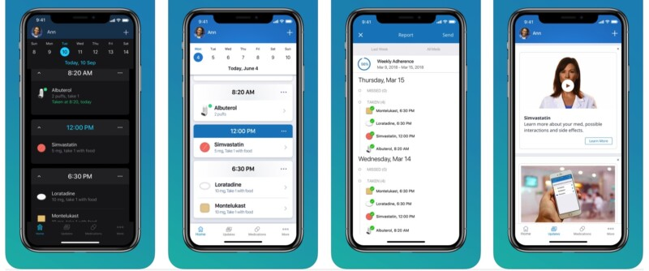
Use Case

Slide 12
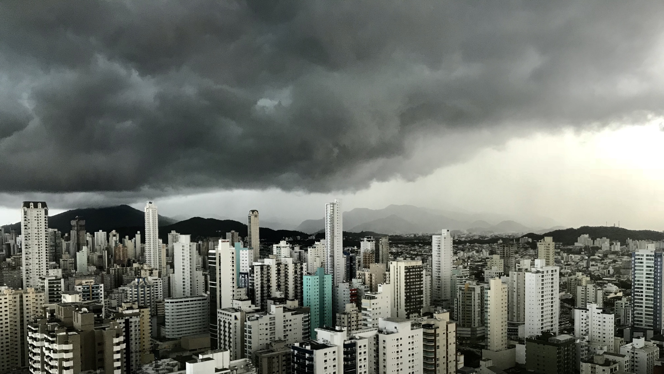
THANK YOU!

