Slide 1
CREATE YCREATE YOUR OWN EMOJI WITH Team Members VINUTHNA VULLIGADDALA NITISHA POTLURI

Slide 2
EMOJI’S BASED ON HUMAN REACTIONS

Slide 3
OBJECTIVE
To express our emotions or feelings, we now use a variety of emojis or avatars. They serve as human nonverbal cues. They play an important role in emotion recognition, online talking, brand emotion, product reviews, and a variety of other activities.
It is now possible to find out human emotions from photos because of advances in computer vision and deep learning. We will classify human facial emotions in this deep learning research in order to filter and map corresponding emojis or avatars.

Slide 4
APPROACH
Firstly, we create a deep learning model that classifies face emotions in terms of photographs. Then, using an avatar or an emoji, we'll locate the previously defined emotion.
Dataset: FER2013 is the dataset we'll be using for this project (Facial Expression Recognition 2013). It has grayscale face images that are 48*48 pixels in size.

Slide 5
FACIAL EMOTIONS
ANGRY
Sad
Surprise
Fear
Natural
Happy

Slide 6
LIBRARIES USED:
Pandas
Numpy
CV2
datetime
Tensorflow
Tkinter
OS
Seaborn
Matplotlib

Slide 7
DELIVERABLES
We will develop a convolution neural network to recognize face emotions. After that, we use the dataset into our model. Finally, we associate each facial emotion with the appropriate emojis or avatars.
Sample output images
Git hub Repository with all documentation and code
You tube link which demonstrates our work

Slide 8
CNN
CONVOLUTIONAL NEURAL NETWORKS
Convolutional Neural Networks (or convnets) are based on the following principles:
Local receptive fields
Shared weights
Pooling (or down-sampling)

Slide 9
R-CNN
R-CNN (regions with convolutional neural networks) combines rectangular region proposals with properties of convolutional neural networks.
The R-CNN algorithm is a two-stage detection method. The first stage finds a selection of image regions that could contain an object.

Slide 10
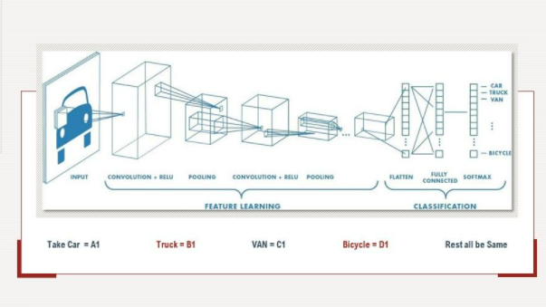
This special neural network architecture takes advantage of the spatial structure of data.
.

Slide 11
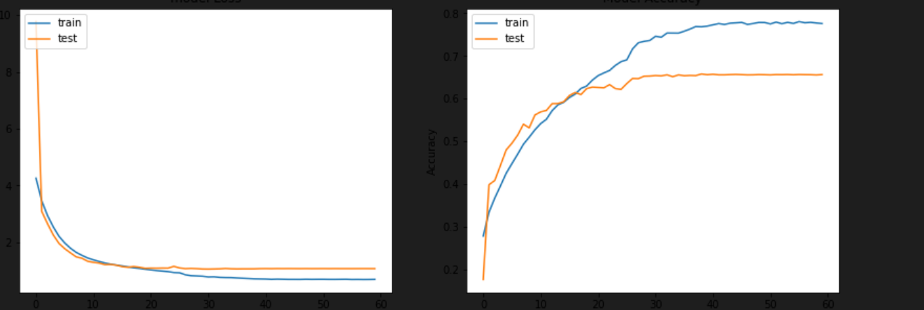
LOSS AND ACCURACY PLOT

Slide 12
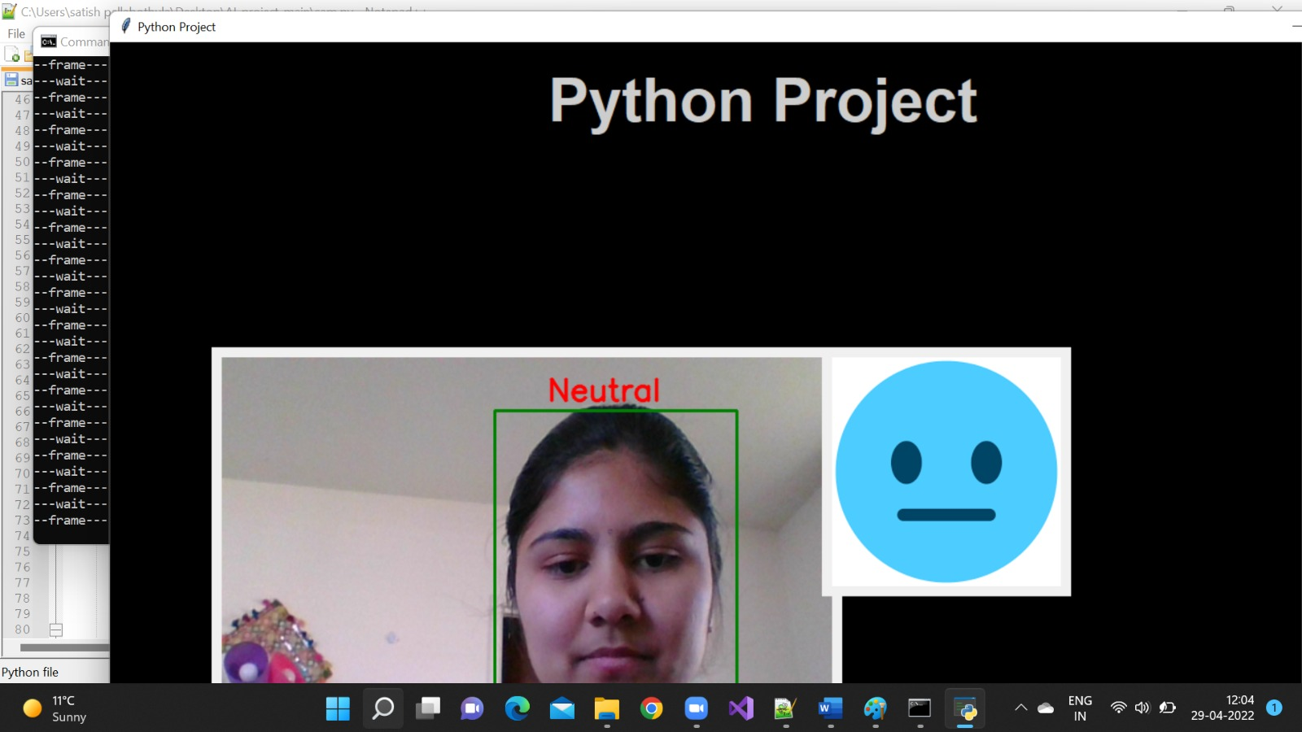
RESULTS

Slide 13
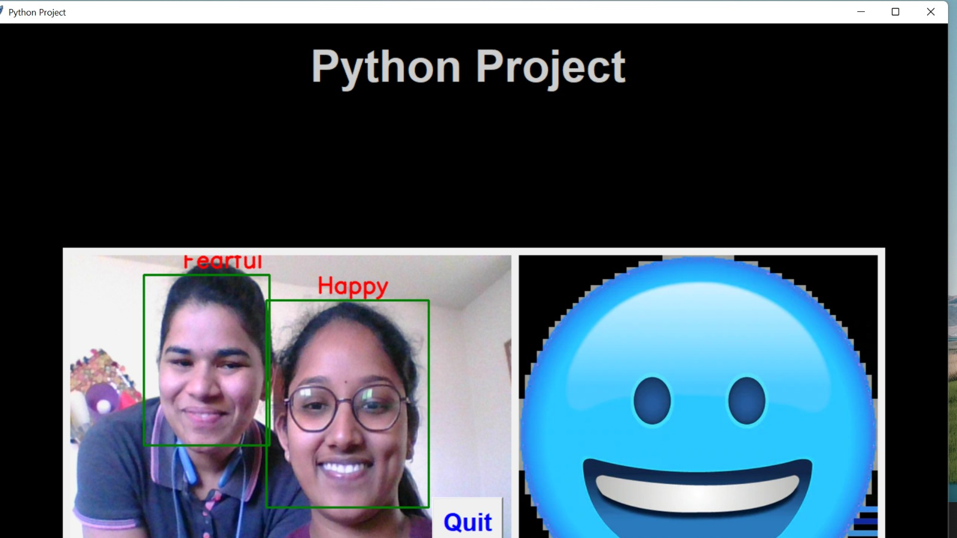
RESULT FOR MULTIPLE IMAGES

Slide 14
THANK YOU

