Slide 1
YARP from command line

Slide 2
A (very) simple example: read data to/from a port
[on terminal 1] yarpserver
[on terminal 2] yarp read /read
[on terminal 3] yarp write /write /read
yarp write
yarp read
/write
/read
$ yarp write /write /read
Port /write listening at tcp://127.0.0.1:10012
yarp: Sending output from /write to /read using tcp
Added output connection from "/write" to "/read"
hello yarp
1 2 3
$ yarp read /read
Port /read listening at tcp://127.0.0.1:10002
yarp: Receiving input from /write to /read using tcp
hello yarp
1 2 3

Slide 3
yarp name list yarp name query /read yarp name register PORT CARRIER IP NUMBER yarp name unregister PORT

Slide 4



how the network grows
It is easy to add, for example, another reader…
Processes can run on different machines, with different OS
yarp write
yarp read
/write
/read
yarp read
/read2
yarp connect /write /read
yarp connect /write /read2
…
yarp disconnect /write /read
yarp disconnect /write /read2
yarp read
/read3

Slide 5
YARP configuration file
Where is the yarp nameserver?
student@ubuntu-1404-yarp:~$ yarp detect
student@ubuntu-1404-yarp:~$ yarp conf
/home/student/.config/yarp/yarp.conf
student@ubuntu-1404-yarp:~$ cat /home/student/.config/yarp/yarp.conf
192.168.59.128 10000 yarp
yarpserver by default decides based on the available network card (i.e. eth0) on which adapter/ip to listen
You can manually modify the yarp.conf file to change adapter/ip.
yarpserver can accept that (--read) or overwrite it (--write).

Slide 6
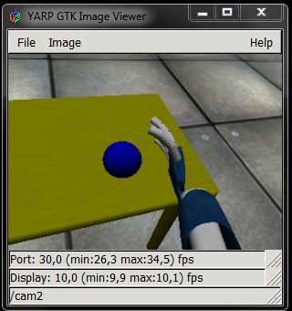
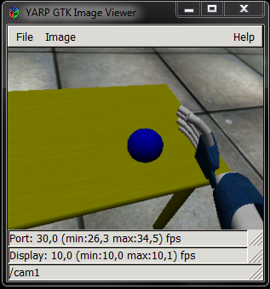
yarpview
yarpdev --device test_grabber --name /cam/right
yarpdev --device test_grabber --name /cam/left
yarpview --name /view1
yarpview --name /view2
yarp connect /cam/right /view1
yarp connect /cam/left /view2

Slide 7
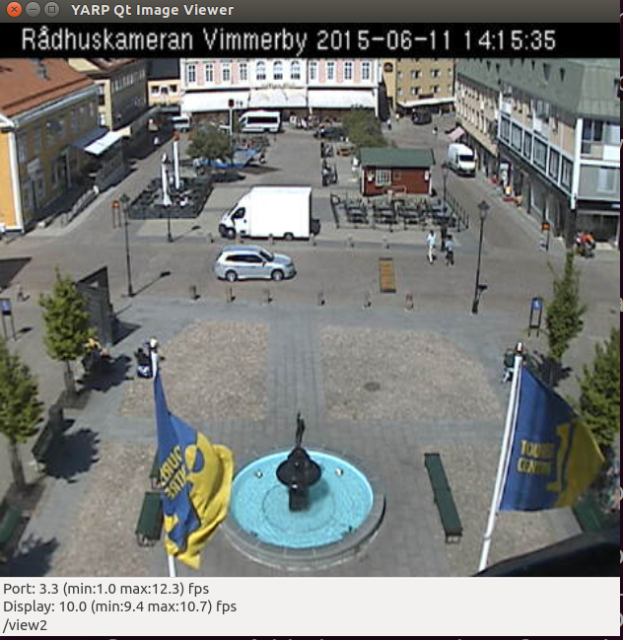
Connecting to mjpeg
Run ccmake in YARP’s build directory
Make sure these CMake flags are enabled:
CREATE_OPTIONAL_CARRIERS=ON
ENABLE_yarpcar_mjpeg_carrier=ON
Rebuild (and install):
$ make
$ sudo make install
yarpview --name /view
yarp connect /195.67.26.73:80 /view mjpeg+path./mjpg/video.mjpg
Alternatively you can register the remote address manually:
yarp name register /webcam mjpeg+path./mjpg/video.mjpg 195.67.26.73 80
And use /webcam as an alias
yarp connect /webcam /view

Slide 8
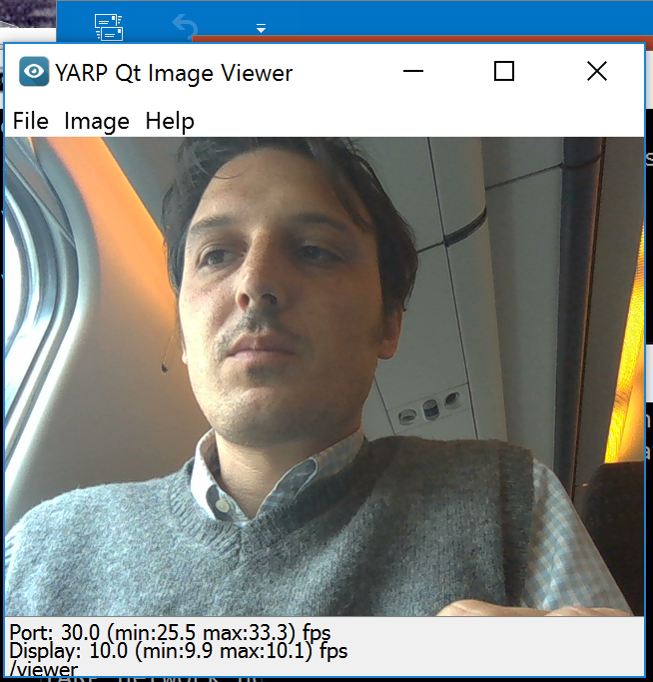
Use your webcam
Run ccmake in YARP’s build directory
Make sure these CMake flags are enabled:
CREATE_DEVICE_LIBRARY_MODULES=ON
ENABLE_yarpmod_opencv_grabber=ON
Rebuild (and install):
$ make
$ sudo make install
$ yarpview --name /viewer
$ yarpdev --device opencv_grabber --camera 0
$ yarp connect /grabber /viewer

Slide 9
Play recorded sequence
$ wget http://www.icub.org/download/software/datasetplayer-demo/testData_20120803_095402.zip
$ unzip testData_20120803_095402.zip
$ yarpmanager

Slide 10
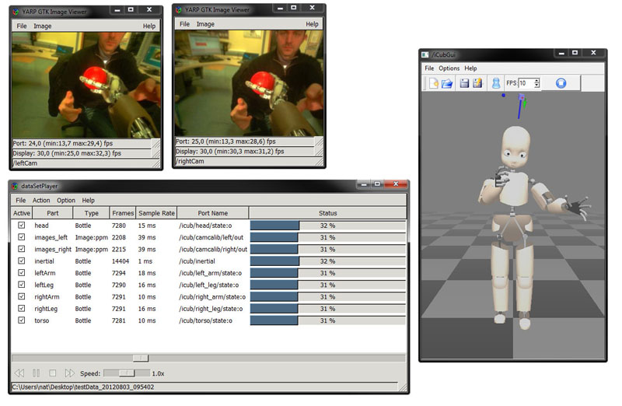

Slide 11
Or run the iCub simulator
$ iCub_SIM
$ yarpmotorgui

Slide 12
Controlling the simulator with the command line
Set of ports for parts {head} {left_arm} {torso} etc…
Ports:
/icubSim/head/rpc:i
/icubSim/head/command:i
/iicubSim/head/state:o
$ yarp rpc /icubSim/head/rpc:i
>>get encs
Response: [is] encs (-0.000015 0.000004 -0.000004 -0.0 0.0 -0.0) [tsta] 1 1434026836.655992 [ok]
>>set pos 0 -10
Response: [ok]
>>set pos 1 20
Response: [ok]
>>set poss (0 0 0 0 0 0)
Response: [ok]
>>get encs
Response: [is] encs (-0.0005 0.000971 -0.000004 -0.0 0.0 -0.0) [tsta] 2 1434026858.553787 [ok]
>>

Slide 13
Tutorials

Slide 14
Tutorial1: tutorial_yarp_automation

Slide 15
Tutorial2: tutorial_yarp_ports (and cmake basics)

Slide 16
Tutorial3: tutorial_yarp_rpc

Slide 17
Tutorial4: tutorial_yarp_rfmodule

Slide 18
Tutorial5: tutorial_yarp_multithreading

Slide 19
Tutorial6: tutorial_yarp_idl

Slide 20
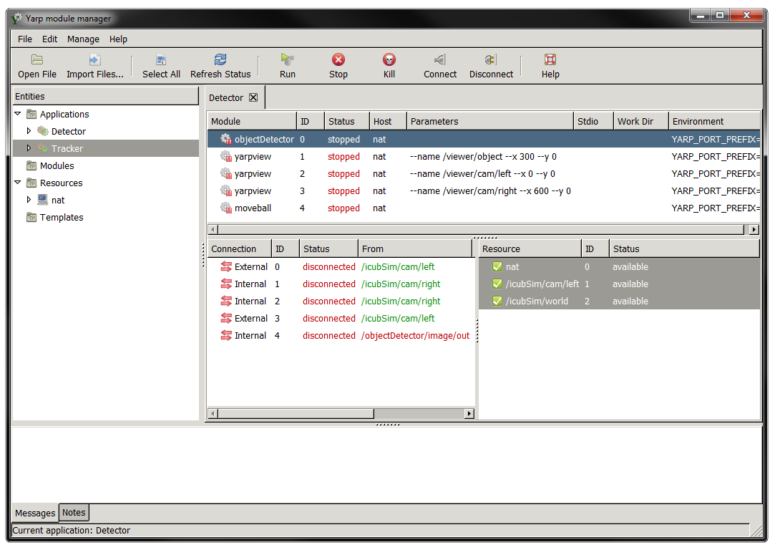
The YARP Manager
The yarpmanager is a graphic interface to monitor processes
It allows to start/stopping/monitor, redirect i/o
In addition it automates establishing connections between modules
…
…
.xml

Slide 21
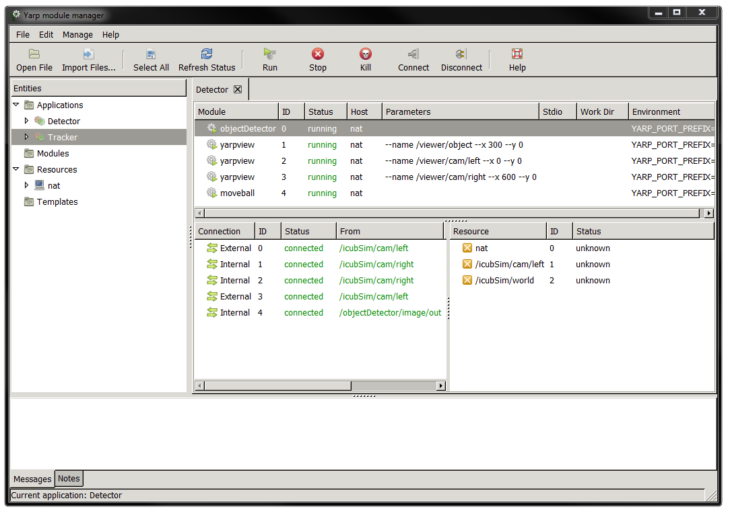

Slide 22
yarpmanager documentation
http://wiki.icub.org/yarpdoc/yarpmanager.html

Slide 23


run a server, which will wait for commands on /node1
Starting a server
$node1: yarprun –server /node1
/node1
localhost
The manager has two ways to execute processes: locally (localhost) or through yarprun
yarprun is a server that waits for commands on a port
start/termination/kill monitor lifecycle
http://wiki.icub.org/yarpdoc/db/dd7/yarprun.html

Slide 24

/pc3
/pc2
/pc1
/pc4
iKinGazeCtrl
/pc104
iKinCartesianSolver
tracker
yarpview –name /view1
iCubInterface

Slide 25
Syntax
<application>
<name>Name of the application</name> //this can be anything, just a symbolic name
<dependencies>
<port>/port1 </port>
<port>/port2 </port>
</dependencies>
<module>
<name>mymodule1 </name>
<parameters>--threshold 1 --name /myName</parameters>
<node>localhost</node>
</module>
<module>
<name>mymodule2</name>
...
</module>
<connection>
<from>/port1</from>
<to>/otherport</to>
<protocol>udp</protocol>
</connection>
<connection>
…
</connection>
</application>

Slide 26
<application>
<name>Name of the application</name> //this can be anything, just a symbolic name
<module>
<name>yarpdev</name>
<parameters>--device test_grabber --name /cam/right</parameters>
<node>localhost</node>
</module>
<module>
<name>yarpview</name>
<parameters>--name /view/right</parameters>
<node>localhost</node>
</module>
<connection>
<from>/cam/right</from>
<to>/view/right</to>
<protocol>udp</protocol>
</connection>
</application>
or any other node in the network:
/node1, /node2 etc..
E.g. on the iCub: icub14, icub15, icub-b11…

Slide 27
Other tags
<dependencies>
<port>/icub/cam/left</port>
<port>/icub/cam/right</port>
</dependencies>
<module>
…
<workdir>C:/mydir</workdir>
<stdio>node3</stdio>
</module>

Slide 29
CMake Basics

Slide 30
Introduction
Open source build manager
Specify build parameters in a simple portable text format
Portable txt file
CMakeLists.txt
CMake
Project Files (i.e. Makefile or .sln)
Code, header files
Libraries
options
User interface
System ‘introspection’

Slide 31
Problems solved by CMake
Write and maintain project files for multiple platforms
Optional components?
Build on more than a single machine: different OS have different libraries, same OS can be installed differently → automatically search for programs libraries header files
Build directory tree different from source tree
Handle dependencies
Static versus Dynamic libraries
…

Slide 32
Basics
Commands (case insensitive)
Variables (case sensitive)
command(a b c)
set(FOO a b c)
command(${FOO})
command(“${FOO}”)
Consider:
set(PATH_TO_MY_FILE C:\program files\myfile)
command(${PATH_TO_MY_FILE})
command(“${PATH_TO_MY_FILE}”)

Slide 33
Hello World with CMake
cmake_minimum_required(VERSION 2.8)
project(hello)
include_directories(${CMAKE_CURRENT_SOURCE_DIR})
message(STATUS "--> Hello from CMake")
if (WIN32)
message("--> Running on windows")
else()
message("--> Assuming running on Linux")
endif()
if (NOT EXISTS "${CMAKE_CURRENT_SOURCE_DIR}/hello.cpp")
message(FATAL_ERROR "File hello.cpp not found!")
endif()
add_executable(hello hello.cpp)

Slide 34
How to run CMake
Source versus build directories
From command line:
mkdir build
cd build
cmake ../ or ccmake ../
From gui:
mkdir build
cmake-gui
Set source and build directories
Hit “c” until you get “g”
When build = source dir: in source build
When build != source dir: out of source build

Slide 35
Cache
Some variables are determined only once and cached on disk; CMake will not touch them, only the user can
E.g. user options or result of system introspection, info that are expensive to determine (compiler to use, system libraries, etc..)
To do a fresh restart, clean the cache
From the gui
Remove CMakeCache.txt

Slide 36
Commands on targets
add_executable(name file1.cpp file2.cpp header1.h header2.h)
target_link_libraries(name libname)
add_library(name file1.cpp file2.cpp header1.h)
include_directories(dir1 dir2)
add_definitions(-DFOO -DBAR)

Slide 37
Example:
#if _ENABLE_DEBUG_
printf(“Value of variable v is %d”, v);
#endif
option(ENABLE_DEBUG "Enable debugging messages"
FALSE)
if (ENABLE_DEBUG)
message(STATUS "Debugging messages are enabled")
add_definitions(-D_ENABLE_DEBUG_)
endif()

Slide 38
Installation
In some builds include an installation step
You can add installation rules using CMake
install(TARGETS myExe RUNTIME DESTINATION <dir>)
install(FILES files DESTINATION <dir>)
<dir> can be:
Absolute path
Relative path, in this case it will be CMAKE_INSTALL_PREFIX\<dir>
The user can customize CMAKE_INSTALL_PREFIX

Slide 39
Hello World with CMake (2)
...
add_executable(hello hello.cpp)
install(TARGETS hello
RUNTIME DESTINATION ${CMAKE_CURRENT_SOURCE_DIR}/../bin)

Slide 40
Finding libraries
The problem
You want to compile an executable that links libraries from another package, e.g. YARP
Naïve way:
cmake_minimum_required(VERSION 2.8)
project(hello)
include_directories(“C:\Program files\yarp\include”)
add_executable(hello hello.cpp)
target_link_libraries(hello “C:\Program files\yarp\lib\libYARP_OS.lib”)

Slide 41
Finding libraries
The problem
You want to compile an executable that links libraries from another package, e.g. YARP
Naïve way:
cmake_minimum_required(VERSION 2.8)
project(hello)
include_directories(“C:\Program files\yarp\include”)
add_executable(hello hello.cpp)
target_link_libraries(hello “C:\Program files\yarp\lib\libYARP_OS.lib”)
Os dependent (.a in Linux)
Installation dependent

Slide 42
Finding libraries…
CMake has a few commands that can be used to find directories, executables and libraries inside a computer
find_file(<var> name dir1 dir2)
find_library(<var> name dir1 dir2)
find_path(<var> name dir1 dir2)
However there is a better interface…

Slide 43
find_package()
A package should provide you:
Paths to libraries
Paths to header files
Linker flags (if any)
find_package(<PACKAGE> [VERSION])
This function attempts to locate the package called <PACKAGE> and will return a set of variables:
<PACKAGE>_FOUND
<PACKAGE>_INCLUDE_DIRS
<PACKAGE>_LIBRARIES
<PACKAGE>_VERSION
<PACKAGE>_VERSION_MAJOR
<PACKAGE>_VERSION_MINOR

Slide 44
Example:
find_package(YARP)
YARP_FOUND
YARP_INCLUDE_DIRS
YARP_LIBRARIES

Slide 45
How does find_package() work?
Looks for system directories
C:\Program files\<package>
/usr/<package>
/usr/local/<package>
…
Look for environment variables, very popular <PACKAGE>_DIR
CMake does not enforce a particular set of variables each package set different variables
Other examples:
<PACKAGE>_INCLUDE_DIR
<PACKAGE>_LIBS
etc..

Slide 46
Hello YARP
cmake_minimum_required(VERSION 2.8)
project(myproject)
find_package(YARP)
include_directories(${YARP_INCLUDE_DIRS})
add_executable(hello hello.cpp)
target_link_libraries(hello ${YARP_LIBRARIES})
add_executable(hello2 hello.cpp)
target_link_libraries(hello2 ${YARP_LIBRARIES})

Slide 47
Hello yarp
#include <stdio.h>
#include <yarp/os/Time.h>
int main()
{
printf("Starting the application\n");
int times=10;
while(times--)
{
printf("Hello iCub\n");
yarp::os::Time::delay(0.5); //wait 0.5 seconds
}
printf("Goodbye!\n");
}

Slide 48
Ports

Slide 49
A (very) simple example: read data to/from a port
[on terminal 1] yarpserver
[on terminal 2] yarp read /read
[on terminal 3] yarp write /write /read
yarp write
yarp read
/write
/read
$ yarp write /write /read
Port /write listening at tcp://127.0.0.1:10012
yarp: Sending output from /write to /read using tcp
Added output connection from "/write" to "/read"
hello yarp
1 2 3
$ yarp read /read
Port /read listening at tcp://127.0.0.1:10002
yarp: Receiving input from /write to /read using tcp
hello yarp
1 2 3

Slide 50
How do we get this?
Let’s now to write a simple “relay” executable which takes whatever comes from a port and forwards it to another one.
int main(int argc, char *argv) {
Network yarp;
Port inPort;
inPort.open("/relay/in");
Port outPort;
outPort.open("/relay/out");
while (true) {
cout << "waiting for input" << endl;
Bottle input,output;
inPort.read(input);
output=input;
cout << "writing " << output.toString().c_str() << endl;
outPort.write(output);
}
return 0;
}
relay
/relay/in
/relay/out

Slide 51
Connect the new module to our network
yarp disconnect /write /read
yarp write
yarp read
/write
/read
relay
/relay/in
yarp connect /write /relay/in
/relay/out
yarp connect /relay/out /read

Slide 52
how the network grows
It is easy to add, for example, another reader…
Processes can run on different machines, with different OS
yarp write
relay
yarp read
/write
/relay/in
/read
/relay/out
yarp read
/read2
yarp connect /relay/out /read
yarp connect /relay/out /read2
…
yarp read
/read3

Slide 53
BufferedPort
In the previous example timing between ports is coupled:
The reader waits until data arrives to the port
The writer waits until data is transmitted
Buffered ports allow decoupling time:
non blocking read
non blocking write
May loose messages

Slide 54
Read:
BufferedPort<Bottle> p; // Create a port.
p.open("/in"); // Give it a name on the network.
while (true) {
Bottle *b = p.read(); // Read/wait for until data arrives. ...
// Do something with data in *b
}
Write:
BufferedPort<Bottle> p; // Create a port.
p.open("/out"); // Give it a name on the network.
while (true) {
Bottle& b = p.prepare(); // Get a place to store things. ...
// Generate data.
p.write(); // Send the data.
}

Slide 55
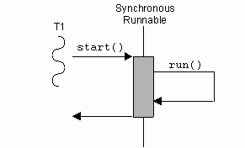
Msg m =port.prepare();
//fill m
Port.write()
BufferedPort
C1
Client1
Msg
Msg
C2
Client2
Msg
C1
Msg *m=port.read();
//read from m
Delay(100000)
Msg
Msg
Msg

Slide 56
Buffering policy
By default BufferedPort drops old messages (Oldest Package Drop)
You can change buffering policy to FIFO
BufferedPort<Bottle> p;
p.open("/in");
p.setStrict(true); // received messages are queued and never dropped
while (true) {
Bottle *b = p.read();
}
BufferedPort<Bottle> p;
p.open("/out");
while (true) {
Bottle& b = p.prepare();
// Generate data.
p.write(true); //wait for previous pending write to complete
}

Slide 57
Polling: when you do not want to wait for input data:
BufferedPort<Bottle> p;
...
Bottle *b = p.read(false);
if (b!=NULL) {
// data received in *b
}

Slide 58
Getting callbacks

Slide 59
Callbacks: useful if you want to be notified when data arrives
Easy to do with BufferedPorts
class DataPort : public BufferedPort<Bottle> {
virtual void onRead(Bottle& b) {
// process data in b
}
};
...
DataPort p;
p.useCallback(); // input should go to onRead() callback
p.open("/in");

Slide 60
Things are a bit more complicated with normal ports
class DataProcessor : public PortReader {
virtual bool read(ConnectionReader& connection) {
Bottle b;
bool ok = b.read(connection);
if (!ok) return false;
// process data in b
return true;
}
};
Port p;
p.open(..)
DataProcessor processor;
...
p.setReader(processor); // no need to call p.read() on port any more.

Slide 61
Replies in a callback
class DataProcessor : public PortReader {
virtual bool read(ConnectionReader& connection) {
Bottle in, out;
bool ok = in.read(connection);
if (!ok) return false;
... // process data "in", prepare "out"
ConnectionWriter *returnToSender = connection.getWriter();
if (returnToSender!=NULL) {
out.write(*returnToSender);
}
return true;
}
};
DataProcessor processor;
...
p.setReader(processor); // no need to call p.read() on port any more.

Slide 62
Bidirectional communication:
Getting replies

Slide 63
Client side
RpcClient p; // Create a port.
p.open("/out"); // Give it a name on the network.
while (true) {
Bottle in,out; // Make places to store things.
... // prepare command "out".
p.write(out,in); // send command, wait for reply.
... // process response "in".
}

Slide 64
Server side
RpcServer p; // Create a port.
p.open("/in"); // Give it a name on the network.
Bottle in, out; // Make places to store things.
while (true) {
p.read(in,true); // Read and warn that we'll be replying.
... // Do something with data, prepare reply
p.reply(out); // send reply.
}

Slide 65
YARP modules: RFModule

Slide 66
The RFModule class
You create a new module by deriving a new class from RFModule
class MyModule:public RFModule
{
public:
bool configure(ResourceFinder &rf)
{ //module configuration }
bool close()
{ //code executed at shutdown }
};
MyModule module;
ResourceFinder rf;
//configure resource finder
module.runModule(rf); //if configure returns true block here until the module closes
get parameters form RF and configure the module, return true on success, false otherwise
perform cleanup, close ports, delete memory
We skip this

Slide 67
What does a module do?
Nothing, really…

Slide 68
What does a module do?
Nothing, really…
Wait for termination signal (message or ctrl-c)
Can be configured to receive messages from a port/keyboard
Can perform periodic activities
It is a container for active objects (threads)

Slide 69
Attach callbacks
class MyModule::RFModule
{
Port handlerPort;
…
bool configure(ResourceFinder &rf)
{
// use rf to configure your module
handlerPort.open(“/myModule”);
attach(handlerPort);
…
}
…
}

Slide 70
Now add a respond message to catch data from terminal or/and the handler port
// Message handler. Just echo all received messages.
bool respond(const Bottle& command, Bottle& reply)
{
cout<<"Got something, echo is on"<<endl;
if (command.get(0).asString()=="quit")
return false;
else
reply=command;
return true;
}

Slide 71
Periodic Activities
In MyModule overload:
define period in seconds
double getPeriod()
{ return 1; }
bool updateModule()
{
// place here code that will be
// executed every “getPeriod” seconds
return true;
}
this function will be executed until termination

Slide 72
You can interrupt blocking reads on ports in the interrupt method:
bool interruptModule()
{
port1.interrupt();
port2.interrupt();
…
return true;
}

Slide 73
Threads

Slide 74
#include <yarp/os/Thread.h>
Class yarp::os::Thread
{
public:
virtual bool start();
virtual bool stop();
virtual bool threadInit();
virtual bool threadRelease();
virtual void run();
bool isStopping();
};
yarp::os::Thread is the class that provides thread support in YARP

Slide 75
#include <yarp/os/Thread.h>
Class MyThread: public Thread
{
public
void run()
{
while(!isStopping)
//thread body
}
};
You can implement your own thread by deriving a class from Thread
MyThread thread;
thread.start();
…
thread.stop();

Slide 76
Class MyThread: public Thread
{
public
bool threadInit()
{
//perform init tasks, memory allocation…
//return true if successful false otherwise
}
bool threadRelease()
{
//cleanup memory, release resources…
}
void run() {..}
}
Override threadInit() and threadRelease() to peform initialization and cleanup:

Slide 77
#include <yarp/os/RateThread.h>
Class yarp::os::RateThread
{
public:
RateThread(int period); //periodicity, ms
virtual bool start();
virtual bool stop();
virtual bool threadInit();
virtual bool threadRelease();
virtual void run();
};
Very often you want a thread to perform periodic activities (e.g. control loop)
RateThread supports periodic threads

Slide 78
#include <yarp/os/RateThread.h>
Class MyRateThread: public RateThread
{
public:
MyRateThread(int p=50):RateThread(p){}
void run()
{
…
}
};
MyRateThread rthread;
rthread.start();
…
rthread.stop();

Slide 79
Getting images

Slide 80
YARP defines an image class
ImageOf<…> is a template class that provides:
basic methods for image manipulation
support for remotization (i.e. images can travel across Ports/the network)
data format is opencv compatible
See: YARP image class online documentation

Slide 81
Images from cameras are streamed from two ports:
/icub/cam/right
/icub/cam/left
Easily read:
BufferedPort<ImageOf<PixelRgb> > imagePort;
imagePort.open("/imageProc/image/in");
ImageOf<PixelRgb> *image = imagePort.read(); //read an image:

Slide 82
BufferedPort<ImageOf<PixelRgb> > imagePort;
imagePort.open("/imageProc/image/in");
//read an image:
ImageOf<PixelRgb> *image = imagePort.read();
//do something with the image, for example cycle through all pixels
int ct=0
for (int x=0; x<image->width(); x++) {
for (int y=0; y<image->height(); y++) {
PixelRgb& pixel = image->pixel(x,y);
// very simple test for blueishness
// make sure blue level exceeds red and green by a certain factor
if (pixel.b>pixel.r*1.2+10 && pixel.b>pixel.g*1.2+10) {
xMean += x;
yMean += y;
ct++;
}
}
}
if (ct>0) {
xMean /= ct;
yMean /= ct;
}
printf("Best guess at blue target: %g %g\n", xMean, yMean);

Slide 83
Complete tutorial shows a program example that control the gaze of the robot to fixate a blue ball:
http://wiki.icub.org/iCub/dox/html/icub_basic_image_processing.html

Slide 84
Controlling the simulator
Set of ports for parts {head} {left_arm} {torso} etc…
Ports:
/icubSim/head/rpc:i
/icubSim/head/command:i
/iicubSim/head/state:o
icub@ubuntu-1404-64-vm:~$ yarp rpc /icubSim/head/rpc:i
>>get encs
Response: [is] encs (-0.000015 0.000004 -0.000004 -0.0 0.0 -0.0) [tsta] 1 1434026836.655992 [ok]
>>set pos 0 -10
Response: [ok]
>>set pos 1 20
Response: [ok]
>>set poss (0 0 0 0 0 0)
Response: [ok]
>>get encs
Response: [is] encs (-0.0005 0.000971 -0.000004 -0.0 0.0 -0.0) [tsta] 2 1434026858.553787 [ok]
>>

Slide 85
Working with configuration files
Configuration files in YARP can be located in two places:
Installed (usr/local/share), local user (home)
A file is first looked-up in local user data and then in installed directory
$ yarp-config context –list
**LOCAL USER DATA:
**SYSADMIN DATA:
**INSTALLED DATA:
* Directory : /usr/local/share/yarp/contexts
yarpdataplayer
yarpscope
* Directory : /usr/local/share/iCub/contexts
actionsRenderingEngine
cameraCalibration
simConfig
simFaceExpressions
..
Simulator files

Slide 86
Working with configuration files
You can modify files directly in the installed directories (bad practice);
You can copy and modify files in the local directory
These file will “shadow” the installed files
$ yarp-config context --import simConfig
Copied context simConfig from /usr/local/share/iCub/contexts/simConfig to /home/student/.local/share/yarp/contexts/simConfig .
Current locations for this context:
/home/student/.local/share/yarp/contexts/simConfig
/usr/local/share/iCub/contexts/simConfig
$ gedit ~/.local/share/yarp/contexts/simConfig/iCub_parts_activation.ini
To undo:
$ yarp-config context --remove simConfig

Slide 87
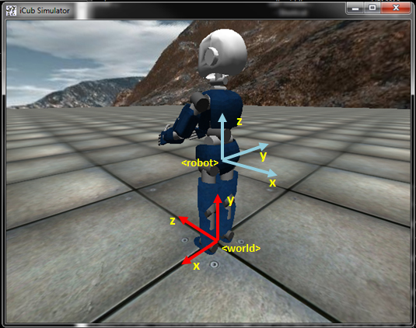
The World Interface
$ yarp rpc /icubSim/world
$ world mk box 0.03 0.03 0.03 0.3 0.2 1 1 0 0
$ world mk sph 0.04 0.0 1.0 0.5 1 0 1
$ world mk cyl 0.1 0.2 0.0 0.9 1.0 0 0 1
$ world get box 1
$ world set box 1 2 2 2
$ world get sph 1
$ world set sph 1 2 2 2
$ world get cyl 1
$ world set cyl 1 2 2 2
$ world del all
More stuff available online: http://eris.liralab.it/wiki/Simulator_README

Slide 88
Using motor control interfaces
remote_controlboard
YARP ports
server_controlboard
user code (remote)
Interface
Client Network Wrapper
Server Network
Wrapper
Interface
Robot/Simulator
network
enc is 5
ack
set pos 0 10
set vel 1 5
get enc 0
IPositionControl
IVelocityControl
IEncoders
/client/left_arm/rpc:i
/client/left_arm/state:i
/client/left_arm/command:o
/iCubSim/left_arm/rpc:i
/iCubSim/left_arm/state:i
/iCubSim/left_arm/command:o

Slide 89
http://wiki.icub.org/yarpdoc/classyarp_1_1dev_1_1IPositionControl.html
http://wiki.icub.org/yarpdoc/classyarp_1_1dev_1_1IVelocityControl.html

Slide 90
PolyDriver
User Code
PolyDriver
open(params)
Create device
view(interface1)
remote_control_board
view(interface2)
open()
close()
Use interface1
Dispatch requests to remote peer
YARP network
Use interface2
close()
Destroy device

Slide 91
Property options;
options.put("device", "remote_controlboard");
options.put("local", "/lookAt/motor/client");
options.put("remote", "/icubSim/head");
PolyDriver robot Head(options);
bool ret=robotHead.isValid();
IControlMode *mode;
IPositionControl *pos;
IVelocityControl *vel;
IEncoders *enc;
robotHead.view(pos);
robotHead.view(vel);
robotHead.view(enc);
robotHead.view(mode);

Slide 92
yarpview
iCub_SIM
/viewer/image:i
/icubSim/cam/left
yarpview
/targetViewer/image:i
object_detector
/objectDetector/image:i
look_at
/objectDetector/image:o
/lookAt/target:i
/objectDetector/target:o
Back to simulator
… head/rpc:i
… head/…

Slide 93
Look-at
x,y
v[4]=+/- k*x
v[3]=+/- k*y
v[0]=+/- k*q[3]
v[2]=+/- k*q[4]
q3
q5
q4
q2
q0

