Slide 1
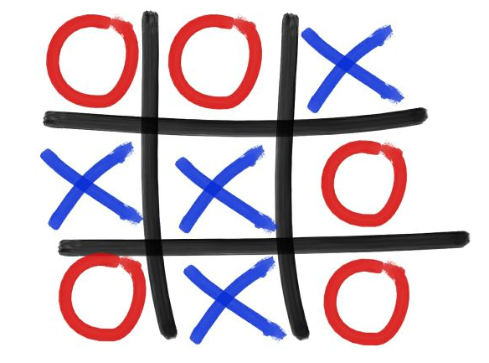
Team Orange
Playing Tic Tac Toe with iCub

Slide 2
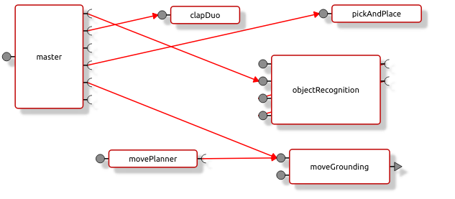
YARP Module

Slide 3
Thank you!
Baris Serhan
Chandrakant Bothe
David Busson
Egor Lakomkin
Gian Maria Marconi
Lukas Kaul
Marie Charbonneau
Massimiliano Iacono
Nuno Duarte
Pedro Vicente

