Slide 1
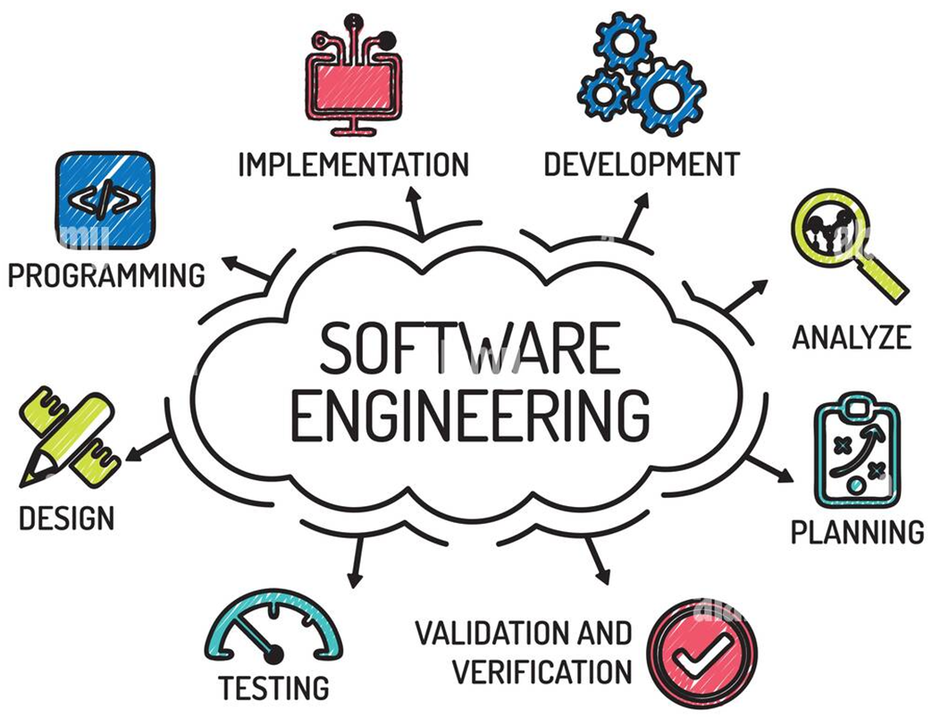
Software Engineering Fundamentals
Software Development Concepts, Phases and Practices
SoftUni Team
Technical Trainers
Software University
https://softuni.bg

Slide 2
Have a Question?
sli.do
#Dev-Ops
Notes:
2

Slide 3
Table of Contents
Software Development Lifecycle
Software Requirements
Software Architecture and Design
Software Construction
Software Quality Assurance
Deployment and Maintenance

Slide 4

Software Development Lifecycle (SDLC)
SDLC
Requirements → Design → Code → Test → Deploy

Slide 5
Coding != Software Engineering
Inexperienced developers consider "coding == development"
Software engineering is not just coding!
In most projects coding is only 20%-30% of the project activities!
The software development process involves many more
The important decisions about the software are taken during the requirements analysis and software design phases
QA, testing, integration, reviews, deployment, documentation, and management are often disparaged
Software engineering is about building software professionally, through a manageable and predictable process

Slide 6
Software Engineering
Software engineering is an engineering discipline aimed to provide knowledge, processes, practices, and tools for
Defining software requirements
Creating software design
Software construction
Software testing and QA
Software deployment
Software maintenance tasks
Managing the development process

Slide 7
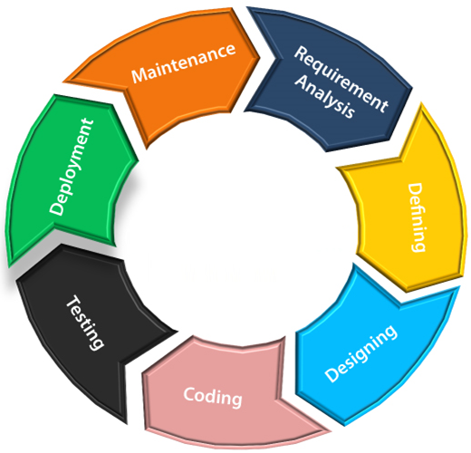
Software Development Lifecycle (SDLC)
The Software Development Lifecycle (SDLC)
Analyzing and defining software requirements
Creating software architecture and design
Software construction
Software testing and QA
Software deployment
Software maintenance
Methodologies manage the development process
SDLC

Slide 8

Software Requirements Analysis
Requirements, User Stories, Prototypes, Specification

Slide 9
Software Requirements
Software requirements describe the functionality of the software
Answer the question "what shall it do?", not "how shall it do it?"
Define constraints on the system
Two kinds of requirements
Functional requirements
Product functions, enabling users to achieve their tasks
Non-functional requirements
Reliability, efficiency, usability, maintainability, etc.

Slide 10
Requirements Analysis
Requirements analysis starts from an idea about the system
Customers often have a broad idea but may lack specifics
Requirements come roughly → adjusted during the development
Requirements change constantly!
Analysis produces some requirements documentation
User stories / UI prototype / Software Requirements Specification (SRS) / informal system description
Should be clear, concise and unambiguous

Slide 11
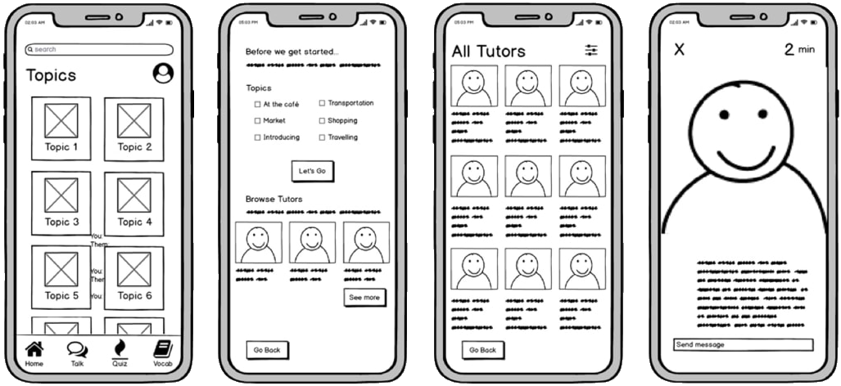
UI Prototype – Example

Slide 12
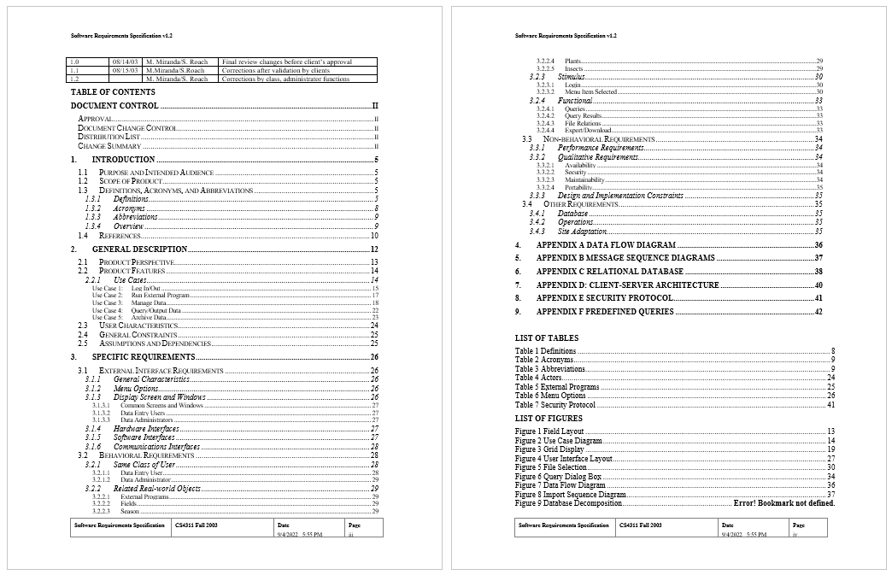
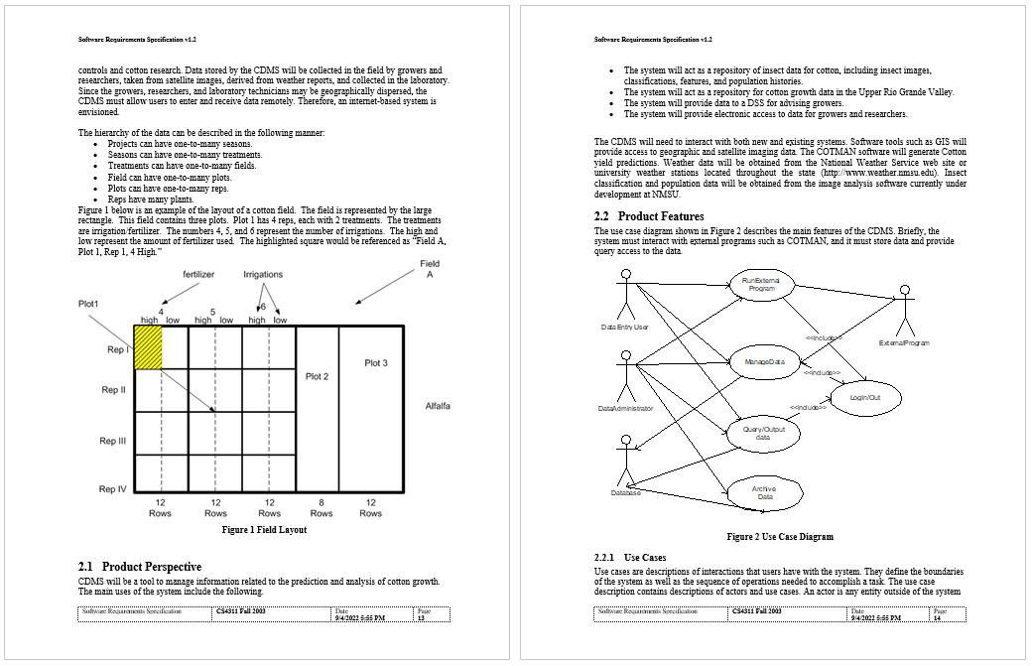
SRS – Example

Slide 13
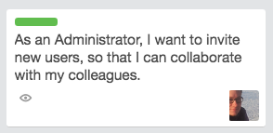
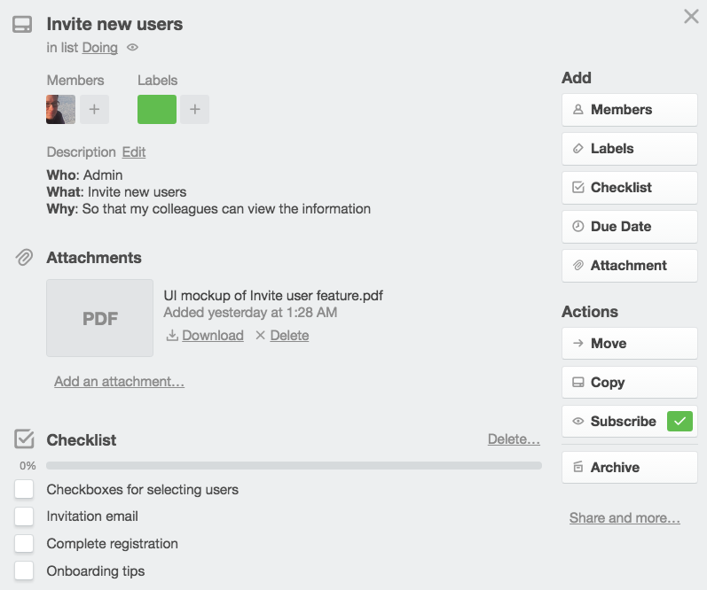
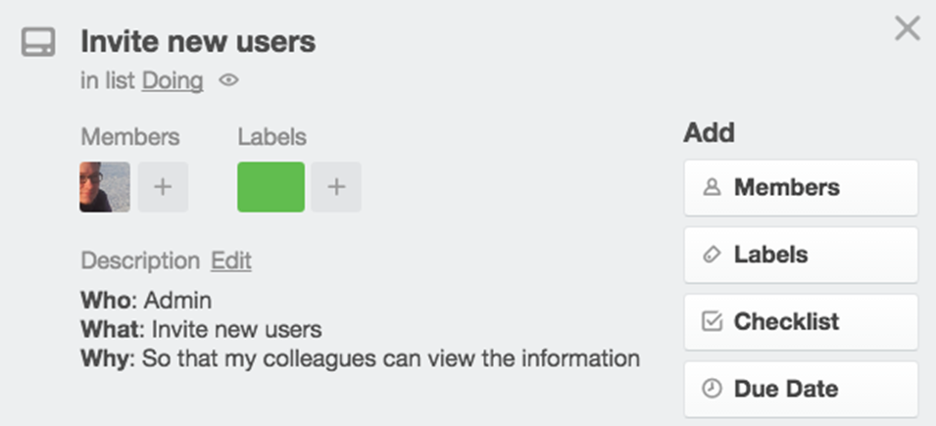
User Story – Example
A story starts from a simple idea (1-2 sentences)
As the team discusses the story, they add more details

Slide 14
Software Requirements Change Over Time
It is always hard to describe and document the requirements in a comprehensive way
Good requirements save time and money, but are hard to reach
Requirements always change during the project!
Good requirements reduce the changes
UI prototypes significantly reduce changes
Agile methodologies are flexible to changes
Use user story tracking tools to handle changing requirements

Slide 15

Live Demo
User Stories, UI Prototypes and SRS

Slide 16

Software Architecture and Design

Slide 17
Software Architecture and Software Design
Software architecture and design
Technical descriptions (e.g., diagrams) about how the system implements the requirements
The software (system) architecture describes the subsystems, their responsibilities and interactions
High-level infrastructure of a software system
Good software architecture == easier maintenance and scalability

Slide 18
Software Architecture and Software Design
The software design describes the system design at a lower level
Functions of individual modules, classes, etc.
Design patterns in software design
Proven solutions to recurring problems
Fundamental in software engineering

Slide 19
System Architecture
The system architecture is a conceptual model, describing
How the system will be decomposed into modules (subsystems)
Responsibilities of each module
Interaction between the modules
Platforms and technologies, communication protocols
Can be formal or informal (typically)
Consists mostly of diagrams / blueprints

Slide 20
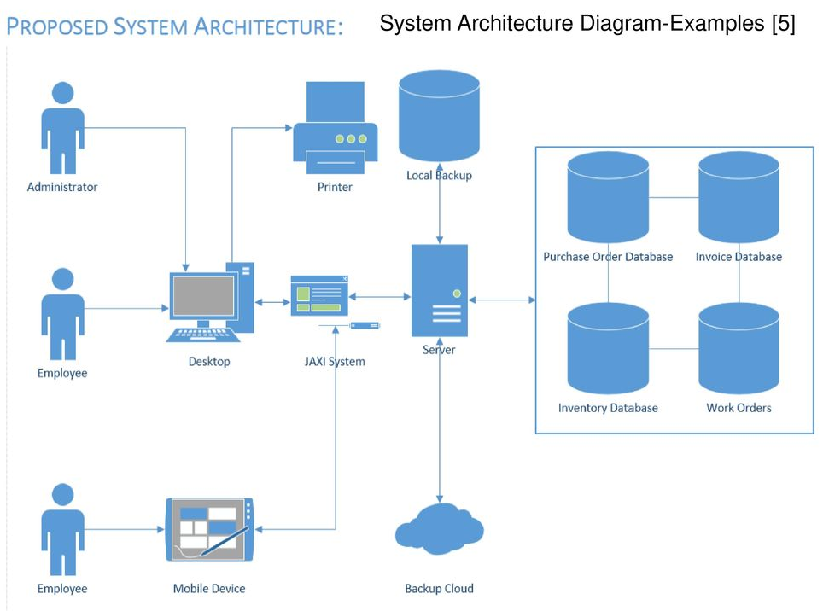
System Architecture Diagram

Slide 21
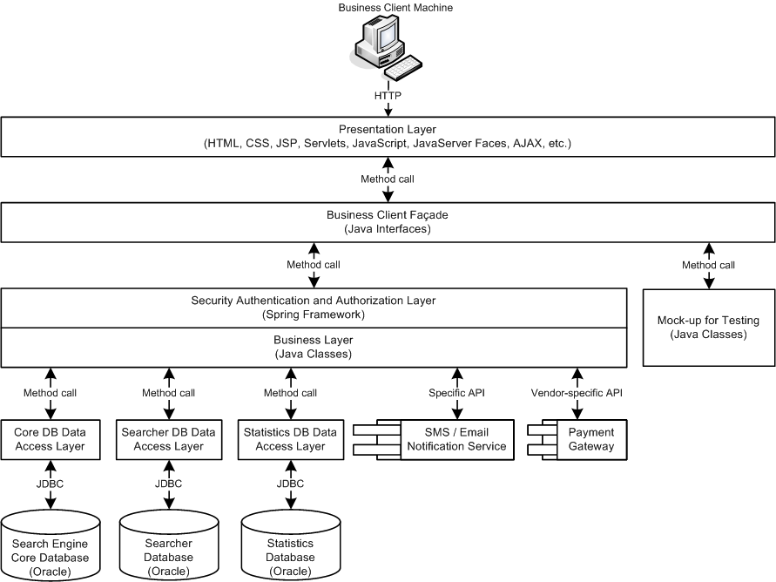
Software Architecture Diagram

Slide 22
Software Design
Detailed design
Describes the internal module structure
Subcomponents, interfaces, process design, data design
Object-oriented design
Describes the classes, their responsibilities, relationships, dependencies, and interactions (usually in UML)
Internal class design
Methods, responsibilities, algorithms and interactions

Slide 23
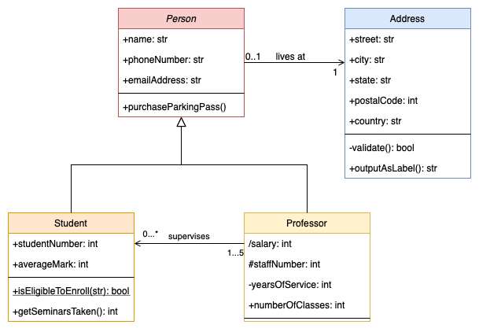
UML Class Diagram
UML Class diagrams
UML == Unified Modeling Language
Visualize classes and their relationships

Slide 24
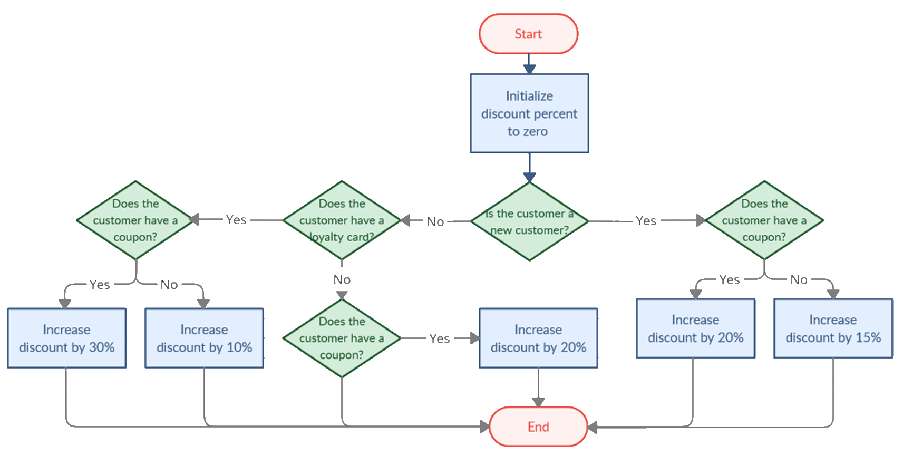
Flowchart Diagram
Flowchart diagrams
Visualize a decision logic / calculation / algorithm

Slide 25
Software Design Document (SDD)
The Software Design Document (SDD)
Formal description of the architecture and design of the system
Essential for software development process
Makes communication between collaborators easier
Often used for future references
Ensures the entire team has a clear understanding of the system's design
Beneficial when onboarding new team members

Slide 26
Software Design Document (SDD)
What's typically inside?
Architectural design
Modules and interactions (diagram)
For each module
Process design (diagrams)
Data design (E/R diagram)
Object-oriented design (class diagram)

Slide 27
Live Demo
Software Design Document

Slide 28

Software Construction
Implementation, Unit Testing, Debugging, Integration

Slide 29
Software Construction
During the construction phase developers build the software
Sometimes it is called "implementation phase"
Software construction includes
Method design
Writing the source code
Testing and debugging
Writing the unit tests
Code reviews and inspections
Integration of classes / modules

Slide 30
Writing the Code
Coding
The process of writing the programming code (the source code), running and debugging it
The code adheres to established architecture and design
Developers perform method design as part of coding
The source code is the output of the software construction process
Written by developers
Can include tests (unit, integration, others)

Slide 31
Testing the Code
Testing
The process of checking whether the developed software conforms to the requirements
Aims to identify defects (bugs)
System testing is done by the QA engineers
Unit / integration testing is done by developers
Developers test the code after writing it
Run it at least once to see the results
Unit testing / integration testing work better
Automated tests are repeatable, executed many times

Slide 32
Debugging
Debugging
Finding the source of an already identified bug and fixing it
Performed by developers (constantly)
Steps in debugging
Find the defect in the code
Identify the source of the problem
Identify the exact place in the code causing it
Fix the defect (modify the source code)
Test to check if the fix is working correctly
Write a unit test for the defect to avoid it reoccurring further

Slide 33
Software Verification Activities
Inspections: requirements / design / code inspections
Aim to find flaws early, e.g., in the requirements
Performed by an experienced dev / QA engineer
Code reviews: developer reviews the code
Find flaws / bugs / improve quality
Static analysis: software tools scan the source code for problems
Security, code quality, potential bugs, etc.
Dynamic analysis: tools asses runtime code to find flaws
Memory issues, bad performance, arithmetic overflows, etc.

Slide 34
Code Reviews
Code reviews
Assessments of the source code and other assets
Developer A reviews the code written by Developer B
Goals
Identify bugs
Increase code quality
Apply best practices
Help developers learn the source code and from other developers

Slide 35
Code Reviews
Code reviews can be
Formal or informal
Live or offline
Code review tools are used to perform code reviews online
Example: GitHub Pull Requests
Code under review gets improvement suggestions and comments
Code under review can finally be rejected or approved

Slide 36
Software Integration
Software integration
Combining multiple software systems to work together seamlessly and efficiently
Enabling data exchange between them
Enhances overall productivity
Reduces redundancy
Improves efficiency
Compile, run and deploy separate modules as a single system
Test to identify defects (integration testing)

Slide 37
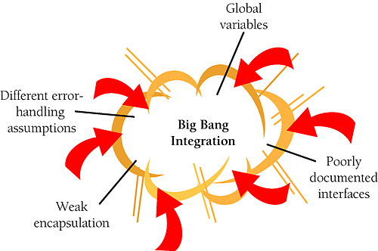
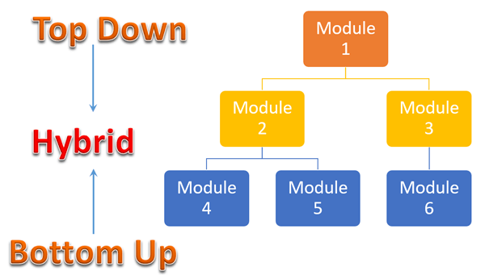
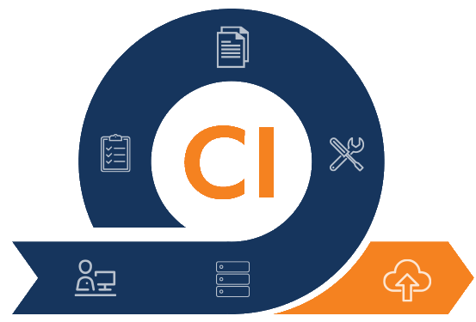
Software Integration Strategies
Big bang
All or almost all modules are integrated together at the same time
Top-down
Integration of the higher-level layers first
Bottom-up
Lower layers first
Continuous integration (CI)
Integrate after each commit in the source control system

Slide 38
Continuous Integration (CI)
Continuous integration (CI)
Integrating the code from different developers frequently (several times a day)
Automated building and testing the software
Typically, at Git push in a certain branch
Finding integration problems and bugs early
Continuously maintain software quality
CI is implemented by a CI system like Jenkins, GitHub Actions, TeamCity, Azure Pipelines
Notes:
Continuous integration (CI) is the practice of frequent integration,
together with automated building and automated testing of the software
after each push in the master branch.
This ensures that the new code integrates correctly with the existing code:
compiles without errors and passes all existing automated tests.
Continuous integration (CI), together with automated testing
allows developers to find the bugs early
and to continuously maintain the quality of the software.

Slide 39
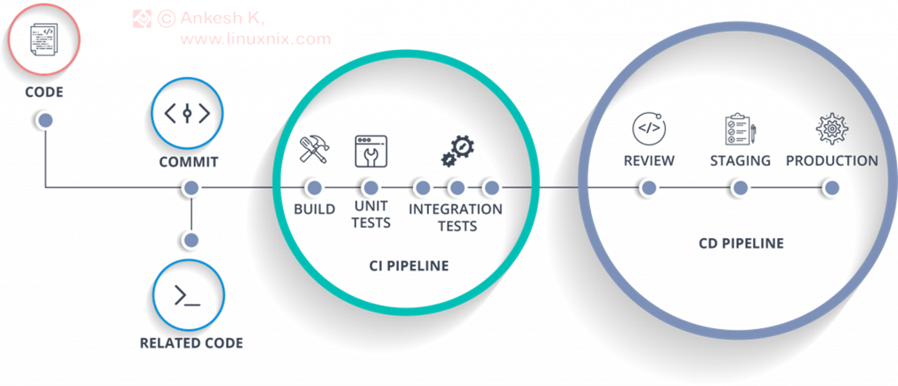
CI/CD Pipeline
CI/CD pipeline
Continuously integrate and release new features
Continuous integration (CI)
Write code, test and integrate it in the product
Continuous delivery (CD)
Continuously release new features
Often QA engineers maintain and monitor the CI/CD pipeline

Slide 40

Software Quality Assurance (QA)
Software Quality, Testing, QA Process

Slide 41
Software Quality Assurance (QA)
What is "software quality assurance" (SQA)?
Software quality assurance aims to
Minimize software defects
Ensure it behaves as expected
Defects are reported and tracked through a bug tracking system
Performed by the Quality Assurance engineers (QA engineers)
Continuous integration and delivery (CI/CD pipeline)
Notes:
Software quality assurance (QA) aims to assure that:
the software works correctly,
is free of bugs (defects),
and behaves as intended.
Software QA is an engineering discipline,
which applies principles, practices, processes and tools to ensure the software quality.
Professionals who implement and maintain QA processes are called "QA engineers".
QA engineering aims to
find the defects and problems in the software development,
earlier in the software development process,
before they reach the end-users.
Software is being tested and inspected
and the development process is being monitored and tracked
in order to find issues (which are also called bugs, defects or problems),
and to report and track them until they get fixed.
Defects and other issues are reported and tracked through
a bug tracking system (also called issue tracker).
In the bug tracking system issues are first logged,
then developers work and fix them
and finally the QA engineers verify and close them.
The software QA activities (such as software testing, bug reporting and tracking and test automation)
are performed by the Quality Assurance engineers (QA engineers).
QA engineers are technical members of the development team,
who are responsible for the software quality.
QA engineers plan, design, automate and execute tests and review the test results.
When an issue is found, it is reported in the issue tracking system and is tracked until resolved.
QA engineers, together with developers implement
the process of automated testing, continuous integration and continuous delivery.
Most of the QA work is software testing.
Software testing is the process of examining the software with set of tests to ensure the it works correctly and is bug free.
Test techniques include the process of executing a program, service, application or system with the intent of finding software bugs (errors or other defects) and verifying that the software product is fit for use.
Testing can be performed manually by hand or can be automated (programmed as script).
Testing can cover a single function or component, the integration between several components or the entire system.
Testing can be black-box (testing without looking inside the code) or white-box (read the code and test suspicious pieces of it).
Testing can be functional (test certain use-case) or non-functional (test the performance, compatibility or security).
Manual testing is "testing by hand".
It consists mainly of "clicking on the user interface, filling the forms and checking the results".
Manual testing is preferred for testing quality aspects, which cannot be easily automated, such as:
usability testing (checking whether the user interface is user-friendly and easy to use),
compatibility testing (checking whether the user interface behaves correctly on different hardware devices, operating systems, Web browsers and environments),
system testing and acceptance testing (testing whether the entire system works as expected).
Manual testing is done by manual QA engineers, which typically follow preliminary prepared test scenarios.
Automated testing (QA automation) is widely used in modern software development.
Automated tests are programs or scripts, which test certain functionality or quality aspect of the software.
Once written, the automated tests are executed continuously many times,
and they ensure that the tested component or subsystem works in the same way over time,
regardless of code changes during development.
Re-executing the same tests to confirm, that the code changes do not affect already tested software,
is called "regression testing".
Automated tests are either written by developers or by QA engineers.
Automated tests usually test the functionality of the system (whether it behaves as expected).
Automated tests can cover a single function or component (unit tests)
or the interaction between components (integration tests).
Continuous integration and continuous delivery (the so-called CI/CD pipeline)
is a practice in modern software development,
where the code is integrated, tested and deployed continuously
and automatically after each significant change in the code.
Continuous integration (CI), together with automated testing
allows developers to find the bugs early
and to continuously maintain the quality of the software.
Continuous delivery (CD) is a practice in modern software development,
which allows to integrate, deploy and release new features continuously
in short release cycles with a lot of automation.
The continuous integration and continuous delivery is often used together in a CI/CD pipeline,
which I will explain and demonstrate later.

Slide 42
Quality Assurance (QA) Engineers
QA engineers ensure the software quality
Plan and execute testing activities
Test the software, its functionality, UX, etc.
Create test plans, design test cases, execute tests
Develop and execute test automation scripts
Report and track bugs and their lifecycle
Perform regression testing when bugs are resolved
Track the development process and its quality
Review the requirements, design and code
Build and monitor CI/CD pipeline, track QA metrics
42
Notes:
Quality assurance (or QA) is an important role in software engineering.
It is played mainly by QA engineers and partially by software developers.
QA engineers ensure the software quality.
This involves software testing, bug tracking, and tracking of the development process.
QA engineers plan and execute testing activities.
This involves preparation, execution and automation of different types of tests,
reviewing the test execution results and logging the bugs in the bug tracking system.
QA engineers test the software, its functionality, UX and usability, performance, etc.
QAs perform functional tests (checking whether the functionality works as expected),
UX and usability tests (checking whether the user interface is easy to use),
non-functional tests (testing performance, security and compatibility) and others.
QA engineers create test plans, design test cases and execute tests.
Test plans describe what and how to test, test scenarios, schedule and other organizational activities around testing.
Test scenarios describe certain use case or functionality to be tested.
A test scenario is covered by multiple test cases (for example, with valid input and invalid input).
QA engineers execute the tests and evaluate the execution results, and report the issues found.
QA engineers develop and execute test automation scripts.
Test automation is an important activity in modern software testing.
Test automation consists of writing a program or script that executes set of test cases.
Test automation uses testing frameworks and tools
that simplify the implementation of different types of tests,
automate their execution and reporting of the results.
Test automation QA engineers are professionals who have both developer and QA skills.
They work closely with the entire development team to automate the testing activities or pieces of them
and build and maintain continuous integration and continuous testing environment.
QA engineers report and track bugs and their lifecycle.
Once a bug is found, the QA engineers report it in the bug tracking system,
together with a detailed description and steps to reproduce it.
The bug stays in the bug tracker and is accessed by developers, QAs and team management.
Its status changes over time, depending on the efforts and activities to fix the bug.
The bug is initially "new", then is "assigned" to someone, then is "fixed" and finally is "closed".
QA engineers perform regression testing when bugs are resolved.
This means to re-check features and functionalities that worked in the past,
whether they still work correctly after another bug is resolved.
This reduces the chance of introducing new bugs with the fix of some existing bug.
QA engineers track the development process and its quality.
This is quite complex activity.
The development process consists of philosophy, practices, processes and tools for developing software.
QAs track whether the developers follow the established processes (like weekly sprint planning),
the established practices (like using correctly the bug tracker and writing unit tests),
and whether the development follows the established workflow.
QA engineers review the requirements, design and code during the development.
QAs review the requirements to ensure they are well defined and in sync with the business case.
QAs perform design and code inspections
to check whether the established conventions, rules and practices are followed.
QAs review the UI design prototypes to ensure the UX and usability of the planned features.
QA engineers build and monitor continuous integration and continuous delivery (CI/CD) pipeline.
Continuous integration (CI) is the process of automated building and testing of the software
after each commit in the master branch.
This ensures that the new code integrates correctly with the existing code:
compiles without errors and passes all existing automated tests.
QAs are involved to track the quality metrics during the development,
such as test coverage (or code coverage),
defect rates, mean time to detect and mean time to repair defects,
burn down chart, and many others.

Slide 43
Bugs and Bug Tracking
Defects (bugs) in software are problems in the source code / requirements / design, which cause incorrect behavior
Once found (typically by the QA), bugs are tracked in a bug trackers / issue tracking software
Examples: Jira, GitHub Issues
Bugs have a lifecycle
new → assigned / rejected → fixed → closed / reopened

Slide 44
Test Plan, Test Scenarios and Test Cases
Test plan
A guiding document outlining the testing approach, environments, schedule, and acceptance criteria to ensure software meets quality requirements
Test Scenarios
High-level descriptions/stories representing the functionality or feature to be tested in the software
Test Cases
Detailed, step-by-step instructions designed to validate specific conditions or functions of the software based on the associated test scenarios

Slide 45
Manual and Automation Testing
Most of the QA work is software testing
Manual testing
Fill forms
Click
Check the results
Automated testing
QA automation
Test cases as code

Slide 46

Deployment and Maintenance
Deployment Environments, Maintenance Process

Slide 47
Software Deployment
What is software deployment?
Getting software out of the hands of the developers into the hands of the users
Compile, package, install, configure and run the software into the customer environment / ship the app to the customer
Web app → deploy the new version to the Web servers
Mobile app → publish a new version to app stores
Desktop app → release a new version installer to the customers
Continuous deployment (CD)
Automatically deploy the software after each commit → ensure the changes are deployable

Slide 48
Deployment Environments
Dev environment
Used by developers
No client data
Test environment
Used by QA engineers
No client data
Staging environment
Used by QA engineers and/or clients for UAT
Limited production data
Production environment
Used by clients
Full Production data

Slide 49
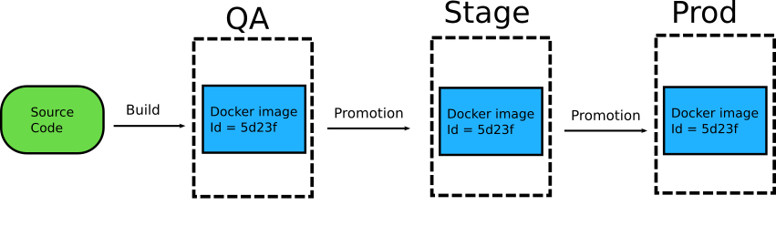
Container-Based Deployment Environments
Containers and clouds simplify creating, configuring and running the required environments

Slide 50
Software Maintenance
What is software maintenance?
The process of changing a system after it has been released
Reasons for maintenance changes
Fixing bugs and patching security vulnerabilities
Changing business needs: new features and requirements
Adapting to new environments: hardware / platforms / software
Typical change process
Analysis → requirements → issue backlog → prioritization
For each fix: design / re-engineering → code → QA → deploy

Slide 51
Software Documentation
Documentation makes software maintainable
Allow new people to join the development team over the time
Best practices in software documentation
Visualize the development process (use a project board)
Written requirements (in a requirements tracking system)
Design and architecture documents (e.g., project Wiki)
Code documentation (comments and built-in docs in the code)
Test management system and CI system (with a dashboard)
User documentation, installation guide, quick start guide, etc.

Slide 52

Summary
…
…
…
Software engineering provides knowledge, processes, practices and tools for all the phases in software development lifecycle (SDLC)
Software requirements describe the functionalities of the software
Software design and architecture describe system structure – modules and interactions
Software constructions involves coding, debugging, unit testing, code reviews and integration (including CI)
The QA engineering process ensures the software works as intended, mostly through testing (manual and automated)
Software deployment ships the software to customers and goes through different deployment environments

Slide 53










Questions?

Slide 54









SoftUni Diamond Partners

Slide 55
Trainings @ Software University (SoftUni)
Notes:
55

Slide 56

License
This course (slides, examples, demos, exercises, homework, documents, videos and other assets) is copyrighted content
Unauthorized copy, reproduction or use is illegal
© SoftUni – https://about.softuni.bg/
© Software University – https://softuni.bg
Notes:
56

