Slide 1


Major Project External Presentation
Reducing Hallucinations in Legal AI: Retrieval-Augmented Generation with a Gated Verification Chain
Team No:
Student Name : Aleti Vivek Reddy Guide Name : S. Ravi Kumar
HT.No : 23EG106C04 Designation : Assistant Professor
Student Name : N. Akshith Sai
HT.No : 23EG106C03
Student Name : K. Uday
HT.No : 23EG106C30

Slide 2
Contents
S.No | Title | Slide No
1 | Abstract | 3
2 | Introduction | 4
3 | Literature Survey | 5
4 | Objectives | 7
5 | Problem Statement | 8
6 | Methodology | 9
7 | Implementation | 14
8 | Results | 16
9 | Discussion | 19
10 | Conclusion and Future Work | 20
11 | Reference | 21

Slide 3
Abstract
• Large language models answer legal questions fluently, but they sometimes cite provisions that do not exist, or state what a clause does not say — in legal work an unsupported answer is worse than no answer.
• Retrieval-augmented generation (RAG) grounds answers in retrieved passages, but nothing checks the answer the model finally writes.
• Legal AI: a question-answering system for statutes and contracts in which every answer is checked against its sources before the user sees it.
– Summary-augmented chunking (SAC) for statutes, paragraph chunking otherwise; embedded LanceDB hybrid index (dense + BM25), RRF fusion, cross-encoder reranking.
– Citation-forced generation: every claim must end with the id of the chunk that supports it.
– Six-layer verification chain (V1–V6) → Verification Confidence Score (VCS); the answer is shown only if VCS ≥ 0.60, with a proof of every claim.
• Results: SAC raised retrieval F1 from 0.333 to 0.417; the full chain showed 0 of 28 corrupted claims (without the gate: all 28); in the end-to-end test no wrong answer was ever shown as verified.
• Main weakness: false abstention — the system refuses some answerable questions; calibrating the gate is the most important next step.
02/05/2026
Reducing Hallucinations in Legal AI
3

Slide 4
Introduction
• Legal answers must be traceable: whether a tenant can be evicted or how long confidentiality lasts depends on the exact words of a statute or contract.
• LLMs (GPT, Gemini, Claude) answer legal questions fluently — but fluency is not accuracy: they hallucinate.
– Mata v. Avianca (2023): two lawyers sanctioned for filing court decisions a chatbot invented [1].
– Even commercial legal research tools built on retrieval still hallucinate at a noticeable rate [2].
• RAG [3] is the standard remedy, but it does not guarantee grounding: the model can misread a passage, combine passages wrongly, or cite a passage that does not support what it wrote.
• Our goal: not another legal chatbot, but a system where verification is a required step — an answer reaches the user only after every claim is checked against the passage it cites, and the system refuses instead of guessing.
02/05/2026
Reducing Hallucinations in Legal AI
4

Slide 5
Literature Survey
• RAG — Lewis et al. [3]: retrieve passages, then generate; no check on the final answer.
• Chunking for legal text — Reuter et al. [4]: summary-augmented chunking (SAC) keeps document context, but uses an LLM-written summary per document.
• Retrieval — Sentence-BERT embeddings [12]; BM25 keyword search; reciprocal rank fusion [13]; BGE cross-encoder reranker [14].
• Hallucination detection:
– NLI entailment: roberta-large-mnli [15] trained on MultiNLI [16].
– FActScore [17]: split answers into atomic facts, check each one.
– SelfCheckGPT [18]: sample several answers; unstable claims are suspicious.
• Legal systems and benchmarks — Figueiredo et al. [5] (citation audit), Maghakian et al. [6] (embedding-free RAG), RAGTruth [7], LegalBench-RAG [8]; datasets ContractNLI [9], CUAD [10], MAUD [11].
02/05/2026
Reducing Hallucinations in Legal AI
5

Slide 6
Literature Survey – Research Gap
• Detection and prevention remain separate: detectors report scores offline, deployed systems show answers unchecked.
• Gaps this project addresses:
– A gate that combines several complementary checks into one score and acts on it — not detectors that only report.
– A per-claim proof: the exact passage, the verdict of every check, the claim's contribution to the score.
– Structure-aware chunking for statutes without a model call per document, with a fallback for unstructured contracts.
– Honest refusal when evidence is insufficient — general-concept answers allowed, but clearly labelled as unverified.
– Measured evidence of what each part contributes (ablations, real-document tests), not one headline accuracy figure.
02/05/2026
Reducing Hallucinations in Legal AI
6

Slide 7
Objectives
• Build an ingestion pipeline for PDF and text documents: detect statute structure, apply SAC where possible and paragraph chunking otherwise, reject duplicate uploads.
• Implement hybrid retrieval (dense vectors + BM25) with rank fusion and cross-encoder reranking over a single embedded index.
• Implement citation-forced generation that works with several LLM providers (Groq, Gemini, OpenAI, Anthropic).
• Design and implement the V1–V6 verification chain, the Verification Confidence Score and the abstention gate.
• Provide a web interface in which every answer carries a verdict, a score and a proof.
• Evaluate with ablation experiments and an end-to-end test on real documents — and report the results honestly, including failures.
02/05/2026
Reducing Hallucinations in Legal AI
7

Slide 8
Problem Statement
• Existing legal RAG systems ground answers in retrieved documents, but:
– Unverified answers: the model's answer is shown as-is, even when a claim is unsupported or cites a passage that was never retrieved.
– Loss of legal context in chunking: fixed-size chunks cut a clause away from the section that gives it meaning.
– No evidence for the reader: users are not shown which passage supports which sentence.
– Guessing instead of refusing: when the documents do not contain an answer, systems answer anyway.
• Need: a system that (1) retrieves the right passages with structure-aware chunking and hybrid search, (2) forces the model to cite them, (3) checks every claim through complementary verification layers combined into one confidence score, and (4) shows the answer only when the score is high enough — with an inspectable proof — and refuses otherwise.
02/05/2026
Reducing Hallucinations in Legal AI
8

Slide 9
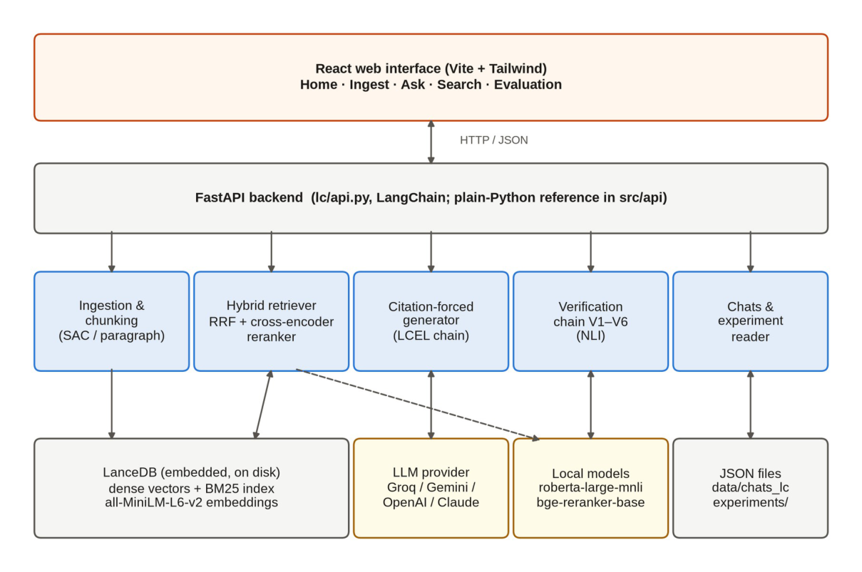
Methodology – System Architecture
• React web interface → FastAPI backend → pipeline modules → embedded LanceDB index; LLM via provider adapter; embedding, reranking and NLI models run locally.
02/05/2026
Reducing Hallucinations in Legal AI
9

Slide 10
Methodology – Ingestion and Adaptive Chunking
• Upload → SHA-256 fingerprint: duplicates are refused, so the index never holds a document twice.
• Text extracted with pypdf (PDF) or read directly; whitespace normalised without disturbing headings.
• Statutes (Act / Chapter / Section / Clause detected) → Summary-Augmented Chunking:
– One chunk per section body and per clause; each chunk carries an extractive summary (section heading + first sentence) embedded with its text.
– “Within thirty days” is found together with the rule it belongs to — no LLM call at ingestion (unlike original SAC [4]).
• Contracts (no structure) → paragraph chunking: split at blank lines, long paragraphs packed into ≤ 700-character windows.
• Chunk ids double as citation tokens: urban_tenancy_act_2019::s7:a (section 7, clause a) · NDA_7::p21 (paragraph 21).
02/05/2026
Reducing Hallucinations in Legal AI
10

Slide 11
Methodology – Hybrid Retrieval and Reranking
• Chunks embedded with all-MiniLM-L6-v2 (384-d, normalised); stored in LanceDB — dense vectors + BM25 full-text index in one on-disk table, no database server.
• A question is searched in both indexes; rankings merged with Reciprocal Rank Fusion:
– score(d) = Σ 1 / (60 + rankᵢ(d)) — a chunk ranked well in both lists wins.
• Fused candidates rescored by the BAAI/bge-reranker-base cross-encoder (question + passage read together); top k = 12 kept for the prompt.
• Candidate pool deliberately large (≥ 100): the reranker can only promote what the first stage returned — a too-small pool caused silent failures on real contracts.
• Cost measured honestly: reranking adds 6.7–12.8 s per question on a laptop CPU.
02/05/2026
Reducing Hallucinations in Legal AI
11

Slide 12
Methodology – Citation-Forced Generation
• Retrieved chunks placed in the prompt, each labelled with its id. Strict rules:
– Use ONLY the supplied passages — never prior knowledge.
– One claim per line; every line ends with the id(s) of the chunk(s) that support it: [urban_tenancy_act_2019::s4:b].
– If the passages cannot answer: reply with a line starting INSUFFICIENT_CONTEXT.
• A deterministic parser maps every claim back to its cited evidence — no guessing about which sentence rests on which source.
• Provider adapter: Groq, Gemini, OpenAI or Claude selected by one environment variable; the web interface uses openai/gpt-oss-120b served by Groq.
• General-concept questions (“What is an indemnity clause?”) declined by the gate are answered from model knowledge — labelled “General knowledge”, no citations, no score.
02/05/2026
Reducing Hallucinations in Legal AI
12

Slide 13
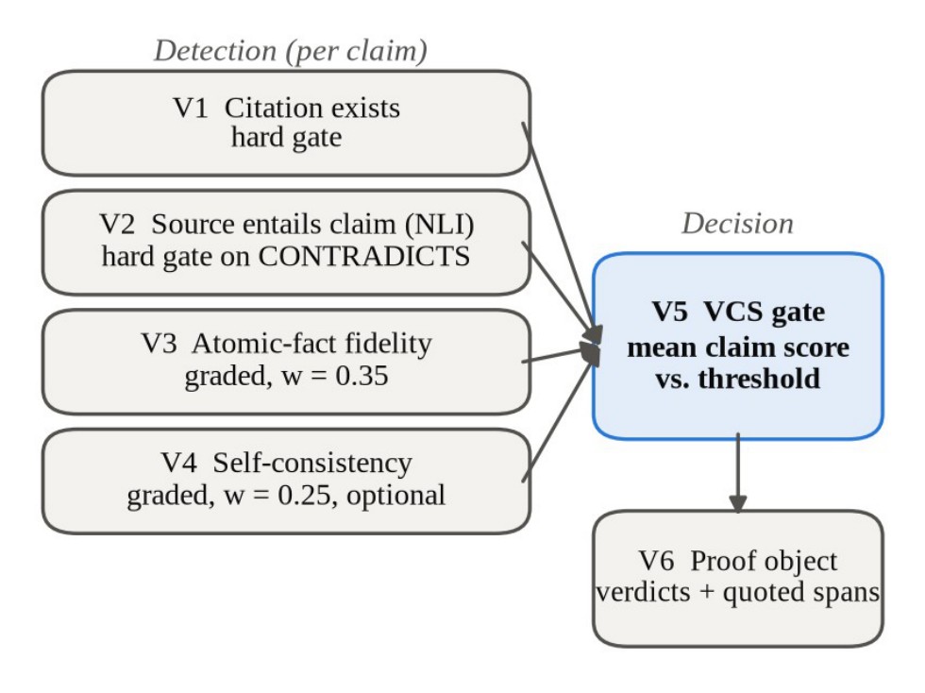
Methodology – Verification Chain (V1–V6)
• V1 Citation existence — cited id must be a retrieved chunk (hard gate).
• V2 Entailment — roberta-large-mnli: passage ⊨ claim? CONTRADICTS = hard gate.
• V3 Atomic fidelity — claim split into atomic facts; fraction entailed.
• V4 Self-consistency (optional) — regenerate; unstable claims suspicious.
• V5 Score and gate — s = (0.40e + 0.35f + 0.25c) / Σ weights run;
– VCS = mean claim score; show only if VCS ≥ 0.60, else abstain.
• V6 Proof object — quoted span + every verdict, per claim, shown to the user.
02/05/2026
Reducing Hallucinations in Legal AI
13

Slide 14
Implementation – Technologies and Modules
• Python 3.11 · FastAPI + Uvicorn · LangChain (LCEL pipeline; loaders, splitters, LanceDB vector store, ensemble retriever) · React 18 + Vite + Tailwind CSS.
• Models: all-MiniLM-L6-v2 (embeddings) · BAAI/bge-reranker-base (reranking) · roberta-large-mnli (entailment) — all local, CPU-only; LLM via API.
• Modular pipeline — ingestion, chunking, embedding/index, retrieval, generation, verification, API, chat store, evaluation, web UI; stages communicate through plain data.
• Two implementations: plain Python (src/) and LangChain (lc/, default) — chunking and verification remain our own code in both.
• Testing: 263 + 113 automated tests (stand-in models — no downloads or keys needed); Playwright drives the real browser for the end-to-end test.
• Phased build (phases 0–8), each with definition of done; every change committed with tests passing.
02/05/2026
Reducing Hallucinations in Legal AI
14

Slide 15
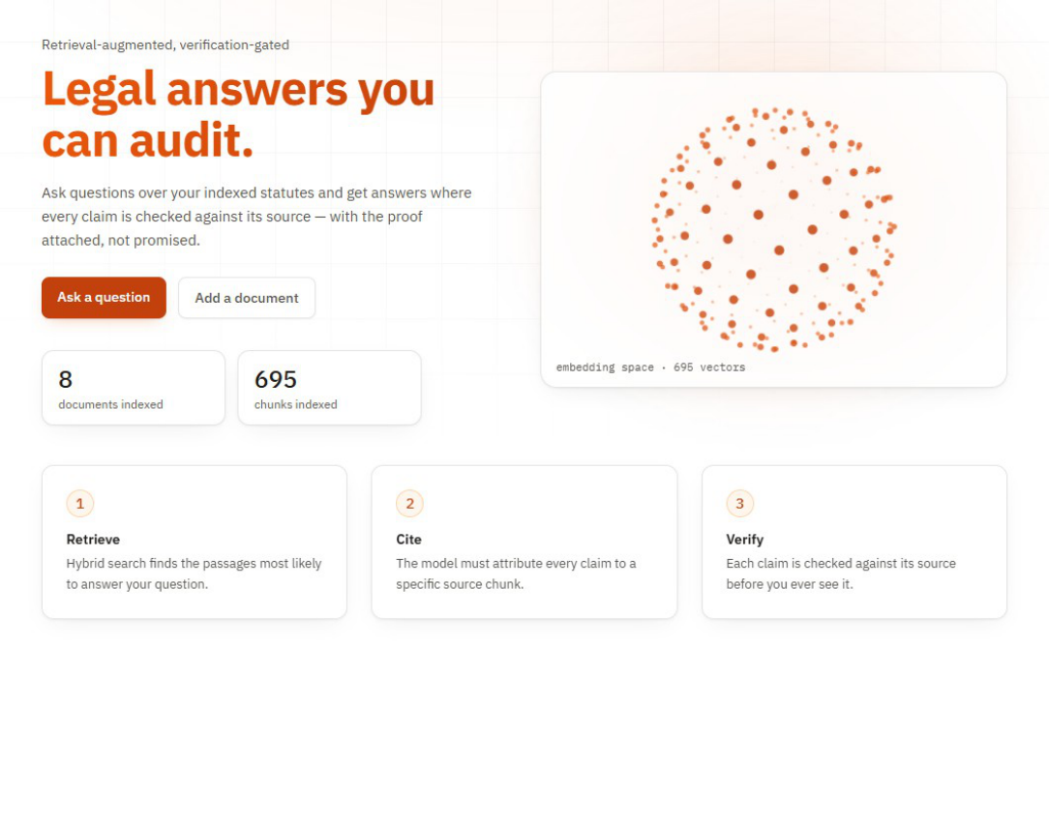
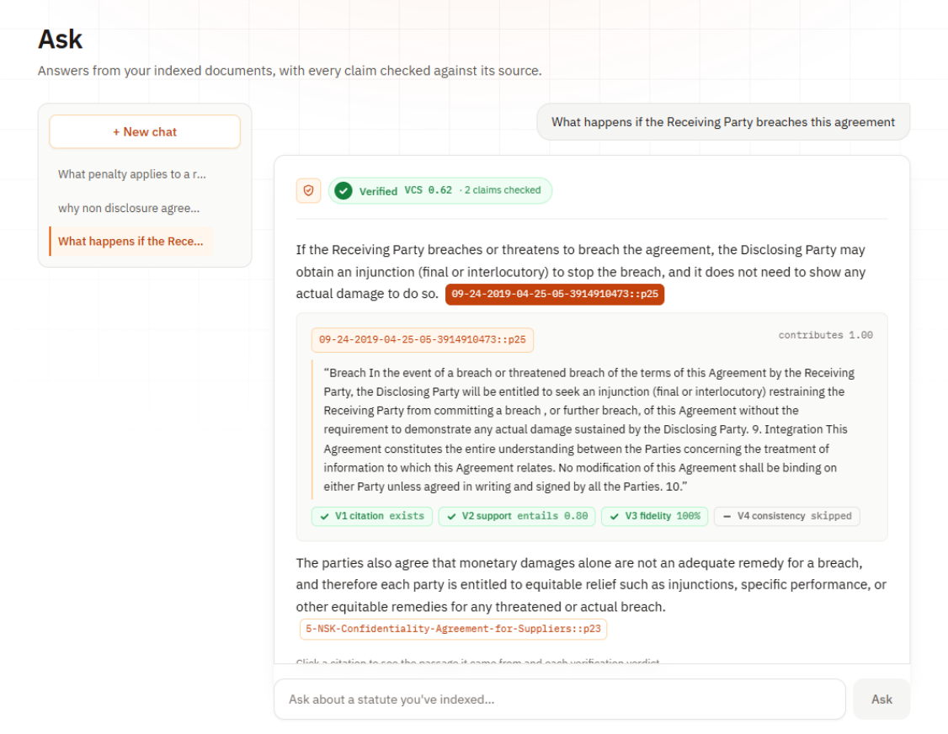
Implementation – Web Application
• Five pages: Home, Ingest, Ask (badge + VCS + clickable proofs), Search (dense vs keyword vs hybrid), Evaluation (embedding map + logged experiments). Left: Home. Right: a verified answer with its proof open.
02/05/2026
Reducing Hallucinations in Legal AI
15

Slide 16
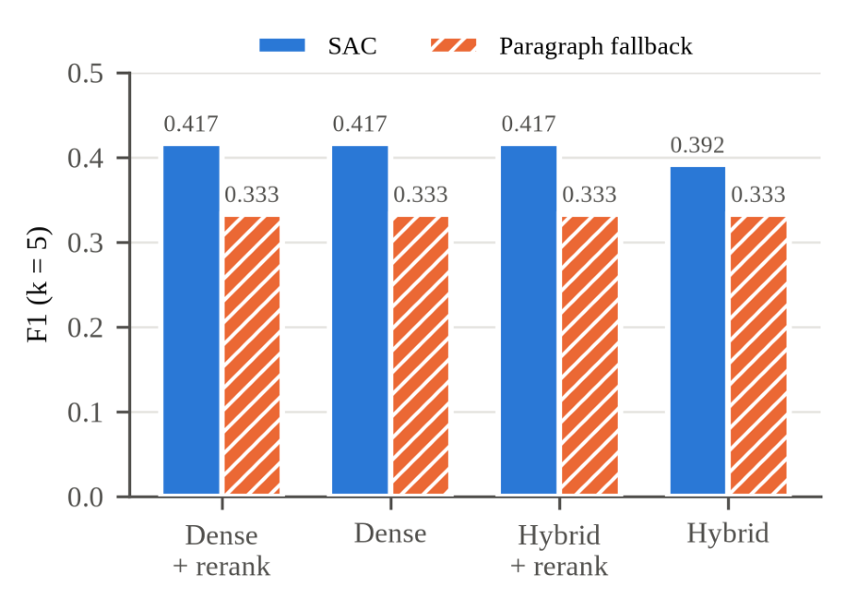
Results – Retrieval and Chunking
• 10 labelled questions over 5 synthetic statutes (k = 5, pool n = 50); gold clauses fixed in advance.
• SAC F1 = 0.417 vs paragraph chunking 0.333 — recall ≈ 1.000 everywhere, so the gain is precision.
• SAC passes ~550 characters of context per question vs 1,500–1,800 for paragraph chunks — a third of the text, no recall loss.
• Question set too easy to separate dense vs hybrid — reported as such, no conclusion drawn.
• Reranking: 6.7–12.8 s per question (laptop CPU) vs < 0.1 s without.
02/05/2026
Reducing Hallucinations in Legal AI
16

Slide 17
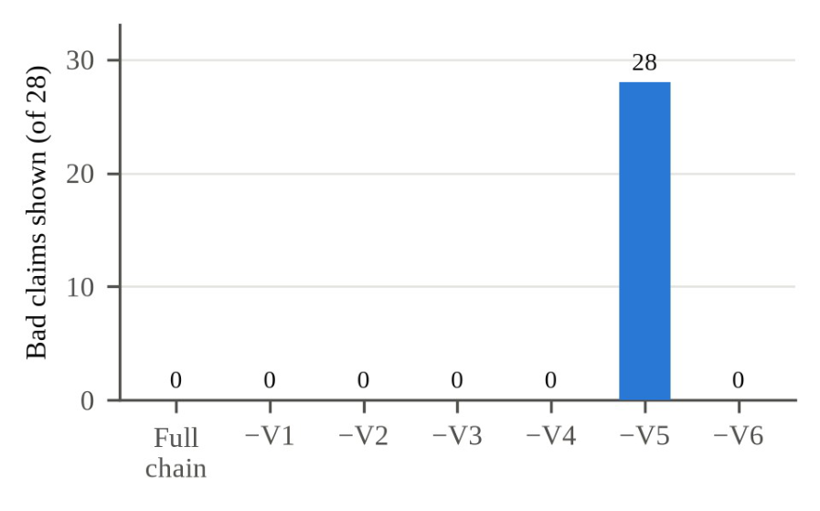
Results – Verification Ablation
• 28 deliberately corrupted claims: 14 fabricated citations + 14 claims swapped between questions.
• Full chain: 0 of 28 shown. Remove any single detector (V1–V4, V6): still 0 of 28 — the detectors overlap.
• Remove the gate (V5): all 28 shown. Scores change nothing unless something acts on them.
• The gate, not any single detector, is what protects the user.
• On clean answers V2 matters most: without it, mean VCS rises 0.768 → 0.813 and one more question is answered.
02/05/2026
Reducing Hallucinations in Legal AI
17

Slide 18
Results – End-to-End Test on Real Documents
• 5 documents through the real interface (3 ContractNLI NDAs, 1 CUAD agreement, 1 synthetic Act); 15 questions in 6 categories, expected answers committed before any upload.
• Outcomes (before → after two parser fixes): correct verified 3 → 4; correct abstention 4 → 5; false abstention 4 → 3; general knowledge correctly labelled 2; wrong-shown-as-verified: 0 → 0.
• No wrong or mis-cited answer was ever shown as verified; every verified claim was supported by the passage its proof quoted.
• Duplicate upload refused; replace restored the same 23 chunks; after deleting a document, questions about it abstained.
• Mean response time 17.3 s (median 16.1 s) — almost all in the model call.
• Most instructive failure: asked the governing law of three agreements, the system showed two correct verified answers and silently dropped the third — verification checks what an answer says, not what it leaves out.
02/05/2026
Reducing Hallucinations in Legal AI
18

Slide 19
Discussion – Limitations and Responsible AI
• Cautious to a fault: 3 of 10 answerable questions refused in the ablation, 4 of 15 in the end-to-end test — mainly a general-domain NLI model judging correct legal claims NEUTRAL.
• The 0.60 threshold is an uncalibrated default; averaging claim scores can let a weak claim ride beside a strong one.
• Completeness is not checked — a partial comparison answer can look complete.
• Small evaluation: the numbers are observations from logged runs, not rates.
• Responsible AI:
– Research prototype — not legal advice; the proof leaves judgement with a person who can read the source.
– Index stays local, but questions + retrieved passages go to the LLM provider — users are told; a local-LLM option is future work.
– Failures are reported alongside successes — the system's limits are part of its record.
02/05/2026
Reducing Hallucinations in Legal AI
19

Slide 20
Conclusion and Future Work
• A small, locally run pipeline can make legal answers checkable: citation-forced generation + overlapping detectors + a single gate kept every corrupted and every wrong answer away from the user in our tests.
• SAC improved retrieval F1 0.333 → 0.417 on a third of the context; the LangChain version reproduced plain-Python results exactly and became the default.
• Future work:
– Calibrate the threshold on a held-out set; gate each claim separately (or use min instead of mean).
– Legal-domain NLI model; add the document title to the NLI premise; flag partial answers.
– Per-document retrieval for comparison questions; evaluate on LegalBench-RAG and Indian statutes from India Code.
– Server deployment with authentication; local LLM so confidential documents never leave the machine; multilingual support starting with Indian languages.
02/05/2026
Reducing Hallucinations in Legal AI
20

Slide 21
References (IEEE Format)
[1] Mata v. Avianca, Inc., No. 22-cv-1461 (PKC) (S.D.N.Y. 2023).
[2] V. Magesh et al., “Hallucination-free? Assessing the reliability of leading AI legal research tools”, Journal of Empirical Legal Studies, 2025.
[3] P. Lewis et al., “Retrieval-augmented generation for knowledge-intensive NLP tasks”, NeurIPS, 2020.
[4] M. Reuter et al., “Towards reliable retrieval in RAG systems for large legal datasets”, Proc. NLLP Workshop, 2025, pp. 17–30.
[5] A. Figueiredo et al., “Grounded in law: A multi-stage anti-hallucination pipeline for legal RAG systems in Brazilian Portuguese”, Proc. PROPOR, 2026.
[6] J. Maghakian et al., “Embedding-free RAG”, Findings of ACL: EMNLP 2025, pp. 24974–24985.
[7] C. Niu et al., “RAGTruth: A hallucination corpus for developing trustworthy retrieval-augmented language models”, Proc. ACL, 2024.
[8] N. Pipitone and G. H. Alami, “LegalBench-RAG: A benchmark for retrieval-augmented generation in the legal domain”, arXiv, 2024.
[9] Y. Koreeda and C. D. Manning, “ContractNLI: A dataset for document-level natural language inference for contracts”, Findings of EMNLP, 2021.
[10] D. Hendrycks et al., “CUAD: An expert-annotated NLP dataset for legal contract review”, NeurIPS Datasets and Benchmarks, 2021.

Slide 22
References (IEEE Format)
• [11] S. H. Wang et al., “MAUD: An expert-annotated legal NLP dataset for merger agreement understanding”, Proc. EMNLP, 2023.
• [12] N. Reimers and I. Gurevych, “Sentence-BERT: Sentence embeddings using Siamese BERT-networks”, Proc. EMNLP-IJCNLP, 2019.
• [13] G. V. Cormack, C. L. A. Clarke, and S. Büttcher, “Reciprocal rank fusion outperforms Condorcet and individual rank learning methods”, Proc. ACM SIGIR, 2009.
• [14] S. Xiao et al., “C-Pack: Packaged resources to advance general Chinese embedding”, arXiv:2309.07597, 2023.
• [15] Y. Liu et al., “RoBERTa: A robustly optimized BERT pretraining approach”, arXiv:1907.11692, 2019.
• [16] A. Williams, N. Nangia, and S. R. Bowman, “A broad-coverage challenge corpus for sentence understanding through inference”, Proc. NAACL-HLT, 2018.
• [17] S. Min et al., “FActScore: Fine-grained atomic evaluation of factual precision in long form text generation”, Proc. EMNLP, 2023.
• [18] P. Manakul, A. Liusie, and M. J. F. Gales, “SelfCheckGPT: Zero-resource black-box hallucination detection for generative large language models”, Proc. EMNLP, 2023.
• [19] H. Chase, “LangChain”, 2022. [Online]. Available: https://github.com/langchain-ai/langchain.
02/05/2026
Reducing Hallucinations in Legal AI
22

