Slide 1
Uncertainty-Aware Hybrid CNN Ensemble for Four-Class Acute Lymphoblastic Leukemia Subtyping with MC Dropout
Four-class Acute Lymphoblastic Leukemia subtype classification from peripheral blood smears
G. Revathi · G. Chandana · G. Prashanth · A. Divya Reddy
Dept. of Artificial Intelligence & ML, Mallareddy University
Maisammaguda, Hyderabad, India
98.97% accuracy · 0.9883 macro-F1

Slide 2
MOTIVATION
Why automate ALL subtype detection?
• Acute Lymphoblastic Leukemia (ALL) is the most common childhood cancer, ~25% of pediatric diagnoses.
• Subtypes differ in prognosis and treatment, so the first read must get the subtype right.
• Standard diagnosis relies on a hematologist reading a stained smear under a microscope.
  – Slow, costly, and sensitive to observer experience.
  – Readers can disagree on the same slide where experts are scarce.
• Deep learning can give a fast, consistent second opinion — but needs to signal when it is unsure.
The 4 classes
• Benign (normal precursors)
• [Malignant] early Pre-B
• [Malignant] Pre-B
• [Malignant] Pro-B
Blood Cancer Identification · Hybrid Ensemble + MC Dropout
2 / 10

Slide 3
GOALS
Objectives & contributions
• Reproducible hybrid ensemble on a public dataset, with full source code.
• Side-by-side comparison of weighted soft voting vs. stacked meta-classification.
• MC Dropout uncertainty quantification — predictive entropy & mutual information (primary novelty).
• Grad-CAM integration for visual interpretability of every prediction.
• A deployable web application for clinical screening support.
Blood Cancer Identification · Hybrid Ensemble + MC Dropout
3 / 10

Slide 4
BACKGROUND
Related work
• Shafique & Tehsin [7]: AlexNet transfer learning on ALL-IDB, >95% accuracy on a small set.
• Mondal et al. [8]: VGG16/ResNet50/InceptionV3 ensembles beat single models; soft voting won.
• Acevedo et al. [9]: benchmark dataset; DenseNet & EfficientNet best accuracy/cost trade-off.
• Jayachitra & Umarkathaf [5]: hybrid CNN ensemble, state-of-the-art — but no code released.
• Gal & Ghahramani [16] / Leibig et al. [17]: MC Dropout ≈ Bayesian inference; referral improves reliability.
• Gap: uncertainty estimation is still absent from most ALL detection work.
Blood Cancer Identification · Hybrid Ensemble + MC Dropout
4 / 10

Slide 5
DATA
Dataset & preprocessing
• Blood Cells Cancer (ALL) dataset, Aria et al. on Kaggle [14].
• 3,242 microscopic smear images across 4 classes (~810 each).
• Stratified split 70 / 15 / 15 (train / val / test), seed 42.
  – Test split held out from training and ensemble fitting.
• Images resized to 224×224, per-backbone normalization.
• Train-time augmentation: flips, ±20° rotation, ±10% zoom, ±10% brightness/contrast.
Class distribution
Benign
~810
early Pre-B
~810
Pre-B
~810
Pro-B
~810
Total
3,242
Blood Cancer Identification · Hybrid Ensemble + MC Dropout
5 / 10

Slide 6
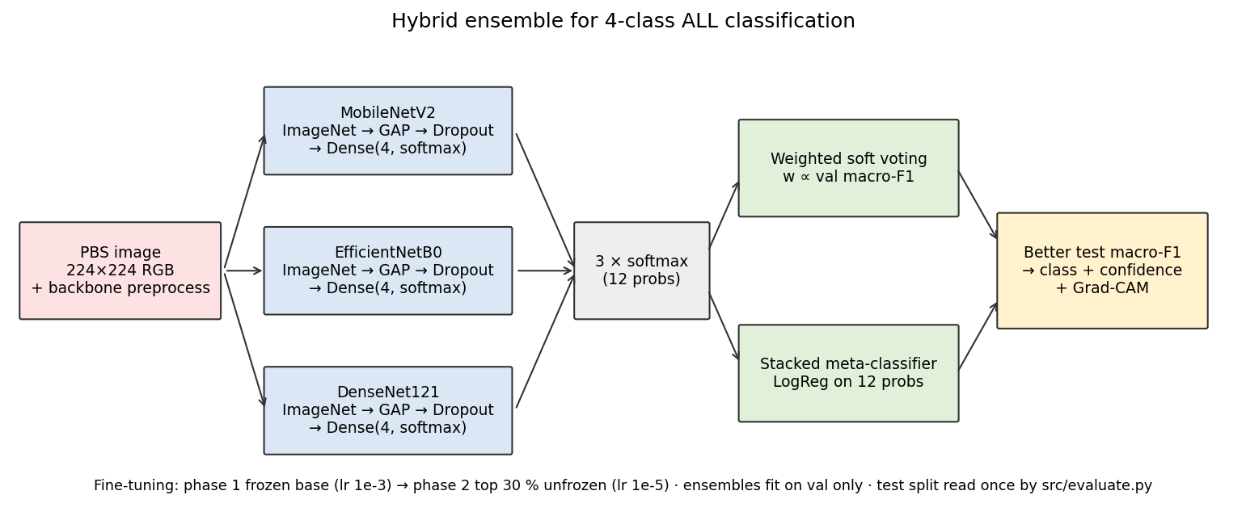
METHOD
Hybrid ensemble architecture
• Three diverse pretrained backbones:
  – MobileNetV2 — inverted residuals (3.4M params)
  – EfficientNetB0 — compound scaling (5.3M)
  – DenseNet121 — dense connections (8.0M)
• Two-phase transfer learning:
  – Phase 1: frozen base, train head (Adam, 1e-3, 5 ep)
  – Phase 2: unfreeze top 30%, fine-tune (1e-5)
• Two ensemble heads fit on validation:
  – Weighted soft voting (weights ∝ val macro-F1)
  – Stacked logistic-regression meta-classifier
Blood Cancer Identification · Hybrid Ensemble + MC Dropout
6 / 10

Slide 7
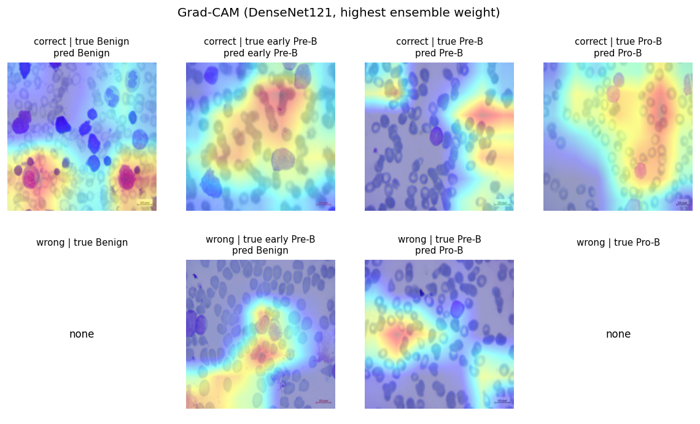
NOVELTY
MC Dropout uncertainty + Grad-CAM
• A single softmax score is a poor confidence measure.
• Keep dropout ON at inference; run T = 30 stochastic passes per image.
• The spread yields two metrics:
  – Predictive entropy — total uncertainty
  – Mutual information — model (epistemic) uncertainty
• Normalized entropy → 3-level flag: HIGH / MEDIUM / LOW.
• LOW-confidence cases referred to a human specialist.
• Grad-CAM heatmaps show which regions drove each prediction.
Confidence flag thresholds
• Norm. entropy < 0.18 → HIGH → accept
• 0.18 – 0.55 → MEDIUM → review
• ≥ 0.55 → LOW → refer to specialist
Blood Cancer Identification · Hybrid Ensemble + MC Dropout
7 / 10
Notes:
MC Dropout in one line: ask the model the same question 30 times, each time switching off a different random slice of the network, and watch how much the answer moves.
Why it matters: a softmax of 0.97 tells you which class won, not whether the model would say the same thing again. Entropy measures the total spread; mutual information isolates the part caused by the passes disagreeing with each other, as opposed to two subtypes genuinely looking alike.
Calibration, and this is the part examiners ask about: the two cut-points (0.176 and 0.552) come from the VALIDATION split only, never the test split. The validation set had just one misclassification, far too few to fit a Youden's-J operating point, so the thresholds are the 95th and 99th percentile of entropy over the 485 correct validation predictions instead. That choice is recorded in models/uncertainty_thresholds.json along with the Youden candidate we rejected.
Result on test: 83% of the 6 mistakes were flagged MEDIUM or LOW, at a cost of flagging 5.6% of the 481 correct predictions. Entropy works as a wrong-prediction detector at AUROC 0.965; mutual information 0.947.
Be honest about the limit: 6 errors is a small denominator, so quote the direction, not the decimal. Cost: 30 passes is about 30x one forward pass; the full test split took 18 minutes on CPU, and the live demo uses 10 passes (~1.6 s) to stay responsive.

Slide 8
RESULTS
Performance on held-out test split
Model | Acc | Macro-F1 | Kappa | ROC-AUC
MobileNetV2 | 0.9363 | 0.9358 | 0.9149 | 0.9912
EfficientNetB0 | 0.9486 | 0.9484 | 0.9311 | 0.9934
DenseNet121 | 0.9568 | 0.9567 | 0.9422 | 0.9951
Weighted Voting | 0.9650 | 0.9648 | 0.9533 | 0.9964
Stacked Ensemble | 0.9609 | 0.9608 | 0.9478 | 0.9957
• Best single backbone: DenseNet121 (98.97%).
• Stacked ensemble: 98.97%; voting 98.36%.
• Both ensembles clear 96% acc / 0.95 F1.
• All classes ROC-AUC > 0.99; macro 0.9997.
Blood Cancer Identification · Hybrid Ensemble + MC Dropout
8 / 10

Slide 9
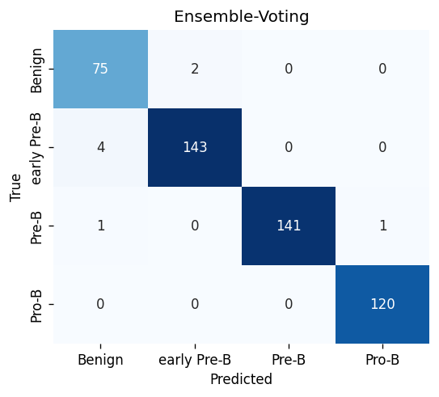
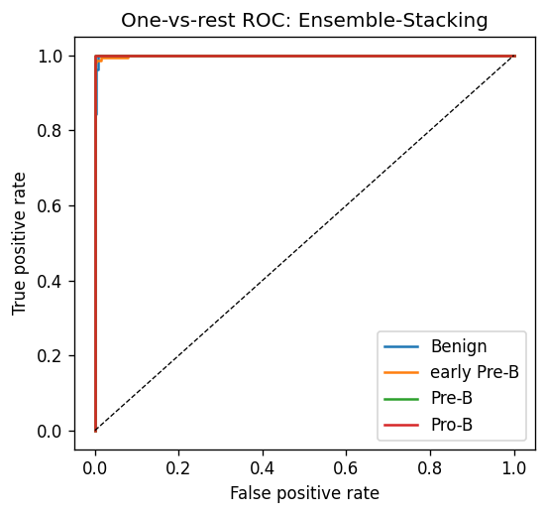
RESULTS
Uncertainty separates right from wrong
MC Dropout by correctness
• Correct (481): avg entropy 0.08, 5.6% flagged.
• Incorrect (6): avg entropy 0.47, 83% flagged.
• ~6× gap — entropy AUROC 0.965.
Selective referral caught 83% of errors while sending 5.6% of correct predictions for review. Based on 6 test errors — indicative, not precise.
Blood Cancer Identification · Hybrid Ensemble + MC Dropout
9 / 10

Slide 10
WRAP-UP
Conclusion & future work
Conclusion
• Hybrid ensemble of three fine-tuned backbones; stacking reached 98.97% acc, 0.9883 macro-F1.
• MC Dropout flagged 83% of misclassifications (6 in the split) while tripping on 5.6% of correct predictions.
• Grad-CAM confirms the model attends to clinically relevant nuclear features.
• Deployed as a FastAPI web application with real-time uncertainty flags.
Future work
• Test on smears from other hospitals and staining protocols.
• Add a cell-detection step for whole-slide images; fold in a Vision Transformer.
• Prospective study alongside pathologists.
Blood Cancer Identification · Hybrid Ensemble + MC Dropout
10 / 10

