Slide 1
+
Heart Disease Prediction
using an Artificial Neural Network (ANN)
T E A M
23EG106C01
Aedula Sricharan
23EG106C02
Akkinepally Nagasai
23EG106C03
Akshith Sai Nalla
23EG106C04
Vivek Reddy A
Deep Learning — Project-Based Learning (PBL)
Notes:
Good morning everyone. Our project is Heart Disease Prediction using an Artificial Neural Network. Presenting on behalf of our team. The goal is to use deep learning to predict whether a person is likely to have heart disease from their basic medical test results.

Slide 2
THE PROBLEM
What are we trying to solve?
Heart disease is a leading cause of death.
+
Doctors read many test results to judge risk.
That takes time and expert skill.
Early warning can save lives.
Our question is on the right →
Can a computer learn to spot heart disease?
Notes:
Heart disease is one of the leading causes of death worldwide. Normally a doctor studies many test reports to judge the risk, which takes time and expertise. Our question is simple: can a computer learn, from past patient records, to flag who is likely to have heart disease — acting as an early-warning helper? If asked whether this replaces doctors: no, it is a support tool; the doctor still decides.

Slide 3
THE DATA
What the model learns from
303
13 in → 1 out
patient records (UCI Cleveland dataset)
13 health measurements predict one answer: disease? yes / no
A few of the inputs
Age
Sex
Chest pain type
Blood pressure
Cholesterol
Max heart rate
Blood sugar
ECG result
Notes:
We used the well-known UCI Cleveland Heart Disease dataset — 303 real patient records. Each patient has 13 health measurements such as age, blood pressure, cholesterol and maximum heart rate. The one thing we predict is whether the patient has heart disease — yes or no. Think of it like an Excel sheet: 13 input columns and one answer column. The data is fairly balanced — about 165 with disease, 138 without.

Slide 4
STEP 1 — PREPARING THE DATA
Cleaning before learning
1
2
3
Scale the numbers
→
Encode categories
→
Split the data
Put age, BP, cholesterol on the same range.
Turn labels like chest-pain type into 0/1 columns.
70% learn · 15% check · 15% final hidden test.
In simple words: Raw data is messy. We tidy it so every feature is comparable, then keep part of it hidden to test the model fairly.
Notes:
Before the model can learn, we prepare the data in three steps. First, scale the numbers so large values like cholesterol don't overpower small ones. Second, convert category codes like chest-pain type into separate yes/no columns. Third, split the data: 70% to learn from, 15% to check during training, and 15% kept hidden for the final honest test.

Slide 5
STEP 2 — THE MODEL
A simple neural network
Input
Hidden 1
Hidden 2
Output
Probability
13 features
(27 after encoding)
→
64 neurons
→
32 neurons
→
1 number
→
of heart disease
(0 to 1)
In simple words: Each layer mixes the numbers and passes them on, learning the hidden pattern. The last layer gives one score — higher means more likely to have heart disease.
Notes:
Our model is a neural network with two hidden layers of 64 and 32 neurons. The 13 features become 27 inputs after encoding. Each layer combines the numbers and passes them forward, gradually learning the pattern that separates healthy from sick. The final layer gives one probability between 0 and 1 — higher means more likely to have heart disease. We use dropout and batch-normalisation so it learns the pattern instead of memorising.

Slide 6
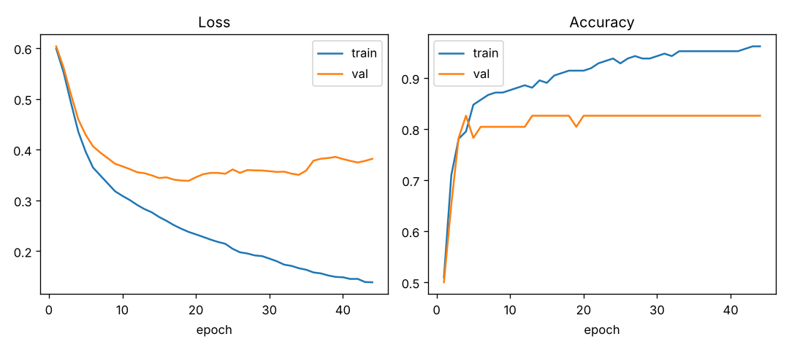
STEP 3 — TRAINING
How the model learns
The idea
Model makes a guess
We measure the error
It adjusts to do better
Repeat many times
In simple words: The line going down means fewer mistakes each round. Training stops automatically when it stops improving (no over-studying).
Notes:
Training means the model makes a guess, we measure how wrong it is, and it adjusts itself to do better — repeated many times. In the graph, the loss going down means fewer mistakes each round. We use early stopping, so training halts automatically once it stops improving, which prevents over-studying the training data. It only trains a few seconds and stopped around 40–50 passes.

Slide 7
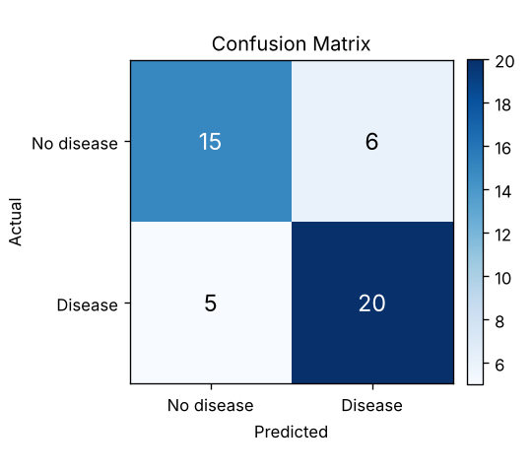
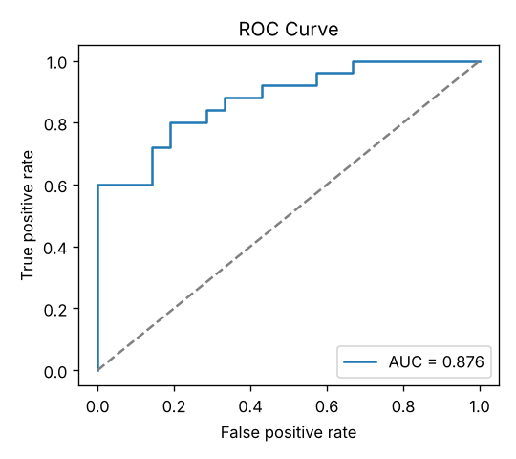
THE RESULTS
How well does it work?
82%
0.88
80%
5-fold cross-validation —
a fair, stable score
Accuracy
ROC-AUC
Recall
What it means
Recall 80% — it catches 80% of patients who truly have the disease.
ROC-AUC 0.88 — it separates sick from healthy well.
Beat / matched logistic regression, random forest and gradient boosting.
Confusion matrix
ROC curve
Notes:
Using 5-fold cross-validation — a fair way to test across all the data — the model reached about 82% accuracy and a ROC-AUC of 0.88. Most important for a health check, recall is 80% — it catches 80% of patients who actually have the disease. The confusion matrix shows correct versus wrong predictions, and the ROC curve shows it separates sick from healthy well. We also compared against logistic regression, random forest and gradient boosting — our network was competitive and had the best ROC-AUC. Recall matters most because missing a sick patient is worse than a false alarm.

Slide 8
CONCLUSION
What we built & learned
What we did
Key takeaways
Built a neural network in PyTorch
Trained it on 303 patient records
Tested it fairly with cross-validation
Compared it to classic ML models
~82% accuracy, 0.88 ROC-AUC
Catches 80% of true cases
On small data, simple models can match deep learning
Next steps: tune settings · explain predictions (SHAP) · test on more data
Thank you!
Notes:
To summarise: we built a neural network in PyTorch, trained it on 303 patient records, tested it fairly with cross-validation, and compared it to classic models. It reaches about 82% accuracy and catches 80% of true cases. One honest finding — on small data, simple models can match deep learning. Future work: tune the settings, explain predictions with SHAP, and test on more data. Thank you — happy to take questions.

