Slide 1
Assignment2
File created on: 01-06-2020 13:40:15

Slide 2
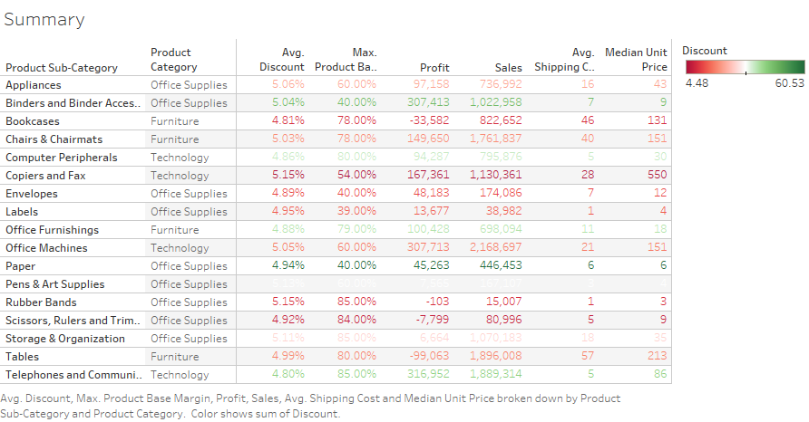

Slide 3
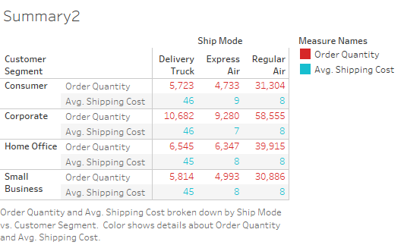

Slide 4


Slide 5
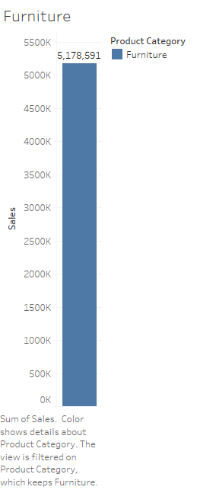

Slide 6
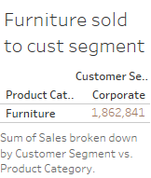

Slide 7


