Slide 1
Presentation on Clustering

Slide 2
Description of data
Data type – Panel
Number of observations – 3294
Observation – Individual
Country - USA
Format – Time series containing:
Experience in years
Gender – a factor with levels (male, female)
School – Years of schooling
Wage – wage (in 1980\$) per hour
Source- Wages1 {Ecdat}

Slide 3
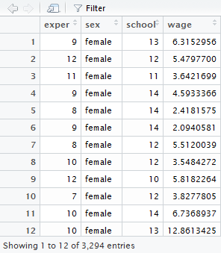
Importing data on R platform and performing basic check
Dataset named as “mydata”. Imported data on R platform via read.csv function

Slide 4
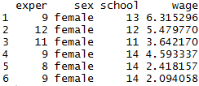


Importing data on R platform and performing basic check
Obtaining first few rows of the dataset.
Identifying class of the dataset and header names of the variable.
Identifying class of each variable of the dataset.

Slide 5
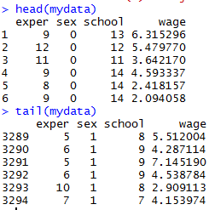
Converting categorical data in binary form
Converting categorical data in binary form to consider it as dummy variable in regression. Installed package and called library “plyr”. Converted categorical column “sex” in binary form by using “revalue” function. Crosschecked the output via function head and tail.

Slide 6

Capping outliers in variable “wage”
Outliers are capped from the dataset so that are excluded from regression to increase the accuracy. Below is the screenshot of the outliers based on quantile.
Capping wages above 99.95 percentile i.e. 31.44
Capped wage added to the dataset.
Removed original wages column from the dataset.

Slide 7
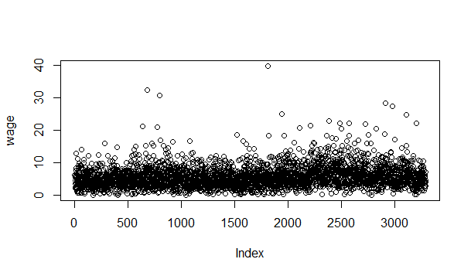
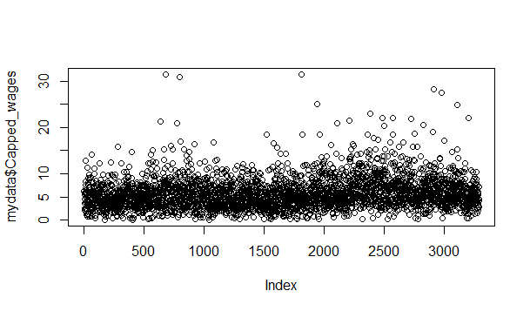
Capping outliers in variable “wage”
Outliers reduced as compared to previous wage data.
Old wage plot
New wage plot

Slide 8
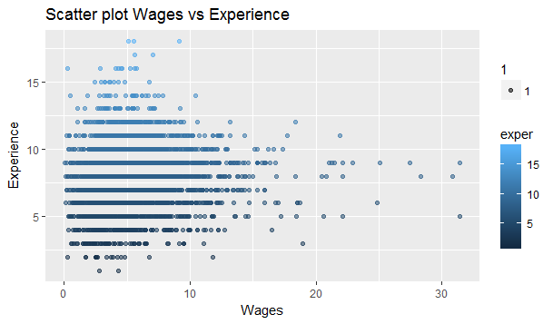
Checking relation between wage and experience
facets=gear~cyl
facets=gear~cyl
Observation – Maximum people with experience 5 years and above has $10 wage/hour.
Few outliers having experience less than 10 years but wage is greater than $10/hour needs to be examined. Availability of data on the degree type and profession would have been helpful to identify describe these outliers.

Slide 9
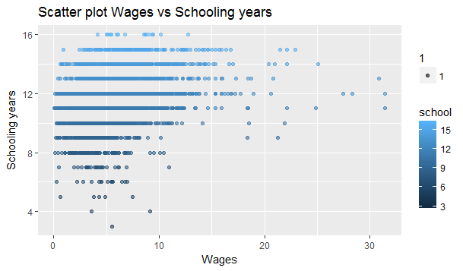
Checking relation between wage and experience
Observation – Maximum people with schooling 10 years and above has $10 wage/hour.
Few outliers having experience greater than 9 years of schooling but wage is greater than $10/hour needs to be examined. Availability of data on the degree type and profession would have been helpful to identify describe these outliers.

Slide 10

Checking relation between wage and experience
Observations mentioned on slide 8 and 9 can also be seen in below correlation matrix. There is no high correlation between any of the variable and we may expect less R square in regression.
Hence availability of more variables like educational degree and profession would have been given more accurate correlation matrix.
In below matrix we can see that correlation between schooling years and wages is higher as compare to experience. Thus we can conclude a person should be well educated along with experience for higher wages.

Slide 11

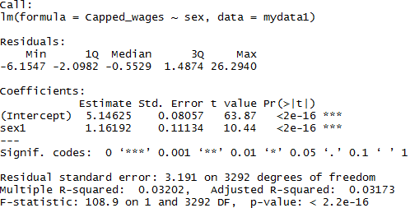
Regression
Model1 – Regression between wages and gender, wages as dependent variable.
The average hourly wage rate in this sample equals $6.31 for males and $5.15 for females.

Slide 12
Regression
Model1
Using the OLS approach the result is:
ˆy= 5.15 + 1.17xi .
This means that for females our best approximation is $5.15 and for males it is $5.15 +$1.17 = $6.31.
We can now say that our estimate of the expected hourly wage differential B2 between males and females is $1.17 with a standard error of $0.11.
We constructed t-ratio to test whether B2=0 by dividing t-statistic (1.16192) estimate by its standard error(0.11134). 5% two tailed critical value is 1.96. This means we can reject H0=B2=0. We thus reject that in population the expected wage differential between males and females is zero. We can also compute a confidence interval, which has bounds 1.17 ± 1.96 × 0.11. This means that with 95% confidence we can say that over the entire population the expected wage differential between males and females is between $0.95 and $1.39 per hour.

Slide 13
Regression
Model2 – Data partition.
Data divided in 80:20 ratio. Model2 is created on 80% (2619) observations.

Slide 14
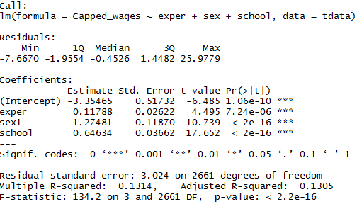
Regression
Regression between wages and all explanatory variables on 80% data.
Intercept is negative which is not true practically and R square is 13%. P value of explanatory variables is significant.

Slide 15
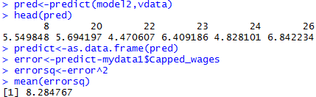
Regression
Model2 – Data partition.
When model2 (tdata) predicted on vdata, mean square error is 8.29.

Slide 16
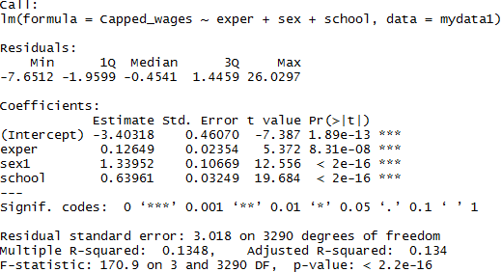
Regression
Model3 – Regression on complete dataset.
Observation: Intercept is negative which is practically not possible. Also, R square is 13.48% which is less. Although P value of all explanatory variables is significant, but accuracy of model if more variables like educational degree and profession are added.

Slide 17
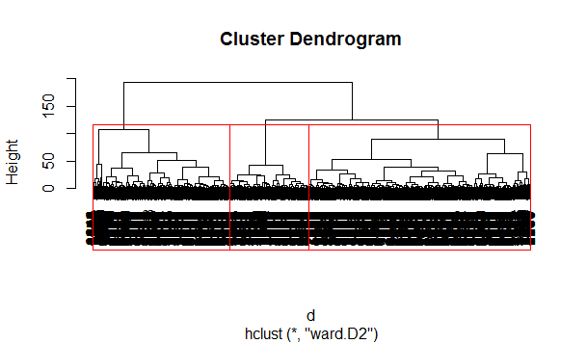
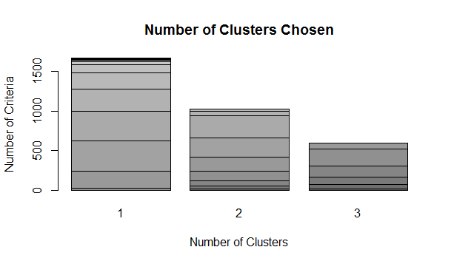
Hierarchical Clustering
Hierarchical methods use a distance matrix as an input for the clustering algorithm on all the observations and variables. Due to large size of data Dendogram is not clear.

Slide 18
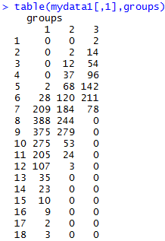
Hierarchical Clustering
Summary of the clustering. Data density is more and overlapping from observation 6 till 12.

Slide 19


Kmeans Clustering
Summary of Clustering between schooling and wage. Number clusters are considered arbitrarily as running NbClust for optimal number clusters was not feasible due to large data size.

Slide 20
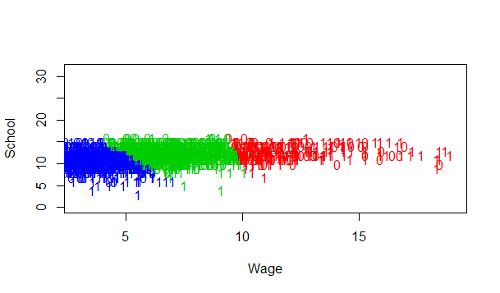
Clustering
Graphical representation of the clustering solution we plot cluster on Schooling years and Wage on a scatter plot. (1=Male and 0=Female)

Slide 21


Clustering
Summary of Clustering between experience and wage.

Slide 22
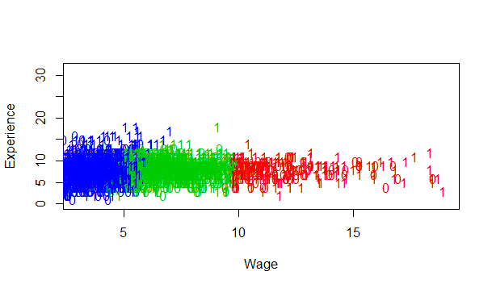
Clustering
Graphical representation of the clustering solution we plot cluster on Schooling years and Wage on a scatter plot. (1=Male and 0=Female)

Slide 23
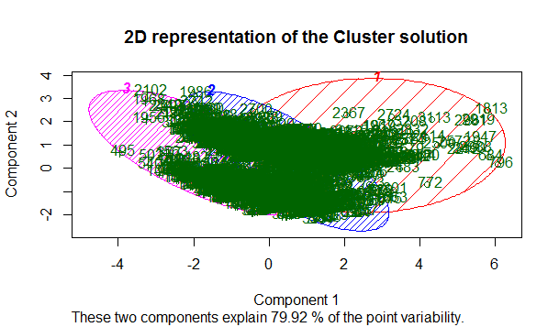
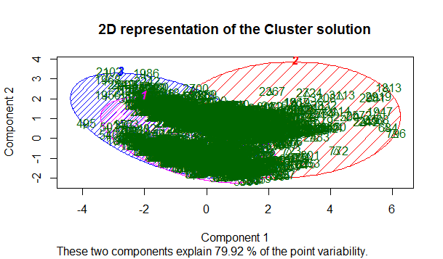
Clustering
2D presentation of the clustering – Both the clustering gives same result
Schooling vs Wages
Experience vs Wages

