Slide 1



ClassicModels
View in Power BI
Last data refresh:
7/10/2021 8:30:50 AM UTC
Downloaded at:
7/10/2021 8:36:14 AM UTC
Notes:
Prepared by: Vijay Waghmare

Slide 2
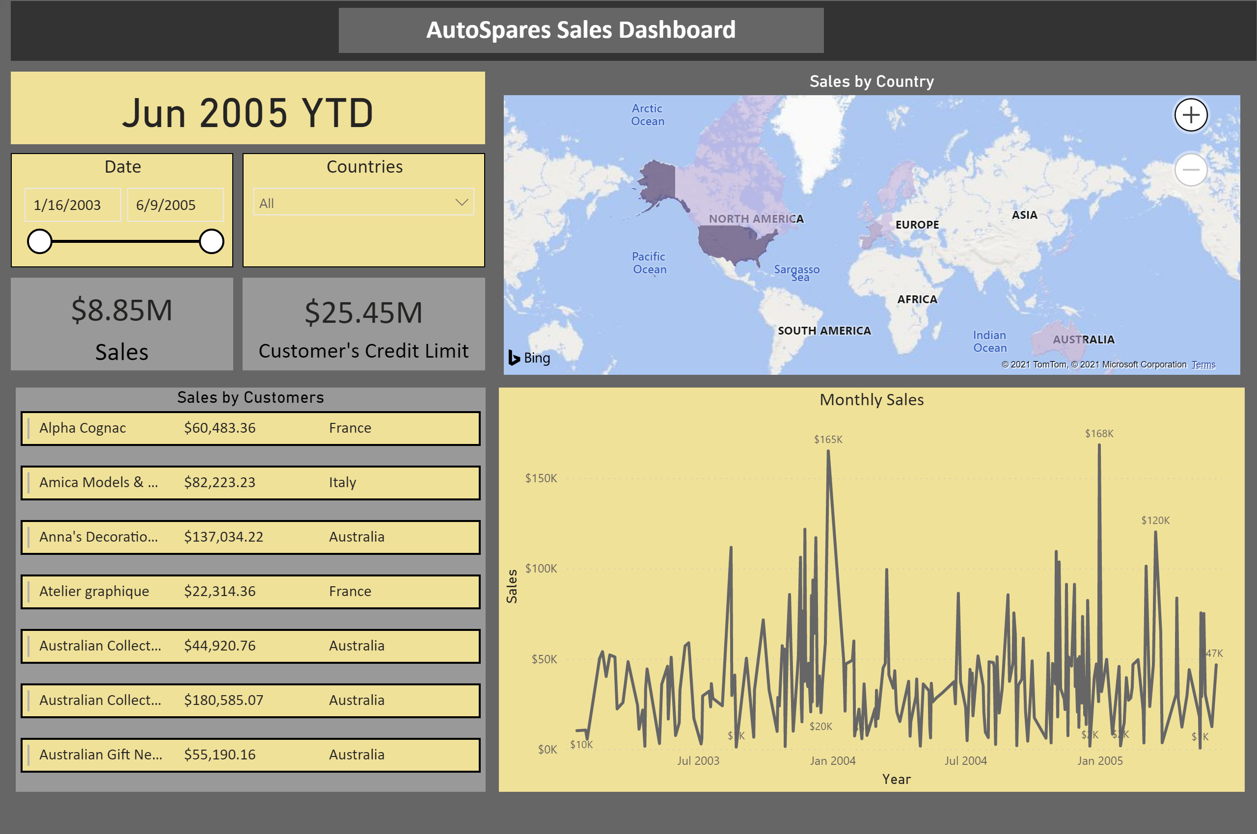
SalesSummary
Notes:
Summary page informs customer Year till date (YTD) of the report and allows user to select date range and/or operational country.
Map provides quick preview of geographical density of Sales in dollars (assumed to be all converted to base USD). Monthly time series plot provides preview on monthly trend in sales data. Also, a quick preview over sales by customers in table format becomes handy to view few customers.

Slide 3
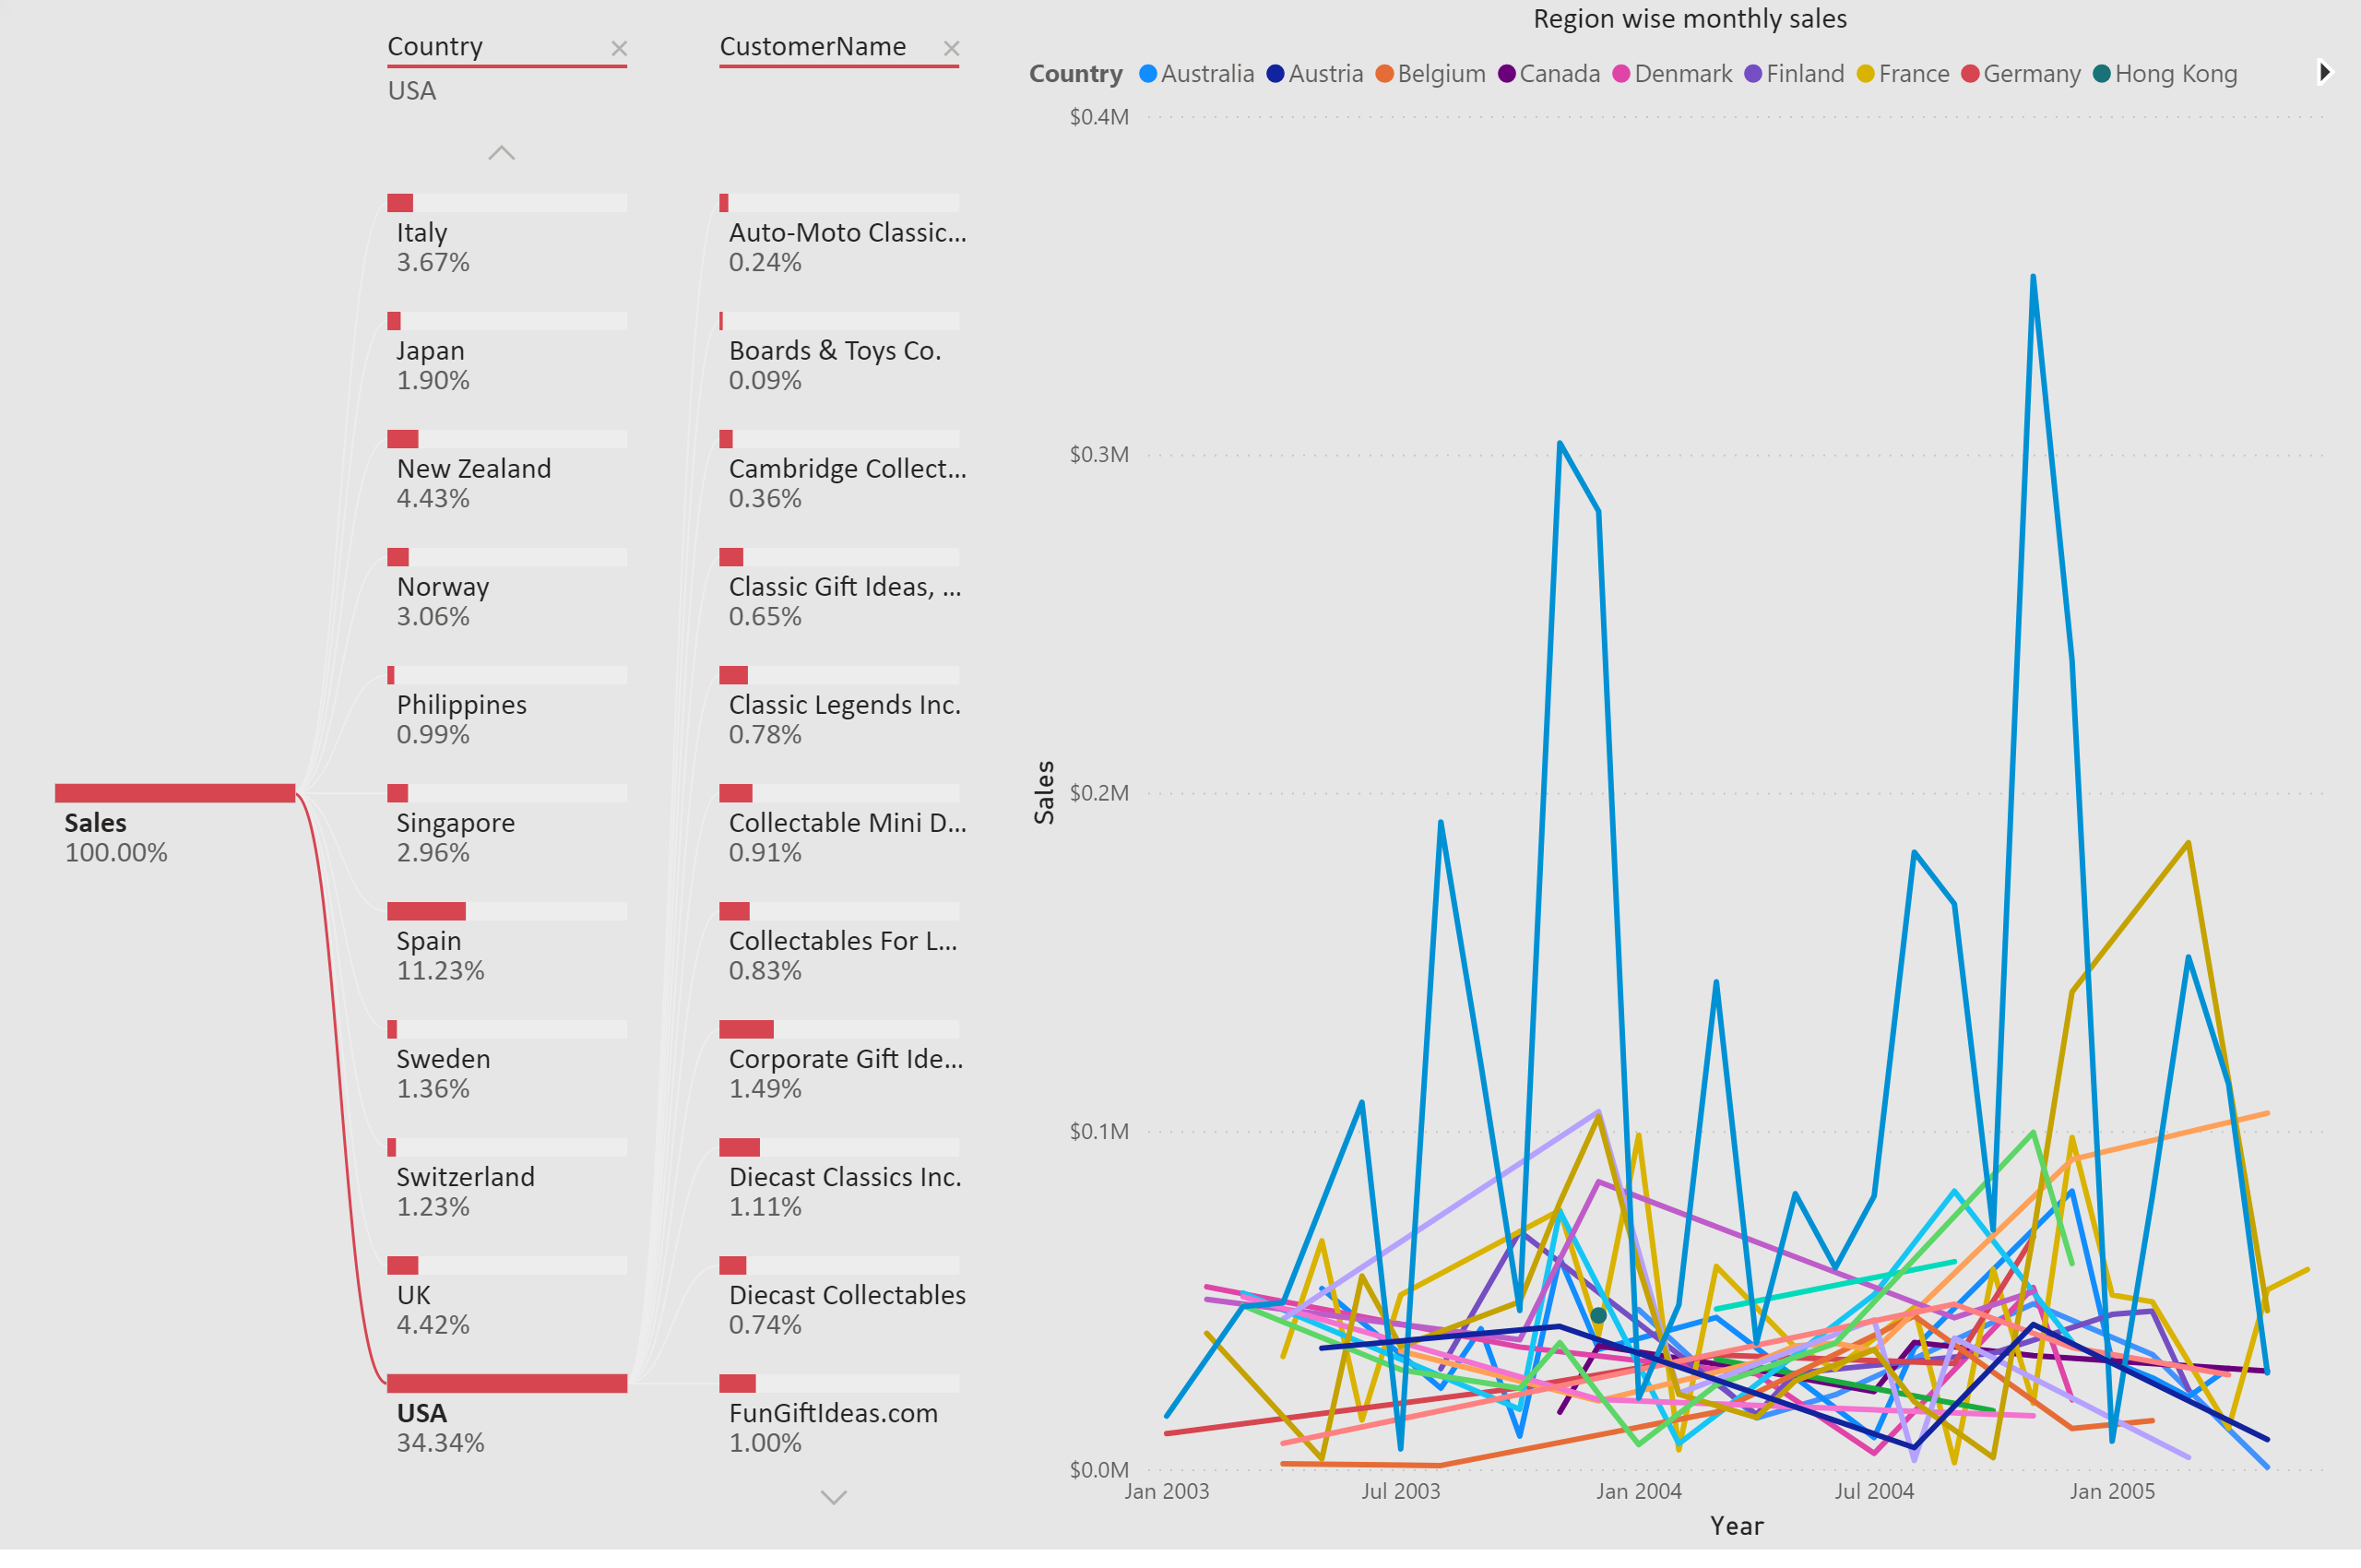
SalesDecomposition
Notes:
Monthly timeseries plot is linked with the decomposition. It provides plot if only USA is selected (first filter), and all customer names within USA if customer name (second filter) is selected. Thus, decomposition provides overall till date summary in one figure, whereas time series provide view on historical trend.

Slide 4
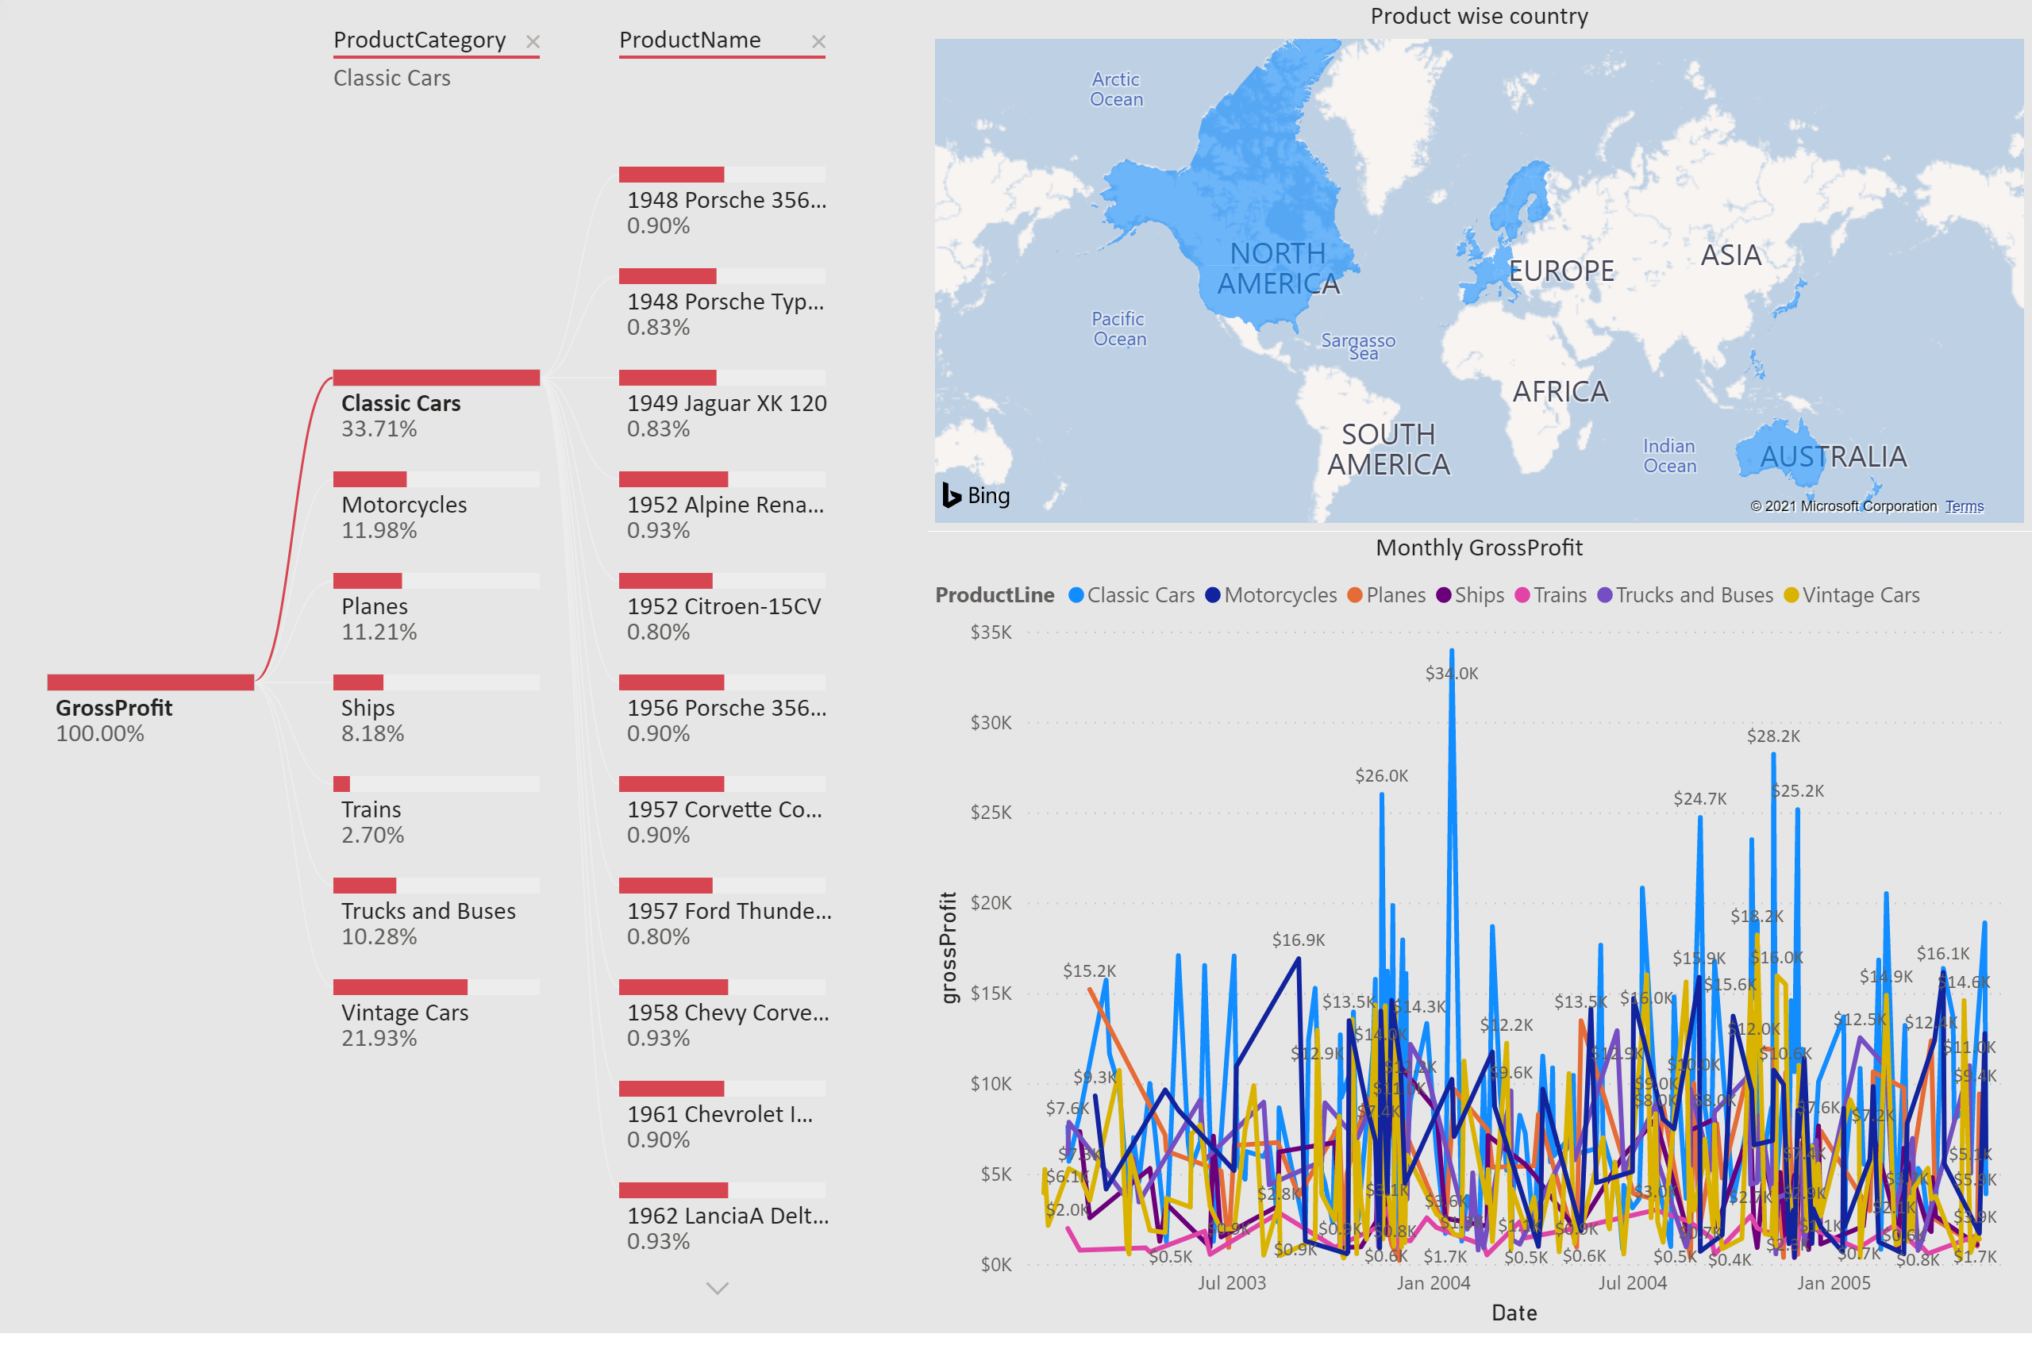
ProductProfitability
Notes:
Gross profit (GP) is calculated using DAX function based on quantity ordered, sale price/unit, buy price/unit. Monthly GP timeseries plot is linked with the decomposition. It provides plot if only Product Category is selected (first filter), and all product names within selected product category if product names (second filter) is selected. Thus, decomposition provides overall till date summary in one figure, whereas time series provide view on historical trend.

Slide 5
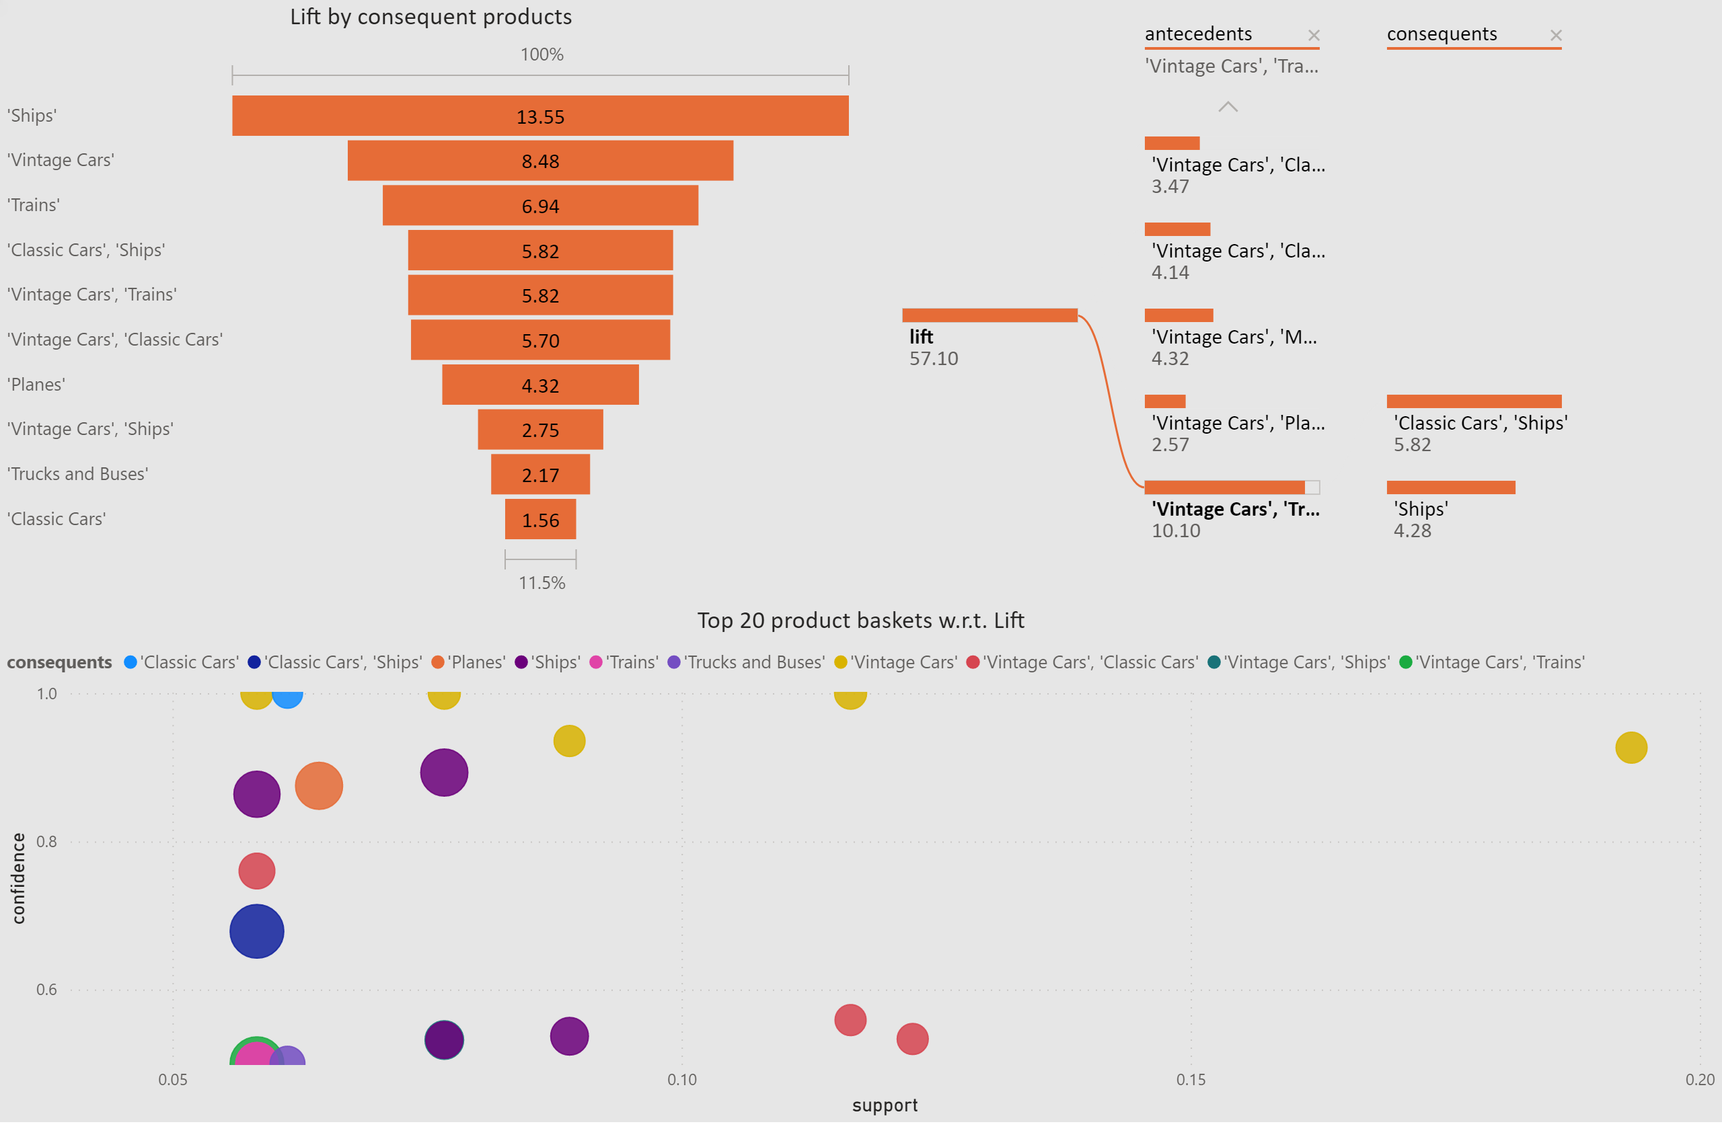
ProductBasketAnalysis
Notes:
This slide represents product basket analysis using Apriori algorithm for association rules in python script using PyCaret package. Variables used were order numbers and product category or line. Lift is the likelihood of association rule, thus top 20 records w.r.t. lift is selected. Decomposition plot suggests that when products related Vintage Cars and Trains are bought, then there are high chances of customers buying products related to Classic cars, and/or Ships. Funnel provides preview on which products categories are likely to be bought as consequents. Scatter plot provides option to user to choose desired level of support, confidence, and lift.

Slide 6
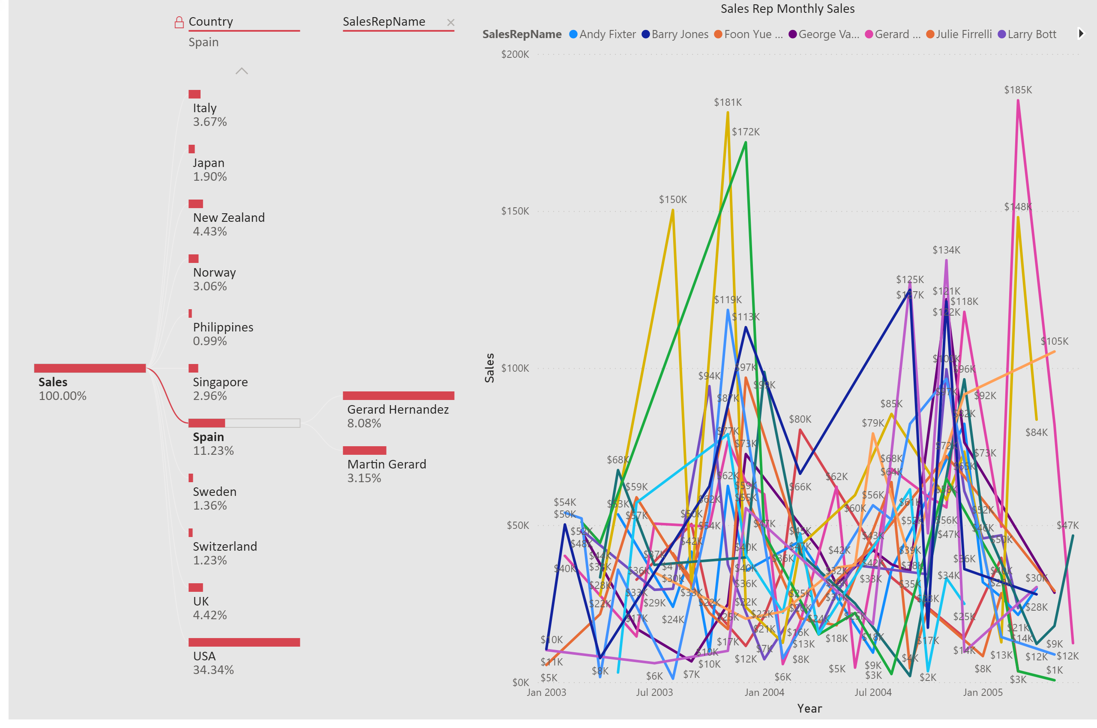
SalesRepPerformance
Notes:
Sales representatives key KPI is sales. Monthly rep wise sales timeseries plot is linked with the decomposition. It provides plot country wise (first filter), and all sales rep names within that country if sales rep name (second filter) is selected. Thus, decomposition provides overall till date summary in one figure, whereas time series provide view on historical trend.

