Slide 1
Cucumber
Behaviour Driven Development Framework

Slide 2
Cucumber
What is BDD?
BDD Behaviour driven development is a extension to TDD (Test Driven Development)& it aims to bridge the gap between
Business Analyst & Developer.
Manual QA with automation Tester (who write BDD)
Manual QA with developer
BDD focus on what to test not how to test
It uses plain English to explain what is exact requirement
It uses Gherkin Language.

Slide 3
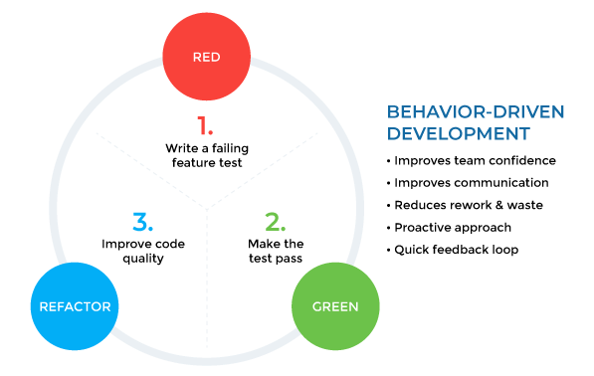
Behaviour Driven Development

Slide 4
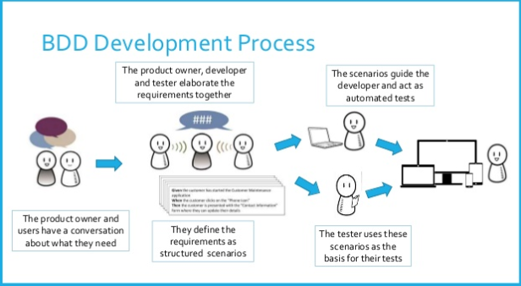
Behaviour Driven Development
Behaviour driven development (BDD) is an Agile software development methodology in which an application is documented and designed around the behaviour a user expects to experience when interacting with it.

Slide 5
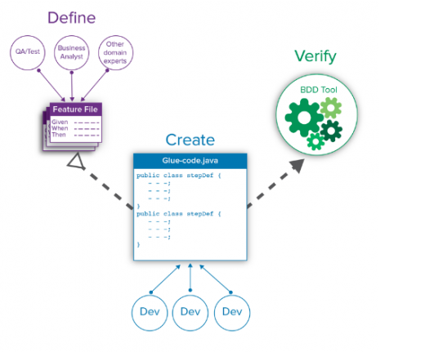
BDD-WorkFlow

Slide 6
Cucumber
BDD Tools in Market
Cucumber (https://cucumber.io/docs/reference)
Jbehave
Spaceflow…..etc

Slide 7
Gherkin Syntax
Gherkin uses a set of special keywords to give structure and meaning to executable specifications.
Each keyword is translated to many spoken languages; in this reference we’ll use English.
Most lines in a Gherkin document start with one of the keywords.
Comment lines are allowed anywhere in the file. They begin with zero or more spaces, followed by a hash sign (#) and some text. Comments do have to start on a new line.
Given
When
Then
And (….etc)
RequirePlugin:http://cucumber.github.com/cucumber-eclipse/update-site

Slide 8
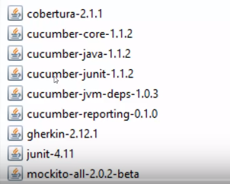
Required Jars

Slide 9
Requirements
Cucumber Plugin
http://cucumber.github.com/cucumber-eclipse/update-site
2.Download following Jar for Cucumber :
https://mvnrepository.com/
cucumber-core-2.4.0.jar
cucumber-java-2.4.0.jar
cucumber-junit-2.4.0.jar
cucumber-jvm-deps-1.0.6.jar
gherkin-5.0.0.jar
junit-4.12.jar
mockito-all-1.10.19.jar

Slide 10
Feature File
Is Nothing but requirement which you need to test. Feature file contains multiple scenarios.
The purpose of the Feature keyword is to provide a high-level description of a software feature, and to group related scenarios.
The first primary keyword in a Gherkin document must always be Feature, followed by a : and a short text that describes the feature.

Slide 11
Feature File
Feature : A feature would describe the current test script which has to be executed.
Scenario : Scenario describes the steps and expected outcome for a particular test case.
Scenario Outline : Same scenario can be executed for multiple sets of data using scenario outline. The data is provided by a tabular structure separated by (I I).
Given : It specifies the context of the text to be executed. By using datatables "Given", step can also be parameterized.
When : "When" specifies the test action that has to performed
Then : The expected outcome of the test can be represented by "Then"

Slide 12
Feature Example
Feature: Test Smoke scenarios of Facebook application.
Scenario: Test facebook Login with valid data
Given Open Facebook application.
When I provide valid Username and Valid Password
Then User should be able to Login.

Slide 13
Test Runner
Cucumber test runner class is one of the many mechanisms using which you can run Cucumber feature file.
The test runner class that will use in this is a JUnit runner class.
Test runner class also acts as an interlink between feature files and step definition classes.
It is in test runner class, that you provide the path for both feature file and step defs class
With a test runner class, you have the option to run either a single feature file, or multiple feature files as well.

Slide 14
Test Runner
Annotation in tets runner class :
1. @RunWith(Cucumber.class) -
This is a JUnit annotation that specifies which runner it has to use to execute this class. You can see that we have provided Cucumber.class as a parameter with this annotation.
With this, JUnit will know that it has to execute this test case as a Cucumber test.
2. @CucumberOptions( features="<path of feature file>", glue="<path of step defs class>")

Slide 15
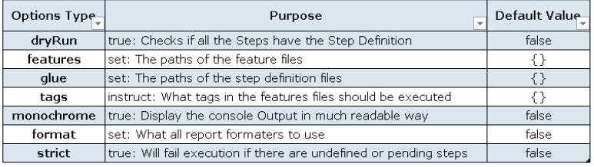
CucumberOptions

Slide 16
Step Definition
Each step starts with Given, When, Then, And, or But.
Cucumber executes each step in a scenario one at a time, in the sequence you’ve written them in. When Cucumber tries to execute a step, it looks for a matching step definition to execute.
Keywords are not taken into account when looking for a step definition. This means you cannot have Given, When, Then, And or But step with the same text as another step.

Slide 17
Tags in Cucumber
In Cucumber, tags are used to associate a test like smoke, regression etc. with a particular scenario.
@: It is a symbol used to declare a tag.
TestName: It is the name of a specific test.

Slide 18
Hooks in Cucumber
Cucumber supports hooks, which are blocks of code that run before or after each scenario.
@Before- execute before every scenario
@After- execute after every scenario

Slide 19
Cumcumber Report Generator
Generate Reports in cucumber
To generate simple html report add plugin inside your TestRunner class
plugin= {“pretty”,
"json:reports/cucumber-report.json",
"junit:reports/cucumber-report.xml"}
Required Jar:

